Slide 1






Notes:
Slide 1: Welcome stilling exercise – rolling dice
Use the stilling slide if desired: the suggested words should be spoken slowly, leaving pauses inbetween to create a sense of stillness.
As you sit quietly, watch the dice rolling….silently count the numbers that you’ll see…..[PAUSE]
Now practise slower breathing…..in…..and out…..in……and out…..keep this going as you continue to watch….[PAUSE]
You maybe notice that you are feeling calmer and more relaxed….[PAUSE]
As you breathe, think about yourself and what you bring into this time today….. [PAUSE]
We come into this special / sacred space and time to be still….to think deeply…..to be together as a school community…..
In our time together today, we will do some counting (!)…..do some finding out…..share some words together, and then think together about what they might mean for our school community.
But first, let’s welcome one another as we begin….

Slide 2
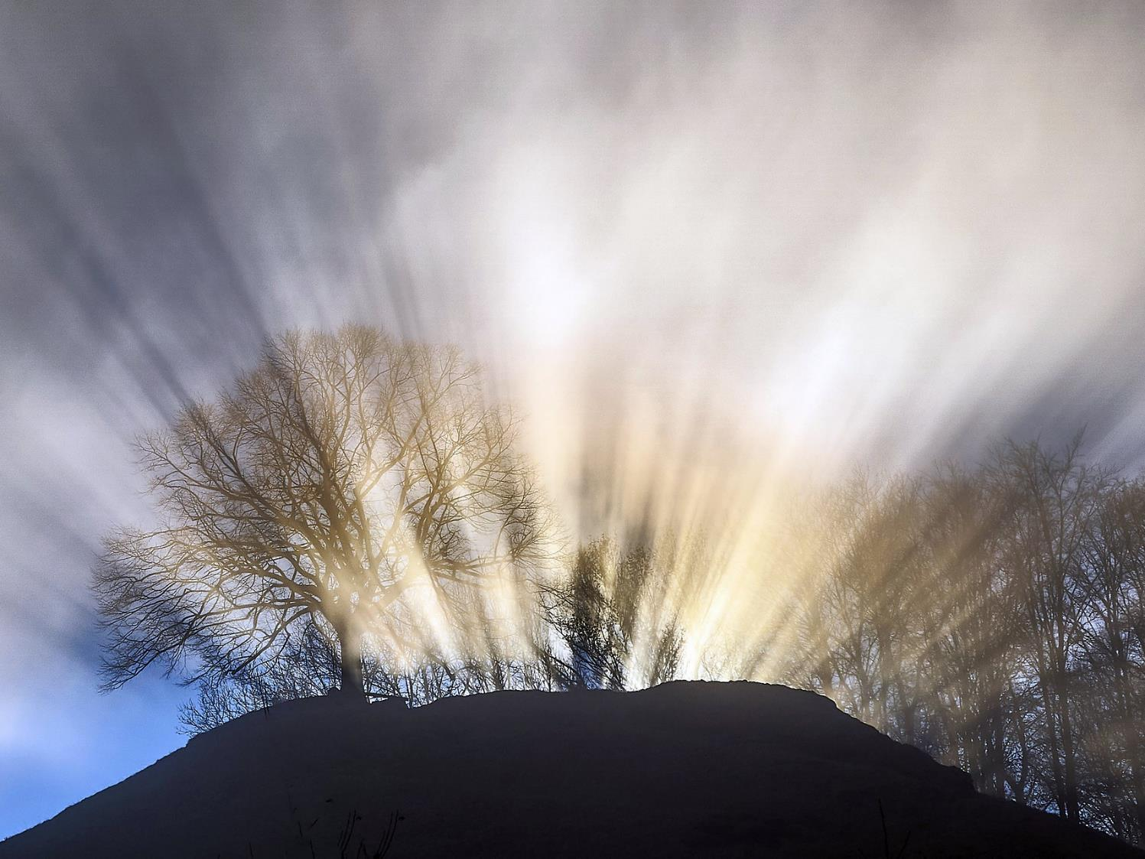
Leader: This is a day that God has made.
ALL: We will rejoice and be glad in it!
Notes:
Slides 2/3: Teach this new greeting to your school community – there are two slightly different versions from the point of view of the leader; choose which best fits your school’s context.
Leader: Today is a brand new day! OR This is a day that God has made!
ALL: We will rejoice* and be glad* in it!
*There are different BSL signs for rejoicing and joy/gladness. View them here: https://www.signbsl.com/sign/rejoice

Slide 3
Leader: Today is a brand new day!
ALL: We will rejoice and be glad in it!
Notes:
Slides 2/3: Teach this new greeting to your school community – there are two slightly different versions from the point of view of the leader; choose which best fits your school’s context.
Leader: Today is a brand new day! OR This is a day that God has made!
ALL: We will rejoice* and be glad* in it!
*There are different BSL signs for rejoicing and joy/gladness. View them here: https://www.signbsl.com/sign/rejoice

Slide 4
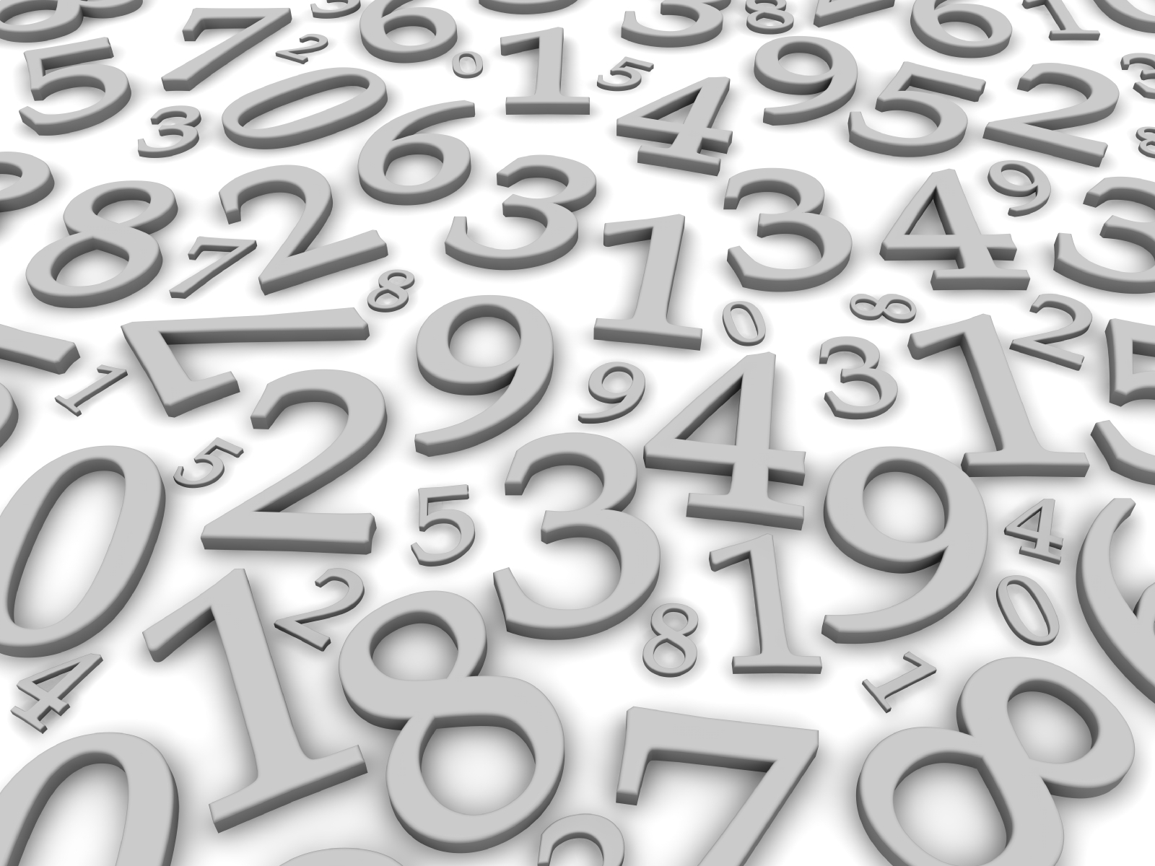
...in 10s
...in 1s
Let’s count…
...in 3s
...in 2s
...in 5s
Notes:
Slide 4: We’re going to start our time together today with some counting. There will be some really easy ones – and some more difficult ones, but let’s have a go together. [Go through the age-appropriate ideas you created]

Slide 5
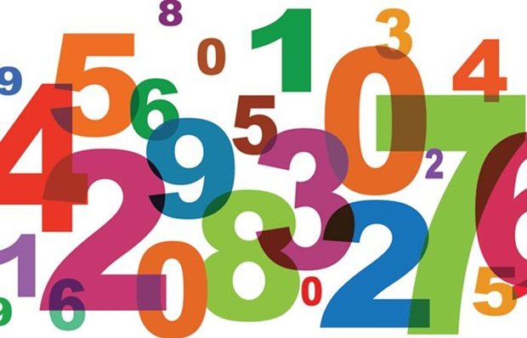
‘count your blessings’
Notes:
Slide 5: This term, we are starting a new theme of assemblies together, ‘Count your blessings’, which will help us to do just this.

Slide 6
What’s a ‘blessing’?
Notes:
Slide 6: But what do we mean? What are blessings? [ask a few children, then summarise their thoughts back to the assembled children] When people talk about their ‘blessings’, they usually mean the good things in their lives, the things that they are grateful for.

Slide 7
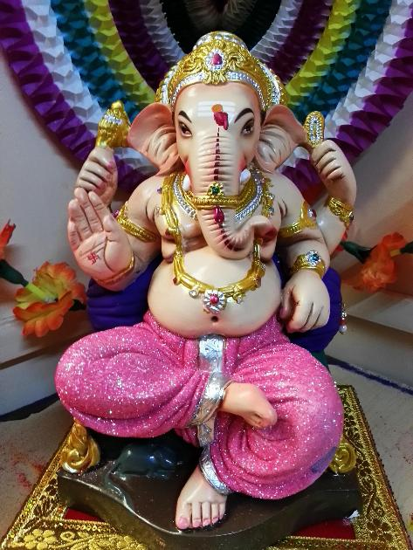
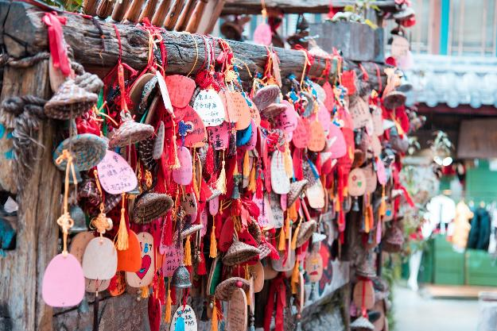
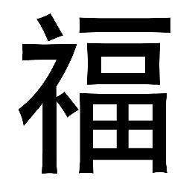
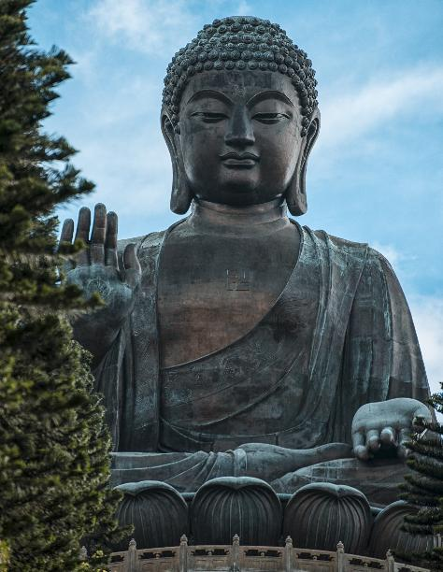
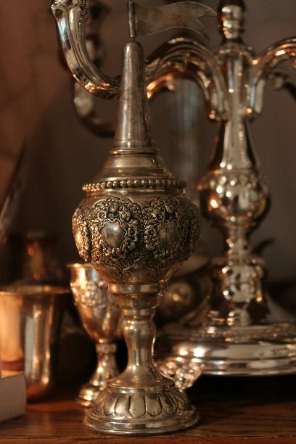
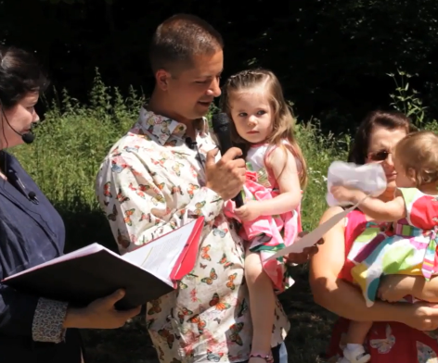
Image from Humanists UK
Notes:
Slide 7: ‘Blessing’ is an idea that is shared across many different religions and beliefs, as you can see in the images here. [from L-R, top-bottom: Ganesh, giver of blessings (Hindu Dharma); Buddhist blessings; Chinese character for ‘blessing’; Humanist baby naming ceremony; Buddha with Varada (blessing) mudra (hand positions); Spice box blessing as part of Havdalah (Jewish)]
A blessing can be a good thing that we have – or it can also be something that we do or give to others to wish them well. It’s a noun – and a verb! (Maths and English – in one collective worship!!)

Slide 8
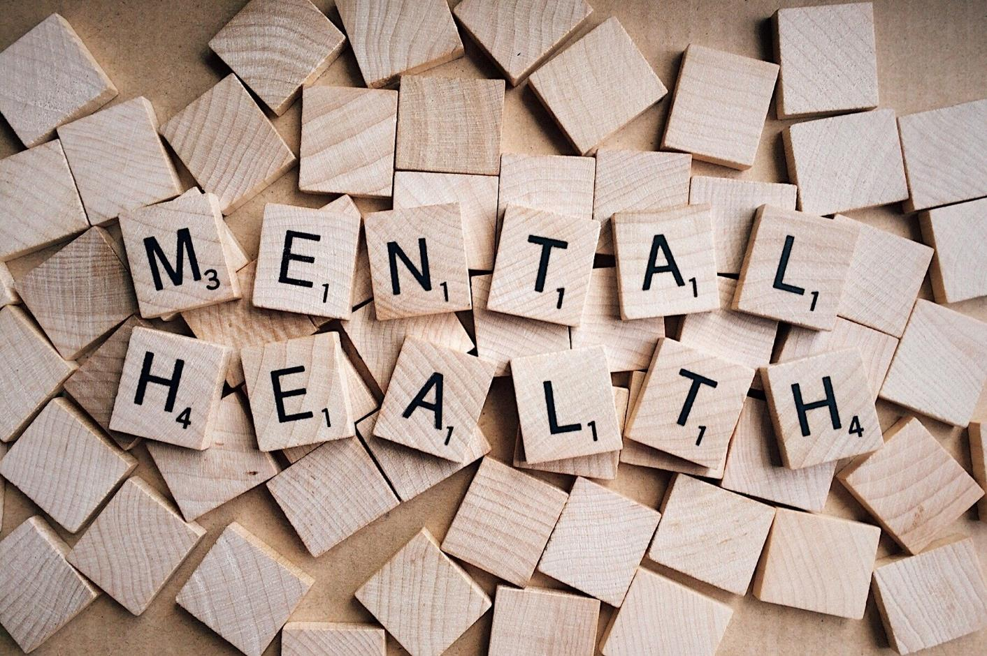
Notes:
Slide 8: Over recent years, many people have found that thinking about the good things in life, their blessings, helps them to cope better with any challenges that might be going on around them. This is what people mean when they say they are counting their blessings. Doing this is good for your mental health, but it’s not a new idea! Let’s share our words for today together, which were written many hundreds of years before the birth of Jesus – so over 3000 years ago!!

Slide 9
‘O my soul, praise God: don’t forget a single blessing!’
Psalm 103:2
Notes:
Slide 9: David talked about how it was good for his soul to remember all that God had done for him, all his blessings. Sometimes, especially when we’re feeling a bit grumpy, it can be easy to forget all the good things that are part of our lives, but ‘counting our blessings’ can help us to get things in balance again, and you might even find that the grumpiness disappears…..try it sometime!

Slide 10


What are my blessings?
Notes:
Slide 10: Ask children to talk with a partner about the question ‘What are my blessings?’ Establish your ground rules for this – level of noise, how children will know when to stop etc. When the allocated time’s up, stop the children and gather some of their ideas onto strips of paper to start off your Blessing Jar (see classroom reflection ideas section) There are some suggestions on Slide 11.

Slide 11
family
nature
fun
money
school
pets
health
friends

Slide 12

…I wonder how we might be a blessing to someone else today?....
…I wonder how our school’s vision/values might help us to do this?....
Count your blessings
Notes:
Slide 12: Responding (and words for worship)
Let’s be still and quiet together now….
…..we’ve been thinking today about our ‘blessings’…..the good things that are part of our lives…..
….[name some that you’ve collected in your jar]….
…..all these things are good things that we can be grateful for…..
…..and counting them is good for us too!.....
….for a few moments, spend some time counting your own blessings now!.....
[leave some quiet space for reflection]
….as we think about others now,
I wonder how we might be a blessing to someone else today?....
….and how this might change how it feels to be a part of our community?....

Slide 13
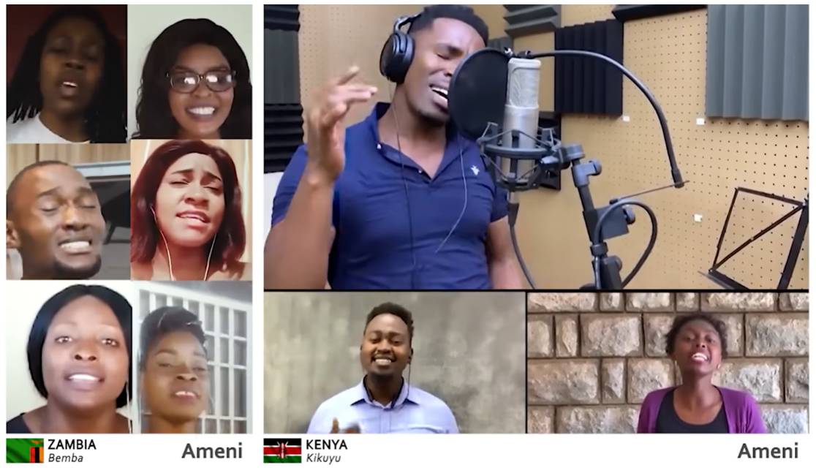
‘May the Lord bless you and
keep you. May the Lord show you
his kindness. May he have mercy on you. May the Lord watch over you
and give you peace.’Numbers 6:24-26
Notes:
Slide 13: Before we end our time together today, we are going to hear some more words of blessing, which David the Psalmist would have known very well. They are the oldest blessing in the Torah (the Jewish holy book) and the Bible (the holy book for Christians) and have been a way for people to declare blessing over one another since ancient times. Many people believe that God has a heart that wants to bless others. The words say this…..
‘May the Lord bless you and keep you. May the Lord show you his kindness. May he have mercy on you. May the Lord watch over you
and give you peace.’
I’m going to use a short clip of a song that uses these words, not just in English, but also in many other languages across the world….there is one word which you will probably recognise in any language though, so do listen carefully!! [It’s Amen!]
[Click on the image to link to the video & use as long or short a clip as you would like here]
Now I’m going to invite you to join me in a prayer, where we will remind each other to ‘count our blessings’….

Slide 14

‘Help us to count our blessings’
Notes:
Slide 13: The words for us to share if you’d like to join me are ‘Help us to count our blessings’….
God who gives good things…HELP US TO COUNT OUR BLESSINGS
When we are sad or weary…HELP US TO COUNT OUR BLESSINGS
When we are grumpy or afraid…HELP US TO COUNT OUR BLESSINGS
Every day when we gather…HELP US TO COUNT OUR BLESSINGS Amen

Slide 15
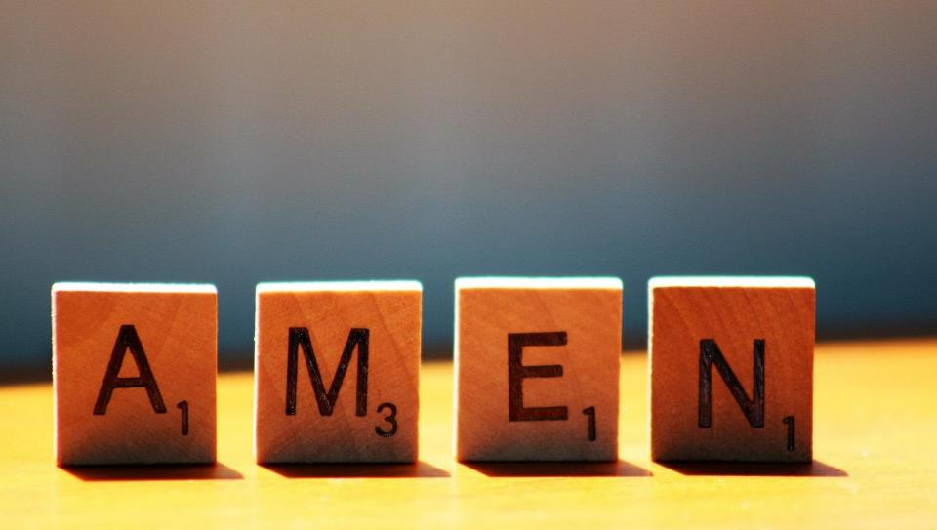

Slide 16



Leader: As we leave this place & time and go into the day ahead…
All: May we count our blessings!

Slide 17

Notes:
Slide 17: Reflection areas
Make a Blessing Jar as a class. Use a clean jar or tin, which your class can decorate if they wish.
Think: What are your ‘blessings’, the things you are grateful for?
Do: Write or draw your thought on a slip of paper and add it to the jar.
Talk: If you’re having a bad day, then use the Blessing Jar! Take out a ‘blessing’ and remind each other of the good things that you are grateful for.

