Slide 1
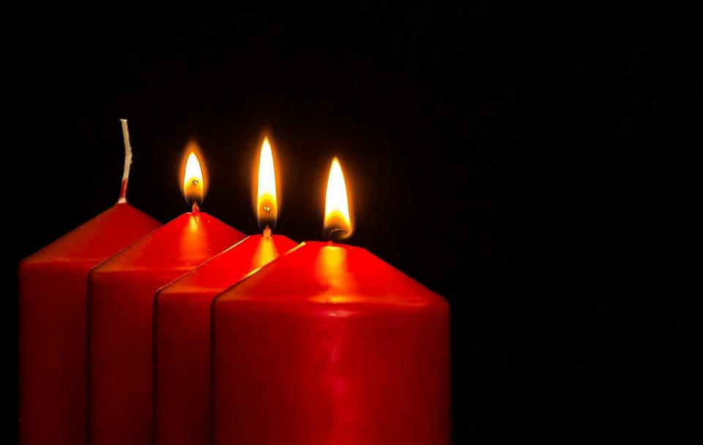


Pictures copyright-free from pixabay
Leader: As we light our Advent candle…
All: May today’s thoughts bring us hope, like light in the darkness.
Notes:
Slide 1: Use this special greeting for the Advent season, as you light your Advent candle.
Leader: As we light our Advent candle…
All: May today’s story bring us hope, like light in the darkness.

Slide 2
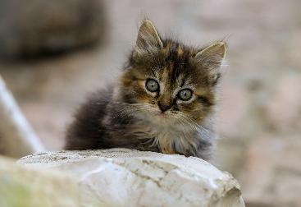
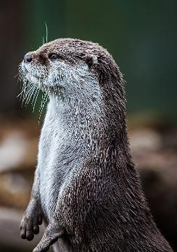
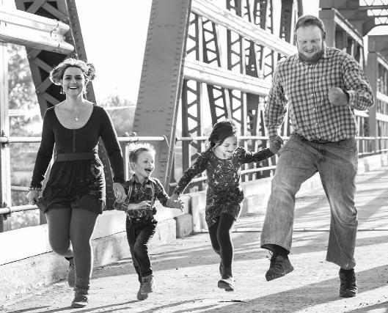
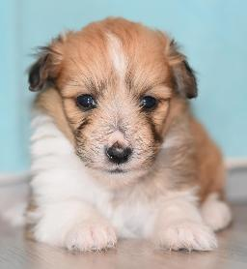
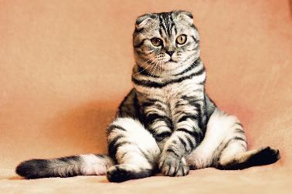
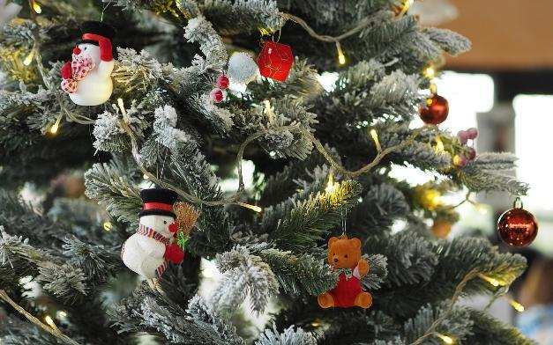

What fills you with joy?
Notes:
Slide 2: What fills you with joy?
Maybe it’s pictures of cute or funny animals, or maybe the sight of your Christmas lights at this time of year…..or spending time with family….or doing something you love…..
Have a chat together now….. [ask for feedback]

Slide 3
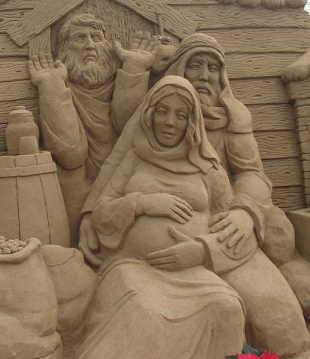
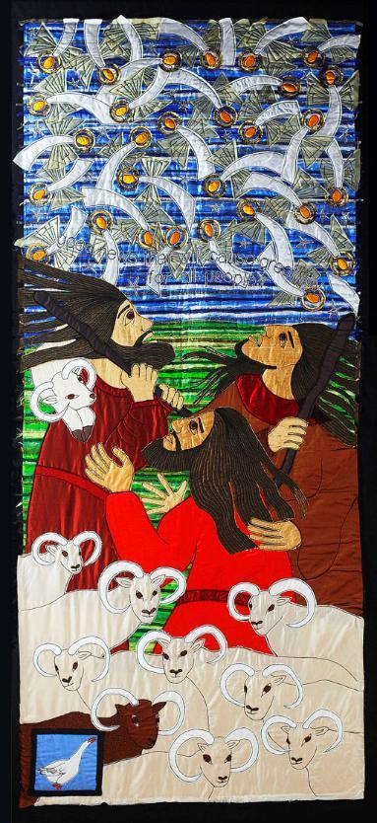
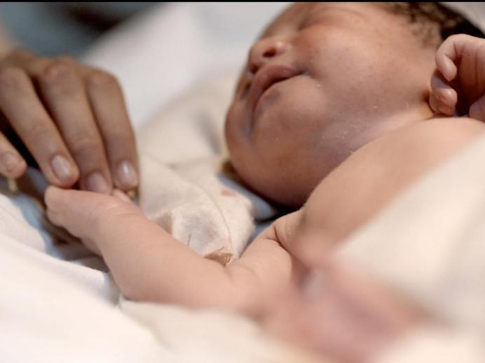
Immanuel: ‘God with us’
….good news of great joy for all people….
Notes:
Slide 3: Last week we heard how, for Christians, Jesus is Immanuel: ‘God with us’ and thought about what this meant for the ordinary people in the Nativity account, as well as what this might mean as a message of hope. We also heard the words of the angels saying that the birth of this special baby was ….good news of great joy for all people….and saw how the shepherds were also filled with joy, so much joy that they told everyone the met about this good news.

Slide 4
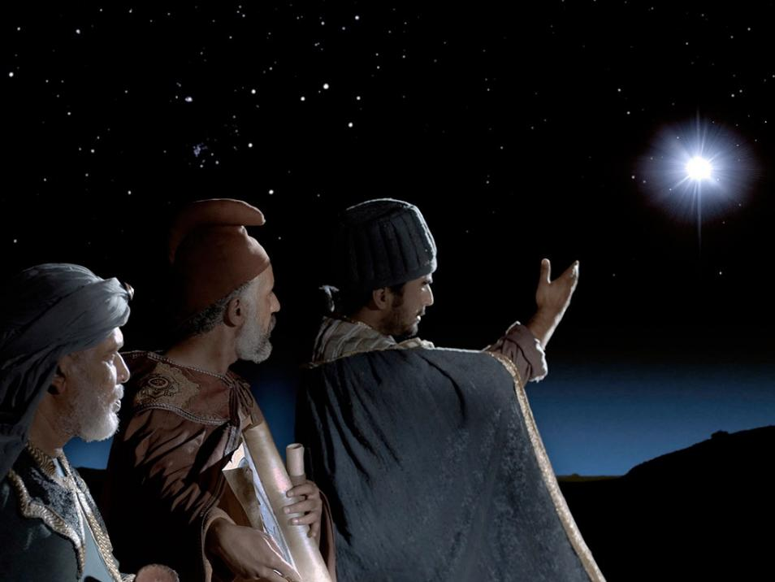
‘When the wise men saw the star, they were filled with joy.’ (Matthew 2:10)
Notes:
Slide 4: In today’s section of the story, found in Matthew’s gospel, it says that wise men in lands far, far away in the East, had been studying their books, maps and charts. They believed that one day, a new King would be born – and that a bright, new star would tell them when. They had been watching the skies for years and years, waiting for the moment when this time would come. The Bible says that ‘When the wise men saw the star, they were filled with joy.’ And so, the star led them to this new King, a journey that brought them from so far, they were probably travelling for over a year….

Slide 5
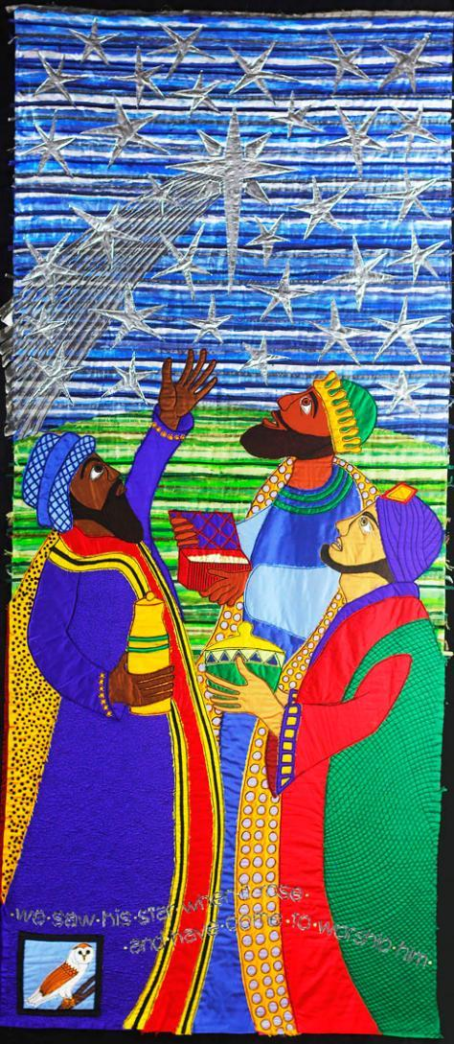
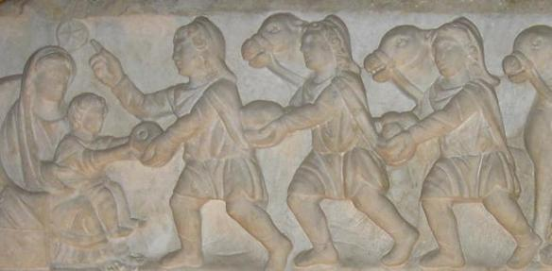
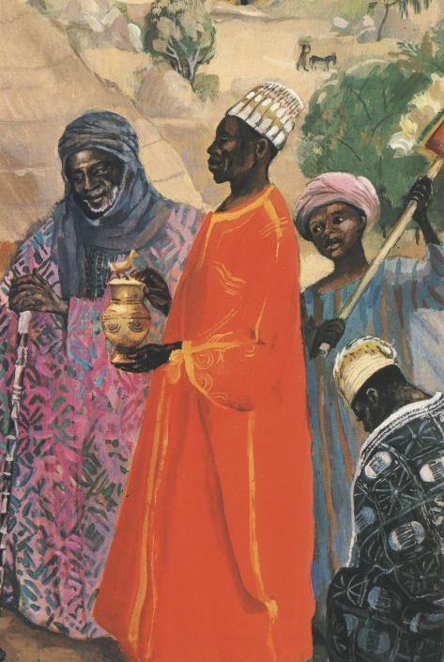

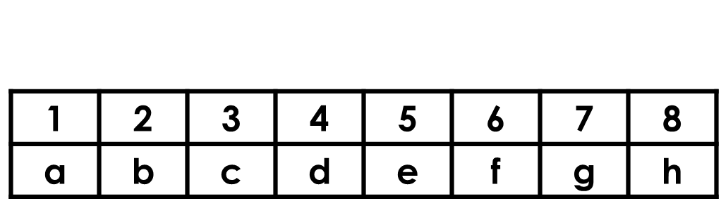
Notes:
Slide 5: …so Jesus would probably have been a toddler! [you can see this in the sculpted panel, top right, part of a 3rd-4th C sarcophagus, from the Vatican Museum]
Imagine what it must have been like for Mary and Joseph to have such important, wealthy and unexpected visitors!
The gifts that the wise men brought with them – gold, frankincense and myrrh – were like their own secret messages to the world….(Remember this from 2 weeks ago?!)
You can probably tell me the gifts they brought….. [wait for response]….gold, frankincense and myrrh: gold – for the highest King; frankincense – an expensive incense used in worship in the temple, so a sign that Jesus was to be worshipped, and myrrh – a spice to anoint the dead, which seems like an even stranger gift for a toddler than gold and frankincense! [older/more able pupils may be able to link these to ideas about Jesus from their learning in RE, or previous weeks’ resources this term]
The angels said that Jesus’ birth was good news for everyone – ‘all people’ – from the ordinary shepherds looking after their sheep to the learnéd wise men, travellers from so very far away.

Slide 6
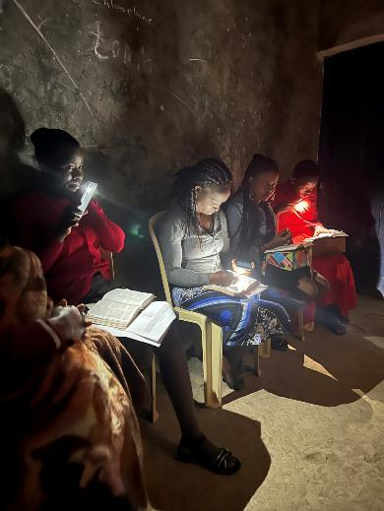
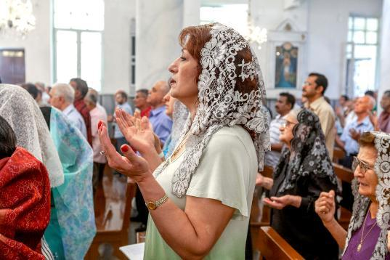
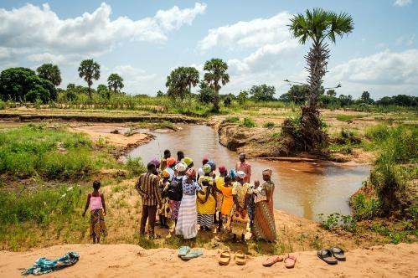
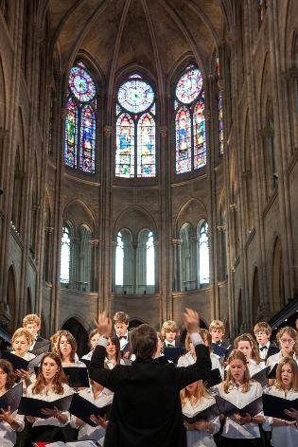
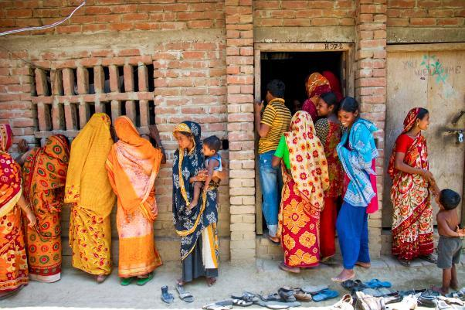
Joy to the world
….good news of great joy for all people….
Notes:
Slide 6: Christians believe that this is still good news for today – and every day: Jesus, God incarnate, came to be Immanuel, ‘God with us’ and joy for the whole world.
As we saw last week, there are Christians all over the world….who will all be gathering to celebrate this ‘joy to the world’ this Christmas.
[All photos ©IMB International Mission Board L-R, top–bottom: Kenya, Syria, Ghana, Bangladesh, France]

Slide 7
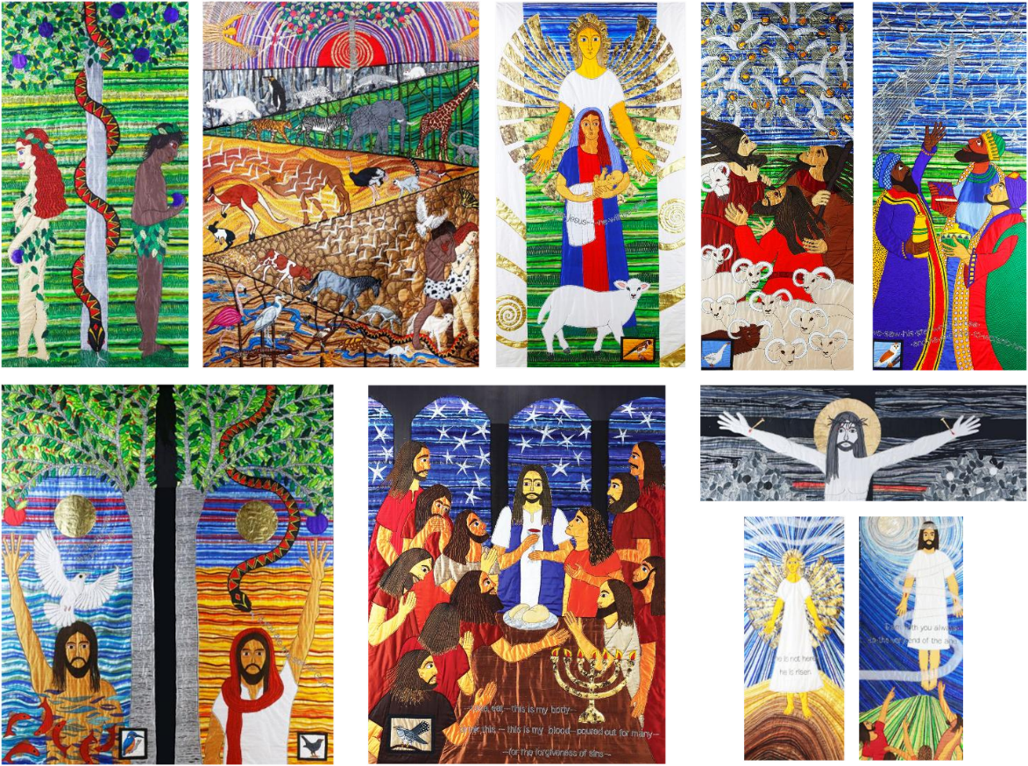
Joy to the world
….good news of great joy for all people….
….there will be no more death, sadness, crying or pain. All the old ways are gone!
Notes:
Slide 7: We heard in the story behind Jacqui’s textile panels that Jesus came to be the Great Rescuer, who would put right everything that had gone wrong in the Garden of Eden. For Christians, it’s this bigger story that makes sense of the angels’ words, that the birth of Jesus was good news of great joy for all people: no matter what happens in their lives or in the world, Jesus came to be Immanuel now, and one day will put everything right again. Some of the very last words in the Bible say this….there will be no more death, sadness, crying or pain. All the old ways are gone!

Slide 8
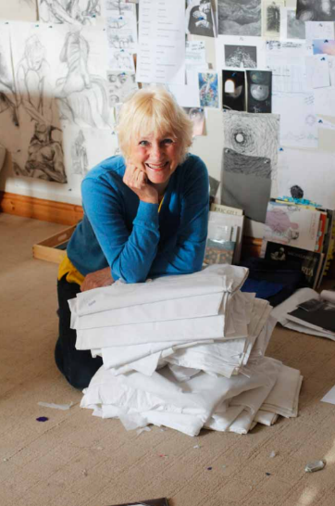
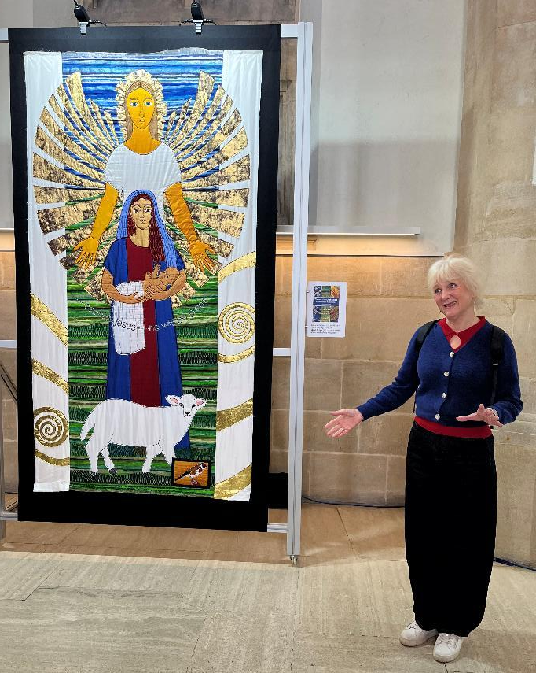
Joy to the world
Notes:
Slide 8: It’s this good news that has inspired Jacqui to create her panels telling this story of Jesus being ‘joy to the world’: it’s not just about his birth being a joyful occasion (which it was!), but about the good news of the whole story.

Slide 9
‘When the wise men saw the star, they were filled with joy.’
….I wonder what you think about this idea?....
….I wonder what fills you with joy at this time of year?....
….I wonder how we might bring joy to others?....not just at Christmas, but every day?!....
Notes:
Slide 9: Responding and words for worship
Let’s draw our time together to a close as we are quiet and still with our thoughts. Today we have heard the story of how the news of the birth of Jesus filled the wise men with joy…and continues to fill Christians with that same joy, as they approach Christmas. The angels said that the birth of Jesus was joy to the world.
….I wonder what you think about this idea?....
….I wonder what fills you with joy at this time of year?....
….I wonder how we might bring joy to others?....not just at Christmas, but every day?!....
You might like to talk about this back in class.

Slide 10
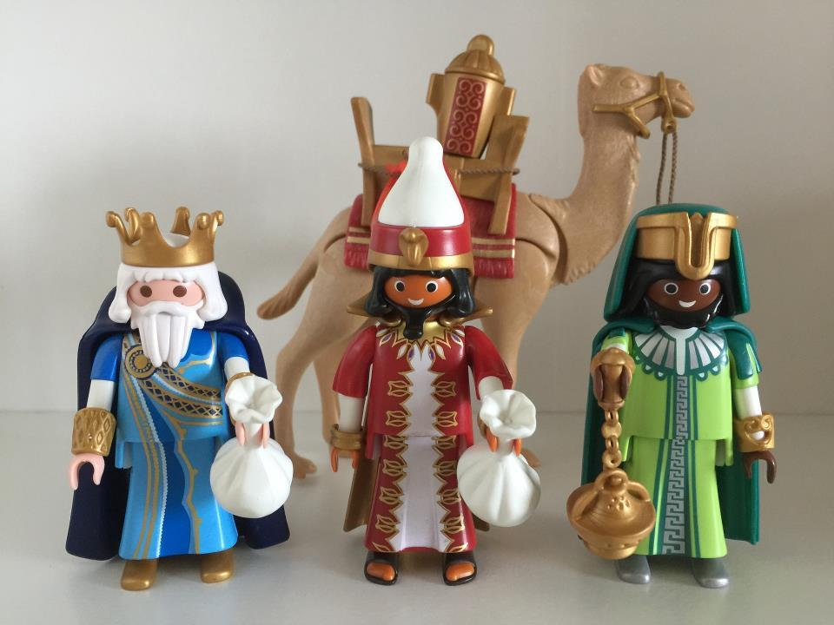
‘O come let us adore him!’
Notes:
Slide 10: Prayer
Like the wise men, and the other visitors who came to visit Jesus, the response of those who saw him was to worship, because of the joy and wonder that they felt.
I’m going to use some words from a famous carol – ‘O come all ye (you) faithful’ – which express this idea: ‘O come let us adore him!’
These words will be a part of my prayer: if you want to pray with me, then you might want to join when these words come on the screen, or you can continue to be quiet with your own thoughts…..

Slide 11
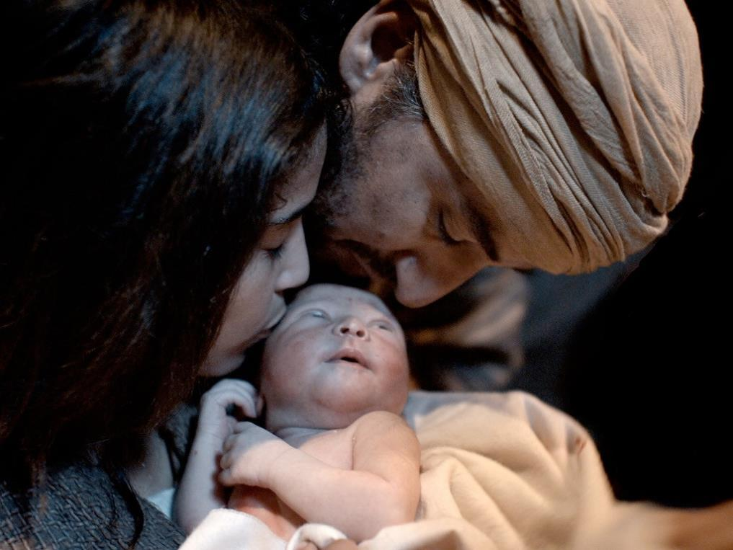
‘O come let us adore him!’
Notes:
Slide 11: As we think about this special story, of Jesus, born as a baby…. ‘O come let us adore him!’

Slide 12
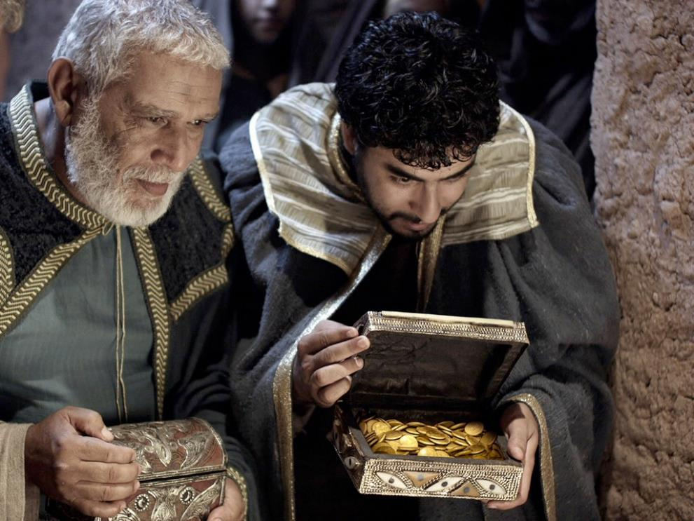
‘O come let us adore him!’
Notes:
Slide 12: As we remember how the wise men knelt in worship…. ‘O come let us adore him!’

Slide 13
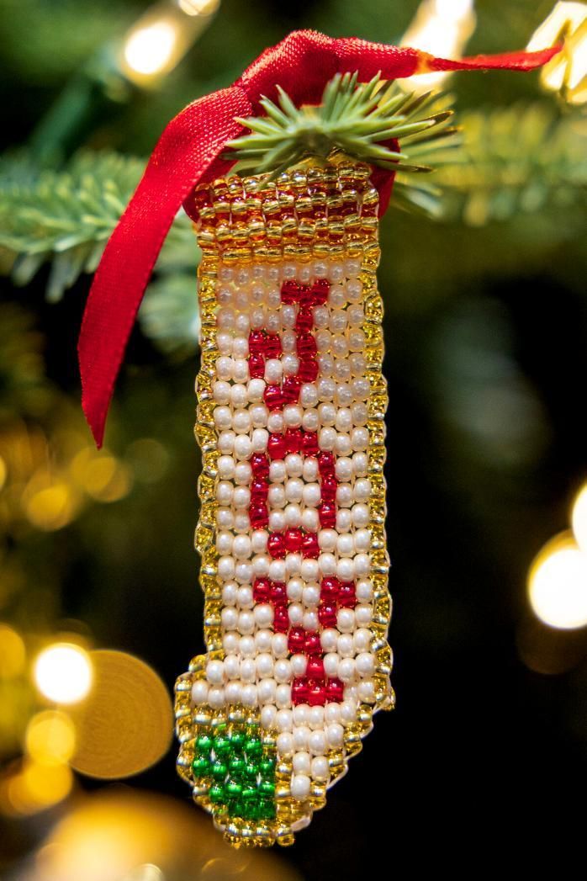
‘O come let us adore him!’
Notes:
Slide 13: As we experience the joy that is a part of this Christmas season….. ‘O come let us adore him!’

Slide 14
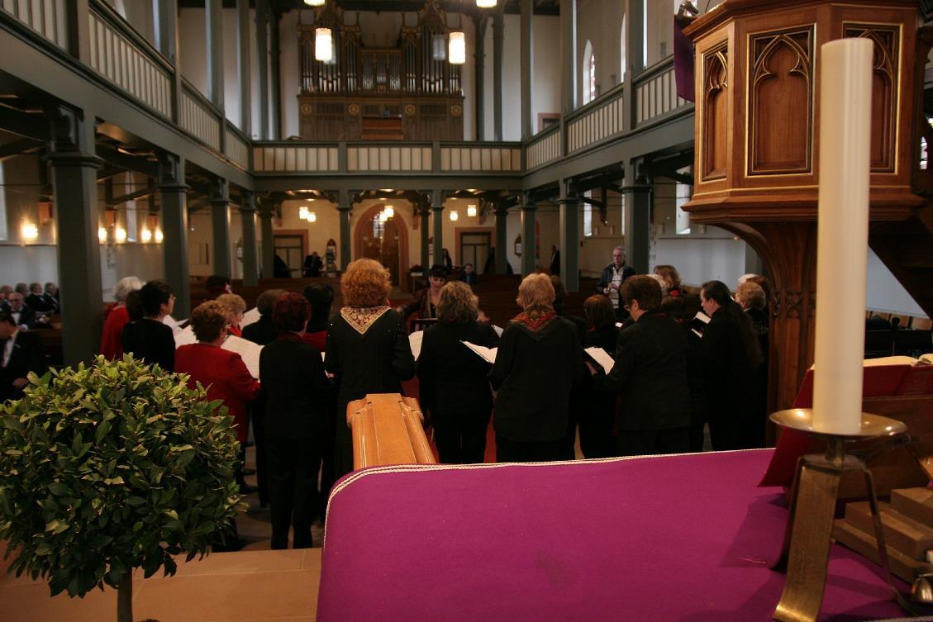
‘O come let us adore him!’
Notes:
Slide 14: With Christians all over the world, may we sing this Christmas time…. ‘O come let us adore him!’

Slide 15




Slide 16
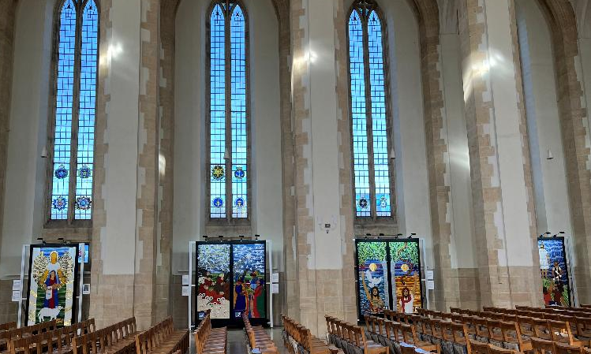
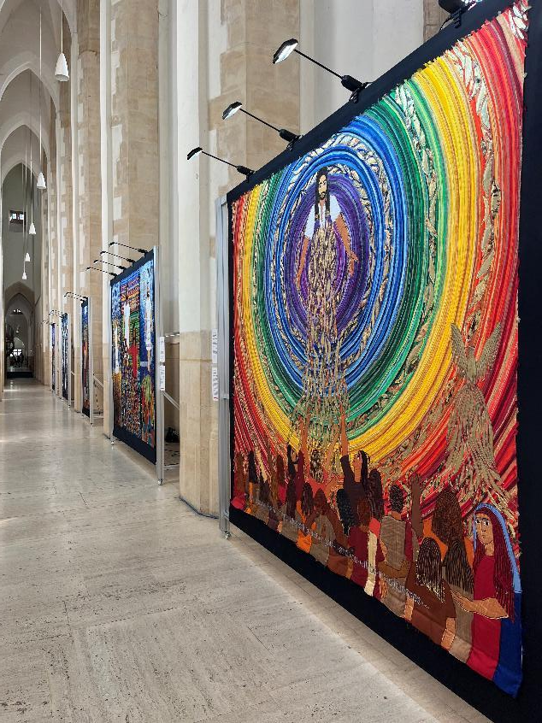
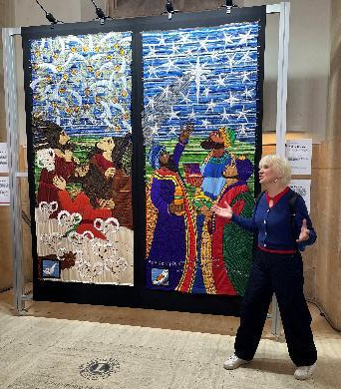
Joy to the world
Notes:
Slide 16: Many of you will recall that Jacqui’s beautiful panels were recently displayed in Guilford Cathedral, which (by the way) is your cathedral, the mother church of all the churches in the Diocese of Guildford!
As you can see, is a beautiful space to see such wonderful art!
As part of our Christmas celebrations across the Diocese, many of our Church schools have sent some artwork of their own to display in Guildford Cathedral across Advent and Christmastide, on the theme of ‘Joy to the world’. Our next few slides are going to show you some of the thought-provoking work…. As you view them, you might like to think about the following questions (there may be some words written by the school to help you here!):
How does this piece of art link to the theme ‘Joy to the World’?
What makes you think as you look at it?
What do you like about it?
What would you like to ask the children who created this?
How might you show your own ideas about ‘Joy to the World’?

Slide 17
Joy to the world
THIS SLIDE IS INTENTIONALLY EMPTY AND WILL BE FILLED AT THE START OF ADVENT!
Notes:
Slide 17:

Slide 18
Joy to the world
THIS SLIDE IS INTENTIONALLY EMPTY AND WILL BE FILLED AT THE START OF ADVENT!
Notes:
Slide 18:

Slide 19
Joy to the world
THIS SLIDE IS INTENTIONALLY EMPTY AND WILL BE FILLED AT THE START OF ADVENT!
Notes:
Slide 19:

Slide 20
Joy to the world
THIS SLIDE IS INTENTIONALLY EMPTY AND WILL BE FILLED AT THE START OF ADVENT!
Notes:
Slide 20:

Slide 21
Joy to the world
THIS SLIDE IS INTENTIONALLY EMPTY AND WILL BE FILLED AT THE START OF ADVENT!
Notes:
Slide 21:

Slide 22


Leader: As we leave this place & time…
All: May the hope of Advent shine brightly in our school today.
Notes:
Sending: Slide 22 (You might want to use this slide throughout the Advent season to end your time together)
Leader: As we leave this place and time….
All: May the hope of Advent shine brightly in our school today.

Slide 23


Notes:
Slide 23: Reflection spaces – online Advent calendar
Use the link to connect you to reflective materials for school days during Advent.

