Slide 1
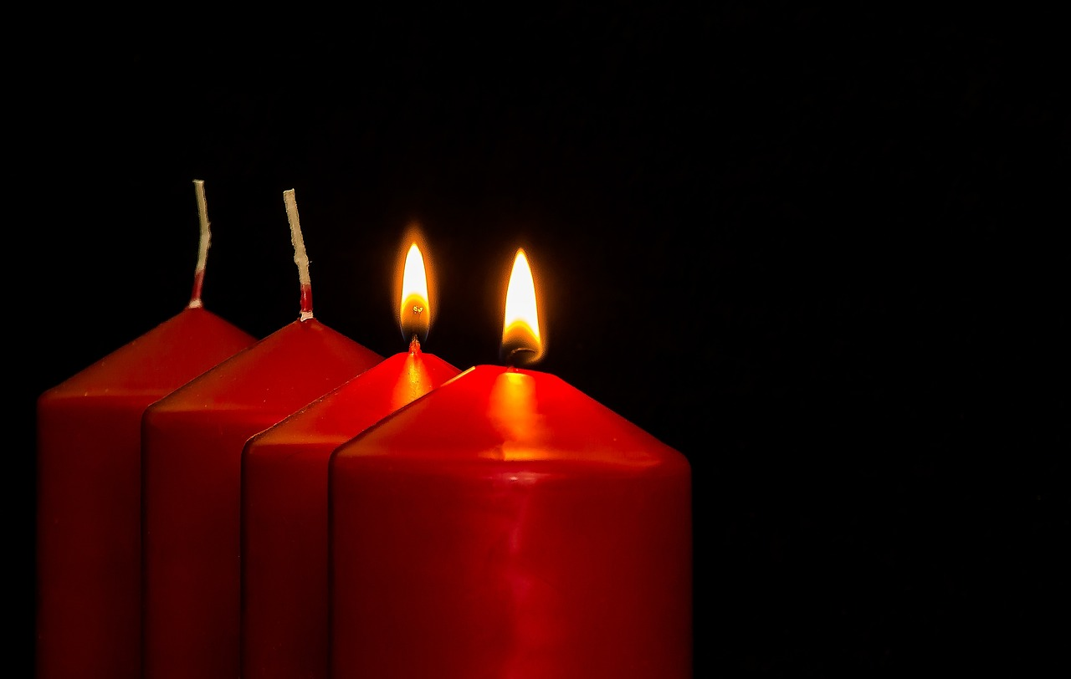


Leader: As we light our Advent candle…
All: May our time today show us something new, like light in the darkness.
Notes:
Slide 1: Use this special greeting for the Advent season, as you light your Advent candle.

Slide 2
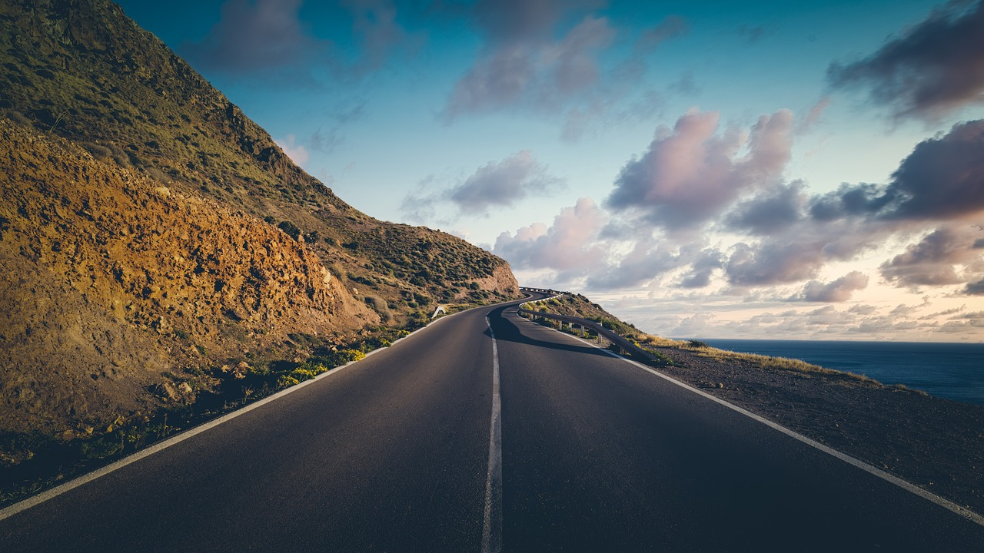
Notes:
Slide 2: Going on a journey I wonder if you’ve ever been on a long, long journey? [Compare who’s been where and talk about the emotions of travelling, exciting and otherwise!]

Slide 3
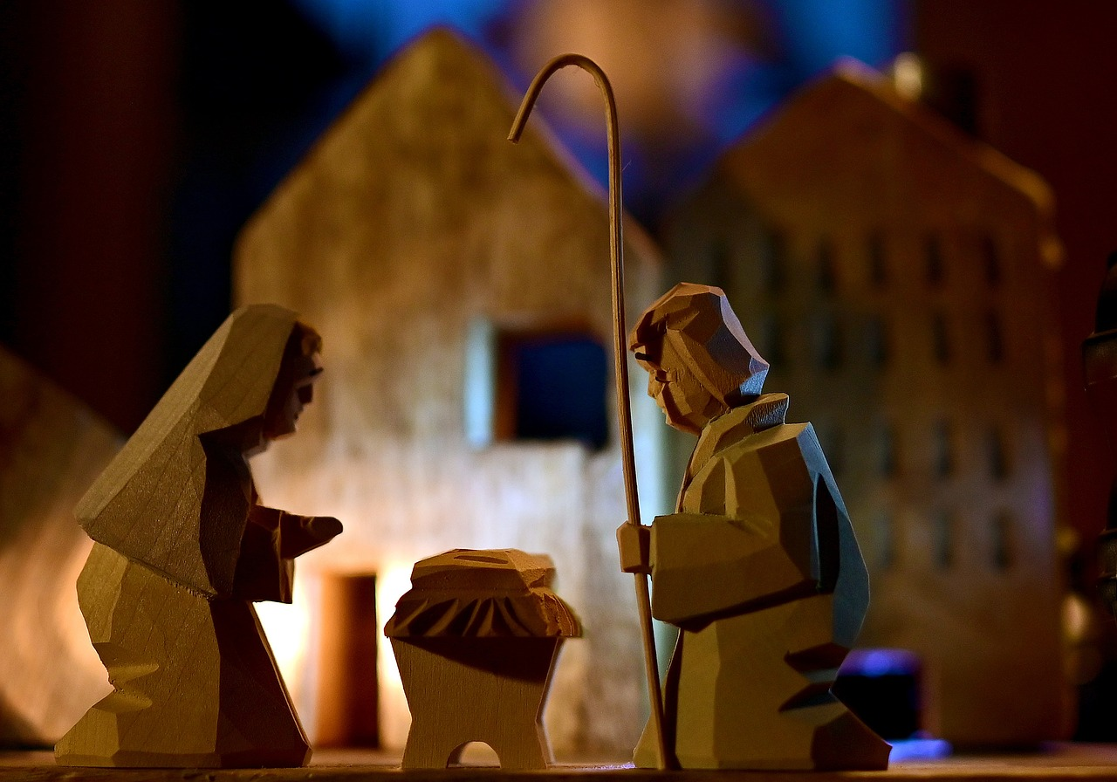
….To Bethlehem we go….
Notes:
Slide 3: To Bethlehem we go…. At this point in the year, we often journey together through the account of the birth of Jesus – and so we are going to dip into this story again now, and reflect on the fact that everyone seemed to be travelling to the same place, but for very different reasons. [You can do this in 2 ways, using the script on p. 3-4 which you can take outside if you’re brave enough!
Or you can use the words under the slides in the PowerPoint] So let’s share this story together now – and spend a few moments wondering….

Slide 4
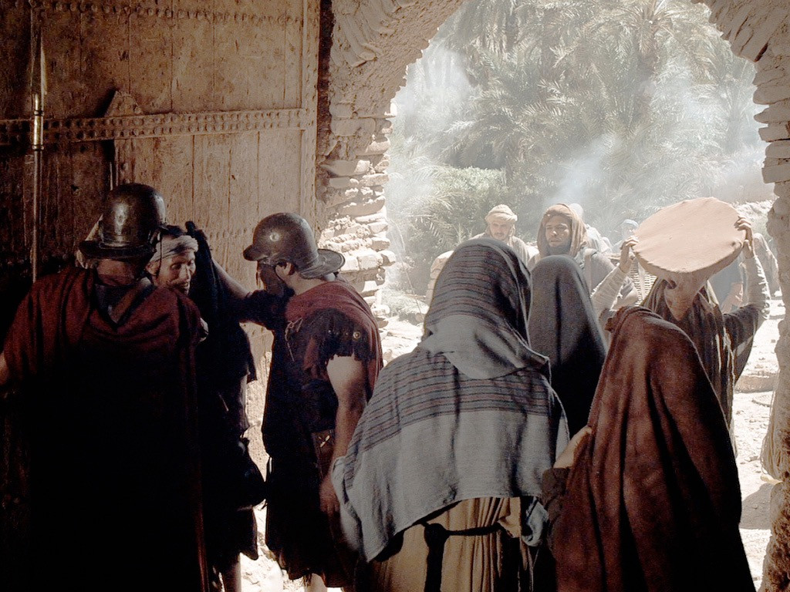

I wonder what all these visitors to Bethlehem thought about the journey they had taken?....
Notes:
Slide 4: That very first Christmas, there were many people travelling to Bethlehem as Caesar had ordered that everyone go back to the town of their birth to be counted. Mary and Joseph travelled too – and Mary was about to have her baby! Bethlehem was a very busy place….and it’s quite likely that not many of the visitors even realised that some very important events were to take place. I wonder what they might have done if they had?.....I wonder what all these visitors to Bethlehem thought about the journey they had taken?....

Slide 5
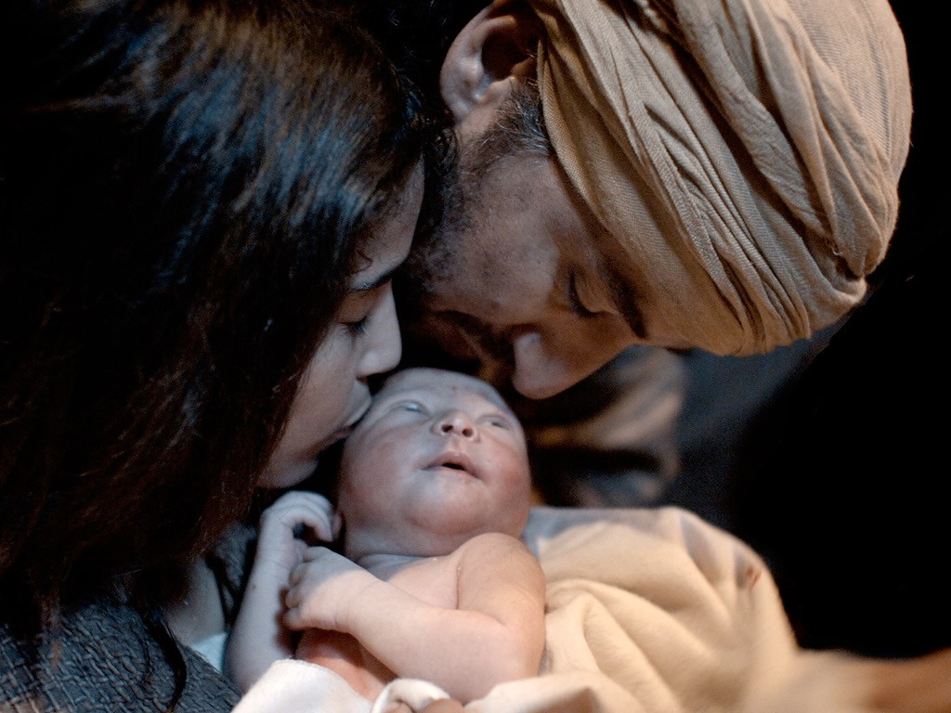
I wonder how Mary and Joseph felt now that Jesus had finally arrived?....
Notes:
Slide 5: We hear in the story that Baby Jesus was born in a stable because all the inns were busy. This part of the story is especially important to Christians because they believe that Jesus, God’s son, was born as a human baby. But any family that has waited for a baby to be born will understand how it feels when that baby finally arrives! I wonder how Mary and Joseph felt now that Jesus had finally arrived?....

Slide 6
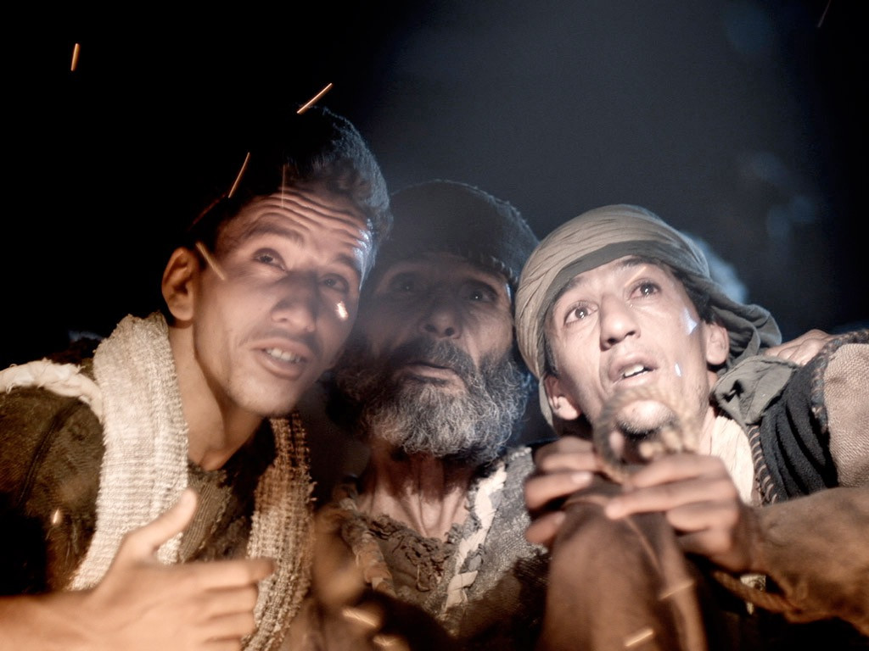
Notes:
Slide 6: Shepherds were watching their flocks during the night – and suddenly the sky was filled with angels who told them all about this special baby.

Slide 7
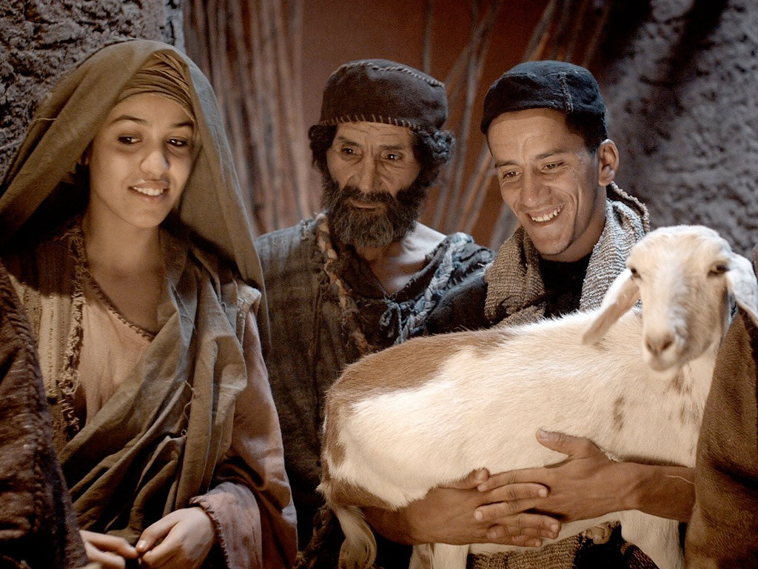
I wonder how they felt to be the first to see such a special baby – and why God chose them to be the first to arrive?....
Notes:
Slide 7: ….and they were the very first visitors to travel to the stable!! I wonder how they felt to be the first to see such a special baby – and why God chose them to be the first to arrive?....

Slide 8
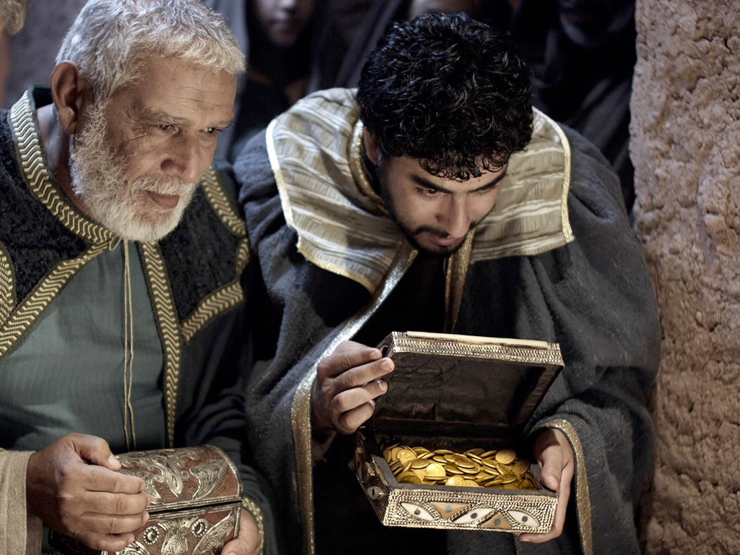
I wonder how these travellers from far, far away felt to finally be able to visit this special baby?....
Notes:
Slide 8: The wise men were the final visitors to travel to Bethlehem. They brought him gifts of gold frankincense and myrrh. They had been watching the skies for many years, searching for a bright new star, the sign of the birth of a new king. I wonder how these travellers from far, far away felt to finally be able to visit this special baby?....

Slide 9


I wonder what brought all those visitors to Bethlehem?
I wonder how it felt arriving to find a new baby, in a manger, and to wonder who that baby might be?
Notes:
Slide 9: Responding (and words for worship):
… We’re going to have some quiet moments now to think about all the different things we’ve explored today…..
…we’ve heard how many visitors travelled to Bethlehem – all for different reasons….
….people whose families lived in Bethlehem….
…..Mary and Joseph…..shepherds…..travellers from far far away….
…I wonder what brought all those visitors to Bethlehem?...
…I wonder how it felt arriving to find a new baby, in a manger, and to wonder who that baby might be?

Slide 10
Notes:
Slide 10: ….Every Christmas, Christians all over the world will remember this story, and travel again in their hearts and minds to Bethlehem to gaze on Jesus….
…take a few moments to think quietly for yourself now…..
…you might want to turn your thoughts into your own prayer….

Slide 11
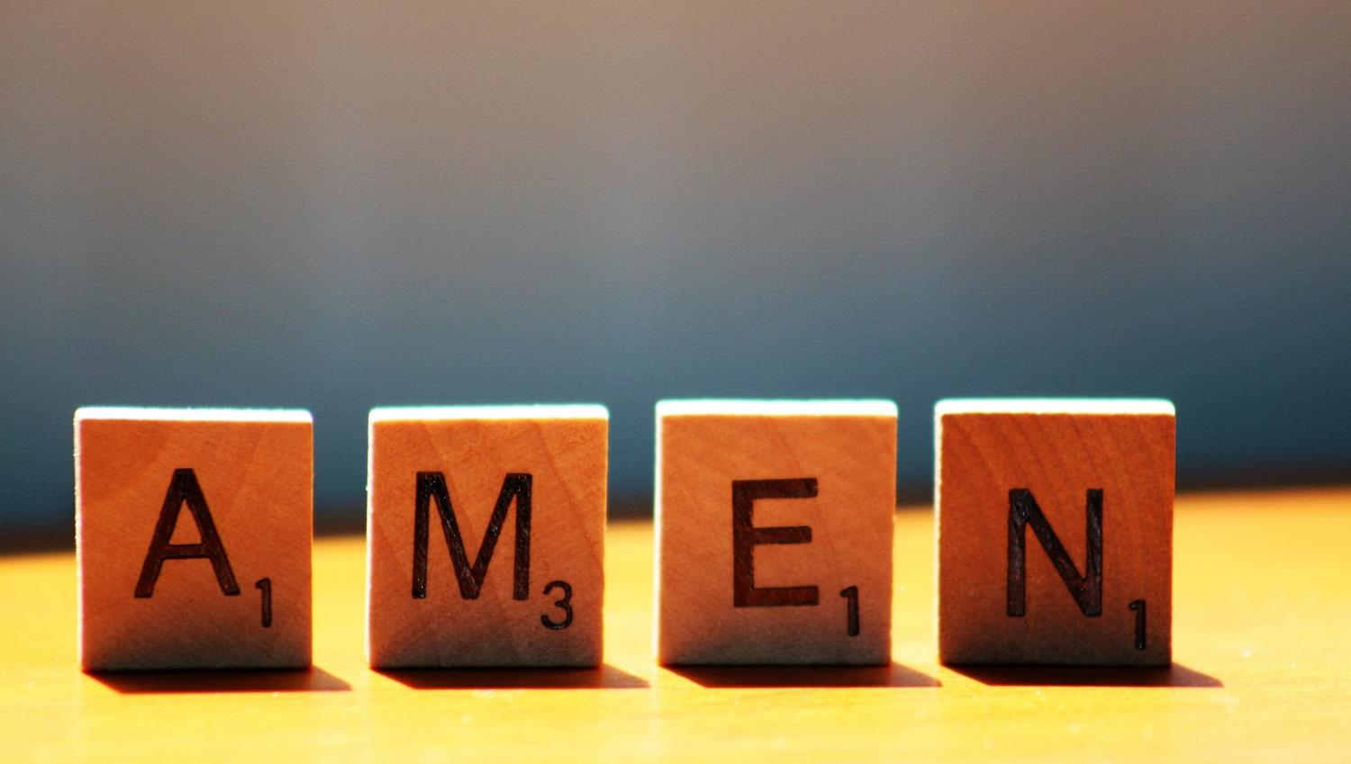



Slide 12


Leader: As we leave this place & time…
All: May the light of Advent shine brightly in our school today.
Notes:
Sending: Slide 16 (You might want to use this slide throughout the Advent season to end your time together)
Leader: As we leave this place and time….
All: May the light of Advent shine brightly in our school today.

