Slide 1
Leader: We are here together
ALL: May we ‘GO FOR GOLD!’ in our words and actions today!
Notes:
Slide 1: Gathering words
Leader: We are here together
ALL: May we ‘GO FOR GOLD!’ in our words and actions today!

Slide 2
The Olympics
Respect
Friendship
Excellence
Determination
Equality
Courage
Inspiration
Olympic rings © Pixabay
Notes:
Slide 2: Well, we’ve reached the final assembly of this term, but before we find out where we are in Olympic history for today, let’s spend a few moments reflecting back over our assemblies this term…..

Slide 3
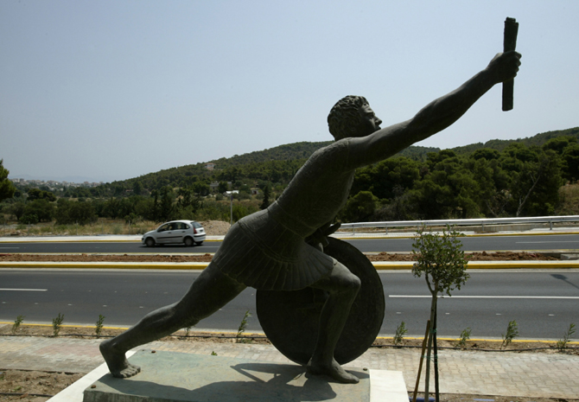
Pheidippides
776 BC
Notes:
Slide 3: We started back in Ancient Greece where the Olympics began, in 776 BC, and since then have visited many different places and times….

Slide 4
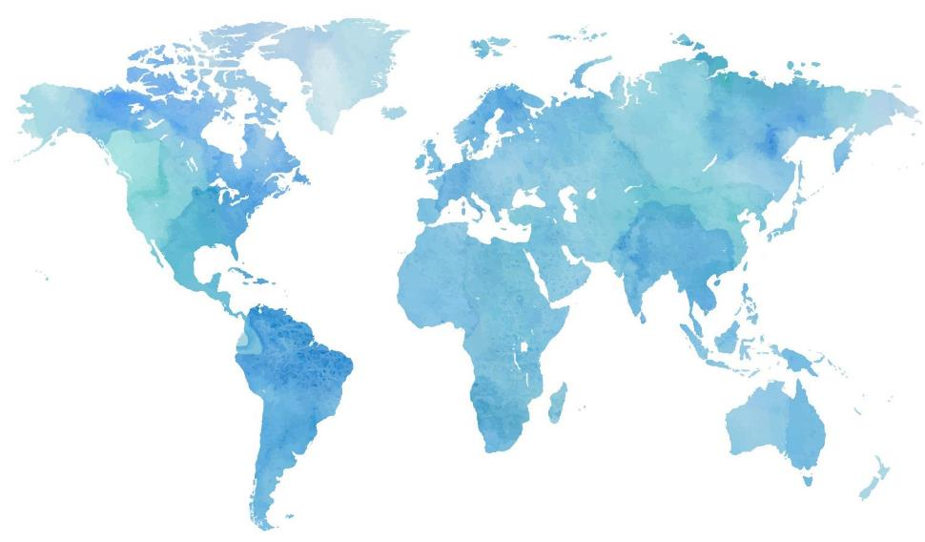
Notes:
Slide 4: [shows all the map locations & dates]
And of course, we are now looking forward to celebrating the Paris 2024 Olympics and Paralympics, the 33rd Olympics, when they start on 26th July [that’s just ….. days from now!]

Slide 5
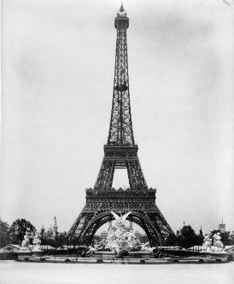
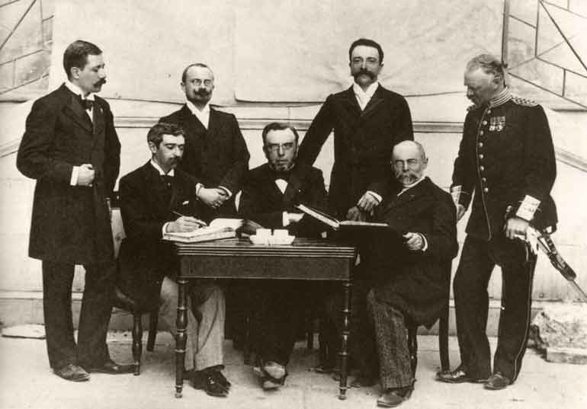
1894
Baron Pierre de Coubertin
Notes:
Slide 5: We heard how Baron de Coubertin started the modern Olympic movement in 1894…

Slide 6
The Olympics
Respect
Friendship
Excellence
Determination
Equality
Courage
Inspiration
Olympic rings © Pixabay
Notes:
Slide 6: …..and we’ve thought about his Olympic values of Respect, Excellence and Friendship…..but also about other important sporting values – Equality, Courage, Inspiration and Determination – values at the heart of the Paralympics….

Slide 7
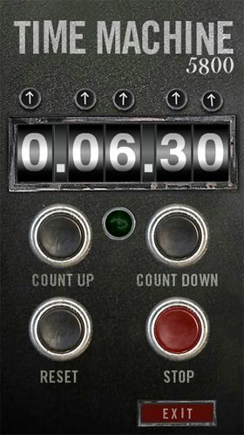
?
2024
CE
2024
CE
Notes:
Slide 7: So, where are we going to be today, for this final assembly? Let’s jump into our Olympic time machine for our final destination……and go…..well, nowhere, actually!

Slide 8
Olympic Achievements Awards
Notes:
Slide 8: We’re staying right here, in this hall, for a very special Olympic assembly – our very own Olympic Awards ceremony, celebrating our own Olympic Achievements….
Our awards are going to be focused on the Olympic values that have been at the very heart of our assemblies this term.

Slide 9
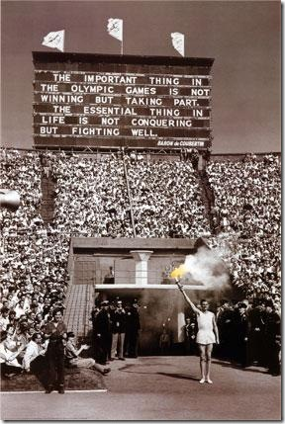
‘The important thing ….is not winning, but taking part….’
Notes:
Slide 9: Before we announce any names, we need to remember those very important words from Baron de Coubertin: ‘The important thing…..is not winning, but taking part’
Every single person in this hall today has achieved many things this year at school – I expect some of you know you’ve got better at some things because your teachers have told you so, or because you find things easier to do than you did at the start of the year. Each teacher has had to think really hard this week and they have only been allowed to choose …. children in their class who they think have shown a great achievement this year. That doesn’t mean just because you don’t come up to the front that you haven’t achieved anything – we all know that’s not true. So, let’s be ‘good sports’, be glad for our friends and celebrate their achievements.
NB Just as happens at the Oscars, display the list of winners in each category on the blank slides in th presentation. As you present each award, you could talk a bit about why each child has been awarded their certificate / medal, or ask each teacher to explain.

Slide 10
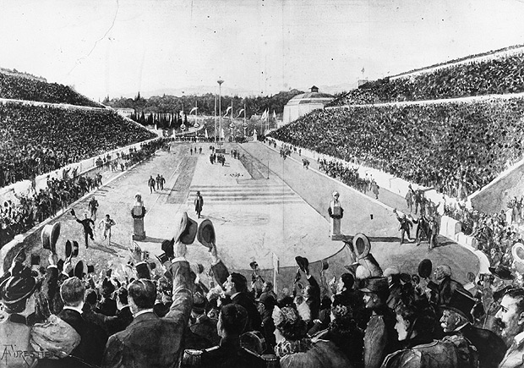
1896
Determination
Notes:
Slide 10: This term, we’ve heard how Spyridon Louis showed great perseverance and determination in the marathon in 1896, and so, our first category is Determination. And the winners are……. [slide 11]

Slide 11
Names

Slide 12
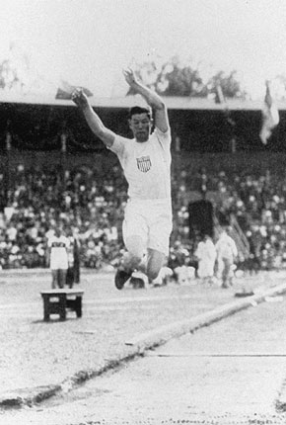
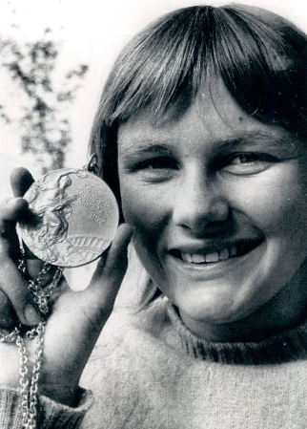
1912
1972
Excellence
Notes:
Slide 12: We’ve also heard how Jim Thorpe excelled in many different sports in the decathlon in 1912, and how Shane Gould’s special talent was for swimming, and so, our second category is Excellence. And the winners are…….[slide 13]

Slide 13
Names

Slide 14
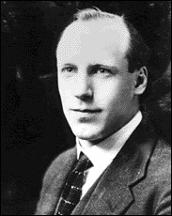
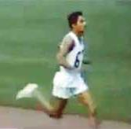
1964
1924
Inspiration
Notes:
Slide 14: We’ve thought about what inspires athletes to keep on going, to become ‘faster, higher, stronger’. We learned that Eric Liddell felt ‘God’s pleasure’ as he ran, and how Ranatunga Karunananda ran to make his little daughter proud, and so, our third category is Inspiration. And the winners are……. [slide 15]

Slide 15
Names

Slide 16
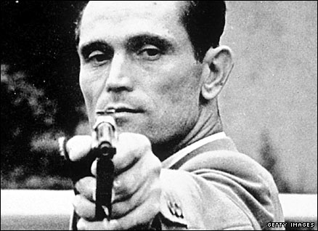
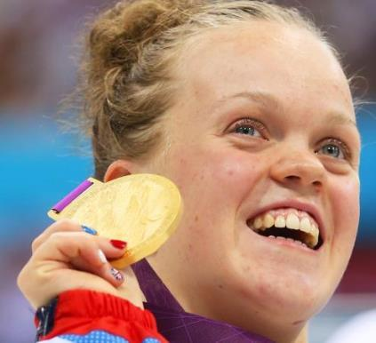
1948
2012
Courage
Notes:
Slide 16: Many athletes, in the Paralympics especially, overcome great difficulties to be able to compete. We heard how Karoly Tackacs taught himself to shoot with his left hand so he could compete in the 1948 Olympic Games, and how home-grown hero Ellie Simmonds overcame great challenges to compete in the 2012 Paralympic Games, and so our fourth category is Courage. And the winners are……. [slide 17]

Slide 17
Names

Slide 18
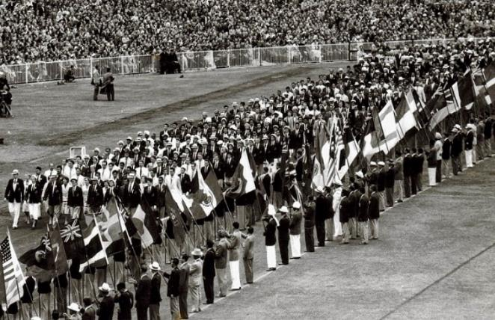
1956
Friendship
Notes:
Slide 18: In 1956, we learned how a young man, John Ian Wing, wrote a letter that encouraged athletes to demonstrate the Olympic value of friendship in the closing ceremony, and so, the next category is Friendship. And the winners are……. [slide 19]

Slide 19
Names

Slide 20
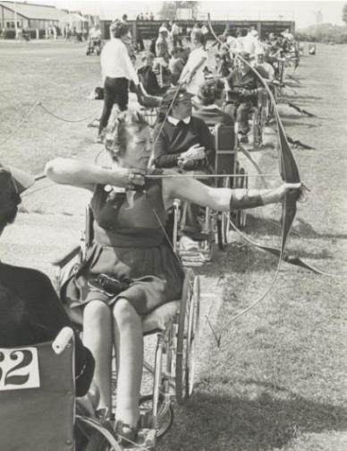
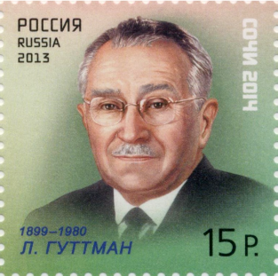
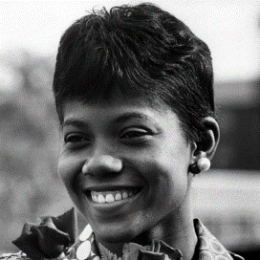
1960
Equality
Notes:
Slide 20: When we visited the Olympic Games in 1960, we heard the story of the beginnings of the Paralympic Games, and how Margaret Maughan competed as one of the very first paralympic athletes. It was also at the 1960 Olympic Games that black athlete Wilma Rudolph competed, and refused to attend her own celebration event until everyone – black and white – was allowed to eat together. So, the sixth category is Equality. And the winners are…….[slide 21]

Slide 21
Names

Slide 22
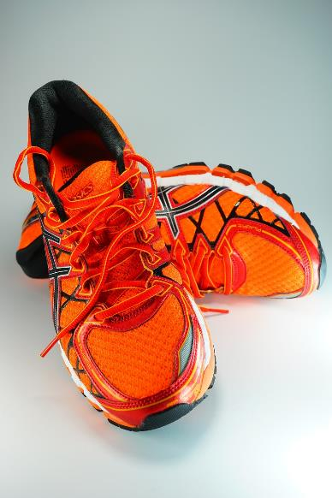
2008
Respect
Notes:
Slide 22: And finally, we heard the story of Samia Yusuf Omar and how she earned the respect of the other athletes, and the crowds, by proudly representing her country in the 200m, even though she came last. And so, our final category is Respect. And the winners are……. [slide 23]

Slide 23
Names

Slide 24
….I wonder what achievement you are most proud of this year?....
…I wonder whose example has inspired you most this term?....
….I wonder how our Olympic Values might help us as we go forwards from here into a new school year?....
Notes:
Slide 24: Responding and words for worship
Now these children are only a few from each class, but I’m sure that if I asked the teachers, they could tell me something that each one of you has achieved this year. Unfortunately, the assembly would probably last all day! They could probably also tell me something they have achieved this year too – because it’s not just children who learn new things!!
This term, we’ve heard many examples of how amazing our bodies and brains are, through the stories of different athletes and their incredible Olympic achievements.
…..the wonderful thing about being a human being is that we all have the ability to learn new things…..
….sometimes, we may not find it easy to do something new, but we know that if we keep on trying, one day we will be able to say ‘I did it!’…..
….in the quietness now, think now about something that you have achieved this year……..you can all feel proud of yourselves……
….I wonder what achievement you are most proud of this year?....
…I wonder whose example has inspired you most this term?....
….I wonder how our Olympic Values might help us as we go forwards from here into a new school year?....
….we’ve also heard during this term how Christians believe that their talents and abilities, the things they are good at, like all good gifts, come from God……
….you might want to say your own thank-you prayer to him for the talents and abilities he’s given to you…..
For the next few moments, I’d like us all to be quiet and think – you might want to close your eyes. Afterwards I will be saying a prayer, which you can make your own if you wish by saying ‘Amen’ at the end:

Slide 25
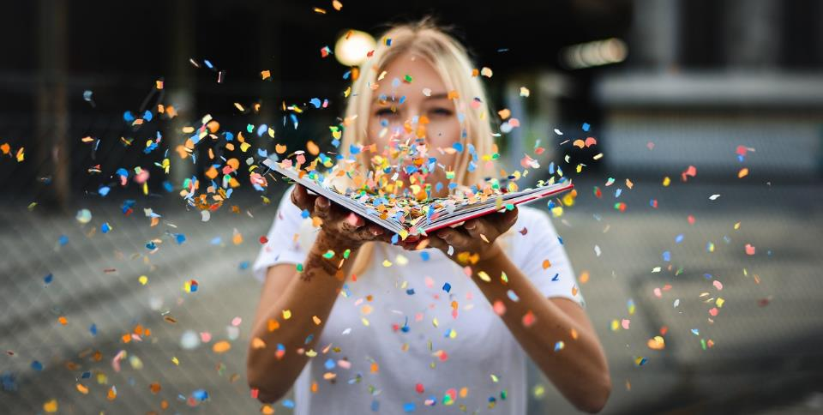
Dear God
We want to thank you for this special time when we have been able to think about what we have achieved this year. As we look back, may we be inspired to carry on working hard to achieve new and greater things in the year to come.
Notes:
Slide 25: Prayer
Dear God
We want to thank you for this special time when we have been able to think about what we have achieved this year. As we look back, may we be inspired to carry on working hard to achieve new and greater things in the year to come.

Slide 26
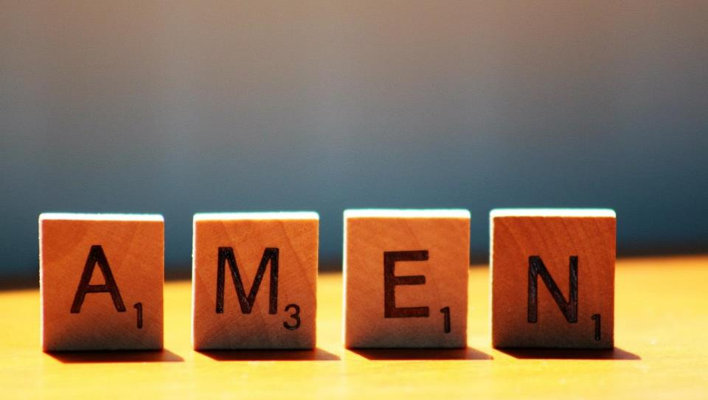

Slide 27
Leader: As we leave this place & time and go into the day ahead…
All: Let’s ‘go for gold’ in all that we do!
Notes:
Sending: Slide 27
Leader: As we leave this place & time and go into the day ahead…
All: Let’s go for gold* in all that we do!
*Again, you might need to unpick what we mean by ‘going for gold’ in the context of today’s words.

