Slide 1
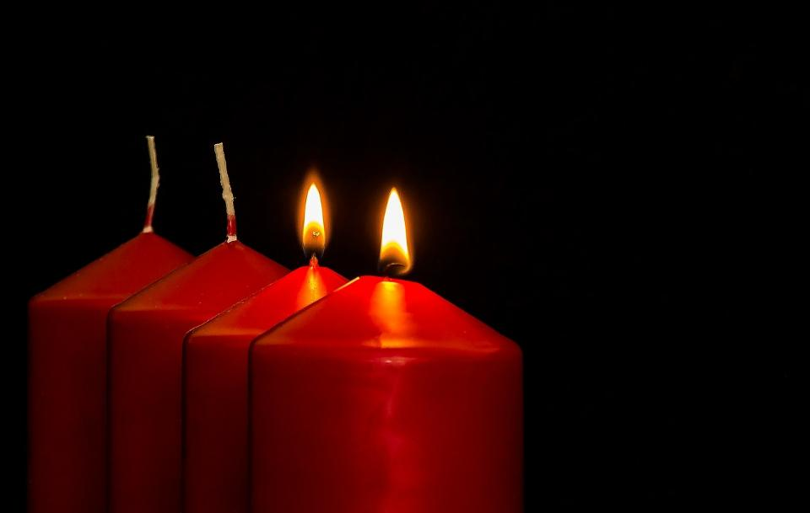


Pictures copyright-free from pixabay
Leader: As we light our Advent candle…
All: May today’s thoughts bring us hope, like light in the darkness.
Notes:
Slide 1: Use this special greeting for the Advent season, as you light your Advent candle.
Leader: As we light our Advent candle…
All: May today’s story bring us hope, like light in the darkness.

Slide 2
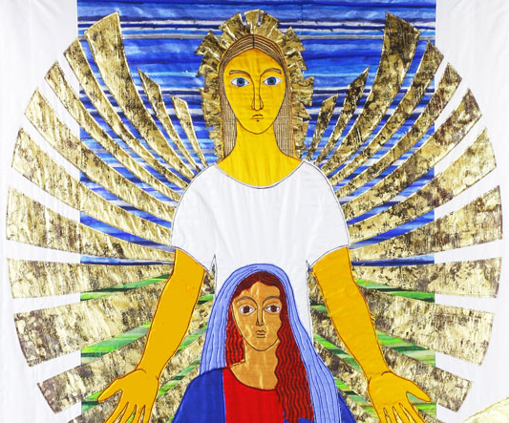
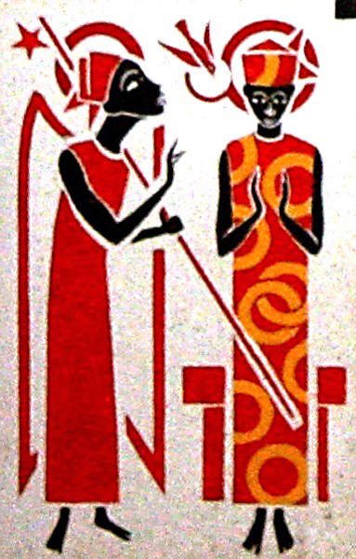
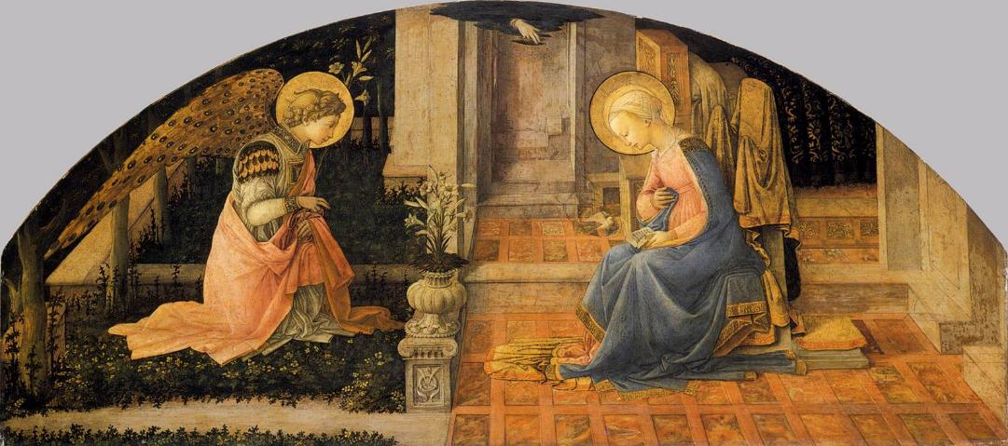
He will be King forever.
He will be God’s Son.
Notes:
Slide 2: Last week, we revisited the Annunciation, and the not-so-secret messages that were hidden in the angel’s words to Mary.
We’re going to think about some more words today….

Slide 3
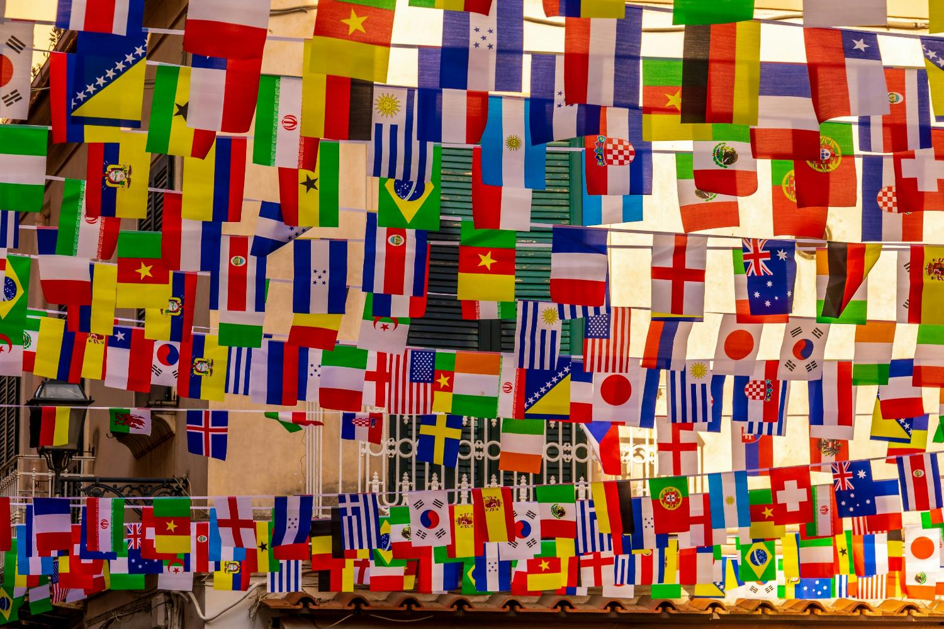
Photo by Nick Fewings on Unsplash
Immanuel
‘God with us’
Notes:
Slide 3: ….starting with some words that you might know from other languages – and what they mean. [ask children to share any words they know in their home language, or any other languages….]
Here’s a word you might NOT know, a word that we often hear at this time of year as people tell the story of the birth of Jesus. It’s a name given to Jesus….. Immanuel which literally means ‘God with us’ [or rather ‘With-Us-God’ – Im=with; Nu=us; El=God] which again, comes from the words of the Prophet Isaiah (chapter 7:14) and is an idea that is very important to Christians.
Today, we are going to think about the message of hope that Christians believe is in this name, through the ordinary people in the Nativity account.

Slide 4
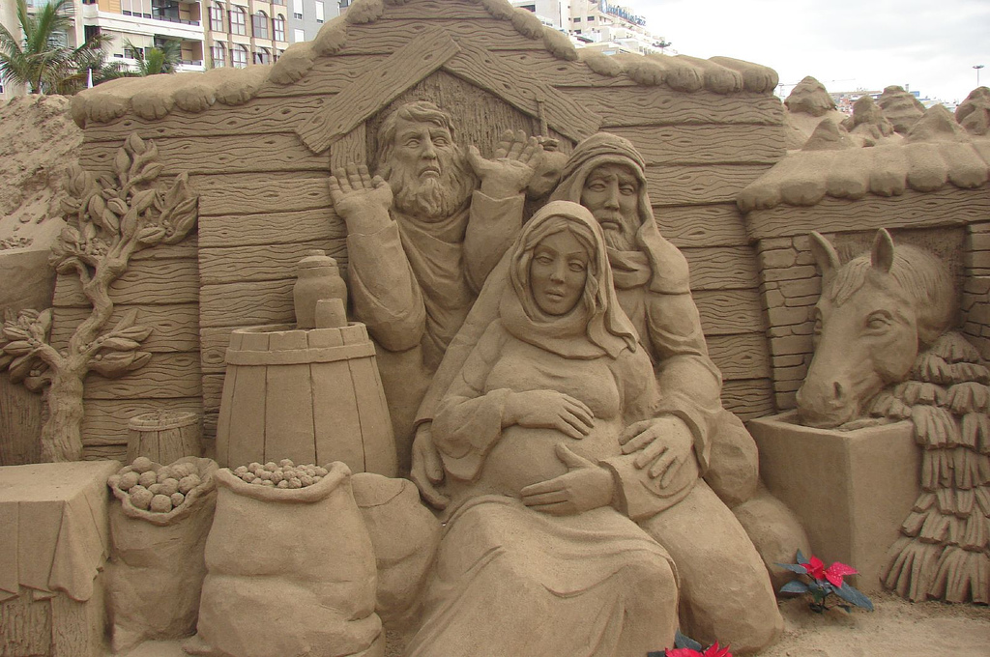
Immanuel: ‘God with us’
Peter Busch, ‘No room at the inn’, created from sand in the Canary Islands, from Art in the Christian Tradition
Notes:
Slide 4: We read in Luke chapter 2 that ‘At that time, Augustus Caesar sent an order to all people in the countries that were under Roman rule. The order said that they must list their names in a register…..And everyone went to their own towns to be registered. So, Joseph….went to the town of Bethlehem in Judea….because he was from the family of David. ….While Joseph and Mary were in Bethlehem, the time came for her to have the baby. She gave birth to her first son. There were no rooms left in the inn, so she wrapped the baby with cloths and laid him in a manger, because there was no guest room available for them.’
This wonderful sculpture by Peter Busch is made entirely out of sand, imagining Mary and Joseph as they search for a room.
We know very little about the innkeeper who found them a space ‘round the back!’ (to quote Nicholas Allan!), but we can be sure that they would have been very busy with so many guests in Bethlehem.
I wonder if the innkeeper, going about his ordinary, everyday business of running an inn, had any idea that the baby born in his barn was Jesus – Immanuel: ‘God with us’? [Talk together for a few minutes if you can: if you have the Nicholas Allan book ‘Jesus’ Christmas Party’, this explores the possible story of the events, in a very child-friendly, humorous way! Maybe add it to your reading list during Advent.]

Slide 5
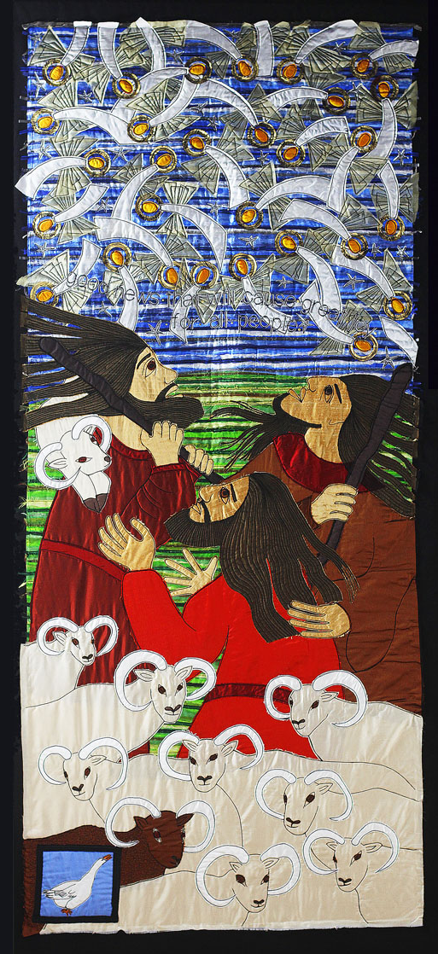
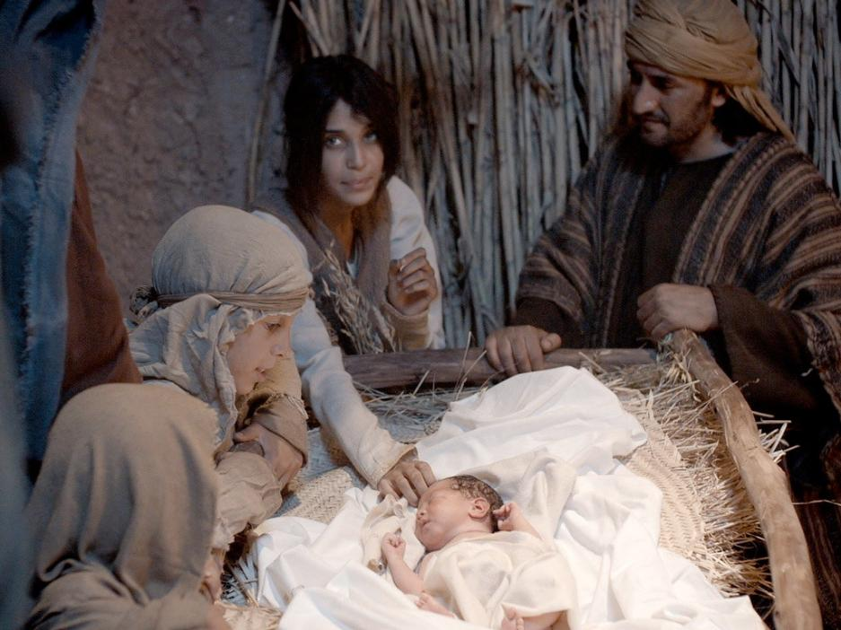

Do not be afraid! I bring good news of great joy for all people….
Today your Saviour was born in David’s town. He is Christ, the Lord.
Notes:
Slide 5: The shepherds, too, were going about their ordinary, everyday business, looking after their sheep in the fields near Bethlehem. As we saw on Jacqui’s panel, they were interrupted by angels with GOOD NEWS!.... ‘Do not be afraid! I bring good news of great joy for all people.’ and ‘Today your Saviour was born in David’s town. He is Christ, the Lord….’ And these poor, ordinary shepherds were the very first people to know!
Unlike the innkeeper, we DO know what the shepherds’ reaction was – they RAN to Bethlehem and found the baby, Mary and Joseph exactly as the angel had told them they would. I wonder how it felt for them to know that this baby, Jesus, Immanuel – was God with them too!

Slide 6
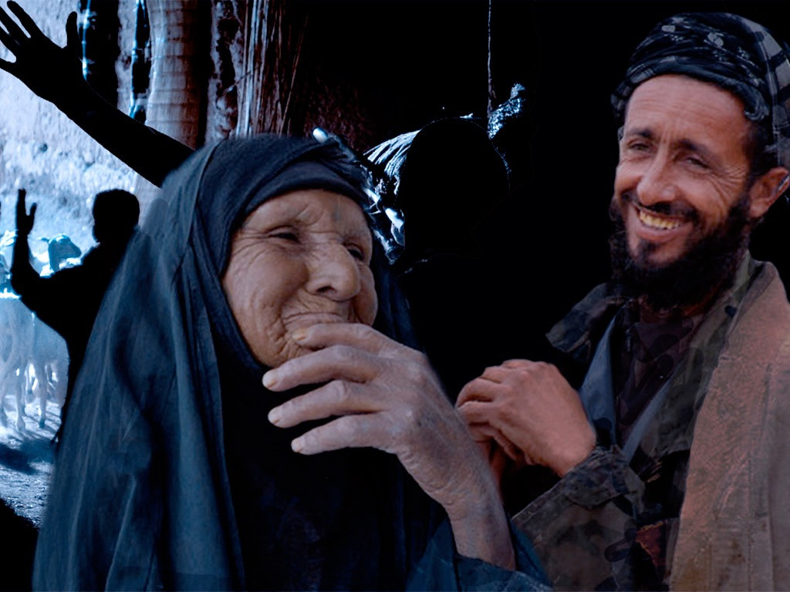
Immanuel: ‘God with us’
Do not be afraid! I bring good news of great joy for all people….
Notes:
Slide 6: After the shepherds left the stable, they told everyone they met about what they had seen and the good news about Immanuel: ‘God with us’ because the angels had said that this news was good news for all people….
I wonder how other, ordinary people felt when they heard that God was ‘with them’?....[you might want to talk again…]

Slide 7

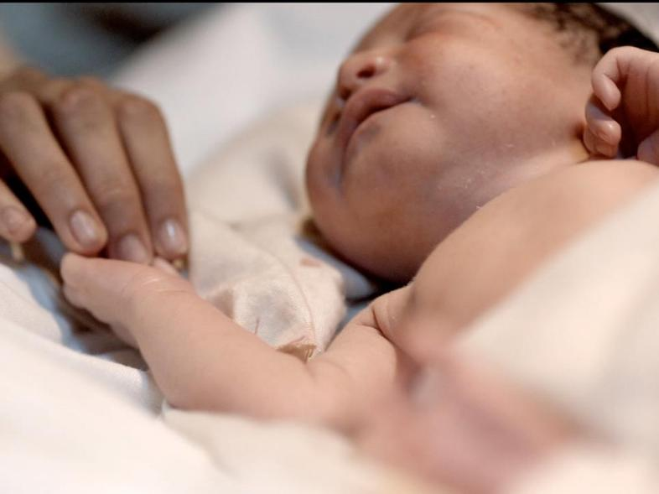

Immanuel: ‘God with us’
Notes:
Slide 7: We’ve been thinking today about Immanuel: ‘God with us’ and how there were ordinary people in the Nativity who heard about the birth of Jesus, and learned of the angels’ words about this good news for everyone.
It’s a really big idea for Christians that it’s possible for God to become a human being, just like us, in the person of Jesus – and it’s not very easy to explain either!! In fact, it’s so hard to explain that Christians call it a Mystery, the Mystery of the Incarnation…..which is another big thought for another day!! But throughout Advent and Christmas these special words ‘Immanuel – God with us’ will be heard in millions of churches across the world….

Slide 8
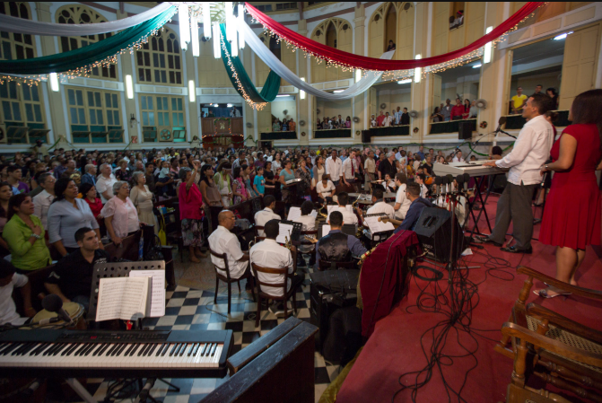
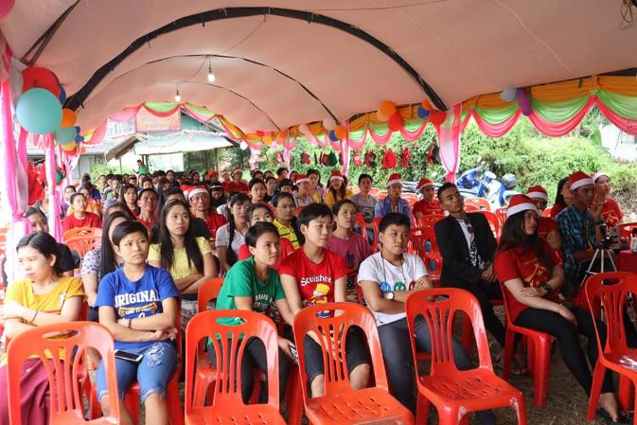
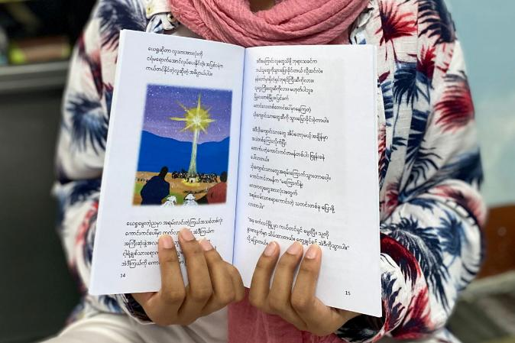
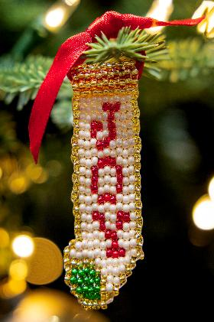
Immanuel: ‘God with us’
Notes:
Slide 8: Churches like these…..all celebrating that Jesus came to Immanuel – God with them too.
[L-R, top-bottom: Christmas worship in Cuba. Myanmar, Bangkok & Columbia (with hand-made decorations sold to raise money for poor communities) – all photos ©IMB International Mission Board]

Slide 9
Immanuel: ‘God with us’
….I wonder what this might mean as we live our ordinary lives?....
Notes:
Slide 9: Responding and words for worship
We’re going to be quiet and still now and think….about Immanuel: God with us.
We’ve heard how Jesus, Immanuel – God with us – was born in a humble stable, as part of an ordinary community, where humble shepherds were the first to be told.
….I wonder what this might mean as we live our ordinary lives?.... [PAUSE]

Slide 10
Immanuel: ‘God with us’
….I wonder what this might mean for us here, in our school community?....or for our families?....
Notes:
Slide 10: ….I wonder what this might mean for us here, in our school community?....or for our families?.... [PAUSE]

Slide 11

Immanuel: ‘God with us’
….I wonder if there are places in our world where people might need to know that God is with them this Christmas?....
Notes:
Slide 11: ….I wonder if there are places in our world where people might need to know that God is with them this Christmas?.... [PAUSE]
In the quietness of this moment, you might want to bring people or places into your mind, and maybe pray for them that they will know God with them this Advent.

Slide 12
Immanuel:
‘God is with us’
Notes:
Slide 12: Prayer
We are going to pray now, using the words that we have been thinking about during our time together today: when I say the word ‘Immanuel’ there are some words that you can join in with ‘God is with us’, if you’d like to. If this is not something that you are comfortable with, then just be quiet with your own thoughts or prayer [NB Watch out for the change of word on slide 16, ‘God is with them.’]

Slide 13
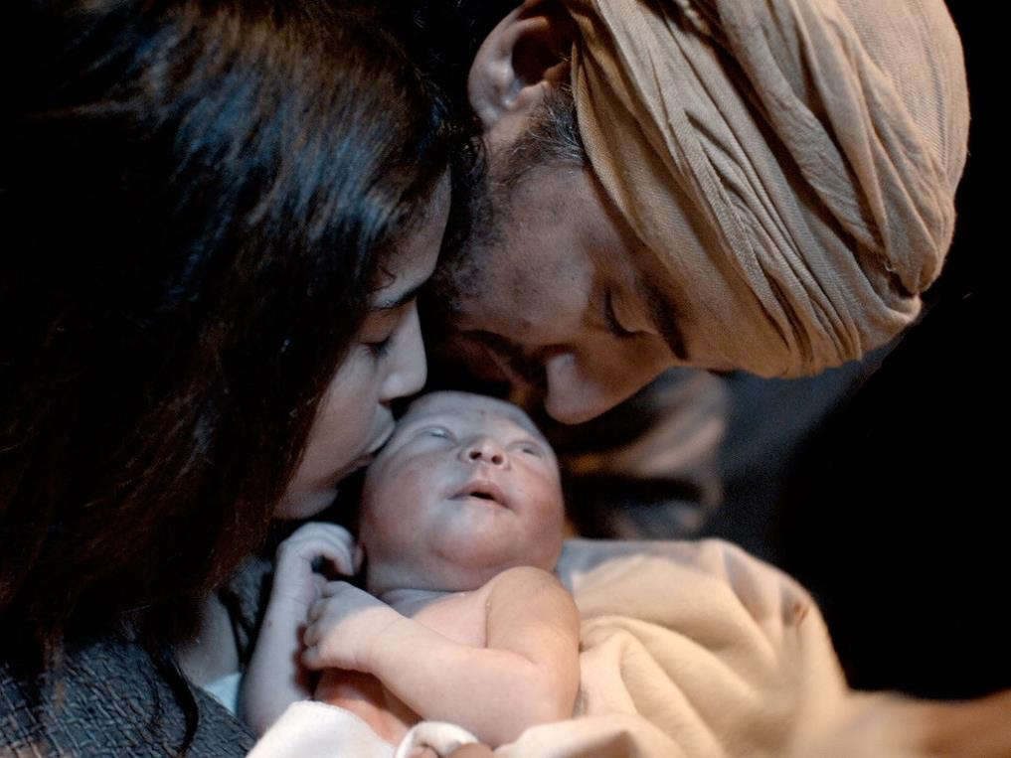
Immanuel:
‘God is with us’
Notes:
Slide 13: As we think about this special story, of Jesus, born as a baby, may we remember that he is Immanuel, God is with us….

Slide 14
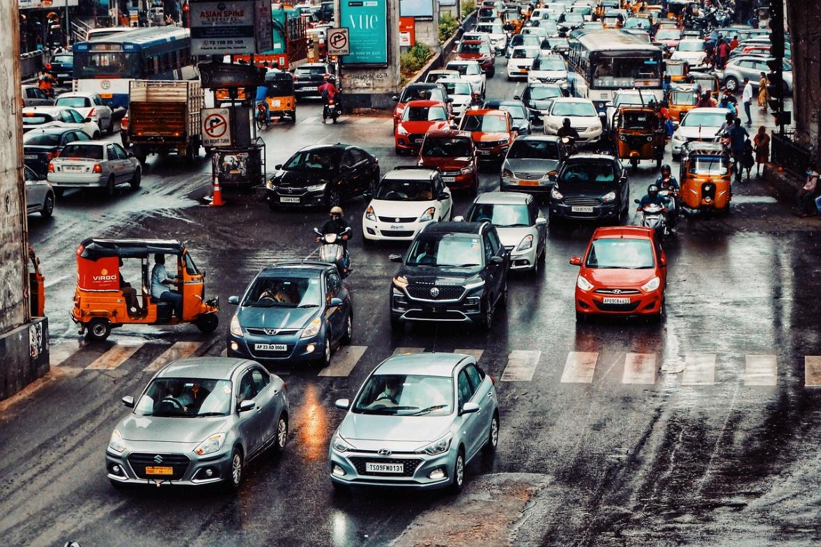
Immanuel:
‘God is with us’
Notes:
Slide 14: As we go about our busy, ordinary lives this Christmas time, may we know the peace of Immanuel, God is with us….

Slide 15
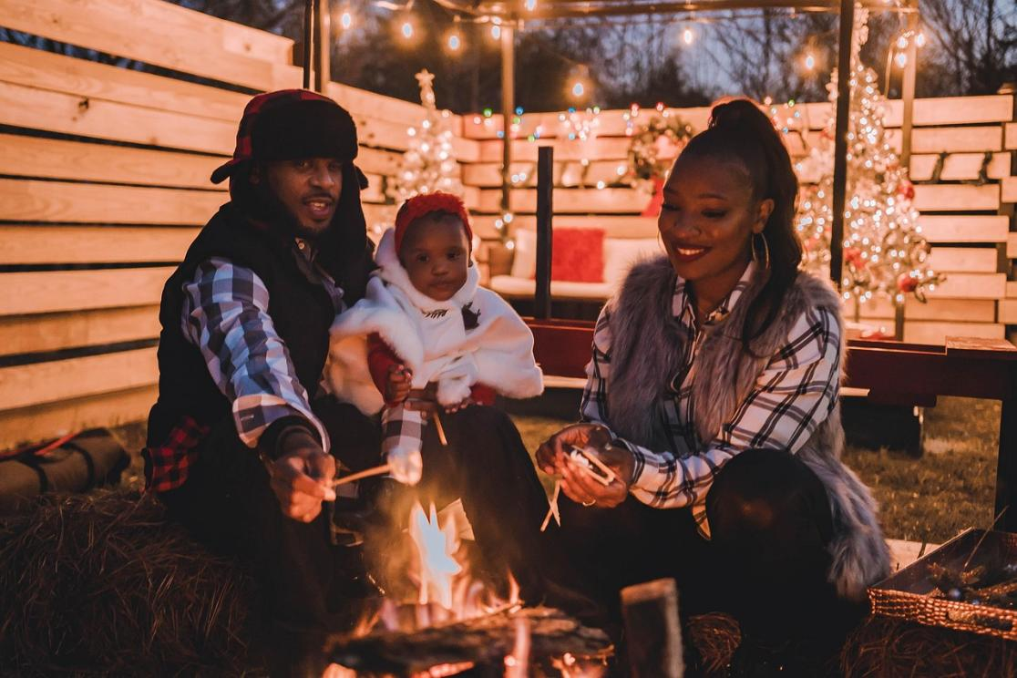
Immanuel:
‘God is with us’
Notes:
Slide 15: As we gather in our homes this Christmas time, may we feel the love of Immanuel, God is with us….

Slide 16

Immanuel:
‘God is with them’
Notes:
Slide 16: In the places where people most need peace, may they too know that Immanuel, God is with them….

Slide 17




Slide 18


Leader: As we leave this place & time…
All: May the hope of Advent shine brightly in our school today.
Notes:
Sending: Slide 18 (You might want to use this slide throughout the Advent season to end your time together)
Leader: As we leave this place and time….
All: May the hope of Advent shine brightly in our school today.

Slide 19


Notes:
Slide 19: Reflection spaces – online Advent calendar
Use the link to connect you to reflective materials for school days during Advent.

