Slide 1
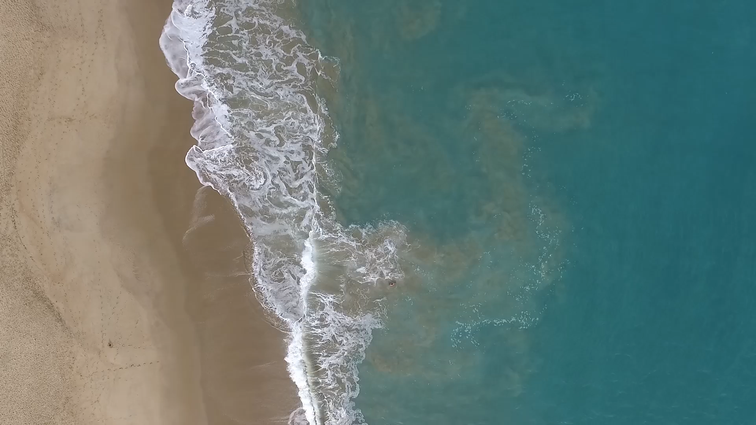
All images copyright-free from pixabay, unless otherwise identified
Notes:
Gathering:
Slide 1: Waves on the beach stilling exercise
Use the stilling slide if desired: the suggested words should be spoken slowly, leaving pauses inbetween to create a sense of stillness.
As you sit quietly, look at the waves washing up onto the beach…..[PAUSE]
Now practise slower breathing…..in…..and out…..in……and out…..as you watch….[PAUSE]
You maybe notice that you are feeling calmer and more relaxed….[PAUSE]
As you breathe, think about yourself and what you bring into this time today….. [PAUSE]
We come into this special / sacred space and time to be still….to think deeply…..to be together as a school community…..
In our time together today, we will sing our story (!), build a wall, and then think together.
But first, let’s share our usual greeting…

Slide 2

Leader: As we gather to share our story today….
All: May we grow in our understanding of ourselves and others.
Notes:
Slide 2: Use our new gathering words for this term, or your usual greeting if you prefer. These greetings may change slightly each week to reflect the spiritual elements that we will be exploring in each week’s materials.
Leader: As we gather to share our story today….
All: May we grow in our understanding of ourselves and others.

Slide 3

Stories that help us to grow
Notes:
Slide 3: Across this term, we have been exploring ‘Stories that help us to grow’, and today is our final week of the term, when we will look back together, and reflect on all the hidden treasure that we have discovered.

Slide 4
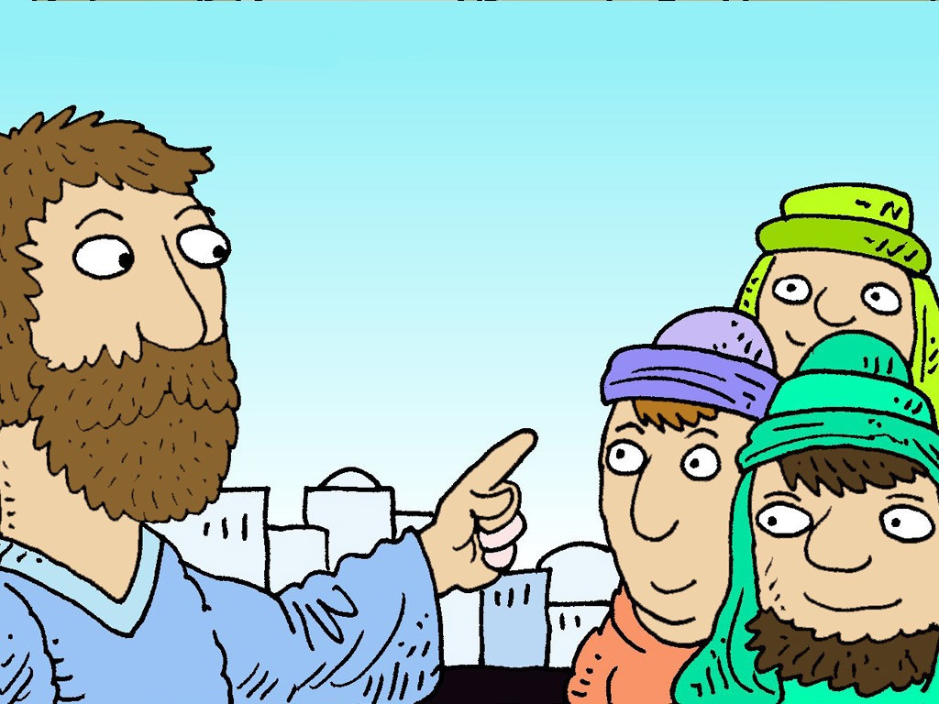

The wise and
foolish builders
Notes:
Slide 4: We’re going to share one final story together now, one of Jesus’ most famous parables. This time, I’m not going to read it to you: we’re going to sing it to each other! (And you can join in the actions! As you listen, think about the hidden treasure that we might find in this parable: The Wise Man Built His House Upon the Rock with actions || Sunday School Song - YouTube)

Slide 5

Notes:
Slide 5: As you know from our stories earlier this term, Jesus often told stories (called parables) to help people to remember important things about God, and what matters to him. he said that people who are wise, who remember his words and put them into practice, are like the builder who built on rock, with firm foundations. Christians believe that the wise words of Jesus are like the rock on which the builder built.
Customise this for your context: Some of these words are really special to us as a school, as they have helped to shape our school community and help us to make wise decisions about how to live together and in our world [If your school has some words of Jesus as part of your vision/values, you might want to add them to this slide]

Slide 6

Building
Notes:
Slide 6: Building
We’re going to do some building of our own now. I’m going to choose a couple of builders, one from each class, to help me: don’t worry, neither of you will have to be the foolish builder! [choose builders & dress them]
I have three bricks here to start us off, that contain some of the words that we have heard during this term, which are going to form our foundations [read your chosen words out as you build together]
Builders, scattered around, you’ll see some more big bricks that we need to build into our wall. These also contain some of the hidden treasure that we have found together in the stories we’ve shared this term – and some very special ones from your teachers: words for you to remember, and ‘build with’, as you move on to your new class / schools. [collect, read words out and build]

Slide 7
….I wonder how we might put some of these words into practice?….
…. I wonder which words might help us as we move into our new classes?....
….I wonder which words might help us to make good decisions in life?.....
....I wonder how we might ‘build wisely’, like Jesus said?....
….help us to build wisely.
Notes:
Slide 7: Responding (words for worship):
….so, at the end of our term and in the stillness of this moment, let’s spend some time wondering together…..
Let’s look at our whole wall together now, built on those firm foundations ….
…I wonder how we might put some of these words into practice?….
….I wonder which words might help us as we move into our new classes?....
….I wonder which words might help us to make good decisions in life?.....
…Jesus’ story of the two builders also reminds us that we have choices: not about actual building, but building our lives wisely, or foolishly….. As we all move on at the end of this school year and look forward to the future, let’s ‘be careful how we build’, and make wise choices…..
I’m going to pray now, and ask God’s blessing on this last week of term as we pack up and wish each other well. You might wish to join in with me, using the words ‘help us to build wisely.’

Slide 8

….help us to build wisely.
Notes:
Slide 8: As we think of all the hidden treasure we have discovered this term….‘help us to build wisely.’

Slide 9
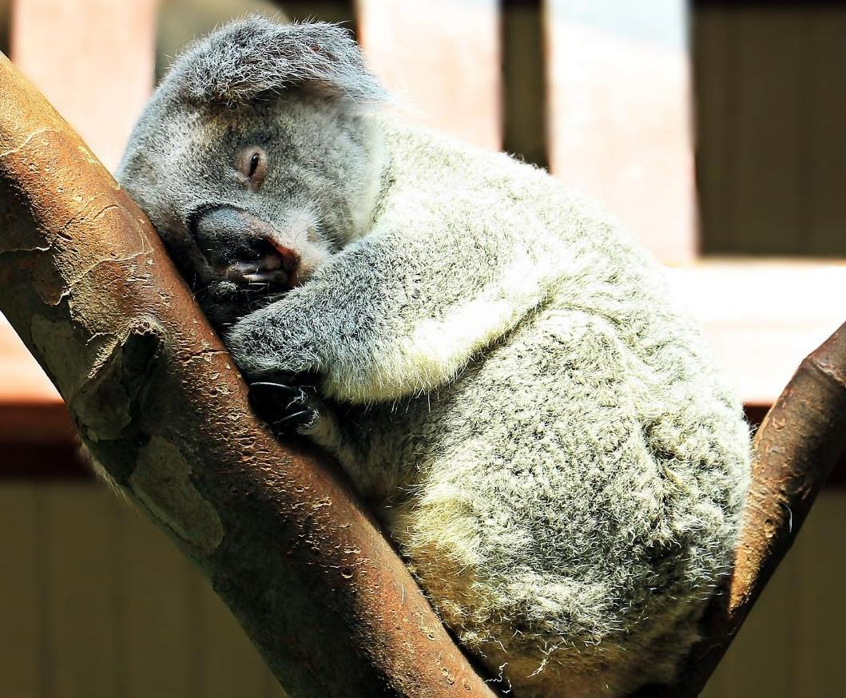
….help us to build wisely.
Notes:
Slide 9: At the end of this term, though we are tired and weary….‘help us to build wisely.’

Slide 10

….help us to build wisely.
Notes:
Slide 10: In the choices that we make, now and in the future….‘help us to build wisely.’

Slide 11


Slide 12


Leader: As we leave this place & time and go into the day ahead…
All: …help us to build wisely!
Notes:
Sending: Slide 12
Leader: As we leave this place and time and go into all that lies ahead…
All: ….‘help us to build wisely.’

Slide 13
Write some wise advice onto your class brick wall and leave it for the next class.

Slide 14
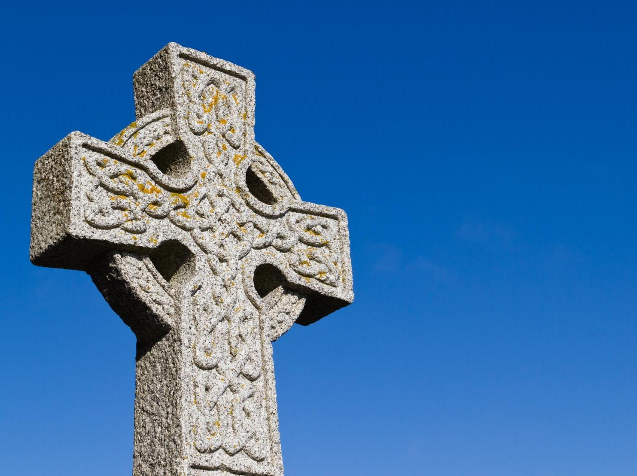
A Celtic Blessing
Notes:
Slide 14: It’s a blessing that is very old, probably from Ireland (which is one part of the British Isles) This blessing talks about wishing someone well as they go on their journey….that their journey will be an easy one. This may be an actual journey, but it could also mean the journey of people’s lives. As you listen, you might not understand every word, because the language is like a poem, so I’m going to use some pictures to help us. [Try to leave a pause between each slide, and resist the urge to explain the words: let them sink in and let the words and pictures ‘speak’ to children at whatever level they will absorb them, even if it’s only to enjoy how they sound. Read it more than once if you think it will help.]

Slide 15
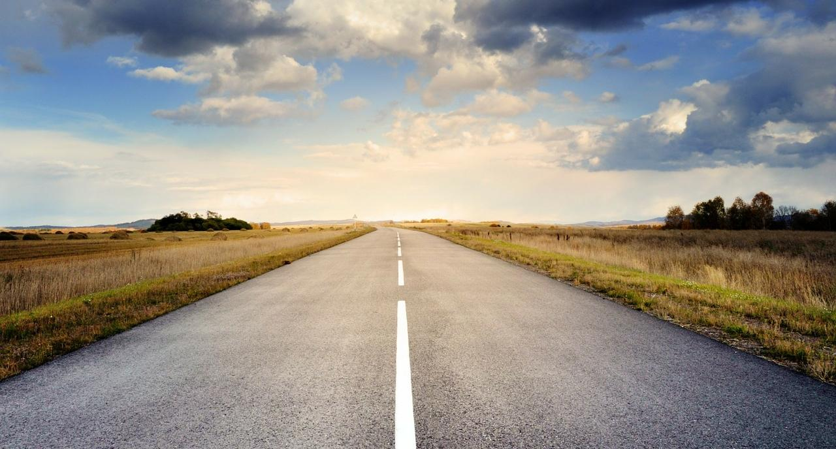
May the road rise up to meet you.

Slide 16
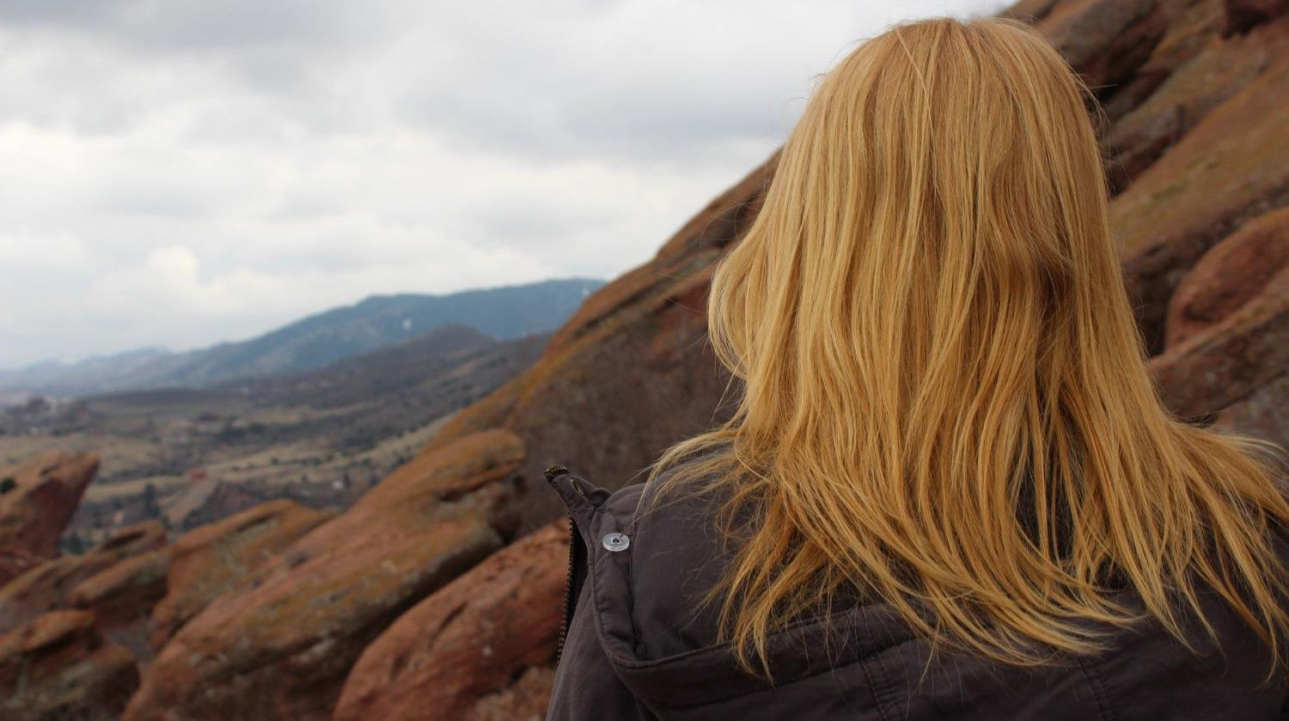
May the wind be always at your back.

Slide 17
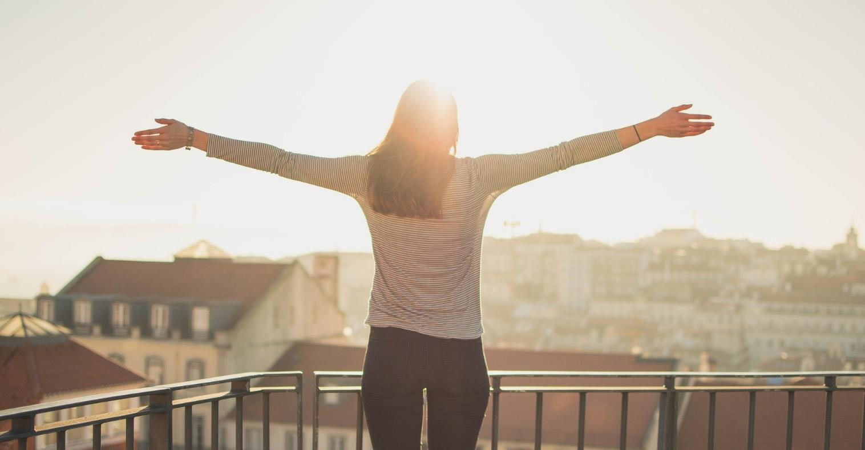
May the sun shine warm on your face,

Slide 18
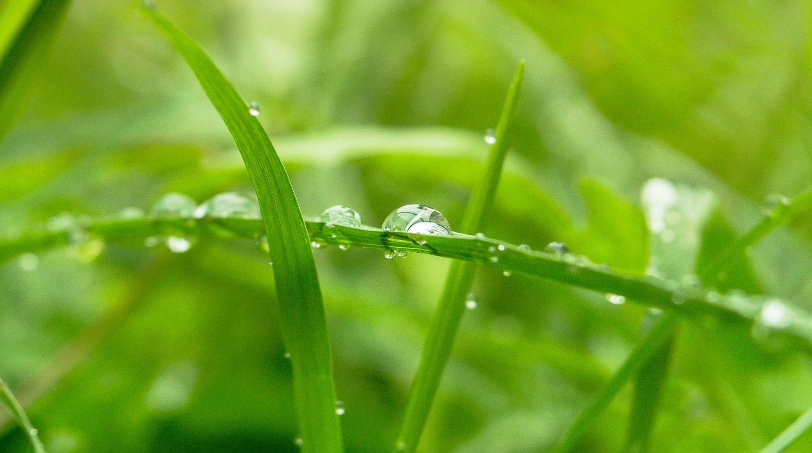
…the rains fall soft on your fields…

Slide 19

…and until we meet again,

Slide 20
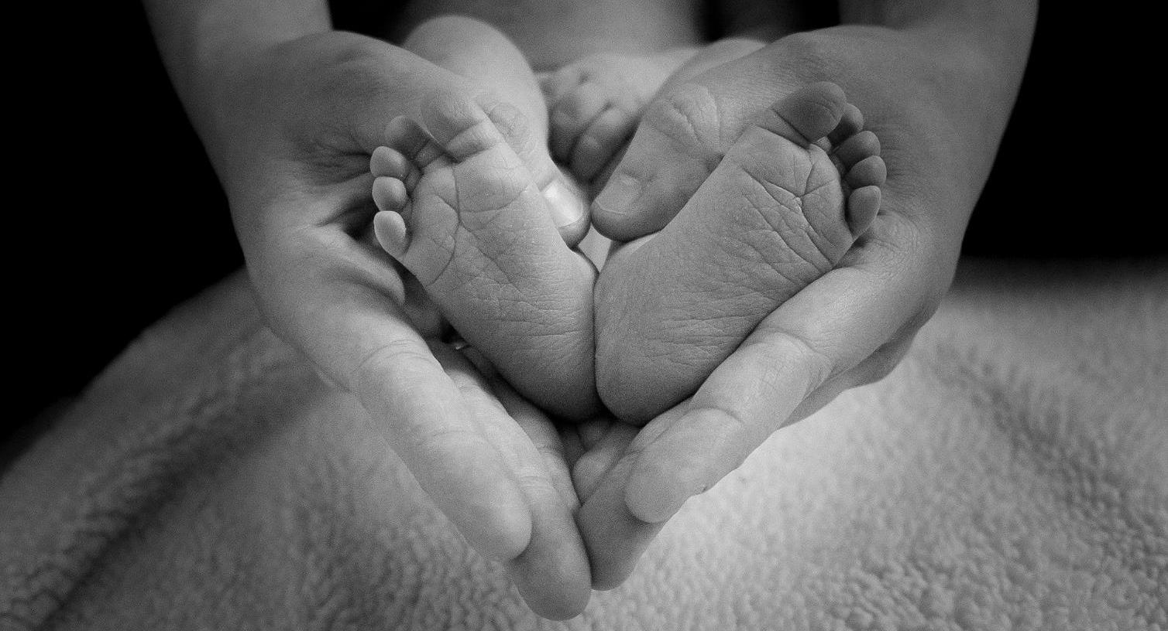
…may God hold you in the palm of his hand.
Notes:
Slide 18: ….may God hold you in the palm of His hand.

