Slide 1
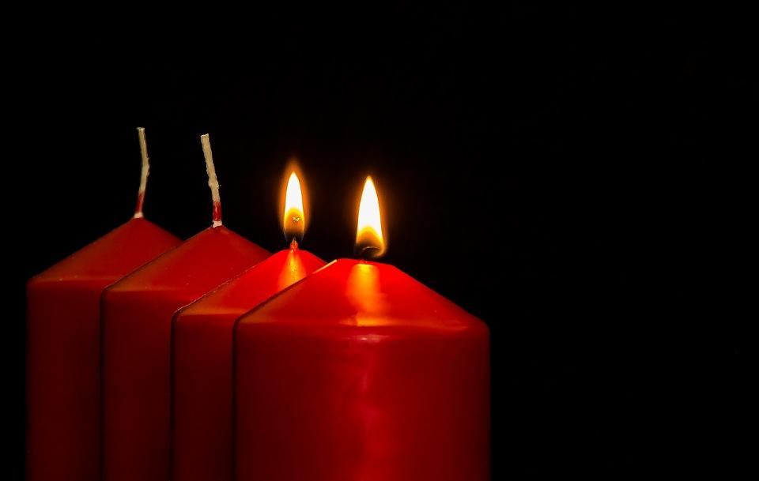
Leader: As we light our Advent candle…
All: May our time today show us something new, like light in the darkness.
Notes:
Slide 1: Use this special greeting for the Advent season, as you light your Advent candle.

Slide 2
Notes:
Slide 2: Show the picture/video, or better still, darken the room and bring in a lit birthday cake. You may have a class version that children are already familiar with. Talk about the sense of expectancy; the anticipation of those moments before the cake appears. Is this an experience just for the person with the birthday, or something that everyone at the party shares? In Advent, Christians prepare for Jesus – who comes to bring light in the darkness.

Slide 3
Notes:
Slide 3: Being a messenger
Share experiences of taking messages e.g. from one class / teacher to another. How did it feel to have this responsible job? What did you have to remember?

Slide 4
Those who walked in the dark have seen a bright light. And it shines upon everyone who lives in the land of darkest shadows.
Notes:
Slide 4: Isaiah 9:2
Long before Jesus was born some messengers, called prophets, brought messages from God about what the Great Rescuer would be like. A prophet called Isaiah was given these messages over 700 years before Jesus was born. It helps to understand what the world was like for the Prophet Isaiah, who was speaking to the people of God when they were far away from their homeland, and things felt very dark. [You might like to talk about what we mean when we talk about the world being ‘dark’ i.e. not physically dark, but living in hard times]
Listen to the words of hope that he shared:
Those who walked in the dark have seen a bright light. And it shines upon everyone who lives in the land of darkest shadows.
We will come back to this idea later on in our time together, and think about how it feels for there to be light in dark times….
Isaiah’s messages remain some of the most important in the whole Bible in helping people to see what this Great Rescuer would be like, so let’s hear some more words from Isaiah to find out more…..

Slide 5
His name will be Wonderful Counsellor, Powerful God, Father Who Lives Forever, Prince of Peace.
Isaiah 9:6
Notes:
Slide 5: In this collective worship we will look at some of the names that the prophet Isaiah used to describe the Great Rescuer, who Christians believe is Jesus. [You could read the text together and pick out the key names, talking about the adjectives.] What other words do you think could’ve been used instead?
I wonder how this Great Rescuer might be like a light in the darkness?

Slide 6
His name will be….. Wonderful Counsellor
Notes:
Slide 6: His name will be Wonderful Counsellor.
A counsellor gives advice, helps people to make choices.
Talk about the choices we make.
Not just what fruit at snack time, but more difficult choices.
What we say to people….. If we will help someone….
Sensitively explore some of the more difficult choices the children have made. Be aware that where parents live apart children may feel that they have to choose between parents.
Christians believe that Jesus will help them to make good choices.

Slide 7
His name will be….. Powerful God
Notes:
Slide 7: His name will be …..Powerful God,
Christians believe that God is a mighty, powerful God. He can do things that seem impossible to humans. He made the universe, including the stars millions of light years away.
How did Jesus show God’s power?
What have you seen that might show Christians that God is powerful? Are there times when you wish God would show his power more in our world?

Slide 8
His name will be ….. Father Who Lives Forever
Notes:
Slide 8: His name will be …..Father Who Lives Forever
Christians believe that God is with them for ever; he loves like a good parent loves their child.
Be sensitive to the fact that not all children will have a father in their lives, and some may have negative experiences of fathers.
This is a mobius strip. If you run your finger round it, it never ends.
Take a long strip of paper, half twist it and stick the ends together with tape. Invite a child to come and runs their hands around the strip showing that it never ends.
How might it help Christians to know that God is ‘everlasting’?

Slide 9
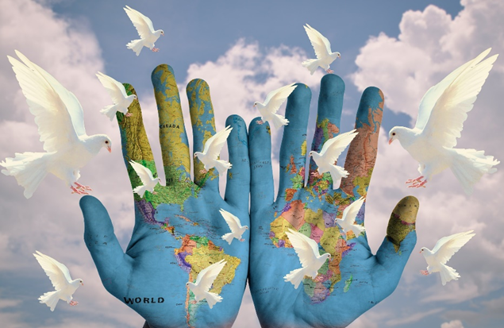
His name will be ….. Prince of Peace
Notes:
Slide 9: His name will be … Prince of Peace
There is so much war and conflict in our world. People find it difficult to make and keep peace.
Our own hearts are often not at peace, but anxious and worried.
Christians believe that Jesus brings peace – for them, and for our world.

Slide 10
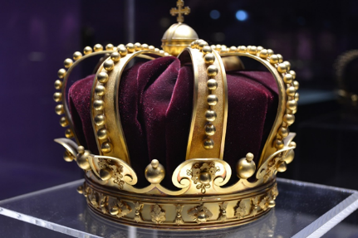
He will rule as king …with goodness and fair judgment. He will rule forever and ever.
Notes:
Slide 10: These are some more words from the prophet Isaiah. Christians believe that in God’s kingdom, everyone is to be good and fair.
I wonder what that might look like?
Christians are called to bring God’s Kingdom to earth here and now, in the way that they love and treat others. At Advent, they will continue to pray ‘Your Kingdom come….’

Slide 11
Notes:
Slide 11: If you haven’t already done so, light a candle for children to see, or darken the room and show your Advent candle, or the one on the slide]. Even a little bit of light lights up the darkness. Have you ever been in a dark place when someone has lit a candle or a torch? How did it make you feel?

Slide 12
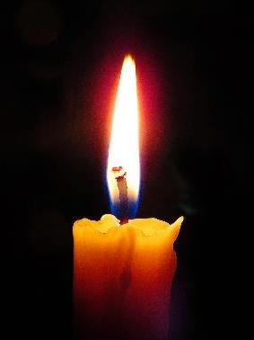
The true light that shines on everyone was coming into the world….The light shines in the darkness and the darkness will not overcome it.
Notes:
Slide 12: John writes in his book in the New Testament part of the Bible that this prophecy is about Jesus: ‘The true light that shines on everyone was coming into the world….The light shines in the darkness and the darkness has not overcome it….’ (John 1: v9 & v5)
Christians believe that Jesus is the Wonderful Counsellor, Powerful God, Father Who Lives Forever, Prince of Peace and Fair King. Jesus came to be a light in the darkness – and His names bring light and hope into a dark world.
But it doesn’t stop there, because followers of Jesus can be a part of God’s Kingdom on earth, and shine God’s light out of their lives, wherever they go.

Slide 13
….I wonder which one is the most important to you?....
….I wonder which one you think is most important for Christians?....
….I wonder which one you think our world needs most this Christmas time?
….I wonder what it might mean for our lives to shine like lights in the darkness?....
Notes:
Slide 13: … We’re going to have some quiet moments now to think about all the different things we’ve explored today…..
…think about the names of Jesus that we have looked at in this assembly.
….I wonder which one is the most important to you? ….
….I wonder which one you think is most important for Christians?....
….I wonder which one you think our world needs most this Christmas time? ….
….I wonder what it might mean for our lives to shine like lights in the darkness?....
Spend some time thinking in the stillness, watching the flame of your Advent candle flicker – and thinking about the places where light needs to shine.

Slide 14
Light a candle in our world, O God
let it brighten our faces
that we may tell this world
the time is arriving
when you will put on flesh
and walk among us.
Notes:
Slide 14: Use your hands to express this response;
Light a candle in our world, O God ( Thumbs-up symbol and wiggle thumb)
let it brighten our faces (Hands at side of the face and wiggle fingers)
that we may tell this world (Hands moving away from mouth)
the time is arriving (Point to watch on wrist)
when you will put on flesh (Mine putting on a coat)
and walk among us. (Draw a circle in front of you with both index fingers)
Amen
Taken from Roots Prayer and Prayer Activities

Slide 16
Leader: As we leave this place & time…
All: May the light of Advent shine brightly in our school today.
Notes:
Sending: Slide 16 (You might want to use this slide throughout the Advent season to end your time together)
Leader: As we leave this place and time….
All: May the light of Advent shine brightly in our school today.

