Slide 1
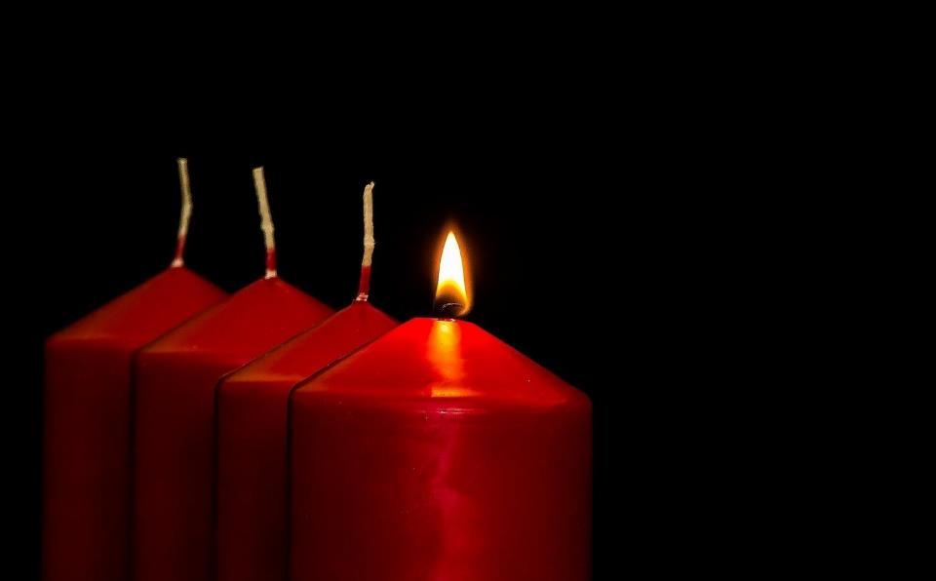
Leader: As we light our Advent candle…
All: May today’s story show us something new, like light in the darkness.
Notes:
Slide 1: Use this special greeting for the Advent season, as you light your Advent candle.

Slide 2
Who lives here?
Notes:
Slides 2-8: Picture Game – Who lives here? Play this together – the answers are under each slide.

Slide 3
Notes:
Slide 3: House of straw…. one little pig!

Slide 4
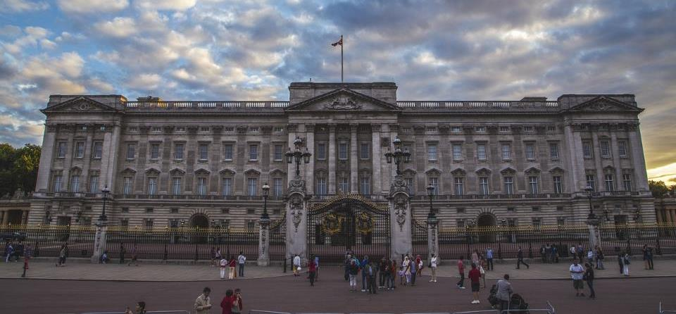
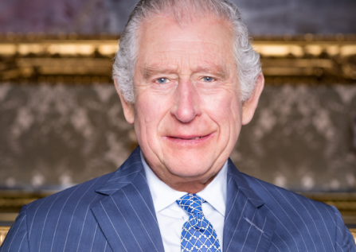
Notes:
Slide 4: Buckingham Palace…. King Charles III

Slide 5
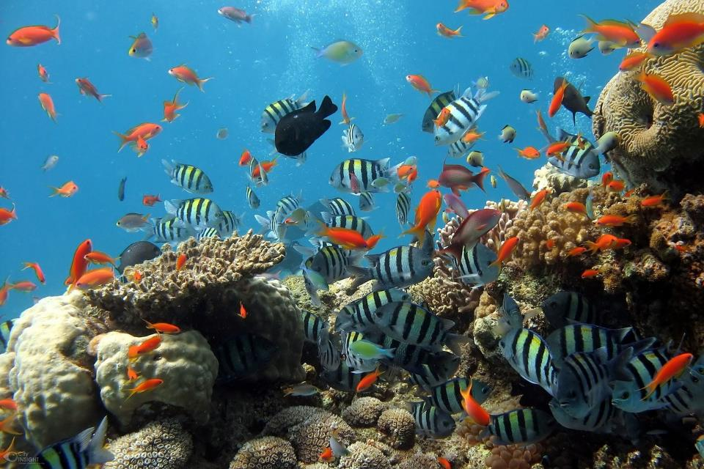
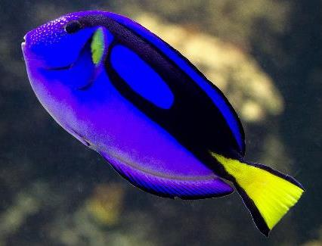
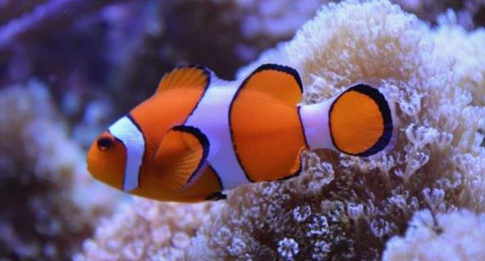
Notes:
Slide 5: Coral reef…. Nemo (and Dory!)

Slide 6
Notes:
Slide 6: Insert photo of your school here…. Your community ‘dwells’ here!

Slide 7
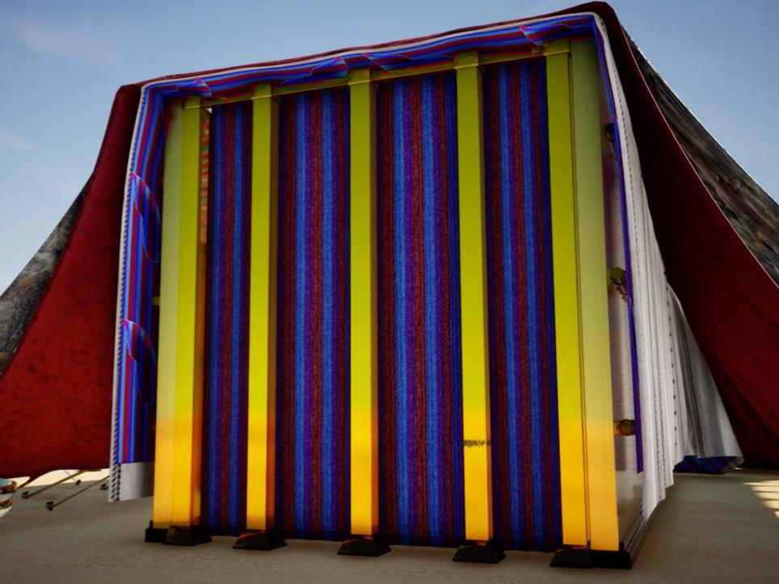
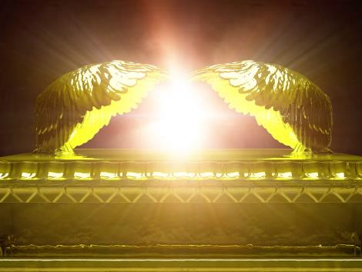
‘Tabernacle’
Notes:
Slide 7: Tent of meeting…..God’s presence
In our series following Moses and God’s people on their epic journey, we heard how God gave instructions for how this special tent should be built, and that it would be a holy meeting place, where God came to meet with Moses.
We also heard that this was called the Tabernacle, which means ‘dwelling place’, the place where God ‘lived’. This is a special word that we hear again in some words much later in the Bible…..more about this in a moment. But here’s one last place for our game……

Slide 8
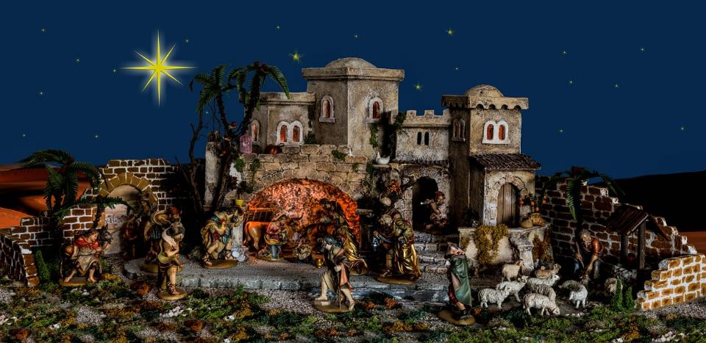
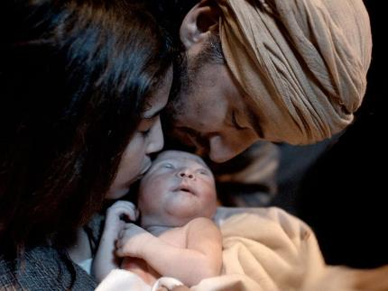
Notes:
Slide 8: Hopefully you will remember that this is Bethlehem – the birthplace of…… Jesus, although he didn’t actually live here!
As we begin this Advent season, this is the place that we associate with this important story.

Slide 9
While Joseph and Mary were in Bethlehem, the time came for her to have the baby. She gave birth to her first son. There were no rooms left in the inn. So she wrapped the baby with cloths and laid him in a manger. Luke 2:6-7
Notes:
Slide 9: The birth of a baby is a truly wonderful thing, and it was for Mary and Joseph, just as it is for most new parents.
At this time of year, people often read these words about the birth of Jesus from the Bible:
While Joseph and Mary were in Bethlehem, the time came for her to have the baby. She gave birth to her first son. There were no rooms left in the inn. So she wrapped the baby with cloths and laid him in a manger. Luke 2:6-7
We find this story in 3 different parts of the Bible, called the Gospels – the Good News books.
Let’s hear the words from another one of these places….some words written by a man named John, who was one of Jesus’ closest friends….
His words describe the birth of Jesus in a very different way….

Slide 10
‘tabernacle’
Before the world began, there was the Word. The Word was with God, and the Word was God…. The Word became a human being and lived among us….. John 1:1 & 14
Notes:
Slide 10: Before the world began, there was the Word. The Word was with God, and the Word was God…. The Word became a human being and lived among us….. John 1:1 & 14
These words might be trickier to understand – but they contain some very important ideas for Christians about who they believe Jesus is. Quite simply, the ‘Word’ is one of the names that they have for Jesus – and these important words written by John explain that Jesus is God, and that God came to ‘live among us’.
In the original language of the Bible, the word ‘lived’ is the same word ‘tabernacle’ that we have heard in the Moses story.
So, the words actually say ‘The Word became a human being and tabernacled among us’. Christians believe that the glory of God that lived in the tabernacle is same glory of God that came to earth as a tiny little baby…..in the person of Jesus.
That’s quite a big thought, isn’t it?!! [you may need to talk through this as an idea, especially with younger pupils]

Slide 11
….I wonder why these words are so important to Christians at this time of year?....
….I wonder what difference it might make to them that God chose to ‘tabernacle’ as a tiny baby?....
….I wonder what difference this idea might make to us as a school community as we reflect over this Advent season?.....
Notes:
Slide 11: We’re going to pick this idea up again next week in our final collective worship of the term, but as we come near to the end of our time together today, let’s be still and wonder together….. [Pause and talk together, as time allows]
….I wonder why these words are so important to Christians at this time of year?....
….I wonder what difference it might make [to them] that God chose to ‘tabernacle’ as a tiny baby?....
….I wonder what difference this idea might make to us as a school community as we reflect over this Advent season?.....

Slide 12
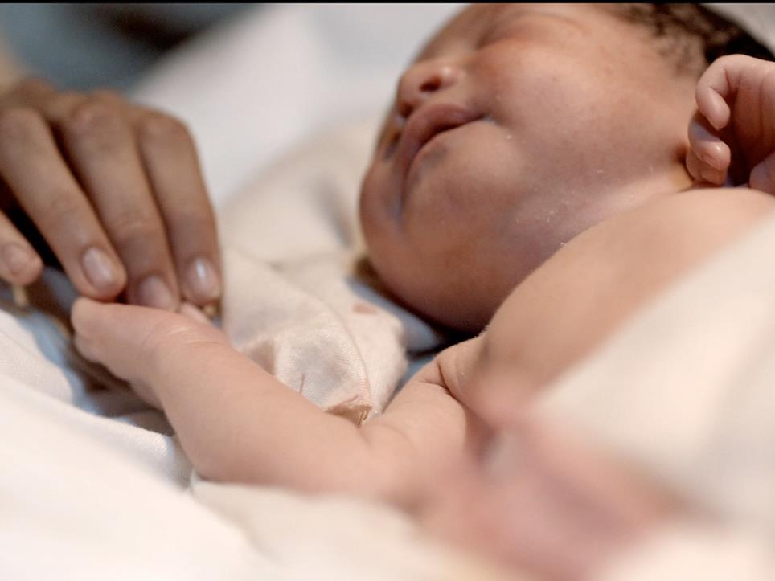
He came down to earth from heaven,
Who is God and Lord of all.
And his shelter was a stable,
And his cradle was a stall….
Notes:
Slide 12: Prayer
These words come from a very famous Christmas carol, called ‘Once in Royal David’s City’, which is often sung in churches over the Christmas period.
They are a reminder of this idea that God came from heaven to live as a tiny baby – born in a stable because there was no room in the inn.
We’re going to use this carol as a prayer now, to give anyone who would like to a chance to pray quietly as they listen: [link works from the image, or paste this into your browser: https://www.youtube.com/watch?v=zh8Op_93rvk]

Slide 13
Leader: As we leave this place & time…
All: May the light of Advent shine brightly in our school today.
Notes:
Sending: Slide 13 (You might want to use this slide throughout the Advent season to end your time together)
Leader: As we leave this place and time….
All: May the light of Advent shine brightly in our school today.

