Slide 1
Leader: We are here together
ALL: May we ‘GO FOR GOLD!’ in our words and actions today!
Notes:
Slide 1: Gathering words
Leader: We are here together
ALL: May we ‘GO FOR GOLD!’ in our words and actions today!

Slide 2
The Olympics
Respect
Friendship
Excellence
Determination
Equality
Courage
Inspiration
Olympic rings © Pixabay
Notes:
Slide 2: We are nearing the end of our Olympic series, with one more Olympics to visit…..and the Paris 2024 Olympics to look forward to very soon!

Slide 3
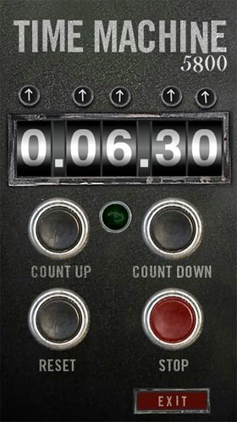
2024
CE
2016
CE
Notes:
Slide 3: Let’s jump straight into our Olympic time machine and go back in time 8 years ….to 2016,

Slide 4
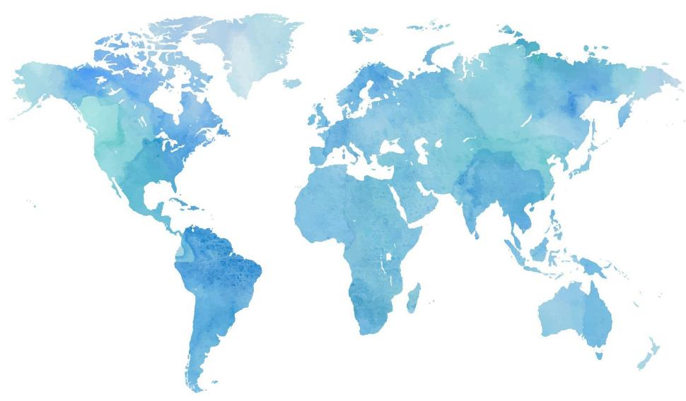
Notes:
Slide 4: When the Olympics and Paralympics were in Rio, Brazil. We’ll be hearing the story of one female athlete who competed in 2016, but first….

Slide 5
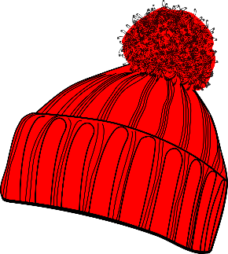
Name that
hat!
All images © Pixabay
Notes:
Slide 5: We’re going to play a short game together, all about head coverings, ‘Name that hat!!’ [work through Slides 6-12 – answers are under the slide if you’re not sure!]

Slide 6
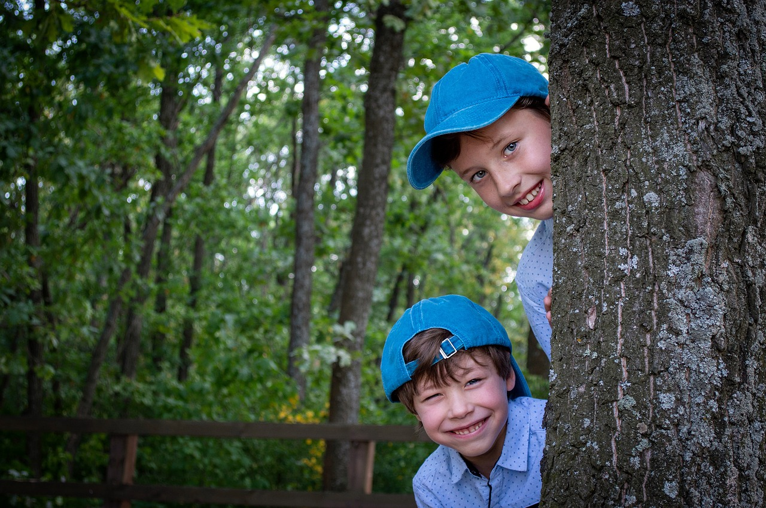
Notes:
Baseball cap

Slide 7
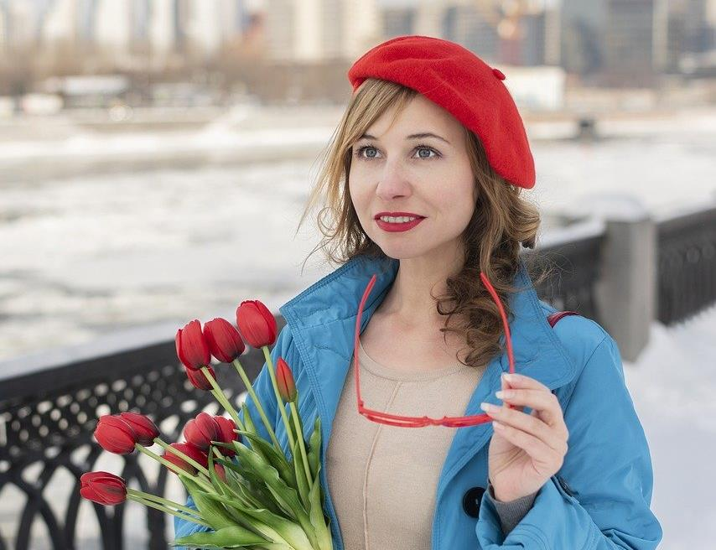
Notes:
Beret

Slide 8
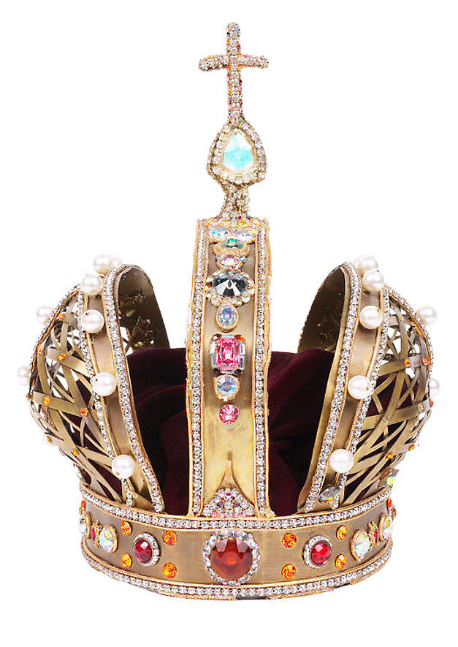
Notes:
Crown

Slide 9
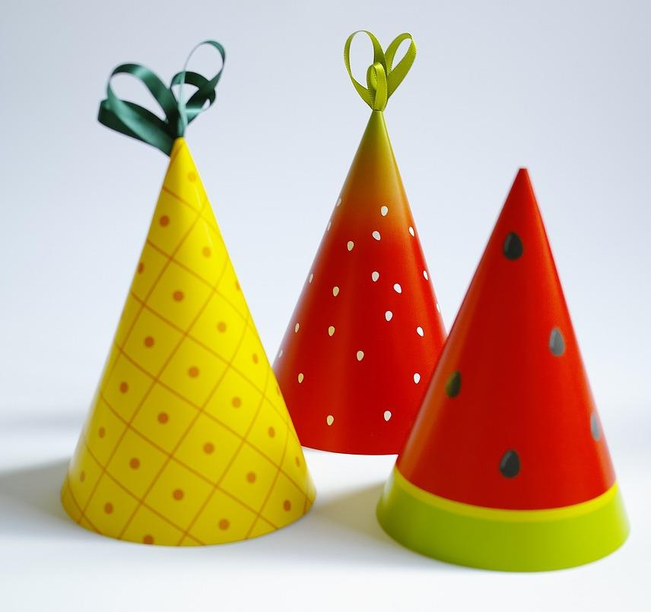
Notes:
Party hat

Slide 10
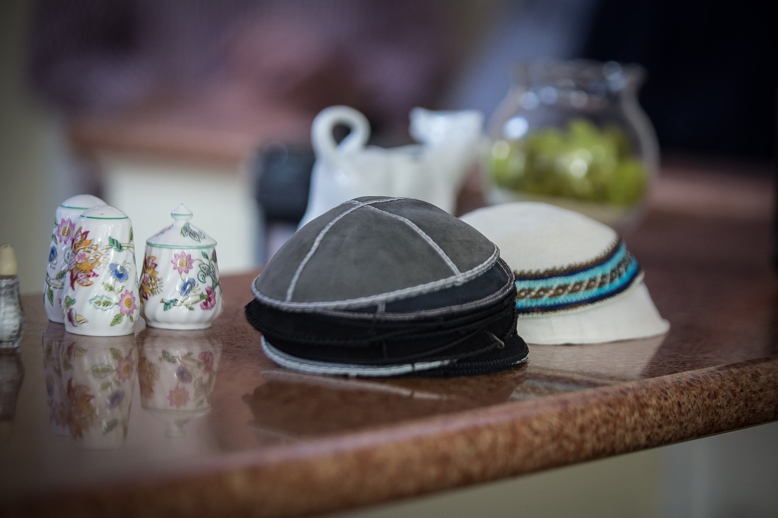
Notes:
Kippah, yarmulke or skull cap (Jewish)

Slide 11
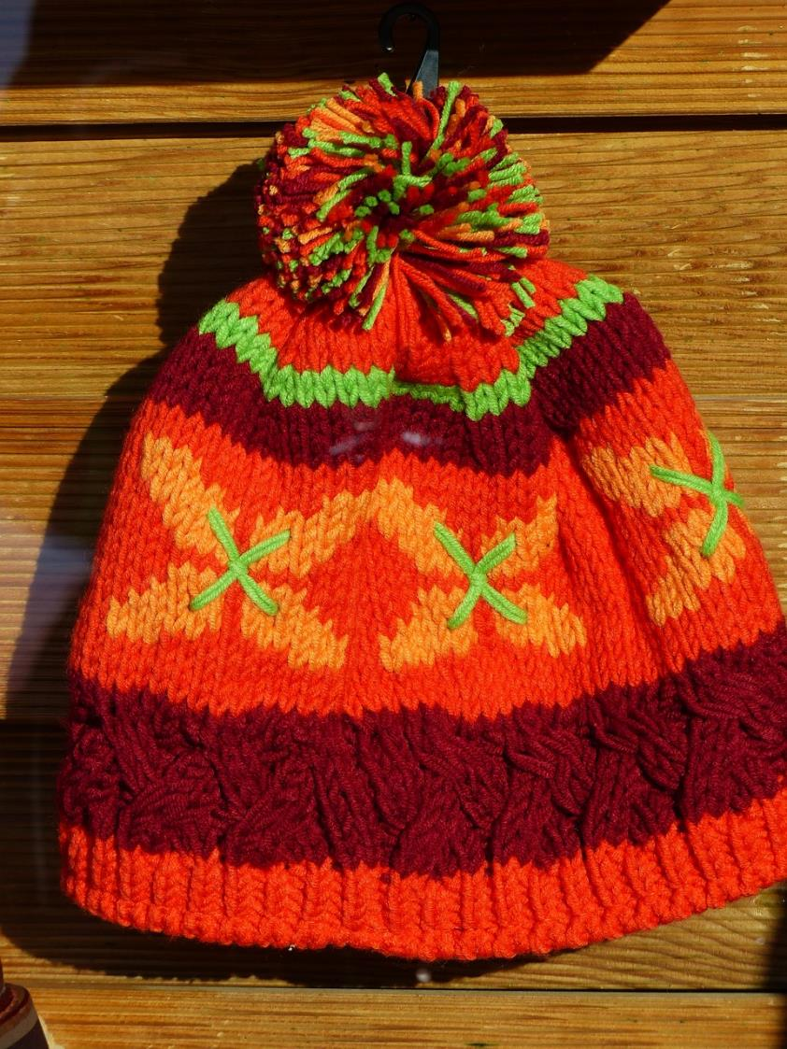
Notes:
Bobble hat

Slide 12
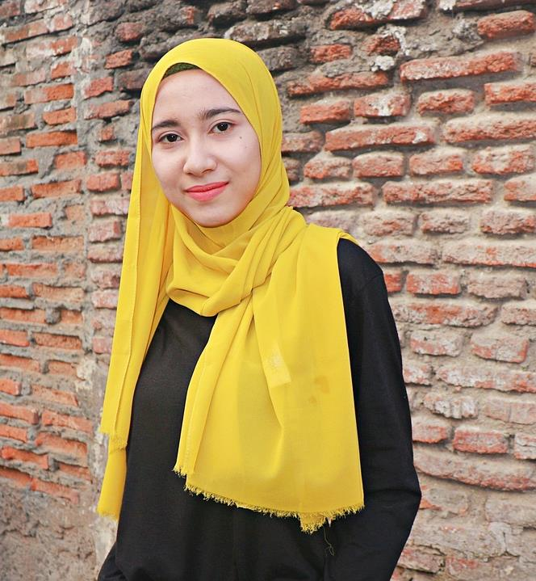
Notes:
Hijab (Muslim)

Slide 13
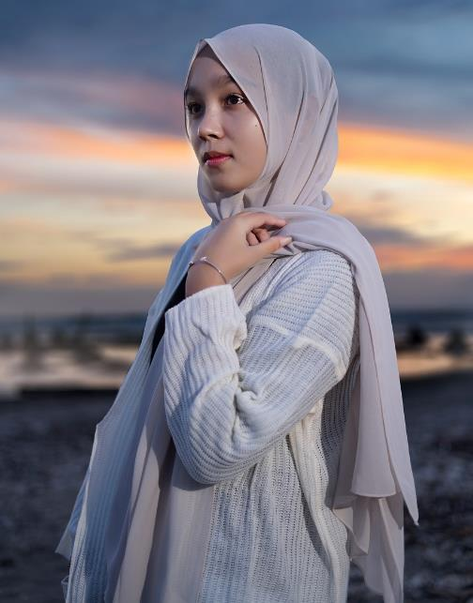
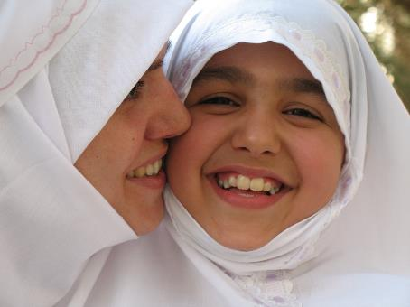
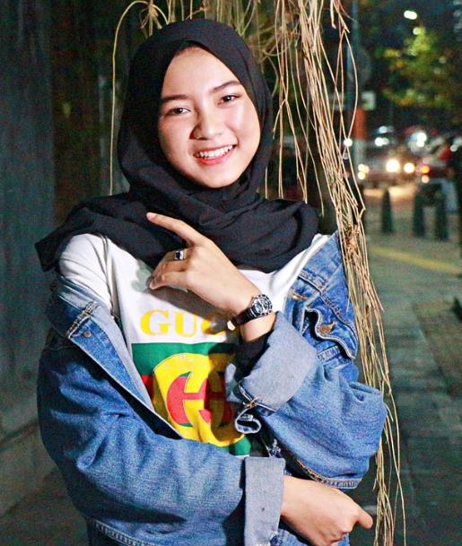
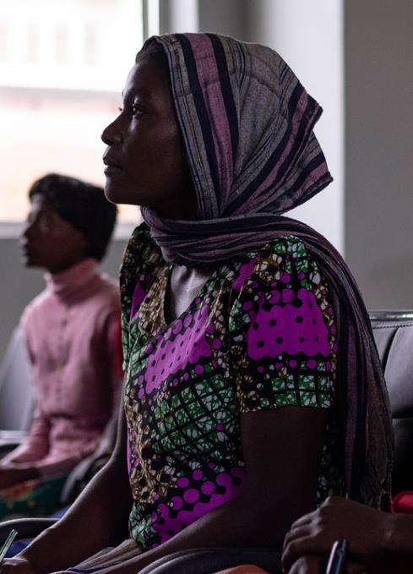
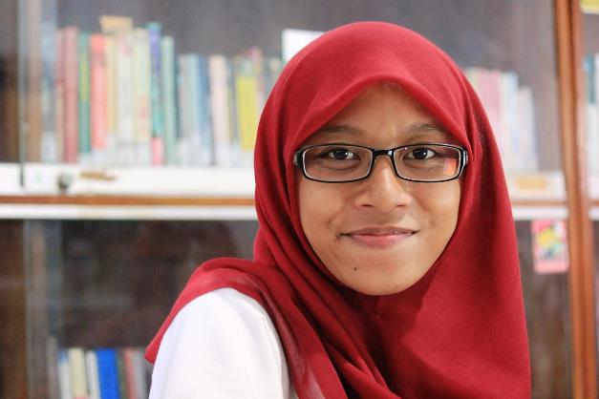
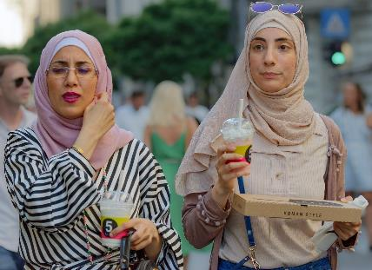
All images © Pixabay
Notes:
Slide 13: A hijab is a special head covering worn by Muslim girls and women. Many Muslims choose to cover their hair in this way as a way of showing respect and being modest: it’s part of their beliefs that only a girl’s close family should see her hair uncovered. There are lots of beautiful designs to choose from….and believe it or not, our story from the Olympics today has something to do with a hijab!

Slide 14
Photo of Ibtihaj Muhammad here
Notes:
Slide 14: Choose an image from her website for this slide: https://www.ibtihajmuhammad.com/
This is Ibtihaj Muhammad, and this is the story of how she became a 2016 Olympic athlete…..

Slide 15
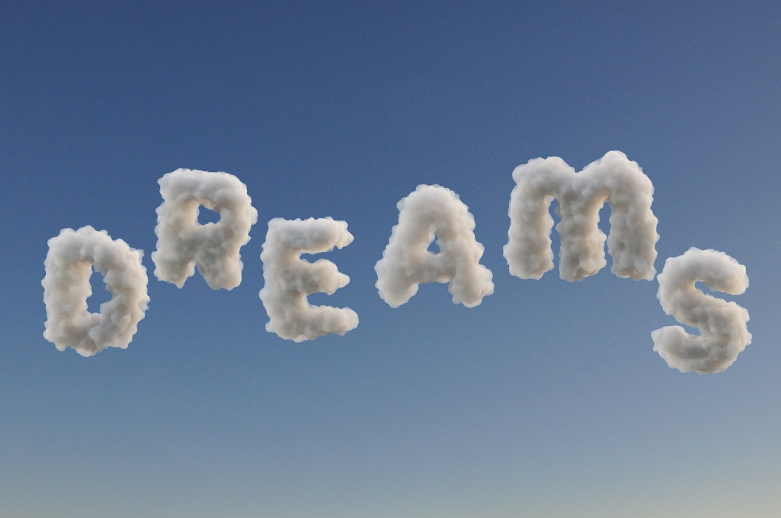
Notes:
Slide 15: I wonder what you dream of becoming?

Slide 16
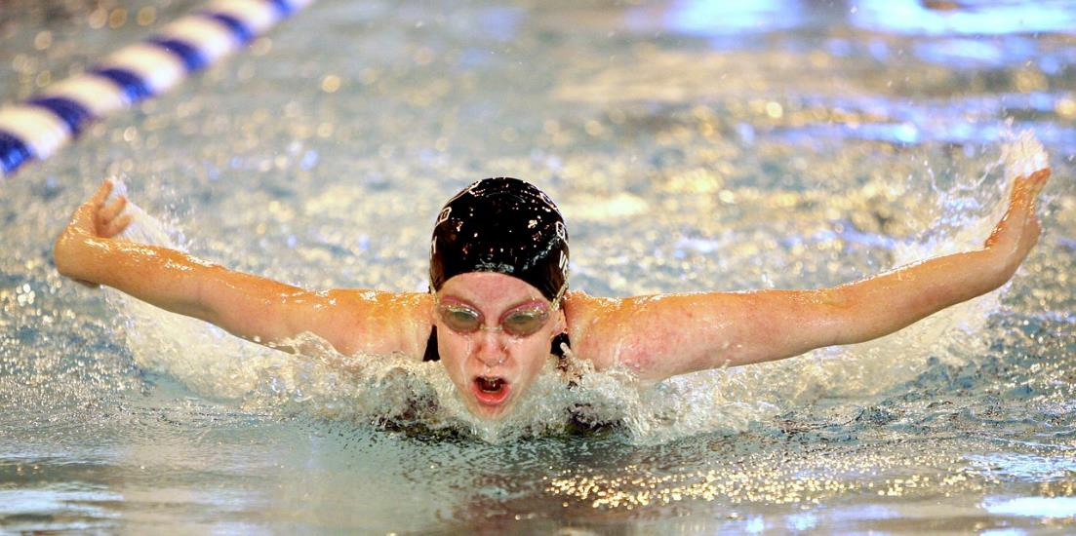
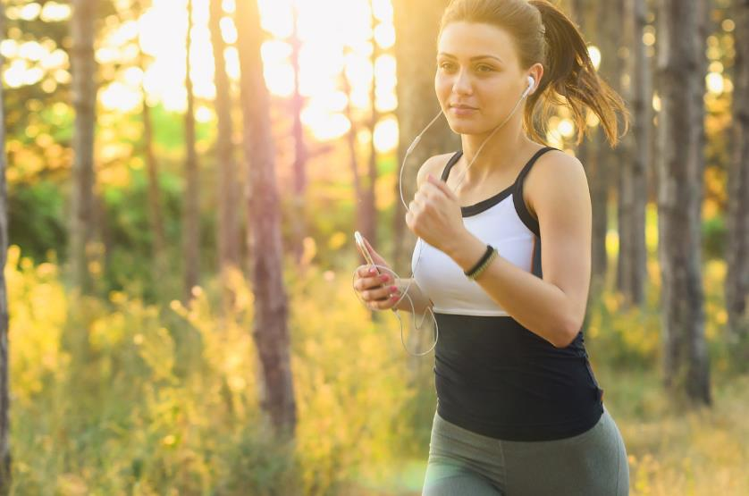
Notes:
Slide 16: At school, Ibtihaj Muhammad loved sport and dreamed of being a professional athlete. But she knew that for many sports, she would not be allowed to wear her hijab, and the sporting outfits she would have to wear would mean that she wouldn’t be able to have her arms and legs covered. Her mum would often alter the sports gear to include long trouser legs and sleeves.

Slide 17
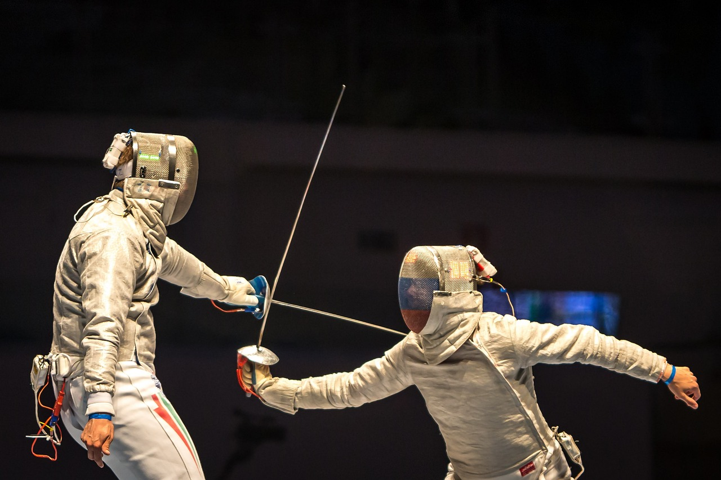
Notes:
Slide 17: Then one day, her parents suggested that she should try fencing. The protective clothing would mean that she could still dress modestly – and she would be allowed to wear her hijab under her helmet. It was the perfect solution! She began learning when she was just 13 years old and by 2005, was the Olympic Junior Champion. However, life was not easy, despite the fact that she now looked and dressed just like everyone else. There were times when she was treated differently to the rest of the team, or her team-mates deliberately ignored her. But she was determined to prove that being black, being a Muslim and being a woman made her strong and proud.
In 2010, she became part of the American National Fencing Team. The team won bronze at the 2011-2013 and 2015 World Championships and gold at the 2014 World Championships.

Slide 18
“What I loved most about fencing was it allowed me to pursue my desire to be involved in sports, but also allowed me to be myself as Muslim woman.”
Notes:
Slide 18: And finally, the moment came and Ibtihaj was chosen to represent her country at the 2016 Olympic Games in Rio – she even gave the American President’s wife, Michelle Obama, a fencing lesson in the lead up to the Games!
As well as winning a bronze medal with her team-mates, she also made a world record, becoming the first female athlete ever to wear a hijab whilst taking part in competitive sport. When interviewed after the competition, she said:
‘What I loved most about fencing was it allowed me to pursue my desire to be involved in sports, but also allowed me to be myself as Muslim woman.’
I wonder what she meant by ‘being herself’ and why this was so important to her? [talk together for a few moments]

Slide 19
Photo of Ibtihaj and her Barbie
Notes:
Slide 19: But she is perhaps more famous now for things other than sport. As a child, when Ibtihaj Muhammad played with her dolls or read books, she noticed that none of them looked like her. She used to cut up small pieces of material to make hijabs for her dolls. Now, thanks to her sporting achievements in international competitions, her example in proudly showing her identity as a Muslim and speaking up for others’ rights be ‘be themselves’, Mattell®, the maker of Barbie figures, have launched their first ever Muslim Barbie [use the link https://www.ibtihajmuhammad.com/ to insert the photo of her with the Barbie] in honour of her. What a proud moment!

Slide 20
“I feel like I have to speak up for those people whose voices go unheard.”
Ibtihaj Muhammad
Notes:
Slide 20: She is also the author of 2 children’s books, ‘The Proudest Blue’ and ‘The Kindest Red’ based on her experiences as a child with her sisters, growing up and wanting to model Muslim values and help others like her to be proud of their identity. [You can find the links to videos showing Ibtihaj reading her 2 books in the main script]
As a Muslim, Ibtihaj tries to follow the teachings of the Qur’an and the example of the Prophet Muhammad (pbuh) in how she treats others, so let’s hear a few more words from her about how she has tried to do this in her own life:
“I feel like I have to speak up for those people whose voices go unheard.”
Her books are part of her work to encourage others to be proud of who they are and not feel as if they need to hide.
Optional question, for older pupils maybe?: I wonder if there might be people in our school community who sometimes feel like this? I wonder how we might help them to feel that their voices are being heard?

Slide 21
The Olympics
Respect
Friendship
Excellence
Determination
Equality
Courage
Inspiration
Olympic rings © Pixabay
Notes:
Slide 21: Throughout our assemblies this term, we have been thinking about these core Olympic and Paralympic values. I wonder which you think Ibtihaj Muhammad has shown during her life and sporting career? [talk together]

Slide 22
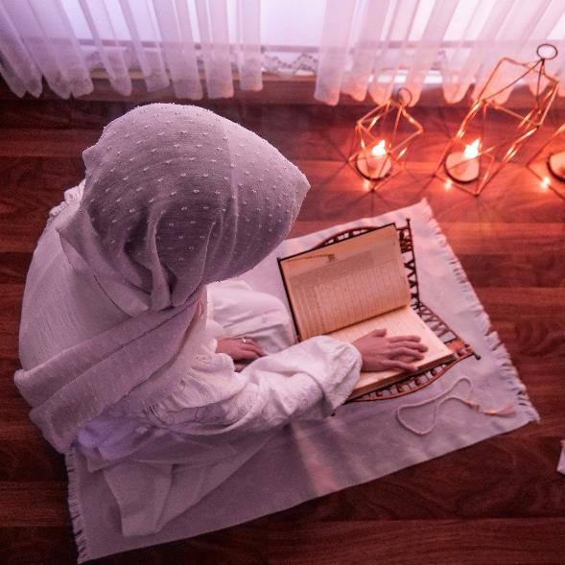
….I wonder why it was so important to Ibtihaj that she was able to wear her hijab when she competed?....
….I wonder how this helped her to feel proud of her religion and proud to represent her country?....
….I wonder what you are proud of?....
….Or how you might speak up for others?....
“I feel like I have to speak up for those people whose voices go unheard.”
Ibtihaj Muhammad
Notes:
Slide 22: Responding and words for worship
Let’s be still and quiet for a few moments now, as we come towards the end of our time together today. We’ve heard today about Ibtihaj Muhammad and how she was the first ever Muslim woman to be able to wear her hijab at the Olympics. We’ve heard how important it is to her that she speaks up for others who are less able to ‘be themselves’…..
Let’s wonder together now…..
….I wonder why it was so important to Ibtihaj that she was able to wear her hijab when she competed?....
…I wonder how this helped her to feel proud of her religion and proud to represent her country?....
….I wonder what you are proud of?....
….Or how you might ‘speak up’ for others?....
….In the quietness now, you might want to take a few moments to think…..

Slide 23
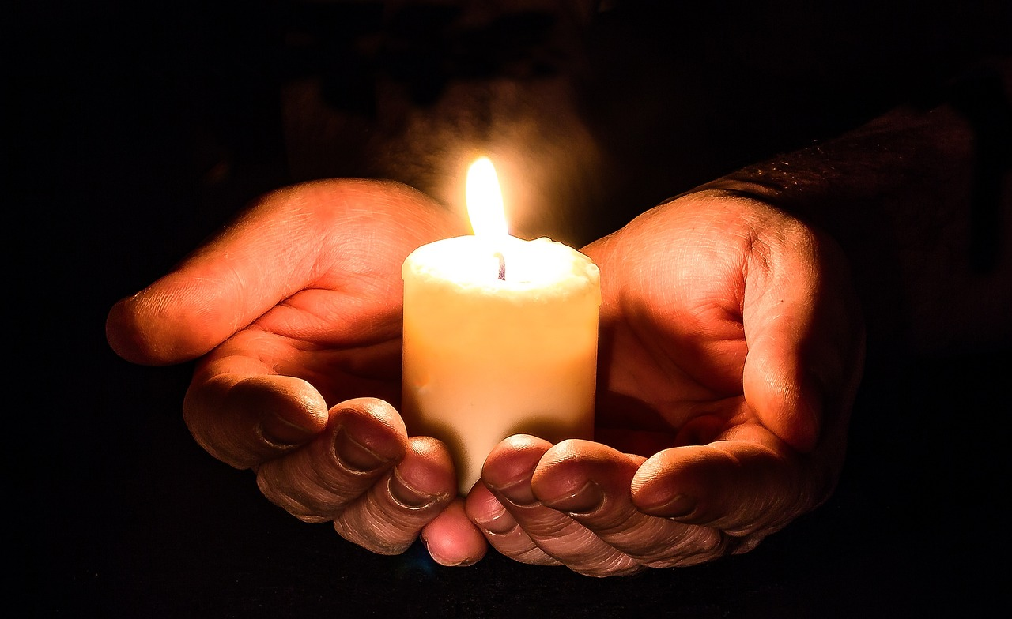
Speak up for those who cannot speak for themselves. Defend the rights of all those who have nothing….the poor and needy… (Proverbs 31:8-9)
Notes:
Slide 23: Prayer
Before we take a few moments to pray today, I am going to use some words from the Book of Proverbs, in the Bible – ancient wisdom about how to live well [you might remember this from our theme of ‘Wise Words’ last term!]. The words sound very similar to the words that we have heard from Ibtihaj Muhammad…. Speak up for those who cannot speak for themselves. Defend the rights of all those who have nothing….the poor and needy…
In the silence now, think quietly about what these words mean – and how we might speak up for those who cannot speak for themselves. You might want to turn your thoughts into a prayer of your own…..
[Leave space for private reflection / prayer here]

Slide 24
Leader: As we leave this place & time and go into the day ahead…
All: Let’s ‘go for gold’ in all that we do!
Notes:
Sending: Slide 24
Leader: As we leave this place & time and go into the day ahead…
All: Let’s go for gold* in all that we do!
*Again, you might need to unpick what we mean by ‘going for gold’ in the context of today’s words.

Slide 25
Notes:
Slide 25: Reflective areas
In her book The Proudest Blue, there is an image of a paper boat

