Slide 1



Pictures copyright-free from pixabay
Leader: As we light our Advent candle…
All: May today’s thoughts bring us hope, like light in the darkness.
Notes:
Slide 1: Use this special greeting for the Advent season, as you light your Advent candle.
Leader: As we light our Advent candle…
All: May today’s story bring us hope, like light in the darkness.

Slide 2
Hopeless
Hopeful
Notes:
Slide 2: Last week, we heard how the disciples went from feeling hope-less to being hope-ful – filled with hope. Our special times together during Advent will be returning to this theme of hope, through different parts of the Nativity account that we have already used this term.

Slide 3


Secret Messages
Notes:
Slide 3: Today we return to the part of the Nativity where the Angel visits Mary, because it contains some secret messages for us to find!

Slide 4
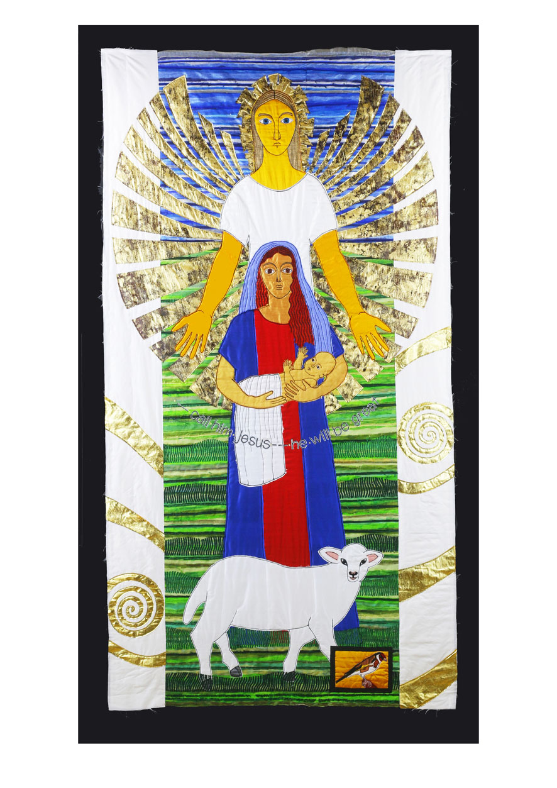
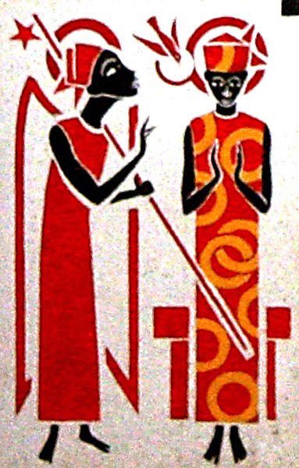
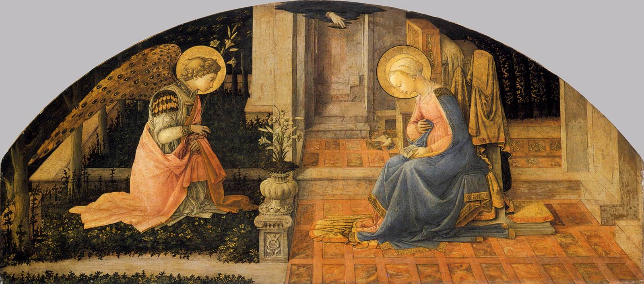
Notes:
Slide 4: As we heard back at the start of the term, Christians sometimes call this part of the Nativity ‘The Annunciation’. This event is quite unusual, to say the least – I don't suppose that your family had a visit by an angel to tell them that they were going to have you! This is one of the important clues that tells us who Christians believe Jesus is.
Image credits: Jacqui Parkinson © Threads Through the Cross; Father George Paget (Senegal) & Fra Filippo Lippi ©Art in the Christian Tradition

Slide 5
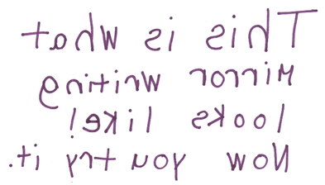

Code 1: Mirror writing
Code 3: Invisible ink
Code 2: Numbers for letters
1 | 2 | 3 | 4 | 5 | 6 | 7 | 8
a | b | c | d | e | f | g | h
Notes:
Slide 5: The message that the angel gave to Mary gives us some more clues, and I’ve got some secret messages here for us to ‘crack’ that will tell us three of the rather extraordinary things that the Angel said – so I need three pairs of children* who will work together to decode what our messages say. The first part is in Mirror Writing; then there’s one in code where you use numbers to stand for letters, and the last clue is in Invisible Ink! [*with younger pupils, you may want to partner them with an adult for expediency’s sake! The next slide shows the answers]

Slide 6
He will be King forever.
He will be God’s Son.
He will be part of King David’s family.
Notes:
Slide 6: Decoding (Answers)
Message 1 Mirror writing: He will be part of King David’s family.
Message 2 Code: He will be King forever.
Message 3 Invisible ink: He will be God’s Son.
So, the angel said that Jesus, Mary’s baby, would be part of King David’s family, that he would be king forever and (even more extraordinary) that he would be God’s Son.
I wonder how your family might’ve felt even before you arrived, to be told something about you that would happen in the future – maybe that you’d grow up to be a great doctor or a scientist or an artist…. that’s quite a thought!!
But what’s even more extraordinary about all this is that the birth of Jesus was actually written about by a man named Isaiah, about 700 years before the angel even visited Mary! So, what the angel told Mary was actually not-so-secret after all!

Slide 7
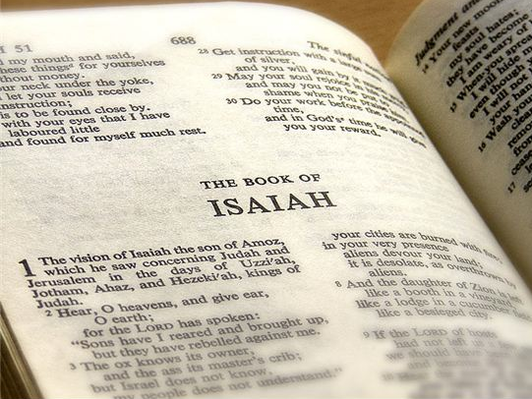
‘For to us a child is born,
to us a son is given….
…He will be called Wonderful Counsellor, Mighty God, Everlasting Father, Prince of Peace…
He will reign on David’s throne from that time on and forever.’
(Isaiah 9:6-7)
‘For to us a child is born,
to us a son is given….
…He will be called Wonderful Counsellor, Mighty God, Everlasting Father, Prince of Peace…
He will reign on David’s throne from that time on and forever.’
(Isaiah 9:6-7)
Notes:
Slide 7: Here’s what the Prophet Isaiah wrote:
‘For to us a child is born,
to us a son is given….
…He will be called Wonderful Counsellor, Mighty God,
Everlasting Father, Prince of Peace…
He will reign on David’s throne
from that time on and forever.’
(Isaiah 9:6-7)
You can find this in the Old Testament part of the Bible, which Christians believe also contains many other messages about the life of Jesus.
I wonder if you can spot those secret messages in this piece of writing as well?! [click, and you’ll see!]

Slide 8
…I am not important, but God has shown his care for me…
‘My soul praises the Lord; my heart is happy because God is my Saviour. I am not important, but God has shown his care for me…
The Lord made this promise to our ancestors, to Abraham and his family forever!’
(Luke 1: 46-48, 55)
Notes:
Slide 8: When Mary heard the words of the angel, here’s what she said:
‘My soul praises the Lord; my heart is happy because God is my Saviour.
I am not important, but God has shown his care for me…
The Lord made this promise to our ancestors, to Abraham and his family forever!’
(Luke 1: 46-48, 55)
Mary said that the angel’s message was full of hope for the whole of God’s people, whom she called ‘Abraham and his family’. Her heart was full of praise, because she recognised that the promises that God had spoken long ago were now coming true. Just imagine for a moment how this felt….. Something that had been promised so long ago that it felt like it might never happen, but now, here it was – and she was a part of the plan!
Mary’s words show us that the message of hope wasn’t just for God’s people, it was for her as an individual too: God had shown his care to her, entrusting her with the job of being Jesus’ mother. As we heard earlier in the term, God had noticed her. We can tell from her words how this made her feel, and the hope that this gave to her heart, knowing that God cared for her.

Slide 9
He will be King forever.
He will be God’s Son.
….I wonder what you hope for, for yourself and for those people you love?....
….I wonder what you hope for our world?....
….I wonder what hope there might be in the Nativity story as we share it again this Advent?....
‘Call him Jesus – he will be great.’
Notes:
Slide 9: Responding and words for worship
The words that Jacqui sewed into this panel remind us that the baby that we think about at Christmas time would one day be great, and the secret messages we looked at earlier said that he would be King forever, and God’s Son. His name – Jesus – means ‘Rescuer’. For Christians like Jacqui, Jesus is hope because he came to rescue the world.
Hope is such an important quality in our lives…we need it when times are hard and we need it when times are good. We’ve thought today about the messages of hope in this part of the Nativity account; hope for God’s people, hope for Mary, and hope for Christians like Jacqui too. Let’s spend a few moments in quiet now and think about our hopes….
As we approach Christmas….
….I wonder what you hope for, for yourself and for those people you love?....
….I wonder what you hope for our world?....
….maybe something so far off that it feels like it might never happen…..
….I wonder what hope there might be in the Nativity story as we share it again this Advent?....

Slide 10

In this Advent season….
Notes:
Slide 10: As we are quiet and still, I am going to use a prayer for Advent about hope. If you want to pray too, then there are some words to join in with which will start each new line….. In this Advent season…
Prayer: God of all hope,

Slide 11
In this Advent season….
Be the hope in our hearts.

Slide 12

In this Advent season….
Be the hope in our homes.

Slide 13


In this Advent season….
Be the hope in our school.

Slide 14

In this Advent season….
Be the hope in our community.

Slide 15




Slide 16


Leader: As we leave this place & time…
All: May the hope of Advent shine brightly in our school today.
Notes:
Sending: Slide 16 (You might want to use this slide throughout the Advent season to end your time together)
Leader: As we leave this place and time….
All: May the hope of Advent shine brightly in our school today.

Slide 17


Notes:
Slide 17: Reflection spaces – online Advent calendar
Use the link to connect you to reflective materials for school days during Advent.

