Slide 1
Leader: As we share these stories of leaders…
ALL: May we follow their example
in thoughts
and words
and actions.
Notes:
Slide 2: Use these new gathering words for this term, or your usual greeting if you prefer. The greeting comes with BSL signing, you can view the demos using links under the slide.
Leader: As we share these stories of leaders…
ALL: May we follow their example in thoughts and words and actions.
Signs for greeting: click on links
Thoughts: British Sign Language BSL Video Dictionary - thought (signbsl.com)
Words (use 3rd definition): British Sign Language BSL Video Dictionary - word (signbsl.com)
Actions: British Sign Language BSL Video Dictionary - action (signbsl.com)

Slide 2
Follow my
lead!
Notes:
Slide 2: This term, we’ve been thinking about leading, leaders and followers. We’ve shared stories together from different parts of the world, as well as stories about leaders from the Bible, and many of you have become very good at working out for yourselves the important messages in these stories. We’re now at the very end of our term of themes and so we’re going to look back – and look forwards…..

Slide 3
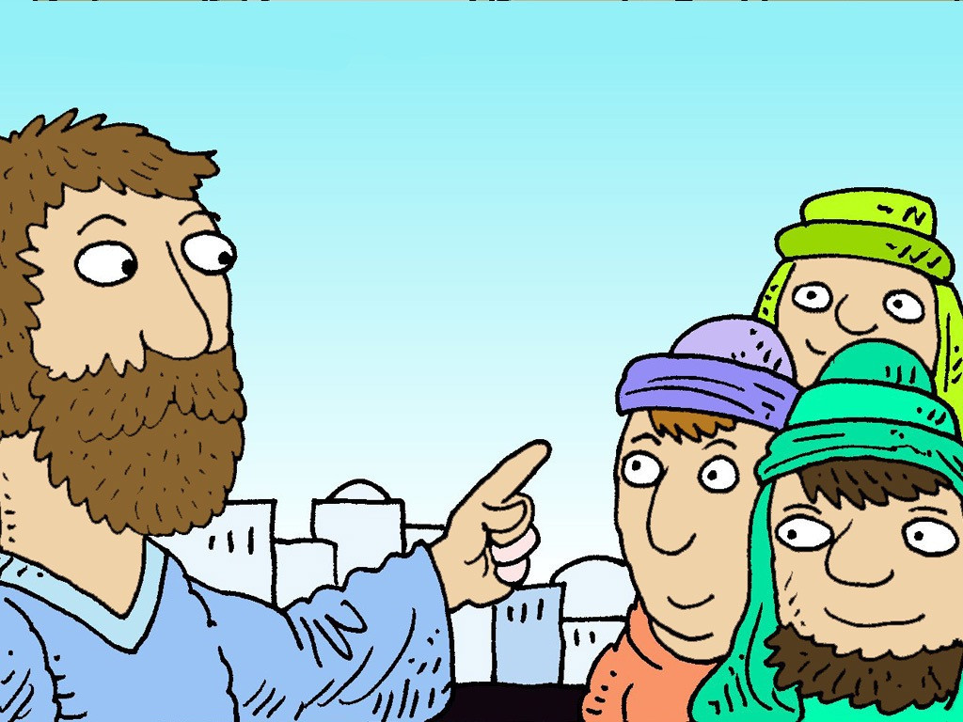
The wise and
foolish builders
Notes:
Slide 3: We’re going to share one final story together now. It’s a story that Jesus told, but I’m not going to read it to you: we’re going to sing it to each other! (And you can join in the actions!: The Wise Man Built His House Upon the Rock with actions || Sunday School Song - YouTube)

Slide 4
Notes:
Slide 4: As you know, Jesus often told stories (called parables) to help people to remember important things about God, and what matters to him: we’ve shared many of Jesus’ stories during our assembly times together. When Jesus told this story, he said that people who are wise, who remember his words and put them into practice are like the builder who built on rock, with firm foundations. Christians believe that the wise words of Jesus are like the rock on which the builder built.

Slide 5
Building
Notes:
Slide 5: We’re going to do some building of our own now. I’m going to choose a couple of builders, one from each class, to help me: don’t worry, neither of you will have to be the foolish builder! [choose builders & dress them]
I have three bricks here to start us off, that contain some of Jesus’ wise words, and they are going to form our foundations [read words out as you build together]
‘Love God, and love others.’
‘Don’t worry, because God cares for you.’
‘Be a peacemaker.’
Builders: scattered around, you’ll see some more big bricks that we need to build into our wall. These also contain wise words from the leaders whose lives we’ve shared this term – and some very special ones from your teachers: words for you to remember, and ‘build with’, as you move on to your new class / schools. [collect, read words out and build]

Slide 6
….I wonder how we might put some of these words into practice?….
…. I wonder which words might help us as we move into our new classes?....
….I wonder which words might help us to make good decisions in life?.....
....I wonder how we might ‘build wisely’, like Jesus said?....
….help us to build wisely.
Notes:
Slide 6: Responding (words for worship):
….so, at the end of our term and in the stillness of this moment, let’s spend some time wondering together…..
Let’s look at our whole wall together now, built on those firm foundations ….
…I wonder how we might put some of these words into practice?….
….I wonder which words might help us as we move into our new classes?....
….I wonder which words might help us to make good decisions in life?.....
…Jesus’ story of the two builders also reminds us that we have choices: not about actual building, but building our lives wisely, or foolishly….. As we all move on at the end of this school year, and look forward to the future, let’s ‘be careful how we build’, and make wise choices…..
I’m going to pray now, and ask God’s blessing on this last week of term as we pack up and wish each other well. You might wish to join in with me, using the words ‘help us to build wisely.’

Slide 7
….help us to build wisely.
Notes:
Slide 7: As we think of all we’ve learned about leaders and about leading….‘help us to build wisely.’

Slide 8
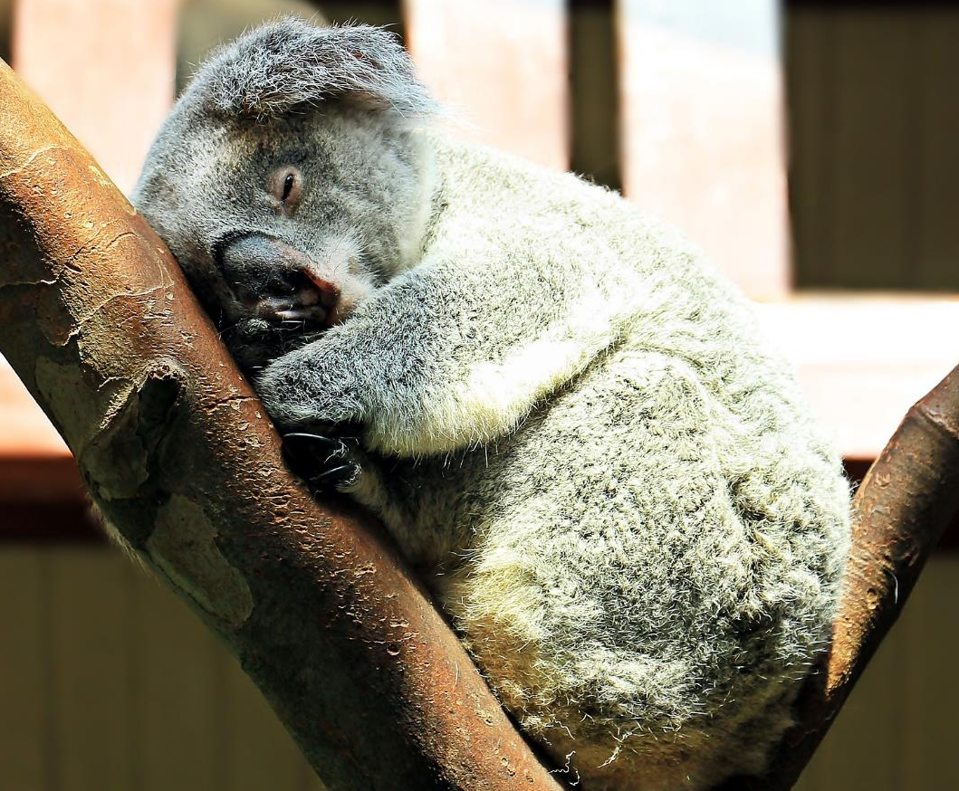
….help us to build wisely.
Notes:
Slide 8: At the end of this term, though we are tired and weary….‘help us to build wisely.’

Slide 9
….help us to build wisely.
Notes:
Slide 9: In the choices that we make, now and in the future….‘help us to build wisely.’

Slide 11
Leader: As we leave this place & time and go into the day ahead…
All: …help us to build wisely!

Slide 12
Write some wise advice onto your class brick wall and leave it for the next class.

Slide 13
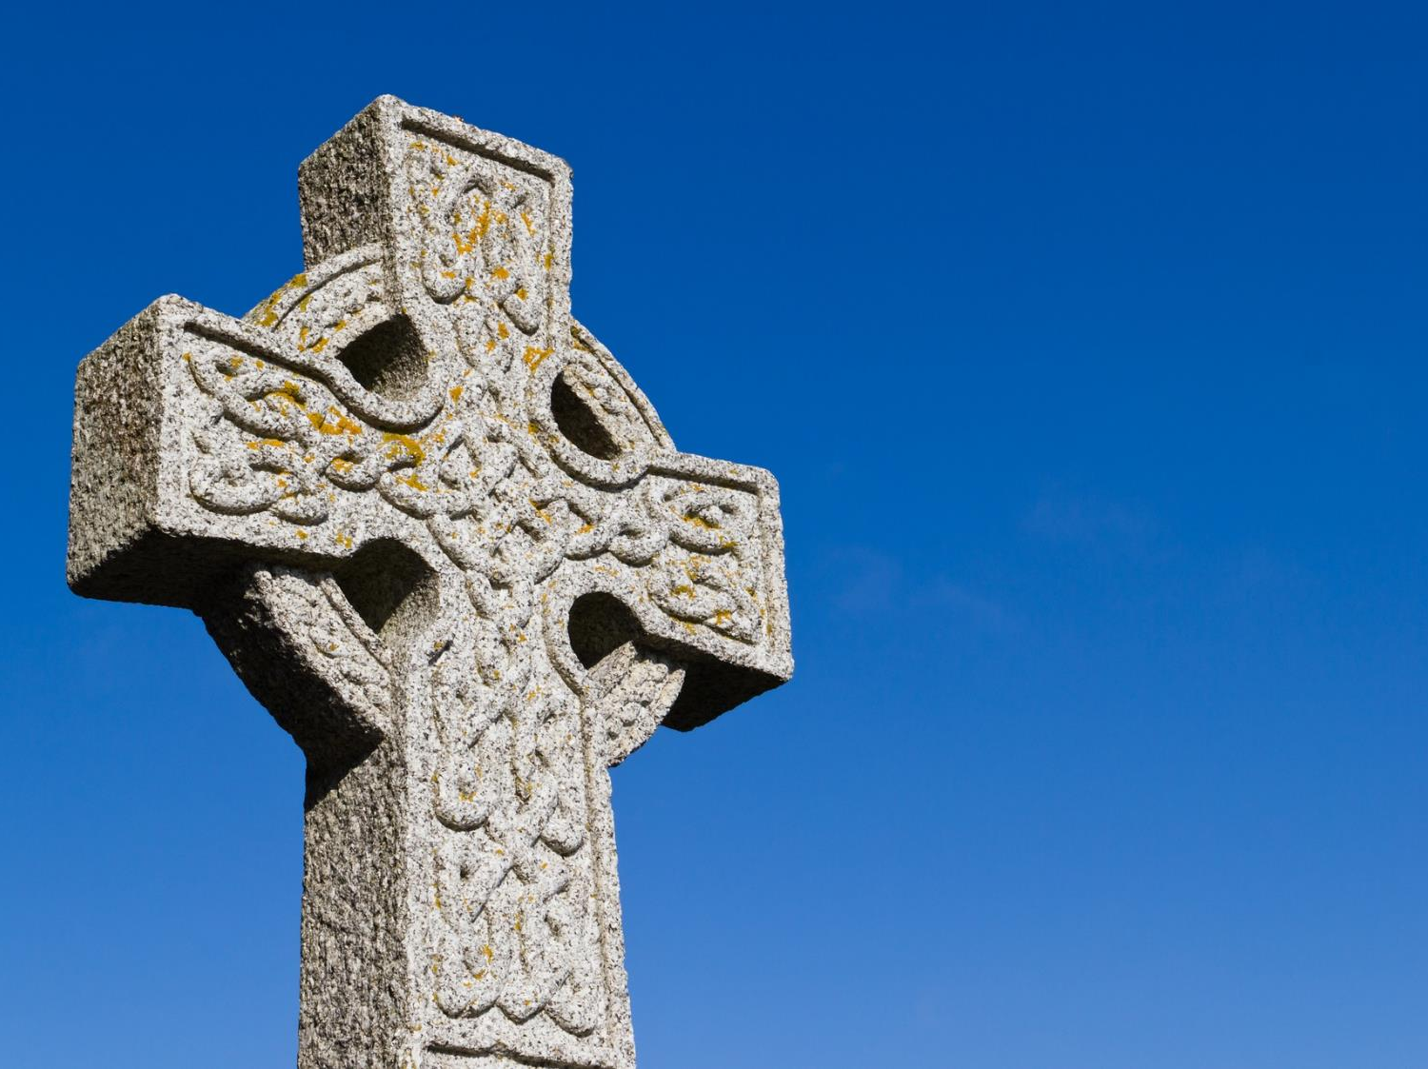
A Celtic Blessing
Notes:
Slide 13: It’s a blessing that is very old, probably from Ireland (which is one part of the British Isles) This blessing talks about wishing someone well as they go on their journey….that their journey will be an easy one. This may be an actual journey, but it could also mean the journey of people’s lives. As you listen, you might not understand every word, because the language is like a poem, so I’m going to use some pictures to help us. [Try to leave a pause between each slide, and resist the urge to explain the words: let them sink in and let the words and pictures ‘speak’ to children at whatever level they will absorb them, even if it’s only to enjoy how they sound. Read it more than once if you think it will help.]

Slide 14
May the road rise up to meet you.

Slide 15
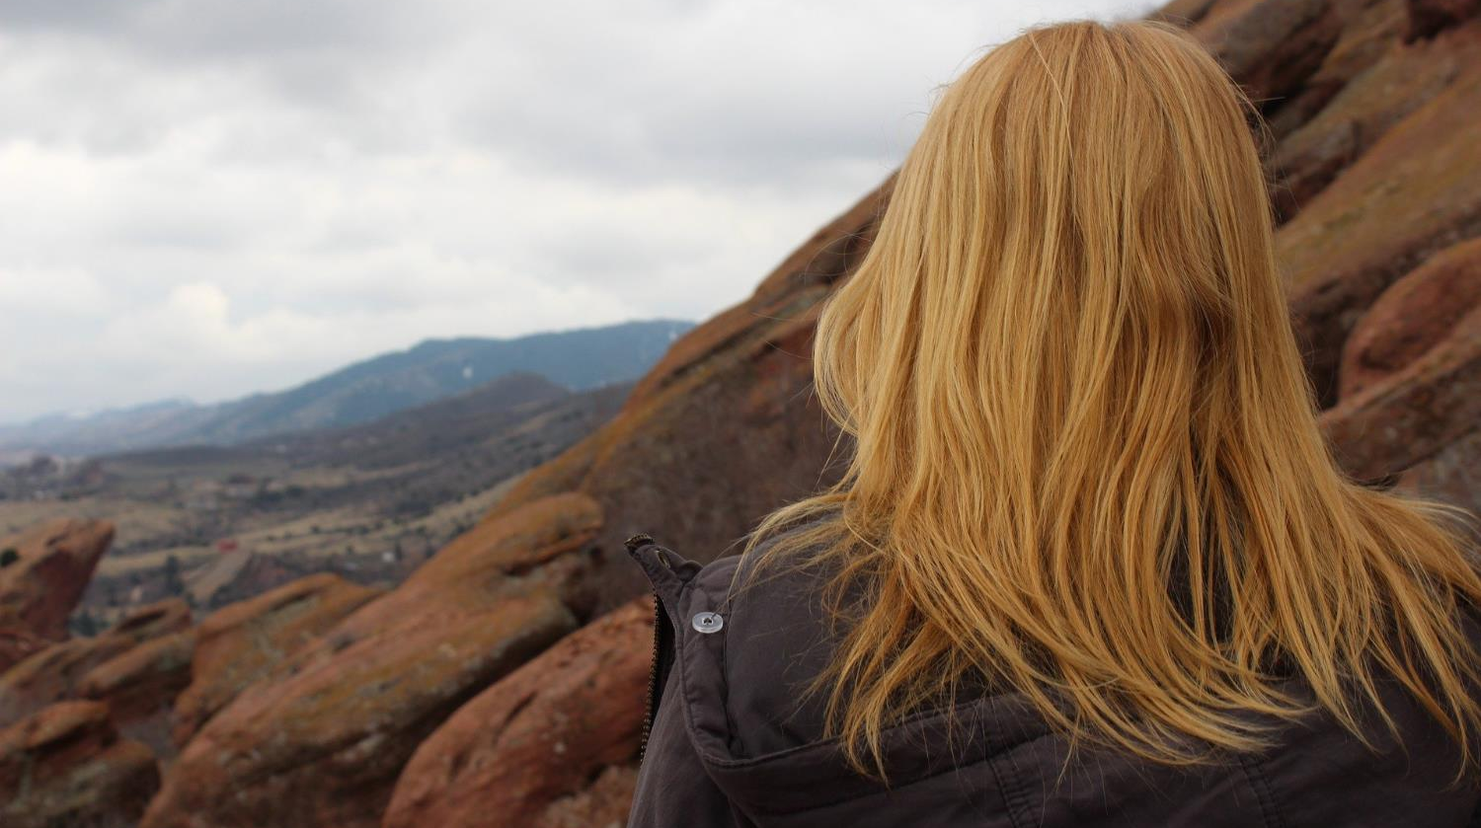
May the wind be always at your back.

Slide 16
May the sun shine warm on your face,

Slide 17
…the rains fall soft on your fields…

Slide 18
…and until we meet again,

Slide 19
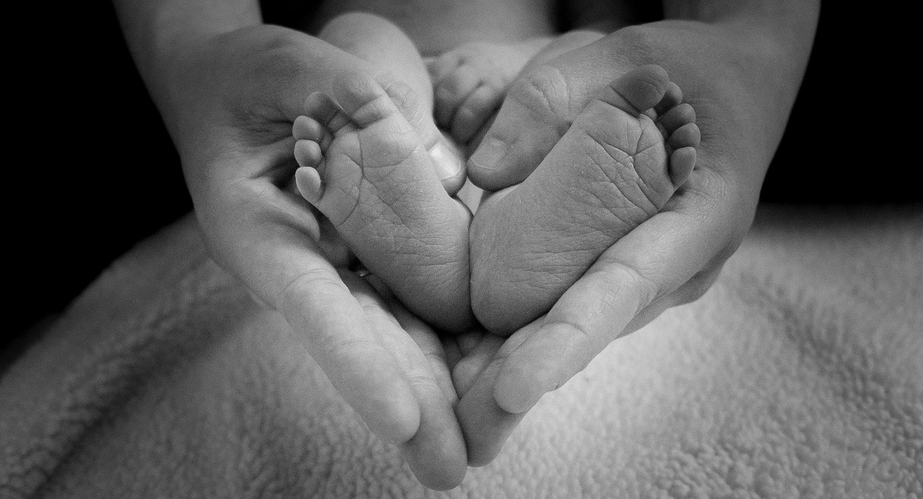
…may God hold you in the palm of his hand.
Notes:
Slide 18: ….may God hold you in the palm of His hand.

