Slide 1
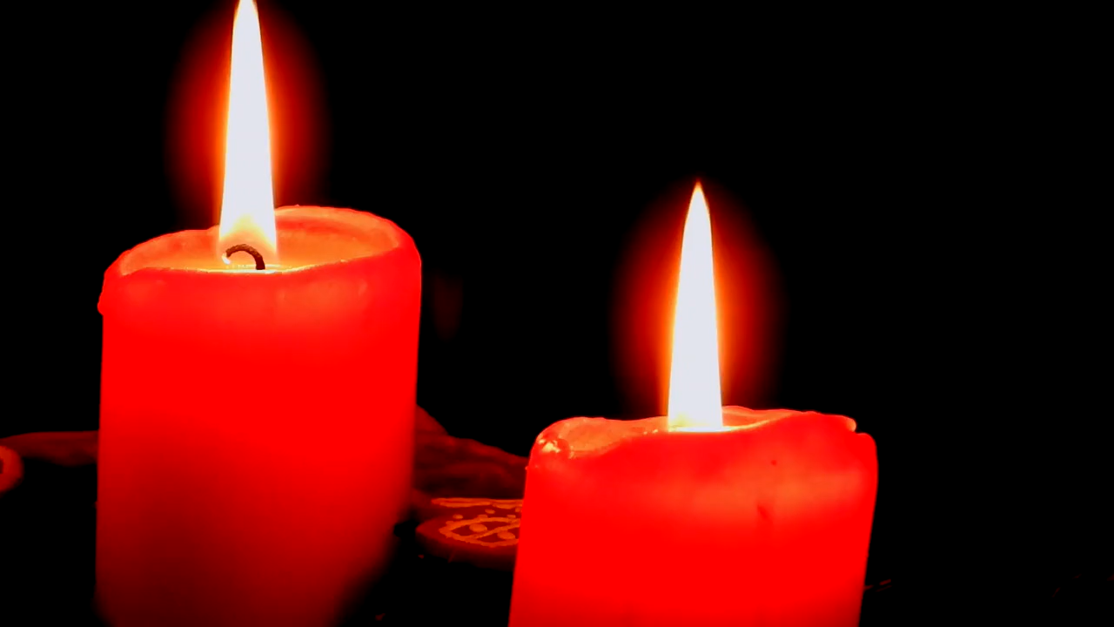
All pictures copyright-free from pixabay
Notes:
Slide 1: Advent candles stilling exercise
Use the stilling slide if desired: the suggested words should be spoken slowly, leaving pauses inbetween to create a sense of stillness.
As you sit quietly here, watch the candles as they flicker…….PAUSE]
Now practise slower breathing…..in…..and out…..in……and out…..keep this going as you continue to watch….[PAUSE]
You maybe notice that you are feeling calmer and more relaxed….[PAUSE]
As you breathe, think about yourself and what you bring into this time today…..[PAUSE]
We come into this special / sacred space and time to be still….to think deeply…..to be together as a school community…..
In our time together today, we will….. Play a game……think about some words together….and then reflect on what they might mean for us here in this school community as we continue through Advent together.
But first, let’s welcome one another as we begin….

Slide 2
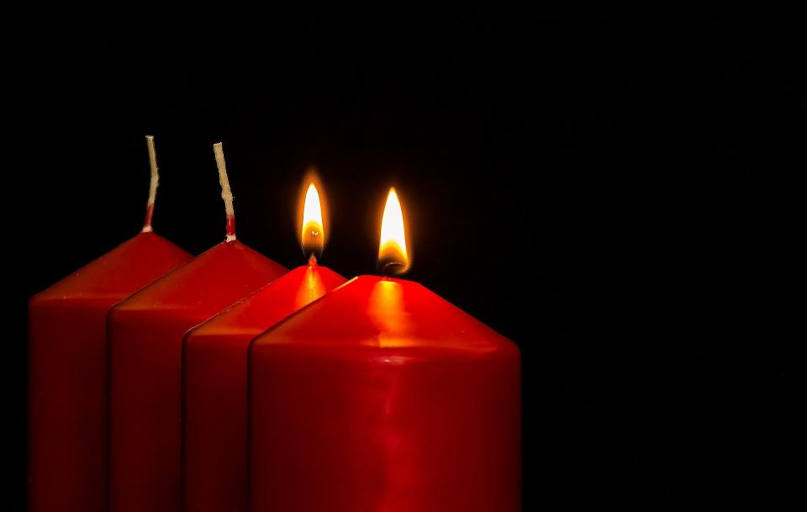


Leader: As we light our Advent candle…
All: May our time today brighten our lives, like light in the darkness.
Notes:
Slide 2: Use this special greeting for the Advent season, as you light your Advent candle(s).

Slide 3
The Name
Game
!
Notes:
Slide 3: We’re going to start our time together today with a game about names. Some of you may know what your name means – and it may have been chosen for you because of that meaning. [Play this together – the answers are on each slide. You might also want to pause and allow a few children to share their own names here – try not to choose anyone whose name appears on slides 4-7!!]

Slide 4
Rachel
a ewe lamb
Notes:
Slide 4: Rachel – a ewe lamb

Slide 5
William
strong warrior
Notes:
Slide 5: William – strong warrior

Slide 6
Sophie
wise one
Notes:
Slide 6: Sophie – wise one

Slide 7
Freddie
peaceful ruler
Notes:
Slide 7: Freddie (short for Frederick) – peaceful ruler

Slide 8
Yeshua
Jesus
God saves
Notes:
Slide 8: Jesus – Yeshua, ‘God saves’
‘Yeshua’ is the Hebrew version of the name ‘Jesus’, and means ‘God saves’ This is a really important idea for Christians – the idea of Jesus as Saviour, the Great Rescuer. We often think about this at Easter time, but you can also hear these words in the story of the very first Christmas – listen out for them!

Slide 9
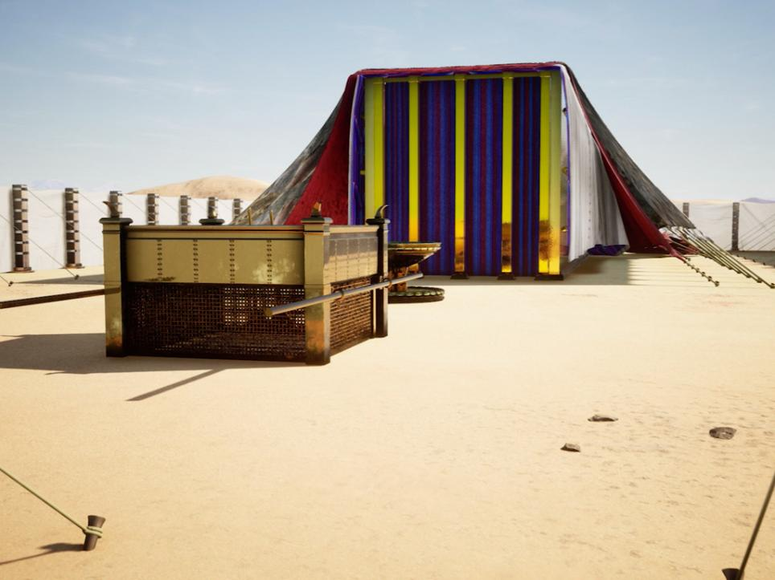
She will give birth to a son, and she will call him ‘Immanuel’ – which means ‘God is with us’. Isaiah 7:14
Notes:
Slide 9: In the history of God’s people, in the stories of Moses, the Bible tells of how God ‘dwelled’ (that’s another word for ‘lived’) in the tabernacle, which was a special tent that Moses built, according to instructions that God gave him. You can see an image of it on the screen here. This tabernacle, which in Hebrew means ‘dwelling place’, went with the people on their journey. God literally travelled ‘with them’ on all their adventures.
Much later in the history of God’s people there are some words that are often read during Christmas services, ancient words that Christians believe are words about Mary & Jesus:
She will give birth to a son, and she will call him ‘Immanuel’ – which means ‘God is with us’. Isaiah 7:14
This name, Immanuel, is one of the names given to Jesus. This is a very big idea, that God might be ‘with us’ – not living in a tent, but as we heard last week….

Slide 10
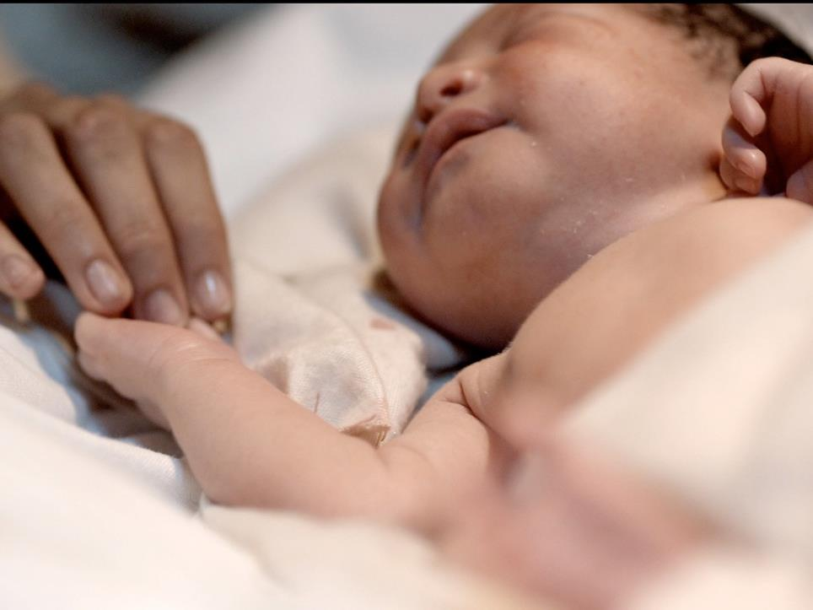

Immanuel – ‘God with us’
Notes:
Slide 10: …..come to earth as a tiny baby.
Immanuel – ‘God with us’
We’re going to think about this idea now as we hear about the visitors who came to see this miracle – and finish off the story that Christians (and we in school!) tell every Christmas. As we tell the story, we are going to think about how these different people experienced ‘God with them’ …..and try to imagine how it felt….
[there are wondering questions to think / talk about to go with each slide]

Slide 11
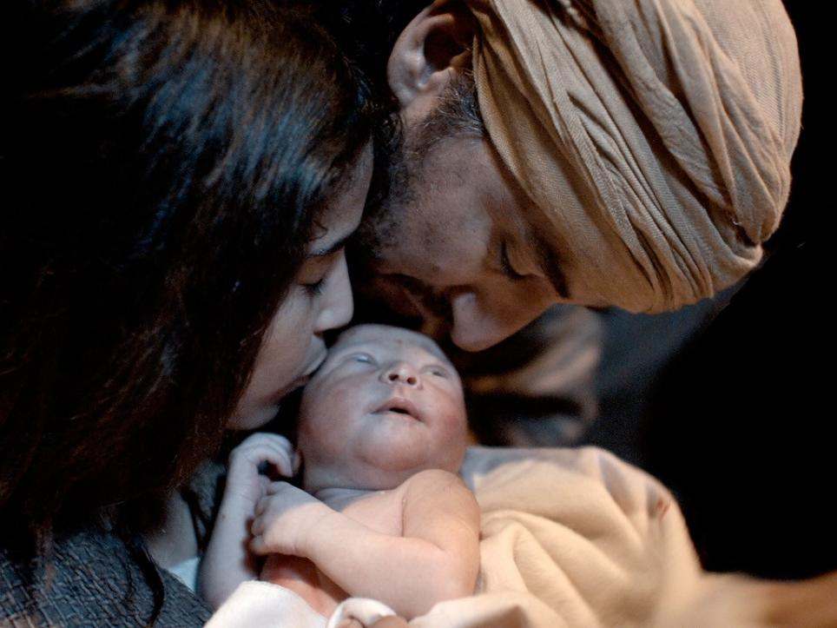
I wonder how Mary and Joseph felt to know that this baby was ‘Immanuel – God with them’?....
Notes:
Slide 11: We heard last week that Baby Jesus was born in a stable because all the inns were busy.
I wonder how Mary and Joseph felt to know that this baby was ‘Immanuel – God with them’?....
This part of the story is especially important to Christians because they believe that Jesus, God’s son, was born as a human baby, to live a human life, just like them.

Slide 12
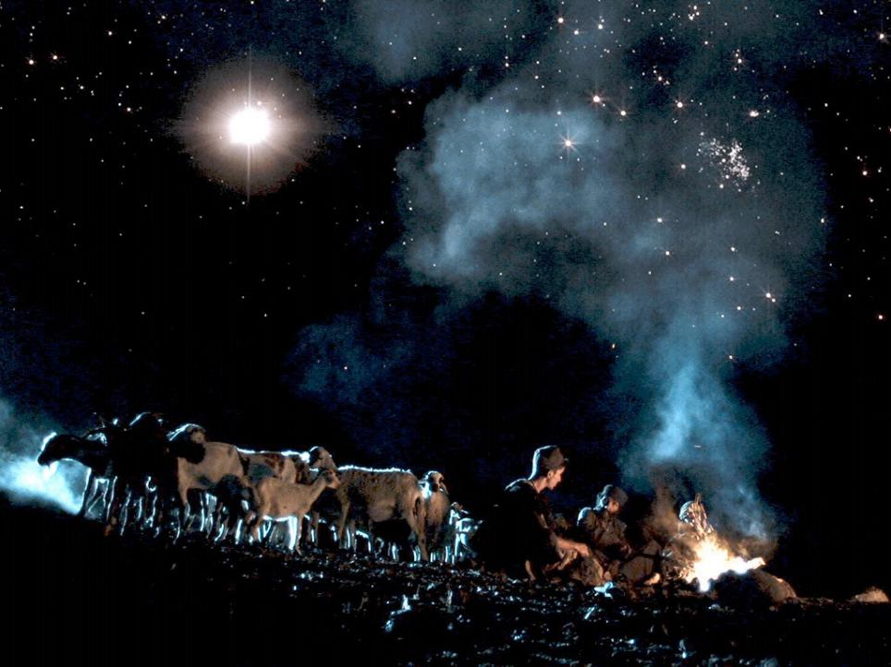
Notes:
Slide 12: The account in Luke’s gospel tells how the angels went first to the very poorest people in Bethlehem – some shepherds, who were out in the fields watching over their sheep through the night.

Slide 13
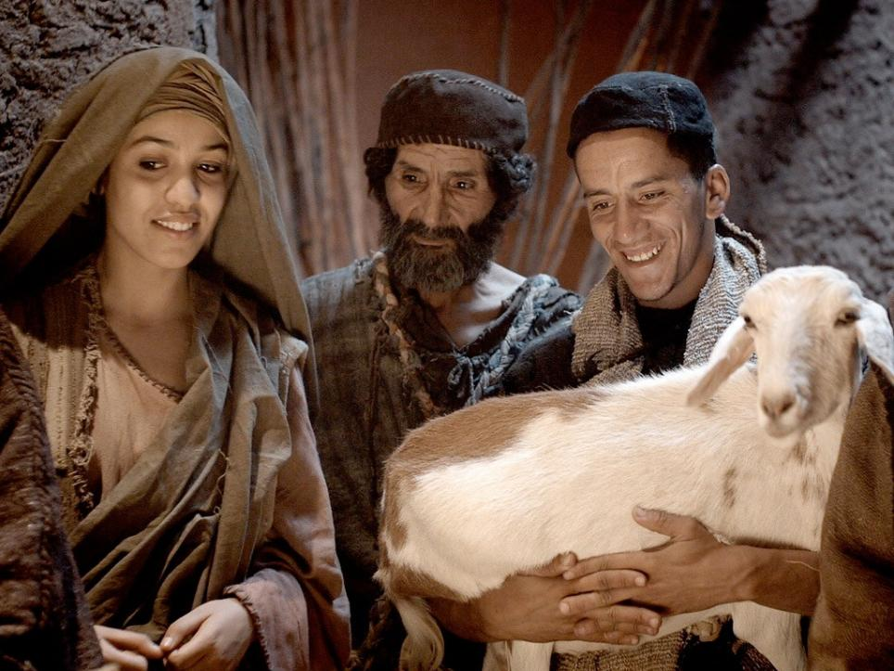
I wonder how the shepherds felt knowing that they were the very first visitors to see ‘Immanuel – God with them’?
Notes:
Slide 13: The shepherds heard from the angels how this new baby would be their Saviour and so they rushed to Bethlehem to find Jesus in the stable, just as the angels had said they would!
I wonder how the shepherds felt knowing that they were the very first visitors to see ‘Immanuel – God with them’? [did you spot the word ‘Saviour’ – rescuer there?!]

Slide 14
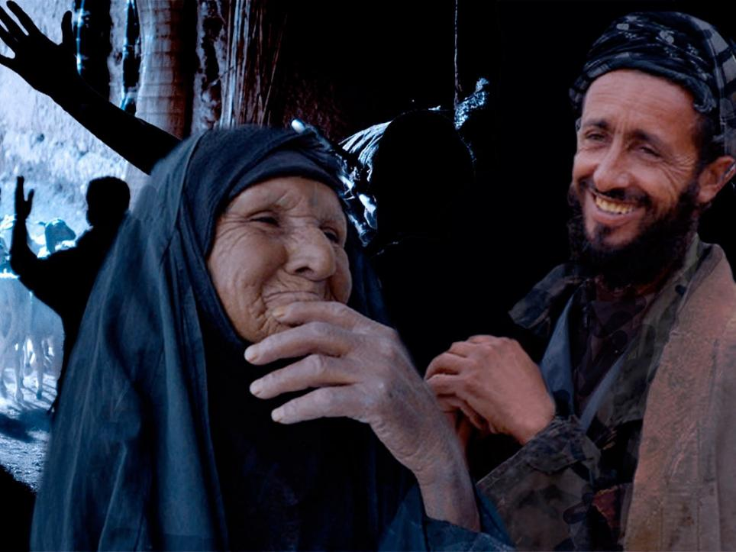
I wonder how these people felt when they heard that God was ‘with them’?
Notes:
Slide 14: After the shepherds left the stable, they told everyone they met about what they had seen – how God had been born among them.
I wonder how these people felt when they heard that God was ‘with them’?

Slide 15
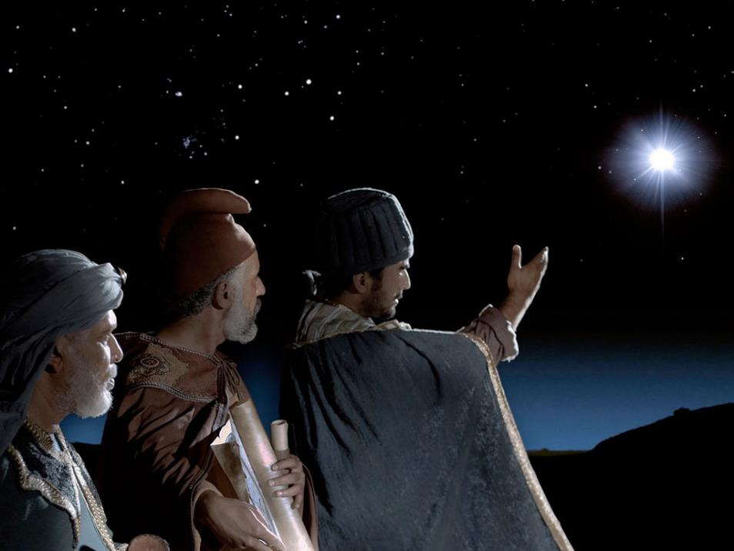
Notes:
Slide 15: We hear in Matthew’s gospel (another part of the story) that wise men had been studying their books, maps and charts. They believed that one day, a new King would be born – and that a bright star would tell them when. They had been watching the skies for years and years, waiting for the moment when this time would come. And so, the star led them to this new King. The gifts that they brought with them – gold, frankincense and myrrh – showed that this was no ordinary King

Slide 16
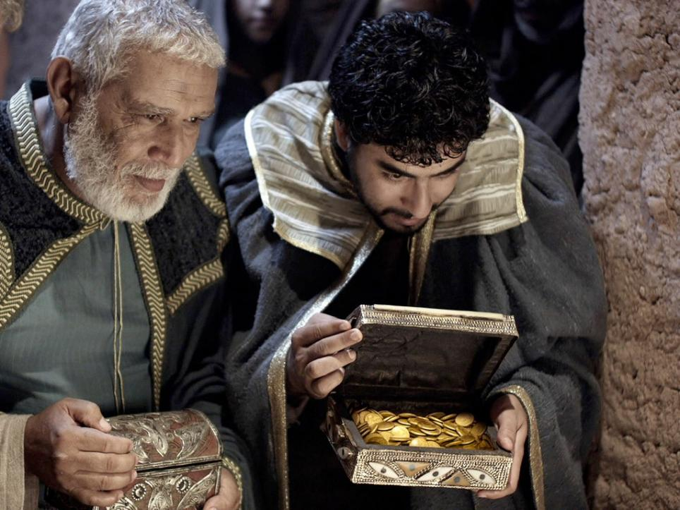
I wonder how the wise men felt to know that God was finally here – with them?
Notes:
Slide 16: The wise men were the final visitors to see the good news that not just a new King, but God himself, had been born among them.
I wonder how the wise men felt to know that God was finally here – with them? ….and why they worshipped?

Slide 17
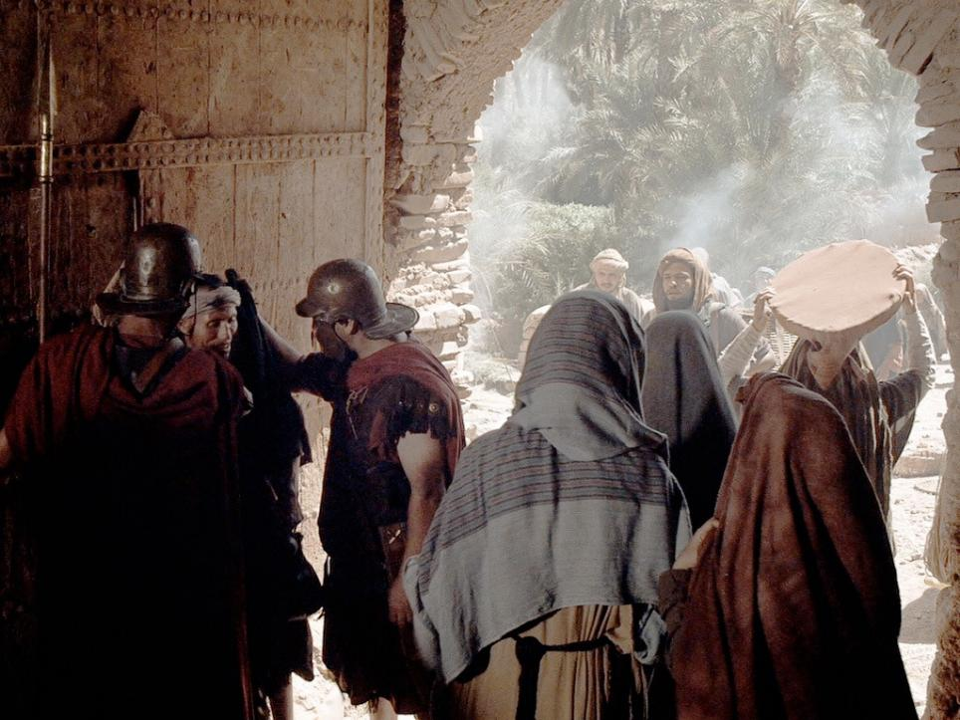
I wonder if these people had any idea that God was ‘with them’?....
Notes:
Slide 17: But we also know that during that very first Christmas, there were many people gathering in Bethlehem as Caesar had ordered that everyone go back to the town of their birth to be counted.
Bethlehem was a very busy place, full of people.
I wonder if these people had any idea that God was ‘with them’?....
….it’s quite likely that very few of them ever realised that some very important events were to take place. I wonder what they might have done if they had realised that Immanuel – ‘God with them’ – had been born?

Slide 18
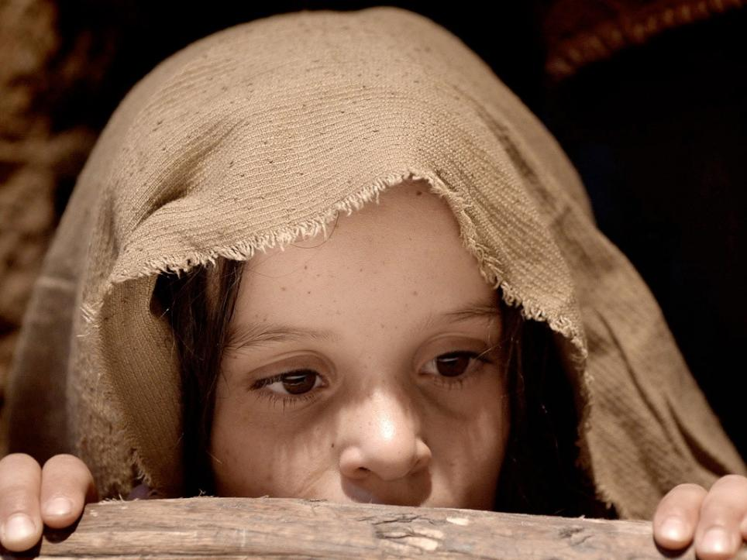
I wonder what you think about the idea of Immanuel – ‘God with us’?
I wonder what difference it might make as we gather as a school community this Christmas time?
Notes:
Slide 18: Responding & words for worship….Let’s bring our thoughts together now.
We’ve heard that at the very first Christmas, many people came to see Jesus, Immanuel – ‘God with us’ …whom Christians believe to be God’s son.
I wonder what you think about the idea of Immanuel – ‘God with us’?
I wonder what difference it might make as we gather as a school community this Christmas time?
We’re coming to the end of our time together today, so let’s be quiet with our own thoughts…..
….we’ve heard today about the people who witnessed the arrival of Immanuel – ‘God with us’ …..
….we’ve heard how the wise men’s visit caused them to worship….
….and Christians ever since have done the same….

Slide 19
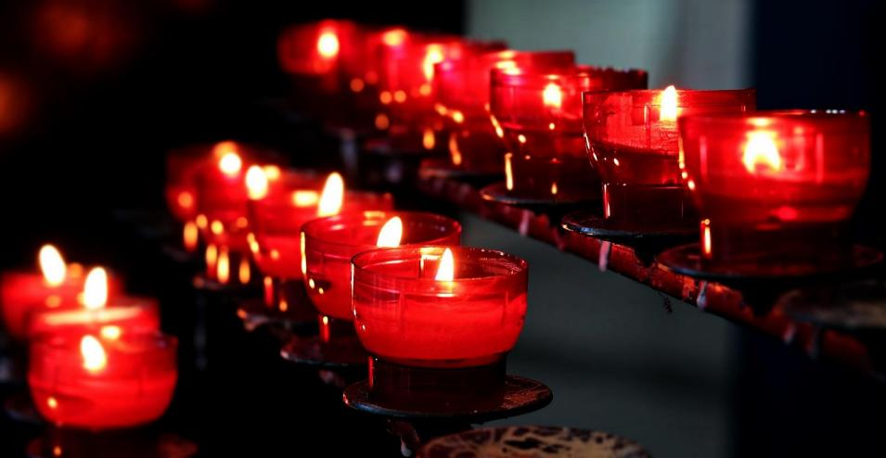
Notes:
Slide 19: Opportunity for reflection / prayer
We’re going to give you an opportunity now to listen, reflect, or pray – whichever you feel most comfortable with.
One of the most familiar Christmas carols that you might hear, or even sing, over Christmas is one called ‘O Come All Ye Faithful’ – which was first published in 1751, but was probably written much earlier than that (in an ancient language called Latin….) We’re going to use a few of the words to help us to pray now (and in a while, we can listen to it too!)

Slide 20
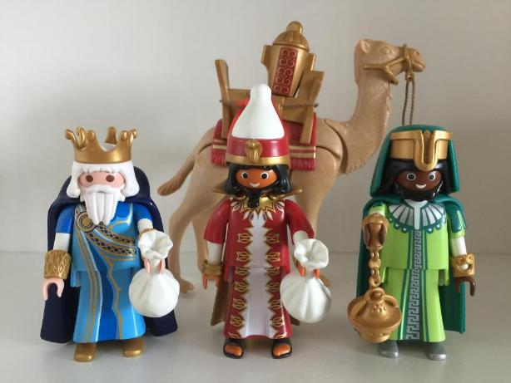
‘O come let us adore him!’
Notes:
Slide 20: Prayer
Like the wise men – and those many other visitors who came to gaze at Jesus, Immanuel – ‘God with us’ – the words that Christians sing say ‘O come let us adore him!’
If you want to pray with me, then you might want to join in those words when they come on the screen, or you can continue to be quiet with your own thoughts.

Slide 21

‘O come let us adore him!’
Notes:
Slide 21:
As we think about this special story, of Jesus, born as a baby…. ‘O come let us adore him!’

Slide 22

‘O come let us adore him!’
Notes:
Slide 22: As we remember how the shepherds saw him first…. ‘O come let us adore him!’

Slide 23

‘O come let us adore him!’
Notes:
Slide 23: As we remember how the wise men knelt in worship…. ‘O come let us adore him!’

Slide 24
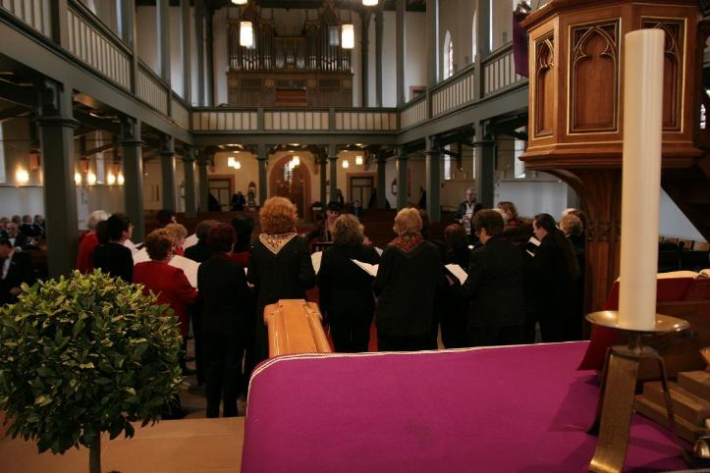
‘O come let us adore him!’
Notes:
Slide 24: With Christians all over the world, may we sing this Christmas time…. ‘O come let us adore him!’

Slide 25
Immanuel – ‘God is with us’
Notes:
Slide 25: Immanuel – ‘God is with us’

Slide 26
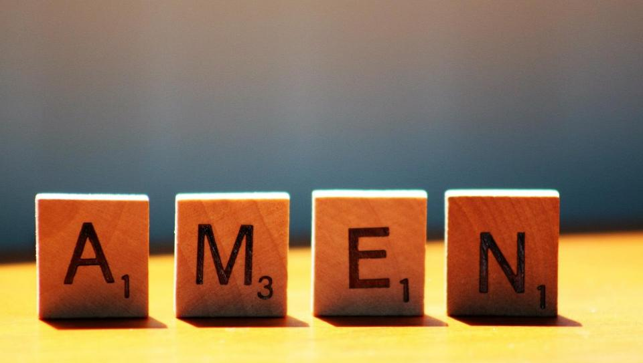
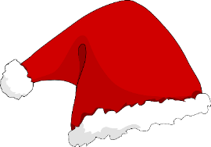


Slide 27


Leader: As we leave this place & time…
All: May the light of Advent shine brightly in our school today.
Notes:
Sending: Slide 26 (You might want to use this slide throughout the Advent season to end your time together)
Leader: As we leave this place and time….
All: May the light of Advent shine brightly in our school today.

