Slide 1
Leader: As we share these stories of leaders…
ALL: May we follow their example
in thoughts
and words
and actions.
Notes:
Leader: As we share these stories of leaders…
ALL: May we follow their example in thoughts and words and actions.
Signs for greeting: click on links
Thoughts: British Sign Language BSL Video Dictionary - thought (signbsl.com)
Words (use 3rd definition): British Sign Language BSL Video Dictionary - word (signbsl.com)
Actions: British Sign Language BSL Video Dictionary - action (signbsl.com)

Slide 2
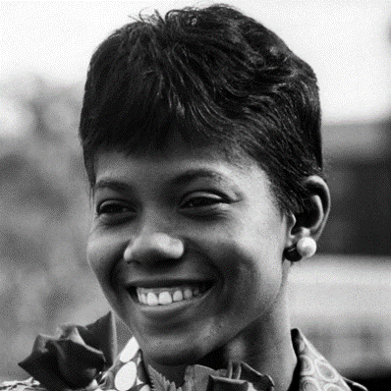
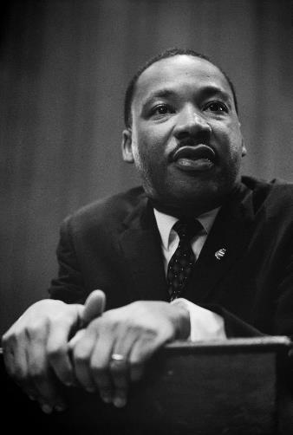
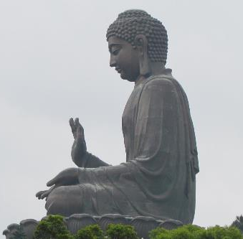
Notes:
Slide 2: Over the past few weeks, we’ve heard from the lives of some leaders who’ve made a difference to the lives of many other people, through their words and their actions. [Pause and recall how here…]
Today, we are going to be hearing about someone else whose life story has also made a huge difference in her home country of Kenya, and whose words we will be thinking about later.

Slide 3
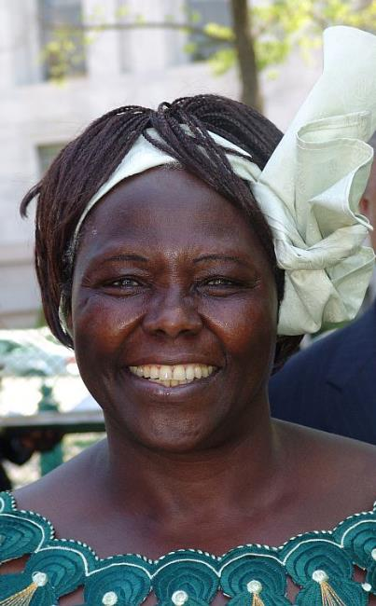
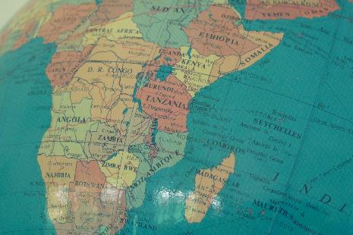
Wangari Maathai (1940-2011)
Notes:
Slide 3: This is Wangari Maathai, who was born in the African country of Kenya, in 1940. She is the founder of the Green Belt movement, a tree-planting charity that has made a difference not only to the environment, but also to the lives of thousands of people, especially the women in her home country of Kenya. As we’ve heard about through the lives of Wilma Rudolph and Dr Martin Luther King, Wangari also championed people who didn’t have a voice – the women….and the trees! She saw the devastation to her village when trees were cut down across large areas – and did something about it. She was also the first ever black woman to win a Nobel Peace prize, in 2004. Let’s find out some more….
[Photo by Kingkongphoto &amp; www.celebrity-photos.com from Laurel Maryland, USA - Wangari Maathai 2004 Nobel Peace prize winner, CC BY-SA 2.0, https://commons.wikimedia.org/w/index.php?curid=75053665]

Slide 4
Notes:
Slide 4: Use the short story video link to find out about Wangari’s life and work: click on the picture and it will take you to the YouTube short film from the Nobel Peace Center.
You may need to pause and explain some sections, especially for younger pupils, as the narrator talks quite quickly!
Spend some time talking with pupils afterwards about the difference that they think Wangari made to people, to plants, and her country.
Wangari herself told a story which helps explain why she didn’t give up…..

Slide 5
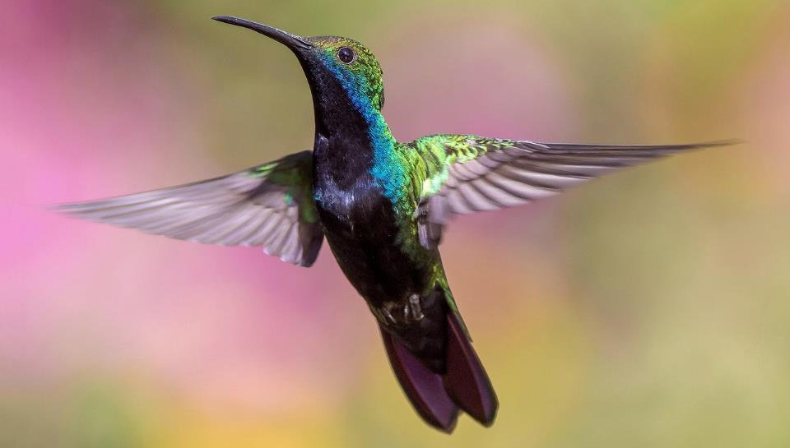
Notes:
Slide 5: She tells the story of a little hummingbird, one of the smallest birds in the forest, who one day spots a fire that’s beginning to burn……

Slide 6
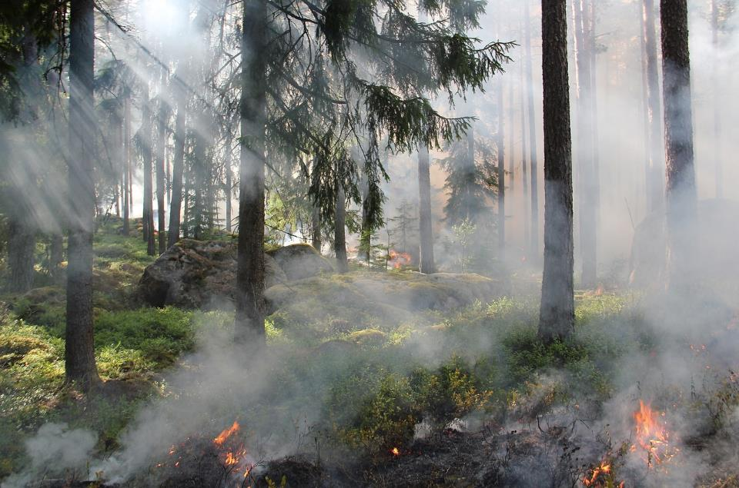
Notes:
Slide 6: All the forest animals look on, helplessly, as they watch the fire beginning to take hold….

Slide 7
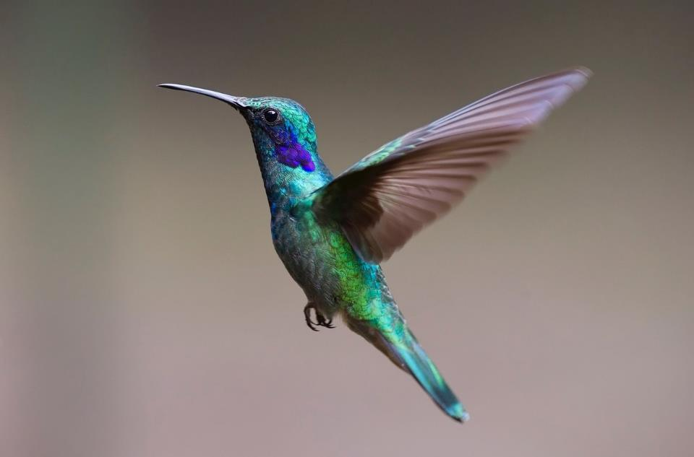
I’m doing the best I can!
Notes:
Slide 7: …but the little hummingbird, instead of just watching like all the other animals, flies to the nearby river and takes just one small drop of water in her tiny beak, which she lets it fall onto the fire. The other animals watch in amazement, not quite believing what they are seeing, and ask hummingbird what she thinks she’s going to achieve with such a tiny drop of water.
Hummingbird replies ‘I’m doing the best I can!’

Slide 8
I will be a hummingbird. I will do the best I can!
Wangari Maathai (1940-2011)
Notes:
Slide 8: Wangari Maathai went on to explain that she would be like the hummingbird, doing the best she could to save the forest too, by planting one small tree at a time.

Slide 9
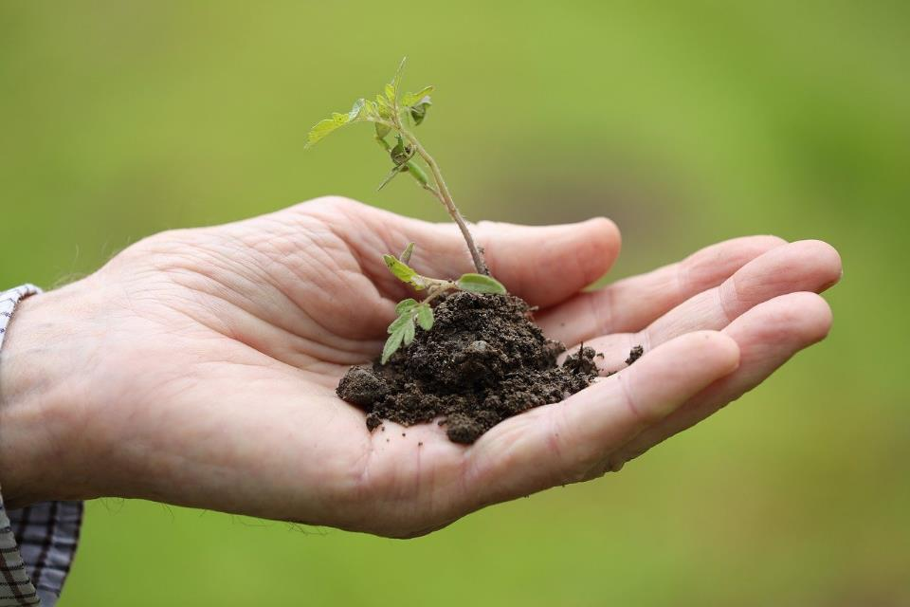
51,000,000
Notes:
Slide 9: I wonder if you can guess just how many trees the women of the Green Belt movement have planted across Kenya?..... [guess]
It’s 51 million…..that’s a HUGE number, and all because one person acted on a small idea that they had!

Slide 10
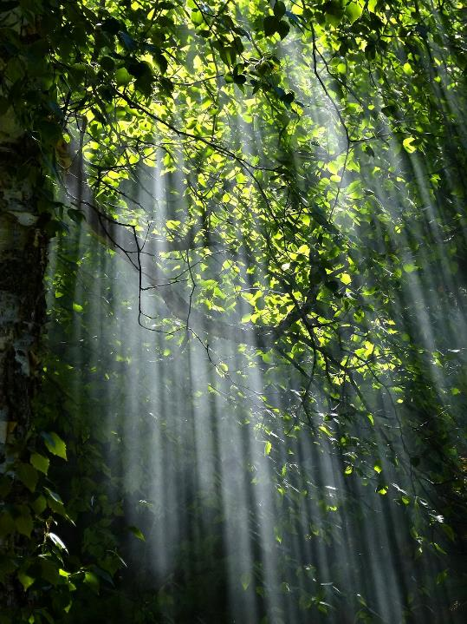
Whose trees are they?
Notes:
Slide 10: So here’s another big question for us to think about as we come towards the close of our time together today…..Whose trees are they?
[allow children to talk about this question, which may have a range of answers, such as:
God’s – Christians, Jews and Muslims believe he gave people the responsibility of caring for his garden, the world – and that it still belongs to him
Ours/everyone’s – if we don’t look after the world, who will?
Children of the future – are we just ensuring that the trees are still there for future generations?
So here’s another question: does who the trees belong to change how we care for them?..... [again, talk] Actually, it doesn’t – I think we can all agree that whatever our reason for caring for the trees, it’s still our job to look after them – and throughout this week, let’s try to find as many ways as we can – and keep on doing it!

Slide 11
Notes:
Use this link to download and add sound to this picture: https://www.videvo.net/sound-effect/backgrounds-forest-ambience-3-b04-00890/763501/
Slide 11: ….now in the stillness of this moment, let’s spend some time being still together…..
Close your eyes and just listen for a few moments to the sounds of the forest…..imagine yourself there amongst the trees…..I wonder how it makes you feel?......stay in this moment for a while…..[leave as long as you feel appropriate: you could even help children to ponder on how it might feel to lose the sound of the forest, if bulldozers move in to clear the trees….]

Slide 12
….Wangari Maathai made a difference one small tree at a time….
….I wonder what we might learn from her example?....
….I wonder how her actions might inspire us today?....
Notes:
Slide 12: Responding (words for worship):
…despite all that human beings have done which has spoiled our world, it is still a place of wonder….
…a place that we want to preserve for future generations…..
…a place that we need to protect and look after….
….I wonder what you feel when you look at our world – maybe at the trees, like Wangari did….
….I wonder if you might feel that you are very small like the little hummingbird, wanting to make a difference….
….Wangari Maathai made a difference one small tree at a time….
….I wonder what we might learn from her example?....
….I wonder how her actions might inspire us today?....
….to start little, and do the best you can....

Slide 13
‘…we will do the best we can’
Notes:
Slide 13: I’m going to pray now, and ask God to help us to do the best we can – which are your words if you’d like to make this prayer your own….Join me if you’d like to at the end of each line of the first part, by saying ‘WE WILL DO THE BEST WE CAN.’
Prayer:
Having heard Wangari’s story – WE WILL DO THE BEST WE CAN.
In treasuring our trees – WE WILL DO THE BEST WE CAN.
In the way we use our world’s resources – WE WILL DO THE BEST WE CAN.

Slide 14
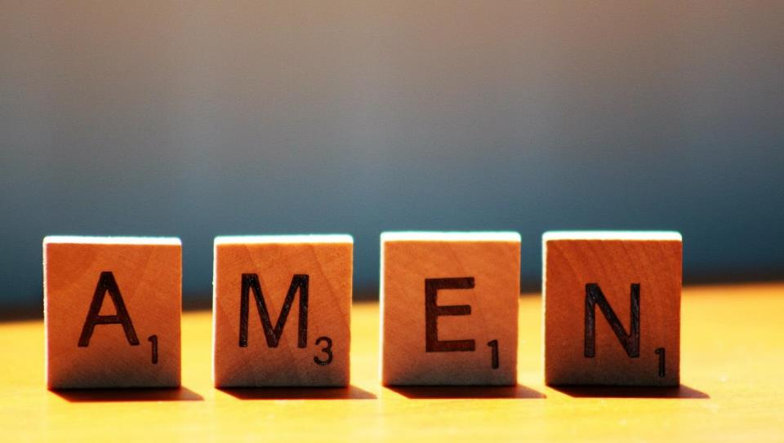

Slide 15
I’m doing the best I can!
Leader: As we leave this place & time and go into the day ahead…
All: …we will do the best we can!

Slide 16
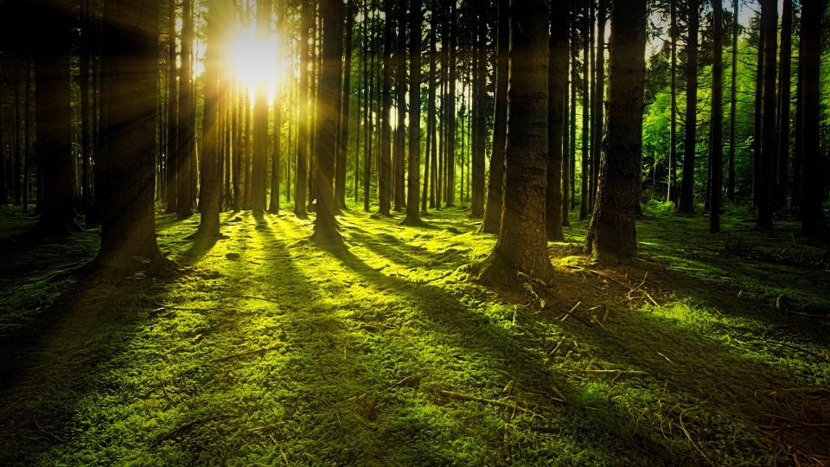
Go outside, lie under the trees and spend some quiet moments appreciating them and thinking about how we might protect them & the world we live in….

