Slide 1
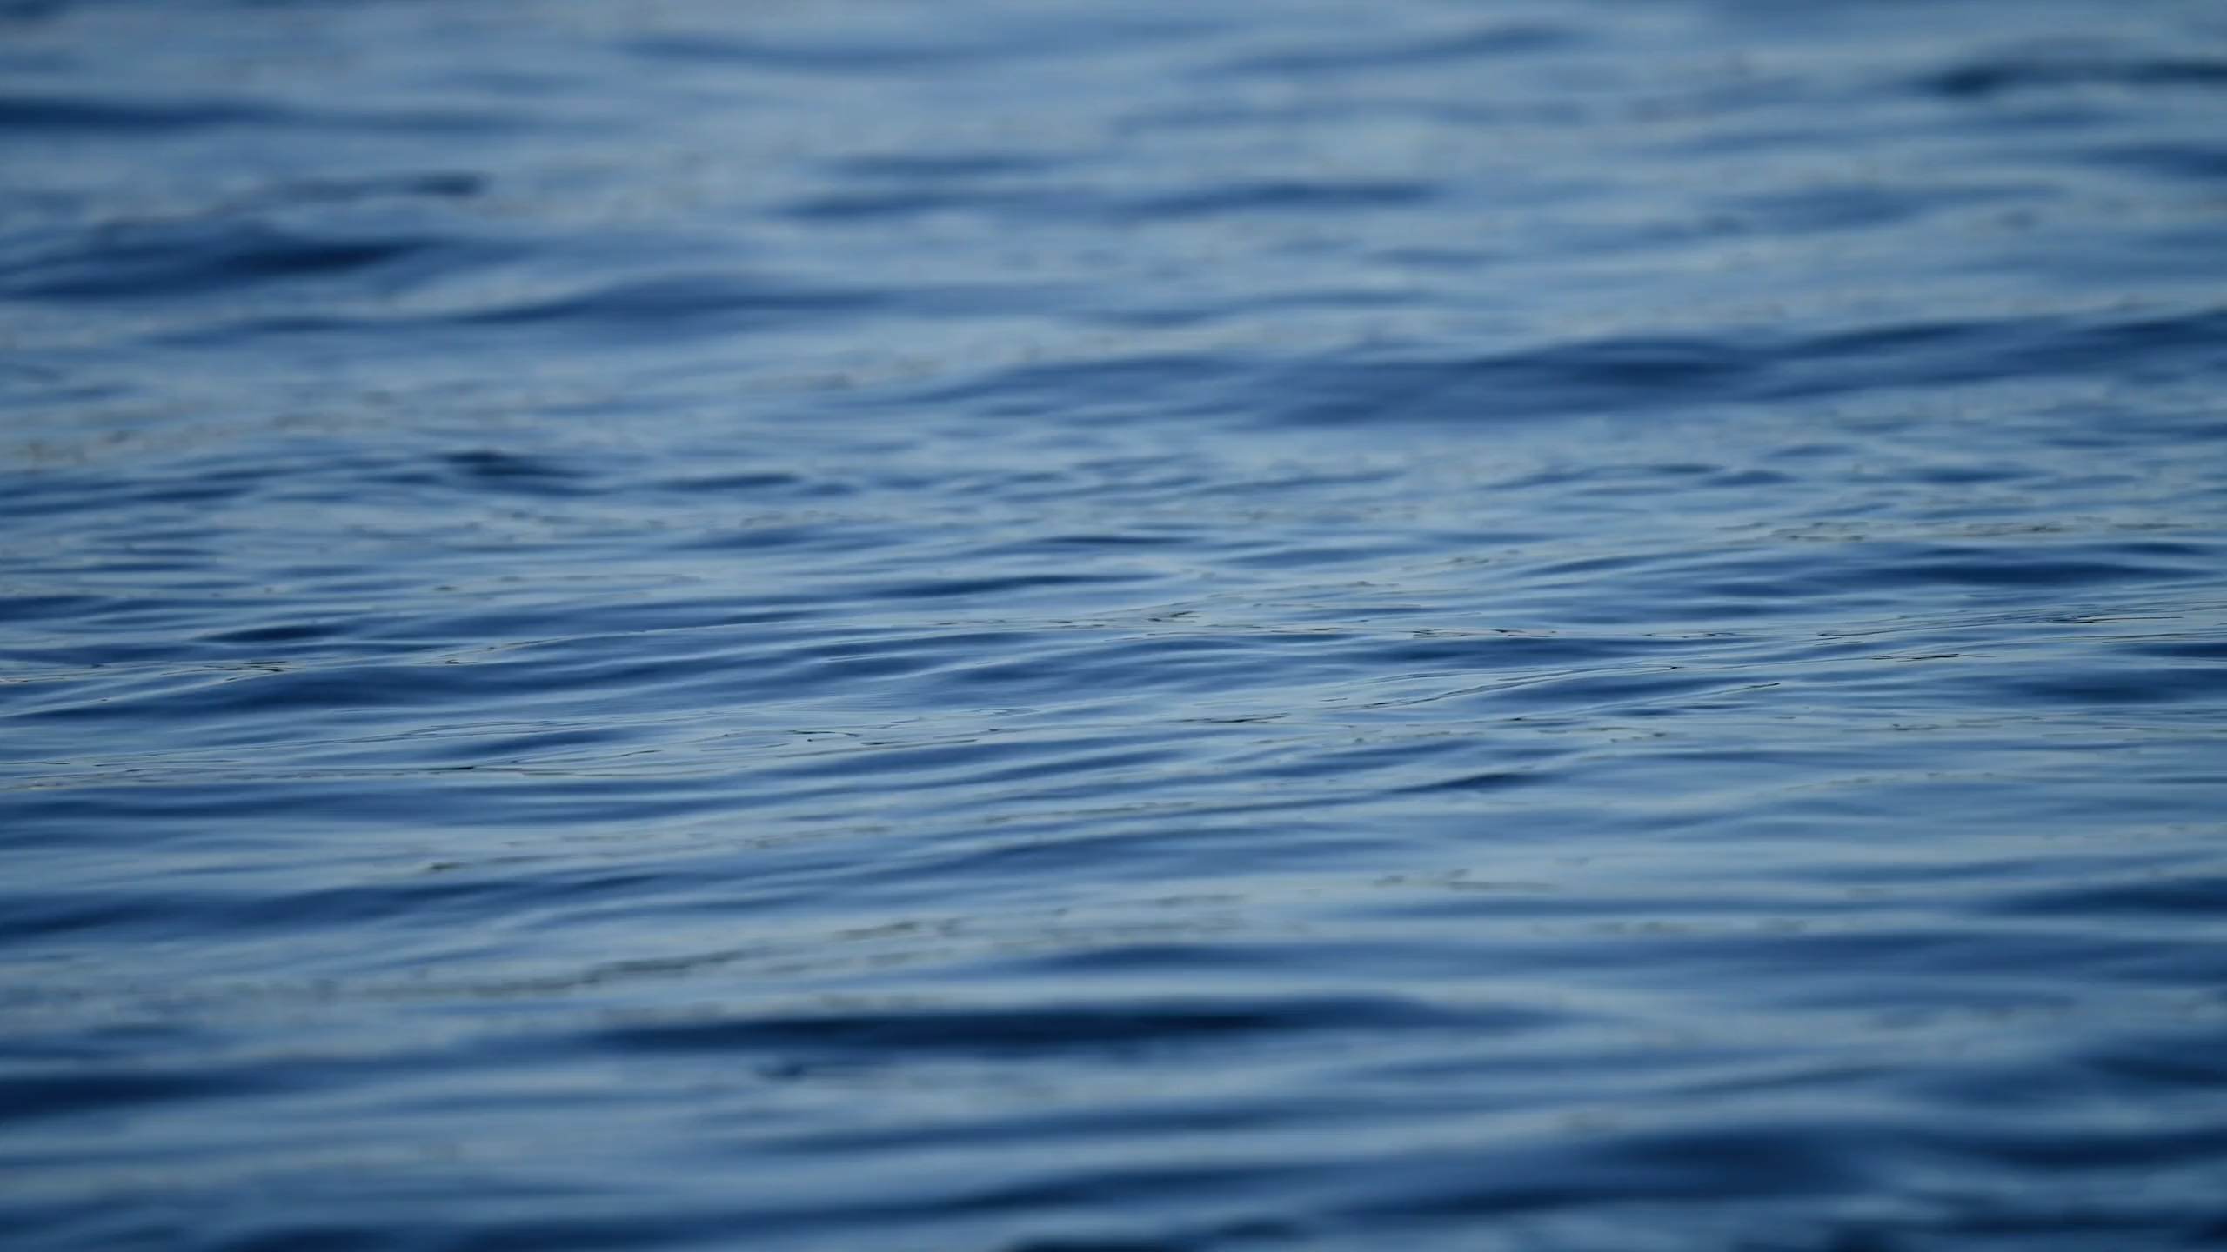
All images copyright-free from pixabay, unless otherwise identified
Notes:
Gathering:
Slide 1: Rippling water stilling exercise
Use the stilling slide if desired: the suggested words should be spoken slowly, leaving pauses inbetween to create a sense of stillness.
As you sit quietly, watch the surface of the water rippling…… [PAUSE]
Now practise slower breathing…..in…..and out…..in……and out…..as you watch….[PAUSE]
You maybe notice that you are feeling calmer and more relaxed….[PAUSE]
As you breathe, think about yourself and what you bring into this time today….. [PAUSE]
We come into this special / sacred space and time to be still….to think deeply…..to be together as a school community…..
In our time together today, we will share a challenge together, share a story, and then share our thinking.
But first, let’s welcome one another as we begin….

Slide 2

Leader: As we gather to share our story today….
All: May we grow in our understanding of ourselves, others and our wonderful world.
Notes:
Slide 2: Use our new gathering words for this term, or your usual greeting if you prefer. These greetings may change slightly each week to reflect the spiritual elements that we will be exploring in each week’s materials.
Leader: As we gather to share our story today….
All: May we grow in our understanding of ourselves, others and our wonder-ful world.

Slide 3
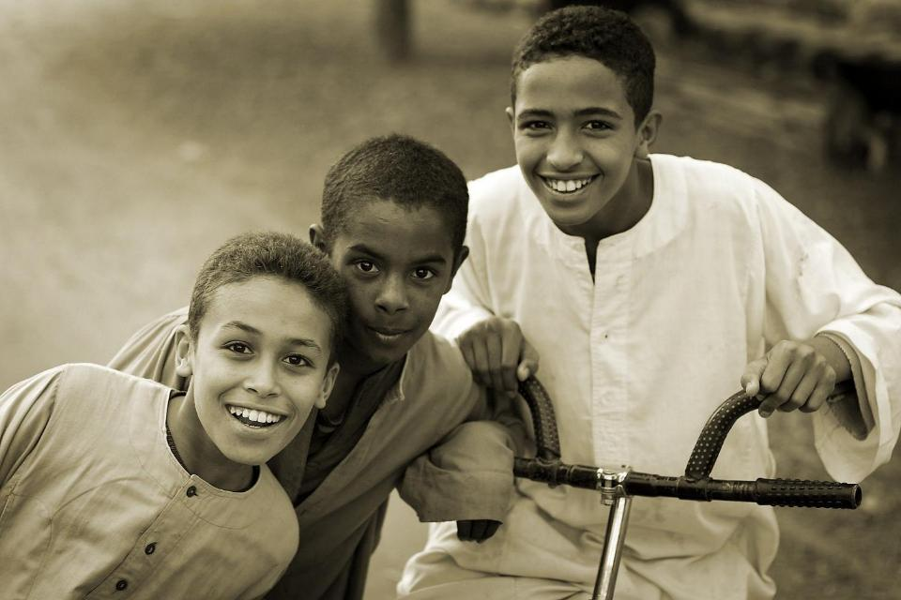
Make me laugh!
Notes:
Slide 3: We’re going to start today with a challenge: Make me laugh! [choose your candidate, if it’s not you, and set up the rules and the scope of your challenge!]
Laughing is important in the story that we will hear shortly, but first….

Slide 4

Stories that help us to grow
Notes:
Slide 4: You may remember that this term, we are exploring stories that help us to grow, and today’s story is another ancient traditional tale. It’s not from France, or Algeria, or New Zealand this time, but from Australia…..

Slide 5
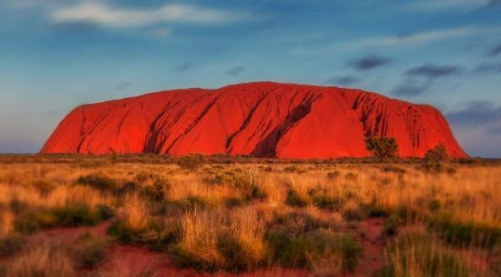
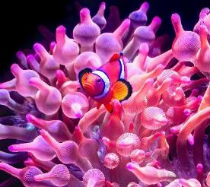

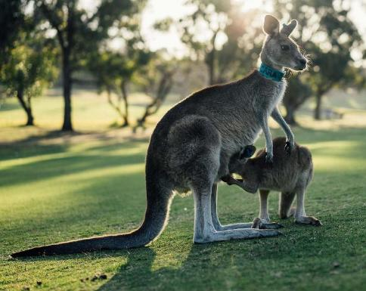
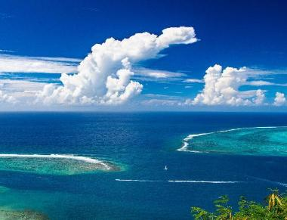
Notes:
Slide 4: Australia
Australia is a huge country – in fact, it’s almost a whole continent, all by itself! Uluru (the red rock you can see at the top) is just one of the things that make Australia famous, and in fact, Uluru is a really important sacred, spiritual space for the aboriginal peoples who live in Australia. Aboriginal culture is full of stories about the land, and about the animals that live on it, and how important the connections between human beings and the land are. So, our story today is one of these….

Slide 6
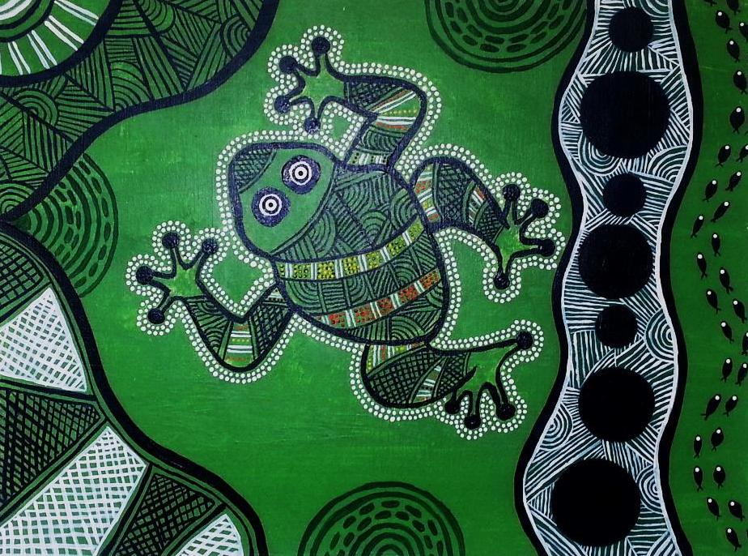
Our thanks to artist Sam Lyons for allowing us to use her work:
https://samlyonart.wordpress.com/2015/01/24/aboriginal-green-frog/
Tiddalik
Notes:
Slide 6: ….about an enormous frog called Tiddalik – and I wonder whether it too might have a message for us all….. [use script on p.4-5]
Tiddalik was a great big, enormous, bull frog.
One hot, sunny day, Tiddalik decided that he needed a drink of water to cool him down, so he went down to the billabong for a drink. To his annoyance, lots of other animals were already there:

Slide 7
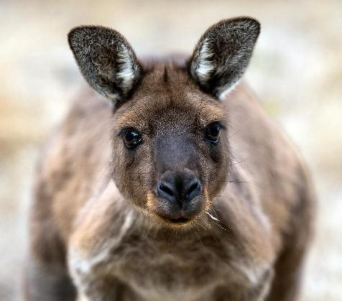
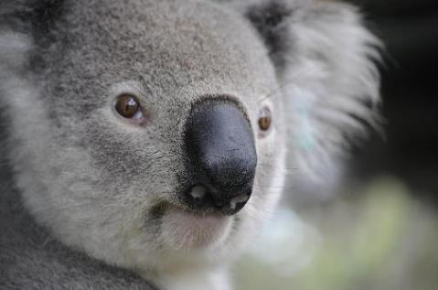
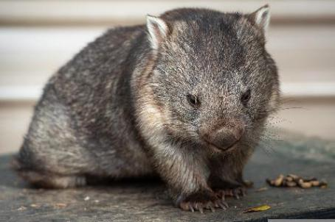
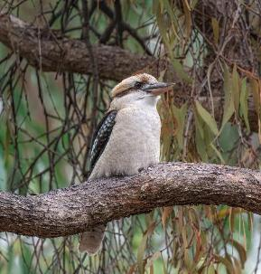
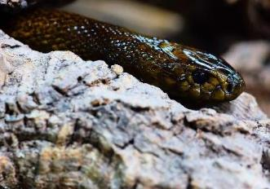
Notes:
Slide 7: …Kangaroo, and Wombat, and Koala, and Snake, and Kookaburra, all of them drinking from the lake.

Slide 8
Notes:
Slide 8: Tiddalik saw them drinking and decided that he didn’t want to share the water with anyone. So, he swallowed up all the water in the land – not just the water in the billabong, but the water in all the streams and lakes as well – in one great, big bull-frog gulp! No more billabong, and no more water for the animals.

Slide 9
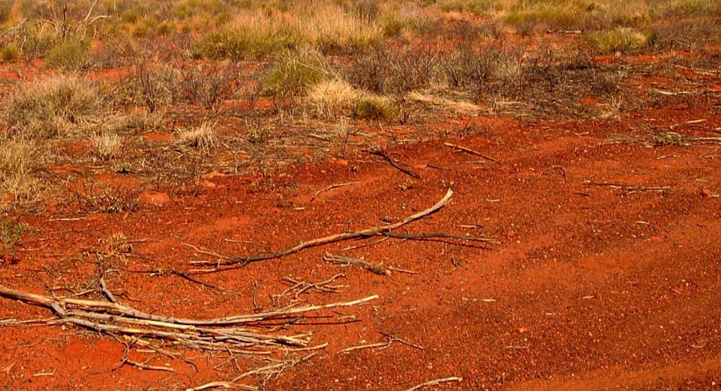
Notes:
Slide 9: Time went by and the sun got hotter and hotter. The other animals in the forest got more and more thirsty, until they could bear it no more. So they went to Tiddalik and pleaded with him to let just a little bit of water out for them all to share.

Slide 10
Notes:
Slide 10: But Tiddalik just stared, with his great, big bull-frog mouth clamped tightly shut. Eventually, the animals called a meeting and decided that something must be done to make Tiddalik give them back their water.

Slide 11


Notes:
Slide 11: Kangaroo said, ‘We must make him open up his mouth,’.
‘Let’s make him laugh,’ suggested Koala and off they went to put their plan into action.

Slide 12
Notes:
Slide 12: Tiddalik was still sitting by the side of the lake, so full of water that he could hardly move….his great, big bull-frog mouth still clamped tightly shut around the precious water.
One by one the animals tried to make him laugh. They pulled funny faces and told funny jokes. They turned somersaults and pretended to fall over each other like clowns, but nothing seemed to work. Tiddalik’s great big bull-frog mouth stayed shut.

Slide 13

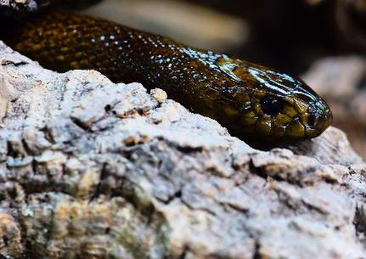
Notes:
Slide 13: Kookaburra told his funniest story. They all pulled funny faces and told funny jokes. They turned somersaults and pretended to fall over each other like clowns, but nothing seemed to work. Snake even tied himself into a giant knot, but Tiddalik’s great big bull-frog mouth stayed shut.

Slide 14
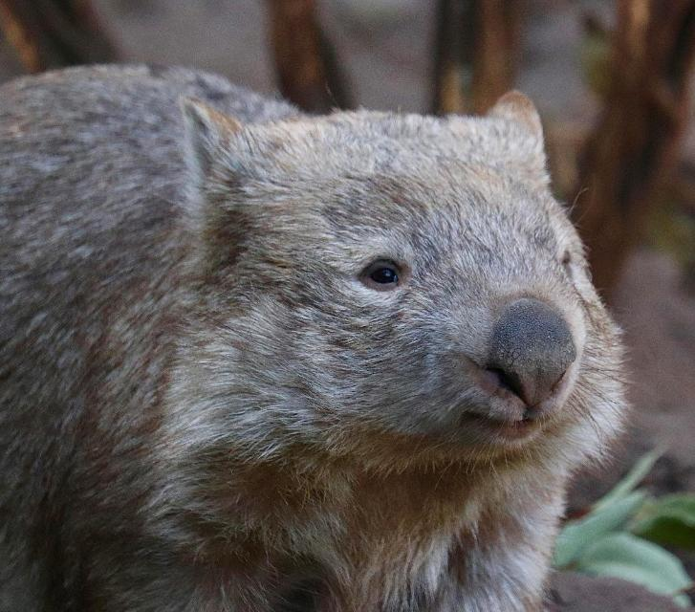
Notes:
Slide 13: They were near to giving up when Wombat had a really good idea. He sneaked up behind Tiddalik and, ever so gently to begin with, he started to tickle him. Tiddalik began to tremble, but his great big bull-frog mouth still stayed tightly shut. So, Wombat tickled some more….and the corners of Tiddalik’s great big bull-frog mouth began to twitch. Some more tickling, and Tiddalik could not keep his great big bull-frog mouth closed a second longer. He let out an enormous giggle….

Slide 15
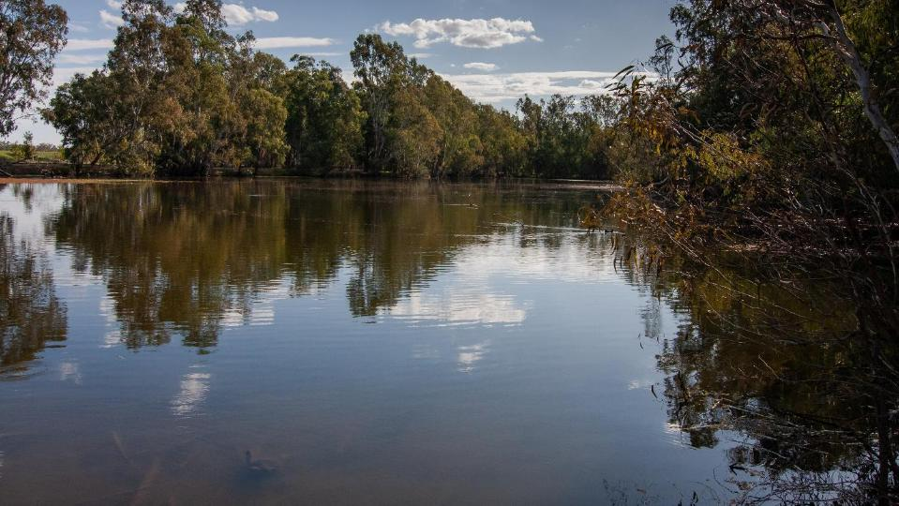
Notes:
Slide 14: ….and out flowed all the water, back where it belonged – enough water for everyone to share.

Slide 16

…. I wonder what you think the message of this story is?
Notes:
Slide 16: We’ve been exploring stories that have hidden messages for us to find, like treasure, so I wonder what you think the message of this story is? [ask children to share ideas]

Slide 17

Notes:
Slide 17: Water is something that we all use, every day. We probably can’t imagine what our lives would be like if we ran out, because we are fortunate enough to have lots of it, most of the time: in fact, some people would say that we see rather a lot of water here in the UK!

Slide 18
Notes:
Slide 18: In our story, Tiddalik’s actions meant that all the other animals had no water to drink. It’s a reminder to us that we all share the world’s resources – and that our actions have an impact too.

Slide 19
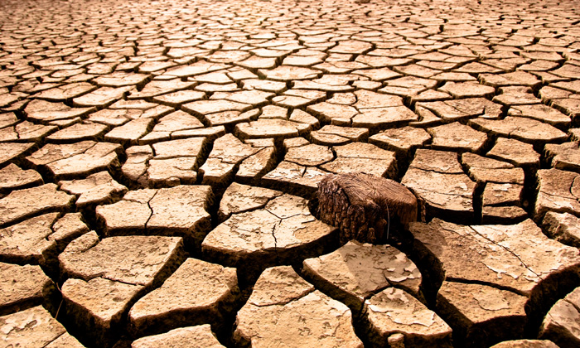
Notes:
Slide 19: Scientists have been reminding us for years that we need to take better care of our world – and learn to be more careful about wasting our world’s resources. Our planet belongs to us all, and we’ve learned that what people do in one place has an impact on the climate in another. In some countries, they can’t take water for granted, and as our planet gets hotter, there is less rainfall, which in the end may mean less water for us all.

Slide 20
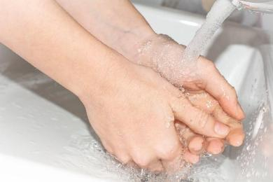
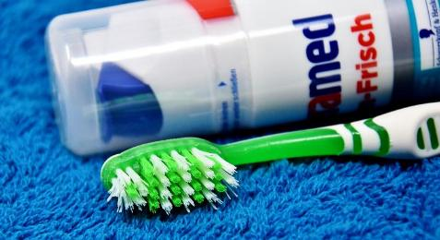
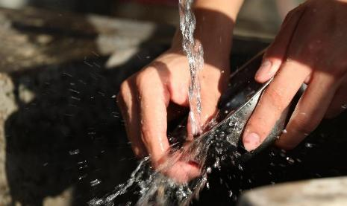
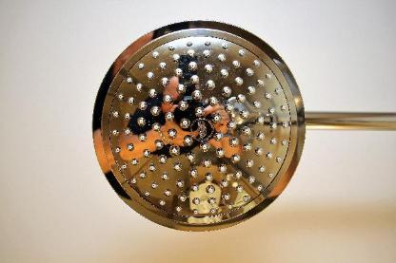
Is there a difference between using water and wasting water?
Notes:
Slide 20: Before we move on, we’re going to spend a few moments talking about a really important question…. Is there a difference between using water and wasting water? [NB spend some time here helping children to understand there is a difference, and that whilst we should be careful with water, it’s essential that children drink enough!]

Slide 21
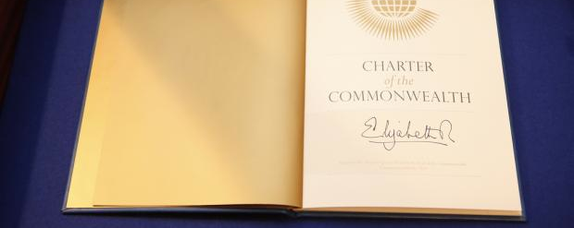
Notes:
Slide 21: This is a very special document called the Commonwealth Charter, signed by our former Queen, Elizabeth II in 2013. It contains the promises that 24 countries across the world (called ‘the Commonwealth’) made to each other. One of them is about caring for the environment – our world – looking after it, because it belongs to everyone. We all know that we all share the same world – but what we may forget sometimes is that we also all share the world’s resources, things like water. It sounds a bit topsy-turvy, but if we waste water, it’s almost as bad as if we were like Tiddalik the frog, keeping all the water to ourselves, because there is less for everyone else.

Slide 22

‘Be generous and willing to share.’
Notes:
Slide 22: In the Bible, the special book for Christians we read these words: ‘Be generous and willing to share.’ Think for a few moments about what you think these words mean.

Slide 23

‘Be generous and willing to share.’
…I wonder what you think these words mean for us, here in our school?...
…I wonder how we might make good choices with the water we use, because we know it’s so precious in other parts of the world?...and how our actions might show that we are willing to share this precious resource with others?...
…I wonder if there might be other ways in which we could be generous and willing to share?...
Notes:
Slide 23: Responding and words for worship
In our story, Tiddalik the giant bull-frog didn’t share – and there were huge consequences for all the other animals. The promises in the Commonwealth Charter and the words from the Bible ’Be generous and willing to share’ have reminded us that our actions matter. Let’s pause and think together…..
…I wonder what you think these words mean for us, here in our school?...
…I wonder how we might make good choices with the water we use, because we know it’s so precious in other parts of the world?...and how our actions might
show that we are willing to share this precious resource with others?....
…I wonder if there might be other ways in which we could be generous and willing to share?...
I’m going to leave some space here for us to think…. [or you might want to give pupils opportunities to talk together in pairs about things they could do]
And now I’ll use a short prayer, which you might like to make your own in some way – or continue to be still with your own thoughts…..

Slide 24
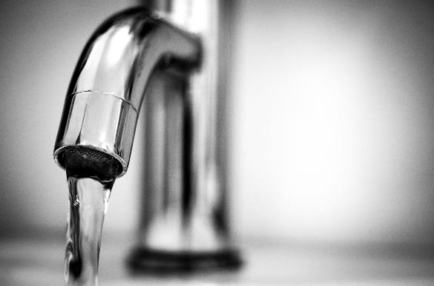
Dear God
We are thankful that we have clean, fresh water to drink, but we realise that we need to use it and share it responsibly. Please help us to remember.
Notes:
Slide 24: Prayer
Dear God
We are thankful that we have clean, fresh water to drink, but we realise that we need to use it and share it responsibly. Please help us to remember.

Slide 25


Slide 26



Leader: As we leave this place & time and go into the day ahead…
All: May we use water wisely!
Notes:
Sending: Slide 26
Leader: As we leave this place and time and go into the day ahead…
All: May we use water wisely!

Slide 27
Notes:
Slide 27: Reflective areas
You will need some glass beads (clear/blue if possible] and a small bowl
Think: Think about the story of Tiddalik and how his actions meant that there was nothing for anyone else.
Talk: Talk about how we can be more careful and responsible in the way that we use water.
Do: Each time you do something to save water, place a glass bead into the bowl.

