Slide 1



Leader: We are here together
Children: With ears ready to hear and hands ready to serve.
ALL: May we be wise in all our actions today.
Notes:
Slide 1: Use our new gathering words. Why not invent your own actions to accompany them?
Leader: We are here together
Children: With ears ready to hear and hands ready to serve.
All: May we be wise in all our actions today.

Slide 2

Notes:
Slide 2: So, this week, we reach the end of our term, and the end of our Wise Words theme. I wonder how many we can remember….here are some picture clues to remind us…..

Slide 3
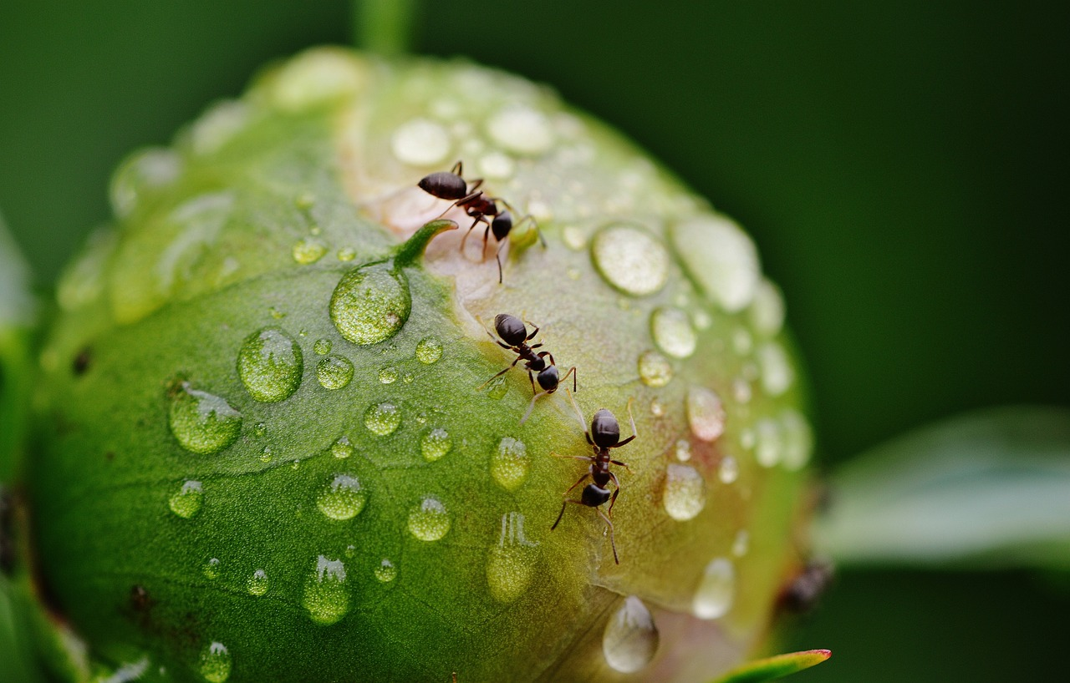
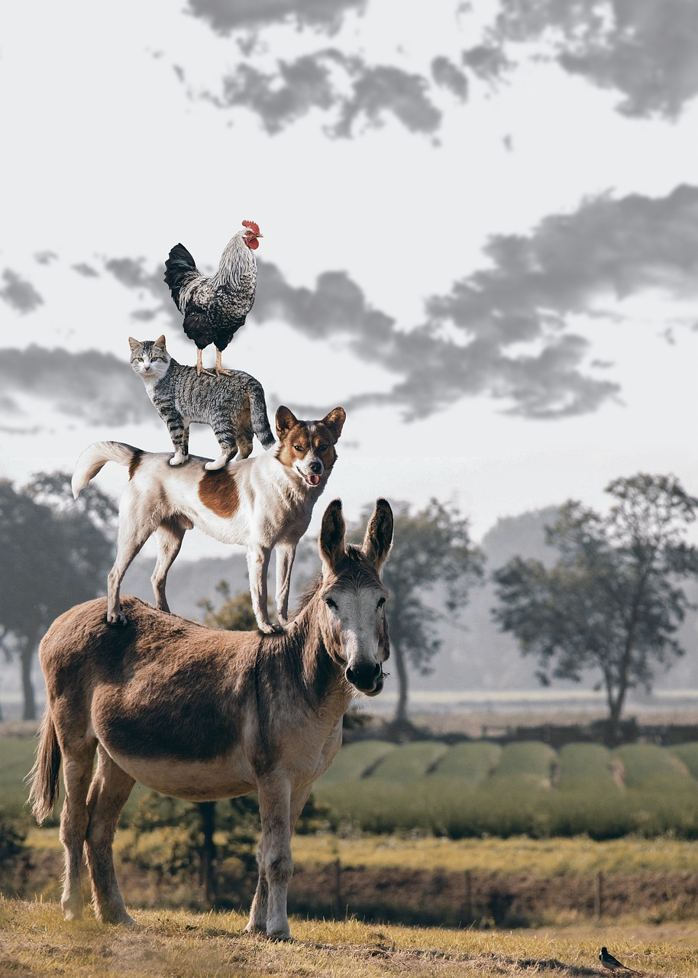


Notes:
Slide 3: Work hard, like the ants!
Good people look after their animals.
The lives of good people are like lights in the darkness.
Whenever you are able, do good to people who need your help…..

Slide 4
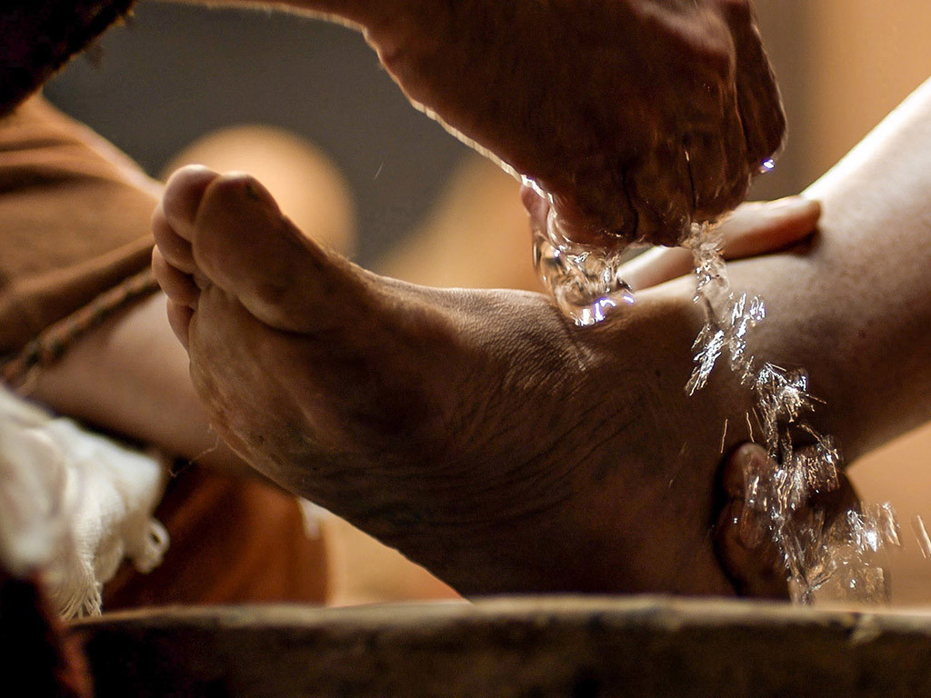

‘We show what we are like by what we do.’ (Proverbs 20:11)
Notes:
Slide 4: …and last week, we heard the Wise Words ‘We show what we are like by what we do.’ and thought about how Jesus showed this in the way that he lived.
Later in our time together today, we will hear some more words from Jesus, as part of a very familiar story, but first…..

Slide 5
Notes:
OPTIONAL Slide 5: Guess how much I love you… [insert pic from book, or use real book!)
I wonder if you know this story? [ask children to paraphrase, or if time allows, you could share the book together]
It’s a lovely story about the love between Big Nutbrown Hare and Little Nutbrown Hare – and the many ways in which they try to put into words the love that they have for each other. Many of you may have your own way of saying ‘I love you to the moon and back’ with your own families [you could share your examples here]

Slide 6

‘Je t’aime.’
‘Te amo.’
‘Я тебе кохаю.’
我愛你
‘Ti amo.’
Notes:
OPTIONAL Slide 6: I wonder how many ways we can say ‘I love you’?
It’s important to find some ways using languages spoken in your school community – there are a few here to get you started….
Je t’aime – French
Te amo - Spanish
yo tebe kokhayu - Ukrainian
Ti amo – Italian
BSL - https://www.signbsl.com/sign/i-love-you
Cantonese

Slide 7
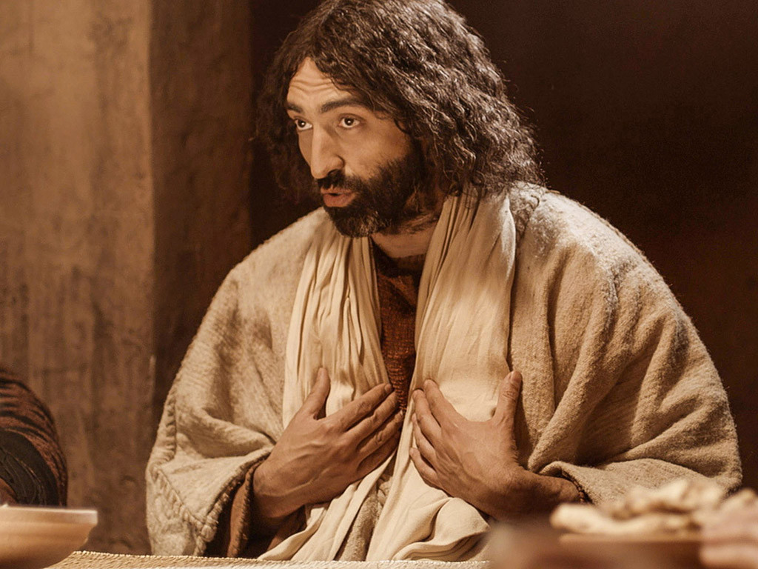
‘As I have loved you, so you must love one another.’ (John 13:34)
Notes:
Slide 7: At the very heart of the Easter story are these words about love, spoken by Jesus: ‘As I have loved you, so you must love one another.’ . They were the last words of advice that Jesus gave to his disciples, as they were gathered around the table, eating the Passover with him.

Slide 8
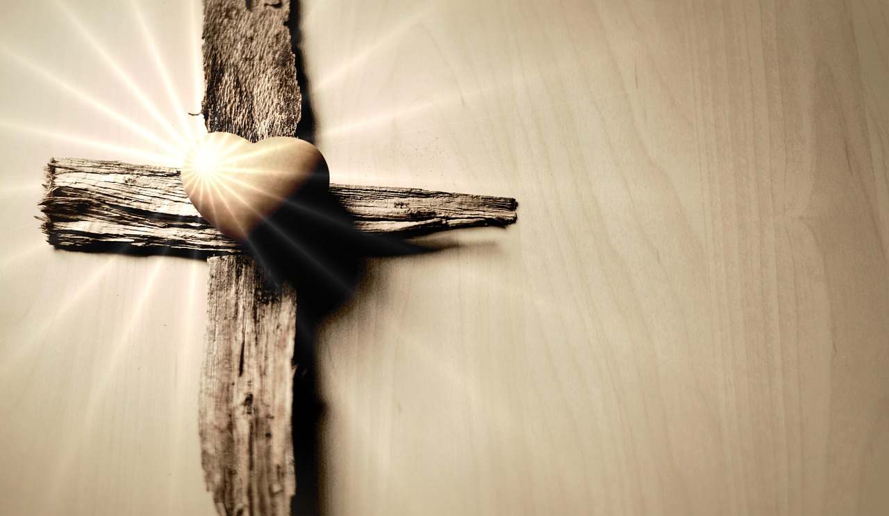
‘This is how much I love you.’
Notes:
Slide 8: Just like the Nutbrown Hares tried to find ways to express the deep love that they had for each other, Christians believe that Jesus showed deep love in the events that followed. In stretching out his arms on the cross, it’s as if Jesus was saying ‘This is how much I love you!’ [enough to die to pay for all the wrong things that people would say or do to each other]
Jesus’ death didn’t seem to make sense to the disciples at the time….

Slide 9
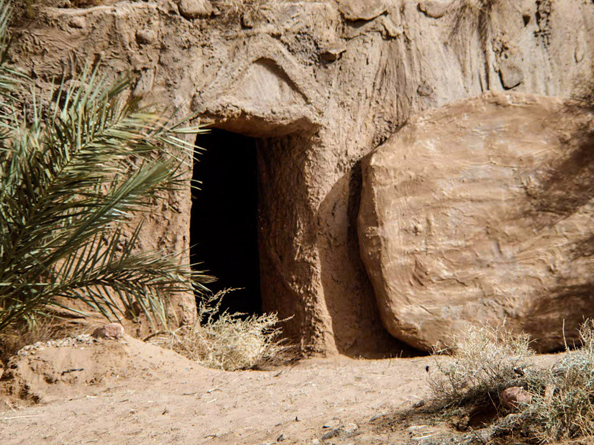
‘As I have loved you, so you must love one another.’ (John 13:34)
Notes:
Slide 9: – and so it was only once Easter Day had come and Jesus was alive again that they realised what this deep love meant for them, and how they should try to live their lives, following Jesus’ example, serving one another & putting the needs of others first. It’s what Christians all over the world will be remembering this Easter time – and putting into practice in their own lives.

Slide 10

….I wonder who you love, and how you show this?....
….I wonder how we might show love for each other, here in our school community?....
….or in our families this Easter time?....
Notes:
Slide 10: Responding and words for worship
Let’s gather our thoughts together now, as we take time to be still and quiet.
We’ve heard today how Christians believe Jesus showed how much he loved the world, in what happened that very first Easter, and that they try to live as he showed them to, loving one another.
….I wonder who you love, and how you show this?....
….I wonder how we might show love for each other, here in our school community?....
….or in our families this Easter time?....
…..

Slide 11


‘We will l ve each other.’
Notes:
Slide 11: Reflection and Prayer
In the stillness now, let’s quieten our minds and hearts.
You might want to think about some actions that you can do that show what you are like…..in school, at home, or in our wider community.
I’m going to pray a short prayer which you can join in with if you would like to make it yours, making a commitment to serve each other. There are some words for you, after I say the word ‘God’: ‘We will love each other.’

Slide 12


‘We will l ve each other.’
Notes:
Slide 12: In our words, God: ‘We will love each other.’

Slide 13
‘We will l ve each other.’
Notes:
Slide 13: In our actions, God: ‘We will love each other.’

Slide 14
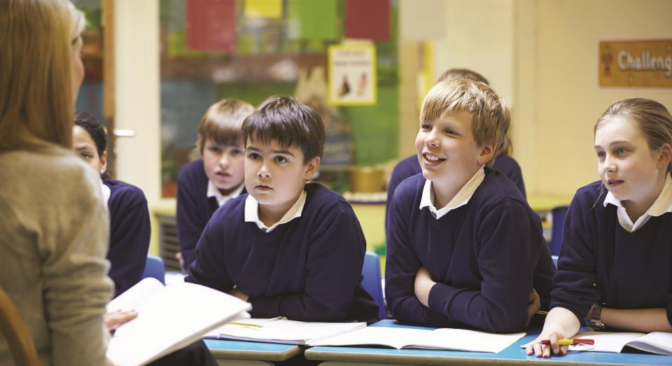
‘We will l ve each other.’
Notes:
Slide 14: In our school, God: ‘We will love each other.’

Slide 15
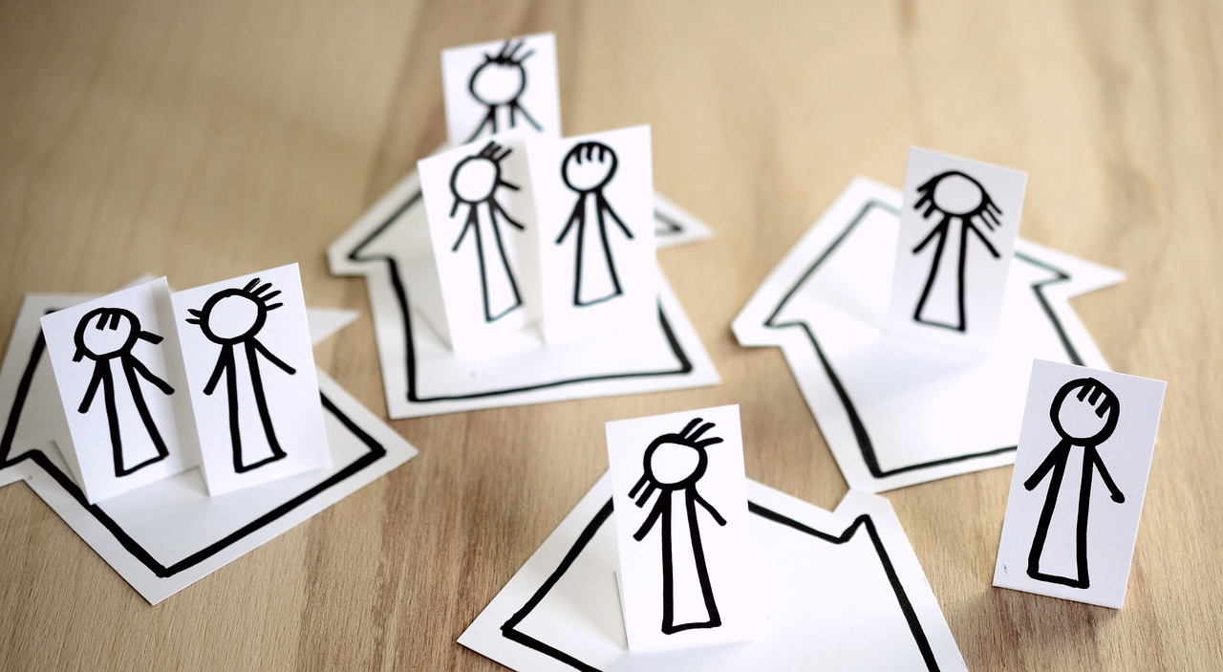
‘We will l ve each other.’
Notes:
Slide 13: In our homes, God: ‘We will serve each other.’

Slide 16
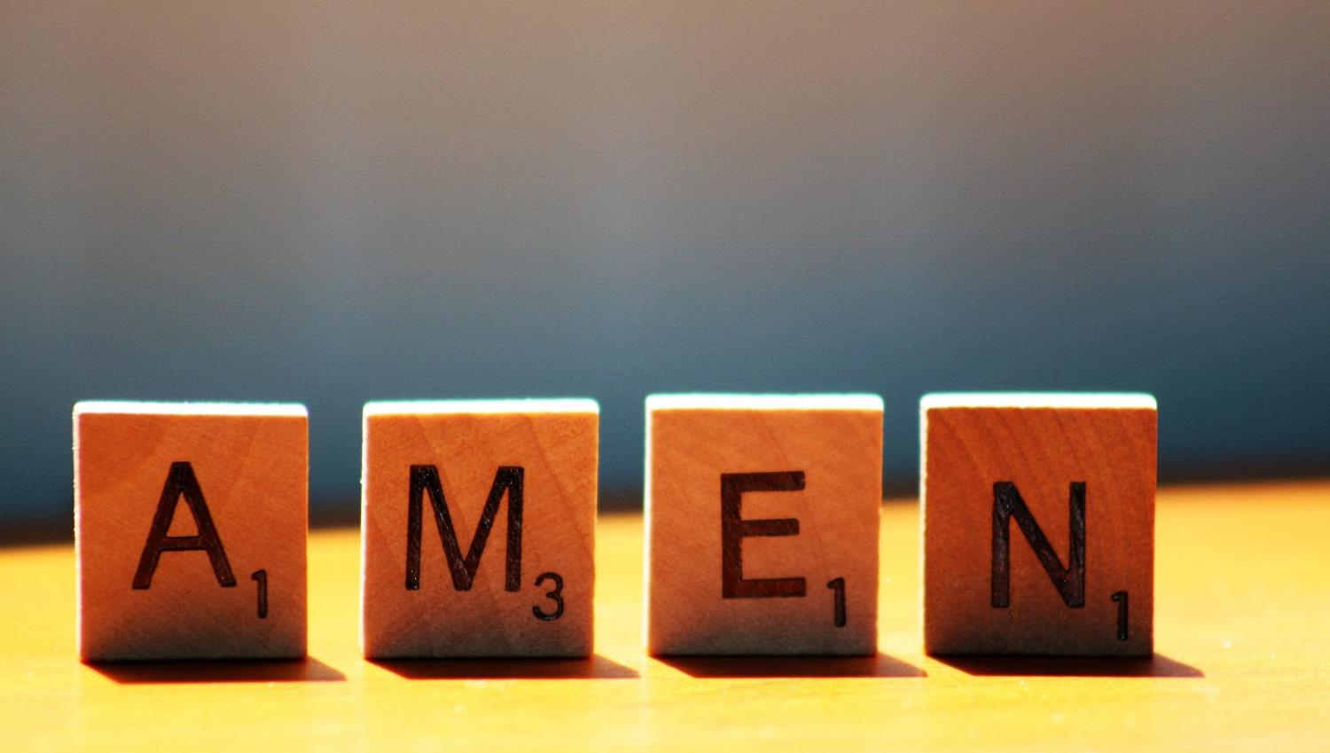

Slide 17



Leader: As we leave this place & time and go into the day ahead…
All: May today’s words help us to make wise choices.

Slide 18
Notes:
Slide 18: Reflective prayer activity:
Put some heart confetti into your reflective area this week.
Share the love this week, in as many different ways as you can – and take a heart for your pocket to remind you to do this!

