Slide 1
Beatitudes
Beati
‘How-to-be-attitudes’
Notes:
Slide 1: We’ve arrived at the finale of our series finding out about Jesus’ words in the ‘Beatitudes’ – the how-to-be- attitudes, as we’ve been calling them. Next week, we will begin on our journey to Christmas…. So for one last time, let’s use our greeting for this series:

Slide 2
We are here together….
May our attitudes make our school community a happy place today.
Notes:
Leader: We are here together
ALL: May our attitudes make our school community a happy place today.
Leader: We are here together
ALL: May our attitudes make our school community a happy place today.

Slide 3
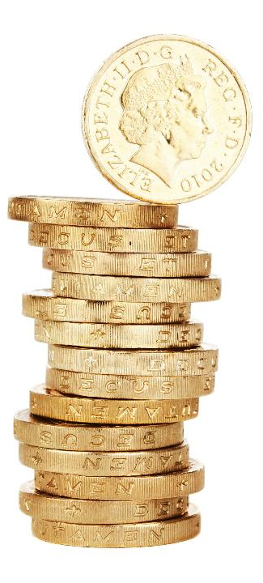
Rewards
St. Paul
(AD5-67)
Notes:
Slide 3: I wonder what you'd choose as a reward for something you’d done well? Talk to the person next to you for a few moments – then we’ll share some ideas.

Slide 4
The servants who invested wisely
Well done, you are a good and faithful servant – you have used your money and your talents responsibly. You have shown me you can take care of a little, so I will put you in charge of many things. I am very pleased with you!
£50
£20
£10
I wonder what you think the message of this story is?
Notes:
Slide 4*: It’s a parable about some servants who were rewarded by their master. The master gave them each some money and asked them to use their skills and his money wisely. Two of the servants worked hard and doubled their profits, but the third servant was rather lazy. He was frightened that he might lose the money and so dug a hole in the ground and buried the money until his master returned. On his return, the Master said these words to the first two servants: ‘Well done, you are a good and faithful servant – you have used your money and your talents responsibly. You have shown me you can take care of a little, so I will put you in charge of many things. I am very pleased with you!" As you might imagine, the master was not too pleased with the third servant!
I wonder what you think the message of this story is? Talk for a few moments again to the person next to you and then we’ll share what you think again.

Slide 5
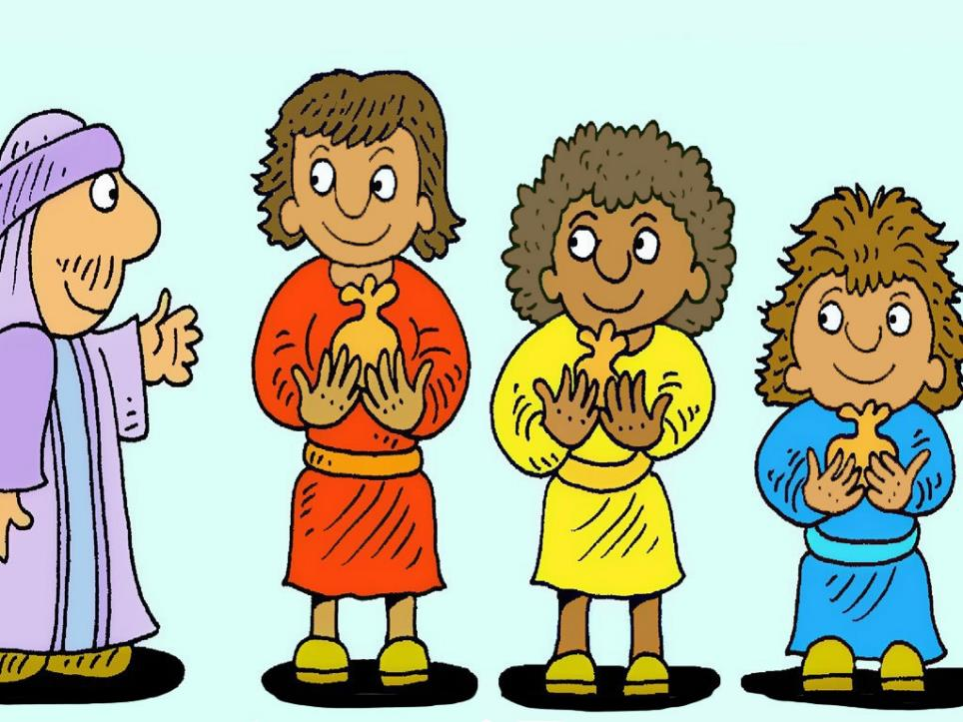
I wonder what message this story might have for us in school?
Notes:
Slide 5: The master in the story gave each of the three servants a chance to invest his money and their skills wisely – and each servant had the same choice: to work hard, or not. I wonder what message this story might have for us in school?

Slide 6
Beatitudes
Beati
‘How-to-be-attitudes’
Notes:
Slide 6: During these last few weeks, we’ve been thinking about Jesus’ words in the Beatitudes, and what they show us about the things that are important in God’s kingdom. I wonder if you can remember some of these important values?.....[allow time for responses]
Jesus said that living in these ways would bring a little bit of God’s kingdom here to earth. I don’t know whether you noticed, but each one of the Beatitudes came with a ‘reward’.

Slide 8
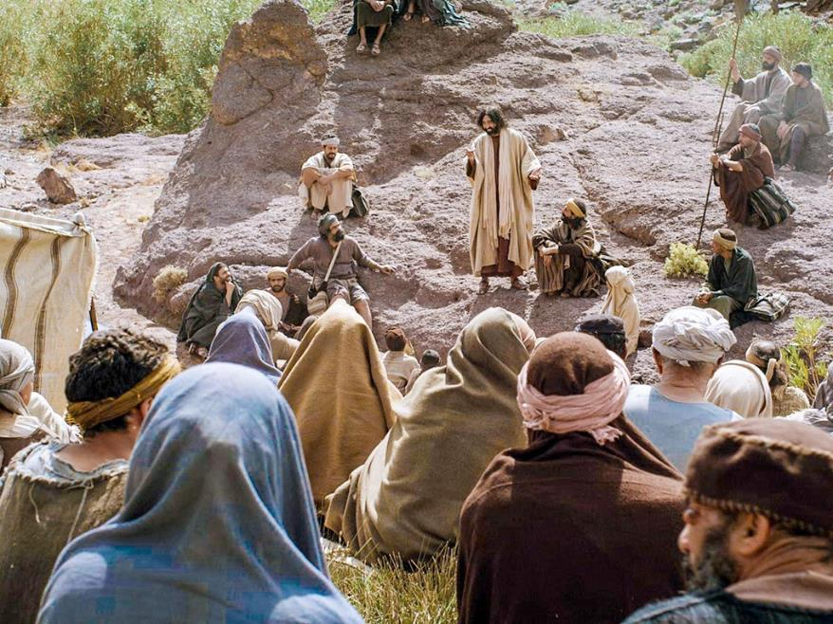
Rejoice and be glad.
You have a great reward waiting for you in heaven.
Notes:
Slide 8: Rejoice and be glad. You have a great reward waiting for you in heaven.
Jesus explained that it would not always be easy for people who follow him to live out God’s kingdom values, who try to bring a little bit of his Kingdom to earth. Like the two servants in Jesus’ parable, it might mean some hard work! Jesus explained to his followers that people around them might not understand or appreciate what they are doing. When things are hard, Jesus wanted his followers to know that their great reward would be the joy of heaven – and to keep on going, to persevere, with joy in their hearts, knowing what they have to look forward to.
These are difficult words, but we all know that sometimes the difficult things in life bring the greatest rewards!

Slide 9
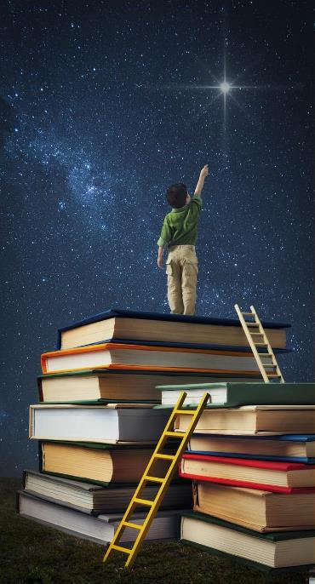
….I wonder why difficult things might bring the greatest joy?.....
….I wonder what ‘joy in heaven’ might be like?....
….I wonder what challenges you might have heard today – and across this term?....
….I wonder which might benefit your school community the most?....
Notes:
Slide 9: Responding (and words for worship):
Let’s be still and quiet together now and think about Jesus’ words, and the rewards he spoke of….
….I wonder why difficult things might bring the greatest joy?.....
….I wonder what ‘joy in heaven’ might be like?....
….I wonder what challenges you might have heard today – and across this term?....
….I wonder which might benefit your school community the most?....
Now I’m going to turn my thoughts into a prayer. If you agree with what I’m saying and would like to make the prayer your own, then you can join with me when I say ‘Amen’ at the end.

Slide 10
Dear God
Thank you for these challenging words that have reminded us of the things that are important to you – and that these things bring the greatest rewards.
Help us to try to live out the ‘How-to-be-attitudes’ in our school community.
Notes:
Slide 10: Prayer
Dear God
Thank you for these challenging words that have reminded us of the things that are important to you – and that these things bring the greatest rewards.
Help us to try to live out the ‘How-to-be-attitudes’ in our school community.

Slide 11
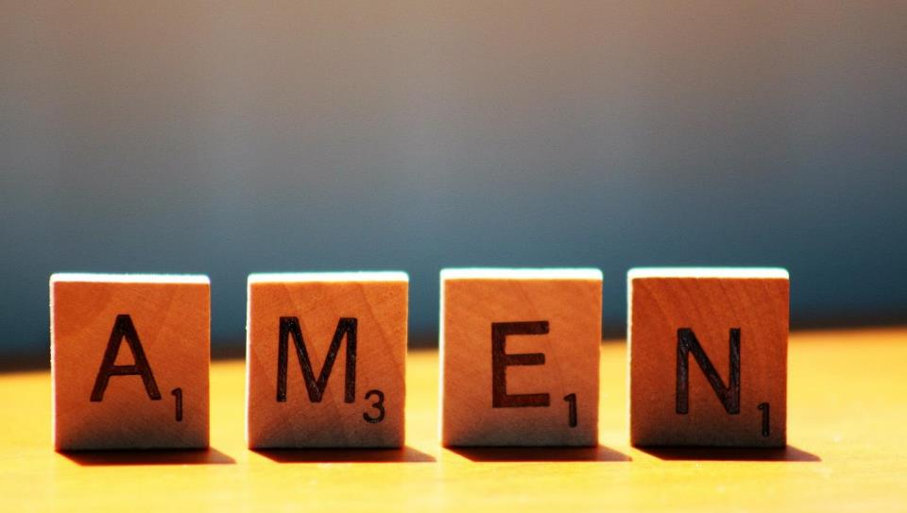

Slide 12
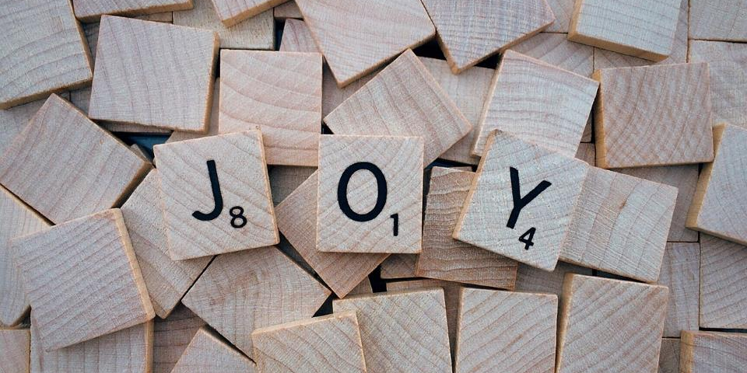
Leader: As we leave this place & time and go into the day ahead…
All: ….may joy be our great reward!

Slide 13
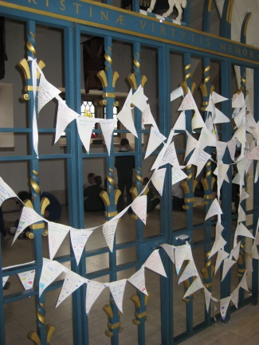
Prayer station image
Notes:
Slide 13: Reflective areas
This week, you will need some paper triangles and some string to make into coloured bunting. Write onto the triangles some thoughts about ‘joy in heaven’, things that bring you joy or about any of the ‘How-to-be-attitudes that have especially challenged you. You could leave the coin cards out to help remind children. Use the guided questions on the reflection card to help you.

