Slide 1
Leader: We are here together
ALL: May we ‘GO FOR GOLD!’ in our words and actions today!
Notes:
Slide 1: Gathering words
Leader: We are here together
ALL: May we ‘GO FOR GOLD!’ in our words and actions today!

Slide 2
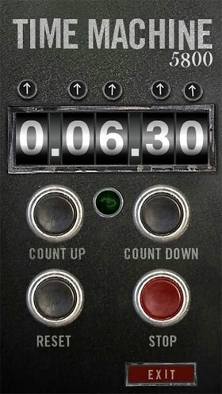
2024
CE
2012
CE
Notes:
Slide 2: We’re going to start our time together today by jumping straight into our Olympic time machine and go back in time 12 years ….to 2012,

Slide 3
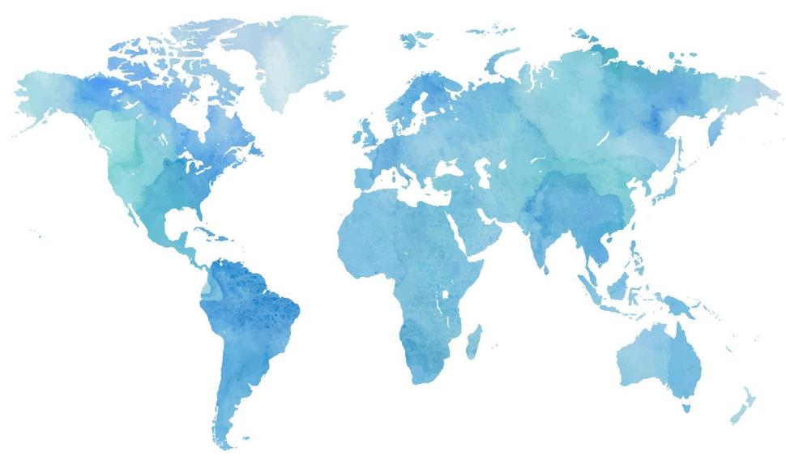
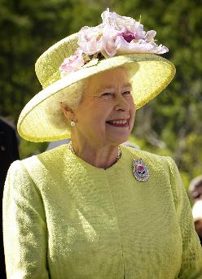
Notes:
Slide 3: When the Olympics and Paralympics were here, in London. For us here in the UK, it was one of the finest Olympic years ever!
It was also the year of our late Queen’s Golden Jubilee. It was a year to remember!

Slide 4
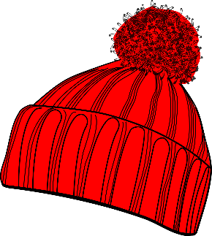
?
Guess
Who
Notes:
Slide 4: We’re going to play a game together to find out which athlete’s story we will share today. The game is a bit like ‘Guess Who’ and you’ll see the photos of some of the Olympic and Paralympic athletes from 2012….Listen to the clues and decide who you think it isn’t!.....

Slide 5
Will Bayley, paralympic table tennis
Paralympics 2012: GB's Will Bayley wins table tennis silver - BBC Sport
Mo Farah, long distance runner
Mofarlonol10m-a - Mo Farah - Wikipedia
Rebecca Adlington, swimmer
Olympics swimming: Rebecca Adlington into 800m final - BBC Sport
Jonnie Peacock, paralympic runner
Paralympics 2012: Jonnie Peacock wins gold in T44 100m - BBC Sport
Andy Murray, tennis player
Victory Andy Murray - 2012 Andy Murray tennis season - Wikipedia
Sarah Storey, paralympic cyclist
Dame Sarah Storey: Para cyclist on motherhood, equality and Tokyo targets | Cycling News | Sky Sports
Jessica Ennis-Hill, heptathlete
Jessica Ennis 100 m - Jessica Ennis-Hill - Wikipedia
Ellie Simmonds, paralympic swimmer
Swimming star Ellie Simmonds wins third Paralympics 2012 medal - Wales Online
Victoria Pendleton, track cyclist
Victoria Pendleton2 (cropped) - Victoria Pendleton - Wikipedia
Notes:
Use the links to put photos on your screen. Then cut and paste the covers on the next slide over your images.
The clues will lead you to Ellie Simmonds. It’s important to use them in the specified order or they won’t match up with the game on the screen! Pupils should find this easy enough but you may have to support younger pupils’ thinking with careful questions about what they are looking for in the photos.
Clue 1: I am not playing with a ball. [covers Will Bayley & Andy Murray]
Clue 2: I am a female athlete. [covers Jonnie Peacock & Mo Farah]
Clue 3: I don’t ride a bike. [covers Sarah Stoney & Victoria Pendleton]
Clue 4: I am a swimmer. [covers Jessica Ennis-Hill]
Clue 5: I am wearing swimming goggles [covers Rebecca Adlington – and reveals that Ellie Simmonds is the correct answer!]

Slide 6
Notes:
Cut and paste all the question mark boxes over your downloaded photos on the previous slide: these will cover each picture in the correct order for the clues. Delete this slide once you have completed making the game.

Slide 7
The Olympics
Respect
Friendship
Excellence
Determination
Equality
Courage
Inspiration
Olympic rings © Pixabay
Notes:
Slide 6: It will come as no surprise that we are thinking today about the Olympic value of courage – and especially how Ellie Simmonds has shown this not just in her swimming career, but also in how she lives her life. So, let’s find out a bit more about her…..

Slide 8
Image of Ellie swimming here
We don’t need to be cured. We’re so happy with who we are.
Work hard, be yourself.
Image of Ellie with her MBE here
Notes:
Slide 7: Use images from this page on the slide: https://paralympics.org.uk/athletes/ellie-Simmonds
Ellie Simmonds was born with a condition called dwarfism (its medical name is achondroplasia) and is famous for her motto "work hard, be yourself".
She has spoken openly about how the demands of professional sport and attitudes of people to her condition have impacted on her as an individual, but despite these challenges, she has 10 World Championship titles, and 9 Gold, 3 Silver and 3 Bronze medals earned during 4 Paralympic Games. She has several entries in the Guinness World Records, including being the youngest ever holder of an MBE, a very special medal awarded by the King, or as it was when she received hers, the Queen.
She is very positive about her condition and promotes educating others about dwarfism. She also said "We don’t need to be cured. We’re so happy with who we are." and has proved this with every challenge that she has faced, including taking part in the TV show Strictly Come Dancing in 2022 for the famous glitterball trophy.

Slide 9
“Life is full of challenges, but it's how you overcome them that defines you.”
Image of Ellie here
Notes:
Slide 8: Use an image from this page on the slide: https://paralympics.org.uk/athletes/ellie-Simmonds
Here are some more words from Ellie:
“Life is full of challenges, but it's how you overcome them that defines you.”
Talk together about what you think Ellie’s words mean.
What challenges have you / do you face in life?
How might Ellie’s words help you?

Slide 10
And we also have joy with our challenges because we know that these challenges produce patience. And patience produces character, and character produces hope. (Romans 5:3-4)
Notes:
Slide 9: A teacher named Paul, who also faced many challenges in his life as one of the very first Christians, wrote these words in his letter to one of the very first churches, in Rome. You can find them in the Bible in Romans chapter 3, verses 3 & 4:
And we also have joy with our troubles because we know that these troubles produce patience. And patience produces character, and character produces hope.
I wonder what is challenging about these words?!
Do you agree with what Paul says?
I wonder how these words might help Christians when they are facing challenges in life?

Slide 11
….I wonder what we can learn from the example of Ellie Simmonds or St. Paul’s words?…..
…I wonder what they show us about handling challenges in life?....
….I wonder how challenges might help us to become better people?....
Notes:
Slide 10: Words for worship & reflection
We’ve been thinking today about how Ellie Simmonds handled challenges in life – and about our own challenges. We’ve also heard some famous words from the Bible about the challenges of life.
As we come towards the end of our time together today, we’re going to be still and quiet together.
Take a few moments now to think about any challenges that you – or people you love – are facing at the moment.
….I wonder what we can learn from the example of Ellie Simmonds or St. Paul’s words?…..
…I wonder what they show us about handling challenges in life?....
….I wonder how challenges might help us to become better people?....

Slide 12
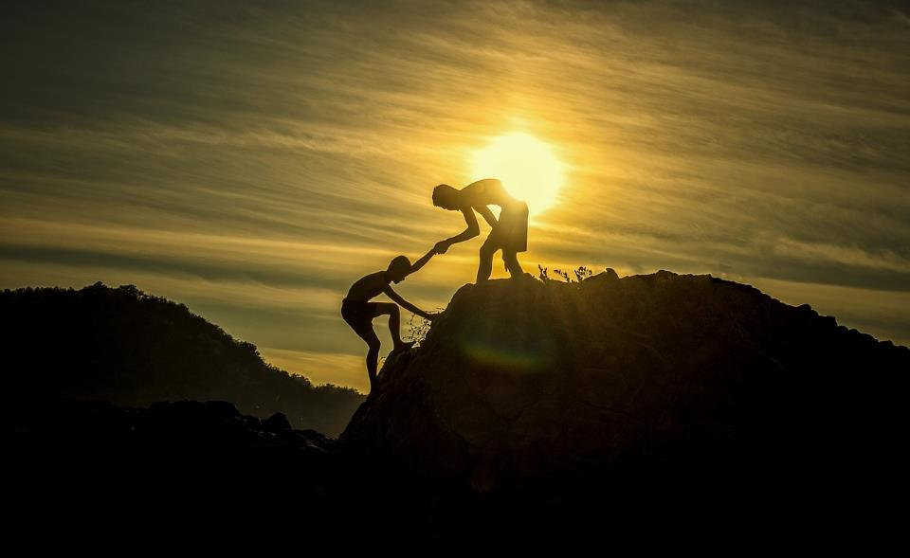
Notes:
Slide 11: Prayer
For many people, prayer is one way in which they handle the challenges of life, and find that giving their concerns to God and asking him for help to overcome them really helps.
So now let’s take a few moments to reflect or pray…. I’m going to use the we’ve just heard from St. Paul and turn them into a prayer asking God for his help: if you want to make the prayer your own, then please do join in with the Amen at the end.
Dear God
We know that life can be full of challenges.
When we are faced with a challenge, help us to be patient with ourselves and with others.
May our patience help us to become better people and give us hope that we will meet future challenges with greater confidence.

Slide 13
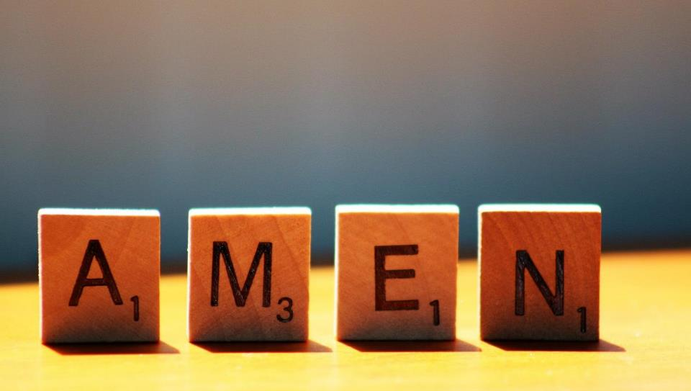

Slide 14
Leader: As we leave this place & time and go into the day ahead…
All: Let’s ‘go for gold’ in all that we do!
Notes:
Sending: Slide 13
Leader: As we leave this place & time and go into the day ahead…
All: Let’s go for gold* in all that we do!
*Again, you might need to unpick what we mean by ‘going for gold’ in the context of today’s words.

Slide 15
Notes:
Slide 14: Reflective areas
Print the Challenge Cards (see page 5) and leave them in your reflective area for this week. Encourage children to talk in groups so that they collaborate on finding answers – or you could select a card to talk about as a class each day

