Slide 1

All pictures copyright-free from pixabay
Notes:
Slide 1: Advent candle stilling exercise
Use the stilling slide if desired: the suggested words should be spoken slowly, leaving pauses inbetween to create a sense of stillness.
As you sit quietly here, watch the candle as it flickers or the snow as it falls…….PAUSE]
Now practise slower breathing…..in…..and out…..in……and out…..keep this going as you continue to watch….[PAUSE]
You maybe notice that you are feeling calmer and more relaxed….[PAUSE]
As you breathe, think about yourself and what you bring into this time today…..[PAUSE]
We come into this special / sacred space and time to be still….to think deeply…..to be together as a school community…..
In our time together today, we will….. Look at some photos……think about some words together….and then reflect on what they might mean for us here in this school community as we start Advent together.
But first, let’s welcome one another as we begin….

Slide 2
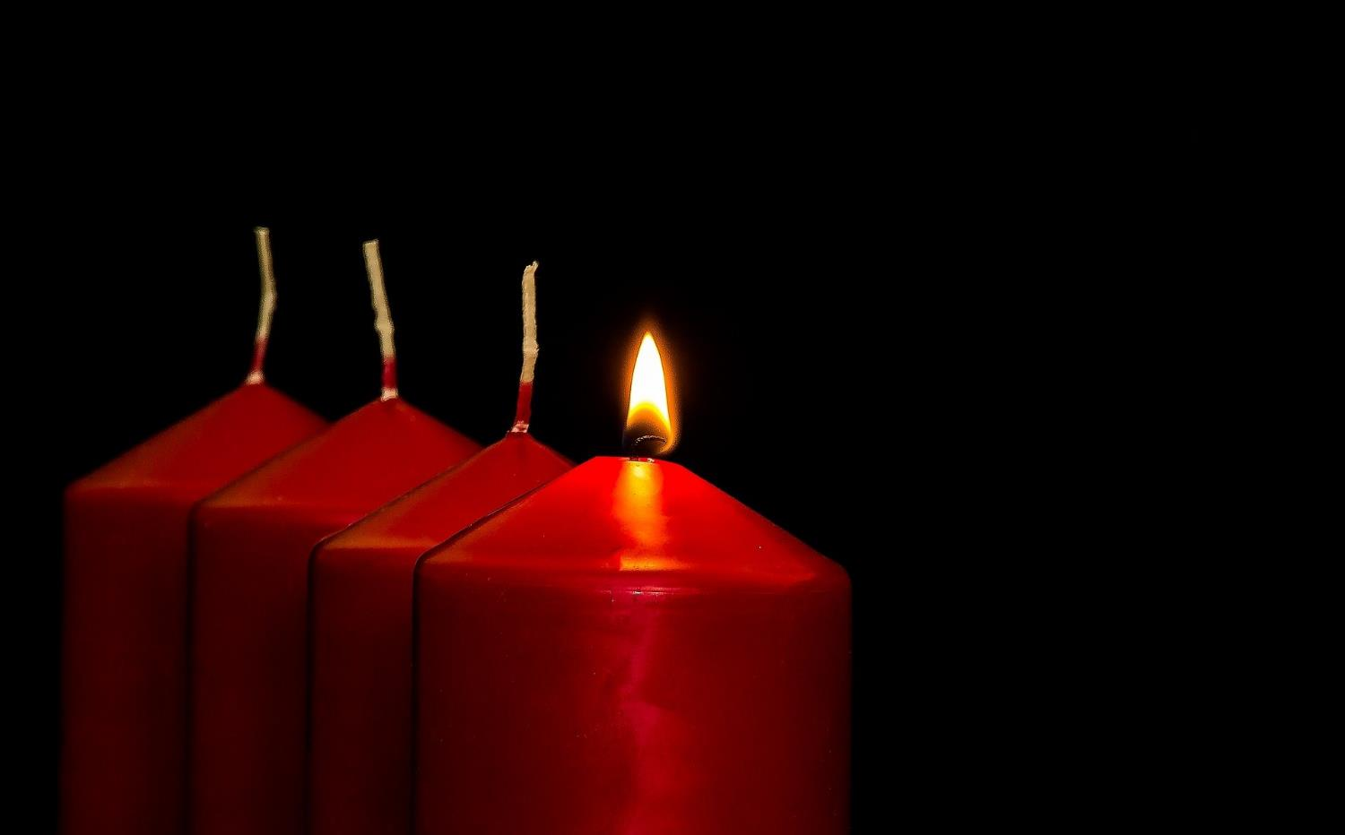


Leader: As we light our Advent candle…
All: May our time today brighten our lives, like light in the darkness.
Notes:
Slide 2: Use this special greeting for the Advent season, as you light your Advent candle.

Slide 3
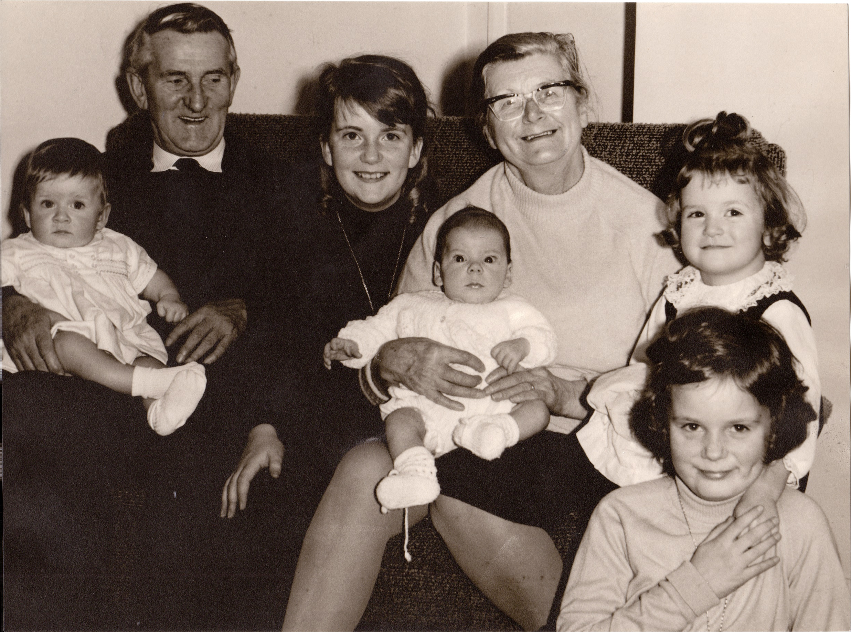
Notes:
Slide 3: Who might these people be? [Insert your own family photographs here…..]
Talk children through some photos from your family album that are important to you. Can children see any family likenesses?

Slide 4


Notes:
Slide 4: I wonder who’s in your family ‘tree’?
Talk together about immediate and wider family, such as cousins, and grandparents – and whether children know anything about people from further back in their family history. Are there any interesting stories from your family history? [Remember that there are many different models of family, and that some children may not know much – or wish to divulge much – about their family, or might be facing difficult situations in their home life.
If it helps, refer back to your own family, referring to the photos you have shown as an illustration: you are just wanting children to get an idea that families can be quite big – and go back through time.]
People sometimes call this their ‘family tree’ because each part of their family history is like a branch, that grows and spreads out over time.
Preparing for a new family member is something that some of you might have experienced if you have smaller brothers or sisters – or even cousins!
A new life is always worth celebrating, and so we can maybe understand why each year, the birth of Jesus is remembered by many people, and the story of Jesus’ family is retold.

Slide 5
This is the family history of Jesus Christ. He came from the family of David.
David came from the family of Abraham.
² Abraham was the father of Isaac. Isaac was the father of Jacob. Jacob was the father of Judah and his brothers. ³ Judah was the father of Perez and Zerah. (Their mother was Tamar.) Perez was the father of Hezron. Hezron was the father of Ram. ⁴ Ram was the father of Amminadab. Amminadab was the father of Nahshon. Nahshon was the father of Salmon. ⁵ Salmon was the father of Boaz. (Boaz’s mother was Rahab.) Boaz was the father of Obed. (Obed’s mother was Ruth.) Obed was the father of Jesse. ⁶ Jesse was the father of King David. David was the father of Solomon. (Solomon’s mother had been Uriah’s wife.) ⁷ Solomon was the father of Rehoboam. Rehoboam was the father of Abijah. Abijah was the father of Asa. ⁸ Asa was the father of Jehoshaphat. Jehoshaphat was the father of Jehoram. Jehoram was the ancestor of Uzziah. ⁹ Uzziah was the father of Jotham. Jotham was the father of Ahaz. Ahaz was the father of Hezekiah. ¹⁰ Hezekiah was the father of Manasseh. Manasseh was the father of Amon. Amon was the father of Josiah. ¹¹ Josiah was the grandfather of Jehoiachin and his brothers. (This was at the time that the people were taken to Babylon.) ¹² After they were taken to Babylon: Jehoiachin was the father of Shealtiel. Shealtiel was the grandfather of Zerubbabel. ¹³ Zerubbabel was the father of Abiud. Abiud was the father of Eliakim. Eliakim was the father of Azor. ¹⁴ Azor was the father of Zadok. Zadok was the father of Akim. Akim was the father of Eliud. ¹⁵ Eliud was the father of Eleazar. Eleazar was the father of Matthan. Matthan was the father of Jacob. ¹⁶ Jacob was the father of Joseph. Joseph was the husband of Mary, and Mary was the mother of Jesus.
He came from the family of David. David came from the family of Abraham…..
…..Jacob was the father of Joseph. Joseph was the husband of Mary, and Mary was the mother of Jesus.
Notes:
Slide 5: In Matthew’s version of the story, we can see Jesus’ family ‘tree’ – it’s a lot of names [pick out any people whose stories you have shared – the references to King David are highlighted in yellow] But here are the most important words…. He (that’s Jesus!) came from the family of David. David came from the family of Abraham…..And then at the end…..…..Jacob was the father of Joseph. Joseph was the husband of Mary, and Mary was the mother of Jesus.
Jesus would not only be part of King David’s family, he would be the Son of God.

Slide 6
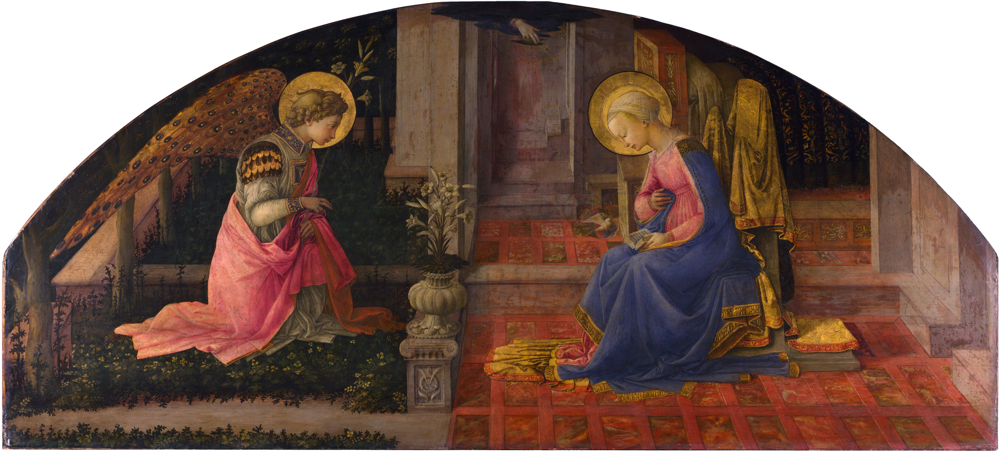
‘The Annunciation’ by Fra Filippo Lippi c.1450CE © National Gallery, London
‘…God will give him the throne of King David, his ancestor…He will be called the Son of God.’ [Luke 1:32,35]
Notes:
Slide 6: The Annunciation
But there words in other parts of the narrative that are even more important than these.
Let’s zoom in on a very important moment at the very start of the story, which thousands of artists across time have captured, like this painting here….
When the Angel Gabriel visited Mary, long before Jesus was born, the Angel spoke these words:
‘…God will give him [that’s Jesus] the throne of King David, his ancestor….He will be called the Son of God.’ [Luke 1:32,25]
At Christmas, Christians will celebrate that Jesus is Mary’s Son – and God’s: Jesus is human – like his mother Mary – and divine – like his Father, God.

Slide 7
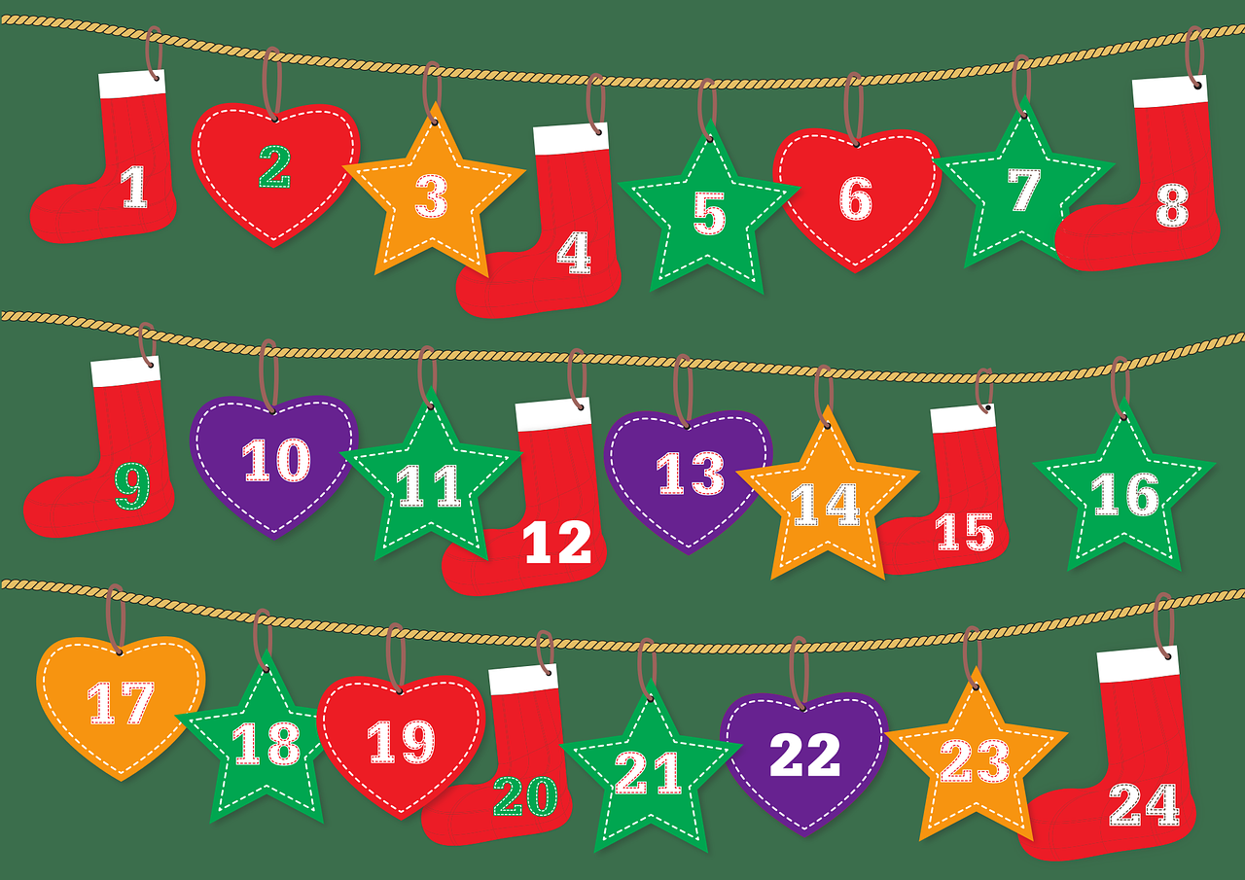
Advent calendar
Notes:
Slide 7 [optional]: This Advent, we will also join together as a school family each day as we open the doors on a very special Advent calendar that will take us to the end of term – and help us to prepare for Christmas….. In our Advent calendar, we will be exploring some more moments from the long history of Jesus’ family and God’s people where angels have visited, so we hope you enjoy exploring these stories with us…..and wondering together.
[If you want to, open the first door image and use the words which explain it….]

Slide 8
‘The Annunciation’ by Fra Filippo Lippi c.1450CE © National Gallery, London
‘…God will give him the throne of King David, his ancestor…He will be called the Son of God.’ [Luke 1:32,35]
Notes:
Slide 8: Responding and words for worship
We’re going to have some quiet moments now to begin/continue our wondering!…..
….you might like to look at the flame of the candle as you think….
…we’ve heard about Mary’s visit from the Angel Gabriel…listen again to the Angel’s words about Jesus:
‘…God will give him the throne of King David, his ancestor…He will be called the Son of God.’
…..I wonder how it felt to know that the Rescuer, God’s Son, would come as a tiny baby?....
….I wonder if this is what people expected?....
….I wonder which other stories we might share together during this Advent to help us to wonder?....
…I wonder what they might say to us?....
Now I’m going to use a short prayer, asking God to help us as we begin this Advent adventure together. If you would like to join me and make the prayer your own, then join in with ‘Amen’ at the end – or if you prefer, just be still with your own thoughts…..

Slide 9
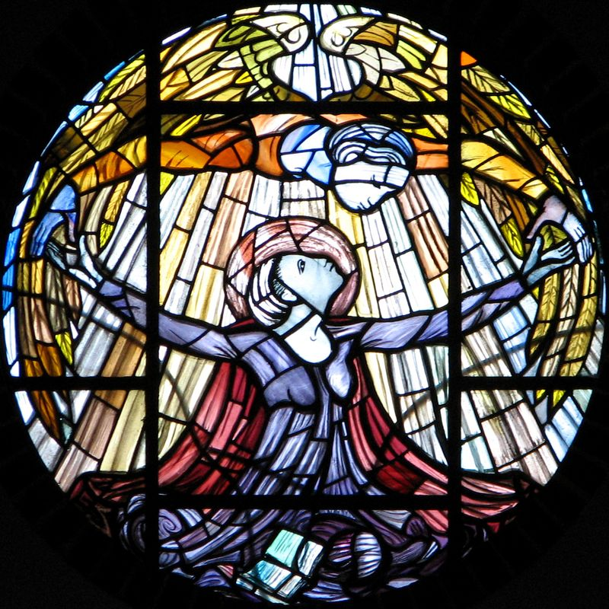
Dear God
As we begin this Advent season, may our hearts be open to hear this special story of the very first Christmas.
May we, like Mary, who heard the words of the Angel Gabriel, find things to make us wonder this Advent.
Notes:
Slide 9: Prayer
Dear God
As we begin this Advent season, may our hearts be open to hear this special story of the very first Christmas.
May we, like Mary, who heard the words of the Angel Gabriel, find things to make us wonder this Advent.

Slide 10


Slide 11


Leader: As we leave this place & time…
All: May the light of Advent shine brightly in our school today.
Notes:
Sending: Slide 11 (You might want to use this slide throughout the Advent season to end your time together)
Leader: As we leave this place and time….
All: May the light of Advent shine brightly in our school today.

