Slide 1
Leader: We are here together
Children: With ears ready to hear and hands ready to serve.
ALL: May we be wise in all our actions today.
Notes:
Slide 1: Use our new gathering words. Why not invent your own actions to accompany them?
Leader: We are here together
Children: With ears ready to hear and hands ready to serve.
All: May we be wise in all our actions today.

Slide 2
YUCK!!!!
Which job is the yuckiest?!!
doing the rubbish
cleaning the toilet
ironing
cleaning windows
washing up / emptying the dishwasher
Notes:
Slide 2: Teacher poll: YUCK! Leave a copy of the questions on p. 3 on each adult’s seat.
Ask pupils the question: ‘Of the jobs that have to be done in your house, which ones do you hate the most?’, allowing a few children to answer.
Then show them the teacher poll, asking pupils to vote first on which one they think the teachers would say was their least favourite. Now you can ask your staff to reveal whether the children are correct or not!
There are lots of jobs that we hate to do, and our story is going to be about another one. It’s a story about something that Jesus did, and is remembered by Christians all over the world on the day called Maundy Thursday. Listen to the story to see if you can spot what the yucky job was….

Slide 3
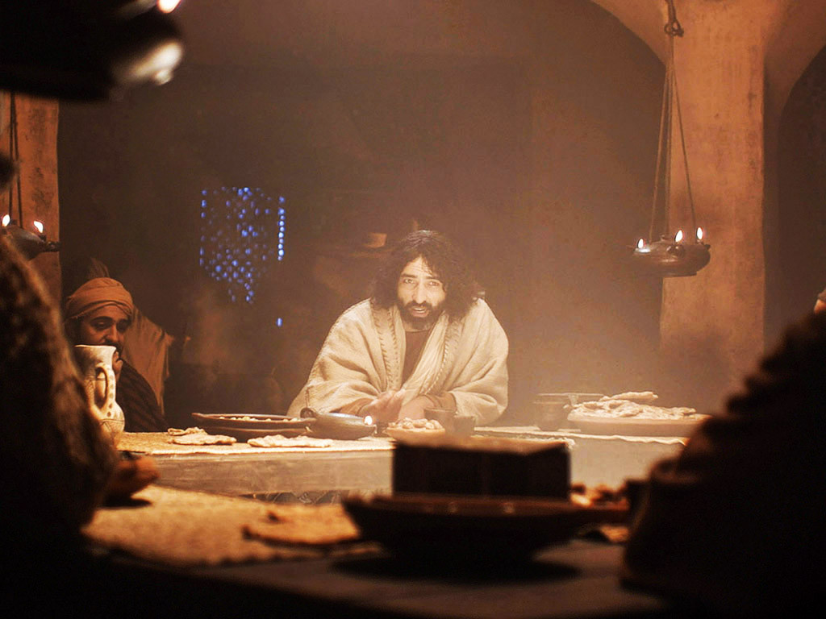
Notes:
Slide 3: Jesus and his disciples had finally arrived in Jerusalem for the Passover celebrations, and they were all gathered together in a room as the meal was being served.

Slide 4
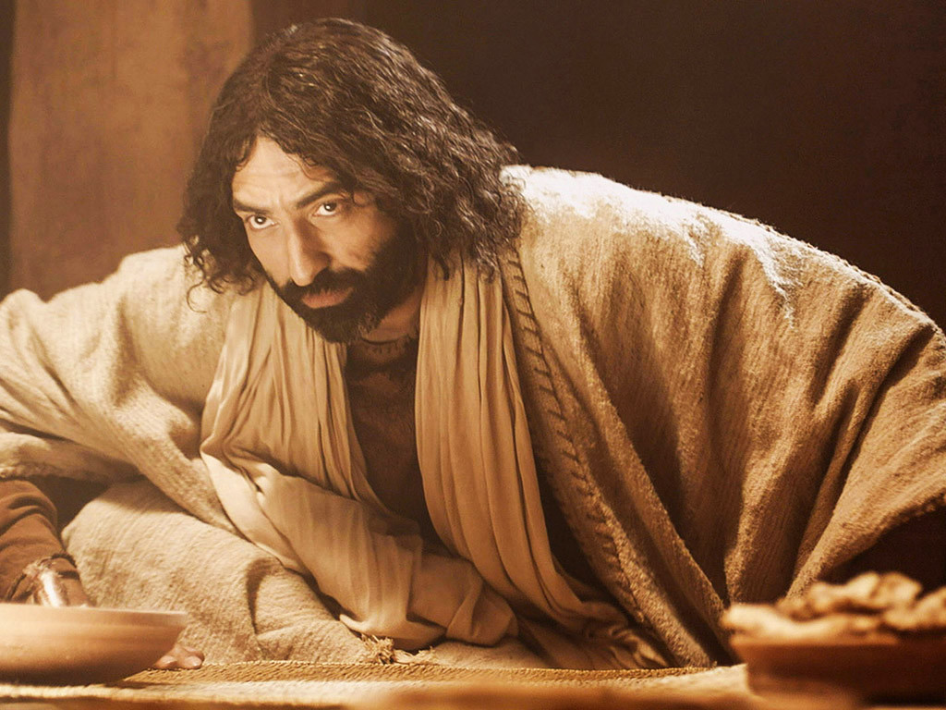
Notes:
Slide 4: Whilst they were waiting, Jesus got up from the table, took off his heavy outer clothing and wrapped a towel around his waist.

Slide 5
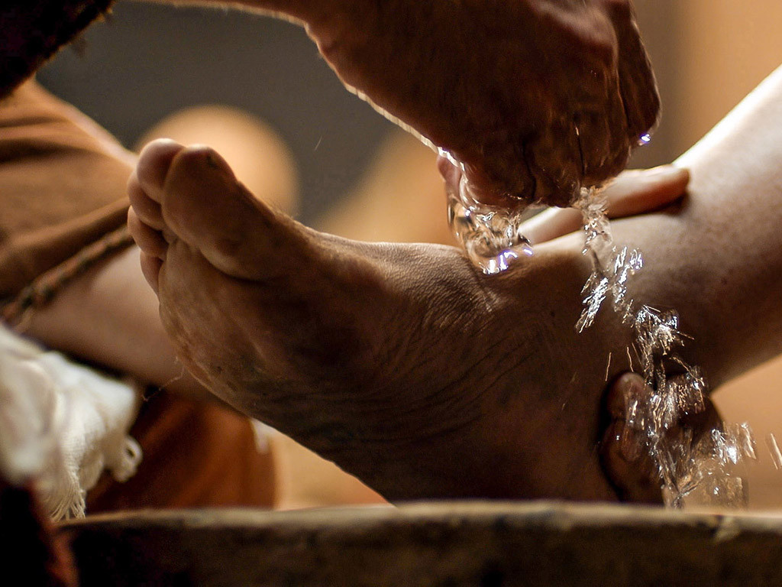
Notes:
Slide 5: He poured water into a basin and knelt down on the floor. Then he began to wash the feet of his disciples,

Slide 6
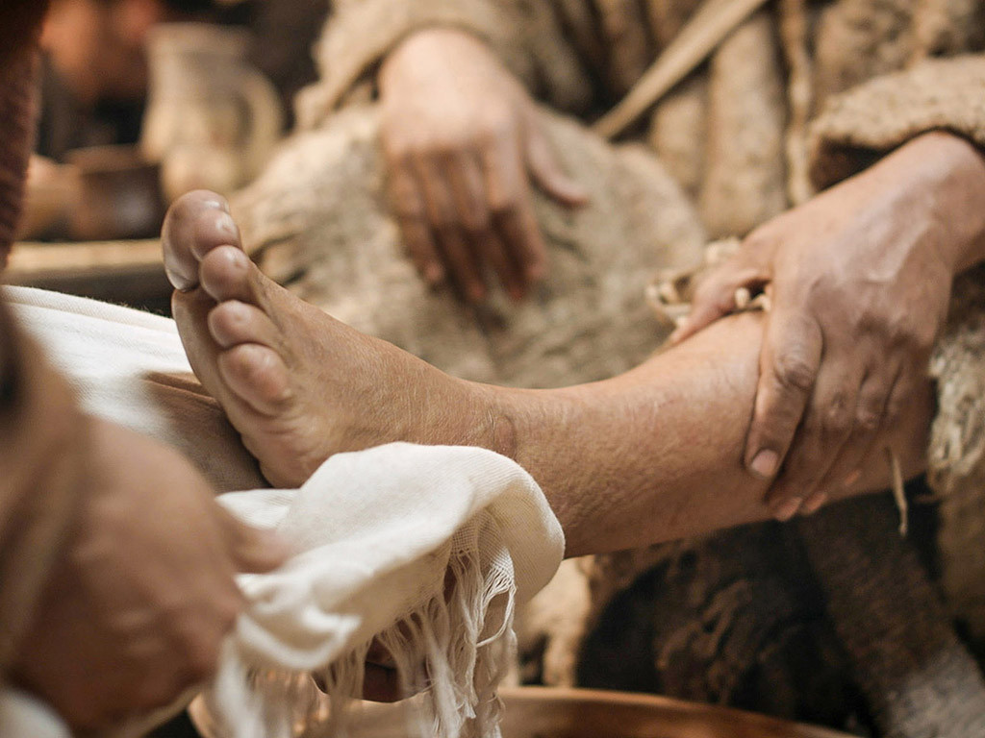
Notes:
Slide 6:….drying them with the towel that was around his waist. The disciples were astonished.

Slide 7
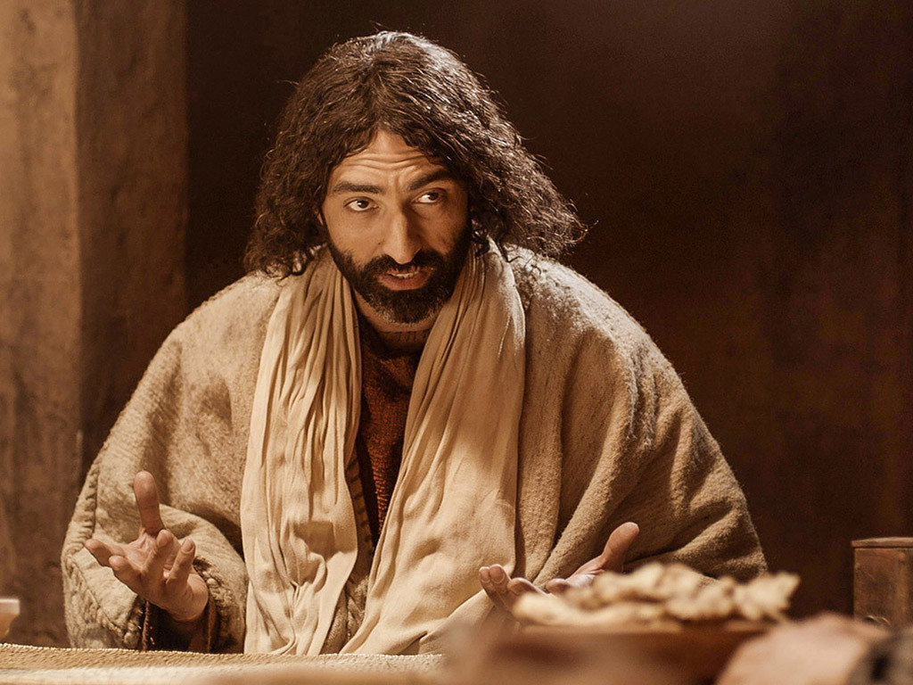
Notes:
Slide 7: Later on, when he had put on his outer clothing again and was sitting once more at the table with them, he asked ‘Do you understand what I was doing for you when I washed your feet earlier?’ No-one answered. ‘I have set you an example of how I want you to treat each other. I, whom you call ‘Master’ and ‘Teacher’, have washed your feet, and I want you to do the same for each other. No-one is too grand or important to serve another. God will bless you if you act in this way.’
Well, did you spot the ‘yucky’ job in the story? That’s right – it was washing feet. Washing someone’s feet in Jesus’ day was a revolting job, because people mostly walked everywhere and their feet got really dusty or really muddy, depending on the weather. They didn’t have baths or showers regularly like you or I, so I expect that their feet got really smelly too!
Usually the job of washing feet was done by a servant. When Jesus washed his disciples’ feet, he was demonstrating that he loved them enough to get down on the floor and clean their dusty smelly feet.

Slide 8
Notes:
Slide 8: So, let’s find out which words from King Solomon’s book of Proverbs we’re thinking about today.

Slide 9
‘We show what we are like by what we do.’ (Proverbs 20:11)
Notes:
Slide 9: ‘We show what we are like by what we do.’
I wonder what you think this means? [talk together briefly, with children giving examples]
How did Jesus do this in the story that we just heard? How did his actions show what he was like?
You might remember in the story that he asked his disciples to do the same: ‘I want you to do the same for each other.’
In many churches on Maundy Thursday, Christians might actually wash each other's feet to show that they want to have this same ‘servant’ attitude. But it’s about more than washing feet!
Jesus showed in how he lived what he wanted his followers to do – having this attitude in their hearts, wanting to serve others.
Let’s think about what this means for us, in our school community this week…..

Slide 10
….I wonder how we might show what we are like in our actions?.....
…..I wonder how this might help us to ‘serve’ others?....
….I wonder how this might change our community?....
Notes:
Slide 10: Responding and words for worship
We’ve heard today how Jesus washed his disciples’ feet to show them how to serve each other. We’ve heard our wise words ‘We show what we are like by what we do.’
Together, these words might help us today….
….I wonder how we might show what we are like in our actions?.....
…..I wonder how this might help us to ‘serve’ others?....
….I wonder how this might change our community?....

Slide 11
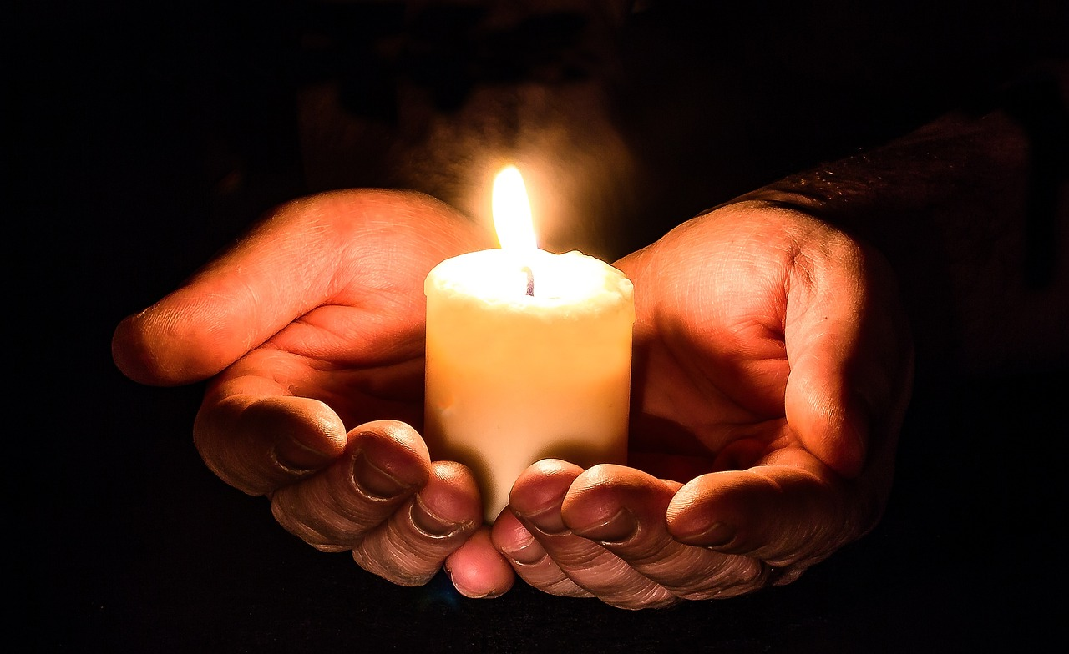
‘We will serve each other.’
Notes:
Slide 11: Reflection and Prayer
In the stillness now, let’s quieten our minds and hearts.
You might want to think about some actions that you can do that show what you are like…..in school, at home, or in our wider community.
I’m going to pray a short prayer which you can join in with if you would like to make it yours, making a commitment to serve each other. There are some words for you, after I say the word ‘God’: ‘We will serve each other.’

Slide 12
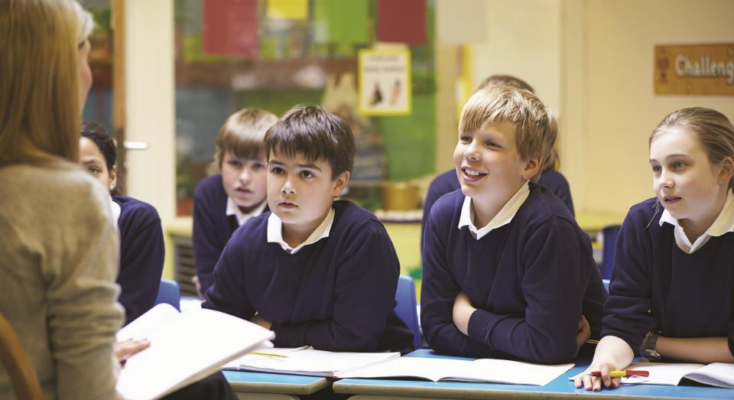
‘We will serve each other.’
Notes:
Slide 12: In our school, God: ‘We will serve each other.’

Slide 13
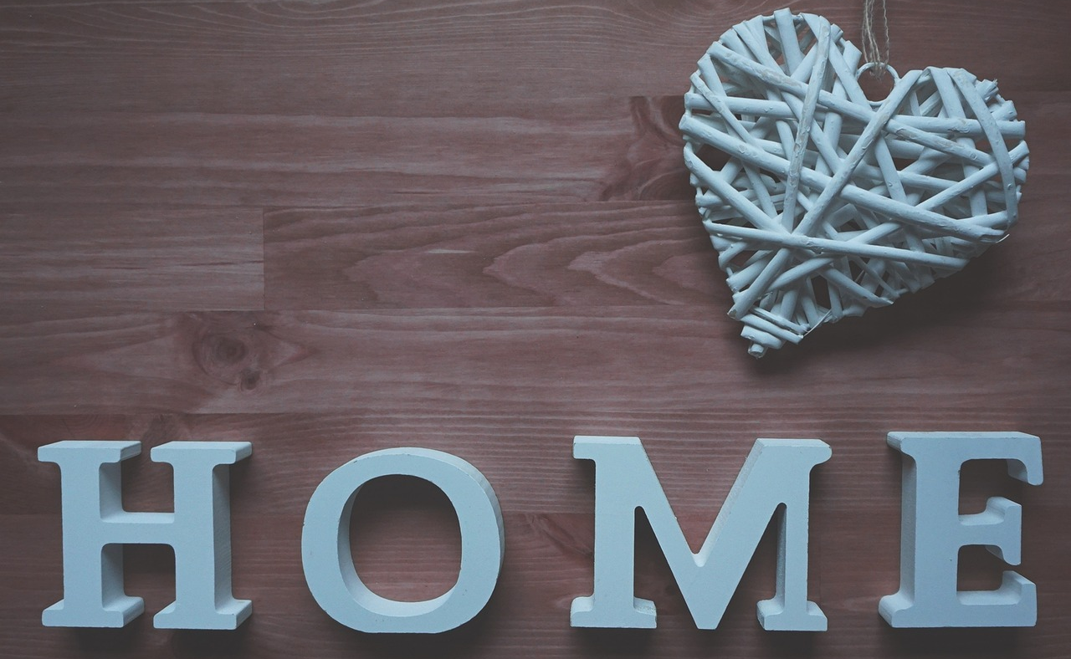
‘We will serve each other.’
Notes:
Slide 13: In our homes, God: ‘We will serve each other.’

Slide 14
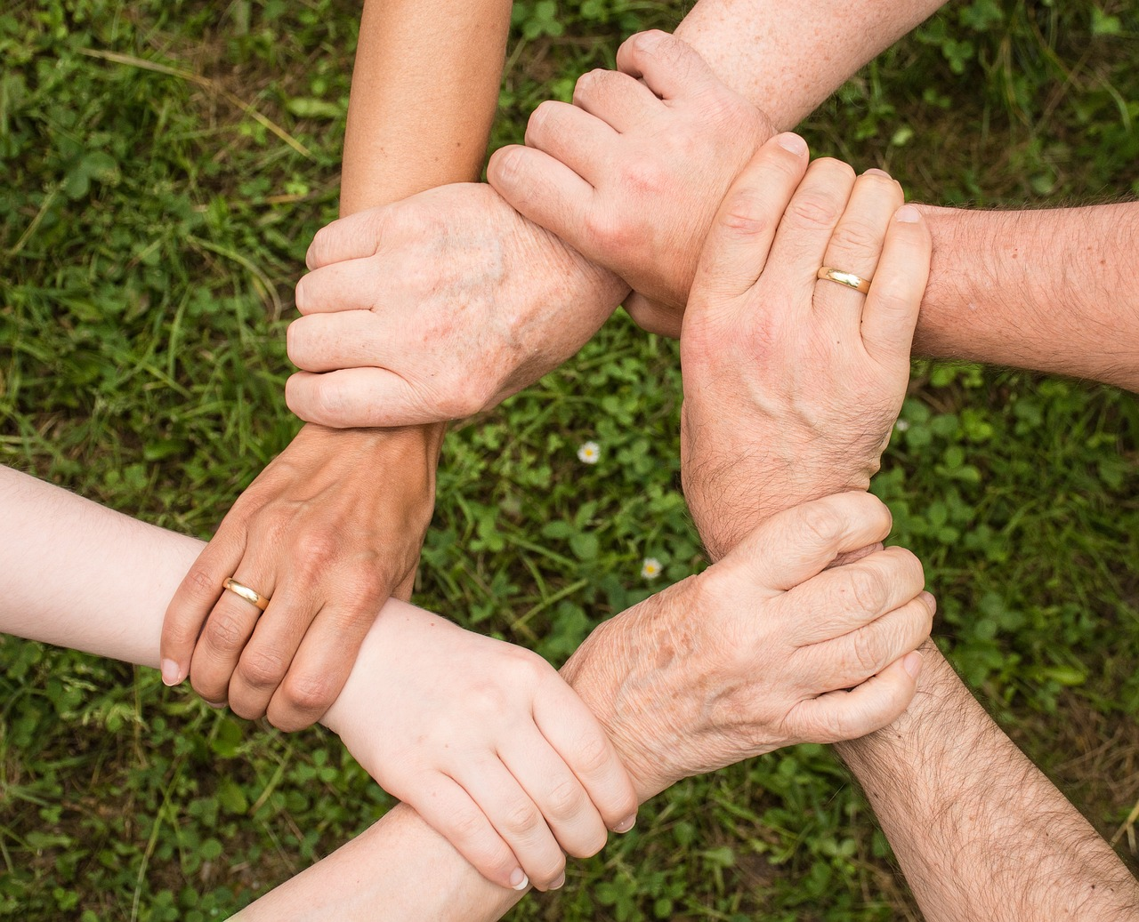
‘We will serve each other.’
Notes:
Slide 14: In our community, God: ‘We will serve each other.’

Slide 15
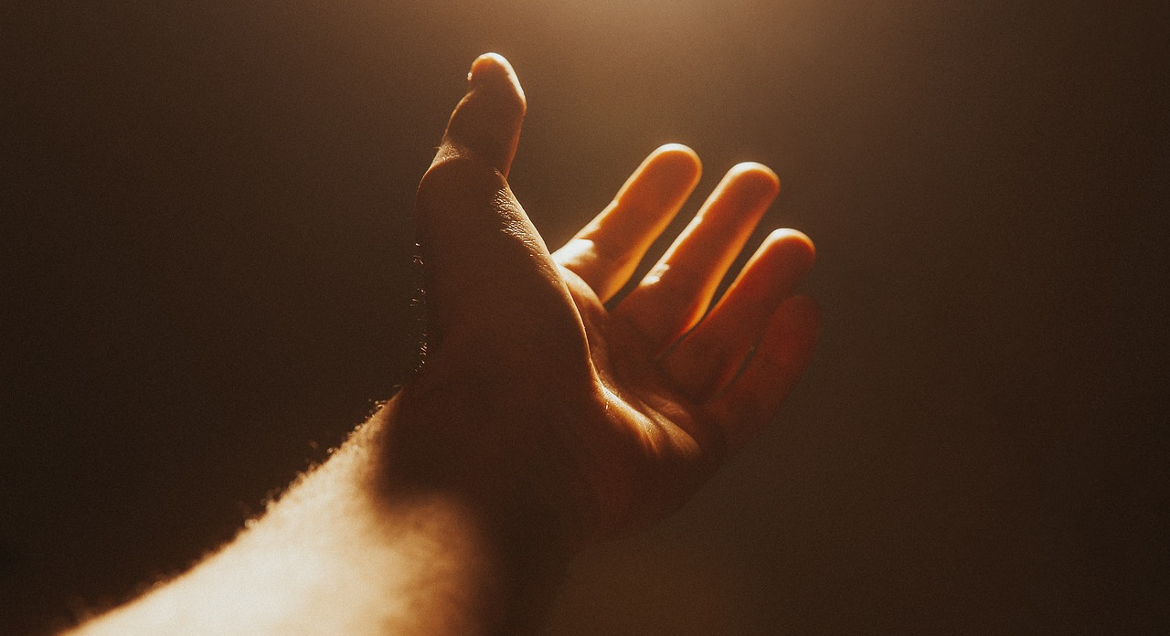
‘We will serve each other.’
Notes:
Slide 15: In our lives, God: ‘We will serve each other.’

Slide 16
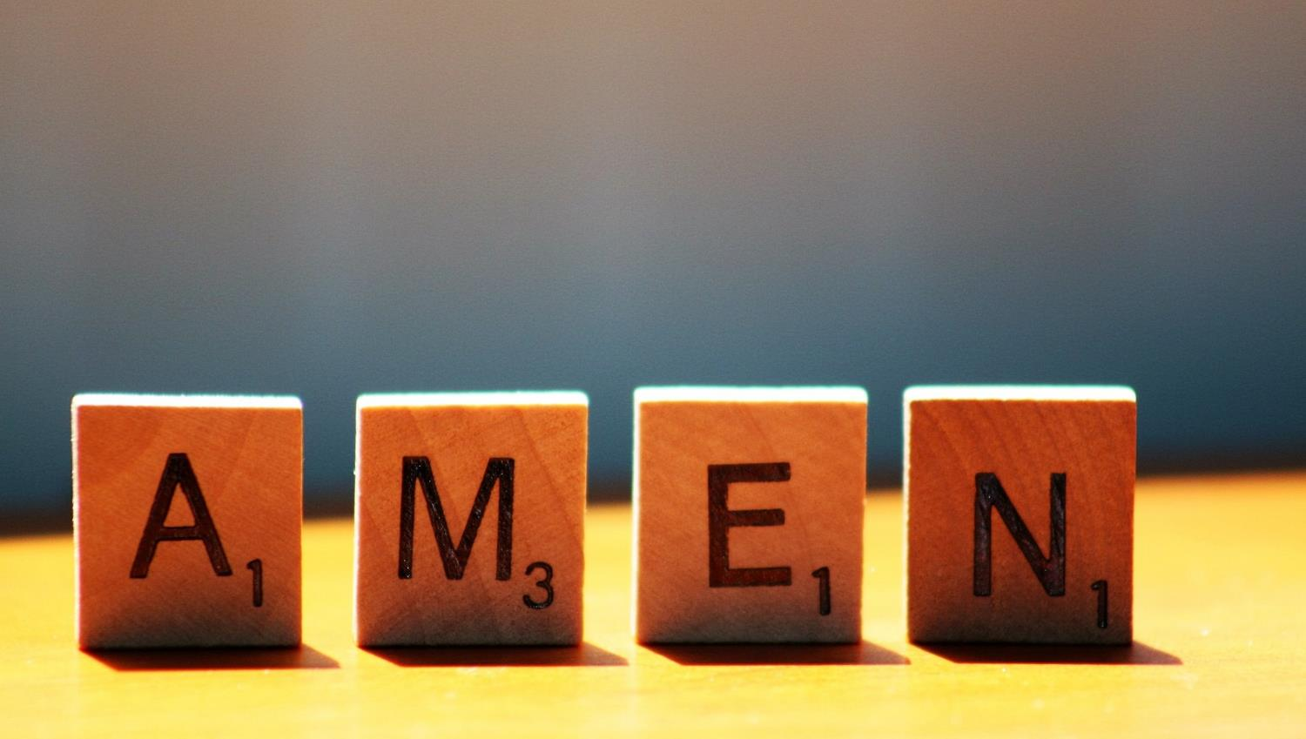

Slide 17
Leader: As we leave this place & time and go into the day ahead…
All: May today’s words help us to make wise choices.

Slide 18
Notes:
Reflective prayer activity:
There are many parts of our world that are not very peaceful at the moment.
Use a zip to help you to pray for places where peace is needed.
Or use the zip to help you pray for people who you know who have argued.

