Slide 1
Leader: As we share these stories of leaders…
ALL: May we follow their example
in thoughts
and words
and actions.
Notes:
Leader: As we share these stories of leaders…
ALL: May we follow their example in thoughts and words and actions.
Signs for greeting: click on links
Thoughts: British Sign Language BSL Video Dictionary - thought (signbsl.com)
Words (use 3rd definition): British Sign Language BSL Video Dictionary - word (signbsl.com)
Actions: British Sign Language BSL Video Dictionary - action (signbsl.com)

Slide 2
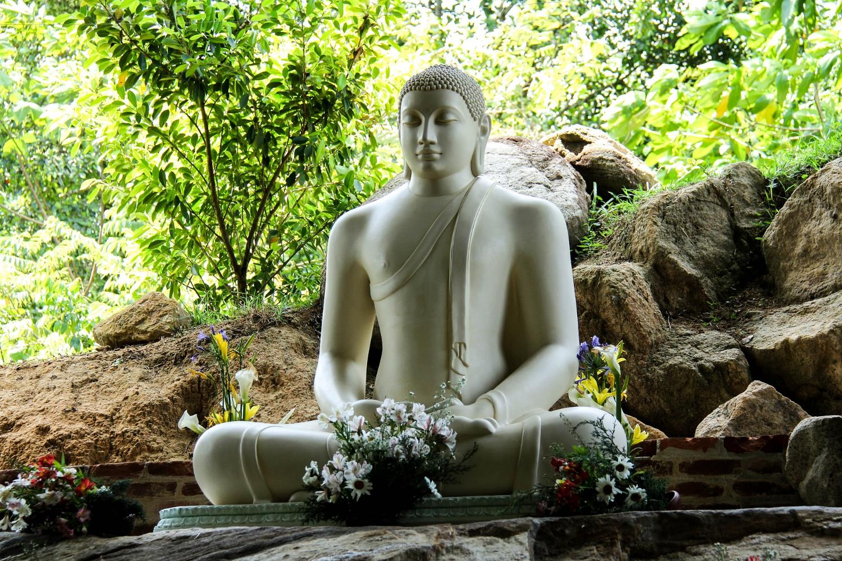
Dharma Day: 3rd July 2023
Notes:
Slide 2: Dharma Day: Today / 3rd July is a special celebration in many Buddhist countries – a celebration called Dharma Day. Buddhism is a religion that started far across the world in countries like China and Tibet, but there are Buddhists in countries all over the world. Dharma Day remembers the time when the Buddha – the first wise teacher of Buddhism – taught his first followers.

Slide 3
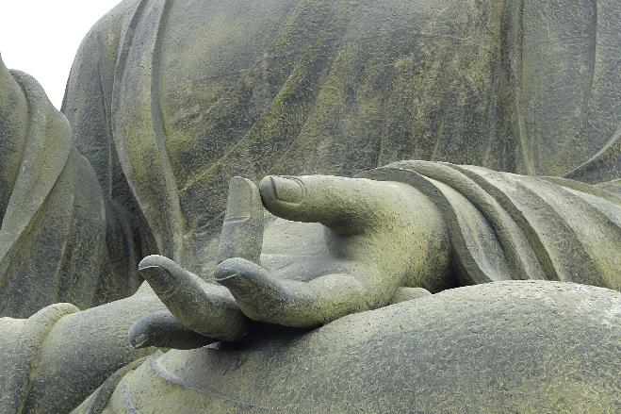
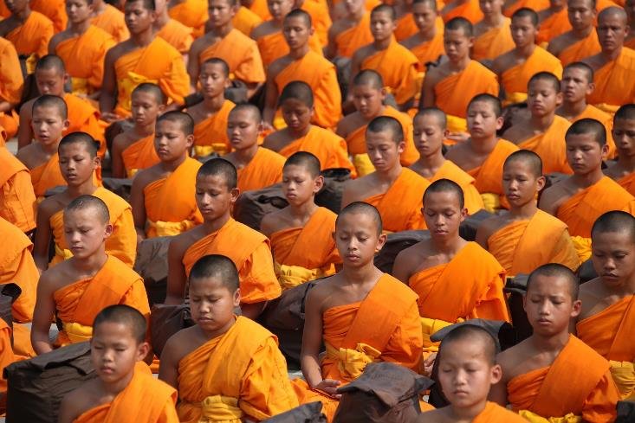
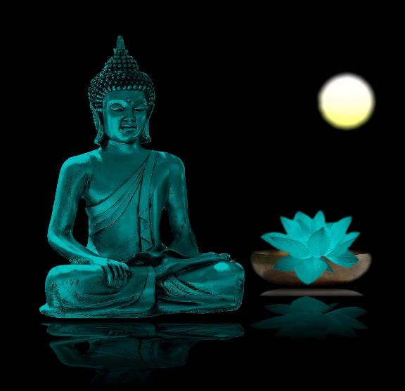
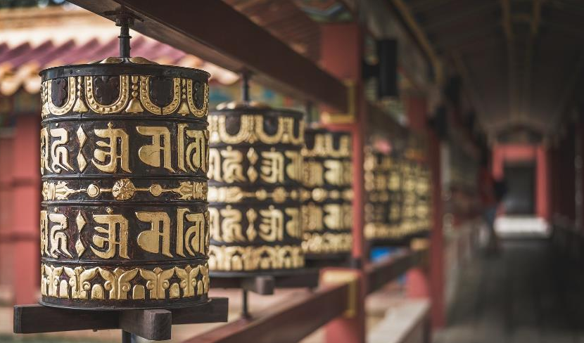
Dharma Day: 3rd July 2023
Notes:
Slide 3: Here are a few photos from across the world, to help to picture what life might be like for Buddhist people……I wonder how these pictures make you feel?...

Slide 4
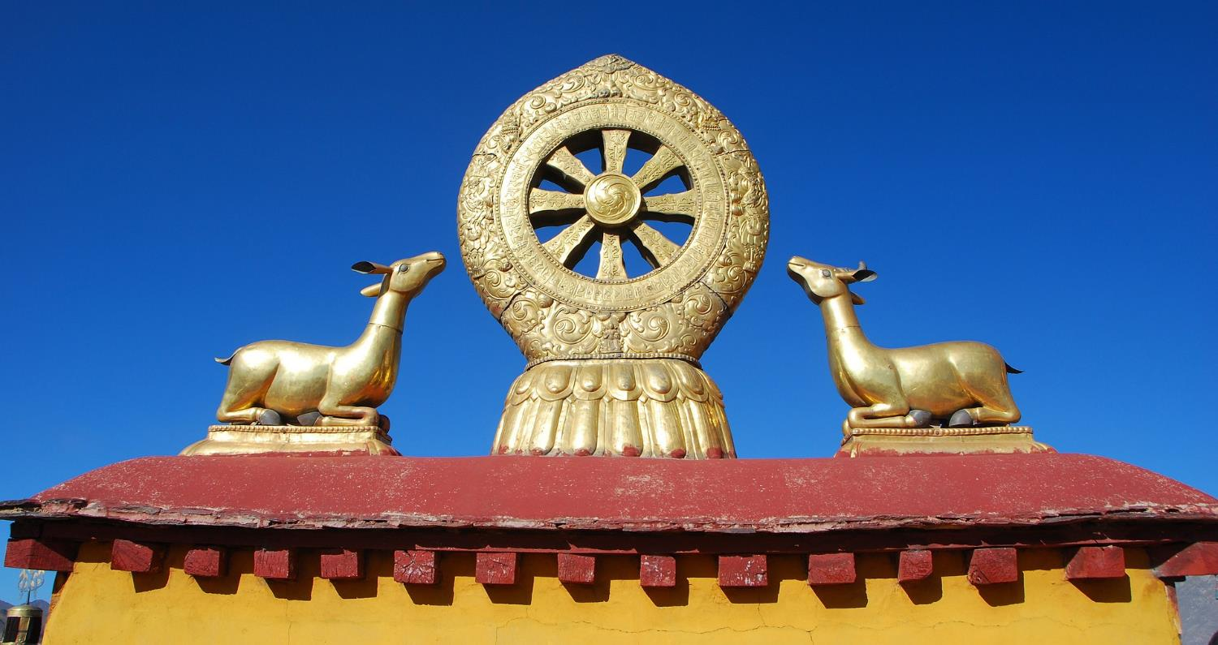
Dharma Day: 3rd July 2023
Notes:
Slide 4: One of the symbols of Buddhism is this – a wheel that symbolises the teachings that Buddhists live by. Dharma Day is also called the ‘festival of the first turning of the wheel’ – because it remembers the day that this teaching started – when the wheel started turning, if you like. Buddhists all over the world will think today about the teachings of the Buddha.

Slide 5
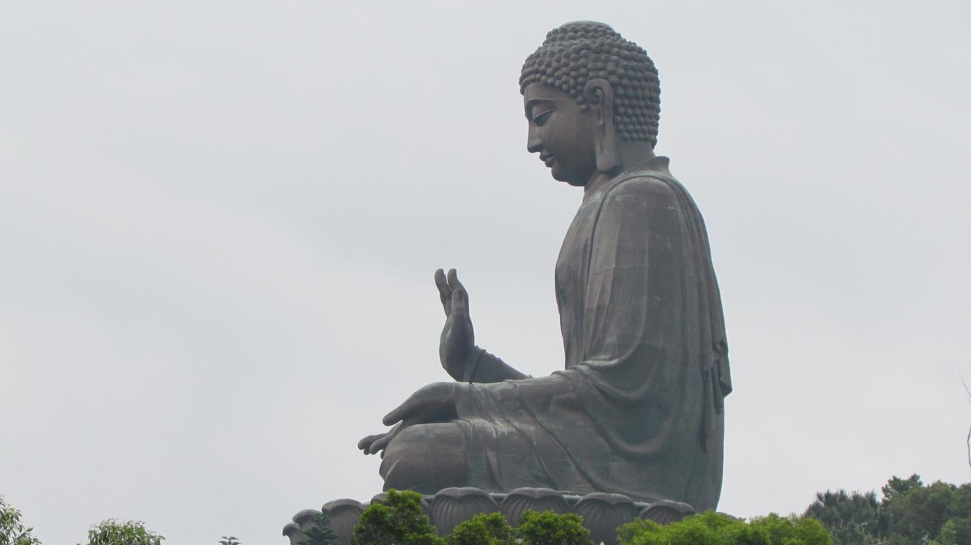
‘Happiness will never come to those who don’t appreciate what they already have.’
Notes:
Slides 5-9: So, let’s hear a few of Buddha’s wise words now – and then we’ll turn our thinking to our own school community, and our own wise teachers!…. [use the words and spend a few moments on each, thinking together about what they might mean, if it’s not obvious]

Slide 6
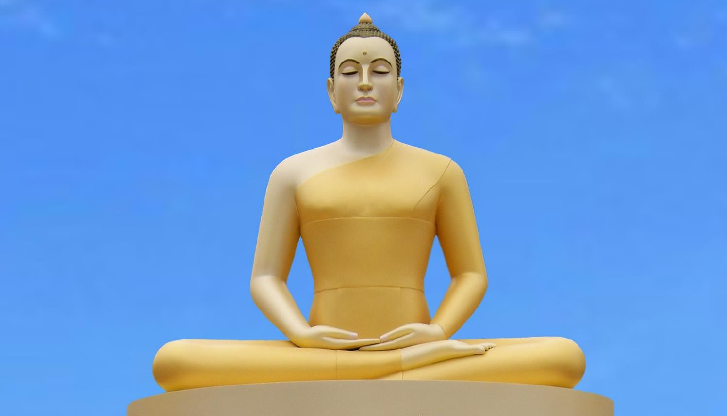
‘Every morning we are born again. What we do today is what matters most.’

Slide 7
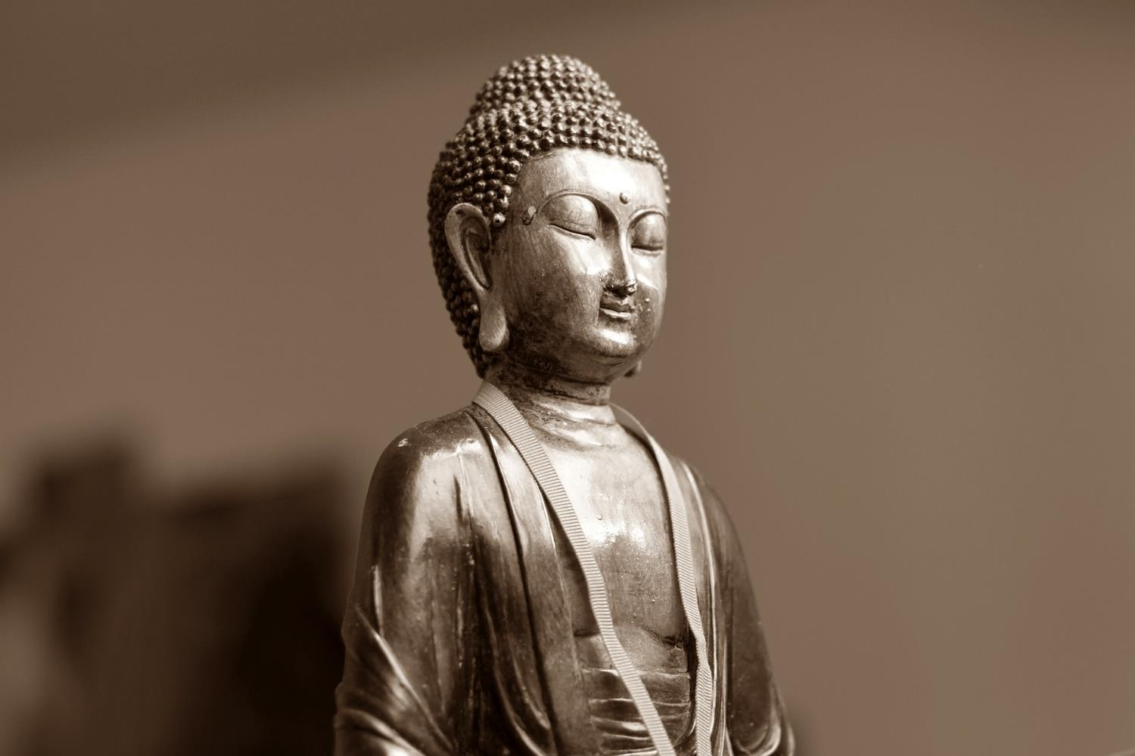
‘Generosity brings happiness.’

Slide 8
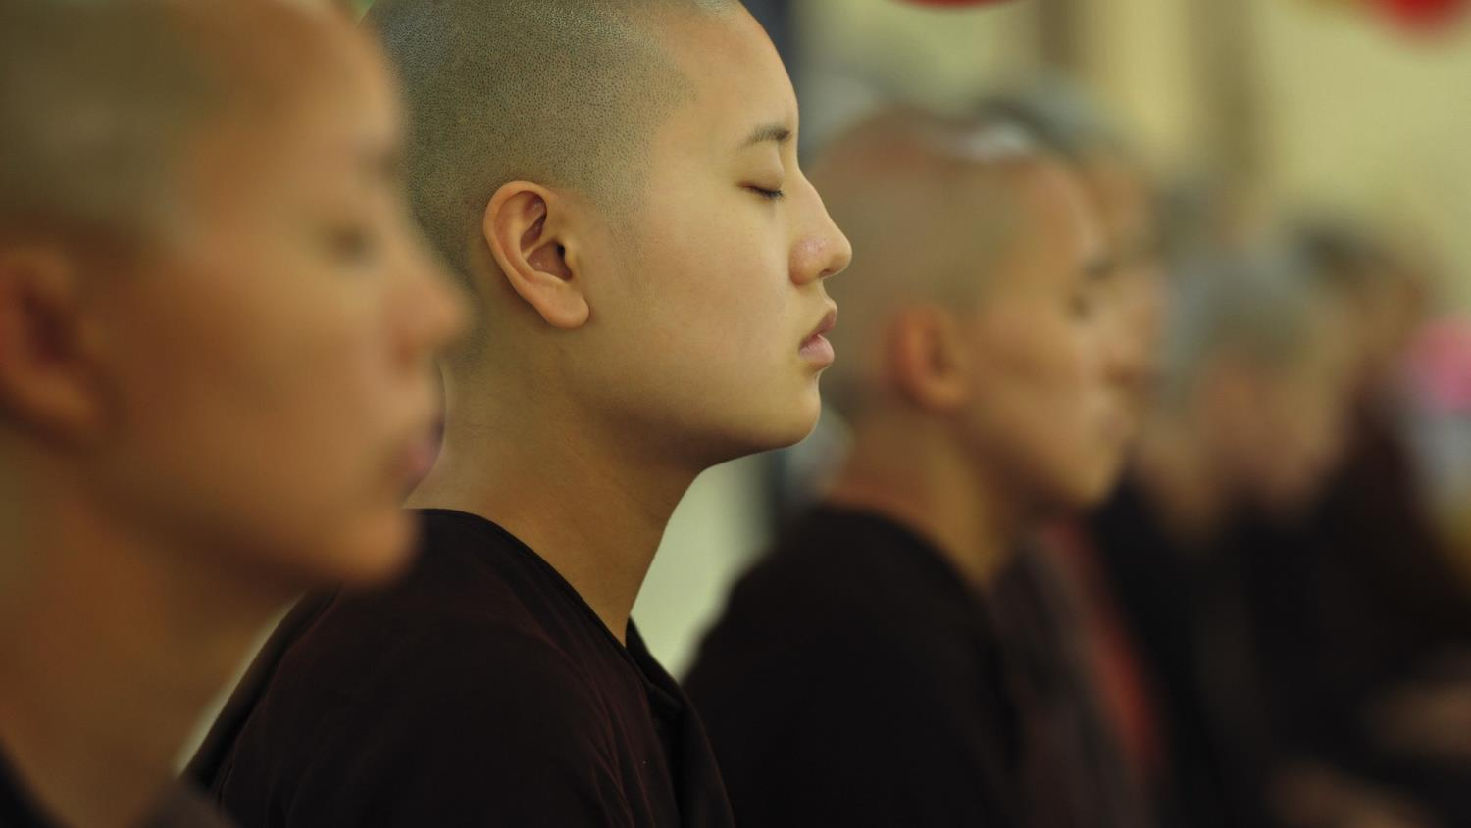
‘Train your mind to see good in everything.’

Slide 9
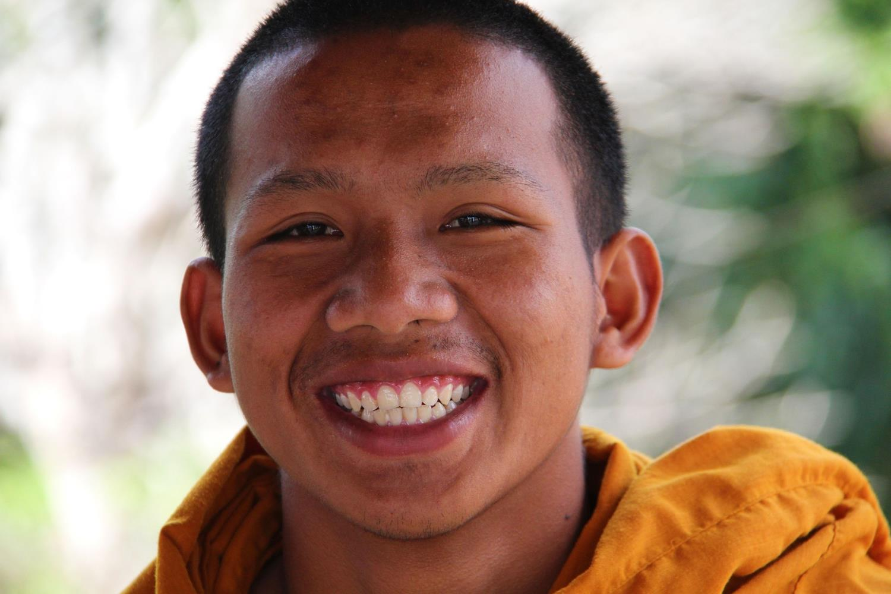
‘A smile is the way to solve many problems.’

Slide 10
Teachers
Notes:
Slide 10: On Dharma Day, Buddhist people will also be thinking about and being grateful for the wise teachers who have taught them. So, what better day for us to look back across the year, and be grateful for our teachers, and some of the things they’ve taught us?! [You may like to put your own personal story here, about a teacher who really had an impact on your life]
I don’t know how many of you have ever really thought about the many different things that a teacher does, but there’s so much more to being a teacher than just teaching you. Ask your teacher – they’ll soon tell you!
On our screen, we’ve got some more wheels that are going to help us to think of things that we might be grateful to our teachers for. As we look at what each says, have a quiet think to yourself – and I might even ask a few of you to tell us what you were thinking!

Slide 11
something new your teacher taught you
Notes:
Slides 11-14: Go through the wheel headings, allowing as many children as you have time for to respond. After this assembly, you might like to take the chance to show your gratitude to your teachers for some – or all – of the things you thought about. But for now, let’s take the chance to reflect together.

Slide 12
a time your teacher was there when you felt sad

Slide 13
a time your teacher helped you solve a problem

Slide 14
a time your teacher made you laugh

Slide 15
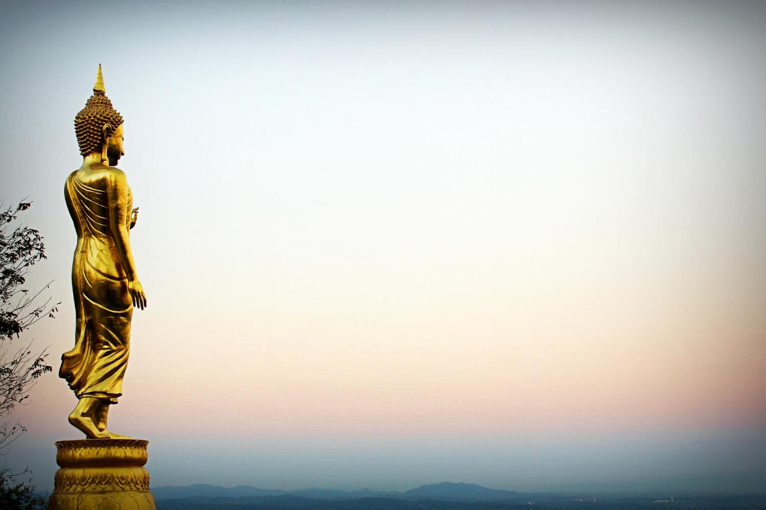
…. I wonder why it’s important that we take time to be grateful?...
….I wonder how we might show our teachers that we are grateful to them?....
…. as we near the end of another school year, I wonder how they are feeling.....and how we might make their lives just a little bit easier?....
Notes:
Slide 15: Responding (words for worship):
….so in the stillness of this moment, let’s spend some time wondering together…..
….we have heard today about Dharma Day, and some wise words of the Buddha….
….I wonder which words were helpful to you?....
…on Dharma Day, we’ve thought about the importance of our teachers in our school community….
….and the things that we are grateful for about them….
….I wonder why it’s important that we take time to be grateful?.....
….I wonder how we might show our teachers that we are grateful to them?....
…as we near the end of another school year, I wonder how they are feeling?.....
…and how we might make their lives just a little bit easier?....
….listen to some more wise words now, written by St. Paul to some very weary people…..

Slide 16
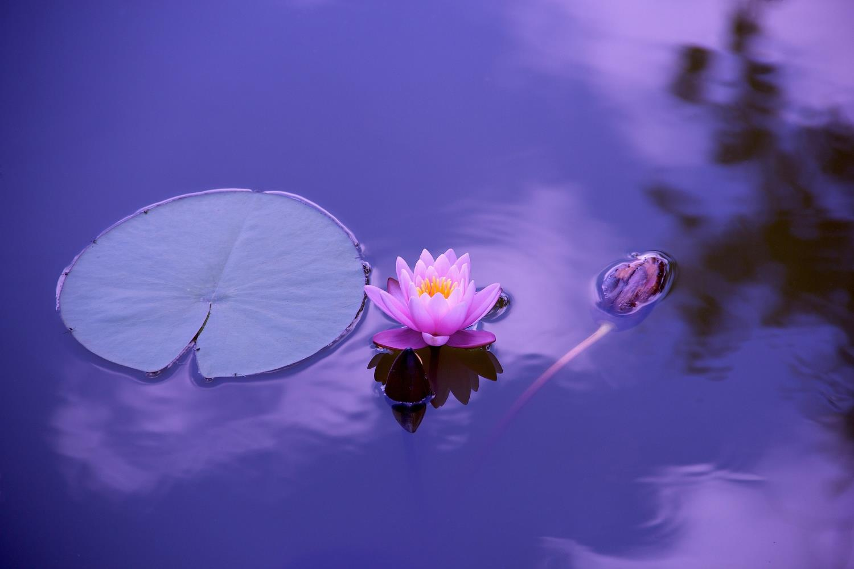
‘We must not become tired of doing good.
We will receive our reward at the right time. We must not give up!
[Paul’s letter to the Galations ch6v9]
Notes:
Slide 16: ‘We must not become tired of doing good.
We will receive our reward at the right time. We must not give up!’
….I wonder how these words might be helpful to us, and to our teachers?....

Slide 17
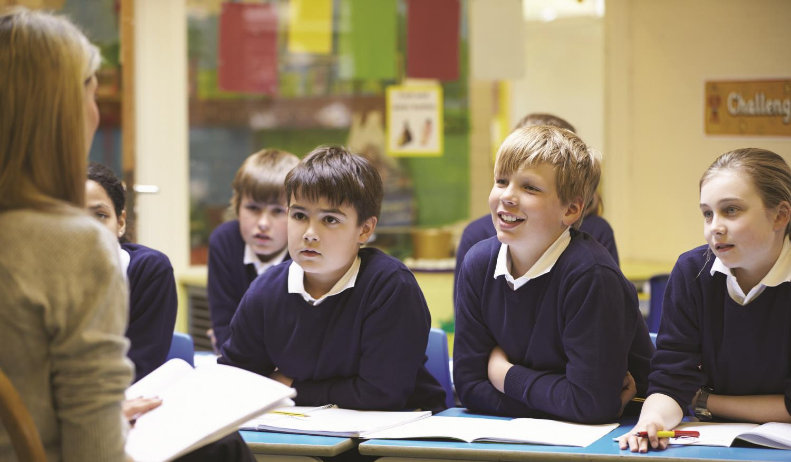
‘…we thank you God’
Notes:
Slide 17: I’m going to pray now, and ask God to bless our teachers as we draw near to the end of a busy term – and school year. They all deserve a break! As we pray, you might want to think back to the thoughts you had about your teacher this year when we were talking about the wheels….
Join me if you’d like to at the end of each line of the first part, by saying ‘WE THANK YOU, GOD.’
Prayer:
For all that our teachers have done for us – WE THANK YOU, GOD.
For the new things they have taught us – WE THANK YOU, GOD.
For the problems they have helped us to solve – WE THANK YOU, GOD.
For the times of fun and laughter – WE THANK YOU, GOD.
We are near the end of a busy year, and ready for a break – WE THANK YOU, GOD.
Give our teachers a happy end to the term, with the reward of good holidays filled with rest and relaxation, and time to be with their families.
Bless them, we pray.

Slide 18
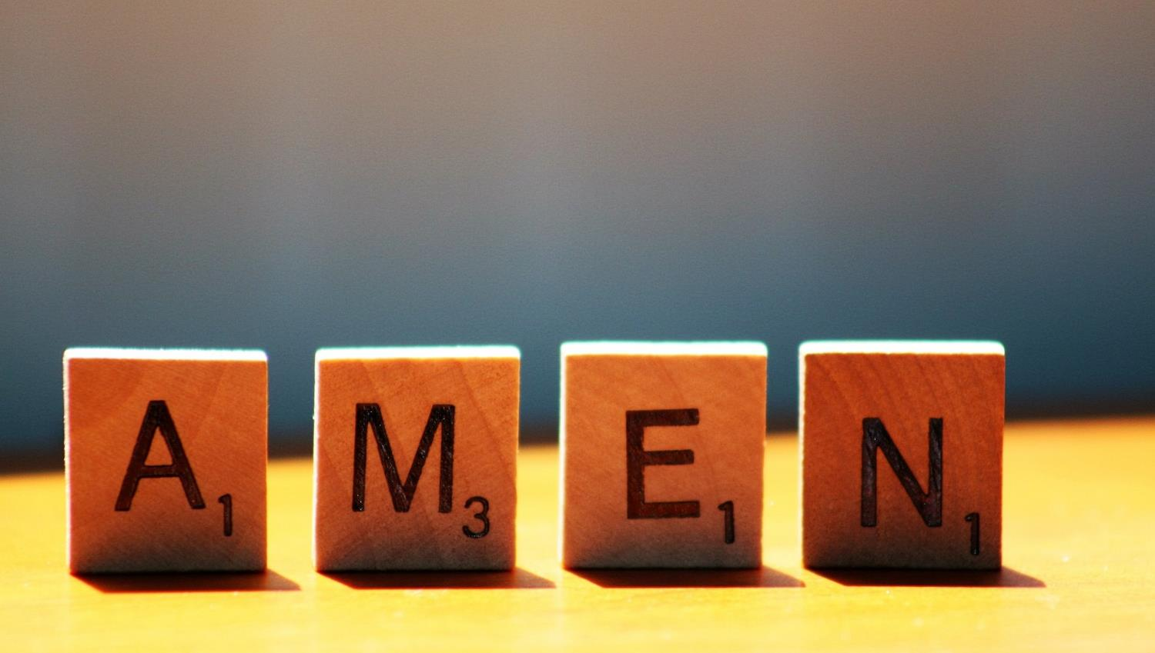

Slide 19
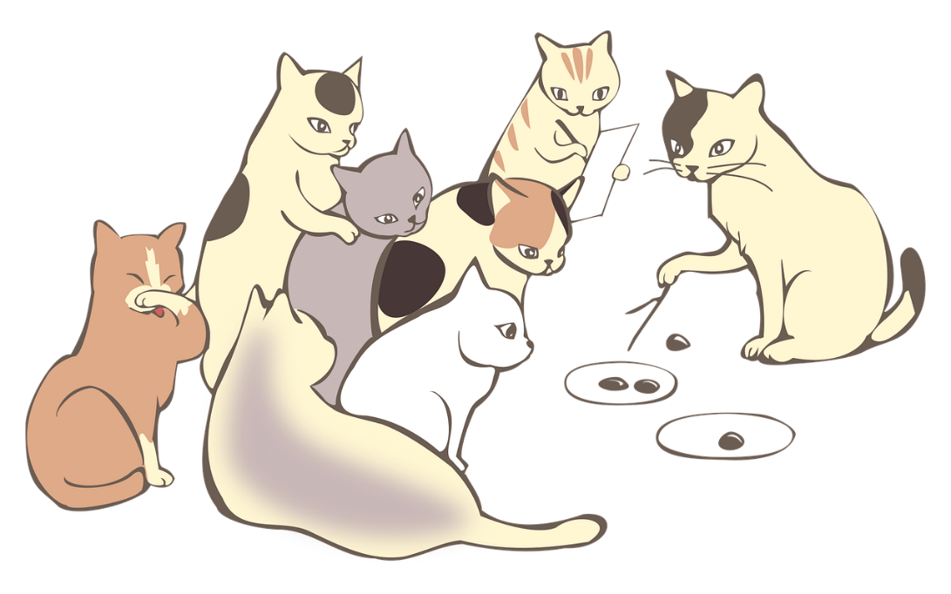
Leader: As we leave this place & time and go into the day ahead…
All: …may today be a special day for all our teachers!

Slide 20
On a lotus flower, write or draw something you are grateful to your teacher for. Fold in the petals and float it on the water…..

