Slide 1





We are here together in our school family. May God be with us…
...and watch over us.
Notes:
Slide 1: Use these new gathering words for this term, or your usual greeting if you prefer.

Slide 2
Beginning
…or end?
Notes:
Slides 2-8: Beginning or end? Ask children to help you decide whether the picture you show is a beginning or an ending (answers are in the notes section under the slide!) This game may generate some conversation and dispute, but don’t worry, this all adds to the point you will make later! Let’s begin with something easy….

Slide 3
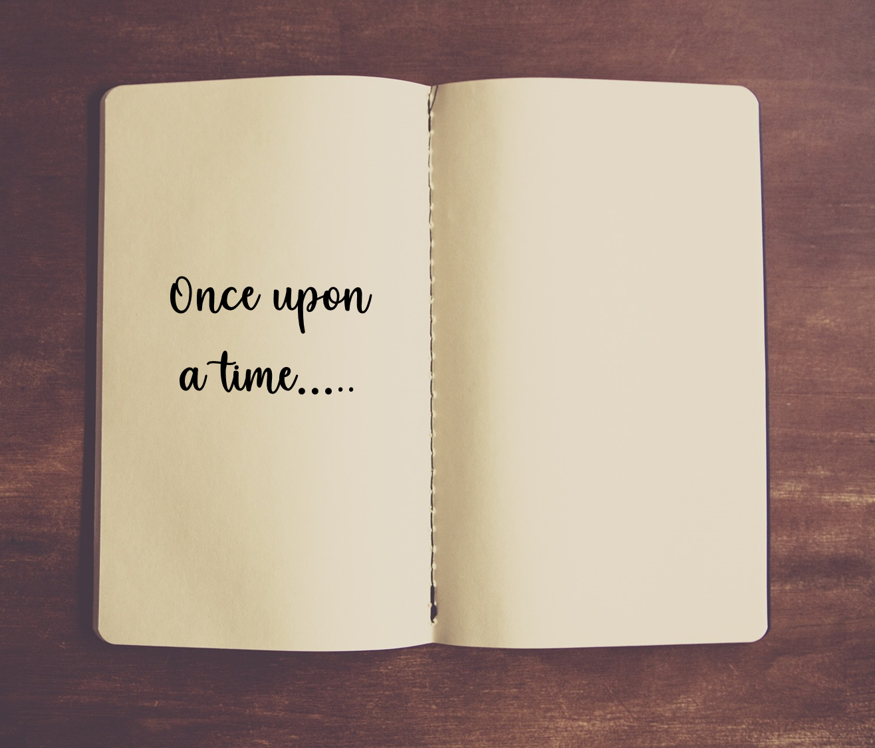
Notes:
1. Quite clearly, it’s the beginning, because the end would be…..

Slide 4
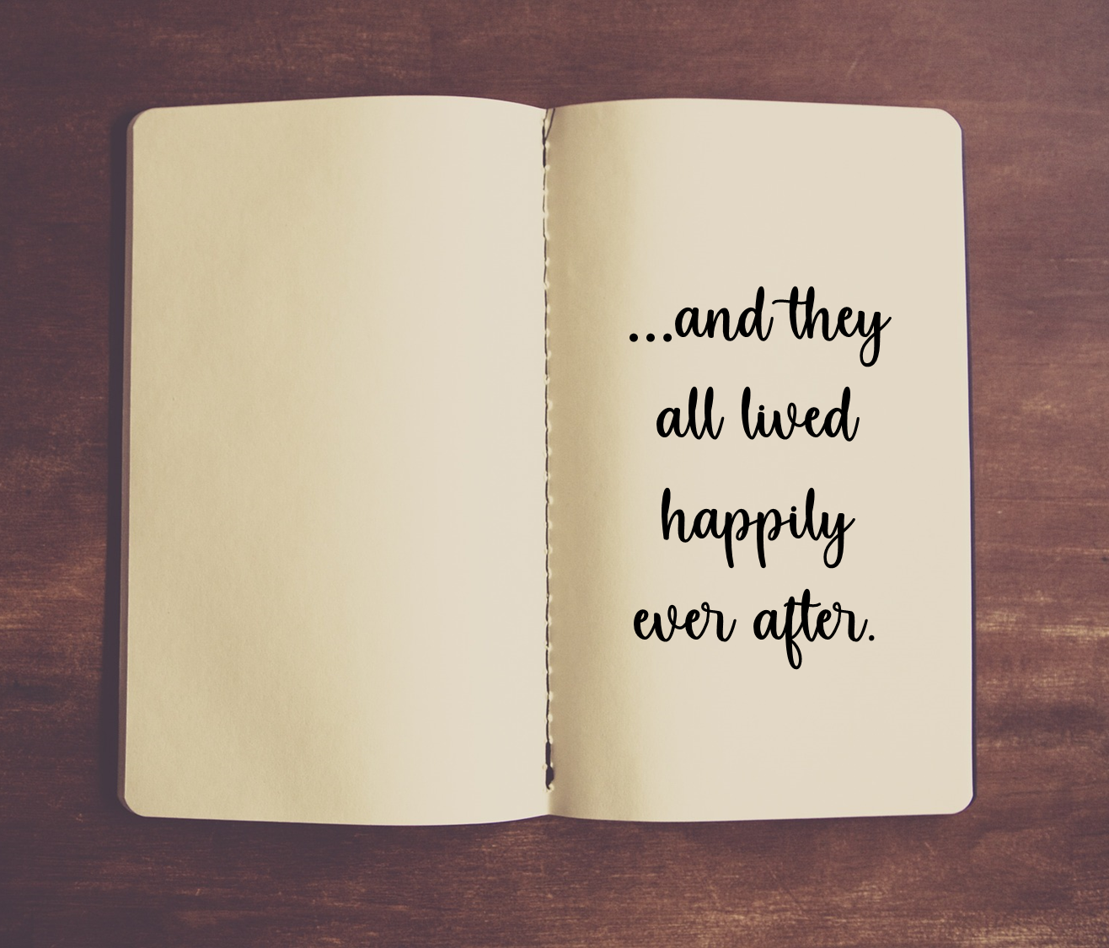

Slide 5

Notes:
2. Is this a beginning or and end?
Beginning – the ingredients for…..

Slide 6
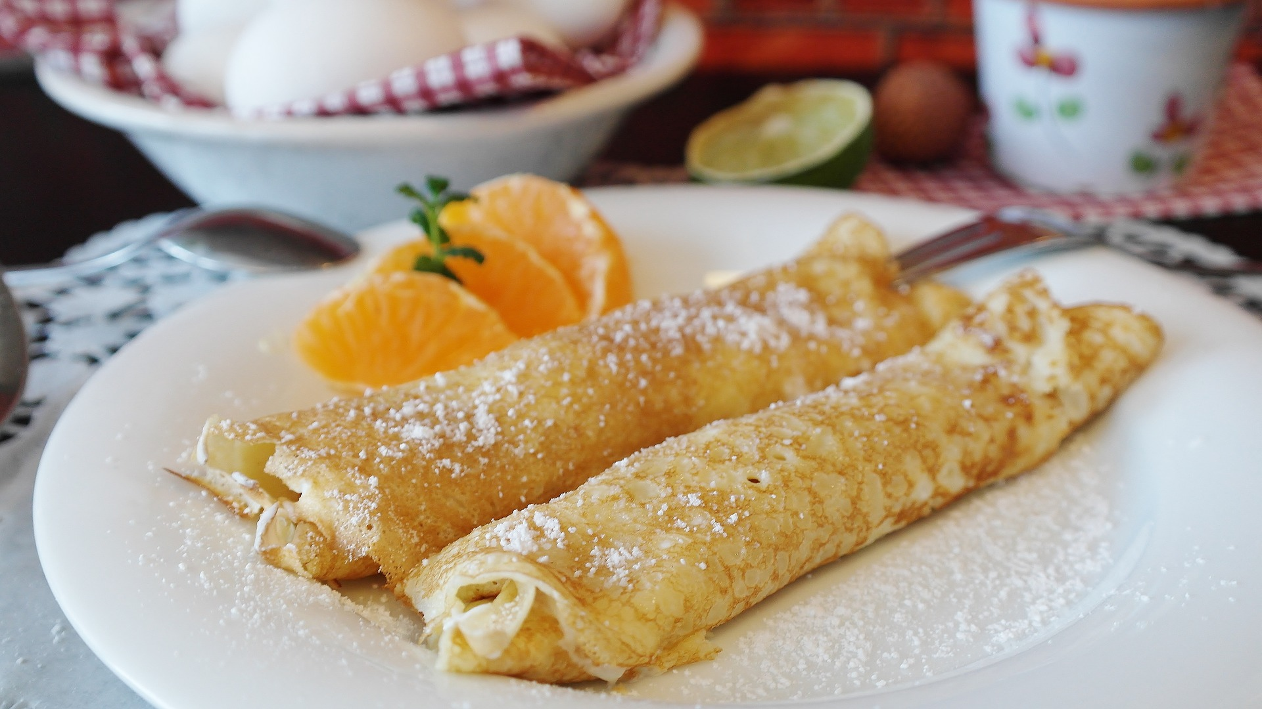
Notes:
….Pancakes! (which are the end!) Or are they….? Maybe the end would be an empty plate and a happy tummy!

Slide 7
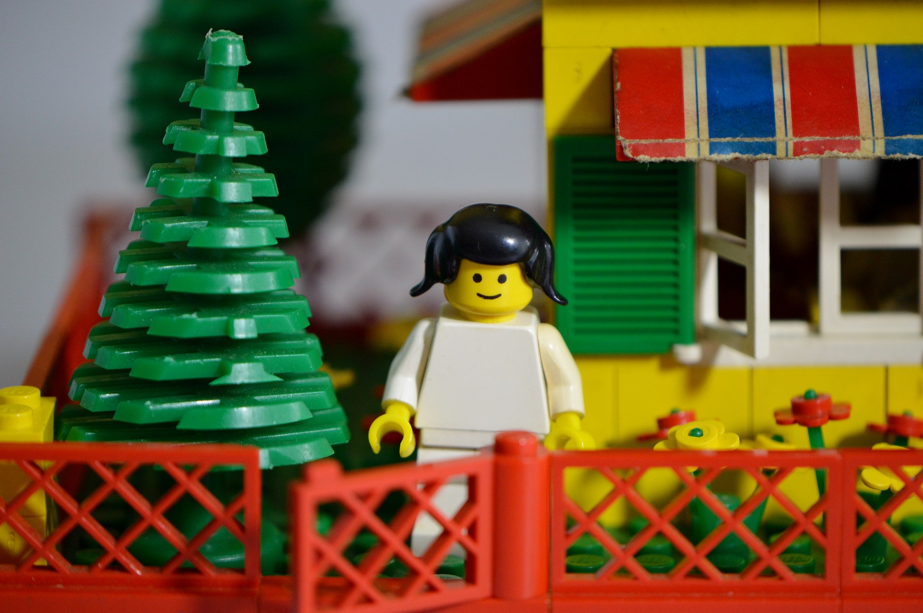
Notes:
2. Is this a beginning or and end? A Lego house…..
…The end

Slide 8
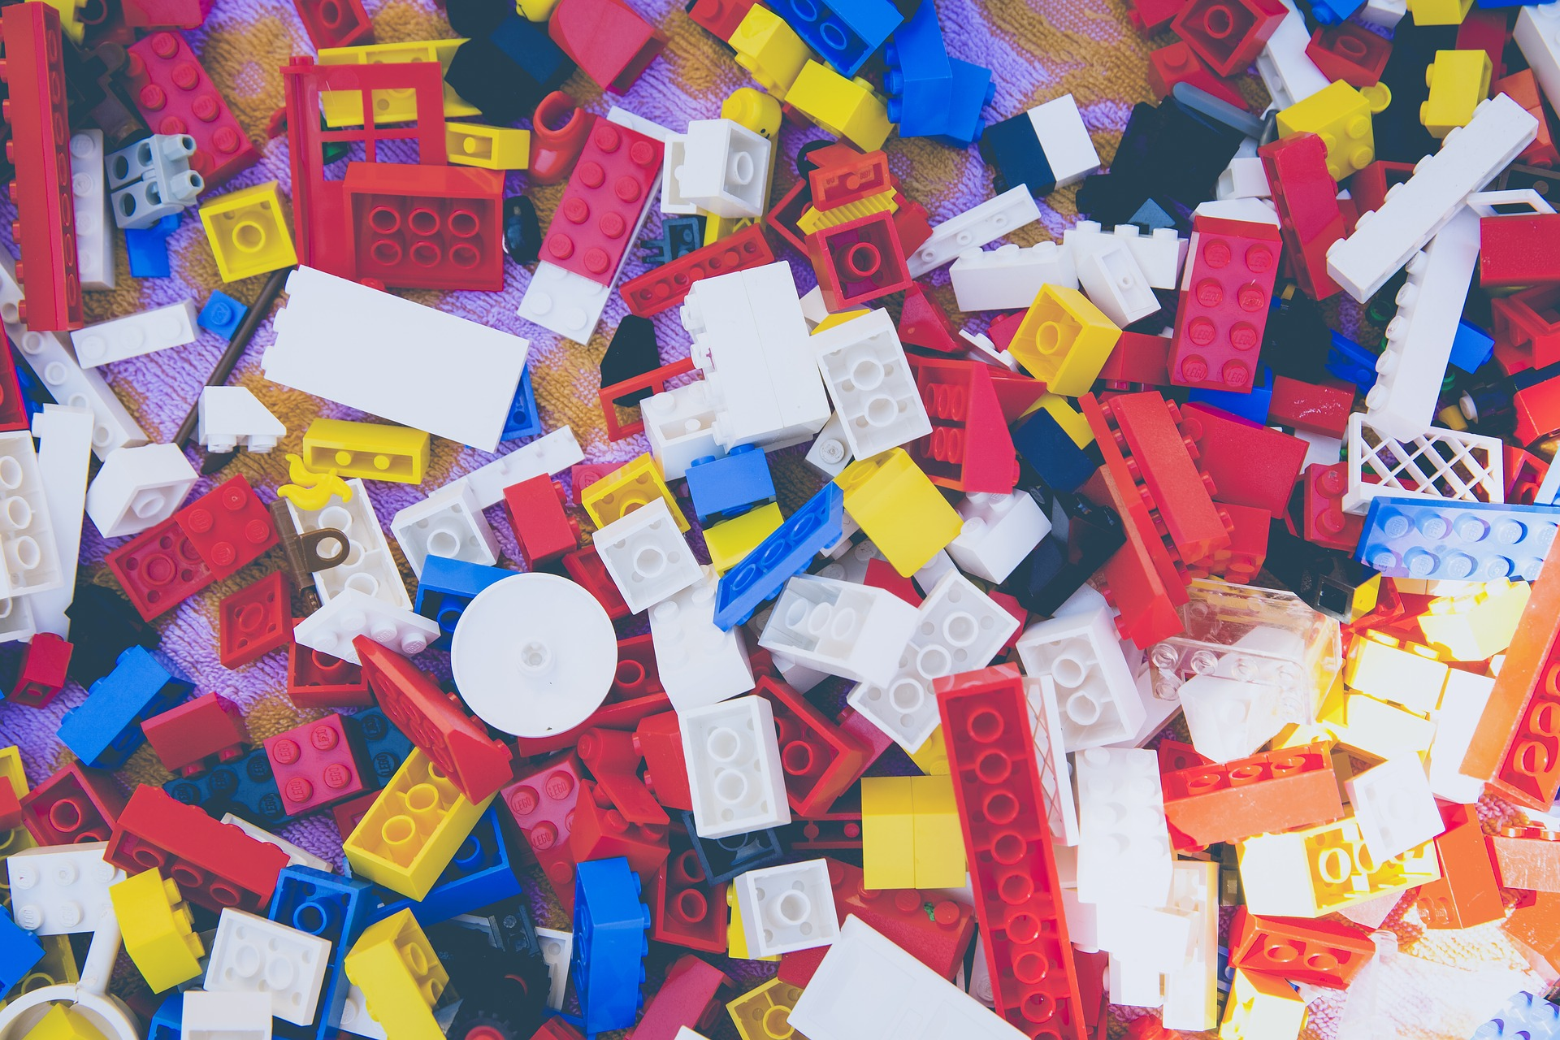
Notes:
….because this is how it starts! (Or again, maybe it ends here after you break it all up!)

Slide 9
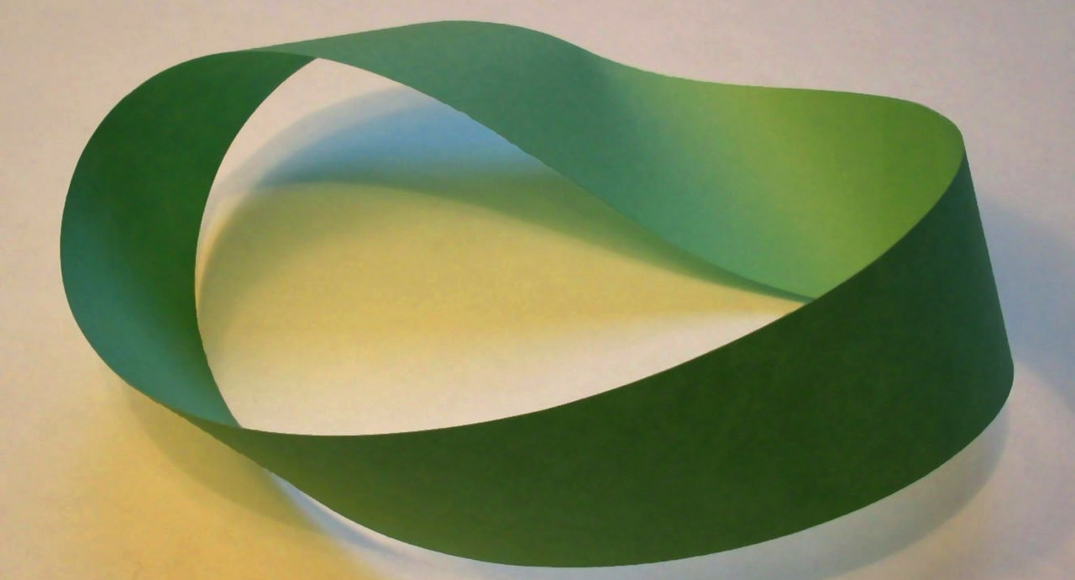
The Möbius strip

Slide 10

The Lord’s Prayer
Notes:
Slide 10: “We’ve been thinking this term about the prayer that Jesus taught to his disciples to help them to pray – and been learning what this means to Christians, as well as thinking about how the ideas might help us to live our lives. We have reached the very end of this prayer now, and almost the end of the term too, so let’s look at how it finishes together:

Slide 11
Our Father in heaven,
Hallowed be your name
Your kingdom come, Your will be done on earth, as it is in Heaven.
Give us today our daily bread.
Forgive us our sins,
As we forgive those who sin against us.
Lead us not into temptation,
But deliver us from evil.
For the Kingdom, the power and the glory are yours, now and forever.
Amen
Notes:
Slide 11: ‘For the Kingdom, the power and the glory are yours, now and forever, Amen.’ Do these words remind you of anything?....

Slide 12
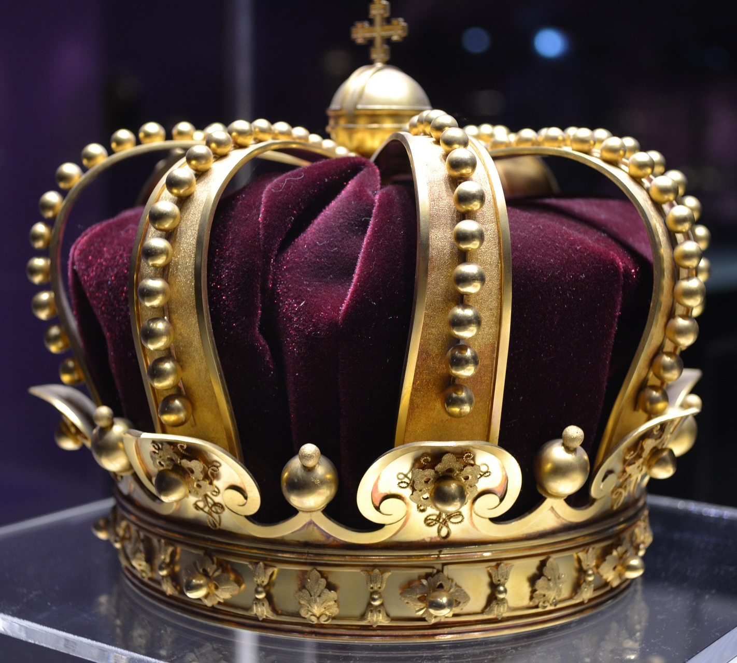
Notes:
Slide 12: Do you remember back to the very start of the term, when we thought about ‘Our Father in heaven’ and ‘Your kingdom come’…? Isn’t it interesting that the end of this prayer reminds us of the beginning?!

Slide 13
God is eternal
Notes:
Slide 13: Christians believe that God, his power, his glory, his kingdom – as well as his love – are eternal: they last forever and ever. Like the Möbius strip, God has no beginning or end, though he was there at the beginning of time and will be there at the end of time. In fact, one of the names that Christians have for God is…

Slide 14
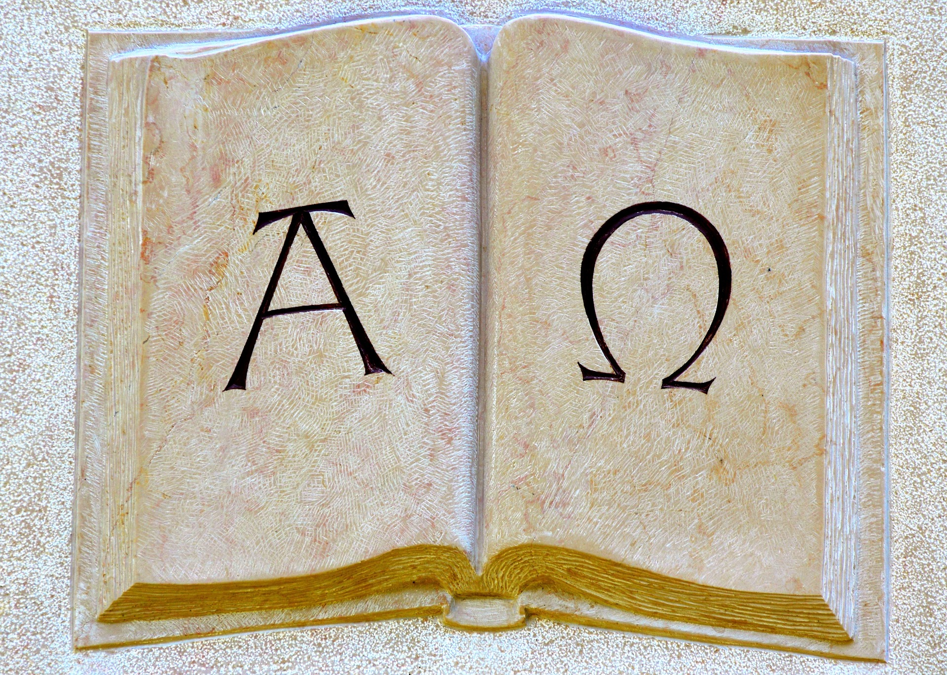
Notes:
Slide 14: …Alpha and Omega (which are the first and last letters of the Greek alphabet). Christians believe that God is the beginning and the ending, and the never-ending, all at the same time! Now that’s a very great mystery!!
As we come towards the end of our time together today we’re going to find one last picture to help us to think….and it’s very appropriate that it is from the very end of the Bible, from a book of visions (or pictures from God) given to John, one of Jesus’ disciples, when he was a very old man. In this book, called ‘Revelation’, God gives John a beautiful picture of God’s kingdom: listen to these words….[read them slowly]

Slide 15
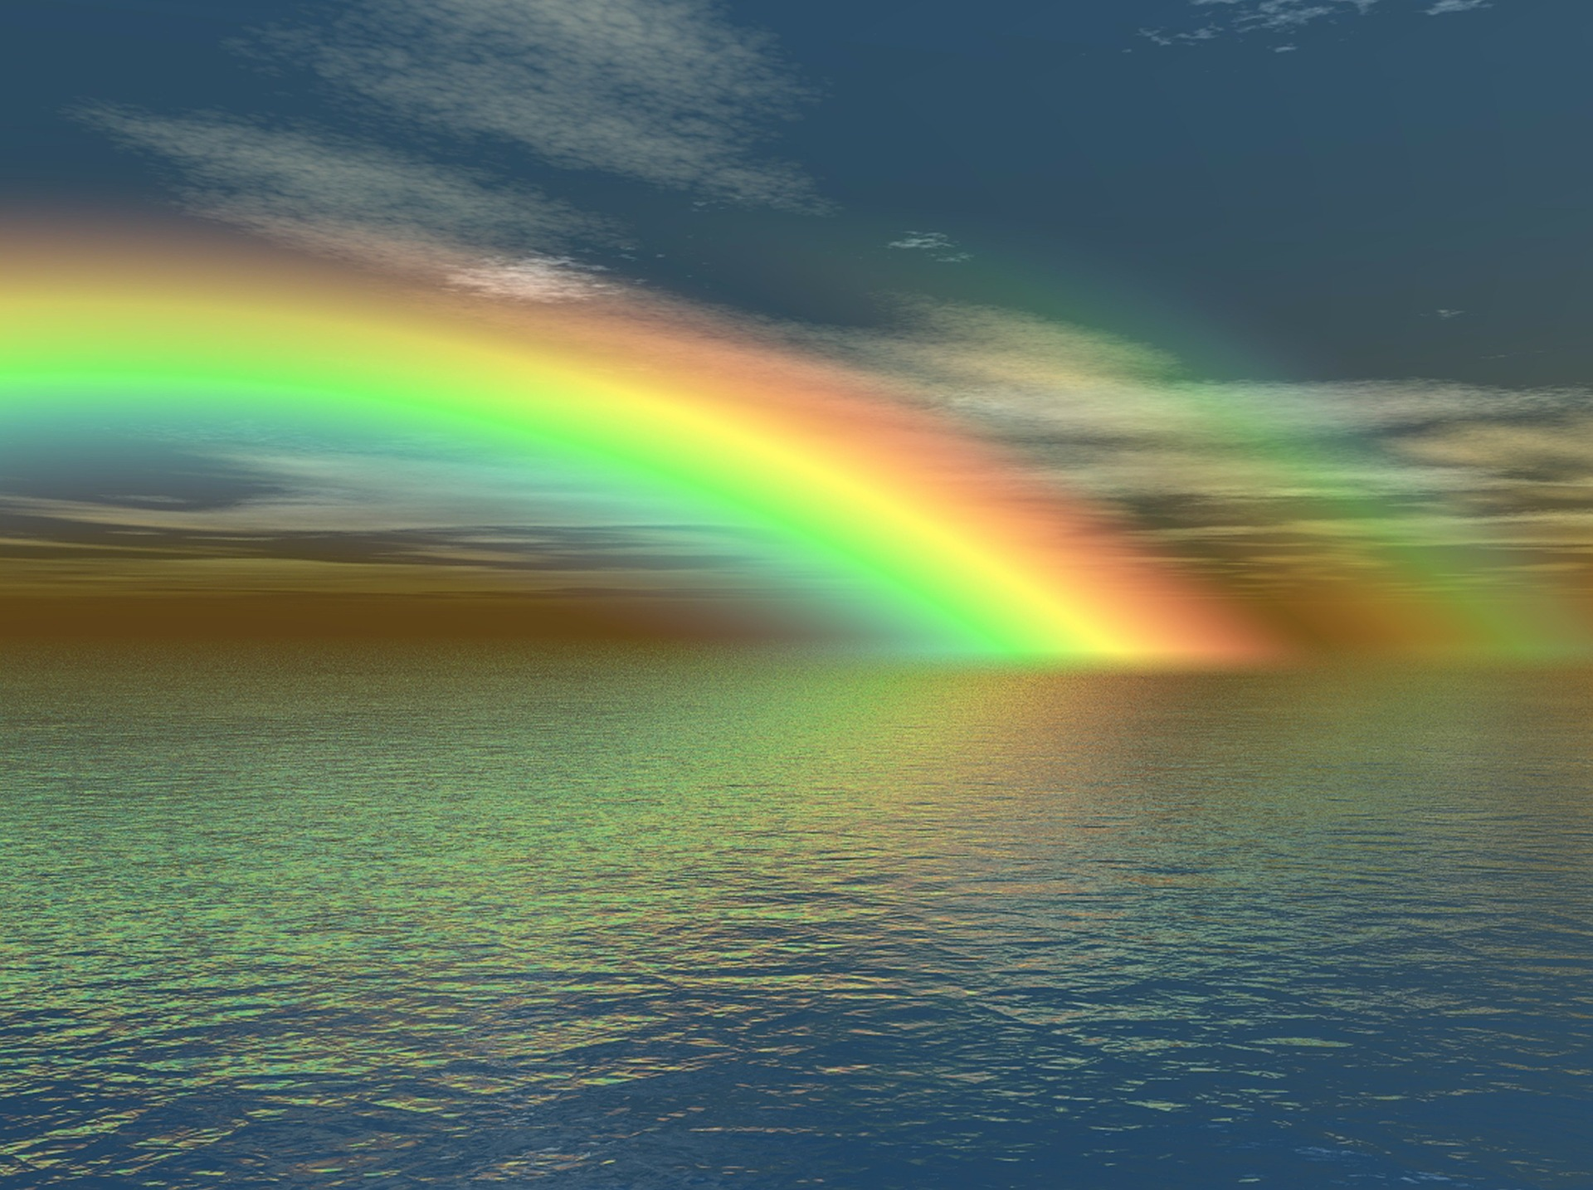
Now God’s home is with his people….He will wipe away every tear from their eyes. There will be no more death, sadness, crying, or pain. All the old ways are gone.
(Revelation 21: 3-4)
Notes:
Slide 15: Now God’s home is with his people….He will wipe away every tear from their eyes. There will be no more death, sadness, crying, or pain. All the old ways are gone. (Revelation 21: 3-4) These are good words to hope for in our world aren’t they? Let me read them again: you may find it helps to close your eyes and imagine what this looks like….

Slide 16
...I wonder how Christians feel knowing that they are praying to God who is eternal?...
…I wonder what you think God’s kingdom might be like?...
...I wonder if this is a place you might want to be?...
….I wonder what your hopes are for our world?...
Notes:
Slide 16: Let’s wonder together about this now… [you may wish to pause and talk together]
….I wonder how Christians feel knowing that they are praying to God who is eternal?....
….I wonder what you think God’s kingdom might be like?....
….I wonder if this is a place you might want to be?....
….I wonder what your hopes are for our world?
…….
So, we’re almost at the end of our time together, but before we end, there’s just one more word to talk about! It’s a word we’ve used every week – and it’s a word that is the same in many places across the world, in many different languages. It’s the word that Jesus taught his disciples and his followers to say at the end of this – and every – prayer, and that word is….

Slide 17

“So be it!”
Notes:
Slide 17: AMEN! We might hear it a lot, but what does it mean? (and it’s not quite ‘The End’!!) ‘Amen’ is an ancient word meaning ‘So be it’… It’s a way for all those who pray to both show God that they really mean what they pray, and also trust God for the answer to that prayer. You might like to remember this as we turn to prayer shortly… …

Slide 18
Notes:
Slide 18: Responding (words for worship):
…we’ve done a lot of thinking today, about the great mystery of God being eternal….
….the beginning and the ending, and the never-ending….
…..I wonder what you think about these ideas?.....
….spend a few moments in quietness now…..
[leave some time for reflection]

Slide 19
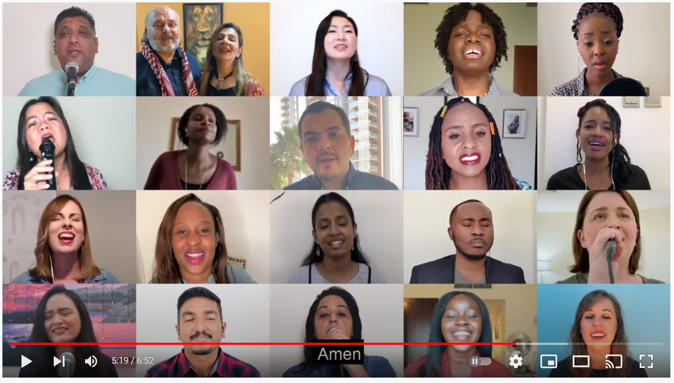
The Blessing (Multi-lingual version) - Fellowship Dubai - YouTube
Notes:
Slide 19: We’re going to pray in a different way today, and send each other out into the day, using a video of a blessing that was recorded during lockdown last year – and as at the very start of term, you’ll hear words in several different languages. Listen out, though, for the ‘Amen’…...the same word, all across the world! You might want to find a way to make this blessing into your prayer, maybe by singing along, or you may prefer to just sit and listen.
The Blessing (Multi-lingual version) - Fellowship Dubai - YouTube

