Slide 1
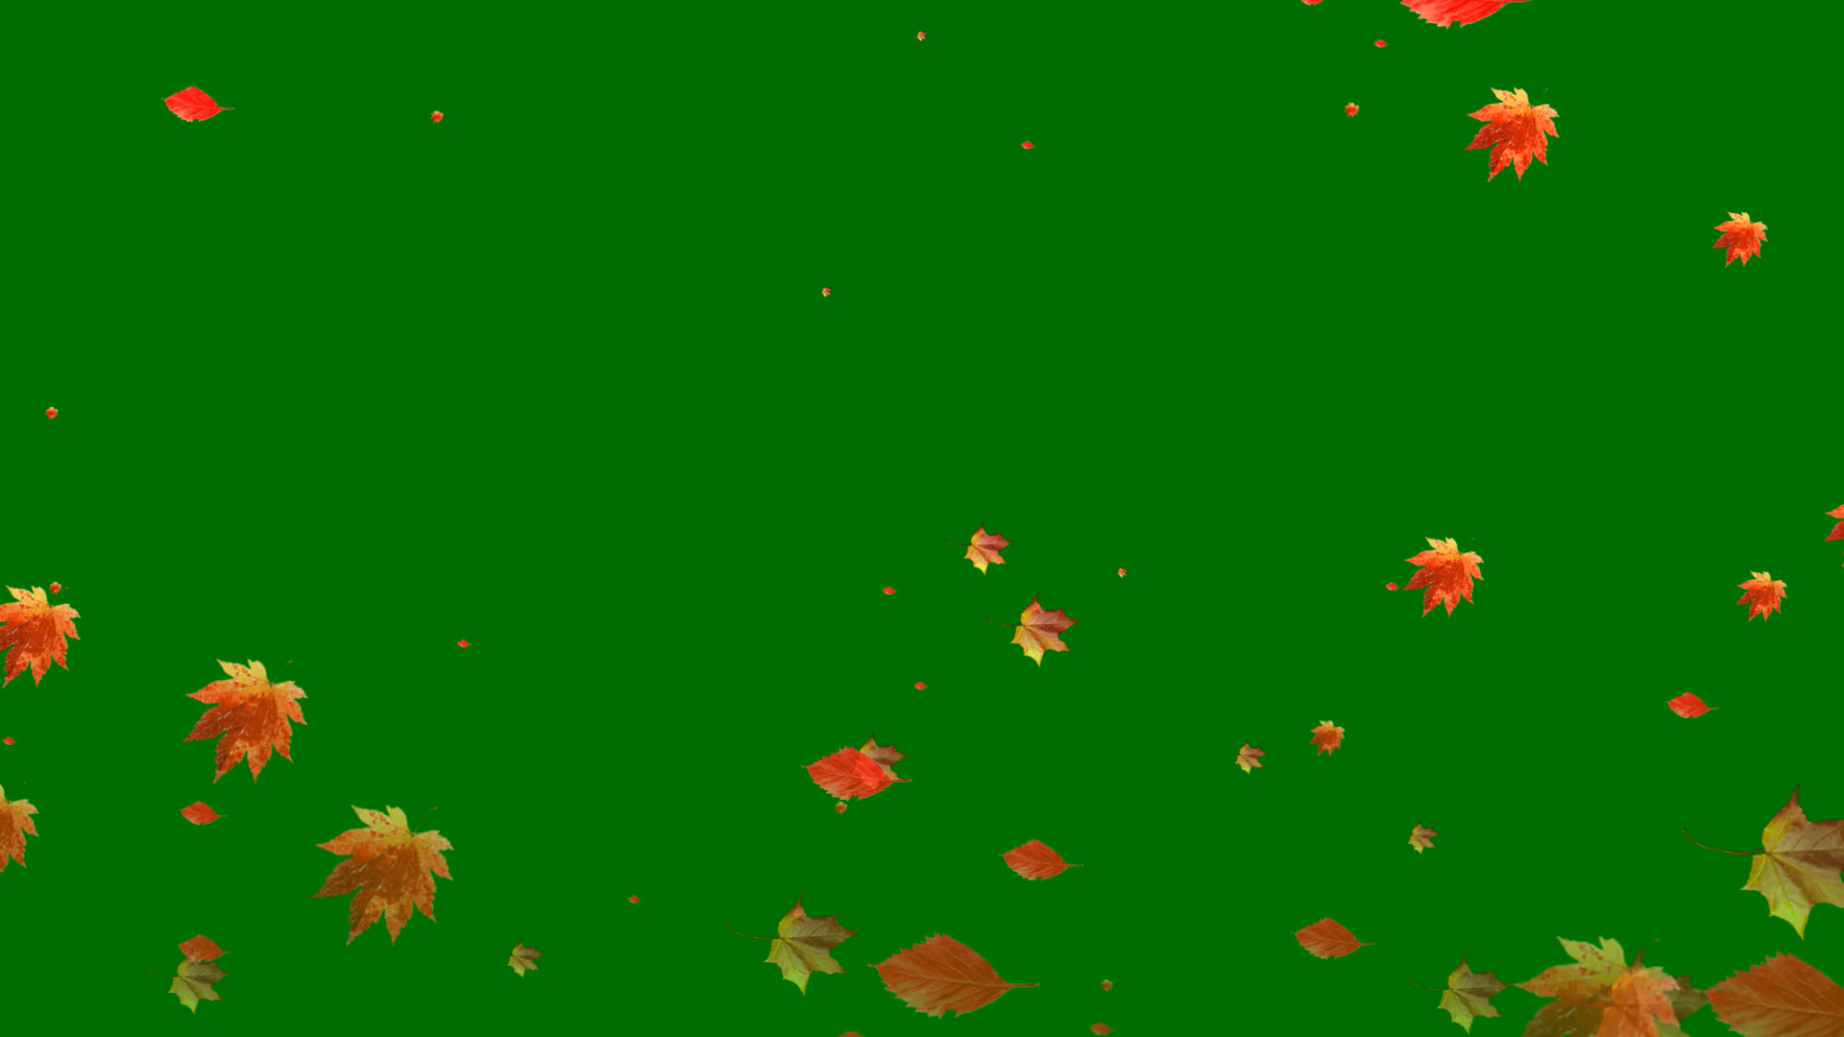
All images copyright-free from pixabay, unless otherwise identified
Notes:
Gathering:
Slide 1: Falling leaves stilling exercise
Use the stilling slide if desired: the suggested words should be spoken slowly, leaving pauses inbetween to create a sense of stillness.
As you sit quietly, watch the leaves falling…… [PAUSE]
Now practise slower breathing…..in…..and out…..in……and out…..as you watch….[PAUSE]
You maybe notice that you are feeling calmer and more relaxed….[PAUSE]
As you breathe, think about yourself and what you bring into this time today….. [PAUSE]
We come into this special / sacred space and time to be still….to think deeply…..to be together as a school community…..
In our time together today, we will talk about some words from the Bible, investigate a mystery, share a story, and then think together.

Slide 2

Leader: As we gather to share our story today….
All: May we grow in our understanding of ourselves, others and our wonder-ful world.
Notes:
Slide 2: Use our new gathering words for this term, or your usual greeting if you prefer. These greetings may change slightly each week to reflect the spiritual elements that we will be exploring in each week’s materials.
Leader: As we gather to share our story today….
All: May we grow in our understanding of ourselves, others and our wonder-ful world.

Slide 3

Stories that help us to grow
Notes:
Slide 3: We’re exploring stories that help us to grow this term, and today’s story is another ancient traditional tale about beginnings. But before we hear it – and think about the message it might have to share with us – we’re going to investigate a mystery….

Slide 4
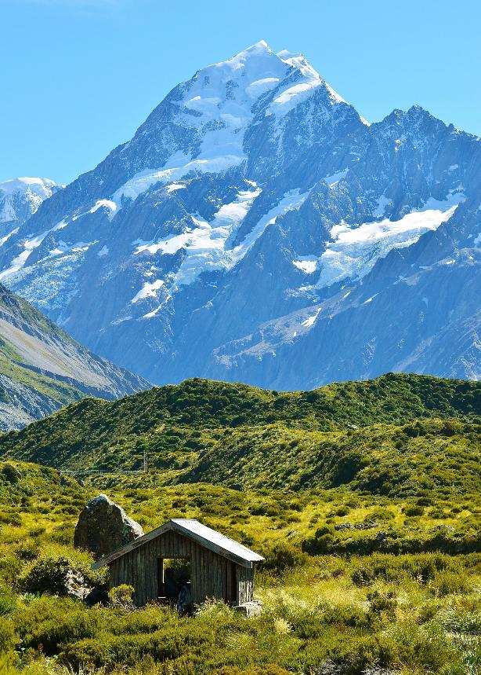
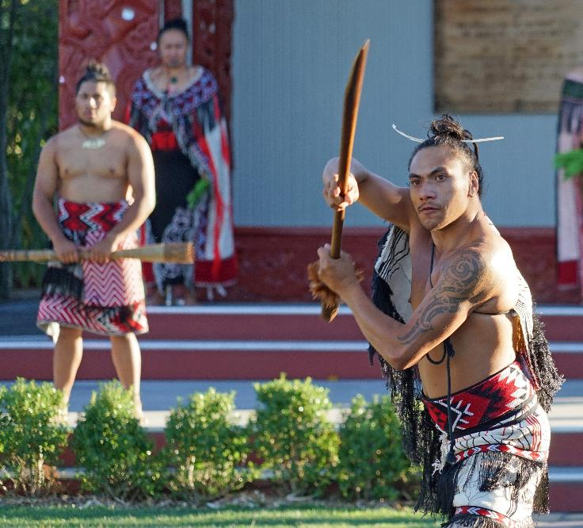
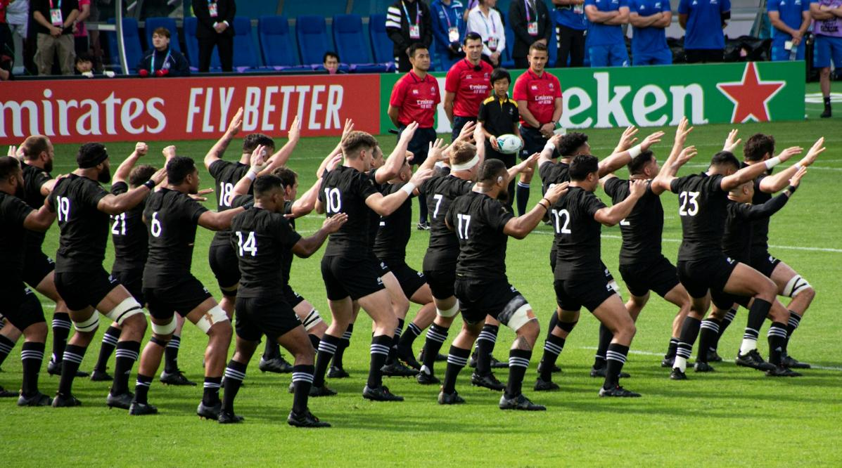
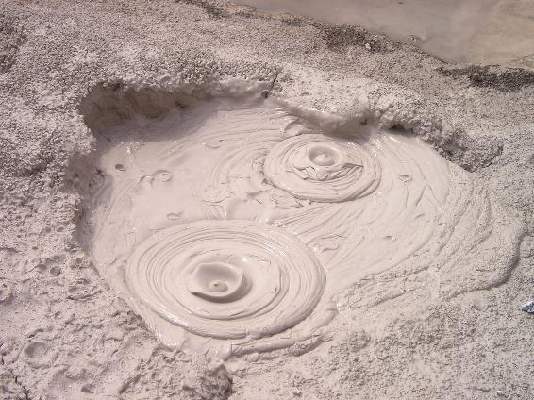
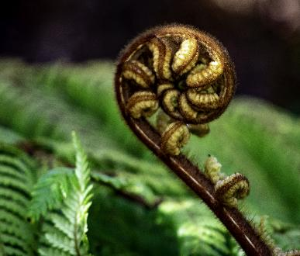

Photo by Stefan Lehner on Unsplash
Notes:
Slide 4: New Zealand
Our mystery – and our story – for today come from this beautiful country, which some of you might recognise as….New Zealand. Like Algeria, where we visited last week, it’s another country of real contrasts, with huge snow-capped mountain peaks and lots of volcanic bubbling mud. It’s famous for its lush green rain forest, with its intricate ferns – and also for its fierce, but beautiful traditional Māori dance, the Haka. You might have seen the New Zealand rugby team, the All Blacks, perform this before the start of the match.
Our mystery is a creature that is only found here, in this one place in the world….it’s totally unique!

Slide 5
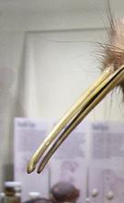

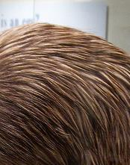

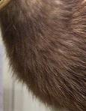
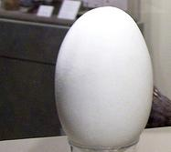
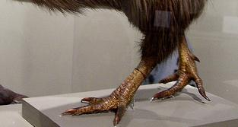
Notes:
Slide 5: The mystery
To help us to identify what this mysterious creature is, I have some clue cards, which some of you are going to read out. If we can identify the part of the creature’s body from the clue, then we will begin to get a picture of this mysterious creature!
Clue 1: My babies hatch out of these. I lay really large ones for my size, weighing up to a fifth of my own body weight (that’s like an average-weight woman having a baby weighing 28lb!) [Answer: its egg]
Clue 2: I would use these for flying if I could, but I can’t, because they’re too short & stubby. [Answer: its wings]
Clue 3: I use this part of my body to rip apart rotten logs to look for insects, or to burrow in the ground. I also use them to frighten away any unwanted visitors to my patch, by stamping so loudly that I sound like a deer charging! (Not bad for a little bird – I’m only about the size of a chicken!!) [Answer: its legs & feet]
Clue 4: If I had one of these, it would be at the opposite end of my body from my nose. [Answer: its tail]
Clue 5: I’m mostly a nocturnal bird, so I open these at night-time when I’m awake! [Answer: its eyes]
Clue 6: I’m the only bird to have these at the end of my beak rather than at the top. I use them to sniff out my favourite food, and I also sniff very loudly at night-time to get the dirt out after I’ve been burrowing! [Answer: its nostrils NB vocabulary enrichment opportunity here!]]
Now that the picture is complete, we can see that it’s a kiwi, but we have one more fascinating fact before we continue with our story…..
Clue 7: EXTRA! Kiwis live in pairs – a mummy and a daddy – so they’re not lonely and they stay together for life!
These little birds are extraordinarily shy; they are nocturnal and it’s quite lucky if you ever get to see one in real life. In a moment, we’re going to hear a traditional Māori tale about how the kiwi came to be a flightless bird, but first, some words to keep us thinking through the story…..

Slide 6
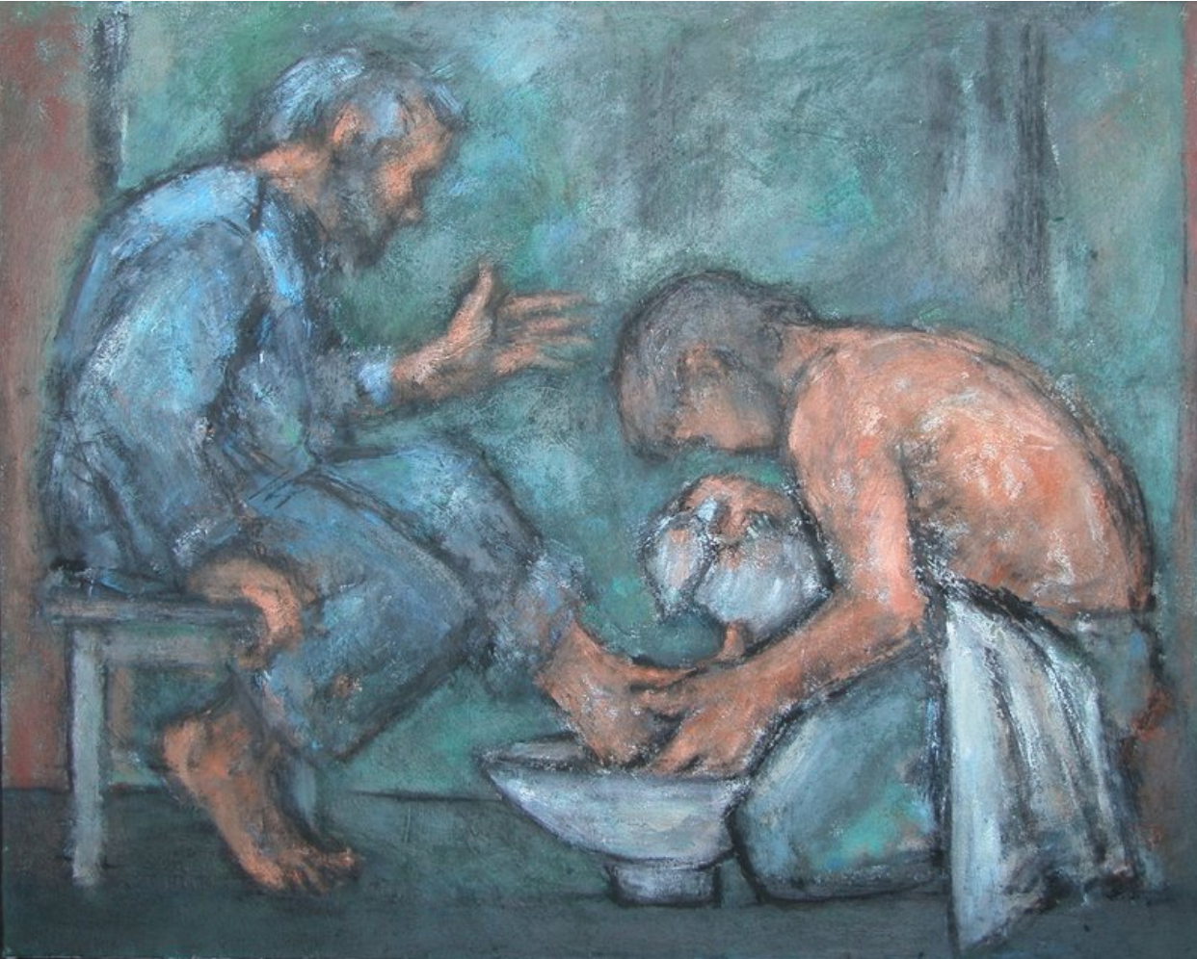
‘The Washing of the Feet’ by Ghislaine Howard from The Methodist Modern Art Collection, ©TMCP, used with permission
‘He who serves you as a servant is the greatest among you…..Whoever makes himself humble will be made great.’
[Matthew 23:11-12]
Notes:
Slide 6: Bible verses
The image that you can see is one of Jesus washing the disciples’ feet, which was a part of the Easter story that you might remember from last term. In doing this, he wanted to show his friends what he meant by serving others. Here are some words that Jesus spoke, ‘He who serves you as a servant is the greatest among you…..Whoever makes himself humble* will be made great.’
These words have a strong connection with our story today, so keep thinking as you listen….
*Humble means ‘like a servant’

Slide 7
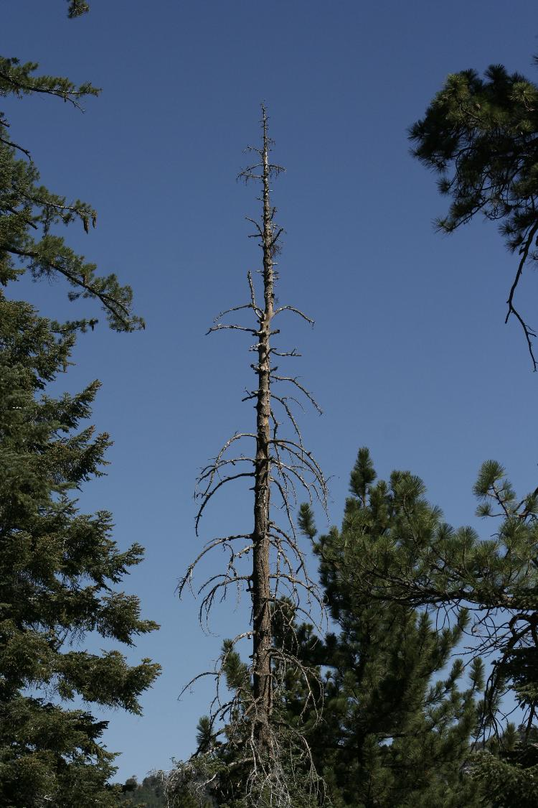
Notes:
Slide 7: One day the King of the Forest, Tane Mahuta [Tarn-ay Ma-hoot-a], was walking through his kingdom on the forest floor. He looked at his children, the trees, and noticed that they looked sick. There were too many bugs on the forest floor, and all the trees were being eaten. Tane Mahuta told his brother, the King of the Sky, whose name was Tane Hokahoka [Tarn-ay Hock-a Hock-a], what had happened to his children the trees.
The King of the Sky wanted to help his brother, so he called all the birds together for a meeting. Tane Mahuta said to them all, “The ground bugs are eating the trees. I need one of you to give up your life in the sky and come and live on the forest floor, in my kingdom. I need you to eat the bugs so that the trees will be saved. Who will come?
Tane Mahuta and Tane Hokahoka waited and listened – but everything was quiet, and not a single bird spoke.

Slide 8
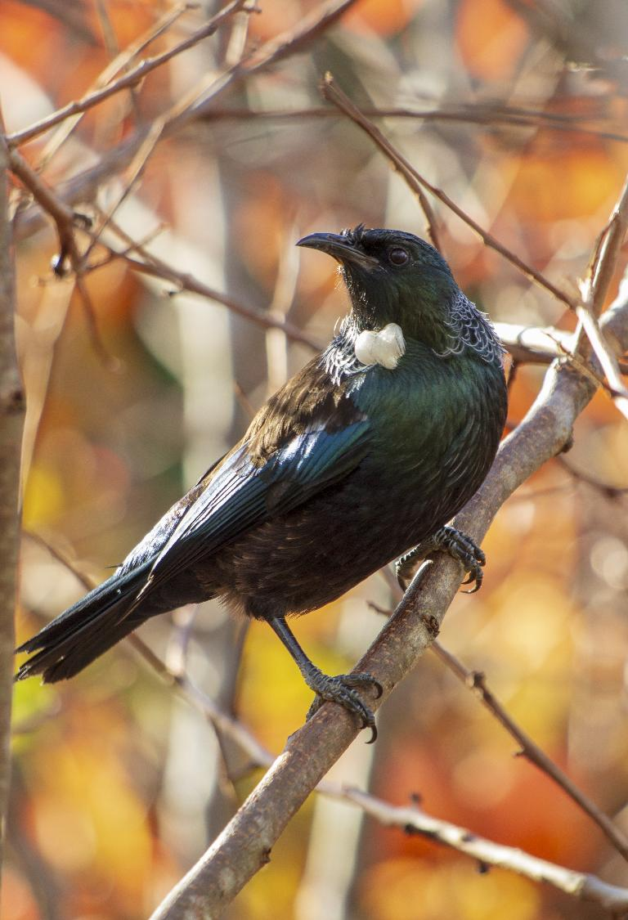
Tui
Notes:
Slide 8: Tane Hokahoka turned to the Tui bird.
“Tui, will you come down from the forest roof?”
The Tui bird replied “Oh no, I could not do that – it is too dark and I am afraid of the dark.”

Slide 9
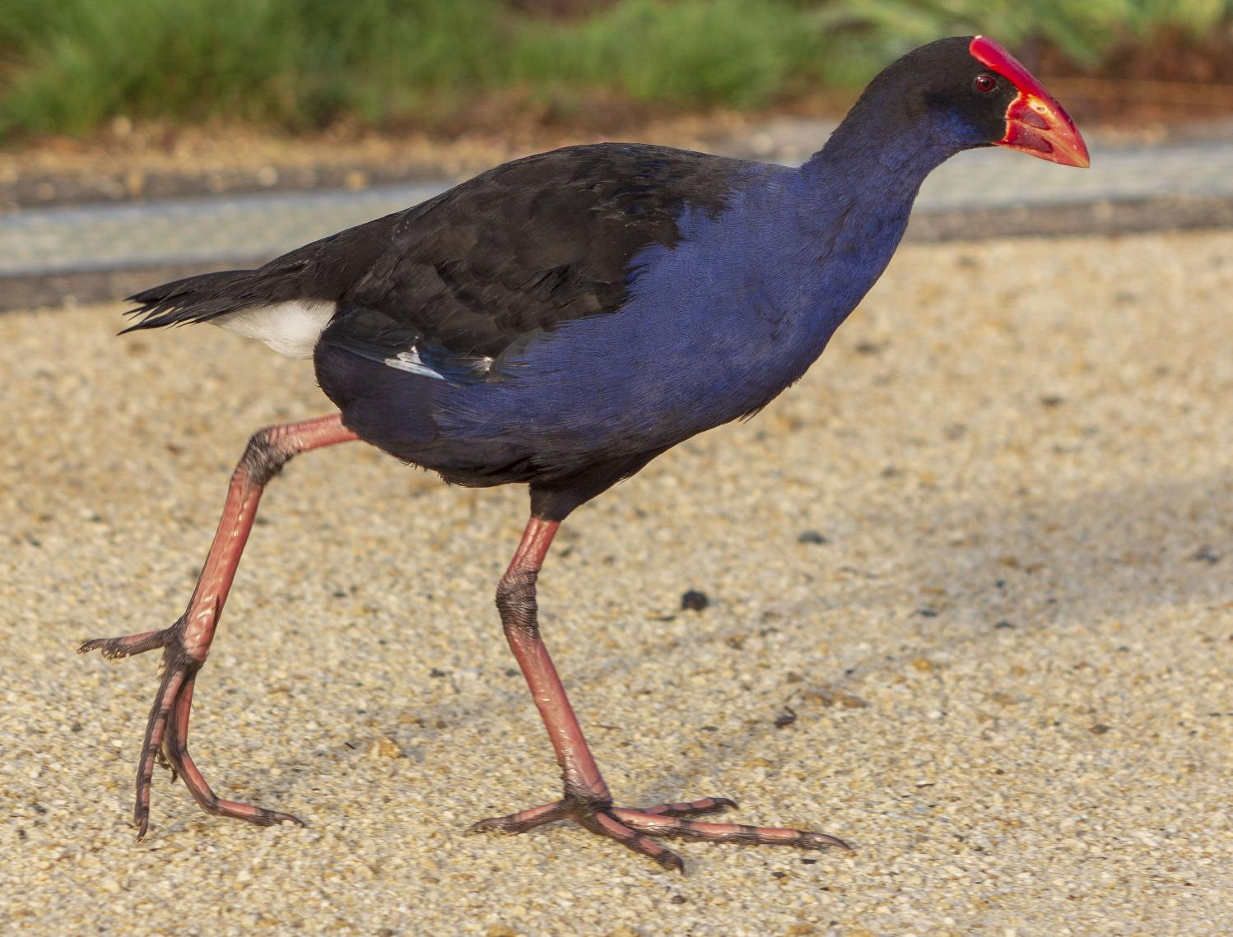
Pukeko
Notes:
Slide 9: So then Tane Hokahoka turned to the Pukeko bird [Poo-kecko]. “Pukeko, will you come down from the forest roof?”
Pukeko said "Certainly not! The ground is far too wet and you know I don't like getting my feet wet."

Slide 10
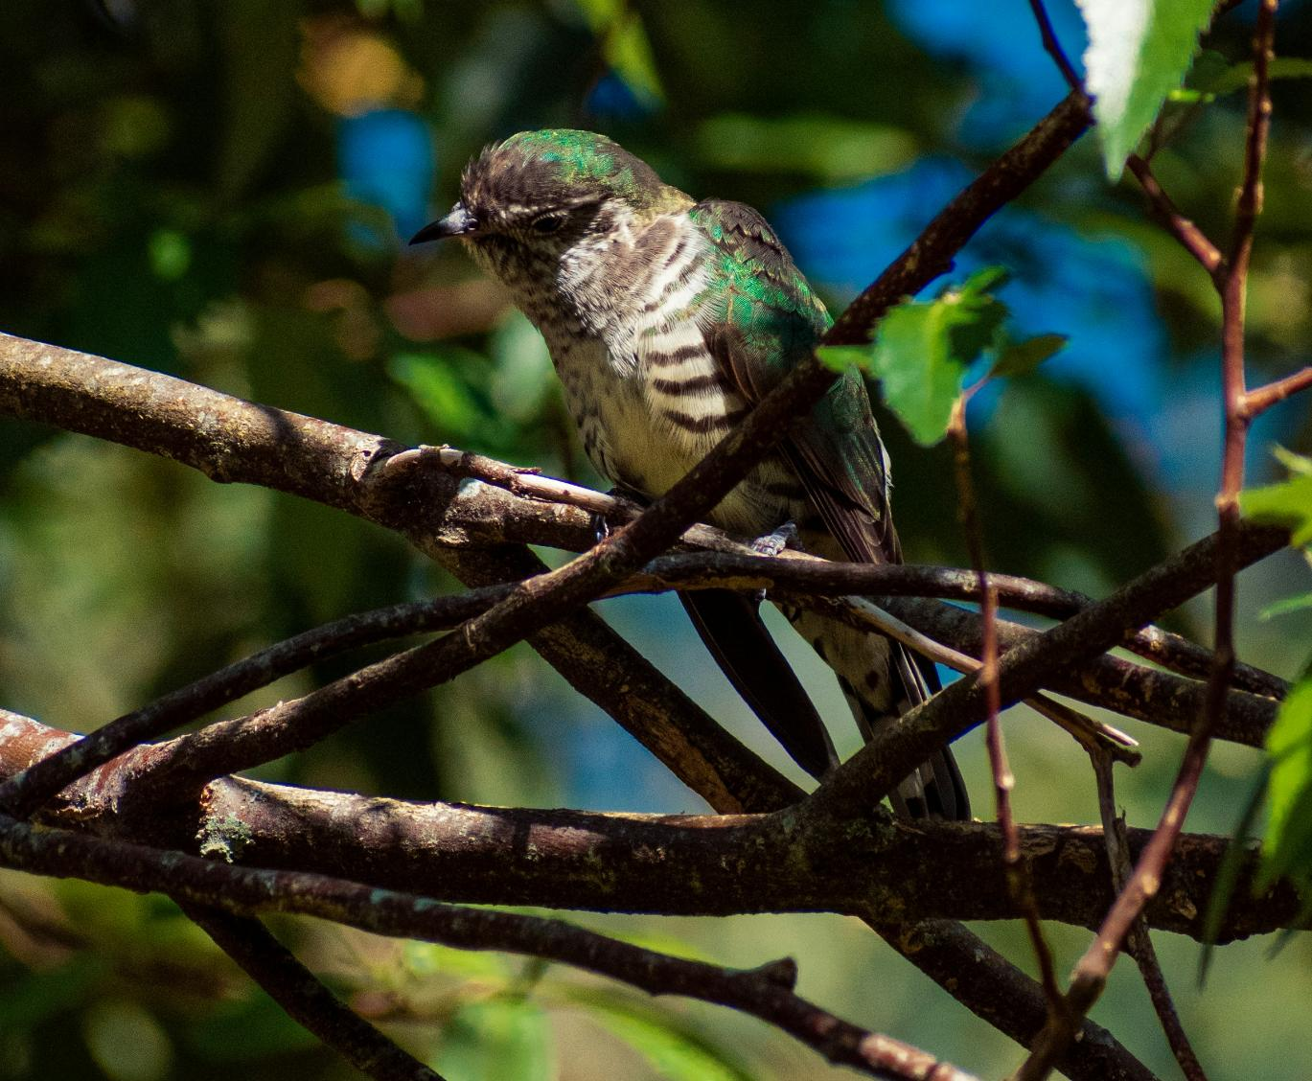
Pipiwharauroa
Photo by Stephen Paterson on Unsplash
Notes:
Slide 10: Tane Hokahoka then turned to the Pipiwharauroa [Pee-pee-fa-raw-rower] bird, also called the Shining Cuckoo, and asked “What about you, Pipiwharauroa, will you come down from the forest roof and save the trees?”
Pipiwharauroa said "I would love to be able to help you, but I’m afraid I’m just too busy building a nest for my family.”
Tane Hokahoka knew that if one of the birds did not come down from the forest roof, not only would all the trees die, but the birds would have nowhere to live, so he had one last try.

Slide 11
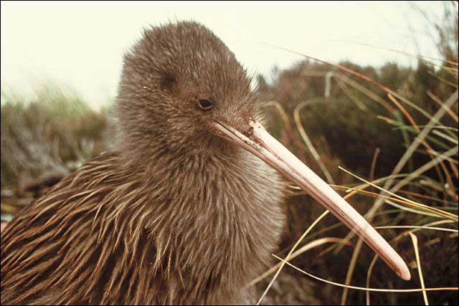
Kiwi
Notes:
Slide 11: Finally, the King of the Sky turned to Kiwi and said “Please, will you come down from the skies and save the trees?” Kiwi looked around and saw his family. Then he looked down at the cold damp earth, and thought about how different his life would be if he agreed. Then once again he looked at his family and realised what would happen if no-one offered – that if the trees died, everyone’s homes would be lost - and he turned to Tane Hokahoka and said “yes.”
Tane Hokahoka and Tane Mahuta were very happy because this little bird would save the trees. The King of the Forest said “Kiwi ,you do realise that if you do this, you will have to grow strong legs and lose your beautiful wings and colourful feathers so you blend in with the colour of the forest floor. You will not be able to return to the forest roof and will never see the light of day again.”
Kiwi nodded, took one last long look at the sun and whispered a quiet “goodbye”, as he headed down to the forest floor forever.

Slide 12
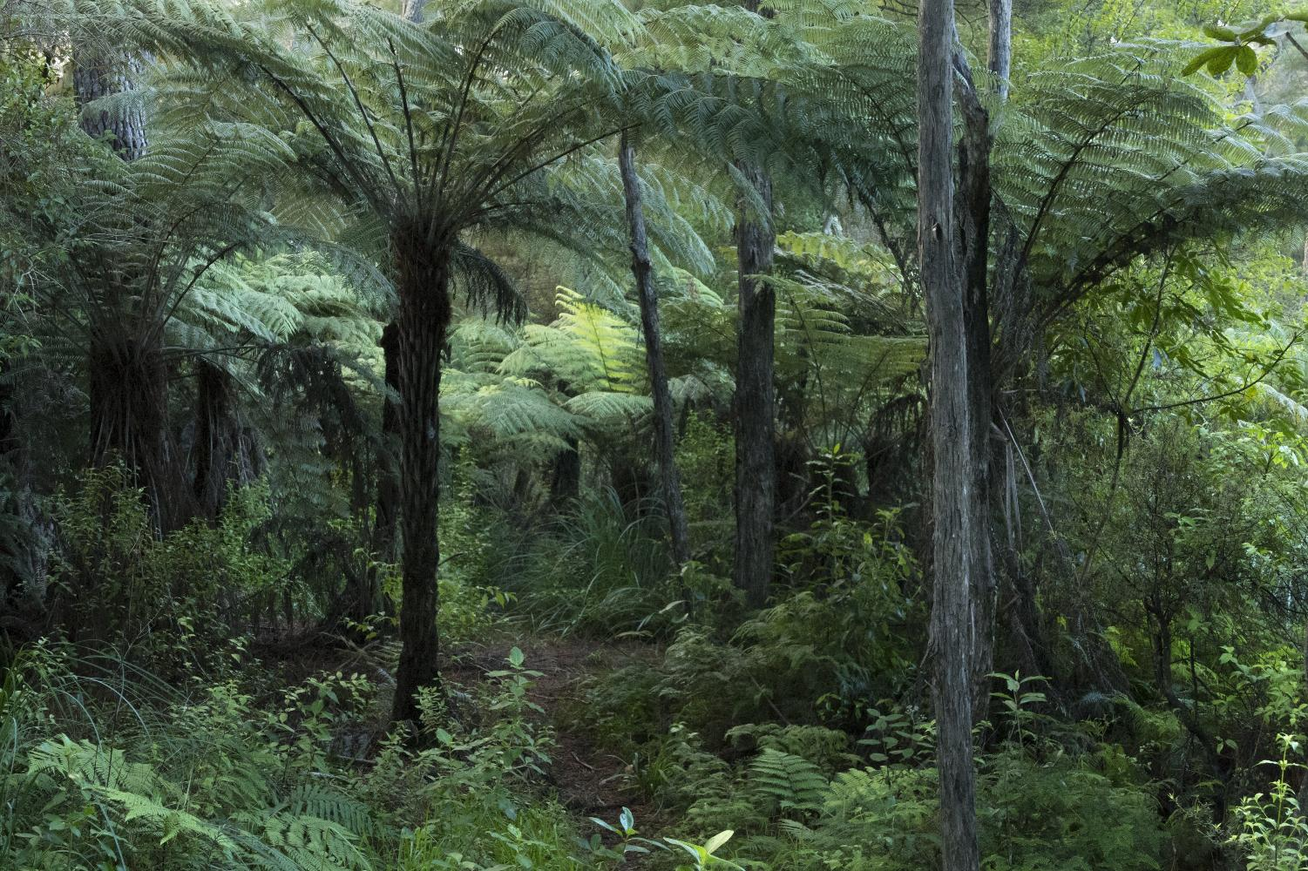
Notes:
Slide 12: Tane Hokahoka turned to the other birds and said, “Look at the example this little bird has set for you!’ Then to the Kiwi he said “Although you will lose much, because of your act of self-sacrifice, you will become the most well-known and best-loved bird of them all! And so it is that little Kiwi is beloved by all who live in New Zealand and by all who visit, hoping to catch a rare glimpse of one in the forest undergrowth. And as you can see, little Kiwi has done much to keep the trees of the New Zealand forest healthy!

Slide 13
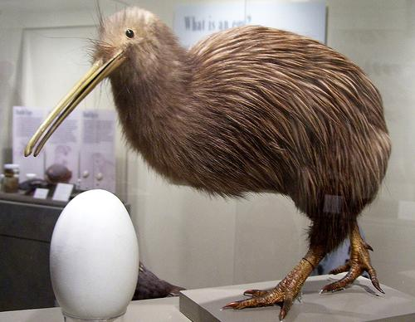
…I wonder what connections there are between these words that we heard earlier and the actions of the little Kiwi?...
……I wonder what you find inspiring about this story, or about Kiwi’s actions?....
‘He who serves you as a servant is the greatest among you…..Whoever makes himself humble will be made great.’
[Matthew 23:11-12]
Notes:
Slide 13: Responding and words for worship
Our wondering questions today are going to create an opportunity for us to think – and talk – together….
…I wonder what connections there are between these words that we heard earlier and the actions of the little Kiwi?... [talk together, you might like to use Think-Pair-Share. Encourage children to make links between the actions of Kiwi and serving the other birds – through saving the trees.]
…I wonder what you find inspiring about this story, or about Kiwi’s actions?....

Slide 14
…I wonder what we might be willing to sacrifice for the sake of others?...
…I wonder what being humble – serving others – might look like for us?...
‘He who serves you as a servant is the greatest among you…..Whoever makes himself humble will be made great.’
[Matthew 23:11-12]
Notes:
Slide 14: Being humble – serving others, like a servant – is not easy. It’s a bit topsy-turvy isn’t it, that this is what matters in God’s Kingdom?! Jesus showed this example to his disciples and said that anyone who followed him should be like this. Kiwi showed this when he chose to leave his home in the trees and live on the forest floor, because he wanted to save the trees. And we can choose to be like this too – to serve our community….
As we draw our time together to an end today….
…I wonder what we might be willing to sacrifice for the sake of others?....
…I wonder what being humble – serving others – might look like for us?...

Slide 15
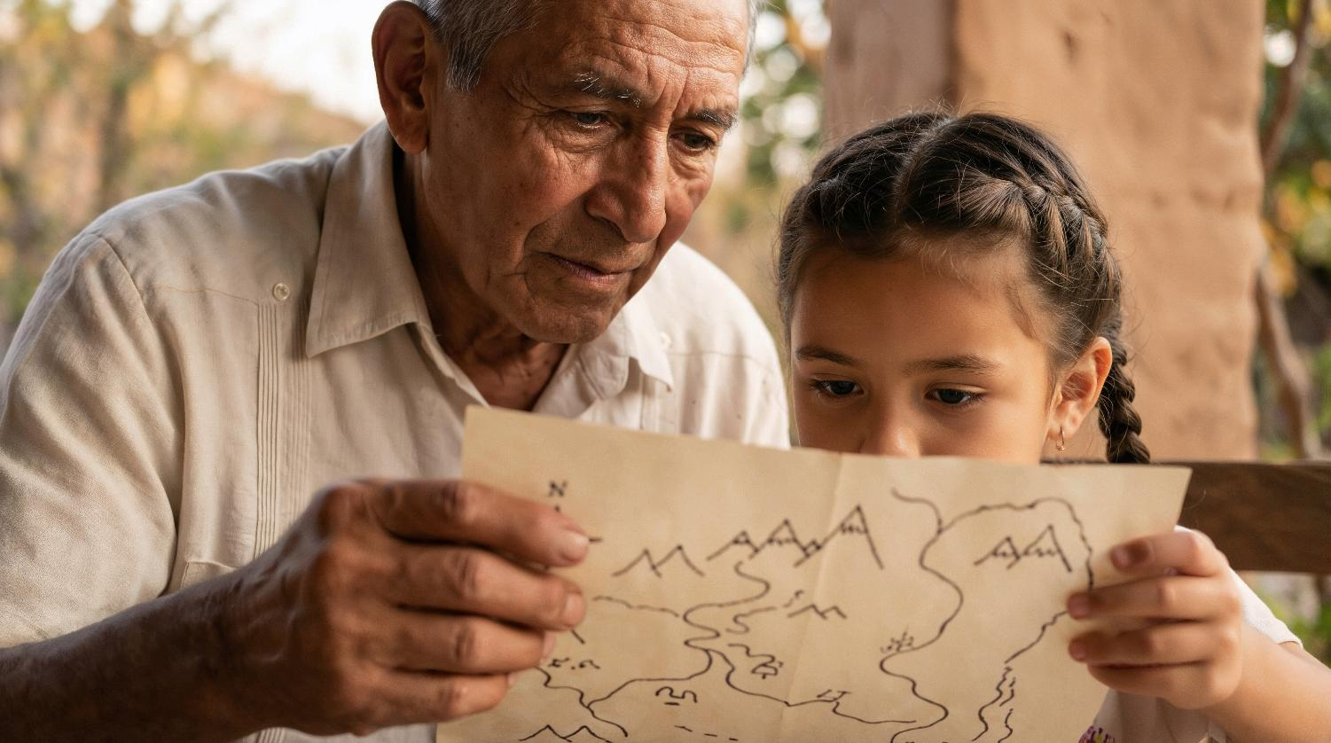
…in our families?...
Notes:
Slide 15: …in our families?...

Slide 16
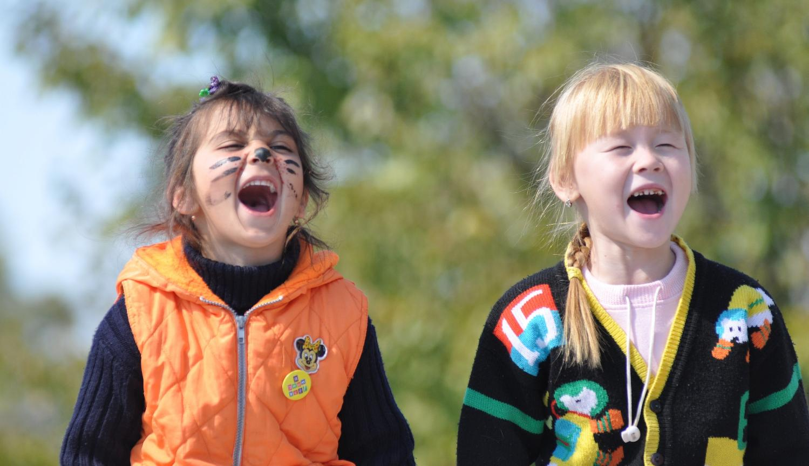
…with our friends, as we play?...
Notes:
Slide 16: …with our friends, as we play?...

Slide 17
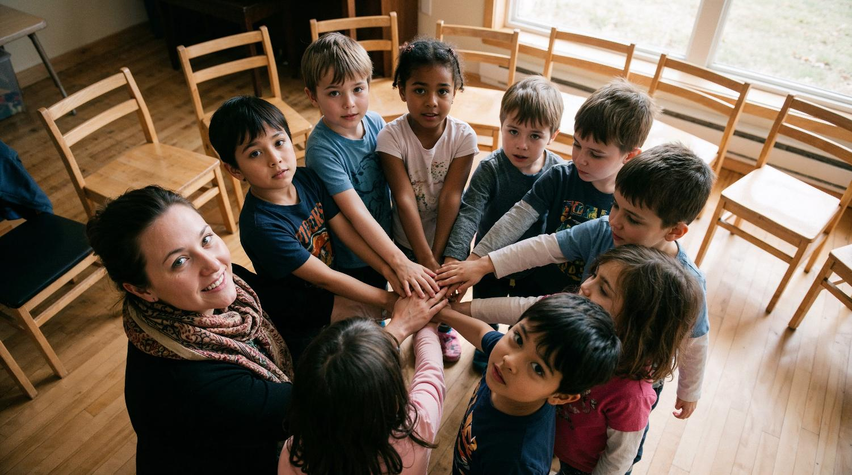
…in our classrooms?...
Notes:
Slide 17: …in our classrooms?...

Slide 18
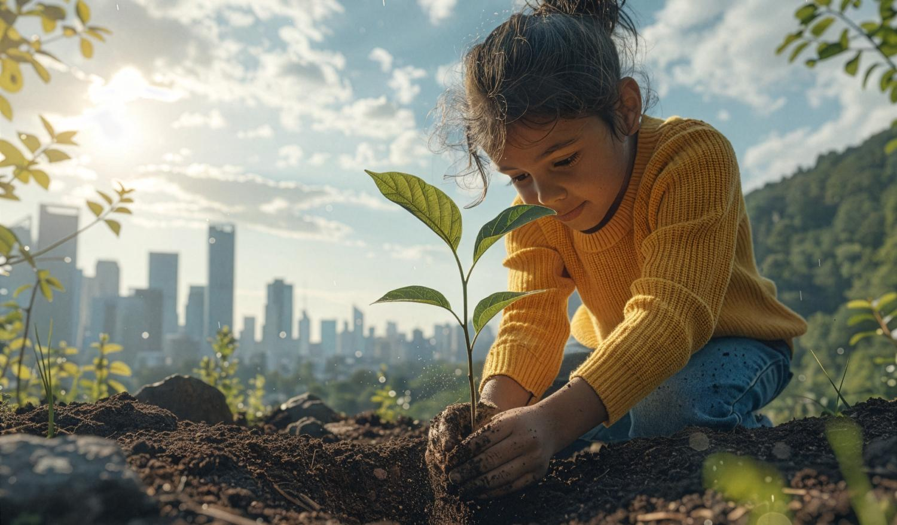
…as part of our world?...
Notes:
Slide 18: …as part of our world?...

Slide 19
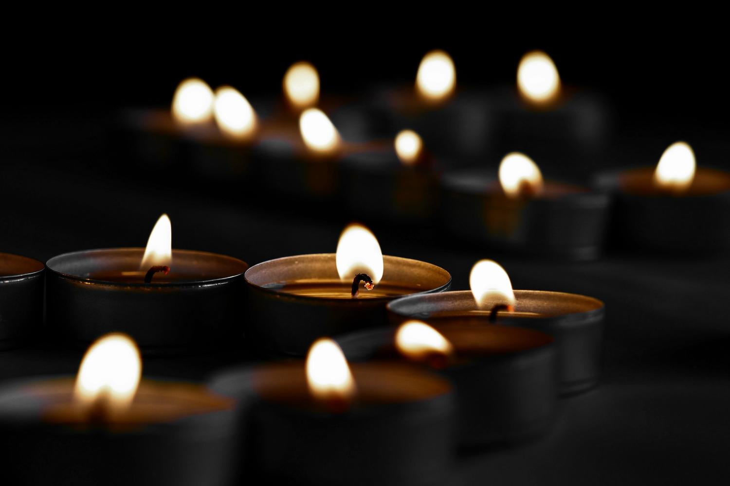
‘God, would you help us to serve?’
Notes:
Slide 19: I’m going to use the same images now to help us to pray. If this is something that you are comfortable with and you’d like to make the prayer your own, then there are some words that you can share with me, ‘God, would you help us to serve?’

Slide 20
…in our families?...
Notes:
Slide 20: …in our families... ‘God, would you help us to serve?’

Slide 21
…with our friends, as we play?...
Notes:
Slide 21: …with our friends, as we play... ‘God, would you help us to serve?’

Slide 22
…in our classrooms?...
Notes:
Slide 22: …in our classrooms... ‘God, would you help us to serve?’

Slide 23
…as part of our world?...
Notes:
Slide 23: …as part of our world... ‘God, would you help us to serve?’

Slide 24

Notes:
Slide 24: Amen

Slide 25


[Slide 4:]
Leader: As we leave this place & time and go into the day ahead…
All: May we be willing to serve.
Notes:
Slide 25: Sending
Leader: As we leave this place & time and go into the day ahead…
All: May we be willing to serve.

Slide 26
Notes:
Slide 26: Reflective areas
You will need some heart-shaped confetti or small paper hearts
Talk: Talk about your thoughts about Kiwi’s actions. What might have been hard for him in making the decision he did?
Think: How might your actions serve others today?
Do: Take a small heart and pop it into your pocket to remind you to take action.

