Slide 1

Pictures copyright-free from pixabay
Leader: We are a creative community. As we gather together today…
ALL: May our thinking, talking and wondering help us to grow.
Notes:
Slide 1: Gathering
Use the new greeting, with BSL actions if desired.
Leader: We are a creative community. As we gather together today….
ALL: May our thinking, talking and wondering help us to grow.
Here are BSL actions for some of the words:
Leader’s words:
Creative: https://www.signdictionary.co.uk/view/creative?q=creative#title
Community: (we use the word ‘gathering’ as it’s a simpler sign!) https://www.signbsl.com/sign/gathering
Gather together: https://www.signbsl.com/sign/gather (1st video)
Pupils’ response:
Think: https://www.brightbsl.co.uk/signs/think
Talk: https://www.signbsl.com/sign/talk (1st video)
Wonder: https://www.signbsl.com/sign/wonder (1st video)
Grow: https://www.signbsl.com/sign/grow (2nd video)

Slide 2
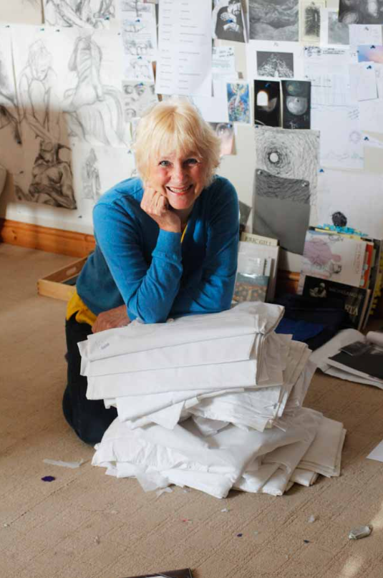
Threads Through the Cross
Notes:
Slide 2: Threads Through the Cross

Slide 3

Notes:
Slide 3: Fork in the road cards
Do you remember these?
We used them 5 weeks ago to help us to think about the choices that we make – all the time – but also to recognise that some choices are harder than others.
We will need this idea to help us when we look at Jacqui’s panels today.
I wonder if you can remember what you wrote on your card?
Was your choice easy or difficult?
What was the last important decision that you made?
Who do you listen to when you make decisions?
Today’s panel is all about making big decisions…..good and bad.

Slide 4
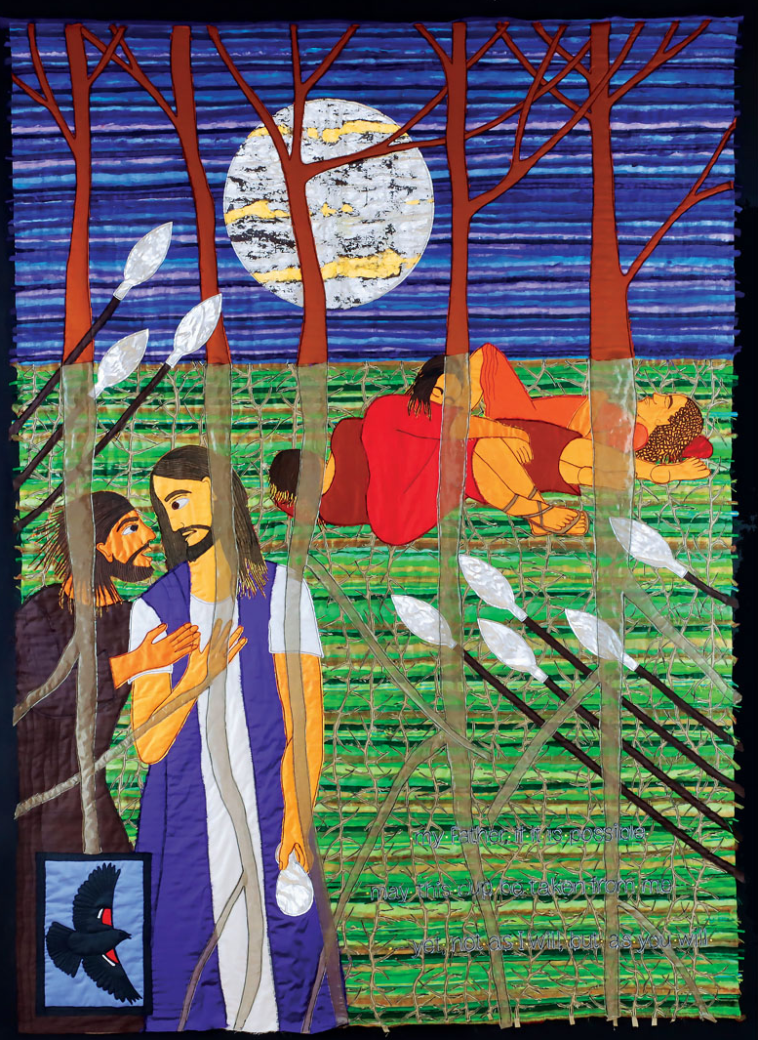
Your will be done
My Father, if it is possible, may this cup be taken from me; yet not as I will, but as you will.
Notes:
Slide 4: Your will be done
Today’s story takes place the night before Jesus died, in a garden where Jesus was praying. He had asked his close friends Peter, James and John to pray with him, but they all fell asleep, leaving Jesus alone. So, Jesus had prayed alone, knowing the big choice that lay ahead of him….
As you gaze at the panel, what do you notice?....
…maybe you notice the three friends, fast asleep?
…maybe you notice Judas, who has come to find Jesus in the garden? He is the one who has made a bad decision and will betray Jesus with a kiss, the sign of friendship.
…maybe you notice the bare trees, with no leaves?…or the moon that is no longer bright, but covered with cloud?
…maybe you notice the spears of the soldiers who have come with Judas?
…maybe you spotted the thorns, giving us a glimpse into what is yet to happen?
…or maybe you spotted the bird?! Jacqui says that this is an American red-winged blackbird, its flash of red signalling danger…..
The hardest thing to spot are the words! These are the words of Jesus, spoken to God his Father in prayer: ‘My Father, if it is possible, may this cup be taken from me; yet not as I will, but as you will.’
If you’ve ever had a hard decision to make, you can maybe appreciate what a difficult decision this was for Jesus. Like the choices that Jesus made at his baptism and in the desert, he knew that they were all leading to this moment of surrender, when he would choose the path to the cross. Jesus knew that although this choice was not easy (look at the first half of the sentence!), he knew that he was making this choice for the greater good – it was part of God’s Great Rescue plan. Although it might’ve looked to the disciples that he was giving in, and not fighting the soldiers, he was surrendering to the better plan that God had for the whole of humankind,

Slide 5
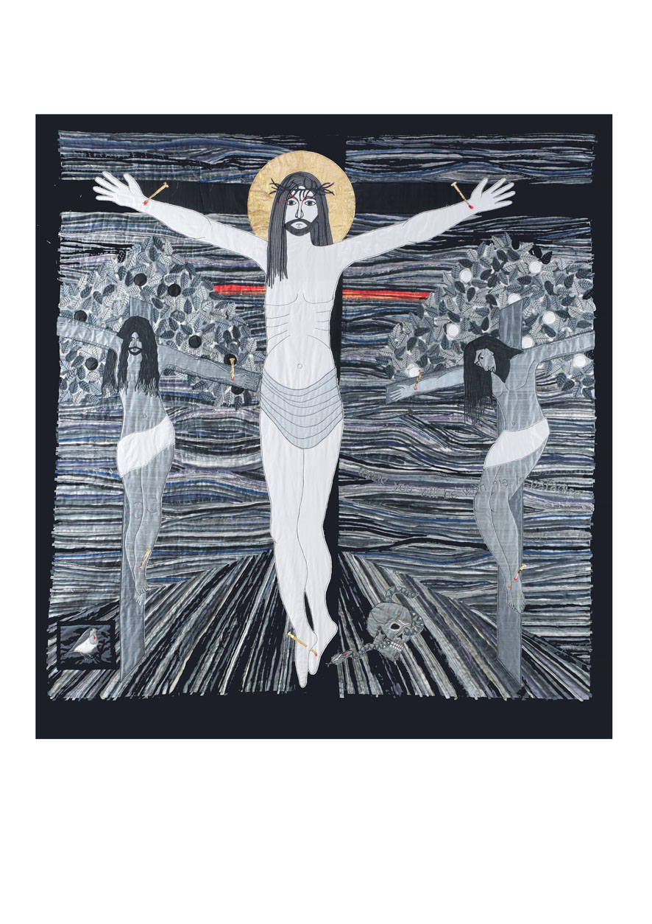
It is finished!
Notes:
Slide 5: Today you will be with me in paradise
Jesus knew all along that he would need to do this difficult thing, because it was what God had planned as the only thing that would put right all that had gone wrong in the Garden of Eden, when Adam and Eve chose their own way. If you look very carefully, you can see the two trees again in the background. Jacqui placed these two trees deliberately here as a reminder. It’s as if Jesus is stretching out his arms in love and forgiveness across history – and he declared from the Cross ‘It is finished!’
….I wonder what you think Jesus meant? What was finished?.... [you might like to leave some room for discussion here, or take it back into class discussions, maybe in RE]
As you gaze at the section* of this panel, what do you notice?....
….why do you think Jacqui chose grey and black as the main colours for this panel?
….which other colours do you notice?
….I wonder why this moment in history has been the focus of so much art? [you can see one of the earliest examples in the comparison slide, from the recent ‘Siena’ exhibition at the National Gallery’.]
*For obvious reasons, we have excluded some of the more distressing detail that Jacqui includes in this panel. You can view a full version of the panel at the very end of this presentation.

Slide 6
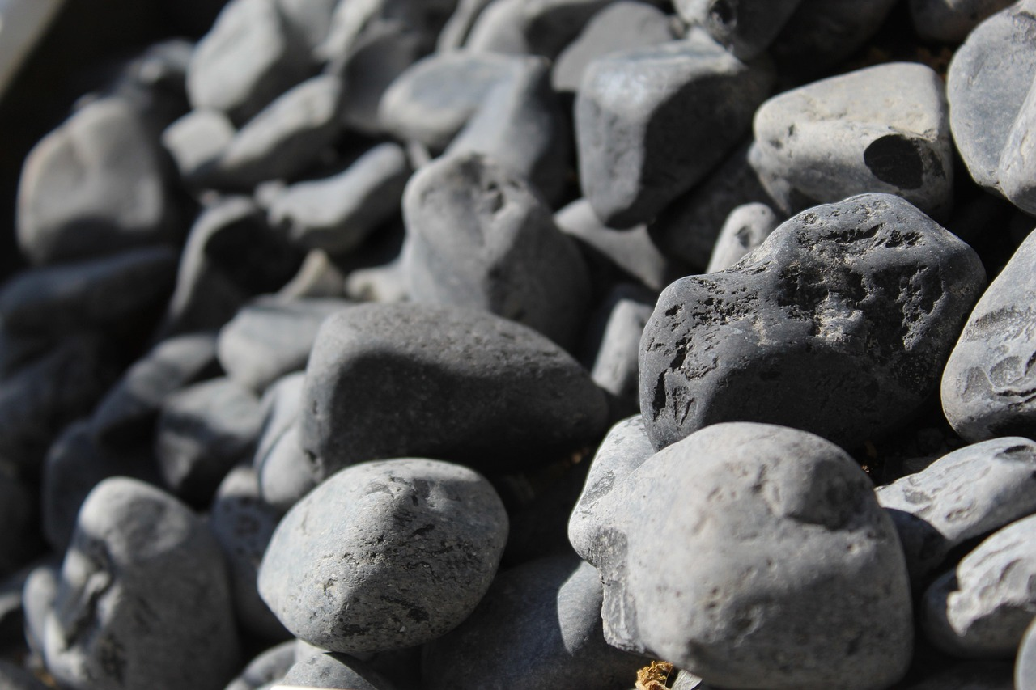
My Father, if it is possible, may this cup be taken from me; yet not as I will, but as you will.
Notes:
Slide 6: Heavy stone
Having a difficult decision to make can sometimes feel like a heavy stone, weighing us down. It’s sometimes hard to make the right choice, especially if it means giving up something that we want for the good of others. Use this time to talk about / share experiences of this in our own lives [e.g. thinking about others instead of ourselves], and strategies that you might have in school that help children to know how to navigate decision making, including how talking about challenges can make all the difference.
Jesus knew that talking to his Father, God, in prayer was the way to help him to make the right choice in the Garden of Gethsemane.

Slide 7
….I wonder why making the right decision sometimes feels so hard?....
….I wonder how Jesus’ example might help us if we are facing difficult decisions or choices?....
….I wonder how you make difficult decisions or who might help you?....
My Father, if it is possible, may this cup be taken from me; yet not as I will, but as you will.
Notes:
Slide 7: Responding and words for worship
We’ve thought today about the difficult choice that Jesus made to follow the plan that would lead to the Cross, because he knew it was the only way. We’ve also thought about difficult choices or decisions that we might have made. Let’s draw our thoughts together now and have some time to be quiet and still.
….I wonder why making the right decision sometimes feels so hard?....
….I wonder how Jesus’ example might help us if we are facing difficult decisions or choices?....
….I wonder how you make difficult decisions or who might help you?....
We’ve also heard how Jesus turned to God in prayer when he needed help to make the right choice.

Slide 8

Dear God,
When we’re faced with the most difficult choices, when we most need your wisdom, may we remember to ask for your help.
Notes:
Slide 8: Opportunity for reflection / prayer
I’m going to leave a short time of silence [or play some reflective music] when you can bring your own difficult decisions to God in prayer if you would like to, before I use some words of a prayer, asking God for his help when we have difficult choices to make, based on some words from the Bible.* Make this prayer your own if this is something you feel comfortable with…..
Dear God,
When we’re faced with the most difficult choices, when we most need your wisdom, may we remember to ask for your help.
[*‘If any of you needs wisdom, you should ask God for it.’ James 1:5].

Slide 9
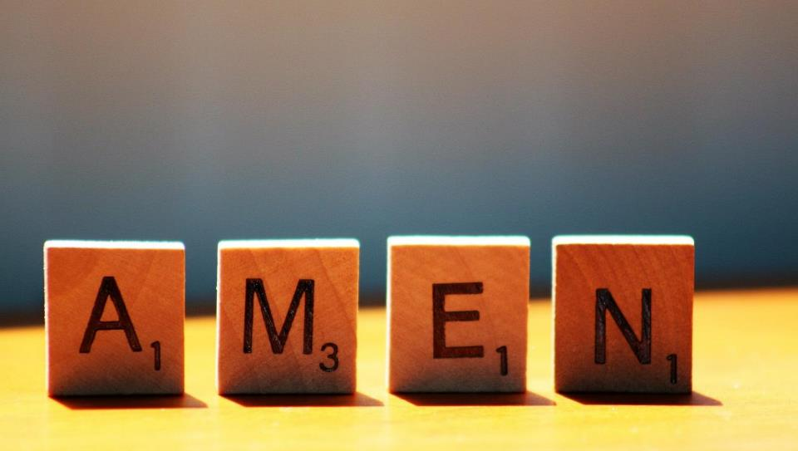

Slide 10
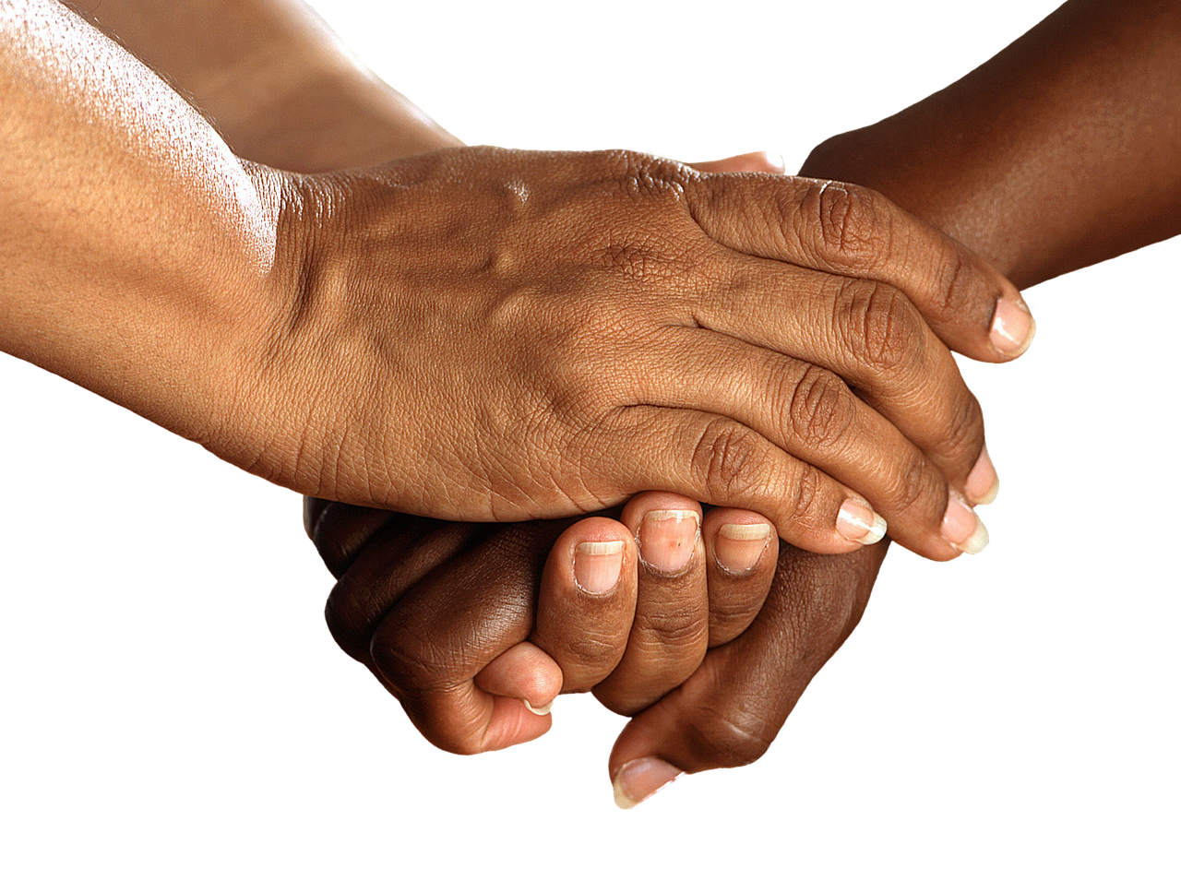


Leader: As we leave this place & time and go into the day ahead…
All: Together, we create a helpful community!
Notes:
Sending: Slide 10 (NB note different word from last week!)
Leader: As we leave this place & time and go into the day ahead…
All: Together, we create a helpful community!
BSL Together: https://www.signbsl.com/sign/together (1st video); Helpful: https://www.signbsl.com/sign/helpful
You already have signs for ‘community’

Slide 11
Notes:
Slide 11: Reflective areas
Talk: What helps you to make difficult decisions? How can we help each other?
Do: Pick up the heavy stone and hold it in your hands as you think.
Think: What difficult decisions might you have to make? You might want to make your thoughts into a prayer asking God for his help. Lay the heavy stone down as a way of letting go.

Slide 12
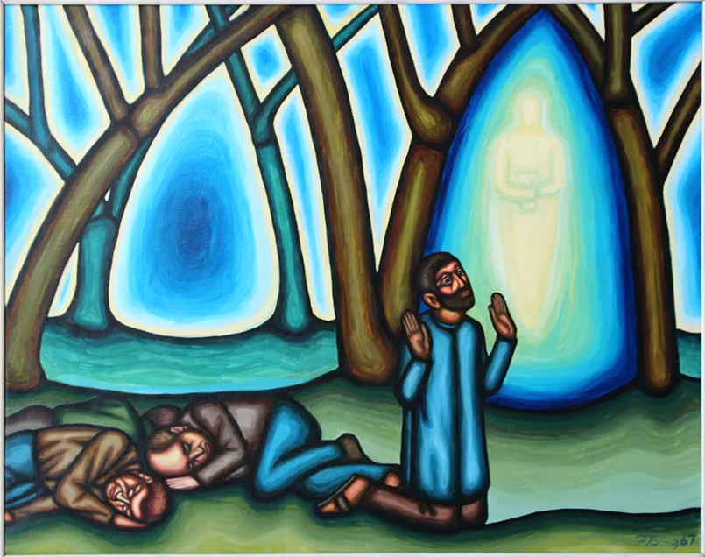
Garden of Gethsemane by Peter Koenig
from Art in the Christian Tradition
Notes:
Slide 12: Showing the Garden of Gethsemane from different cultural perspectives
Link to original artwork: https://diglib.library.vanderbilt.edu/act-imagelink.pl?RC=58532, which includes some key information.
Looking at these three creative interpretations of this part of the story may be something that links with your RE curriculum, reflecting the fact that Christianity is a global religion, encouraging pupils to appreciate the diversity that exists across cultures, traditions and geographical areas. It’s important for pupils’ wider understanding that they are given opportunities to think about how Christians show Jesus as being ‘like them’, and that this important story for Christians is imagined in different ways across the world. It also creates an inclusive classroom environment, giving all pupils opportunity to see themselves in the art that they view.
You may wish to consider these questions:
What is the same? What is different?
Which cultures / traditions do the other pieces come from?
Why do we think this?
What questions might we want to / need to ask?

Slide 13
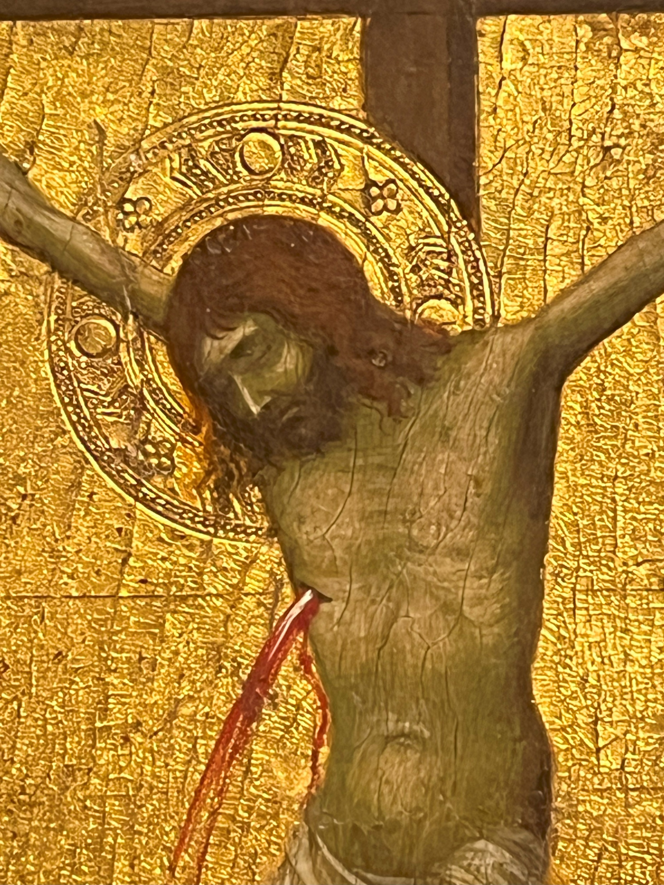
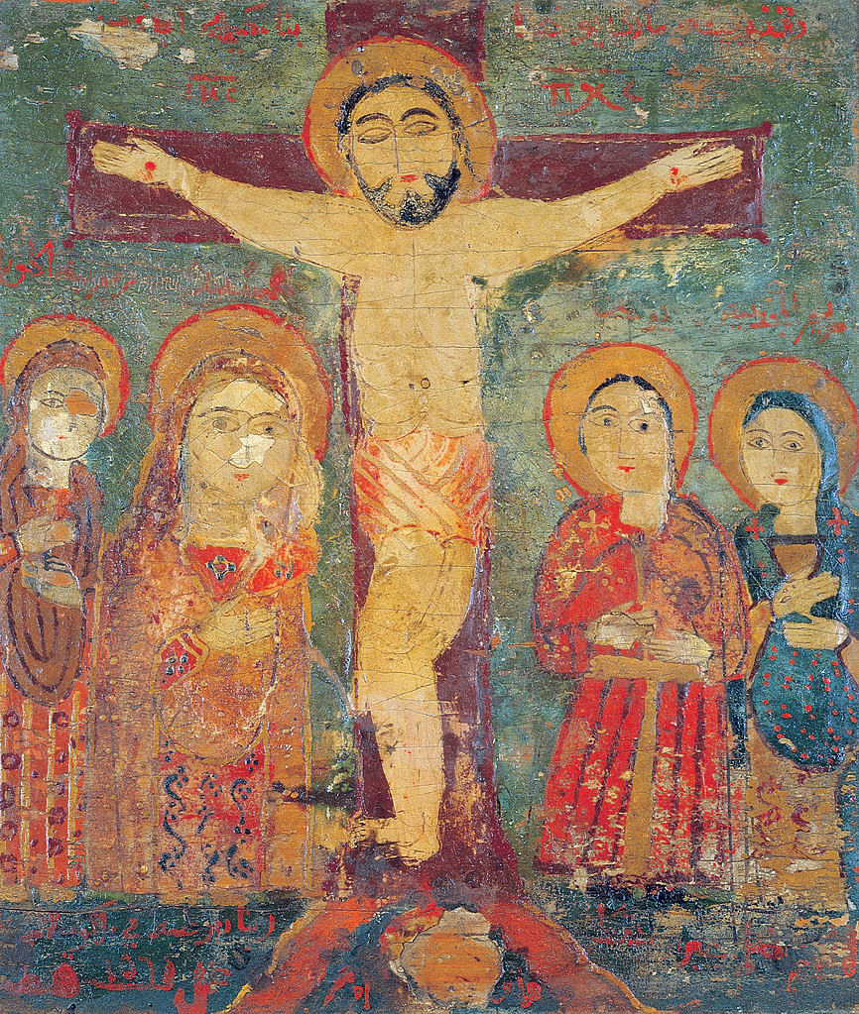
Crucifixion icon from Syria or Egypt c.1560 from Art in the Christian Tradition
Crucifixion icon from Siena, Italy c. 1320
Notes:
Slide 12: Showing the Crucifixion from different cultural perspectives
Link to original artwork: https://diglib.library.vanderbilt.edu/act-imagelink.pl?RC=56778, which includes some key information.
Looking at these three creative interpretations of this part of the story may be something that links with your RE curriculum, reflecting the fact that Christianity is a global religion, encouraging pupils to appreciate the diversity that exists across cultures, traditions and geographical areas. It’s important for pupils’ wider understanding that they are given opportunities to think about how Christians show Jesus as being ‘like them’, and that this important story for Christians is imagined in different ways across the world. It also creates an inclusive classroom environment, giving all pupils opportunity to see themselves in the art that they view.
You may wish to consider these questions:
What is the same? What is different? Notice the difference in colours especially.
Which cultures / traditions do the other pieces come from?
Why do we think this?
What questions might we want to / need to ask?

Slide 14
Notes:
Full panel: Today you will be with me in Paradise
Notice how the thieves’ crosses form a part of the two trees from the Garden of Eden, and what’s happened to the snake!

