Slide 1
We are here together….
May our attitudes make our school community a happy place today.
Notes:
Slide 1: Use the gathering words for this term
Leader: We are here together
ALL: May our attitudes make our school community a happy place today.

Slide 2
Peace
Notes:
Slides 2-7: Show the word ‘Peace’ and ask children what they think of. You could use the pictures in the PowerPoint to help if you’d like. (There are words to help you underneath!)

Slide 3
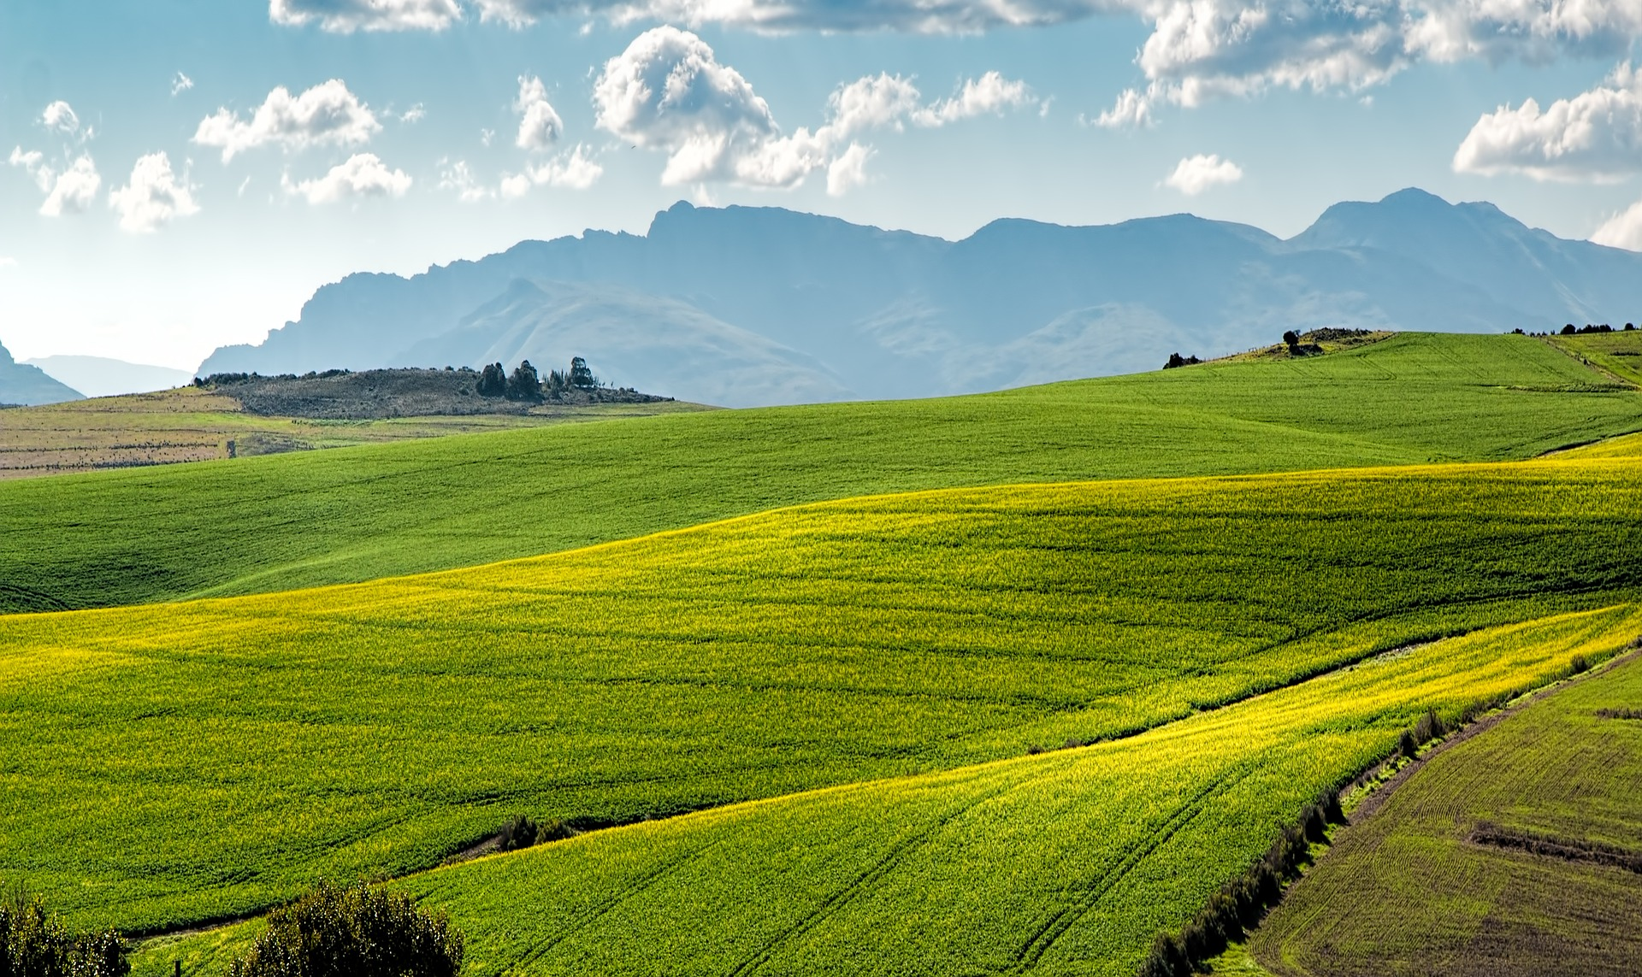
Notes:
Calming green hills….

Slide 4
Notes:
….a beautiful beach

Slide 5
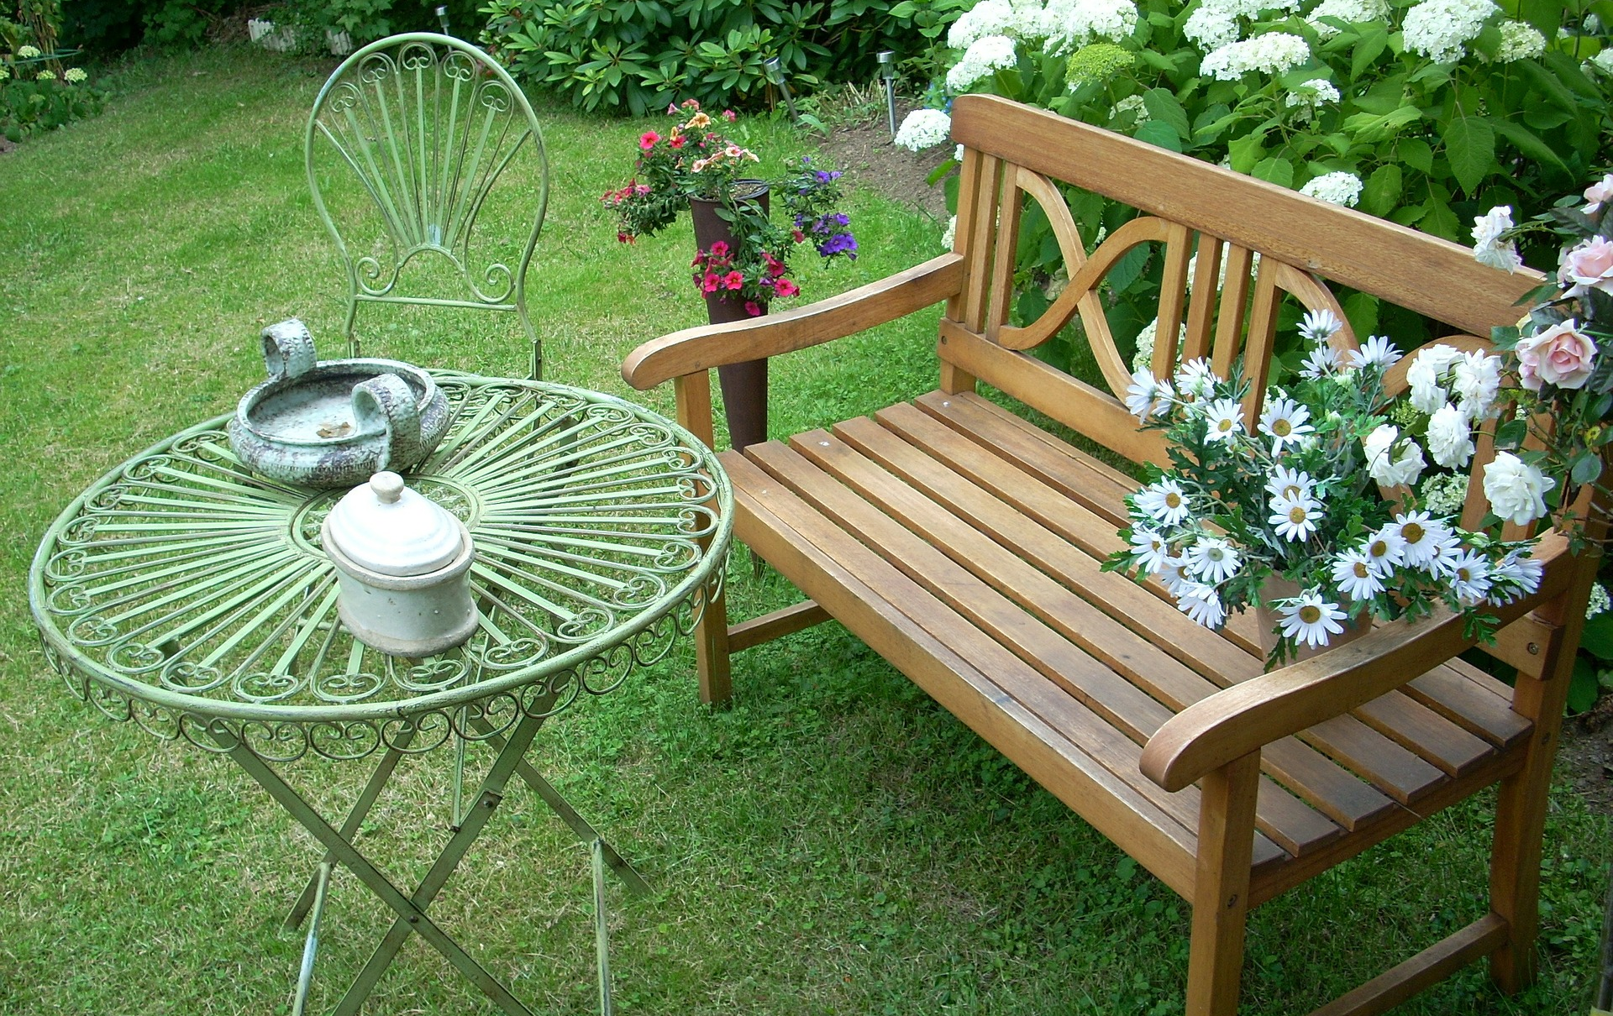
Notes:
…a quiet place in the garden…

Slide 6
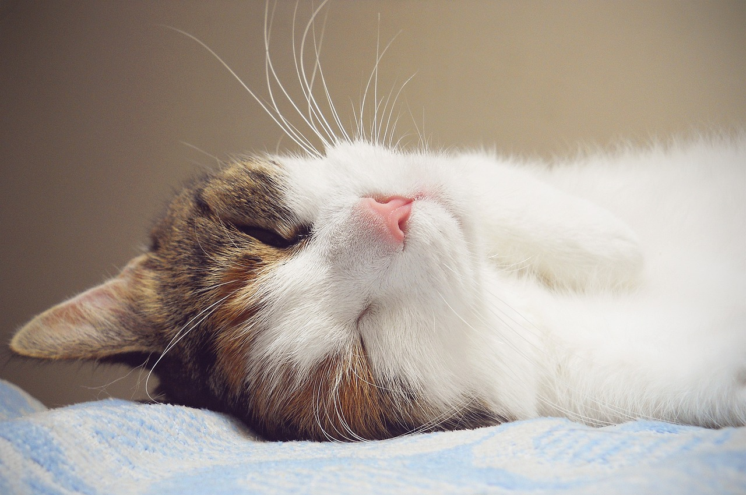
Notes:
Cat cuddles….

Slide 7
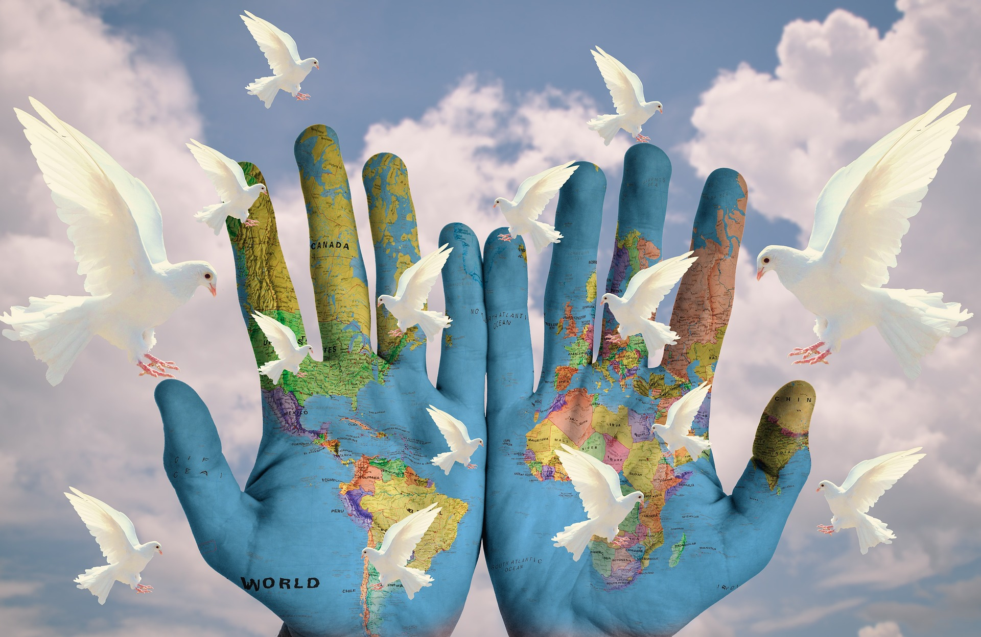
Notes:
….or maybe the peace that we want for the world?

Slide 8
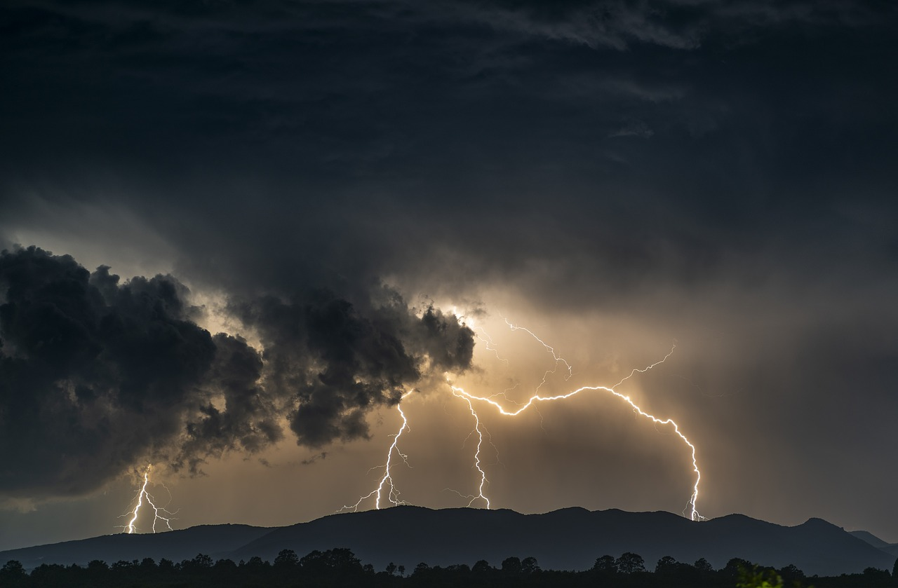
Notes:
Slide 8: ‘In a few moments, we’re going to hear about a storm, a not-very-peaceful experience! As I tell the story, there are certain words you’ll hear that mean you need to do or say something rehearse the actions if you need to.

Slide 9
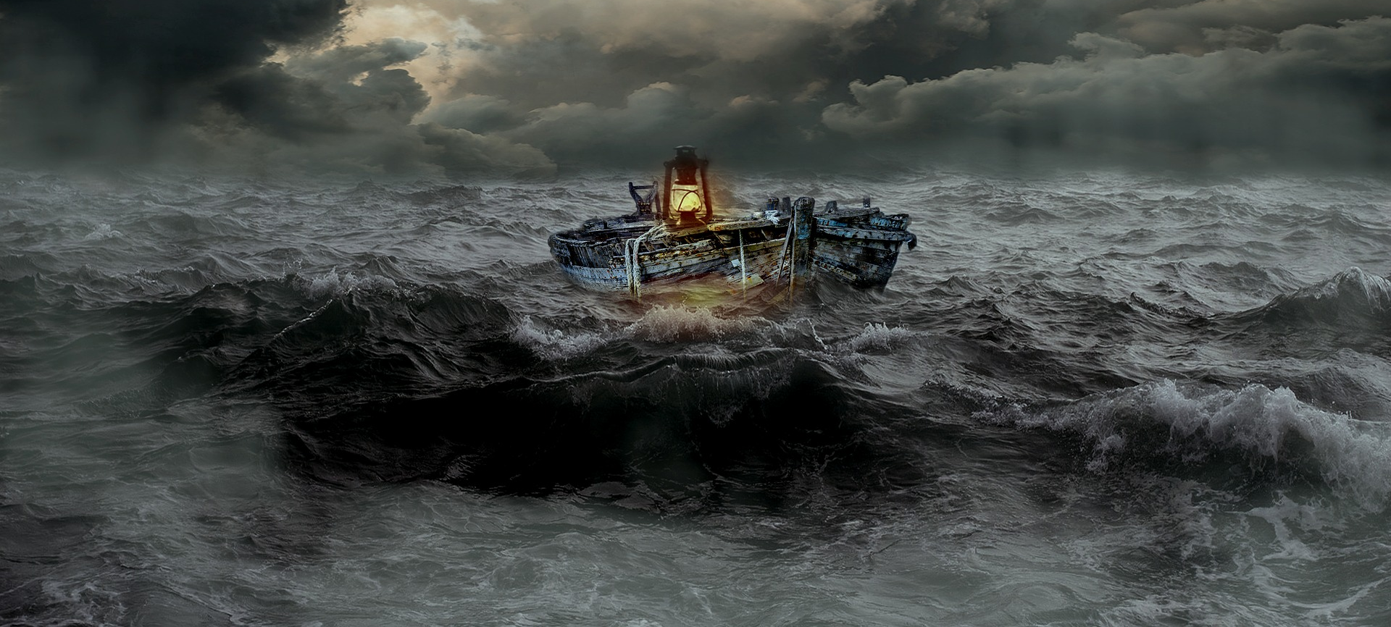
Jesus calms the storm
Notes:
Slide 9: Then use the script on p.3-4 to tell the story.
Jesus brought peace into a situation that the disciples weren’t expecting could be changed. He literally brought calm into the storm, and many Christians would say that Jesus still does this, not by calming waves and winds, but bringing calm into troubled situations in their lives: being with them through good times and bad. I wonder whether there are places in your life or in our world that could use some of this kind of peace….?

Slide 10
Beatitudes
Beati
‘How-to-be-attitudes’
Notes:
Slide 10: This term, we’ve been thinking about Jesus’ words in the Beatitudes, and the words we’re looking at today say:

Slide 11
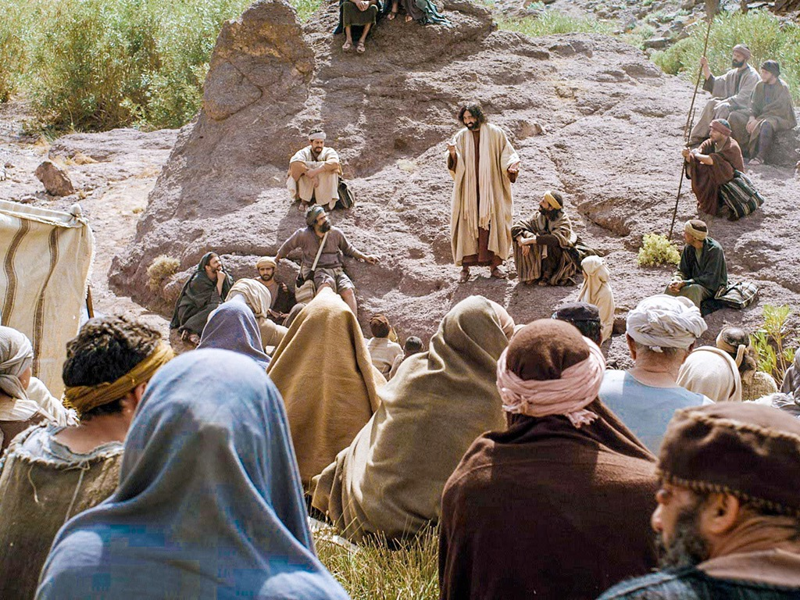
Those who work to bring peace are happy. God will call them his children.
Notes:
Slide 11: ‘Those who work to bring peace are happy. God will call them his children.’
In these words, Jesus was asking his followers to do as he did – to bring peace wherever they could, changing situations of conflict, being a calming influence….. one Bible translation calls it being a ‘peacemaker’.’

Slide 12
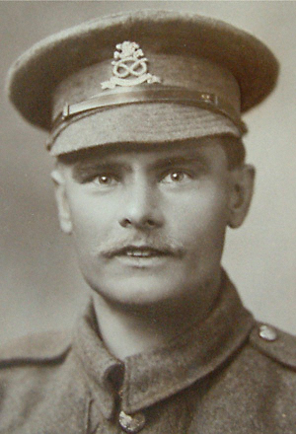
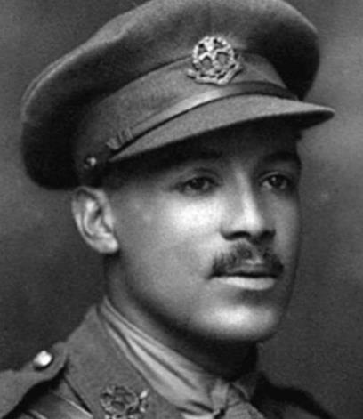
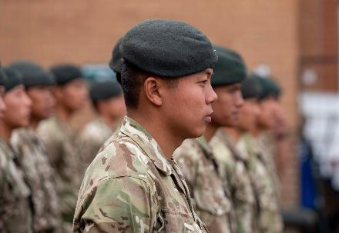
Lance Corporal William Coltman
(1891-1974)
2nd Lieutenant Walter Tull
(1888-1918)
Photo © Tull family archives & National Archives
Notes:
Slide 12: When we remembered together last week, we thought about the example of men and women who have been peacemakers in difficult times. But Jesus’ words remind us that we can all be peacemakers, wherever we are!

Slide 13
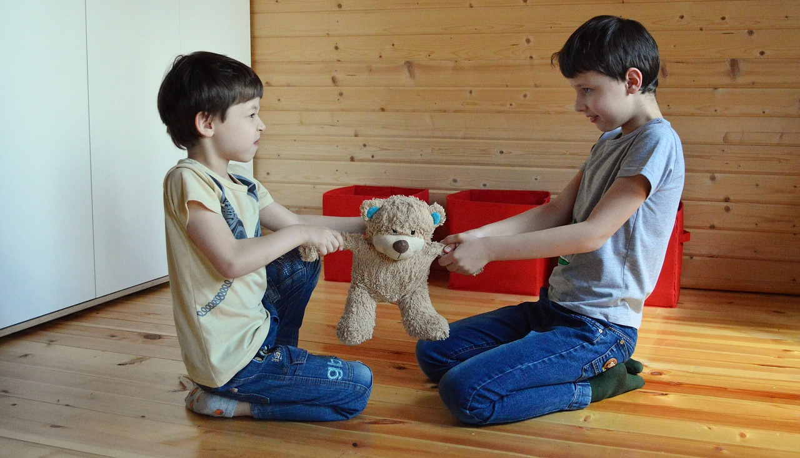
What does it mean to be a ‘peacemaker’?
Notes:
Slide 13: What does it mean to be a ‘peacemaker’? Spend a few moments thinking together about where your school or our world might need us to be ‘peacemakers’ – you might like to create some practical suggestions (from your classroom peace-making experience!) to help them.

Slide 14
…....I wonder if there are situations you are facing that could use a little peace?.....
….I wonder where peace might be needed in our world?.....
….I wonder how you might be the peacemaker that someone else needs?.....
Notes:
Slide 14: Responding (and words for worship):
….In the stillness now, I invite you to think quietly to yourself….
....you might like to close your eyes.....
…Jesus’ words in the Beatitudes remind us that it’s important to be a peacemaker…
….to bring peace and calm into troubled situations….
….to work for peace….
….I wonder if there are situations you are facing that could use a little peace?.....
….I wonder where peace might be needed in our world?.....
….I wonder how you might be the peacemaker that someone else needs?.....
Now I’m going to turn my thoughts into a prayer. If you agree with what I’m saying and would like to make the prayer your own, then you can join with me when I say ‘Amen’ at the end.

Slide 15
Dear God
Thank you for the story of Jesus calming the storm. Thank you for what it teaches us about Jesus being present through good times and through bad. Please help us as we try to follow his example, and be peacemakers in our troubled world.

Slide 17
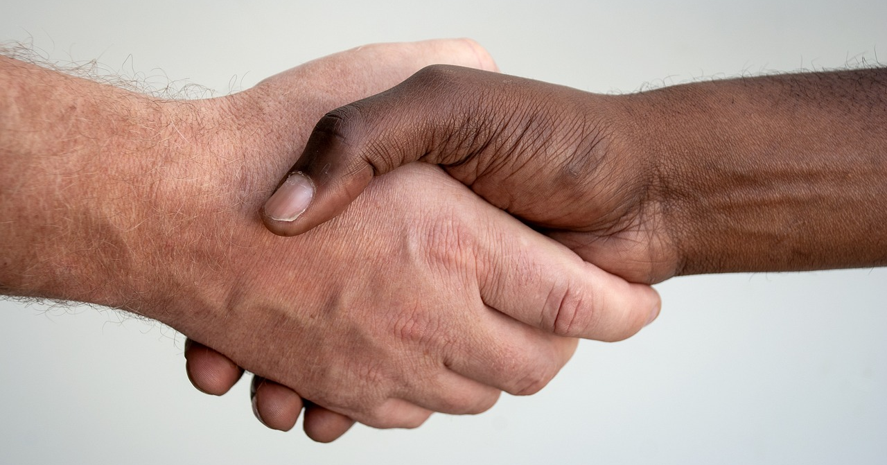
Leader: As we leave this place & time and go into the day ahead…
All: …may we be peace-makers wherever we go.

Slide 18
Notes:
Slide 18: Reflective areas
This week, you will need a selection of zips for your reflective area. These symbolise how ‘peacemakers’ bring sides together and offer children the opportunity to use these to pray for peace if it’s something they are comfortable with. Use the guided questions on the reflection card to help you.

