Slide 1

All pictures copyright-free from pixabay
Notes:
Slide 1: Rising hearts stilling exercise
Use the stilling slide if desired: the suggested words should be spoken slowly, leaving pauses inbetween to create a sense of stillness.
As you sit quietly here, watch the hearts as they grow…….PAUSE]
Now practise slower breathing…..in…..and out…..in……and out…..keep this going as you continue to watch….[PAUSE]
You maybe notice that you are feeling calmer and more relaxed….[PAUSE]
As you breathe, think about yourself and what you bring into this time today…..[PAUSE]
We come into this special / sacred space and time to be still….to think deeply…..to be together as a school community…..
In our time together today, we will….. have a challenge……think about some words together….and then reflect on what they might mean for us here in this school community.
But first, let’s welcome one another as we begin….

Slide 2
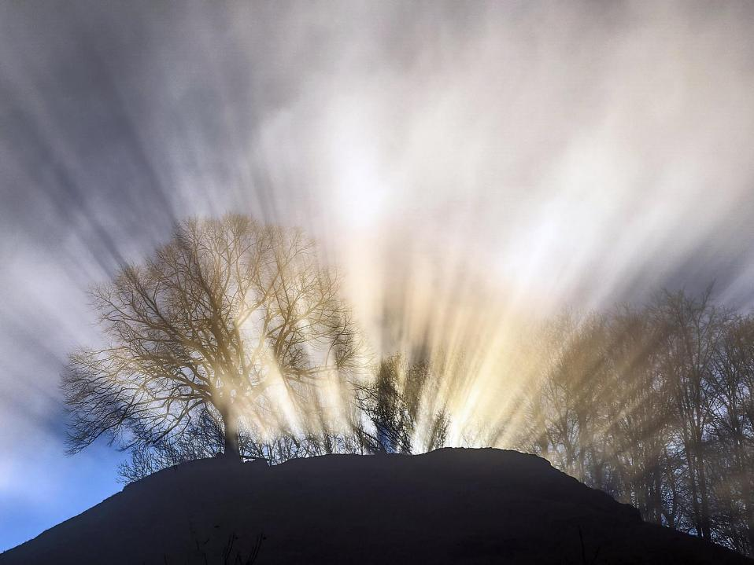
Leader: This is a day that God has made.
ALL: We will rejoice and be glad in it!
Notes:
Slides 2/3: Teach this new greeting to your school community – there are two slightly different versions from the point of view of the leader; choose which best fits your school’s context. One uses words adapted from Psalm 118:24
Leader: This is a day that God has made!
ALL: We will rejoice* and be glad* in it!
OR:
Leader: Today is a brand new day…..
ALL: May we be a blessing to each other!
*There are different BSL signs for rejoicing and joy/gladness. View them here: https://www.signbsl.com/sign/rejoice
Blessing: https://www.signbsl.com/sign/blessing (1st video)

Slide 3
Leader: Today is a brand new day!
ALL: May we be a blessing to each other!
Notes:
Slides 2/3: Teach this new greeting to your school community – there are two slightly different versions from the point of view of the leader; choose which best fits your school’s context. One uses words adapted from Psalm 118:24
Leader: This is a day that God has made!
ALL: We will rejoice* and be glad* in it!
OR:
Leader: Today is a brand new day…..
ALL: May we be a blessing to each other!
*There are different BSL signs for rejoicing and joy/gladness. View them here: https://www.signbsl.com/sign/rejoice
Blessing: https://www.signbsl.com/sign/blessing (1st video)

Slide 4

How far can you reach?
Notes:
Slide 4: How far can you reach? Let’s start with a challenge: who can reach the furthest, like this....? [stretch arms out sideways. Choose a few children to try, and compare their reaches] How about another challenge? Who can reach from one side of the room to the other – let’s try.....
Is there a way we can do it? [Ask for some suggestions – someone might just realise that if you were able to join hands, your reach can go a lot further! If not, then make the suggestion yourself. Hold hands to make a chain to show how this would work.]

Slide 5
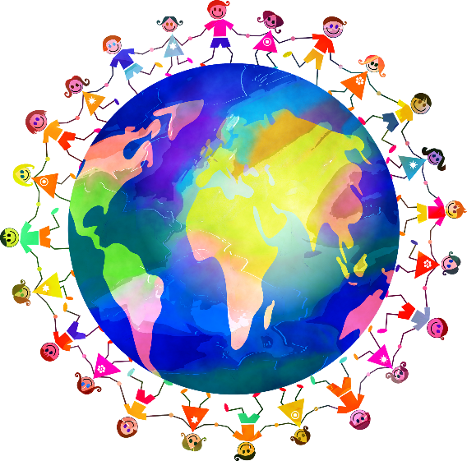
Chain of love, chain of love,
Circle the world with a chain of love, Chain of love, chain of love,
Circle the world with a chain of love.
© BBC
Notes:
Slide 5: I wonder whether you noticed some of the words in the song that was playing as you came in? The chorus says: ‘Circle the world with a chain of love’. Can we do THAT?!!!....

Slide 6
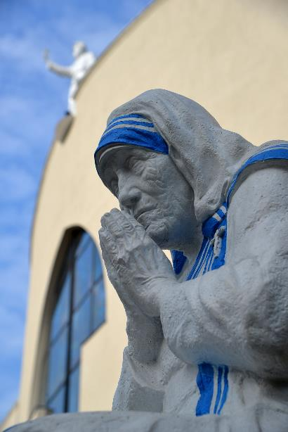
“Peace begins with a smile.”
“What can you do to promote world peace? Go home & love your family.”
Notes:
Slide 6: One of my very favourite people is Mother Teresa, who always had time for other people and lived her life amongst the poorest people in the world. We heard these words of hers a few weeks back…when we were thinking about peace.

Slide 7

Good works are links that form a chain of love.
Notes:
Slide 7: She also spoke these words: ‘Good works are links that form a chain of love’. We’re going to spend some time today thinking about this idea. I wonder what you think Mother Teresa meant by ‘good works’? And how they might form a ‘chain of love’? [Spend some time talking and sharing your ideas together, using talking partners if possible so that every child gets to contribute] The small, thoughtful acts of kindness that we do for others transform our world and make it a different, more loving place, to live in.

Slide 8
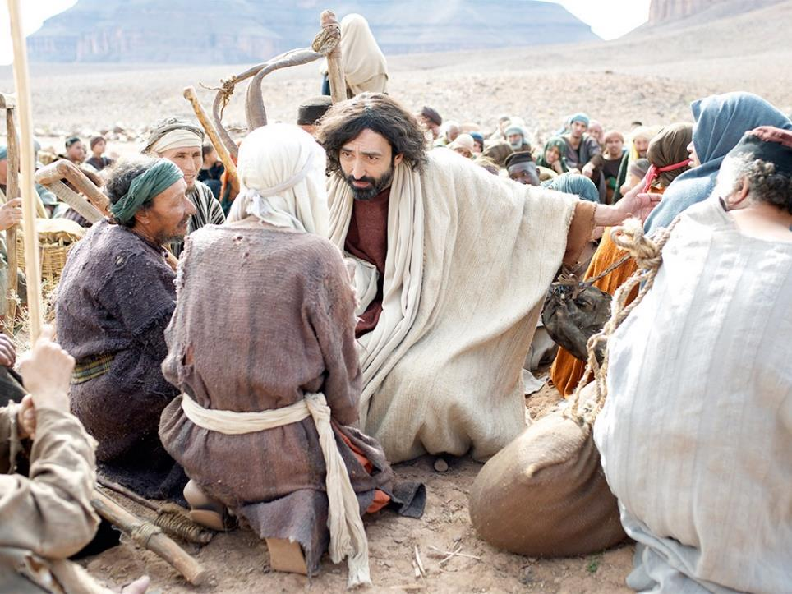

‘Each time you do these things to anyone, it’s as if you’re doing them to me’.
Notes:
Slide 8: In the Bible, the special book for people who are Christians, there are many stories showing how Jesus lived his life putting other people first. Mother Teresa copied his example. Jesus spent time with sick people....and poor people, the people that no-one else were bothered with, and he taught his disciples, those people who learned from him like you learn from your teachers, to live their lives the same way. He once told them that ‘each time you do these things to anyone, it’s as if you’re doing them to me’.
Jesus’ followers did what he said, and by following his example, they did indeed change their world. The first followers of Jesus began this ‘chain of love’. It has been continued by others, including Mother Teresa, and is still circling the world today!

Slide 9
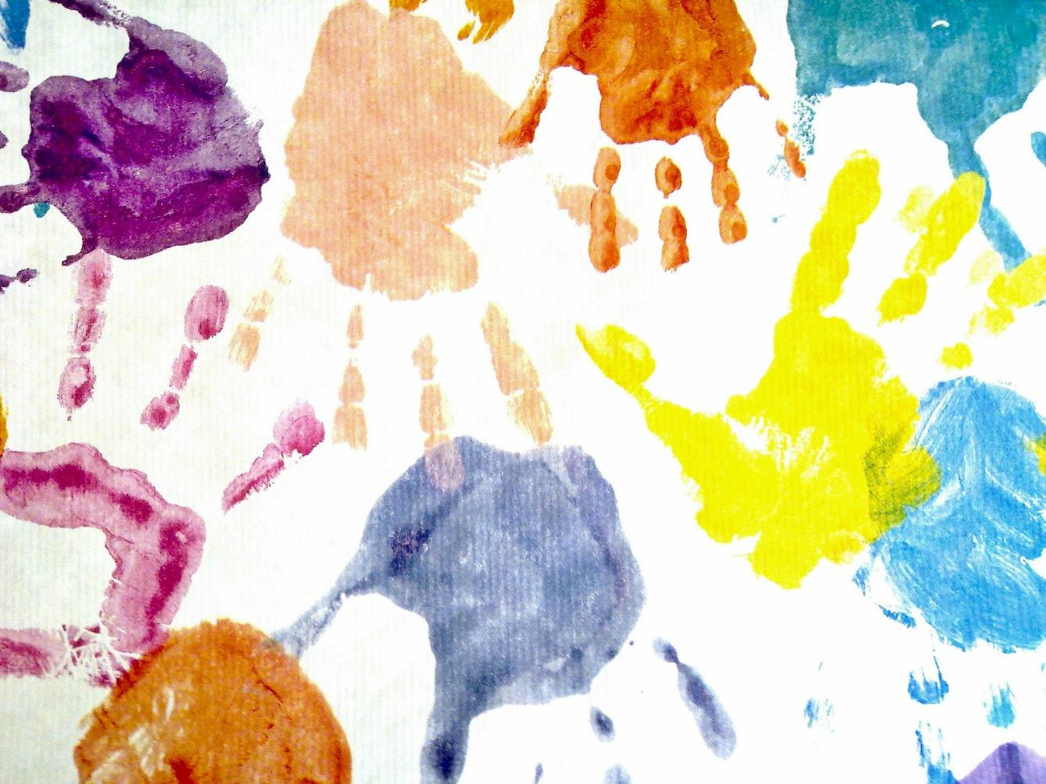
Notes:
Slide 9: We’re going to make a picture of this together now, using lots of hands / a paper chain. On each hand / strip, I’ve an idea for something you might do to begin that ‘circle’ around the world. [With older children, use the blank hands / strips and take their own ideas. As you read out each, display it so that it’s touching fingers with another (or staple it into the paper chain). If you’re leaving some blanks for children to add their own ideas onto, then explain this at this point during the assembly.]

Slide 10
Good works are links that form a chain of love.
I wonder how far that chain of love could reach?
Notes:
Slide 10: Responding and words for worship
… We’re going to have some quiet, thinking time now. You might wish to close your eyes to help you think.....
I’m going to read out what’s written on our handprints / chain again now. As I do, think about how you might change the world this week, and start that chain of love circling around the world!
[read your chosen handprints / links, leaving a pause between each for children to think]
Many people believe that doing these things is not always easy – it’s often much easier to do the things that we want to do than think of ways of putting other people first. And so I’m going to pray, and ask God to help us. If you’d like to make the prayer your own, then you can join with me by saying ‘Amen’ at the end.

Slide 11
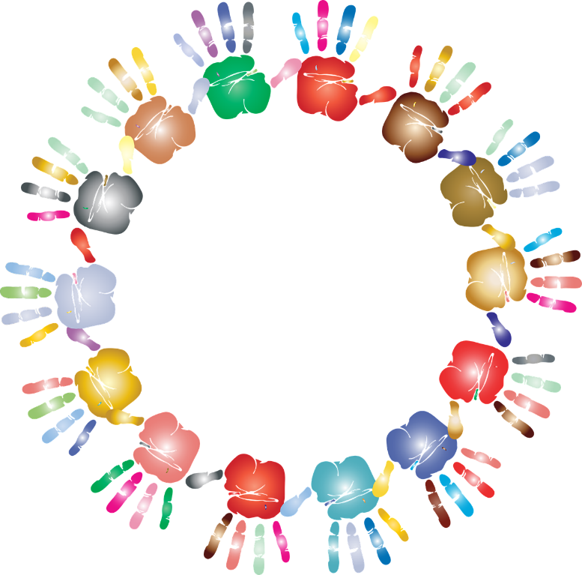
Dear God
We thank you for the people who are a part of our lives whom we can show love and care for.
Help us, this week, to think of ways to put other people first, and to begin the chain of love that will circle the world.
Notes:
Slide 11: Prayer
Dear God
We thank you for the people who are a part of our lives whom we can show love and care for.
Help us, this week, to think of ways to put other people first, and to begin the chain of love that will circle the world.

Slide 12
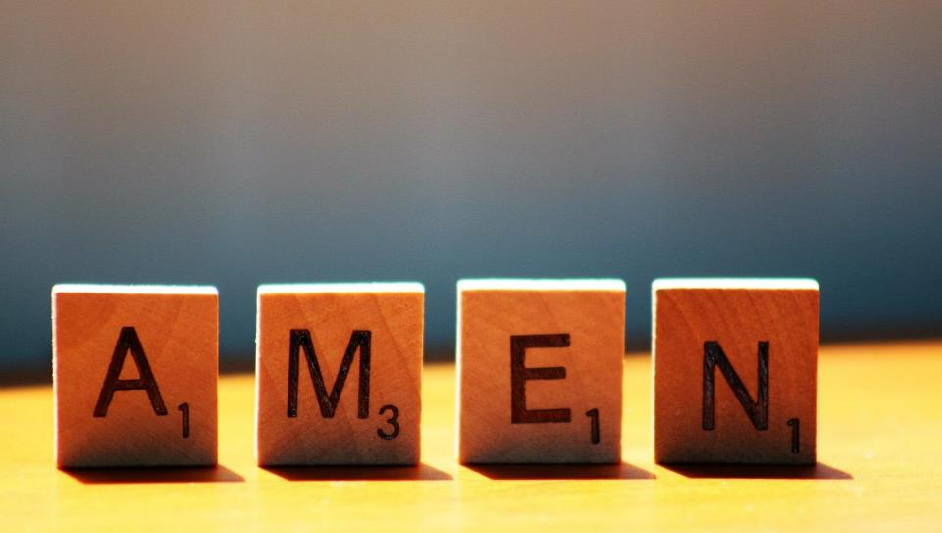

Slide 13


Leader: As we leave this place & time and go into the day ahead…
All: Let’s ‘circle the world’ with our chain of love!

Slide 14

Notes:
Slide 14: Reflection areas
Provide paper for children to draw around & cut out their own hand, or print/cut more of the hands used for the main collective worship, using the template on p. 4
Think: What might you do this week to continue the ‘chain of love’?
Do: Write or draw your idea on a hand shape and add it to the chain.
Talk: At the end of the week, talk about your class chain of love. What difference has it made to your school community?

