Slide 1





On the journey of life….
....we are glad to be together as a school community.
Notes:
Slide 1: Use these gathering words for this term, or your usual greeting if you prefer. Why not invent some actions to make them extra memorable?!

Slide 2
As we gather today….
....may we learn from each other and hear from God.
Notes:
Slide 2: Use these gathering words for this term, or your usual greeting if you prefer. Why not invent some actions to make them extra memorable?!

Slide 3
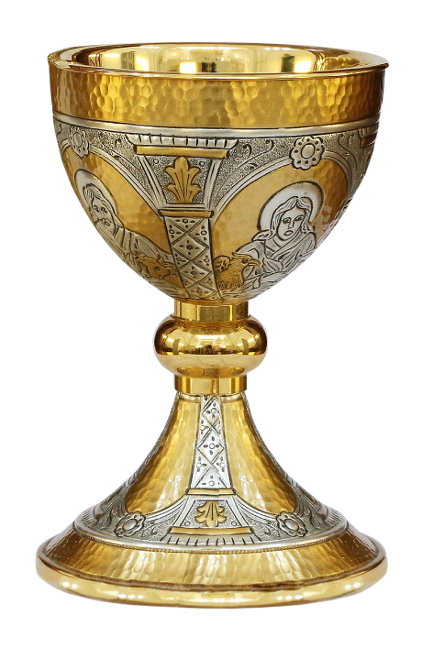
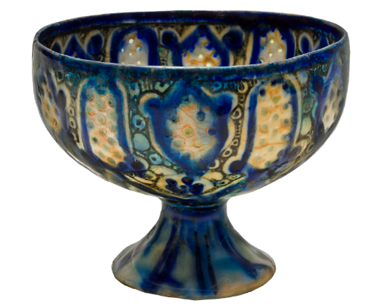
Notes:
YOU COULD USE YOUR OWN IMAGES OR OBJECTS HERE, ESPECIALLY IF THIS FITS IN WITH YOUR ART CURRICULUM
Slide 3: What makes these objects beautiful? Which one is more beautiful, do you think?
What do you think they are used for?
Why do you think someone took the time to make them look like this, when they’re only for drinking from?

Slide 4
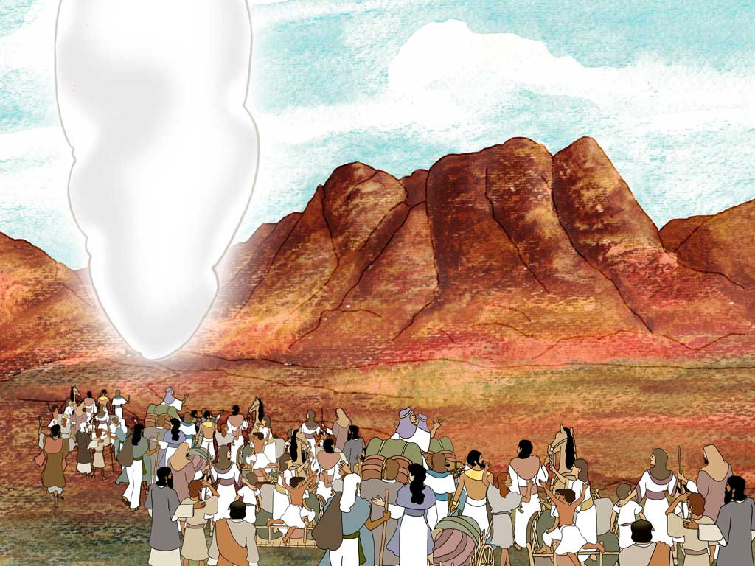
Moses: Are we nearly there yet?!
Autumn 2023
Notes:
Slide 4: We have journeyed now with God’s people through 11 weeks of term, sharing their adventures, their mistakes and their wanderings.

Slide 5
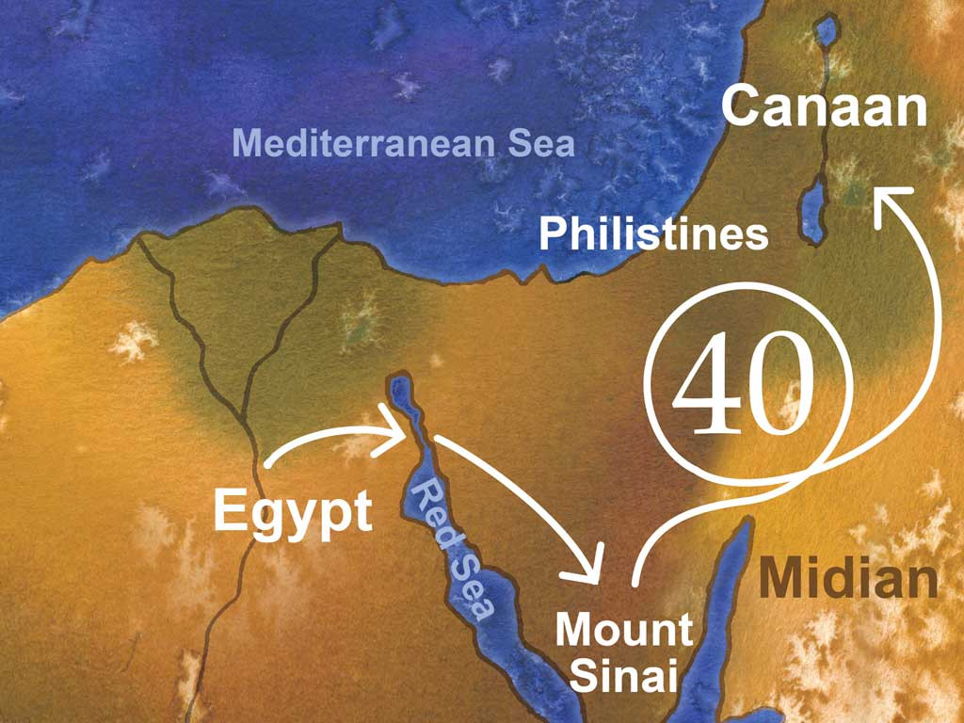
Notes:
Slide 5: As we heard last week, it took God’s people 40 years of wandering through the desert to finally have sight of the Promised Land – which we will hear about next week!
We heard in our story how everyone lived in tents – and packed up each time that the pillar of cloud of God’s presence moved on.

Slide 6
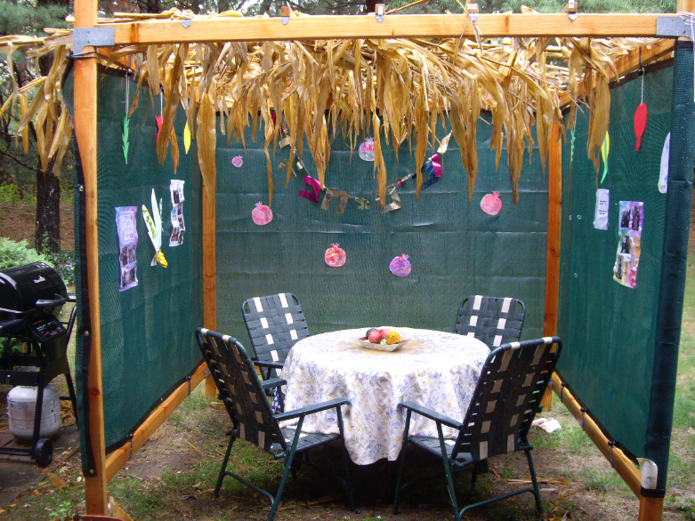
Sukkot: feast of tabernacles
Notes:
Slide 6: Earlier in the term, we learned that even today, Jewish people still spend 8 days in makeshift shelters during Sukkot, to keep God’s commandment to ‘Remember’. They call these ‘tabernacles’, which is what the tents in the desert were called. ‘Tabernacle’ means ‘dwelling place’ – the place where someone lives.
Today we’re going to find out about a very special tabernacle that was part of the Israelites’ camp wherever the pillar of cloud stopped.

Slide 7
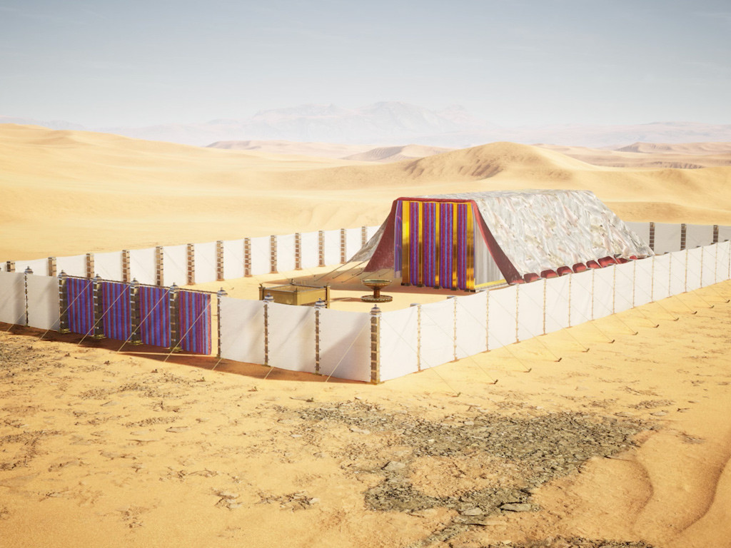
This is the House that God built
Notes:
Slide 7: This is THE Tabernacle – the place where God ‘lived’ when the people set up camp in the desert.
Although the events in the story of Moses took place many thousands of years ago, we know a lot about what this looked like because of the very detailed instructions that God gave to Moses.
Our story for today, about the Tabernacle, is another story that follows a pattern, which some of you might know as ‘This is the house that Jack built’ or even ‘I know an old woman who swallowed a fly…’
Our story is called ‘This is the House that God built.’ We’ve given the word House a capital letter to show that it’s a very important place, as you’ll hear.
Let’s begin – and do join in if you can, because it’s a repeating story!
‘This is the House that God built.’
There are some extra notes about the Tabernacle, under each slide, if you or your class would like to know more:
The Tabernacle was pitched facing the east, the position of the sun at sunrise. It was made out of very special materials, to show how special this ‘tent’ was.
Blue is a holy colour, meaning that this was a place of God and purple, the most expensive dye to produce, was a symbol of royalty.

Slide 8
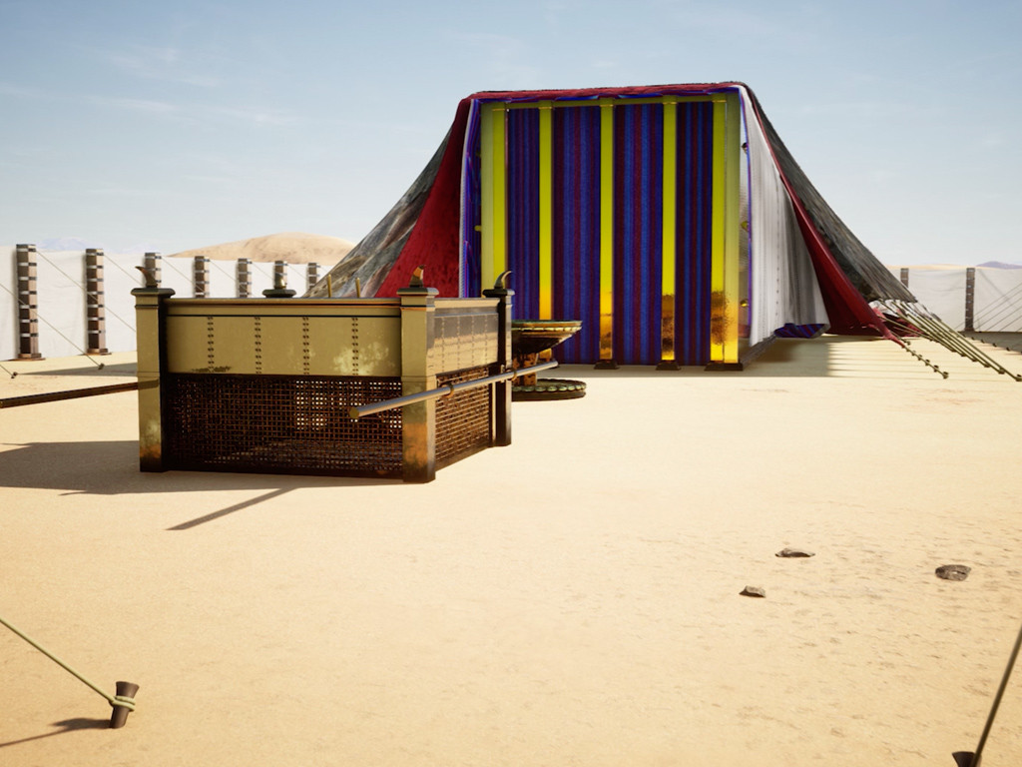
Notes:
Slide 8: This is the courtyard where [the] people would gather, inside of the House that God built.
There are some extra notes about the Tabernacle, under each slide, if you or your class would like to know more:
Directly upon entering the courtyard you would see the place where God’s people brought their offerings to God every day – to say sorry to God for the wrong things they might have done. (Exodus 29:38).
I wonder why it was important to say ‘sorry’ to God?

Slide 9
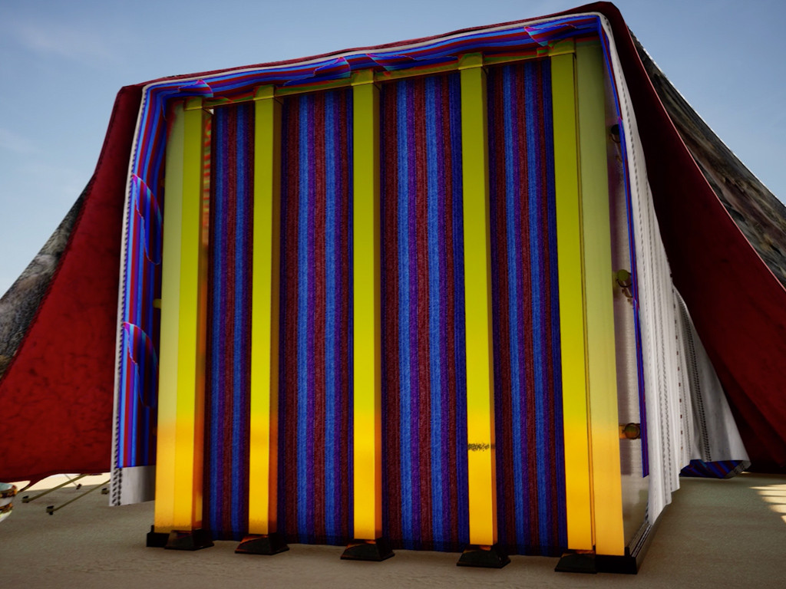
Notes:
Slide 9: This is the curtain with purple stripes, that hung in the courtyard where [the] people would gather, inside of the House that God built.

Slide 10
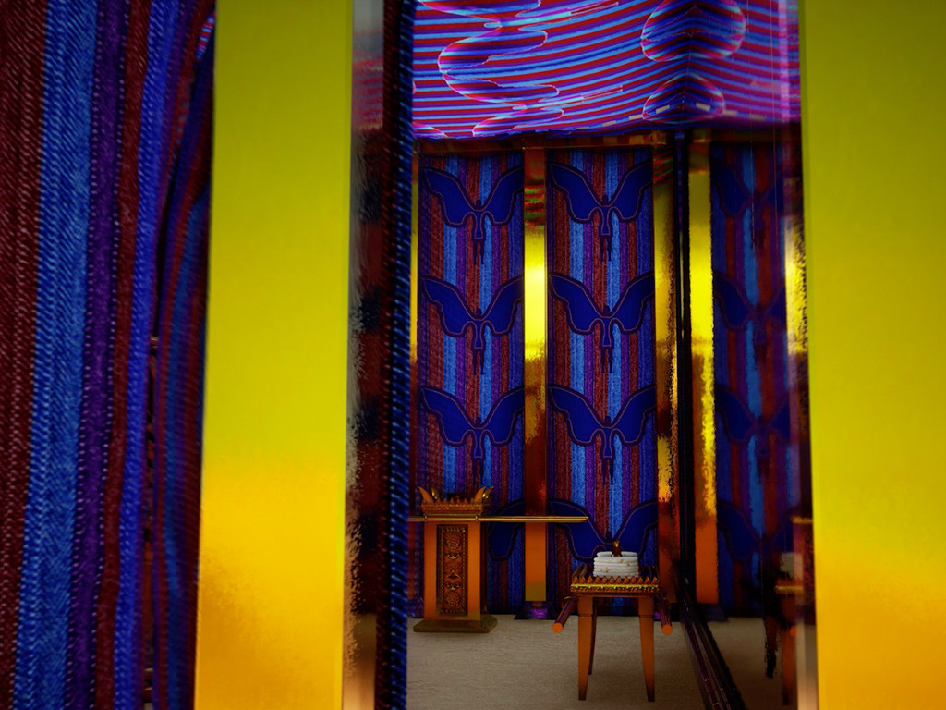
Notes:
Slide 10: This is the room, the Holy Room, behind the curtain with purple stripes, that hung in the courtyard where [the] people would gather, inside of the House that God built.
There are some extra notes about the Tabernacle, under each slide, if you or your class would like to know more:
Only priests could enter the Holy Place where there were three special items: a table, an altar and a lampstand.

Slide 11
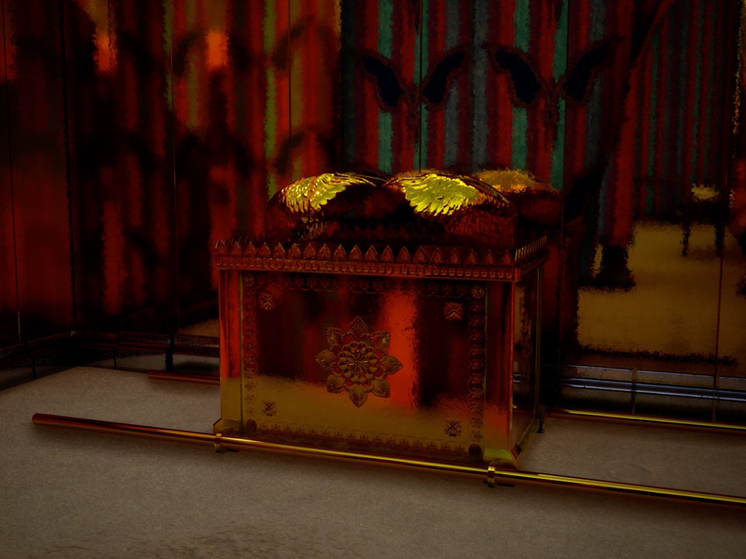
Notes:
Slide 11: This is the Ark that Bezalel made, that lay in the room, the Holy Room, behind the curtain with purple stripes, that hung in the courtyard where [the] people would gather, inside of the House that God built.
There are some extra notes about the Tabernacle, under each slide, if you or your class would like to know more:
A craftsman called Bezalel was given the job of creating three special items for the Most Holy Place: a table, an altar and a lampstand. We’ll find out more in the ‘wondering’ section.

Slide 12
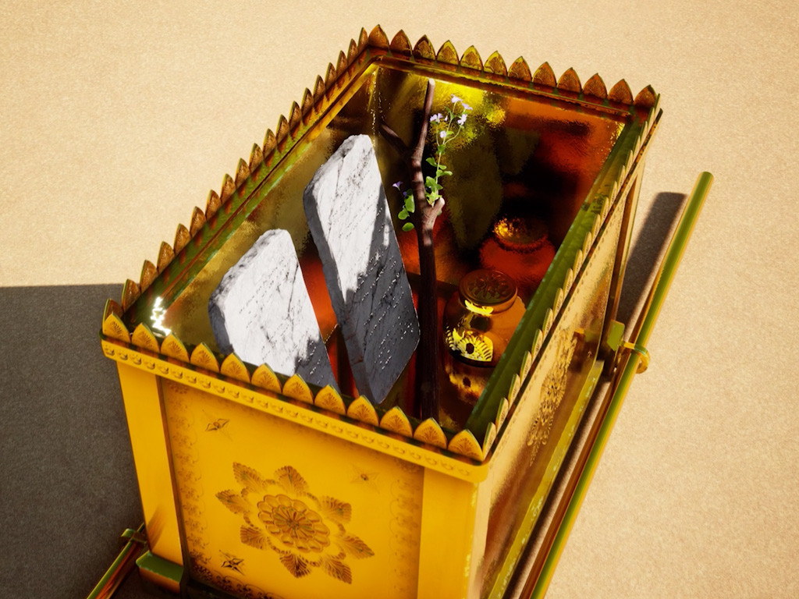
Notes:
Slide 12: These are the treasures of God’s provision, that lived in the Ark that Bezalel made, that lay in the room, the Holy Room, behind the curtain with purple stripes, that hung in the courtyard where [the] people would gather, inside of the House that God built.
There are some extra notes about the Tabernacle, under each slide, if you or your class would like to know more:
The 3rd special object was called the Ark of the covenant, a very special box for very special objects.
The Ark of the Covenant was made with special handles so that the priests could carry it with them when they travelled.
In it, God told Moses to place the Ten Commandments, Aaron’s staff and a pot of the manna that had fed God’s people in the desert. This manna never went bad!
I wonder why God chose these objects to go into the Ark?

Slide 13
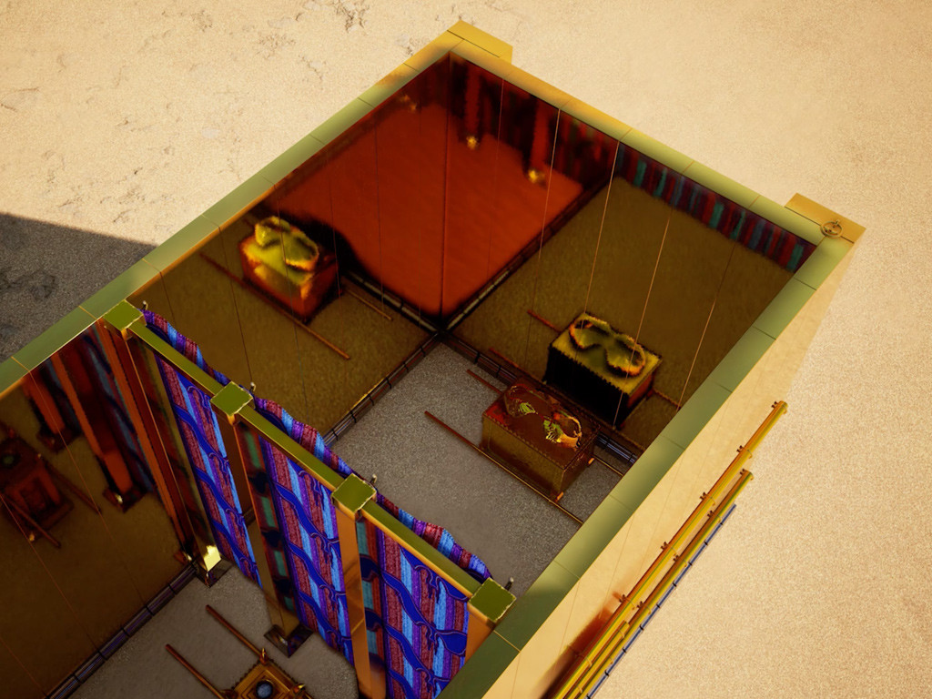
Notes:
Slide 13: This is the place where Moses would wait, next to the treasures of God’s provision, that lived in the Ark that Bezalel made, that lay in the room, the Holy Room, behind the curtain with purple stripes, that hung in the courtyard where [the] people would gather, inside of the House that God built.
There are some extra notes about the Tabernacle, under each slide, if you or your class would like to know more:
In later times, the High Priest alone could enter through the curtain to the Holy of Holies. This was allowed once a year on the Day of Atonement. Inside was the Ark of the Covenant.

Slide 14
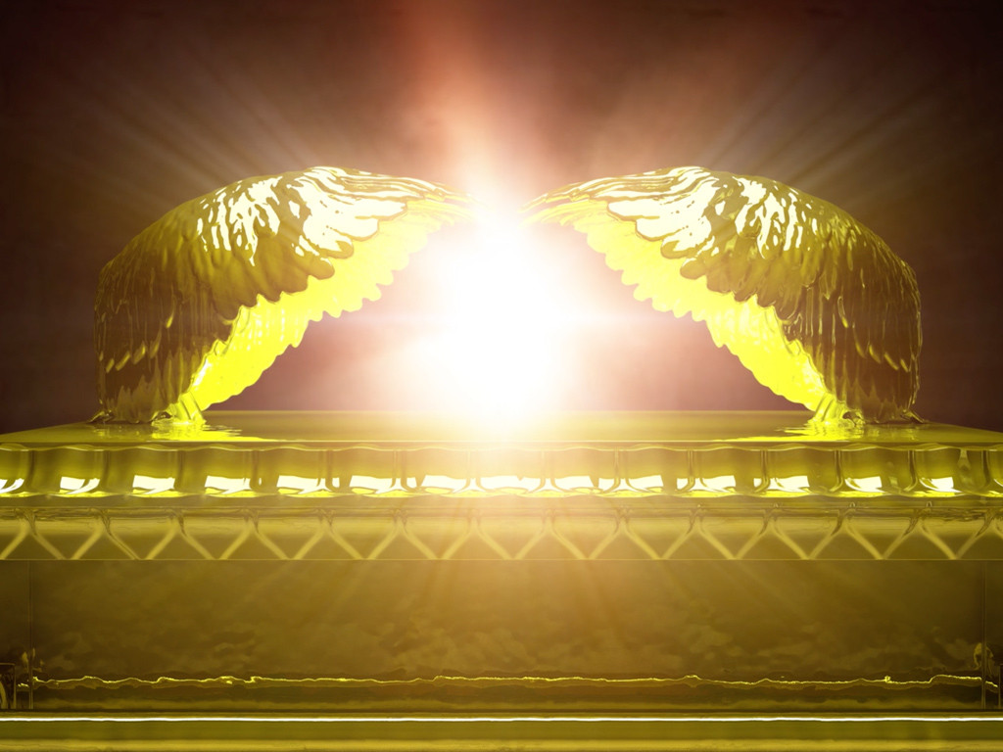
Notes:
Slide 14: This is the spot where God’s presence came down, in the place where Moses would wait, next to the treasures of God’s provision, that lived in the Ark that Bezalel made, that lay in the room, the Holy Room, behind the curtain with purple stripes, that hung in the courtyard where [the] people would gather, inside of the House that God built.
There are some extra notes about the Tabernacle, under each slide, if you or your class would like to know more:
It was here, in this place right near to the Ark of the Covenant, between the wings of the two heavenly creatures called cherubim, that God would meet with Moses. Only Moses was allowed in this Most Holy Place, when God’s presence was there. (Numbers 7:89).

Slide 15
But why did God build such a Holy House, where the people would gather and treasures would live….?
Notes:
Slide 15: But why did God build such a Holy House, where the people would gather and treasures would live….?
Let’s wonder together….

Slide 16
….I wonder why God needed a ‘House’?....
….I wonder how the ‘Tabernacle’ helped God’s people to worship?....
…. I wonder why there were such special objects inside?....
….I wonder what special objects help us to worship or reflect as a school community?....
Notes:
Slide 16: Let’s be still together and turn our ‘wondering’ thoughts to our own school community….. [Pause and talk together, as time allows]
….I wonder why God needed a ‘House’?
….I wonder why there were such special objects inside?....
….I wonder what special objects help us to worship or reflect as a school community?....

Slide 17
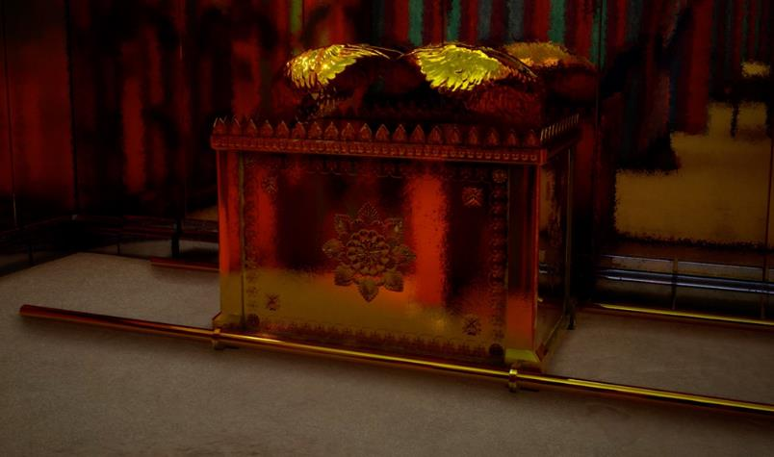
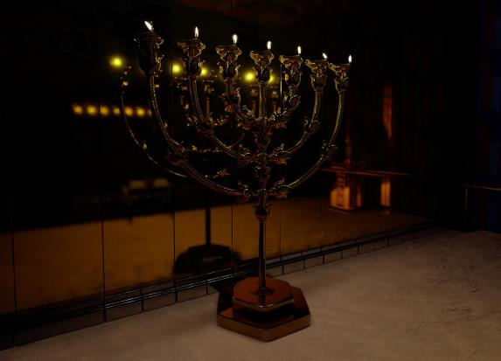
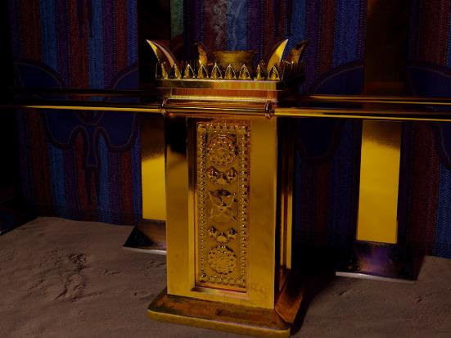
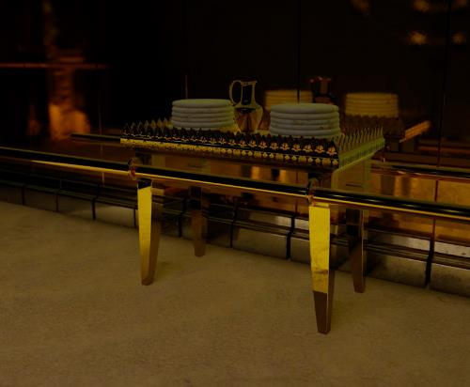
I wonder how Bezalel’s objects helped the people to worship God?
‘I have given Bezalel the skill, ability and knowledge to do all kinds of beautiful work.’ Exodus 31:3-4
Notes:
Slide 17: As you heard in the story, the Ark of the Covenant was crafted by a man named Bezalel. God told Moses: ‘I have given Bezalel the skill, ability and knowledge to do all kinds of work.’ (Exodus 31:3-4)
It goes on to say that Bezalel was able to design pieces to be made from gold, silver and bronze, to cut jewels and put them in metal, and carve wood. That’s quite a craftsman!!
As well as the Ark, Bezalel made a beautiful golden lampstand, and two places to bring offerings for God: an altar and a table.
I wonder how Bezalel’s objects helped the people to worship God?
There are some extra notes about the Tabernacle, under each slide, if you or your class would like to know more:
The Lampstand was designed like a tree, with the base and middle shaft representing the trunk and with three ‘branches’ on each side. The lamp was to be looked after by Aaron and his sons so that its light never went out. I wonder if you’ve seen anything like this before?
Aaron was instructed to burn fragrant incense on the altar each morning and again in the evening as it got dark, as an offering to God with the prayers of the people.
At the start of each week the priests placed 12 loaves of fresh bread on the beautiful table, as an offering to God — one loaf to remember each of the 12 families of Israel (Joseph & his 11 brothers!!)

Slide 18
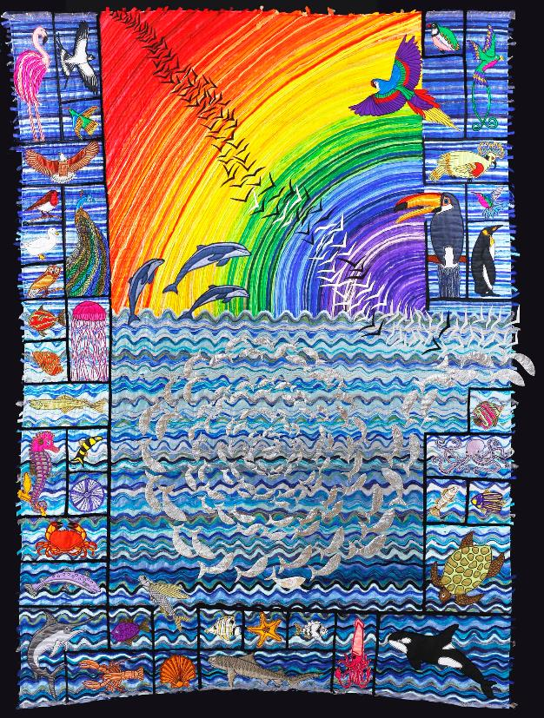
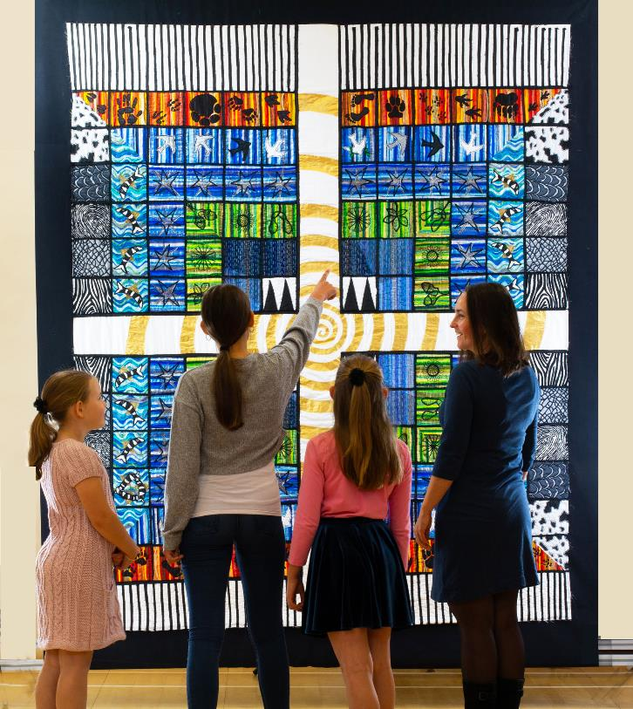
I wonder how we might use our gifts of creativity to help us to worship or reflect as a school community?
Notes:
Slide 18: This is a beautiful piece of tapestry created by textile artist Jacqui Parkinson as part of her series on the Creation story from the Bible. Many people have been to see her exhibition and her tapestries have helped people to reflect on and wonder about this part of the Bible. Jacqui says that she believes that human beings are made to be creative, just like God the Creator is.
I wonder how we might use our gifts of creativity to help us to worship or reflect as a school community? [you may wish to talk about this together and set it in the context of the reflective task this week.]

Slide 19

Dear God
Thank you for our own abilities to create things that are beautiful – a reminder of how you are the Creator. Help us to use our creativity well.
Notes:
Slide 19: Prayer
Now I’m going to use the words of a prayer to draw our time together today to a close. Make it your own if you would like to, or just be still and quiet with your own thoughts.

Slide 20
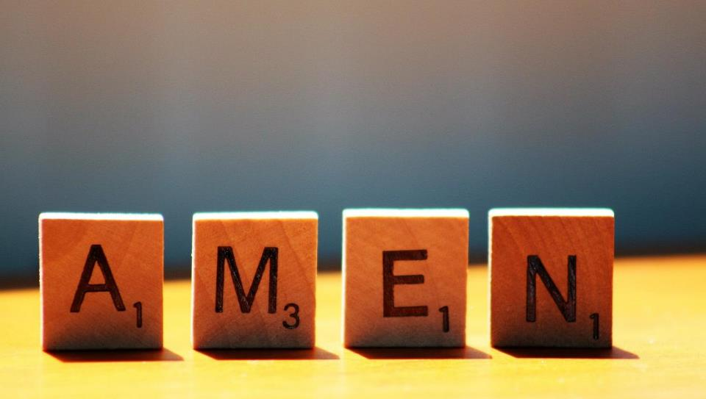

Slide 21
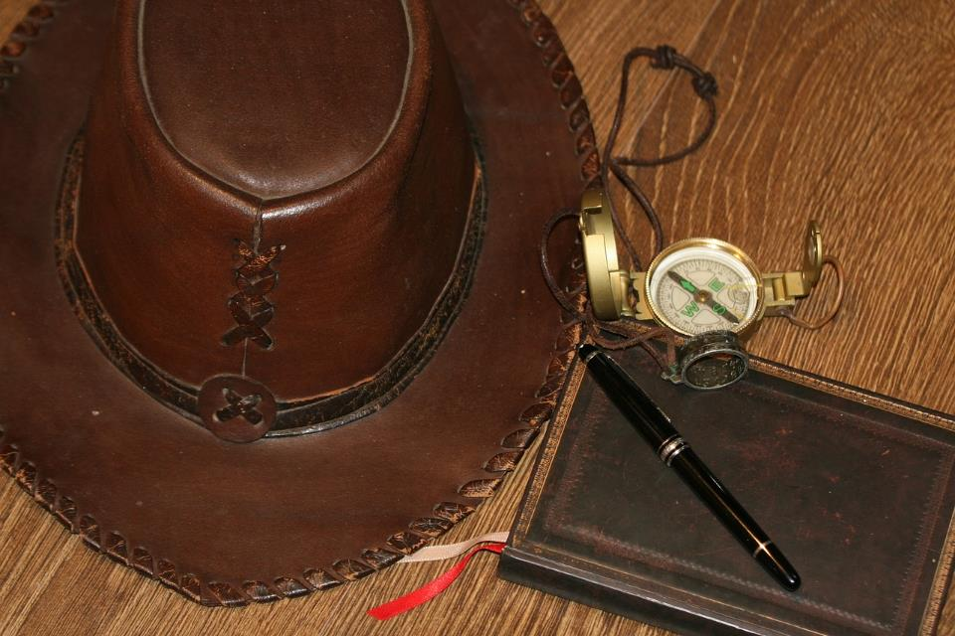
Notes:
Slide 21: Just before we leave….
For those of you who are familiar with the Indiana Jones (Indy) films, the Ark of the Covenant that he found in the movie was the same Ark of the Covenant that is mentioned in the Bible, which Bezalel crafted…..

Slide 22

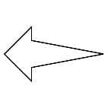
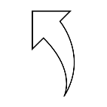
Leader: As we leave this place & time and go into the day ahead…
All: May today’s words help us to become a stronger community.
Notes:
Sending: Slide 22: Remind children of today’s key message – creating beautiful things for collective worship
Leader: As we leave this House and time and go into the day ahead…
All: May today’s words help us to become a stronger community!

Slide 23
Notes:
Reflective activity: Beautiful!
Put a beautiful object or image in your reflective area.
Children think about what makes it beautiful, or what inspires them about it – and use it to inspire them to think about how their own creativity might help others.
OR:
Create something beautiful to use in collective worship during the Advent season.

