Slide 1
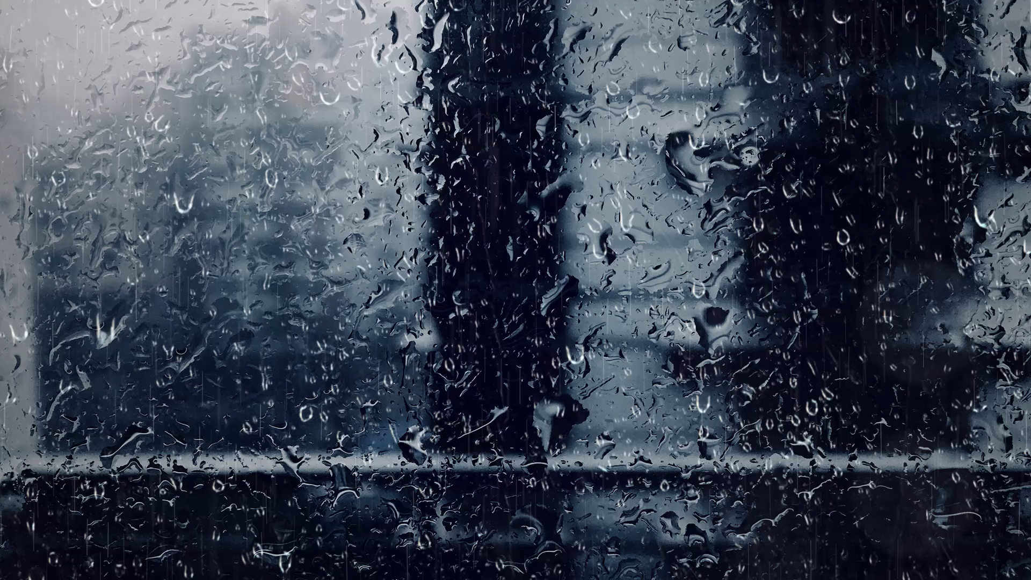
All images copyright-free from pixabay, unless otherwise identified
Notes:
Gathering:
Slide 1: Rain falling stilling exercise
Use the stilling slide if desired: the suggested words should be spoken slowly, leaving pauses inbetween to create a sense of stillness.
As you sit quietly, watch the raindrops falling on the window…… [PAUSE]
Now practise slower breathing…..in…..and out…..in……and out…..as you watch….[PAUSE]
You maybe notice that you are feeling calmer and more relaxed….[PAUSE]
As you breathe, think about yourself and what you bring into this time today….. [PAUSE]
We come into this special / sacred space and time to be still….to think deeply…..to be together as a school community…..
In our time together today, we will talk about a question together, share a story, and then think together.

Slide 2

Leader: As we gather to share our story today….
All: May we grow in our understanding of ourselves and others.
Notes:
Slide 2: Use our new gathering words for this term, or your usual greeting if you prefer. These greetings may change slightly each week to reflect the spiritual elements that we will be exploring in each week’s materials.
Leader: As we gather to share our story today….
All: May we grow in our understanding of ourselves and others.

Slide 3

Stories that help us to grow
Notes:
Slide 3: In a short while, we’re going to hear another story that will help us to grow, from a very different place in the world that last week’s story – and from the places we live. But before we share our story…..

Slide 4
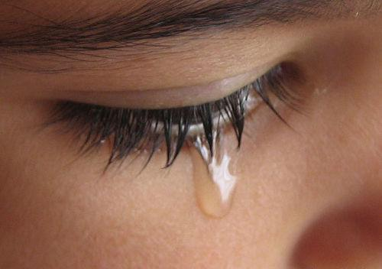
What makes us sad?
Notes:
Slide 4: What makes us sad?
I wonder what might have happened for this person to be sad? What do you think?.... [allow children to talk to each other, then interview a few children about their thoughts]
Quite often, we don’t want to think about any sad times we’ve experienced, do we? But feeling sad is a very natural emotion, and it’s really important that we learn how to deal with sadness as well as all the other emotions we experience.
There is nothing wrong with feeling sad – in fact, the sad times of our lives can help us to really appreciate the happy times and also help us to grow. In everybody’s life there will be happy times, a time to laugh, and sad times, a time to cry. We’ll come back to this thinking in a little while, but now it’s time for our story.

Slide 5
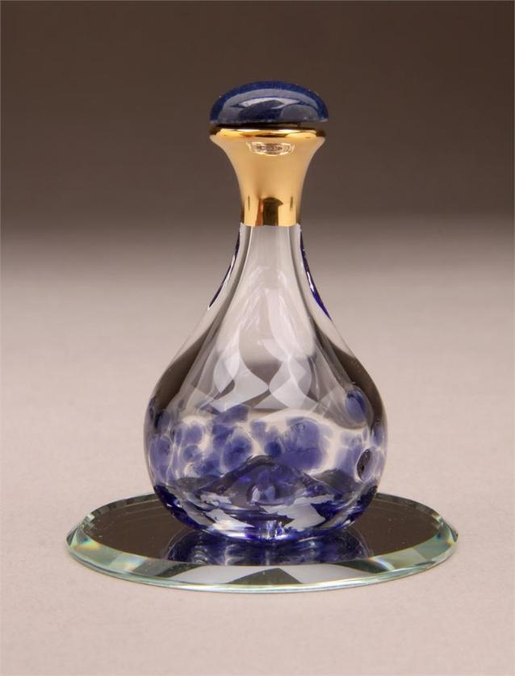
‘You have counted each of my tears and stored them in a bottle.’
Notes:
Slide 5: ‘You have counted my tears and stored them in a bottle’ (Psalm 56:8)
If God thinks our tears are important, then surely crying can’t be wrong. Someone once said that ‘tears are the words that our hearts can’t express’. When we are really sad, we need to express how we feel – and that means sometimes that we need to cry. Many people believe that God made us with the ability to express how we feel through our tears, because our tears can help to heal the hurts we have deep inside us, and that’s got to be good news. We’ll come back to this thinking in a little while, but now it’s time for our story.

Slide 6
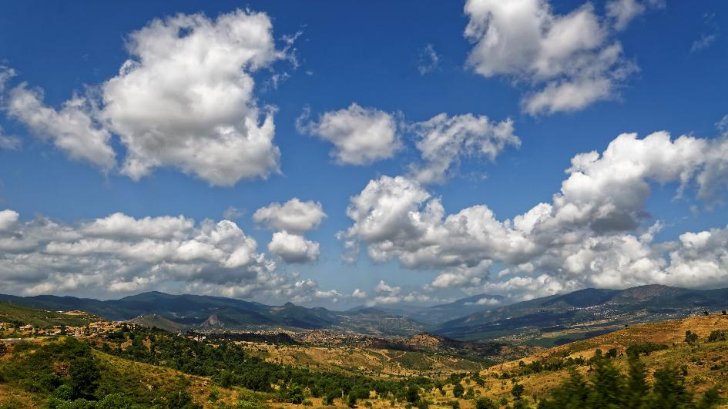

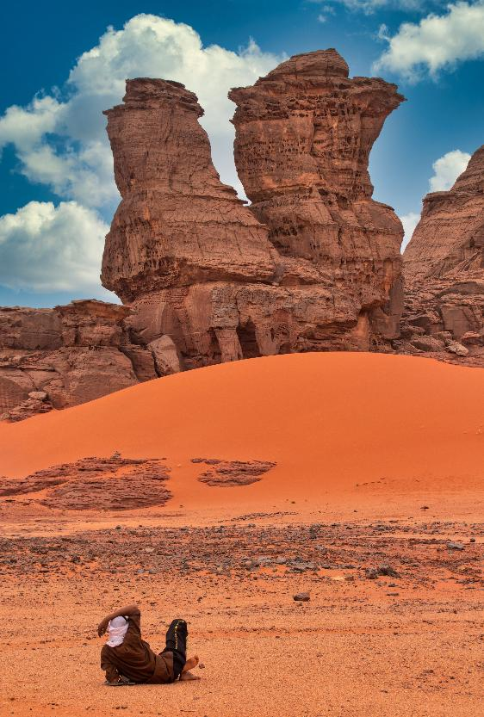
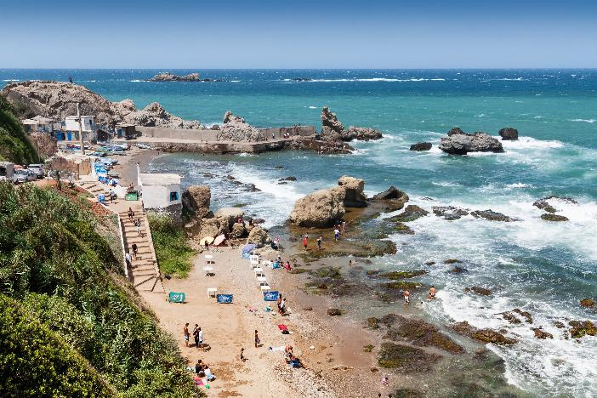
Notes:
Slide 6: Algeria
This story is another traditional tale, and another story that can tell us things about ourselves, about others…..and maybe about the world around us. This story comes from the North African country of Algeria, which sits both on the Mediterranean coast and the Sahara Desert, so it’s a country of real contrasts, as you can see from the images here. Across the history of our planet, people have asked big questions about things that seem mysterious about our world and there are many really old stories from cultures all over the world that try to explain how different parts of it came to be as they are. Our story today is one of those stories. I’m going to put a picture of the moon up for you to look at as I tell this story, called ‘Why the moon is sad’…..

Slide 7
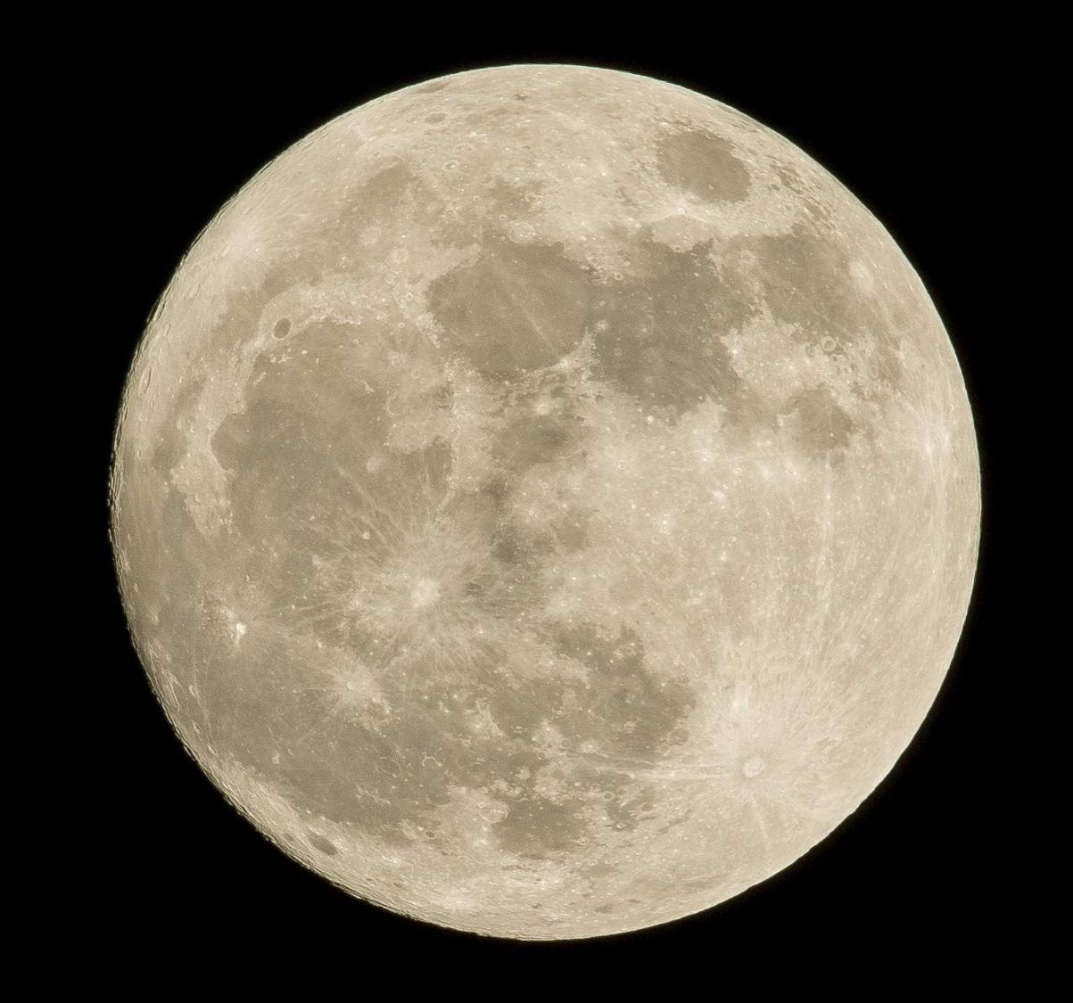
Notes:
Slide 7: Why the moon is sad
Many years ago there was an orphan child wandering about upon the earth. He was very sad, as he had no one to care for him and he was all alone.
As night fell, and the moon rose in the sky, the moon saw the little boy, and felt great compassion towards him.
The moon decided that the boy could be alone no longer and so it came down from the night sky to sit beside the lonely child, and spoke these words to him:
"Weep, sad child! Let your tears fall onto me. I will then carry them all back with me up into the sky."
As the orphan child began to weep, the tears rolled down his cheeks and dropped onto the moon. Then Moon gave the lonely child a blessing saying: "From now on, every person shall love you." When the child could weep no more, the moon returned to the heavens.
After this, people did love the orphan boy and gave him all that he needed and all that would make him happy.
And now, every time you look at the moon's face, you will be able to see the stains left by the tears of the orphan child.
Then continue, by looking at the picture of the moon:
Can you see the patterns on the face of the moon – these dark patches? They do look a little bit like the kind of marks you get when something gets wet, don’t they, a little bit like tear-stains? We’re going to have some quiet, thinking time now…. you might want to continue looking at the moon while we think.

Slide 8
‘When others are happy, be happy with them, and when they are sad, be sad with them.’
(Romans 5:12)
Notes:
Slide 8: Responding (and words for worship)
I don’t know what you think about whether that story’s true or not [you might want to talk about this afterwards, and also about any big questions of their own that children have about the world] but I really like the idea that the moon was saddened by how the little boy was feeling, decided to do something about it, and came down from the night sky to sit with him.
There’s another verse in the Bible that says this:
‘When others are happy, be happy with them, and when they are sad, be sad with them.’ (Romans 15:12)
Understanding how it feels to be sad also means that we are more able to really help other people when they are sad. Maybe when we look at the moon, it’ll be a reminder to us to do just that – to be the friend that other people need when they are sad, because we know how it feels…..

Slide 9
…I wonder how the actions of the Moon in this story might help us when we see others feeling sad?...
…or how the words from the Bible might inspire us to take action?...
…I wonder how these words might help us next time we are feeling sad?...
…or how they might help us to bring comfort to others?...
Notes:
Slide 9:
…I wonder how the actions of the Moon in this story might help us when we see others feeling sad?...
…or how the words from the Bible might inspire us to take action?...
Earlier, we heard how our tears matter to God, that he knows them and counts them….
…I wonder how these words might help us next time we are feeling sad?...
…or how they might help us to bring comfort to others?...
For many people, talking to God in prayer helps them when they are experiencing sadness, so I’m going to pray now, asking God to be with us….If you would like to pray too, find a way to make the prayer your own, or if praying is not something you are comfortable with, then just continue to be quiet and still with your own thoughts…

Slide 10
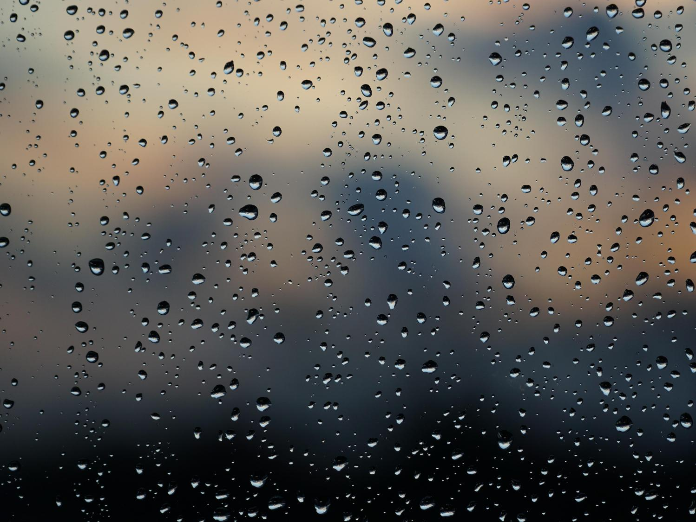
Dear God
It is good to know that our tears matter to you. We are grateful for all the happy times of our lives, but please help us to know what to do when we are having a sad or difficult time. Help us to find the right people to talk to, who will stand by us when it’s hard to keep going. Thank you for those people who have helped us already. May we in turn be good friends to others during their sad times.
Notes:
Slide 10: Prayer
Dear God
It is good to know that our tears matter to you. We are grateful for all the happy times of our lives, but please help us to know what to do when we are having a sad or difficult time. Help us to find the right people to talk to, who will stand by us when it’s hard to keep going. Thank you for those people who have helped us already. May we in turn be good friends to others during their sad times.

Slide 11

Notes:
Slide 11: Amen

Slide 12
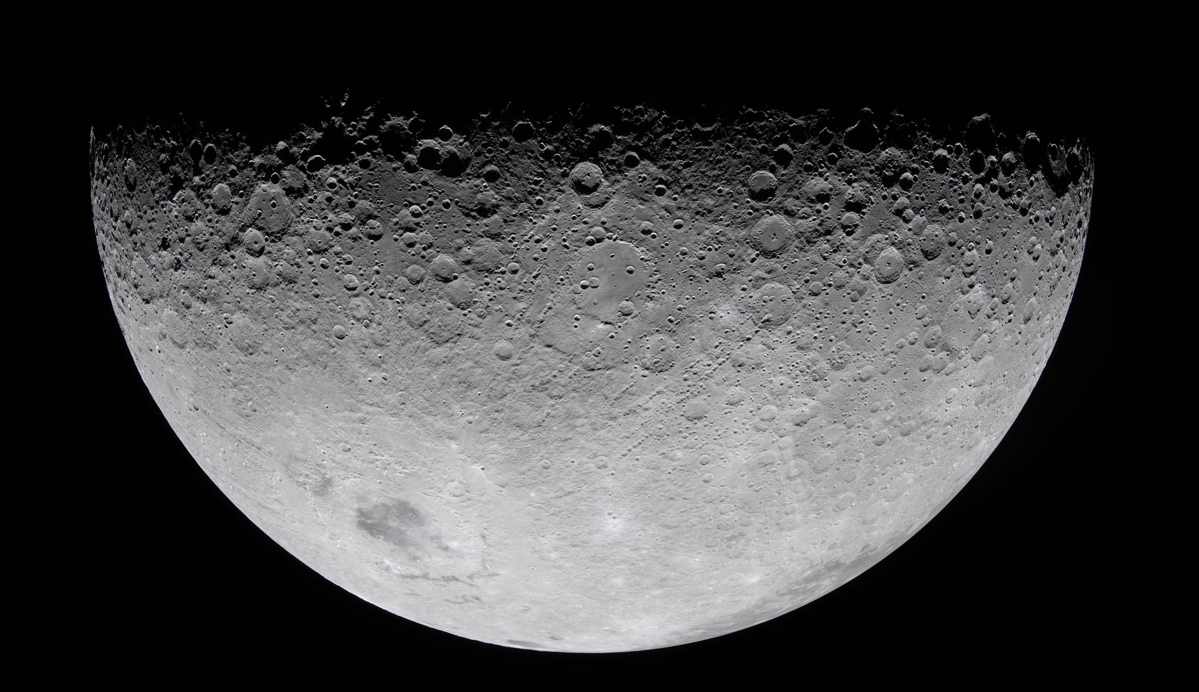
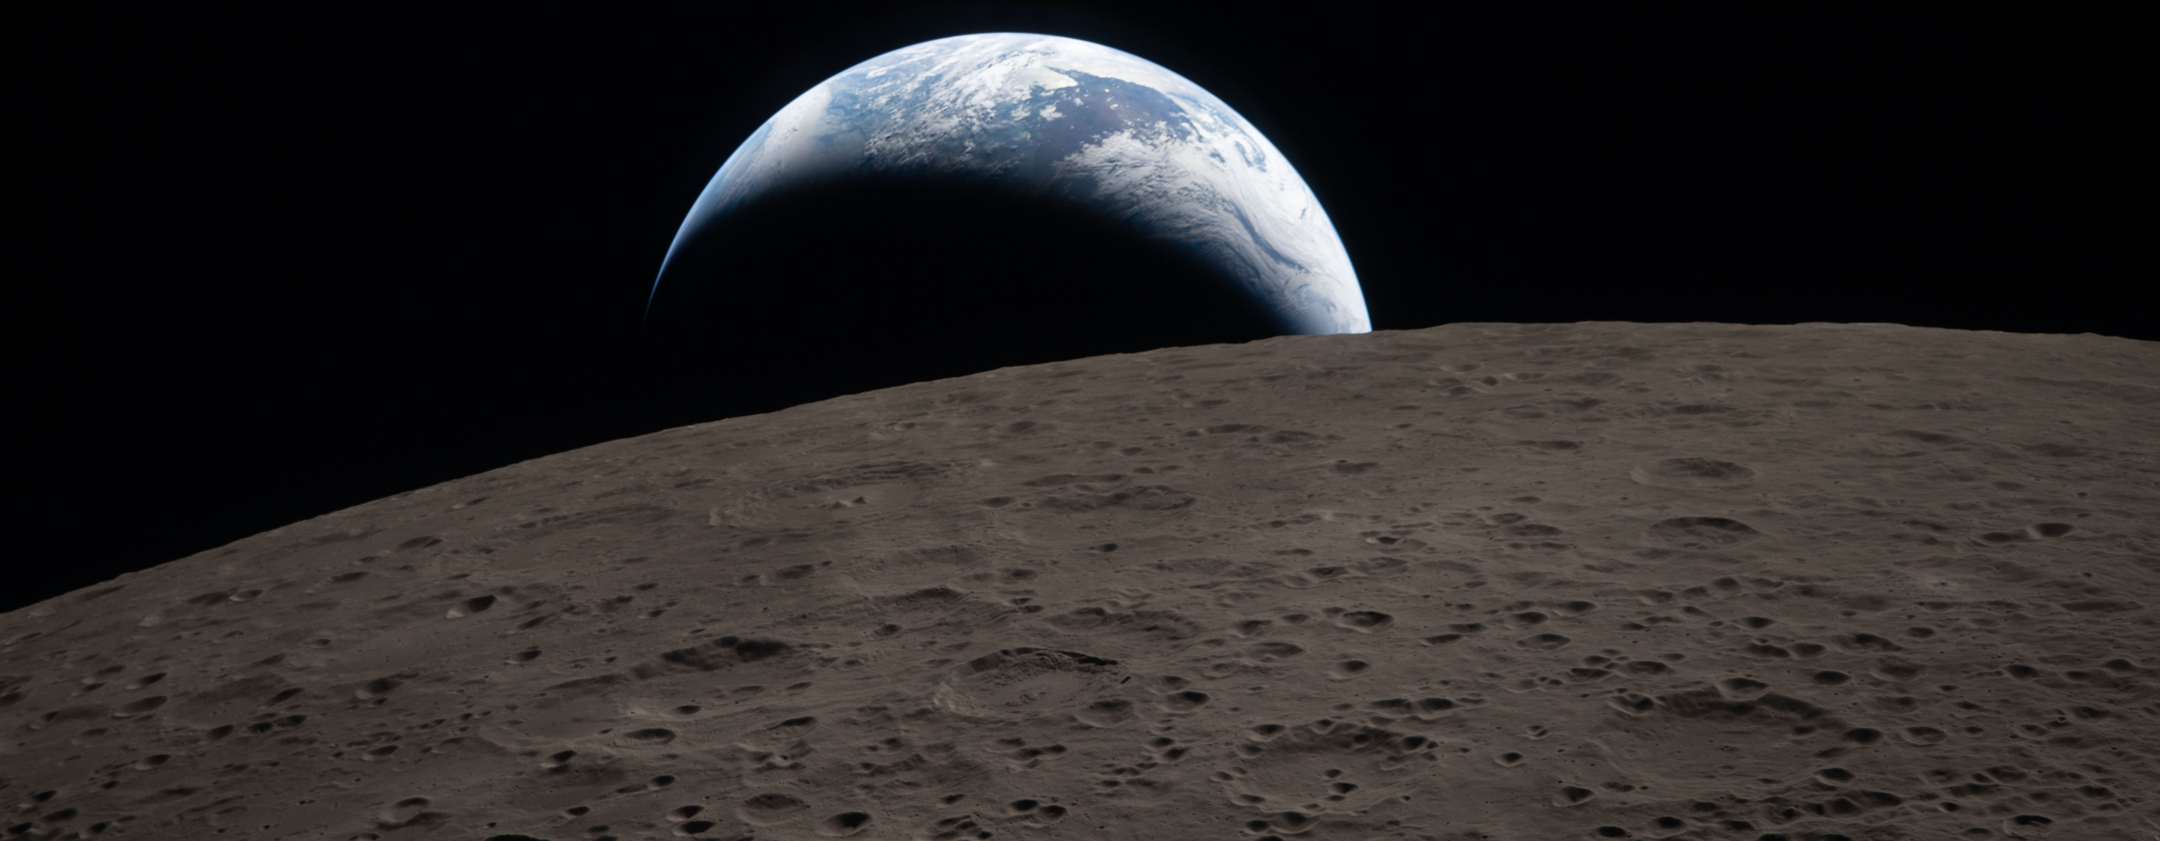
These images are ©NASA
Notes:
Slide 12: The Moon from Artemis II
But just before we leave, I couldn’t waste this chance to show you some images of the Moon taken from NASA’s recent trip around the Moon as part of the Artemis II expedition, in April 2026. You can clearly see the craters, which are a more scientific explanation of the dark patches. I’ll leave it up to you to decide which version you prefer!! [You can find more imagery and information here: https://www.nasa.gov/gallery/lunar-flyby/page/2/
[bottom image] It’s also the first time human beings have ever seen what’s called the ‘dark side of the moon’ – that’s the side that we can’t see from Earth – and has never been visited by humans.
Images are © NASA, but available for use with attribution.

Slide 13


[Slide 4:]
Leader: As we leave this place & time and go into the day ahead…
All: May we support anyone who is feeling sad.
Notes:
Slide 13: Sending
Leader: As we leave this place & time and go into the day ahead…
All: May we support anyone who is feeling sad.

Slide 14
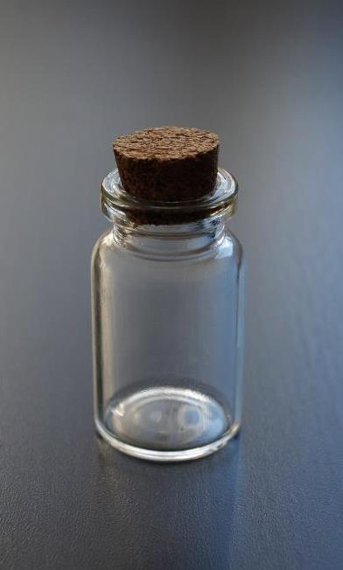

Notes:
Slide 14: Reflective areas
You will need a plastic water bottle and some glass beads, preferably blue, to represent tears.
Think: Is there anyone you know who is sad today?
Do: Take a ‘tear’ and hold it in your hand. Then pop it into the bottle as a way of bringing their sadness to God.
Talk: You might want to go and find that person and speak some words of comfort to them.

