Slide 1
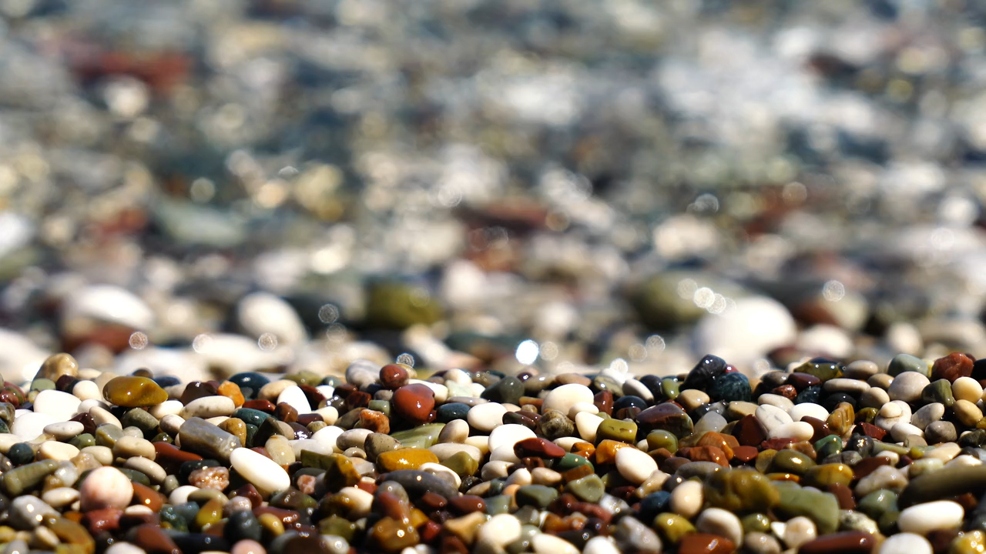
All images copyright-free from pixabay, unless otherwise identified
Notes:
Slide 1: Welcome stilling exercise – Stones
Use the stilling slide if desired: the suggested words should be spoken slowly, leaving pauses inbetween to create a sense of stillness.
As you sit quietly here, watch the water rippling on the pebbles…….PAUSE]
Now practise slower breathing…..in…..and out…..in……and out…..keep this going as you continue to watch….[PAUSE]
You maybe notice that you are feeling calmer and more relaxed….[PAUSE]
As you breathe, think about yourself and what you bring into this time today…..[PAUSE]
We come into this special / sacred space and time to be still….to think deeply…..to be together as a school community…..
In our time together today, we will….. think about a question together……share a story….and then think together.
But first, let’s welcome one another as we begin….

Slide 2
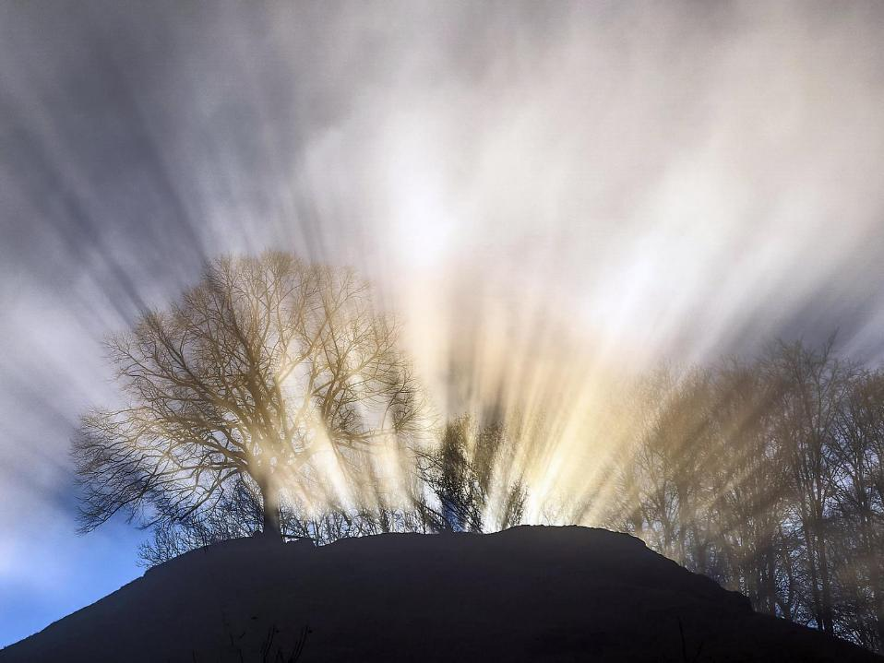
Leader: This is a day that God has made.
ALL: We will rejoice and be glad in it!
Notes:
Slides 2/3: Teach this new greeting to your school community – there are two slightly different versions from the point of view of the leader; choose which best fits your school’s context. One uses words adapted from Psalm 118:24
Leader: This is a day that God has made!
ALL: We will rejoice* and be glad* in it!
OR:
Leader: Today is a brand new day…..
ALL: May we be a blessing to each other!
*There are different BSL signs for rejoicing and joy/gladness. View them here: https://www.signbsl.com/sign/rejoice
Blessing: https://www.signbsl.com/sign/blessing (1st video)

Slide 3
Leader: Today is a brand new day!
ALL: May we be a blessing to each other!
Notes:
Slides 2/3: Teach this new greeting to your school community – there are two slightly different versions from the point of view of the leader; choose which best fits your school’s context. One uses words adapted from Psalm 118:24
Leader: This is a day that God has made!
ALL: We will rejoice* and be glad* in it!
OR:
Leader: Today is a brand new day…..
ALL: May we be a blessing to each other!
*There are different BSL signs for rejoicing and joy/gladness. View them here: https://www.signbsl.com/sign/rejoice
Blessing: https://www.signbsl.com/sign/blessing (1st video)

Slide 4
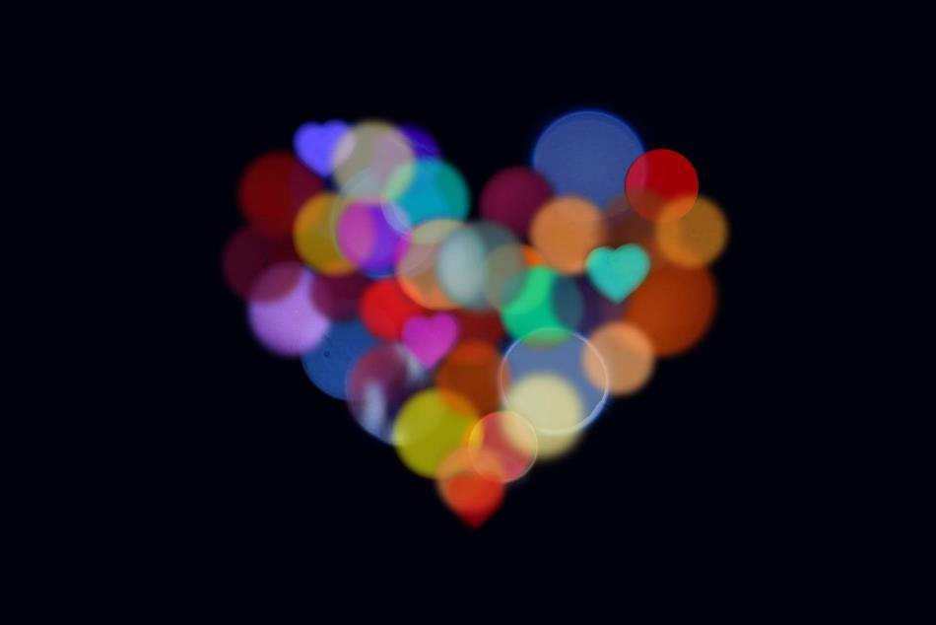
Count your blessings
Notes:
Slide 4: This term, we are thinking about our blessings – all the good things in our lives. I wonder if you can remember any of the blessings we’ve been grateful for so far this term? [Children may not be able to remember them all, so the pictures on the next but one slide will demonstrate the point that pictures / objects are sometimes a helpful reminder!]

Slide 5

What might help us to remember?
Notes:
Slide 5: “What might help us to remember?” [gather some responses.]

Slide 6
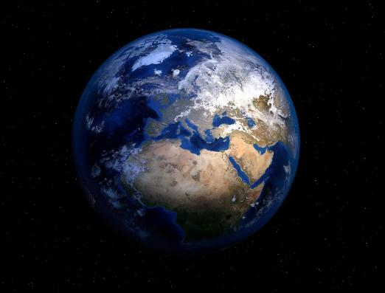
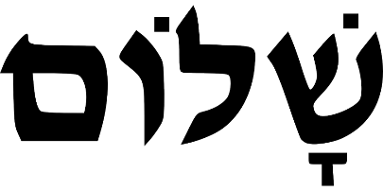
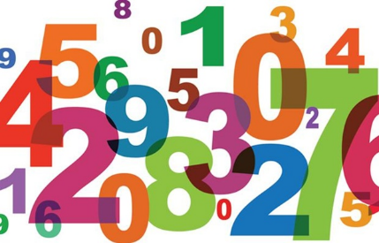

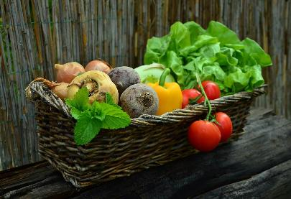
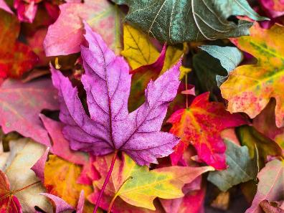
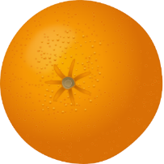
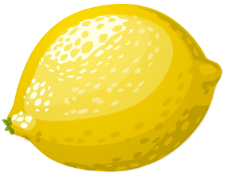
Notes:
Slide 6: On this slide are some pictures that might help us to remember some of the things we’ve thought about over the last few weeks. [From L-R, top-bottom: Counting our blessings; blessing of peace (Shalom]; our beautiful world; peace in a world at war; Harvest; Autumn time; God’s provision - Sukkot]
And here’s the science bit…. pictures really DO help us to remember!! Research shows that using simple pictures as well as words can help us all, children AND adults, to recall information much more quickly – and store it in our long-term memory.

Slide 7
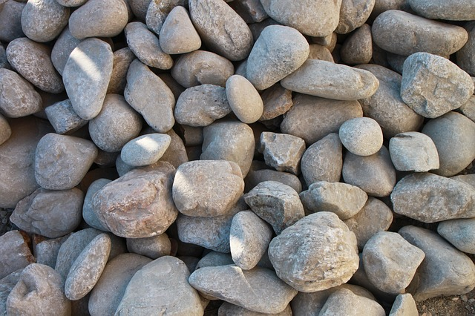
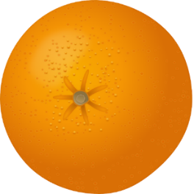

A mountain of praise
Notes:
Slide 7: Our story for today is one from the Old Testament part of the Bible, so one about the People of God. It is the end of the long, 40-year story that we heard part of when we thought about Sukkot, a few weeks ago – and how ‘God did provide!’ It’s called ‘A mountain of praise’. [use script & slides 8-14]

Slide 8

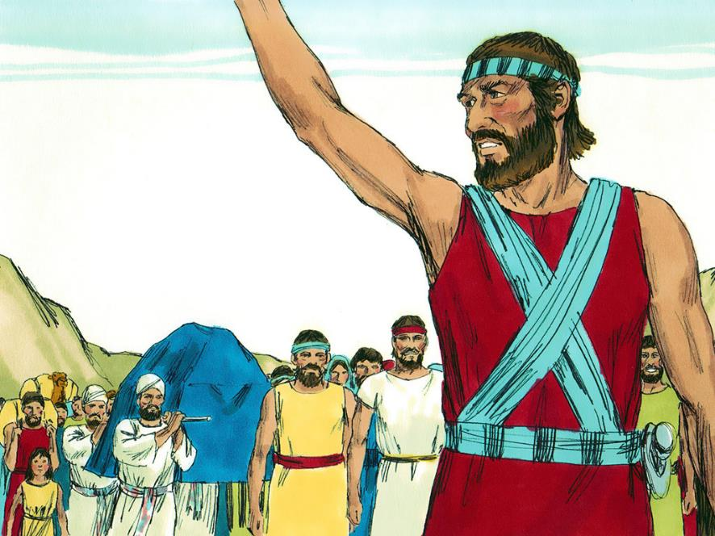
Notes:
Slide 8: God had chosen Joshua to lead the Jewish people on the final part of their long journey from Egypt. The Jordan River was the last big obstacle in their path as they neared the Promised Land. During harvest time, the river was very full, and flowed very fast, and so as Joshua led the people closer, they wondered how they would get to the other side. But Joshua knew that God had already solved this problem!

Slide 9
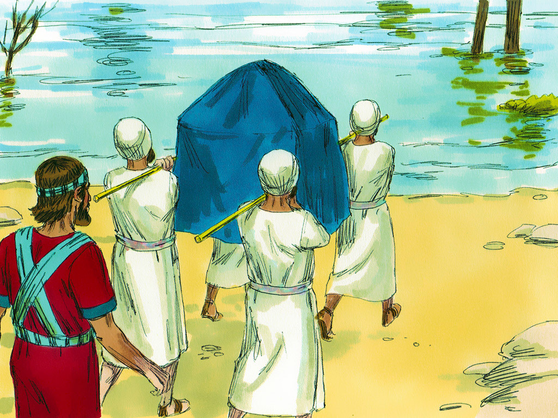
Notes:
Slide 9: God had spoken to Joshua and told him that as he had helped Moses cross the Red Sea when they were fleeing from the Egyptians, so he would help them get through the Jordan River. With them, the Jewish people carried their most precious possession – a box that contained God’s special rules, the Ten Commandments, that God had given to Moses. This box was called the Ark of the Covenant of God’s promise and was carried by priests.

Slide 10
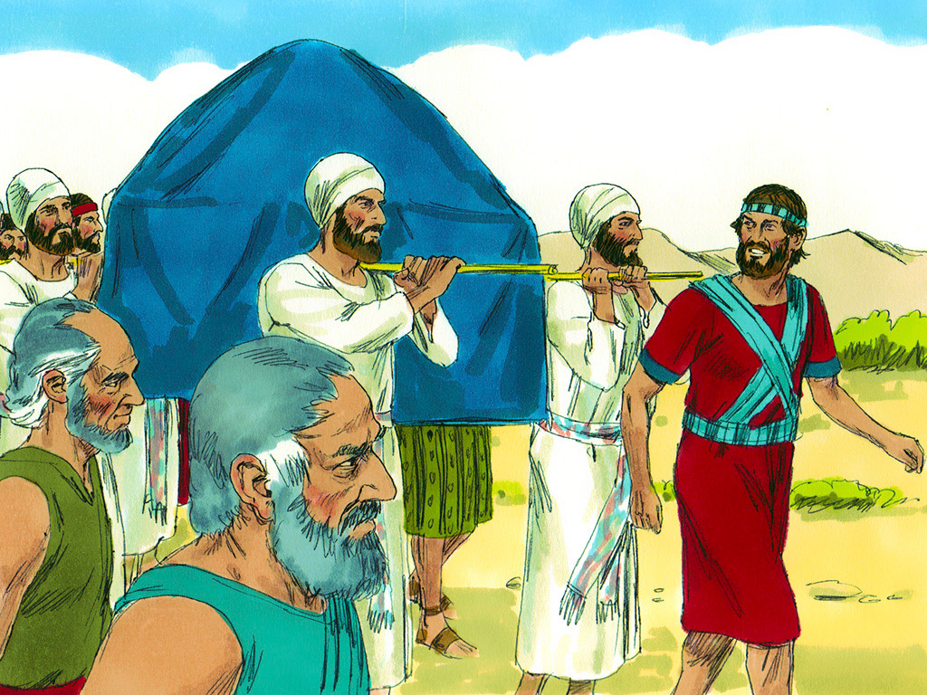
Notes:
Slide 10: God told Joshua: ‘Tell the priests carrying the ark that when they reach the edge of the river, they are to stand in the water.’
And so that’s what happened. When the priests carrying the Ark reached the edge of the Jordan, they put their feet into the river at the edge of the bank.

Slide 11
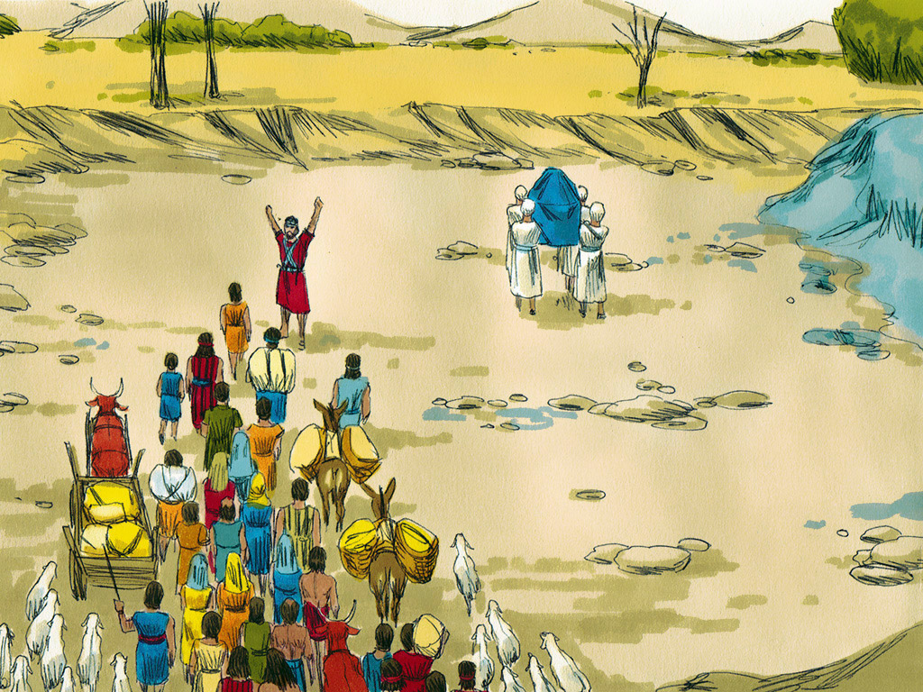
Notes:
Slide 11: As they did, the waters of the river parted, and the priests walked into the middle on dry land, carrying the ark. Once all the people had crossed on dry land, God spoke once more to Joshua: ‘Choose twelve men from among the people – one from each tribe. Tell them to choose a stone from the middle of the river and make a pile on the river bank, where you are standing. These stones will be a reminder for all time of what has happened here today.’

Slide 12
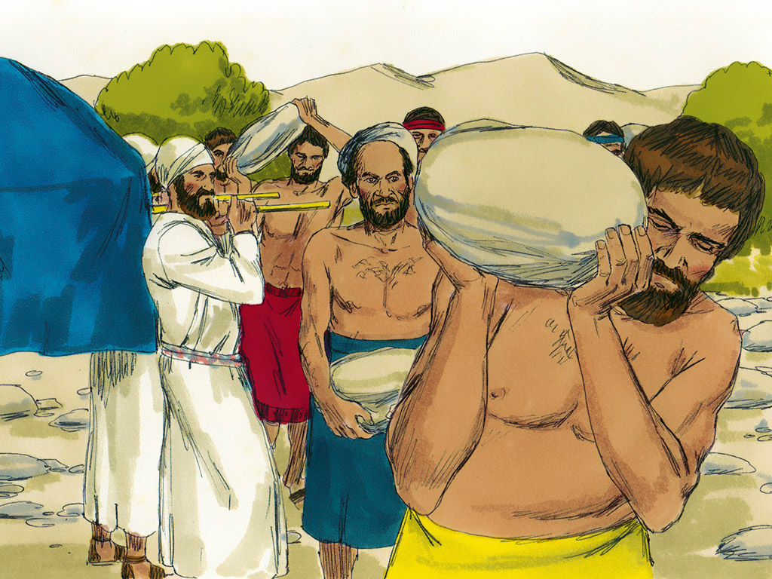
Notes:
Slide 12: The twelve men did as God instructed them, and when they had completed their task, the priests carried the Ark of the Covenant of God’s promise out of the river.

Slide 13
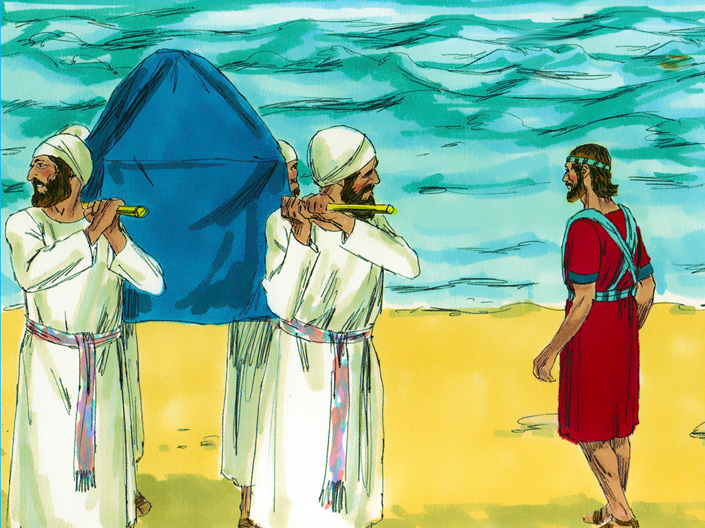
Notes:
Slide 13: As their feet touched the river bank, the waters of the Jordan River covered the river bed once more.

Slide 14
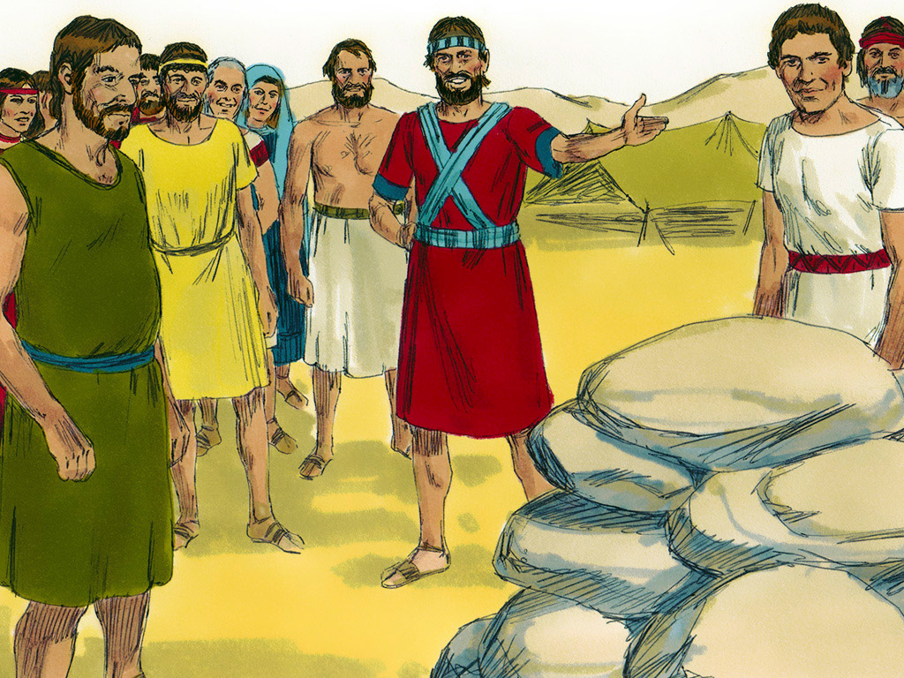
Notes:
Slide 14: And Joshua told the people that when their children, or grandchildren, or great-grandchildren or great-great-grandchildren asked what the stones were for, that they should be told the story of how God parted the River Jordan so that the Jewish people could walk through on dry land, and always remember what God had done for them.

Slide 15
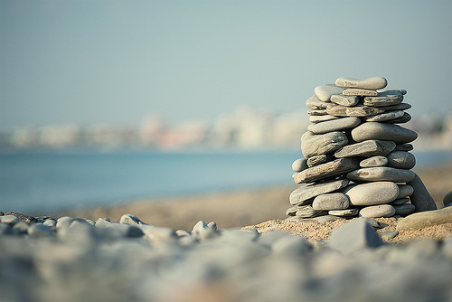
‘These stones are a reminder of what God has done.’
Notes:
Slide 15: Just as Joshua was told that he should remember, it’s good for us to remember too. The stones that God’s people gathered were supposed to make future generations ask questions and encourage the telling of the stories of how God had been with his people and provided for them. We’re going to use these stones to create our own ‘mountain of praise’ here, in our school. You can do this in your own classroom during the week as well.

Slide 16
What good things have happened for you?
What are you grateful for?
What ‘story’ does your stone tell?
Notes:
Slide 16: Responding and words for worship
Ask some wondering questions:
I wonder what these pebbles might represent for us?
I wonder what good things have happened in your life, or what God has done for you – or what you might be grateful for?
I wonder how these stones might help us to tell our stories?
Gather some ideas and model how to write each onto a stone before starting a pile of pebbles in your reflection area.
When you have gathered a small ‘cairn’, look at it together for a short time of quiet reflection together…..
I’m going to invite you to join me in a prayer now if you would like to…..
There are some words to join in with….

Slide 17
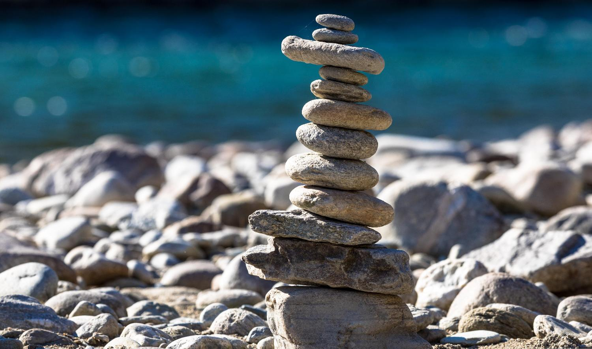
These stones are a reminder….
Notes:
Slide 17: Prayer
These stones are a reminder…..
So, please join in with these words as I pray, if you would like to make the prayer your own….
These stones are a reminder…..

Slide 18
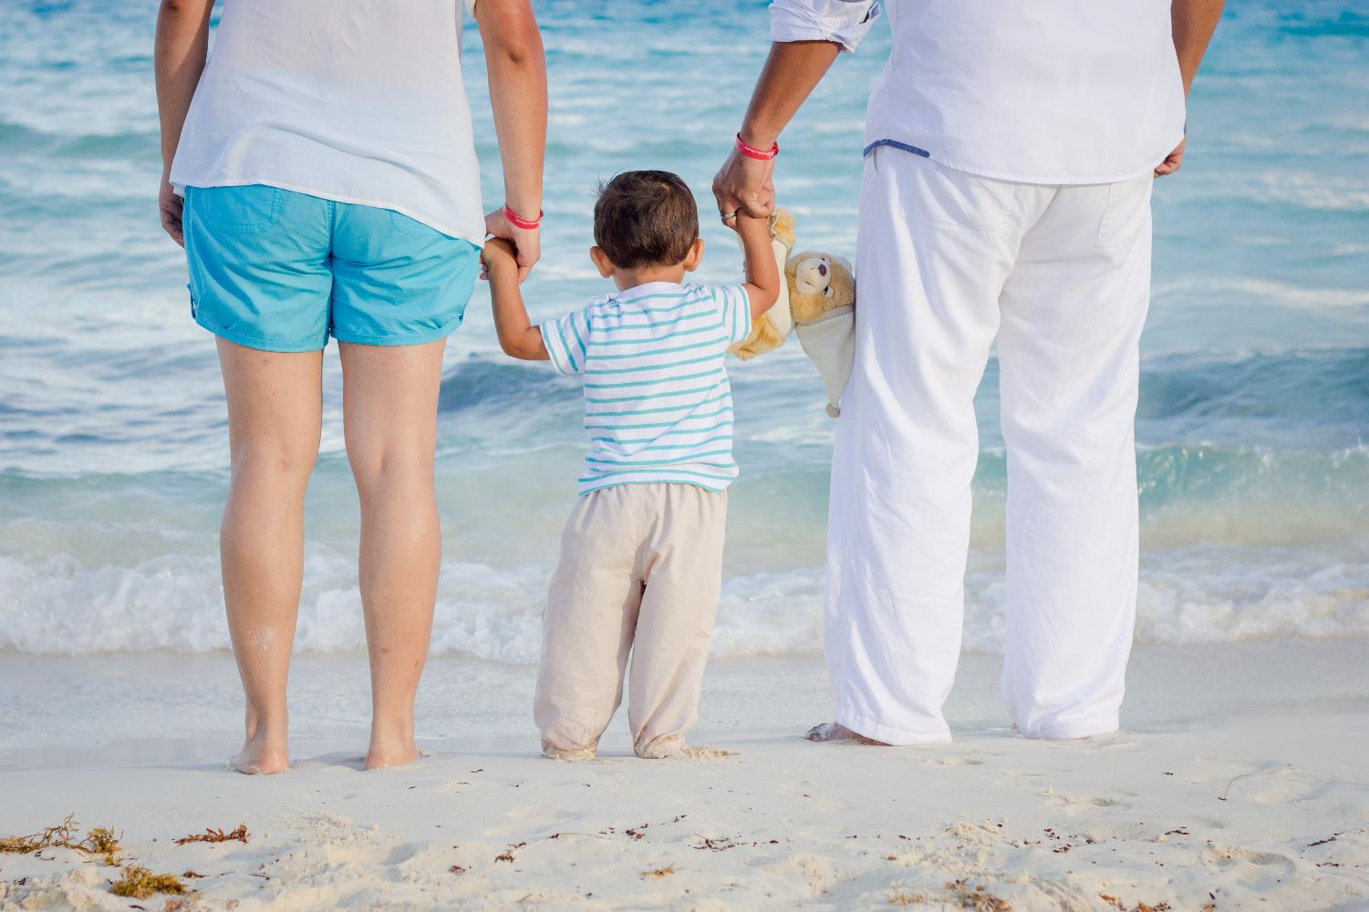
Notes:
Slide 18: ….of times that we are grateful for.

Slide 19
These stones are a reminder….
Notes:
Slide 19: These stones are a reminder…..

Slide 20
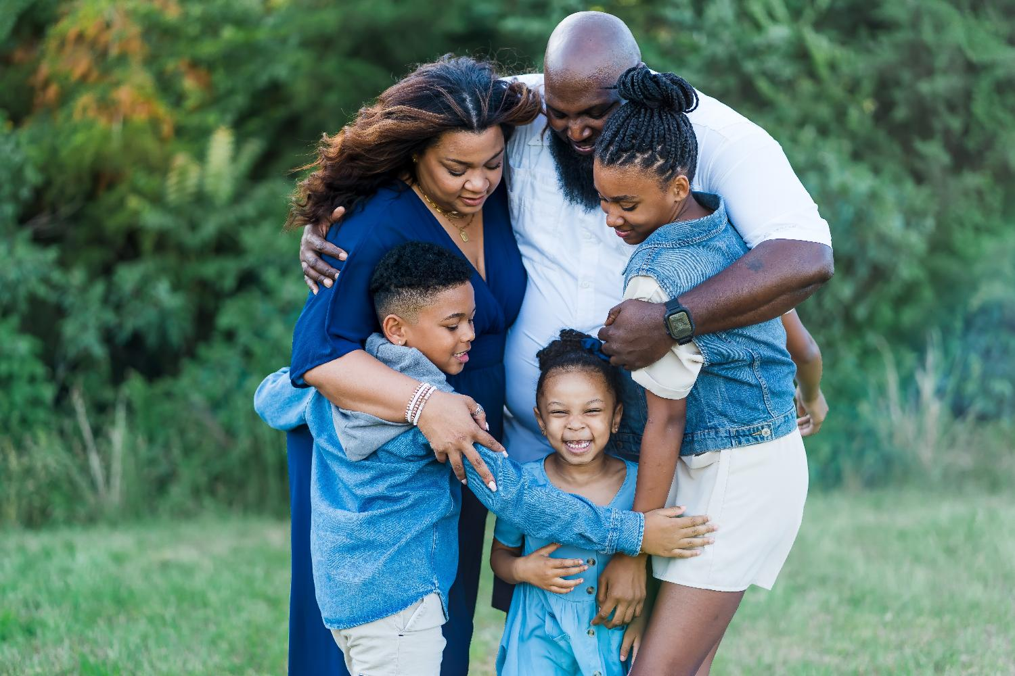
Notes:
Slide 20: ….of people who we are grateful for.

Slide 21
These stones are a reminder….
Notes:
Slide 21: These stones are a reminder…..

Slide 22
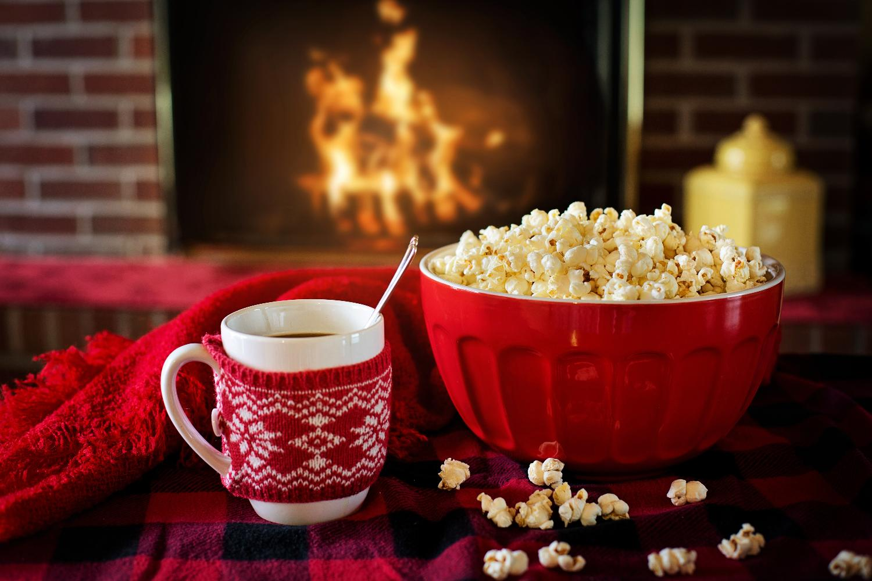
Notes:
Slide 22: ….of places that we are grateful for.

Slide 23
These stones are a reminder….
Notes:
Slide 23: These stones are a reminder…..

Slide 24
Notes:
Slide 24: ….of all the good things that we are grateful for.
God, we give you thanks.

Slide 25
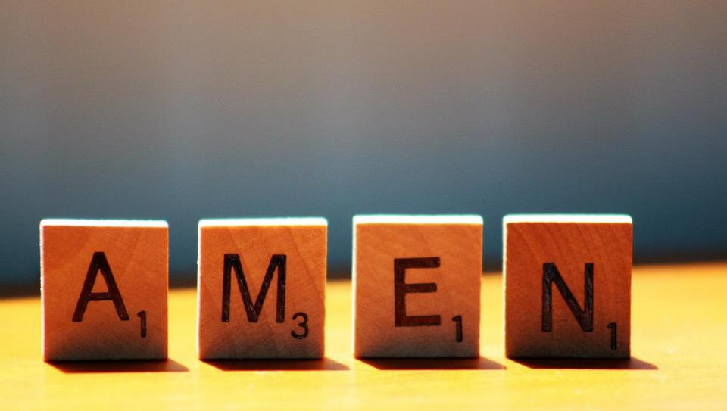

Slide 26


Leader: As we leave this place & time and go into the day ahead…
All: We will remember with thanks.
Notes:
Slide 26: Sending
Leader: As we leave this place & time and go into the day ahead…
All: We will remember with thanks.

Slide 27
Notes:
Slide 27: Reflection areas
Gather a bowl full of washed pebbles, to build a cairn of gratitude in your classroom reflection area. You will also need felt pens (Sharpies are best, but permanent markers, so you may wish to stick to washable!)
Talk: What good things are you grateful for?
Do: Write or draw your idea on a pebble.
Think: As you place your pebble on the pile, you might want to bring gratitude into your heart or say a prayer of thanks.

