Slide 1



Leader: We are here together
Children: With ears ready to hear and hands ready to serve.
ALL: May we be wise in all our actions today.
Notes:
Slide 1: Use our new gathering words. Why not invent your own actions to accompany them?
Leader: We are here together
Children: With ears ready to hear and hands ready to serve.
All: May we be wise in all our actions today.

Slide 2
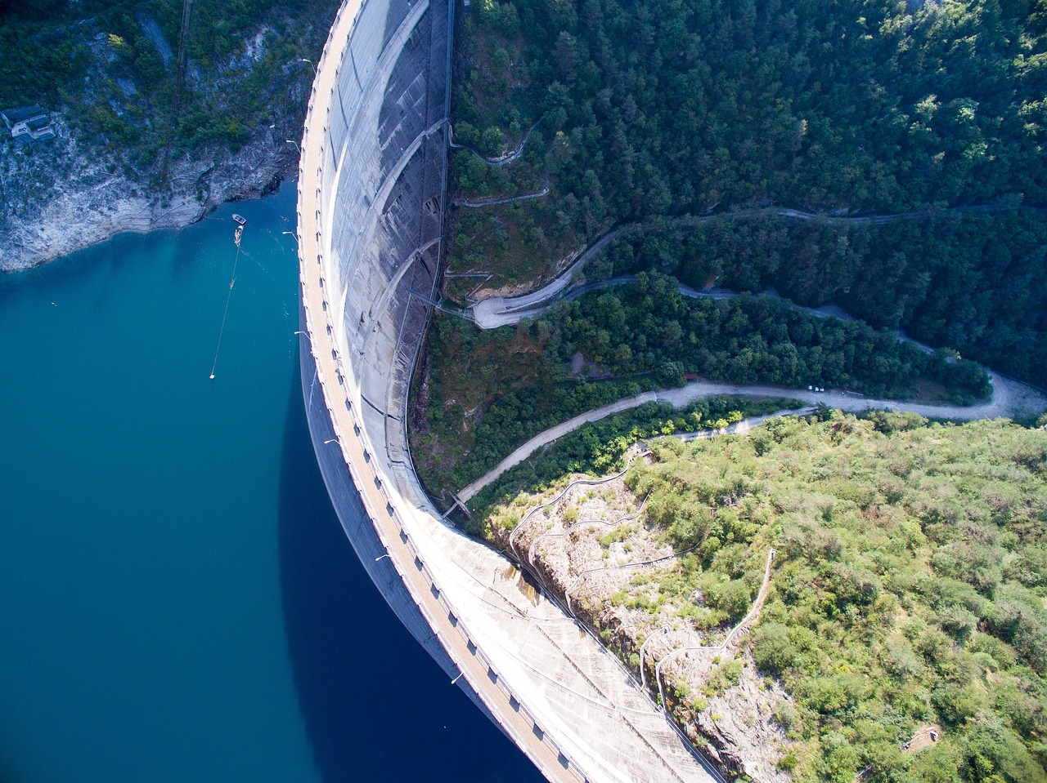
Notes:
Slide 2: I’m going to start today with a picture. I wonder if you know what it is? [explain how a dam works, in ways that are appropriate for the assembled age group] I wonder what might happen if there was a little hole, right here?! What would happen to the water? [explain that as more water trickles through, and pushes the hole open a bit wider, there’s a risk that the dam might burst….]

Slide 3

Notes:
Slide 3: So, what has this got to do with our time together today? Let’s read today’s Wise Words and find out!…..

Slide 4
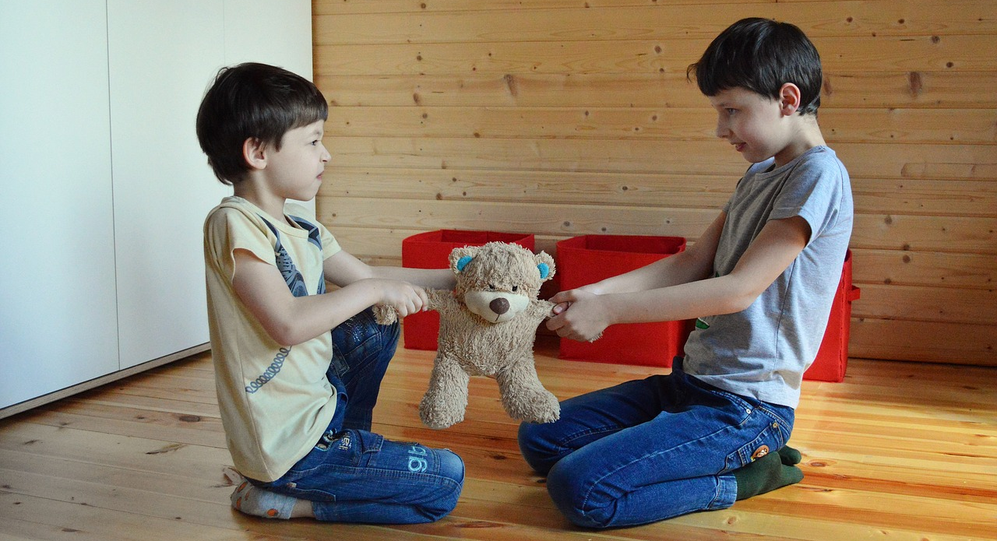

‘The start of an argument is like a leak in a dam – so stop it before it bursts!.’ (Proverbs 17:14)
Notes:
Slide 4: ‘The start of an argument is like a leak in a dam – so stop it before it bursts!’
I wonder whether you’ve ever experienced this – an argument that starts small, and quickly gets out of hand?.... [you might want to unpack this, and help children to link with the image of the dam]
From my experience in school, this can happen very easily….. [show pics on next slide, or replace with your own examples from your own school context]

Slide 5
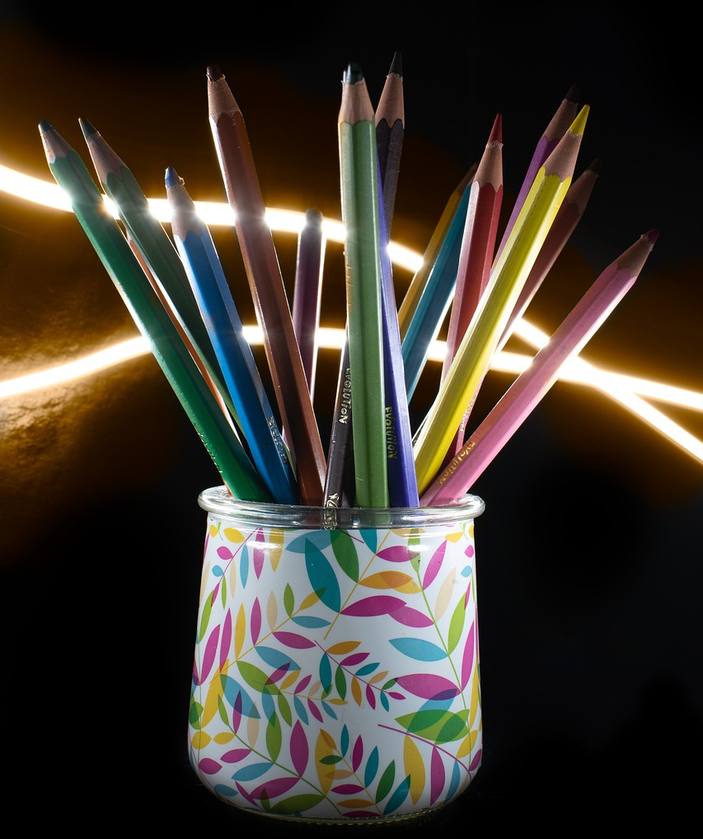
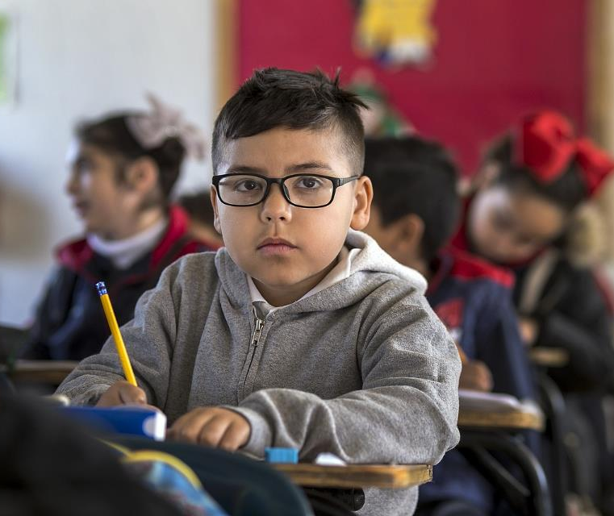
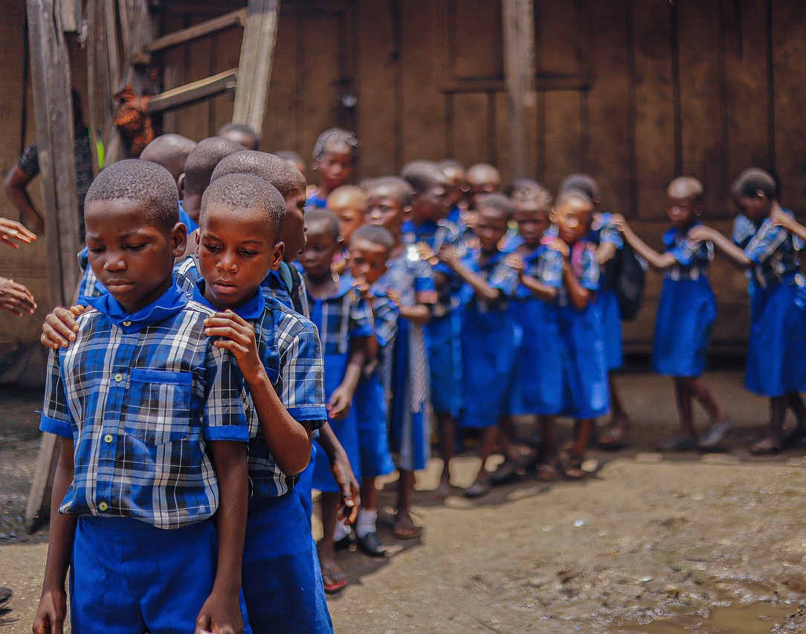
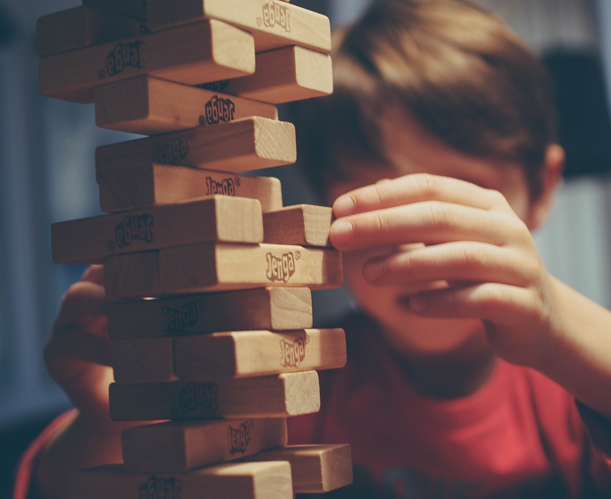
Notes:
Slide 5: Use examples from your own classroom / school experience, or….
Pencils in the pot!!
Who sits next to who at the table
Who’s in charge of a game
Who’s first in the line!!
Arguments can easily get out of hand. When people are cross – even about something quite little – an argument can turn into something much bigger, and much harder to sort out. Like the leaky dam, what started out as a little problem ends up as a full-scale flood! In a few moments, we’re going to think some more about what to do when arguments happen – which they will, because everyone does it from time to time!

Slide 6
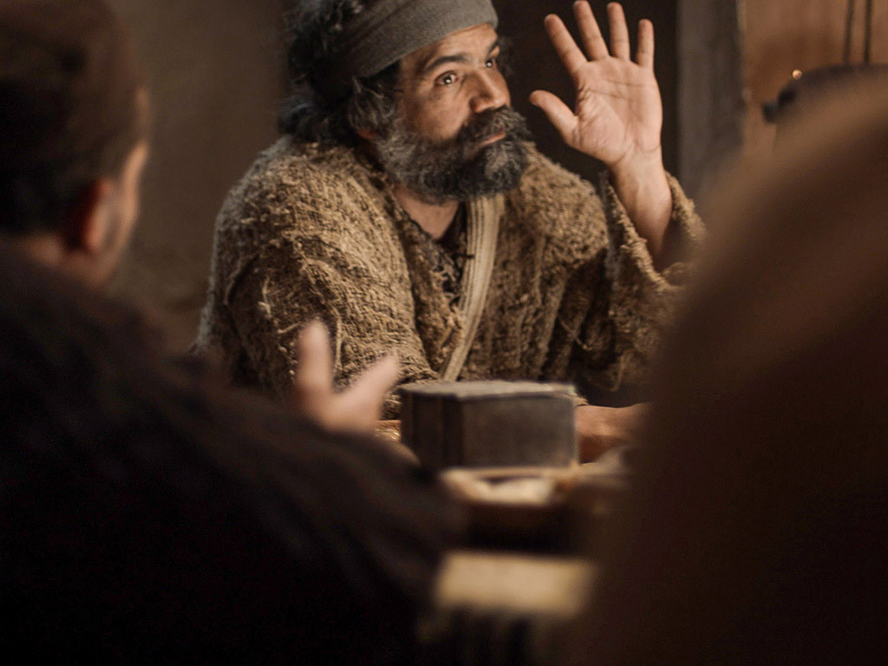
Notes:
Slide 6: Even Jesus’ friends – the disciples – argued – and sometimes about really silly things.
Once, they had an argument about who was the greatest among them. When he saw what was happening, Jesus sat the disciples down and said, "If anyone wants to be first, and the greatest, he must be the very last, and the servant of all."

Slide 7
argument
argument
‘God blesses those who make peace.’
Notes:
Slide 7: I wonder if you’ve ever looked at the word ‘argument’?
I wonder if you’ve ever noticed a tiny word in the middle?....
It’s ‘ME’. Arguments usually happen because WE want something OUR way. That’s what Jesus was saying to his friends.
In our school examples, all the arguments happened because people were thinking more about themselves – ‘ME’ – than about others. (You might want to refer specifically to some of the examples that your children had given).
Jesus taught his disciples to live another way – by thinking of others first, to be the greatest of all by serving each other.
He also taught them: ‘God blesses those who make peace.’ I wonder what this might look like in our school? Let’s think together….

Slide 8
‘The start of an argument is like a leak in a dam – so stop it before it bursts!.’ (Proverbs 17:14)
Notes:
Slide 8: Our wise words today remind us to try to stop arguments before they get out of control.
I wonder how being a peacemaker might have put a stop to each of those silly arguments we thought about earlier?....

Slide 9
Notes:
Slide 9: Talk through each example….and how being a peacemaker might stop the argument from happening in each case.
Pencils in the pot!!
Who sits next to who at the table
Who’s in charge of a game
Who’s first in the line!!

Slide 10
argument
….I wonder how we might put these wise words into action in our school this week?....
….I wonder how Jesus’ words about serving others might help us to be peacemakers?....
‘The start of an argument is like a leak in a dam – so stop it before it bursts!.’ (Proverbs 17:14)
Notes:
Slide 10: Responding and words for worship
We’ve been thinking about arguments and peacemaking – how sometimes arguments happen because we are only thinking about ourselves – ME!
Let’s spend some time wondering together about today’s wise words and how they might help us…..[you might want to pause and talk together]
….I wonder how we might put these wise words into action in our school this week?....
….I wonder how Jesus’ words about serving others might help us to be peacemakers?....

Slide 11
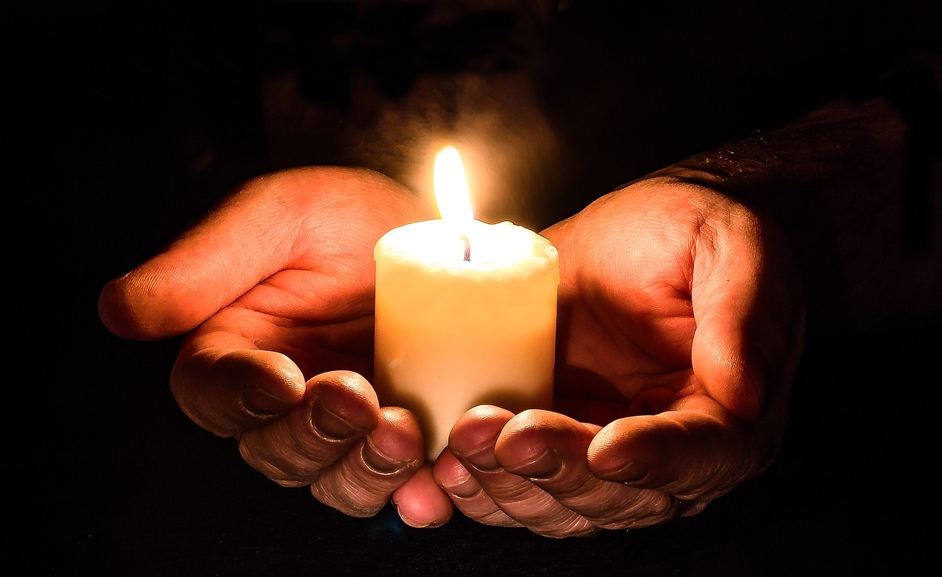
‘We will say the right thing.’
Notes:
Slide 20: Prayer
I’m going to use some words with a response for anyone who would like to pray too: your words are ‘We will say the right thing.’

Slide 12
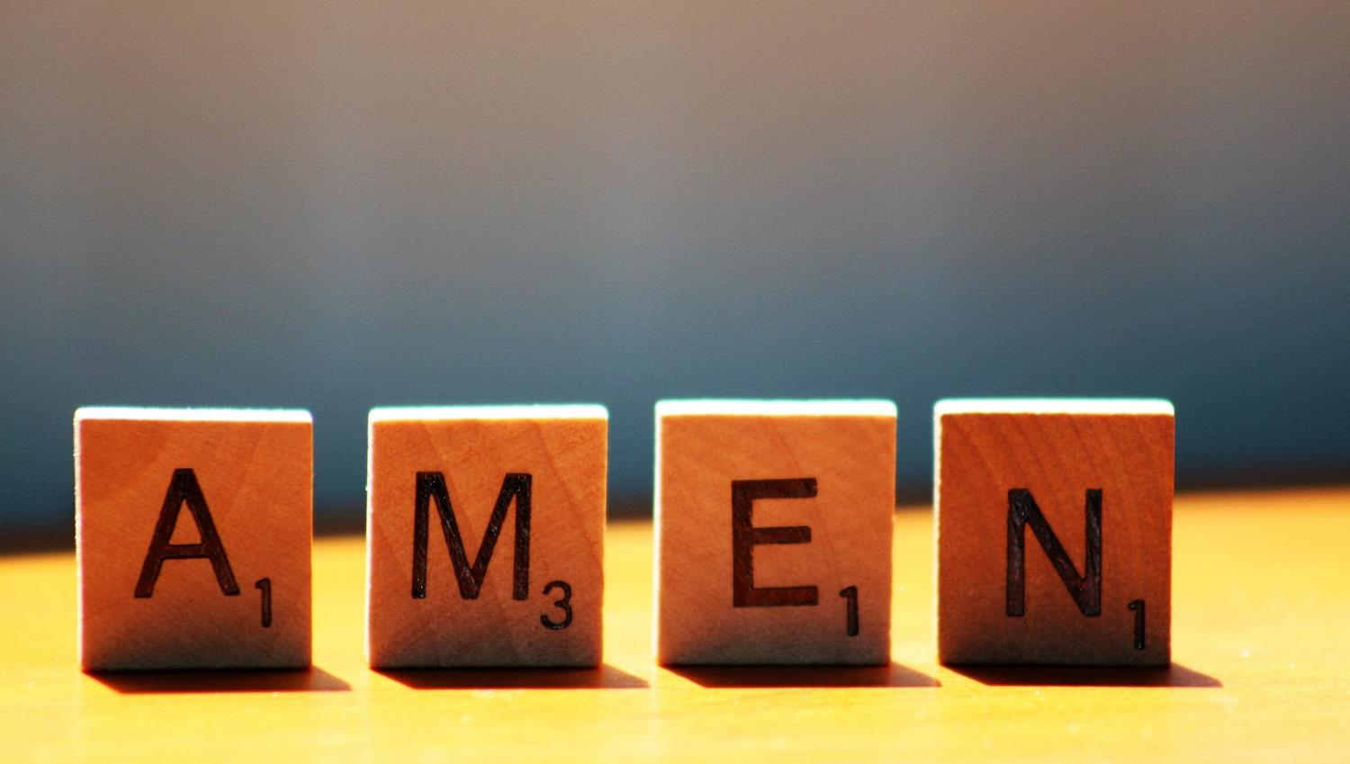
Notes:
Slide 11: Prayer
As we come to pray today, there might be arguments or conflict that are part of our own lives. You might want to use this time to bring these situations to God and ask for his help. I will leave a quiet space now for you to do this if you want to, or to be still with your own thoughts… [leave as long as you feel children need]

Slide 13
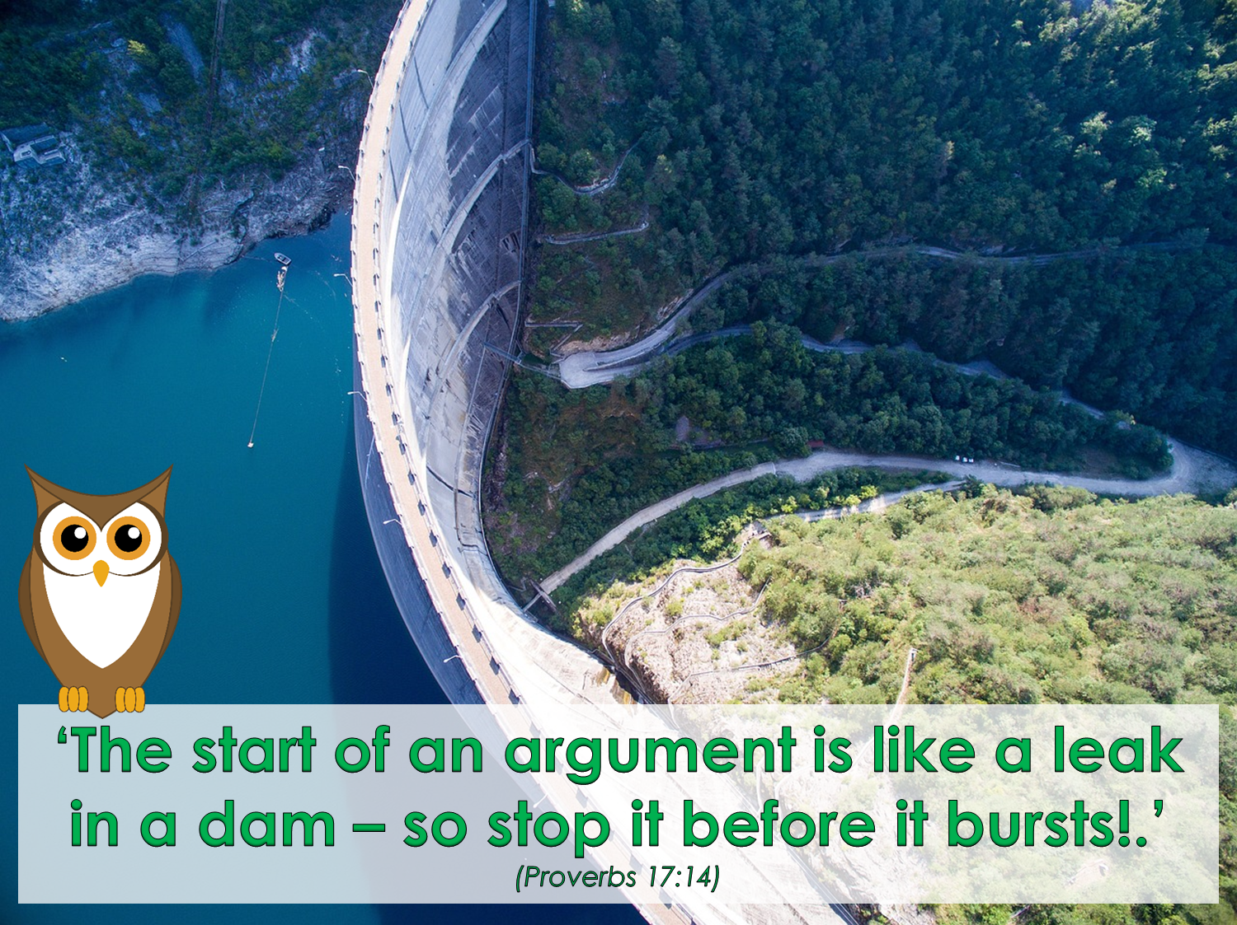


Leader: As we leave this place & time and go into the day ahead…
All: May today’s words help us to make wise choices.

Slide 14
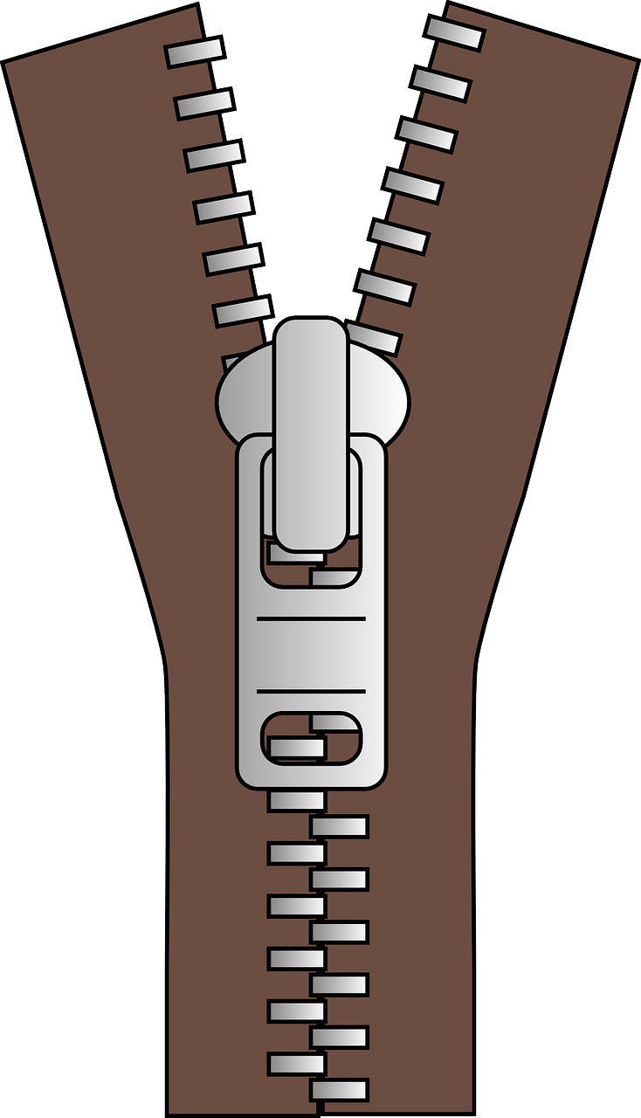
Notes:
Reflective prayer activity:
There are many parts of our world that are not very peaceful at the moment.
Use a zip to help you to pray for places where peace is needed.
Or use the zip to help you pray for people who you know who have argued.

