Slide 1

Leader: We are here together
ALL: May we ‘GO FOR GOLD!’ in our words and actions today!
Notes:
Slide 1: Gathering words
Leader: We are here together
ALL: May we ‘GO FOR GOLD!’ in our words and actions today!

Slide 2
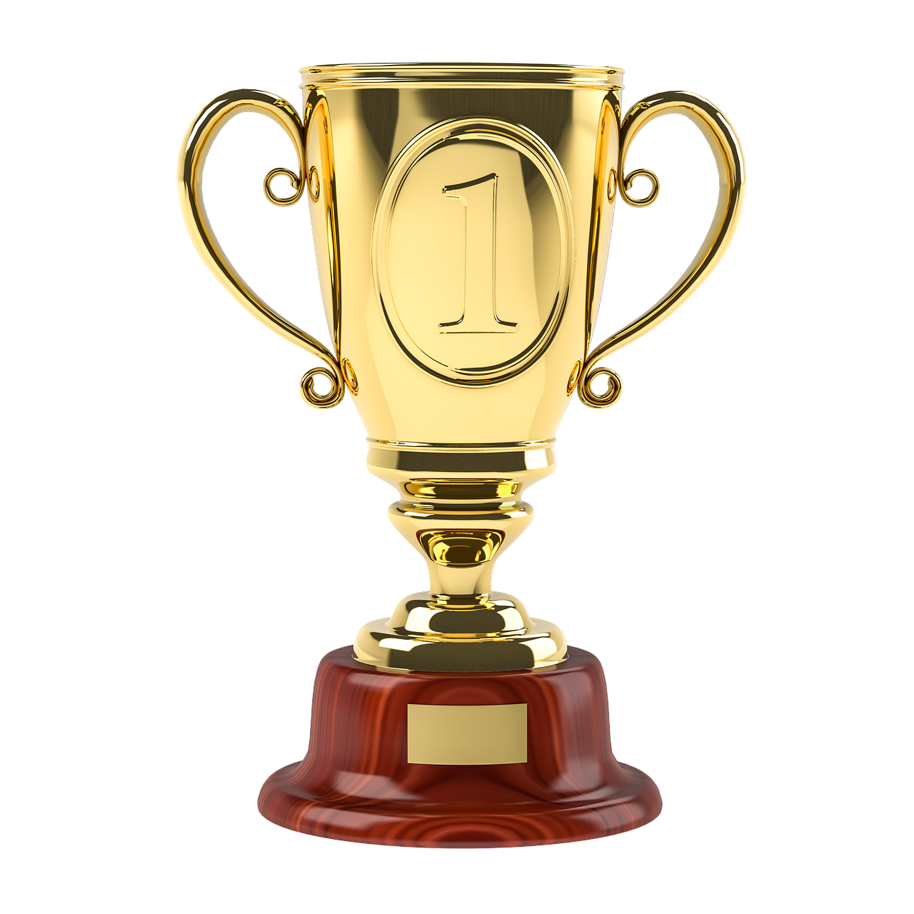
That’s EXCELLENT!

Slide 3
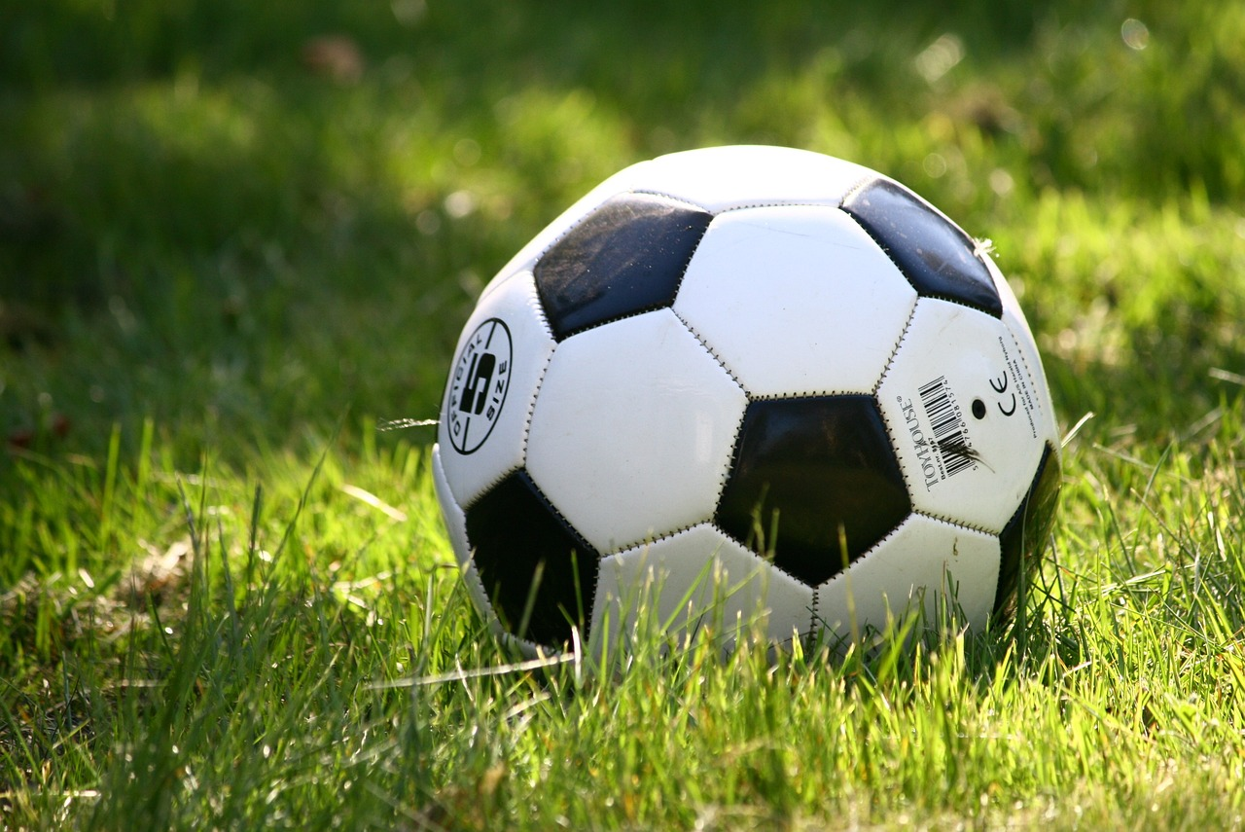

Slide 4
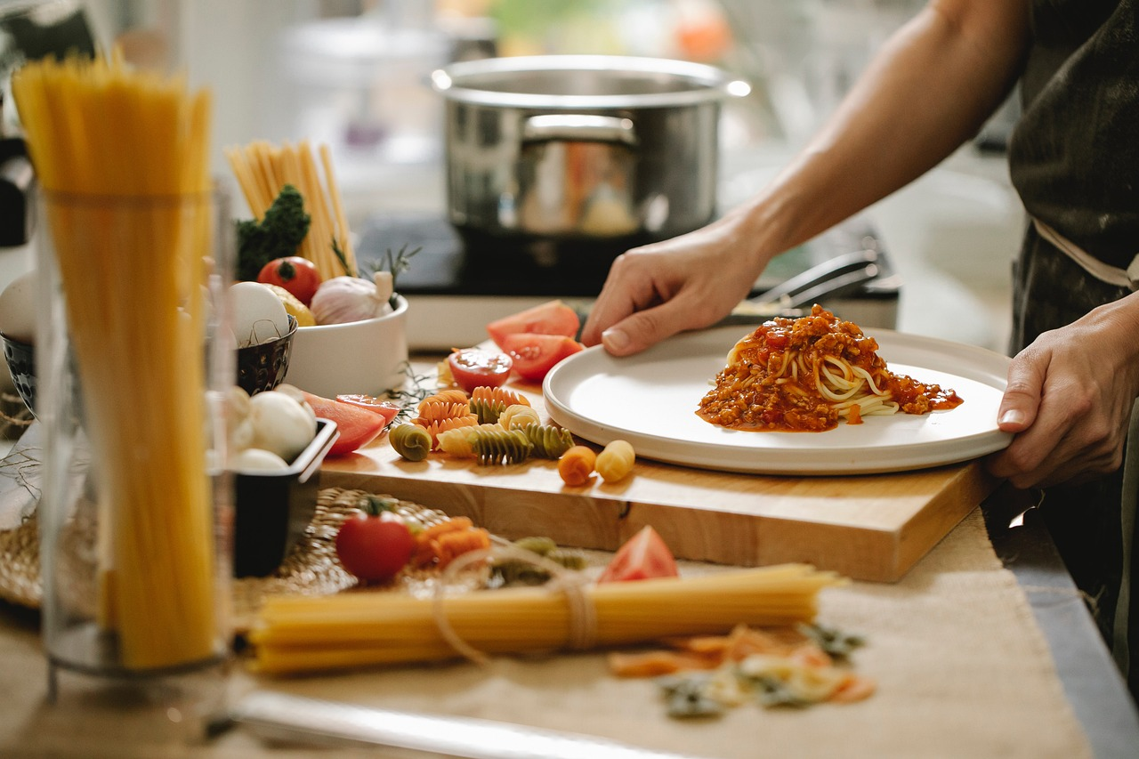

Slide 5
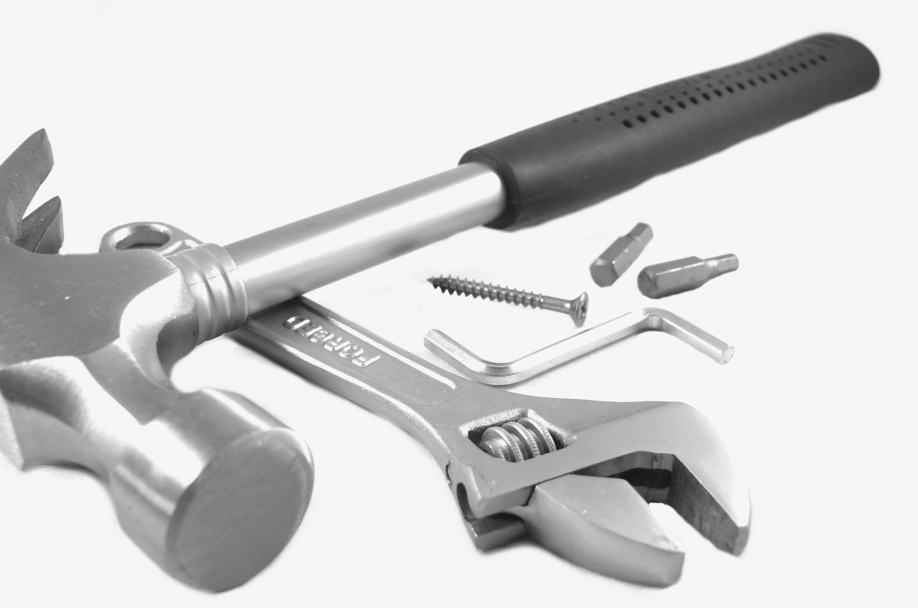

Slide 6
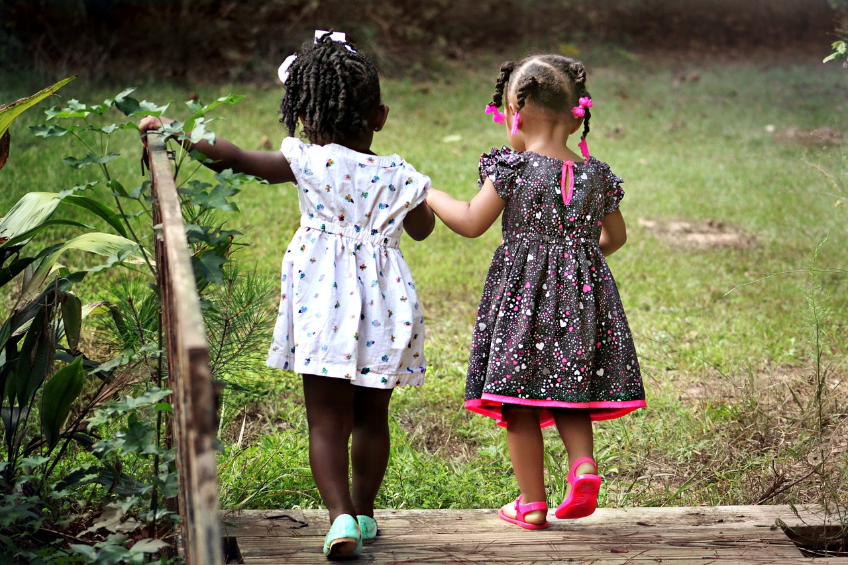

Slide 7
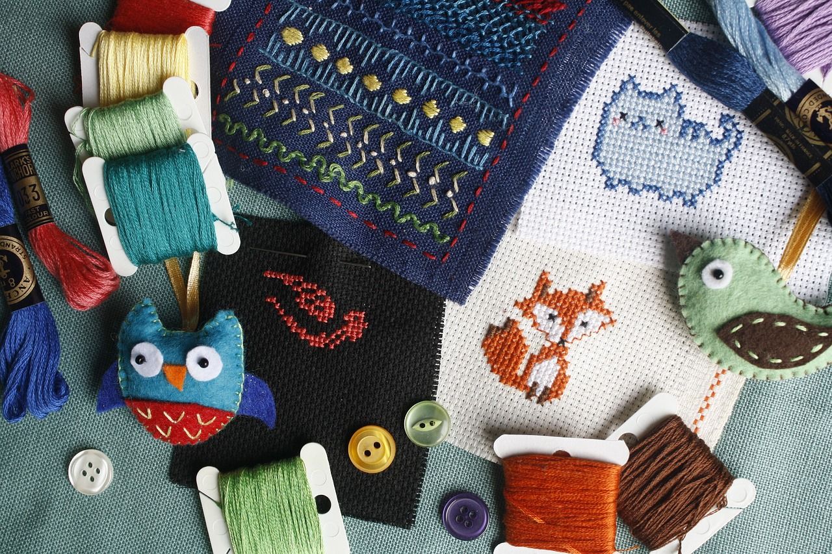

Slide 8
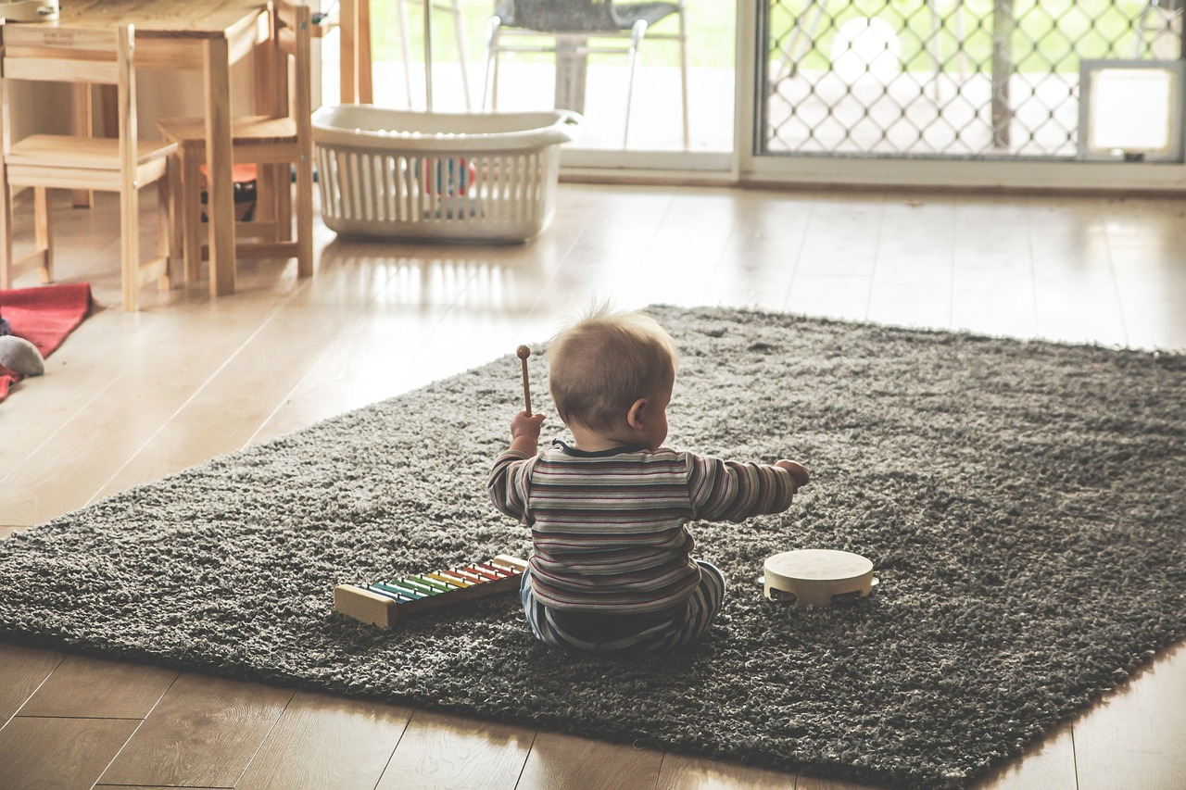

Slide 9
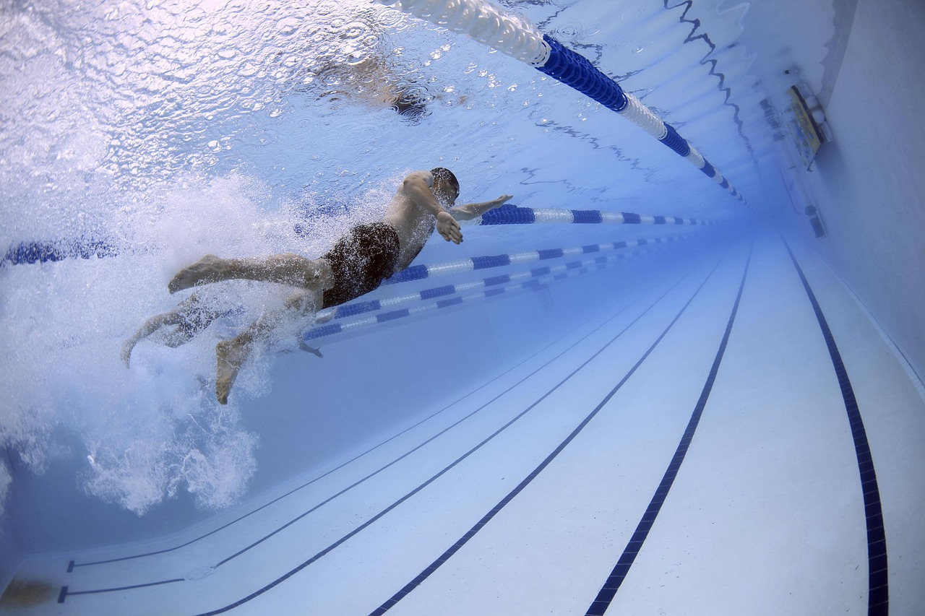

Slide 10

The Olympics
Respect
Friendship
Excellence
Determination
Equality
Courage
Inspiration
Olympic rings © Pixabay
Notes:
Slide 9: It probably comes as no surprise to hear that we are today focusing on the Olympic value of excellence – which I guess we have also been thinking about in most of our stories so far!

Slide 11
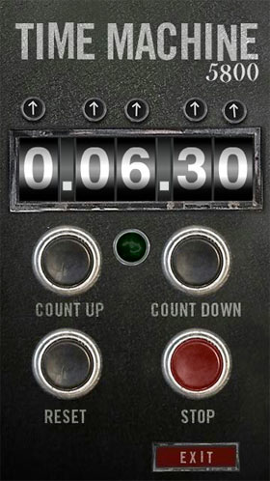
2024
CE
1972
CE
Notes:
Slide 11: This summer during our Olympics, we’ll be seeing many more demonstrations of excellence, but for today, we’re going back in our Olympic time machine again, to 1972,

Slide 12
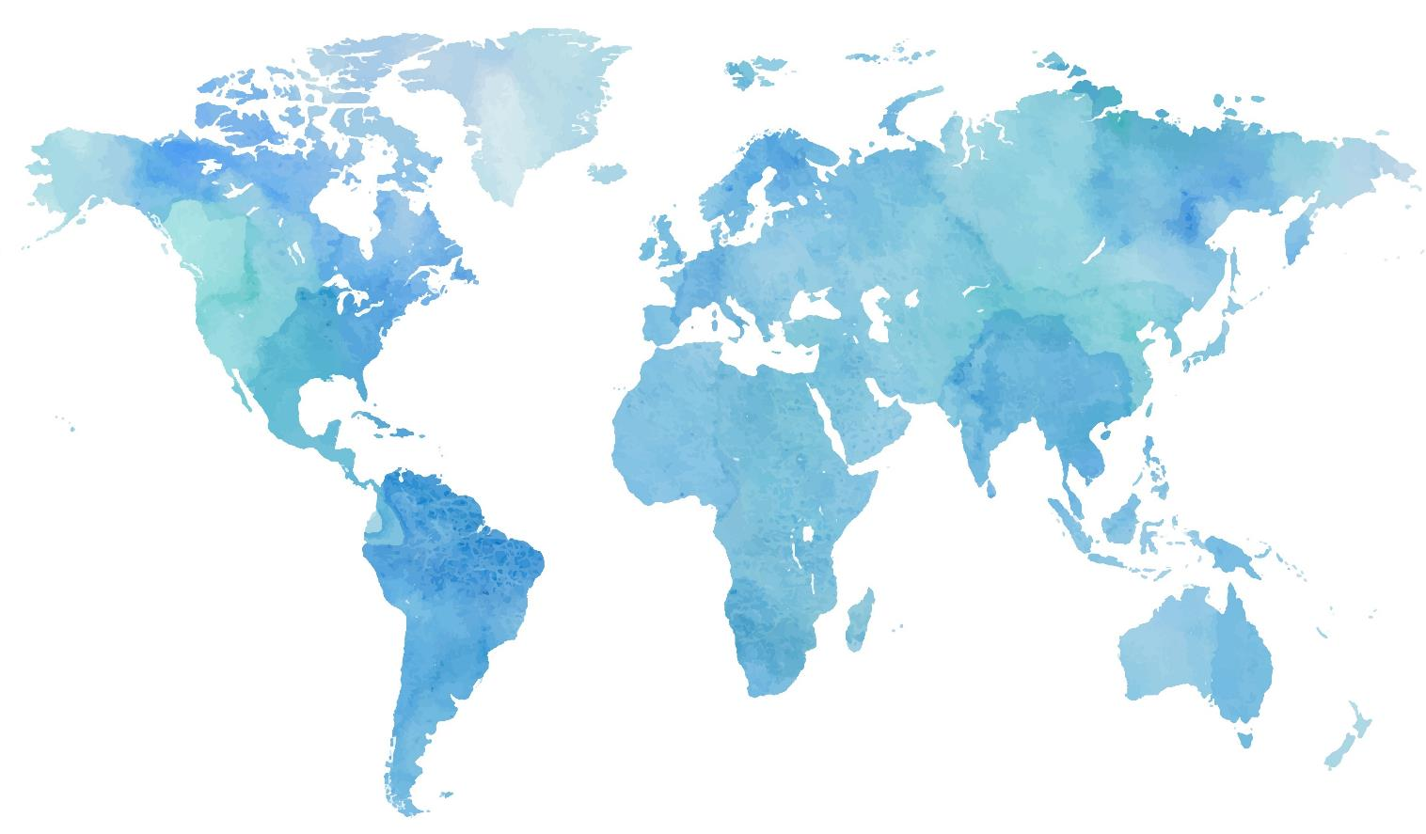

Notes:
Slide 12: when the summer Olympics were held in Munich, Germany.

Slide 13
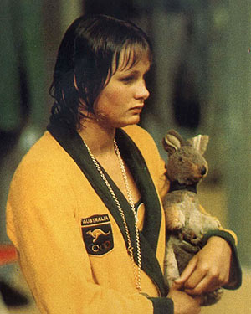

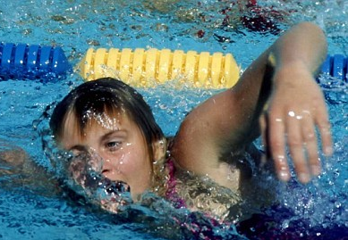
“the Australian goldfish”
Shane Gould - 1972
Notes:
Slide 13: This is Shane Gould, whose nickname was ‘the Australian goldfish’! I wonder if you can guess which sport she might’ve been good at?! [swimming]...and which country she represented at the 1972 Olympics?!!! [Australia]

Slide 14
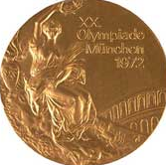
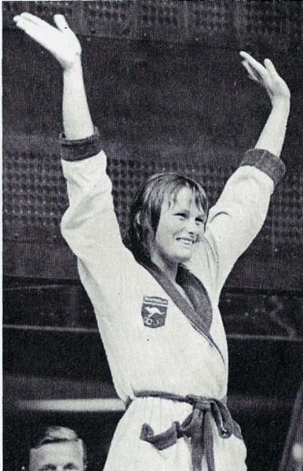
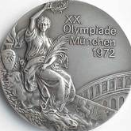
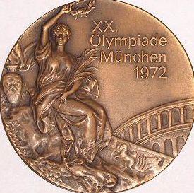
Notes:
Slide 14: Between July 1971 and January 1972, Shane Gould set world records in all five freestyle swimming distances. ‘Freestyle’ is when you choose the swimming stroke that you prefer – most competitors choose front crawl, because it’s the fastest. So this means she was the fastest swimmer in the world across the 5 freestyle distances: the 100m, 200m, 400m, 800m and 1500m. She is still the only person, male or female, to have ever achieved this.
So, before she’d even won her medals at the 1972 Summer Olympics, she was already pretty excellent! At the Olympics, she won:
In Munich, Shane Gould swam 12 races in 8 days, logging a total of 4,200m of competitive swimming in the process. She won her first gold in the 200m individual medley – that’s doing a length of the pool 4 times, using a different swimming stroke each time. She went on to win two further golds in the 400m and 200m, in which she also set her third world record. She finished her first Olympic Games with these three golds, a silver medal in the 800m, and a bronze in the 100m.

Slide 15
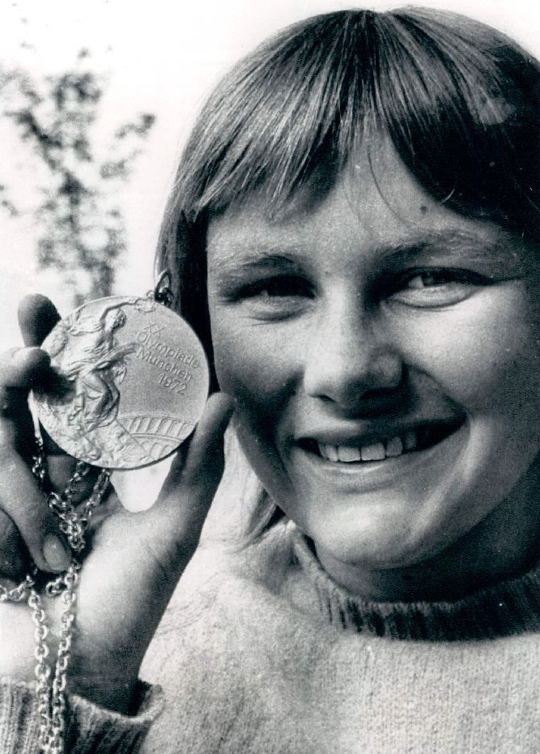
‘….winning races, achieving gold medals and setting world records were all incidental to the experience of swimming…..’
Notes:
Slide 15: And the most extraordinary thing about this is that she was aged only 15 at the time! But she’s also remembered as someone who swam because she loved to swim – she just happened to win as well! Someone said of her:
‘….winning races, achieving gold medals and setting world records were all incidental to the experience of swimming…..’
For Shane, swimming was more important to her than winning medals, and when she got back home to Australia after the Olympics, she struggled being the centre of everyone’s attention. What do you do when you’ve won just about everything it’s possible to win – and you’re only 15? Her mother suggested an idea……

Slide 16
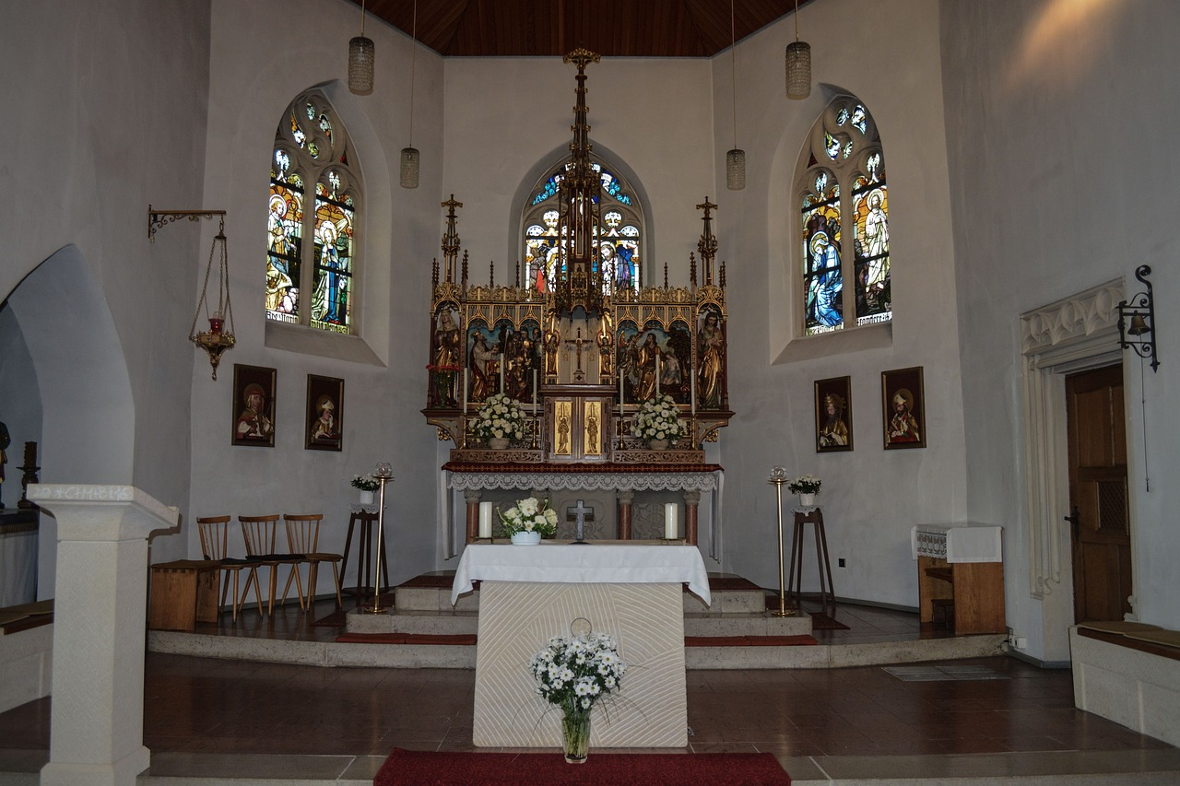
Notes:
Slide 16: One Sunday, when the Gould family went to church, Shane took her five medals with her. During the service, she took the medals up to the front and laid them down on the clean, white cloth that covered the big altar table. They glistened in the sunlight. As she placed them there, Shane said a quiet prayer of thanks to God for them, and stepped back. It felt good. Swimming was a beautiful thing to be able to do, but it was better to recognise that this talent she enjoyed so much came from God. And for the first time since she’d won the medals, she felt as if a great weight had been lifted from her shoulders.

Slide 17
….I wonder what you think you are good at?...
…I wonder what we need to help our talents to grow strong, and not waste them?....
Notes:
Slide 17: Responding and words for worship
Let’s be quiet and still with our own thoughts now…..
In 1972, Shane Gould laid her medals down to show that she recognised that her talent, the thing she was good at, swimming, was a gift from God.
Each of us have different talents and abilities too……things that we are good at……
…..I wonder what you think that you are good at?…..
….maybe it’s swimming, like Shane Gould……or singing, like…..[insert name]
…..maybe it’s cooking….or dancing……or playing a musical instrument…..
…maybe it’s being a good listener….or a good friend…..
….all these are special gifts given to us to look after and develop…..
....I wonder what we need to help our talents to grow strong, and not waste them?….
……many people, like Shane, would say that all these different talents come from God…..
…..maybe in the quietness you’d like to pause and say ‘thank you’ to God for the abilities he’s given to you…..or to be quietly thankful for your talents
[leave space for private prayer / reflection here]

Slide 18



Leader: As we leave this place & time and go into the day ahead…
All: Let’s ‘go for gold’ in all that we do!
Notes:
Sending: Slide 18
Leader: As we leave this place & time and go into the day ahead…
All: Let’s go for gold* in all that we do!
*Again, you might need to unpick what we mean by ‘going for gold’ in the context of today’s words.

Slide 19

Notes:
Slide 19: Reflective areas
Put star shaped paper (or sticky notes) in your reflective area for children to write things that they are ‘excellent’ at. Encourage your class community to help the less confident to identify things that they are good at – and praise them for them. Some children find this very hard, so be very encouraging!

