Slide 1





We are here together in our school family. May God be with us…
...and watch over us.
Notes:
Slide 1: Use these new gathering words for this term, or your usual greeting if you prefer.

Slide 2
Stay Safe!
Notes:
Slides 2-5: Stay safe! Ask children to help you decide how each of the pictures show something that helps us to stay safe: you might want to ask children to think of their own examples as well. Keep this section brief!

Slide 3
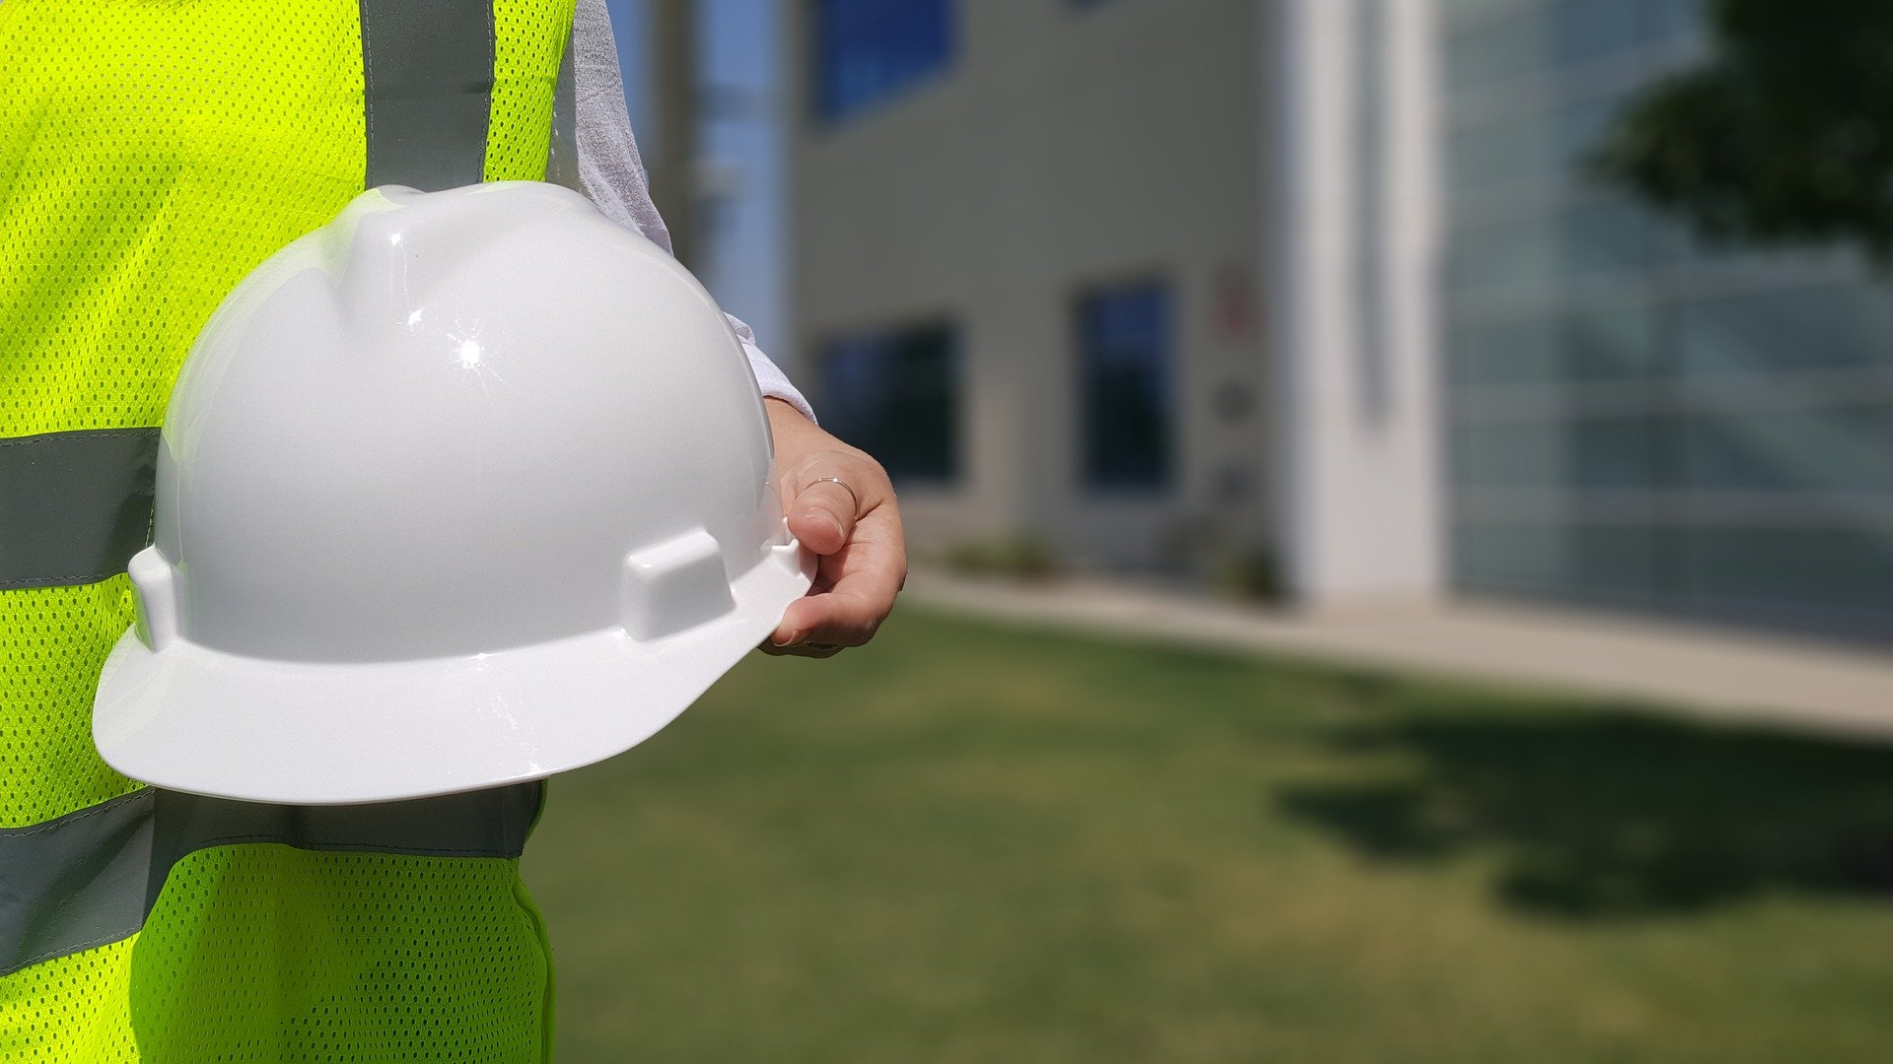

Slide 4
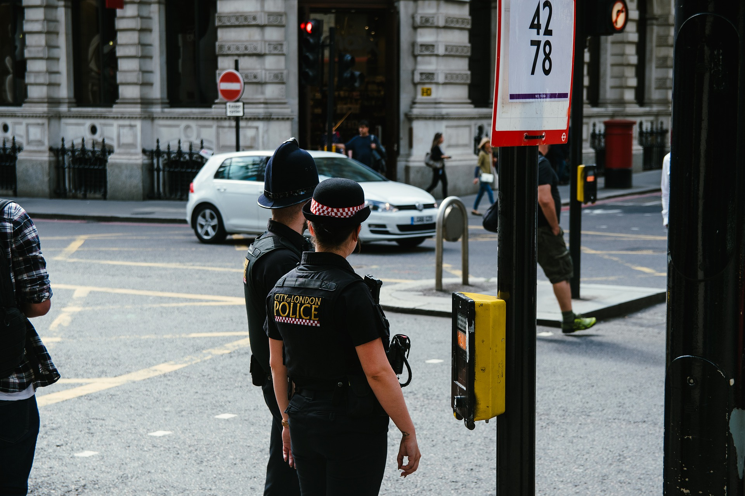

Slide 6

The Lord’s Prayer
Notes:
Slide 6: “We’ve been thinking this term about the prayer that Jesus taught to his disciples to help them to pray – and been learning what this means to Christians, as well as thinking about how the ideas might help us to live our lives.

Slide 7
Our Father in heaven,
Hallowed be your name
Your kingdom come, Your will be done on earth, as it is in Heaven.
Give us today our daily bread.
Forgive us our sins,
As we forgive those who sin against us.
Lead us not into temptation,
But deliver us from evil.
For the Kingdom, the power and the glory are yours, now and forever.
Amen
Notes:
Slide 7: The next part of the Lord’s Prayer says this: ‘Deliver us from evil’. When Christians pray this part of the prayer, they’re simply asking God to protect them, to keep them safe from harm. We’re going to look at two more word-pictures from the Bible that remind Christians about God’s protection.

Slide 8
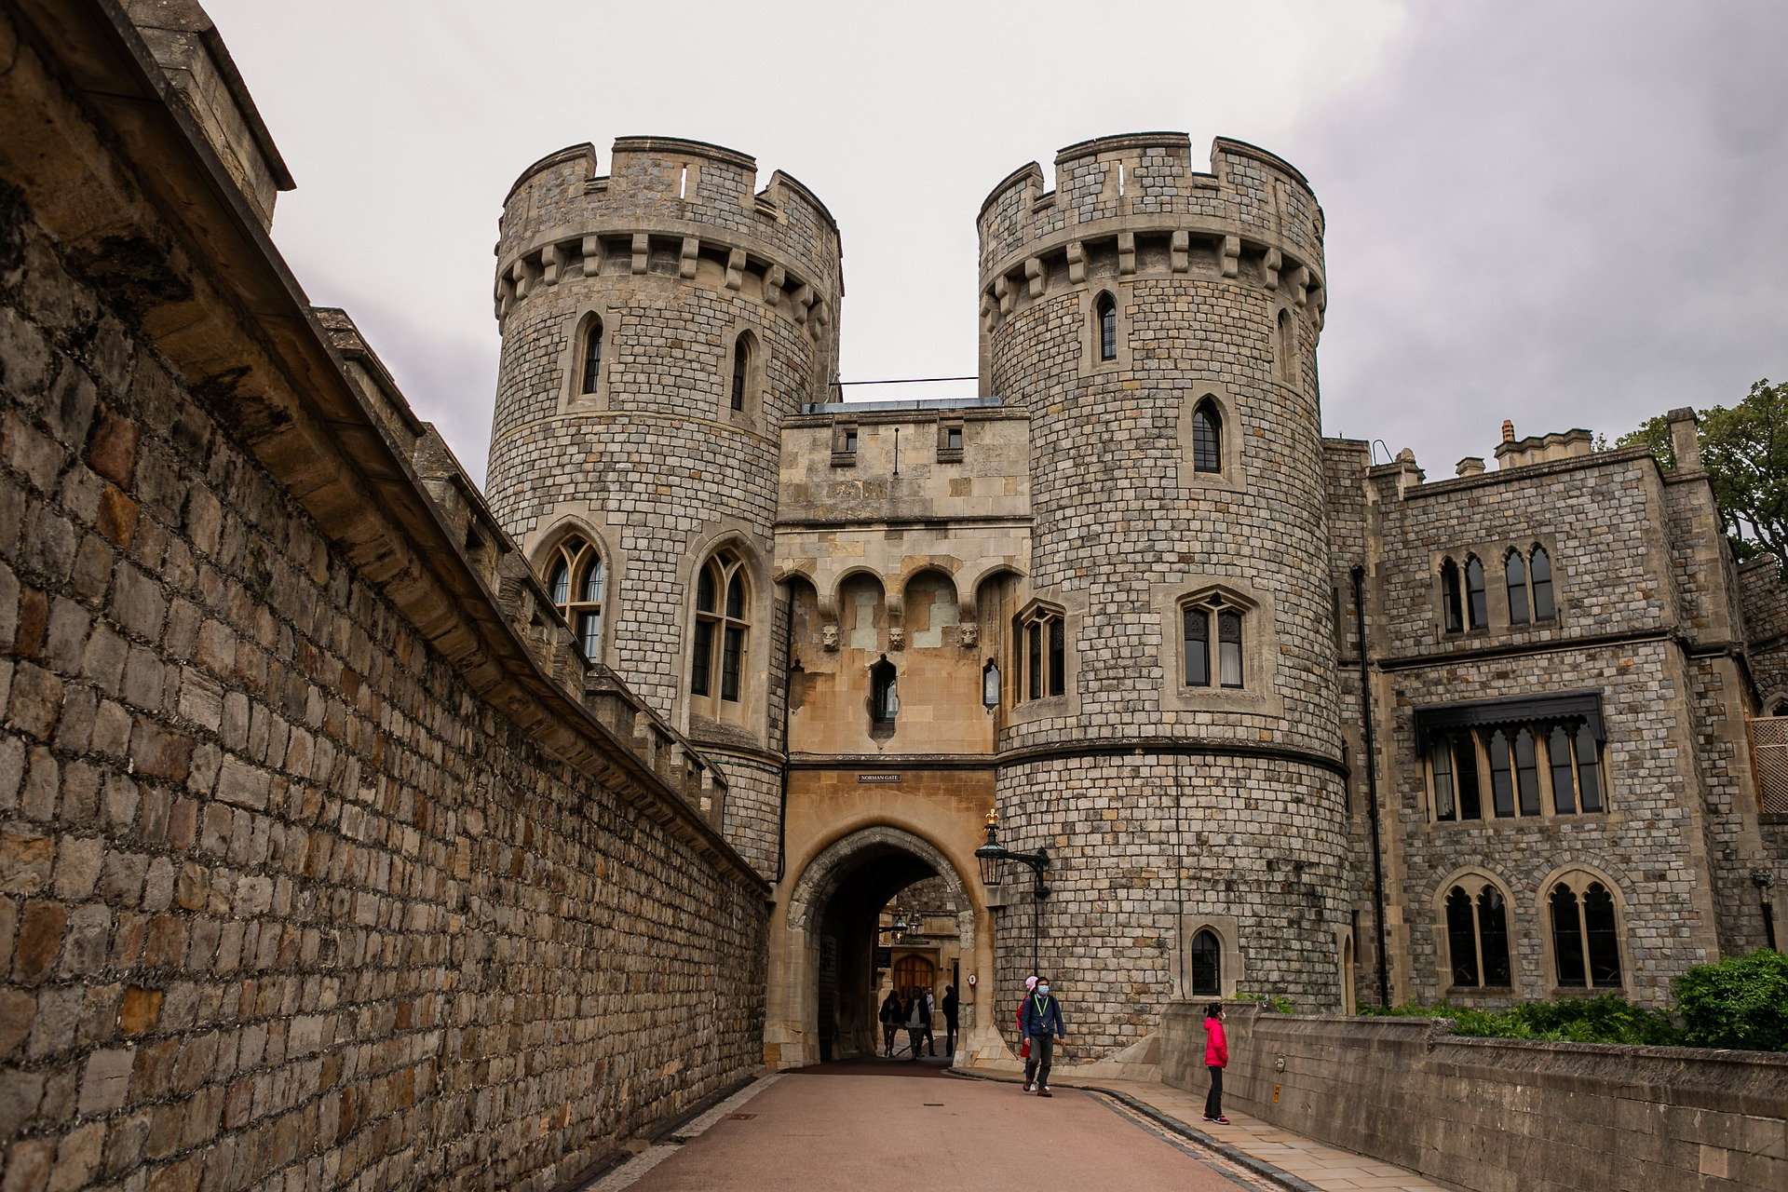
‘God’s name is like a strong and mighty tower – people who love him can run inside and be safe.’ (Proverbs 18:10)
Notes:
Slide 8: Here’s the first one…a castle. I wonder what this has to do with being safe?....For thousands of years, people have built castles not just as a high place to guard the land around from – or shoot arrows! – but a place where the people living on the surrounding land could run to whenever there was trouble. The tower of the castle (the keep) kept the people of the village safe. In a place of the Bible called Proverbs (Proverbs 18:10), Christians read that ‘God’s name is like a strong and mighty tower – people who love him can run inside and be safe.’ When life is hard, or sad things happen, people who are Christians will ask God to protect them and keep them safe, just as if they were inside a tower. That doesn’t always mean that the hard situation they’re facing goes away, but it does mean that God can help them to get through it, that God will be with them and that being with him is a safe place.

Slide 9
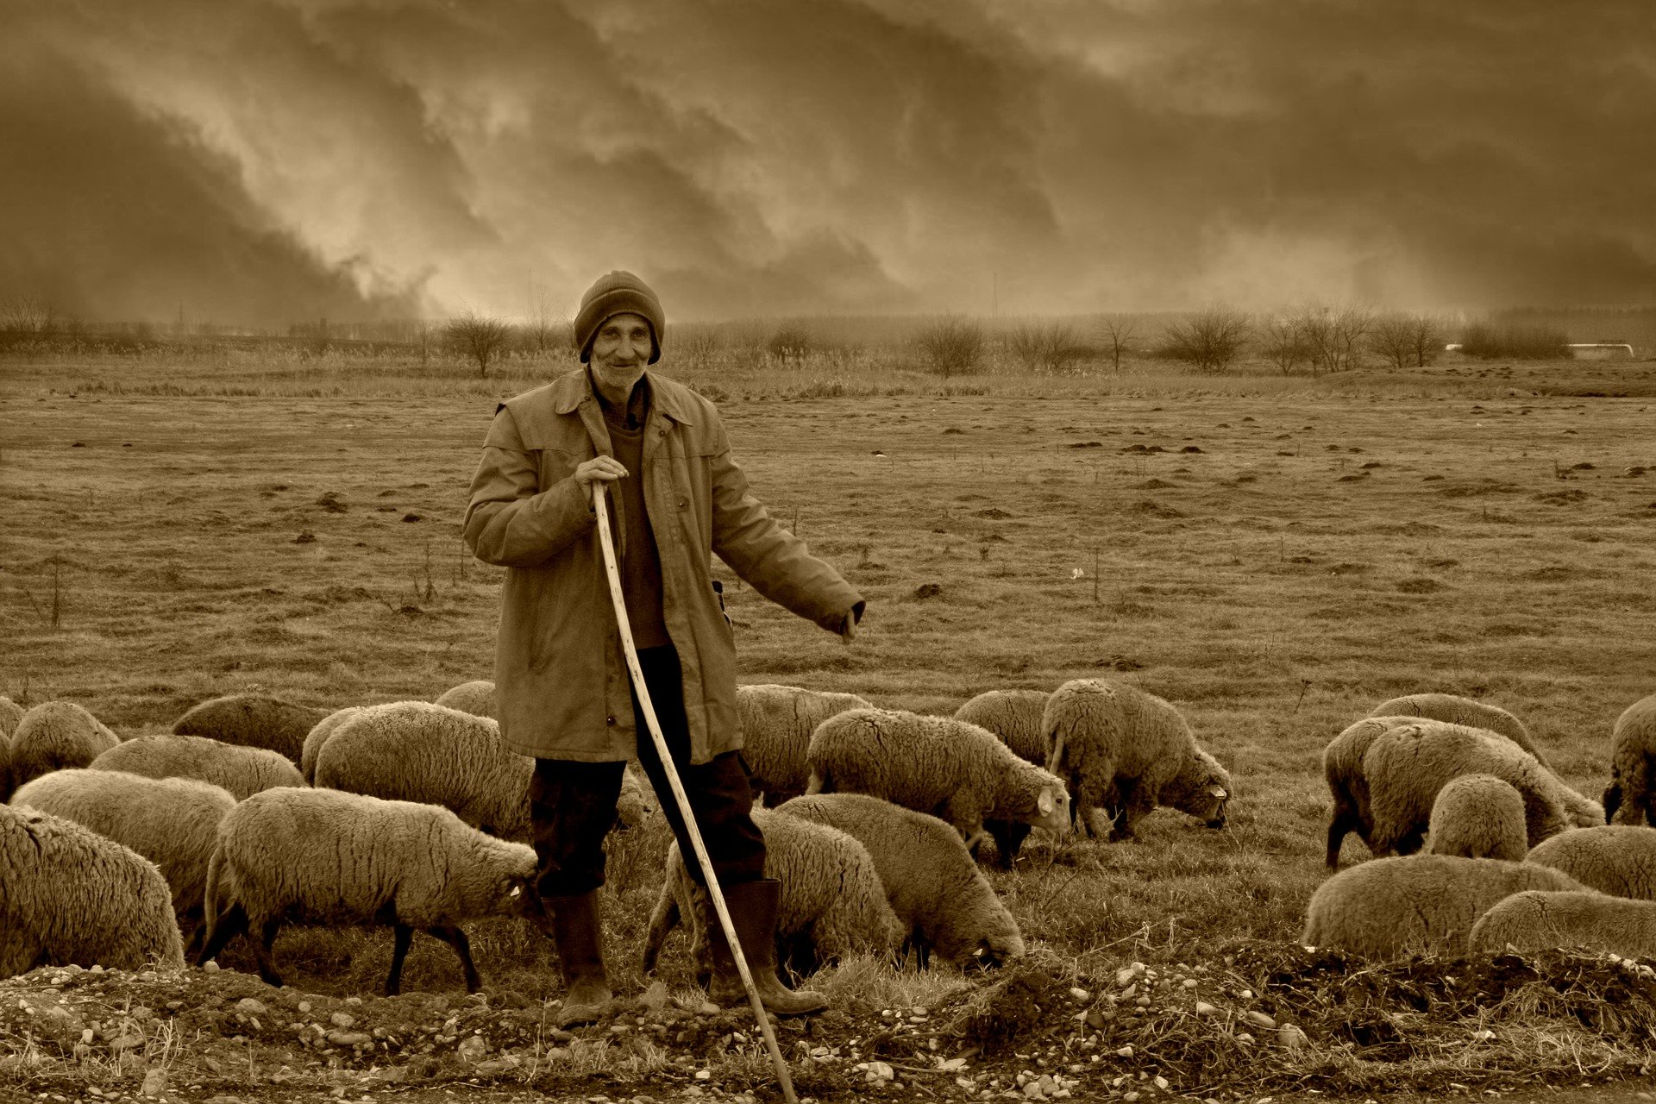
Notes:
Slide 9: Our second picture is in the form of a story, based on one of King David’s most famous psalms about a shepherd. As you listen, think about the things that the shepherd does to keep his sheep safe [use script p.3-4, and briefly allow children time after to share their ideas]
Video link: https://youtu.be/6Jaog2N_wj4

Slide 10
….I wonder when Christians might ask God to keep them safe?....
.…I wonder how these pictures of what God is like help Christians to feel safe?....
….I wonder where you feel really safe?....or who you turn to when you are afraid?....
IF IT IS, GO AHEAD
Notes:
Slide 10: Let’s wonder together about this now… [you may wish to pause and talk together]
…. I wonder when Christians might ask God to keep them safe?....
….I wonder how these pictures of what God is like help Christians to feel safe?....
…I wonder where you feel really safe?....or who you turn to when you are afraid?....

Slide 11
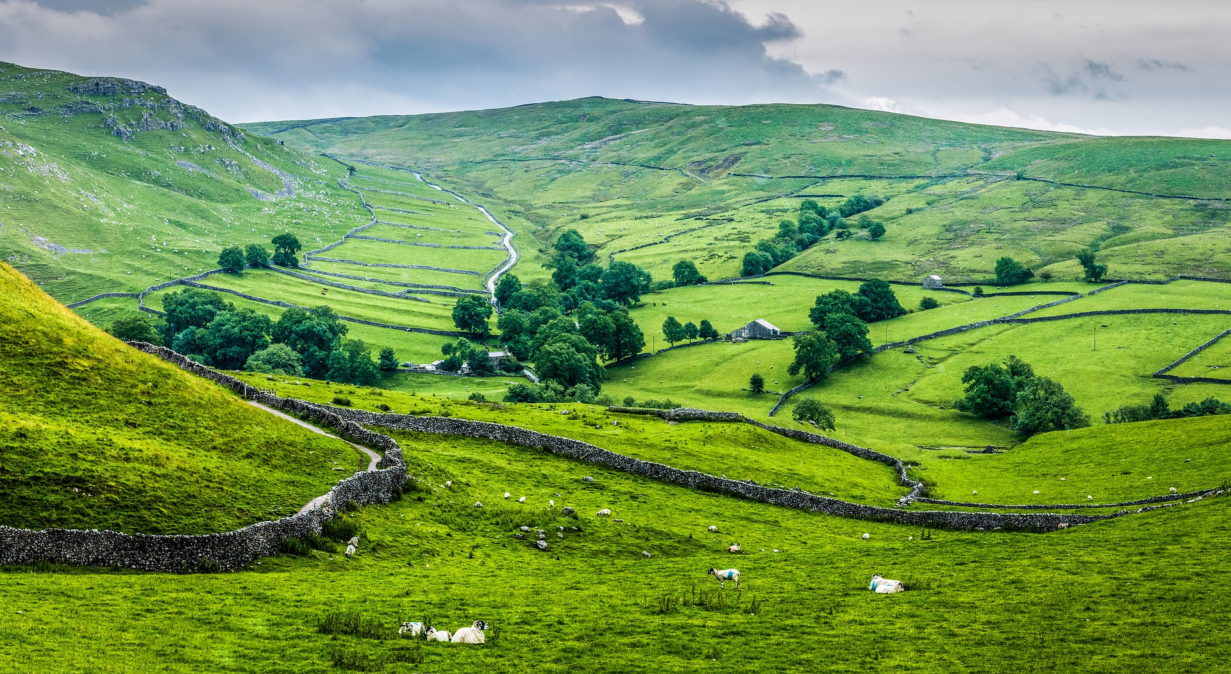
Notes:
Slide 11: …we’ve been thinking today about how two pictures help Christians to understand how God keeps them safe….
….God the strong tower…..and God the good shepherd….
….when Christians pray ‘deliver us from evil’, these pictures can be a reminder that God is with them always….
….
….in the quietness, allow your soul, or the inner you, to be still and calm for a few moments….
….you might want to look at the picture to help you….
….you might want to bring your thoughts and prayers to God now: I’m going to use some words from Psalm 23, the Shepherd’s Psalm that we heard earlier….
You can make the prayer your own in some way, if you’d like to, or if you’d prefer not to pray, then just sit quietly with your own thoughts.

Slide 12
Thank you God, that you are like the very best shepherd – you give us everything we need. You lead us along safe paths, and we don’t need to be afraid because you are with us wherever we go.
Thank you God, our shepherd.

Slide 13


Slide 14


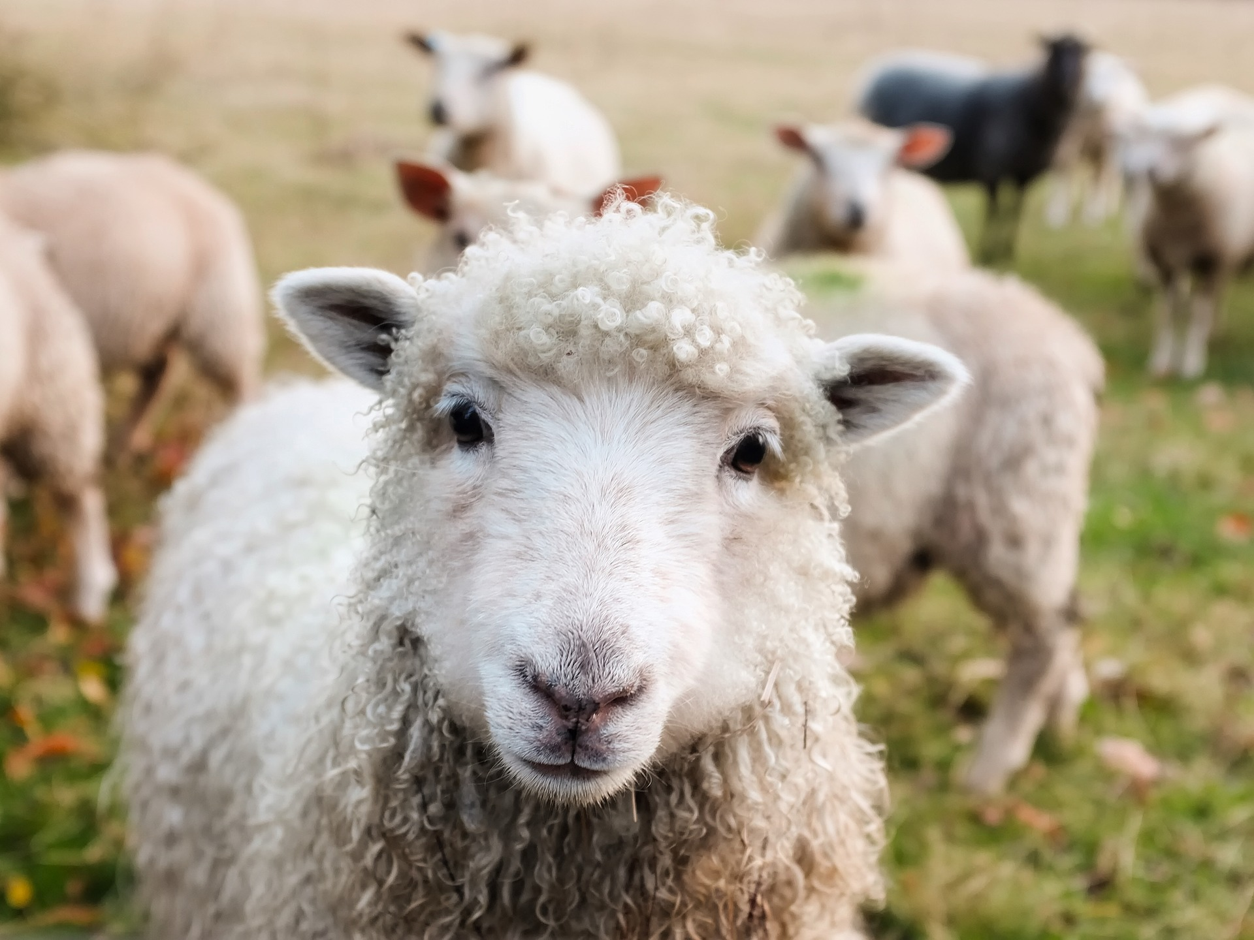
Leader: As we leave this place & time and go into the day ahead…
All: May we find safety and rest – just like the shepherd’s sheep!

