Slide 1
Leader: As we share these stories of leaders…
ALL: May we follow their example
in thoughts
and words
and actions.
Notes:
Leader: As we share these stories of leaders…
ALL: May we follow their example in thoughts and words and actions.
Signs for greeting: click on links
Thoughts: British Sign Language BSL Video Dictionary - thought (signbsl.com)
Words (use 3rd definition): British Sign Language BSL Video Dictionary - word (signbsl.com)
Actions: British Sign Language BSL Video Dictionary - action (signbsl.com)

Slide 2
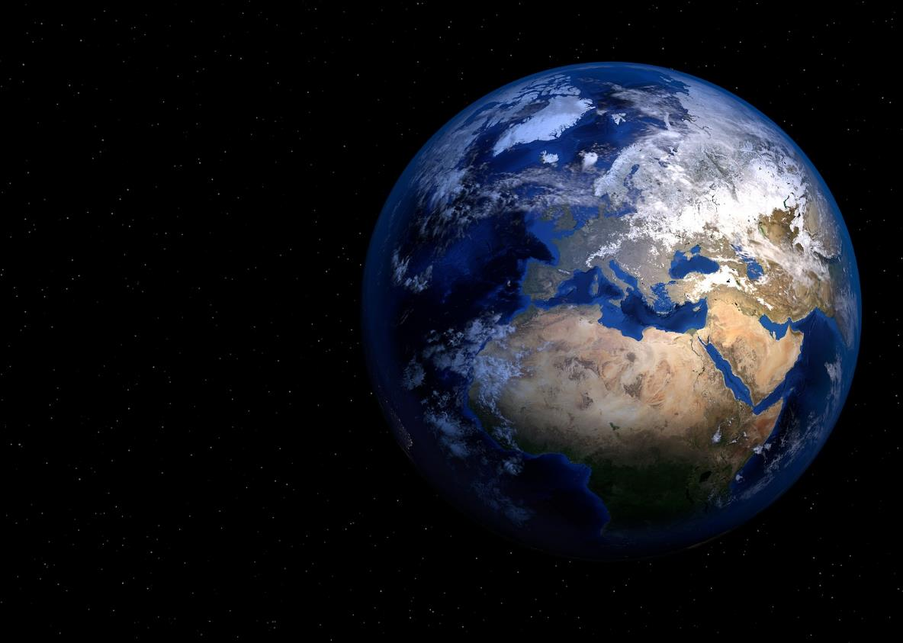
In my perfect world….
Notes:
Slide 2: In my perfect world…..
Last week, we heard a story about athlete Wilma Rudolph and how she wanted a better world where black and white people were treated the same. I wonder what it might be like in your perfect world? [Share your thoughts and ideas together: you might do this using talking partners. Try not to comment on thoughts as they’re shared]

Slide 3
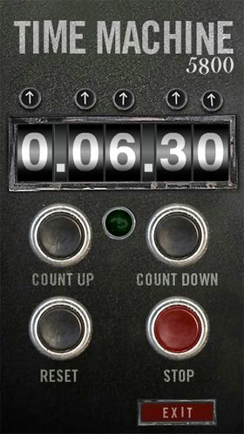
1963
2023
AD
AD
Notes:
Slide 3: We’re going to travel back in time again, to America, and the summer of 1963, just 3 years after Wilma Rudolph won her medals and the fight to have a celebration in her home town so that black and white people could eat together. I wonder what we’ll find?..... [you might actually want to ask this question, as the sense of disappointment that nothing’s changed might help pupils understand the significance of what MLK achieved!]

Slide 4
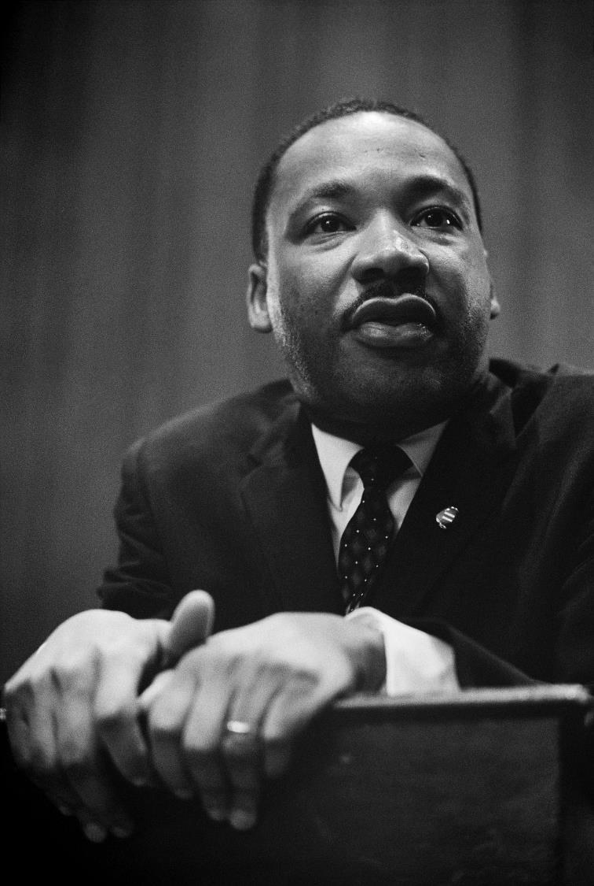
I have a dream….
….that my four little children will one day live in a nation where they will not be judged by the colour of their skin but by the content of their character.
Dr. Martin Luther King
Notes:
Slide 4: This [show photo] is Dr Martin Luther King. He is considered to be one of the greatest leaders of all time and these words that he spoke ‘I have a dream…..’ are some of the most famous in history, spoken 60 years ago, in the summer of 1963.
Despite people like Wilma Rudolph’s actions, it was sadly still the case that black people and white people were not allowed to live together: they were kept apart and could not travel sitting side by side in the bus, or eat at tables in restaurants, or go to the same schools, or even drink from the same water fountains. Black people were not allowed to vote in public elections so couldn’t even vote to help change the laws that kept them separate. People call this racism.
His views made him unpopular with many white people and he was sent to prison many times just for speaking out for a fairer world. After he was released from prison in 1963, he went to Washington, the capital city of America.
There, in front of a crowd of about 250,000 people, and with many more people tuned to their TV and radio, he spoke these words…..
‘I have a dream that that my four little children will one day live in a nation where they will not be judged by the colour of their skin but by the content of their character.’ [you may wish to talk a bit more about this, depending on the age of your children.]
Little by little, people began to listen, and although he was killed in 1968 whilst delivering another of his famous speeches, the changes that he had started continued after his death and slowly laws were changed. He had indeed changed the world, not just for his four children, but for all children. And to honour his memory, Dr Martin Luther King is remembered every year on the Monday closest to his birthday, January 16th, for his courage in speaking up against unfair laws.

Slide 5
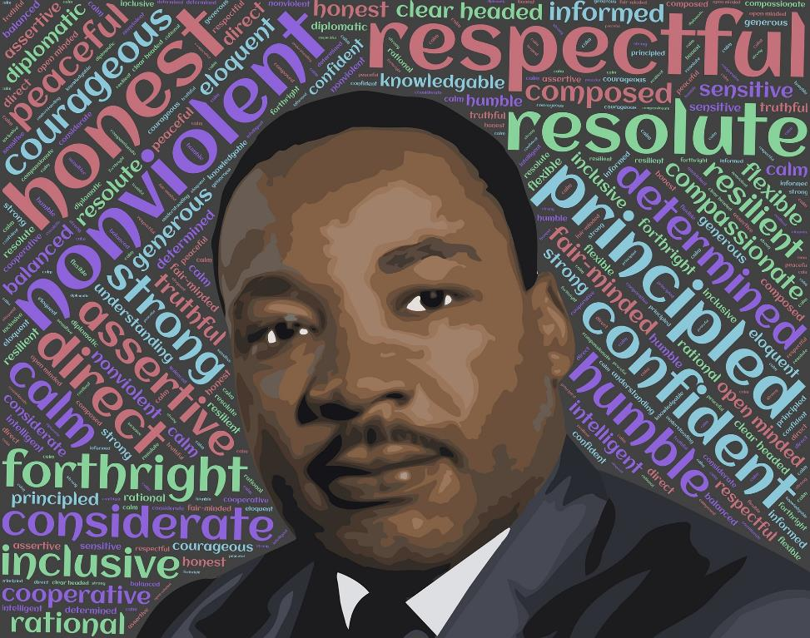
‘Speak up and judge fairly. Defend the rights of the poor and needy.’ [Proverbs 31:9]
Notes:
Slide 5: Dr Martin Luther King was also a Christian, who took the words he read in the Bible about injustice, like these ones, very seriously. He wanted to see a world that reflected the truths of God’s Kingdom, where all are equal and no one is treated badly. He also spoke against violence of any sort: he wanted people to be allowed to speak up for their rights peacefully – and be listened to.

Slide 6
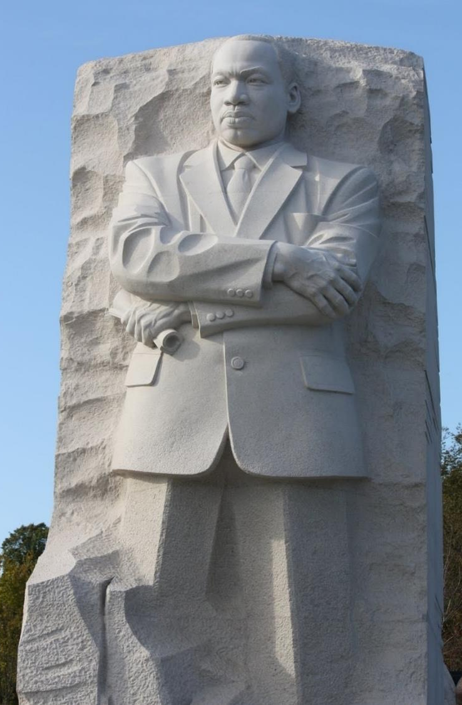
Injustice anywhere is a threat to justice everywhere.
Life’s most urgent question is ‘What are you doing for others?’
The time is always right to do what is right.
Forgiveness is not an occasional act, it is a constant attitude.
Notes:
Slide 6: This memorial statue was placed very near to the spot in Washington where he delivered his most famous speech.
Let’s hear a few more of his words now, before we think together about what inspires us about his leadership…..[you might want to talk together about these words and what they mean, especially if you have younger pupils]:
Injustice anywhere is a threat to justice everywhere.
Life’s most urgent question is ‘What are you doing for others?’
The time is always right to do what is right.
Forgiveness is not an occasional act, it is a constant attitude.

Slide 7
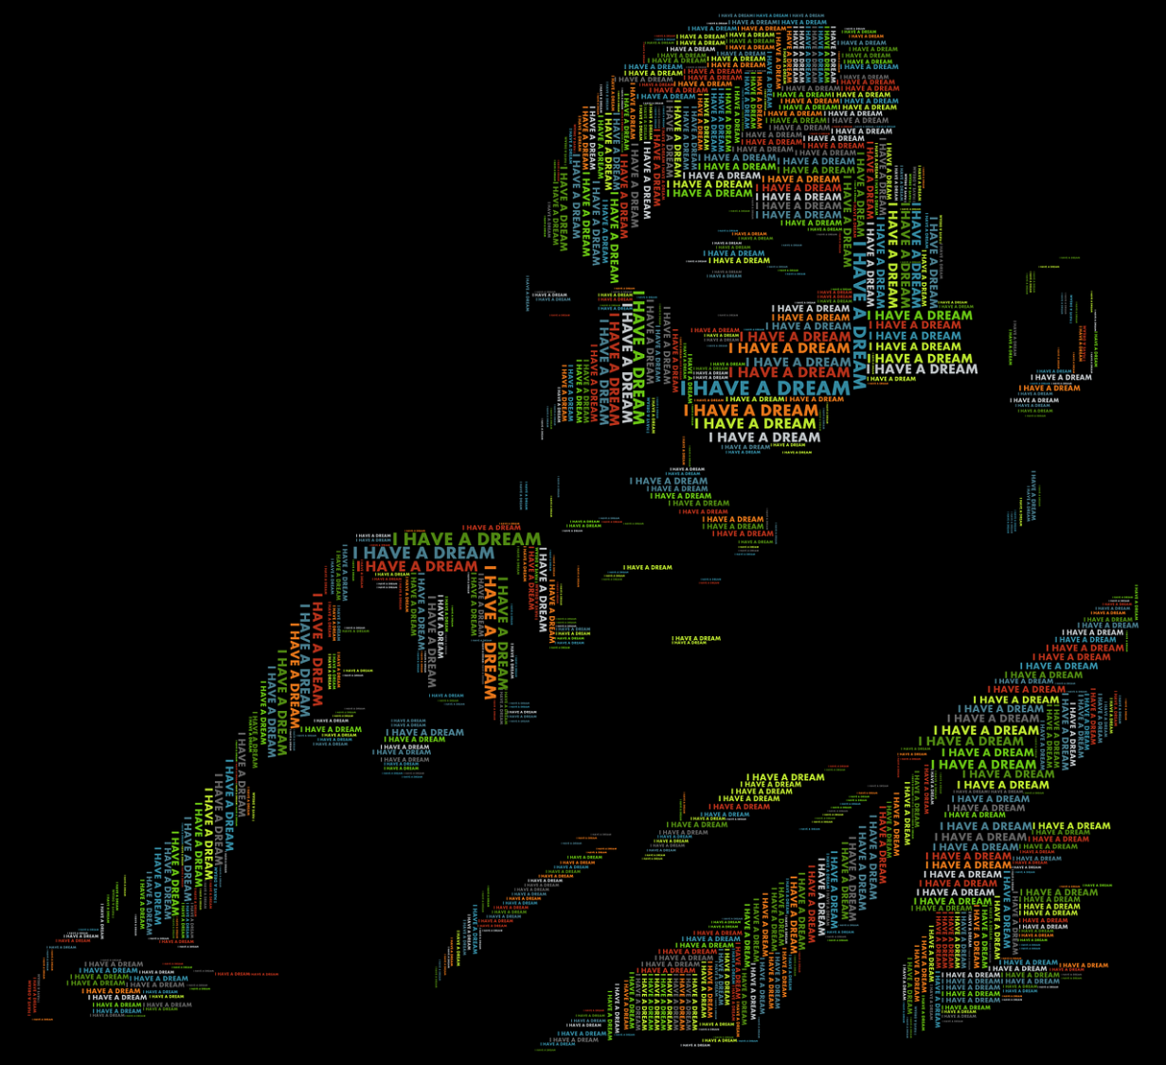
…. I wonder how the world might have been a different place if Martin Luther King had not spoken out?.....
….I wonder what we might learn from Martin Luther King’s life and example?...
….I wonder which of his words inspire you most?....
Notes:
Slide 7: Responding (words for worship):
….now in the stillness of this moment, let’s spend some time wondering together…..
…we’ve been thinking today about the life and words of Dr Martin Luther King, whose words about his vision for the world have continued to inspire many….
…let’s wonder together now….
….I wonder how the world might have been a different place if Martin Luther King had not spoken out?.....
….I wonder what we might learn from Martin Luther King’s life and example?...
….I wonder which of his words inspire you most?....
…..our world still needs people like Martin Luther King to dream about the world that they want to see – and to be brave enough to do something about it …..

Slide 8
…. I wonder what might be needed to change the world for the better in the way that you thought?
….I wonder what we might need to do to make it happen, remembering again that we can be the change we want to see in the world?....
In my perfect world….
Notes:
Slide 8: …let’s go back to the question we started with about your perfect world….
….I wonder what might be needed to change the world for the better in the way that you thought?....
…I wonder what we might need to do to make it happen, remembering again that we can be the change we want to see in the world?....
[talk together as much as time allows]

Slide 9
..the time is always right to do what is right.
Notes:
Slide 9: We have heard Martin Luther King’s words that ‘the time is always right to do what is right.’ So, let’s use these words as we pray now. If you’d like to pray with me, then join in with ‘the time is always right to do what is right’ after I say ‘help us to remember that….’
God of justice,
When we see people being treated unfairly, help us to remember that the time is always right to do what is right.

Slide 10
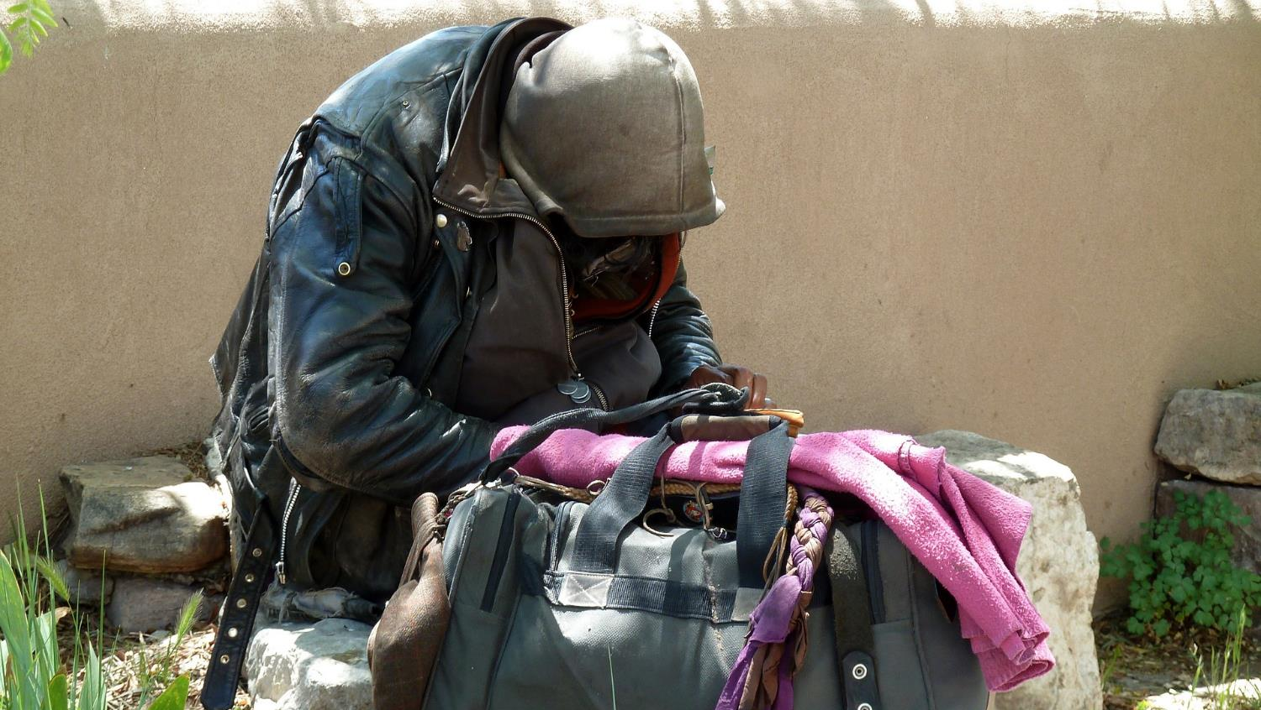
..the time is always right to do what is right.
Notes:
When we see someone poor or in need, help us to remember that the time is always right to do what is right.

Slide 11
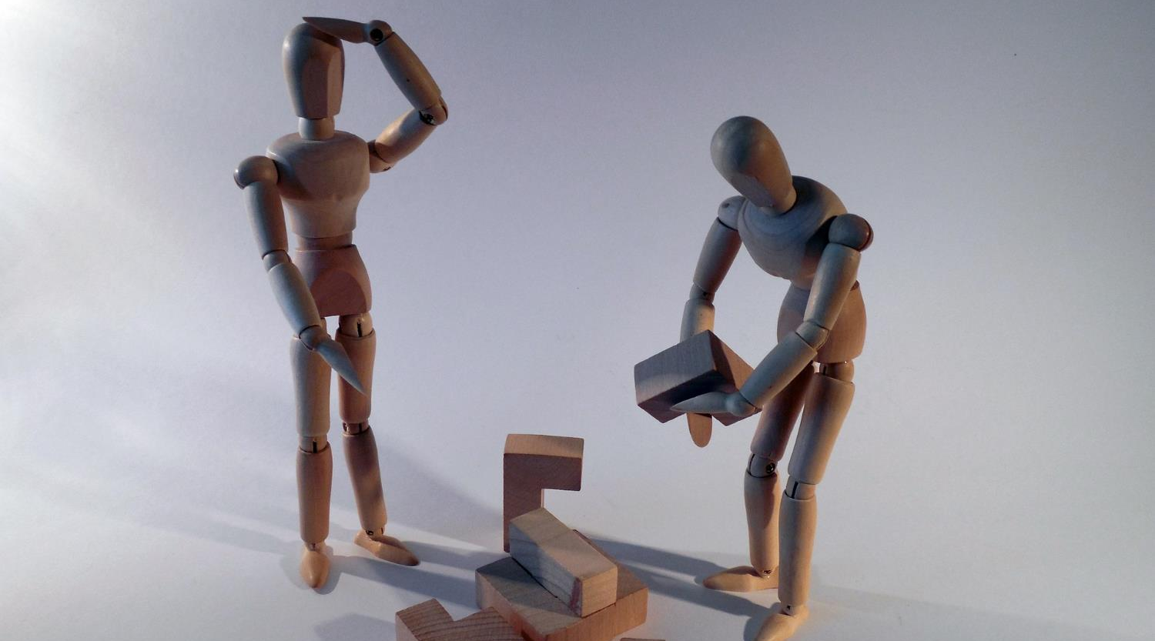
..the time is always right to do what is right.
Notes:
Whatever someone’s situation, help us to remember that the time is always right to do what is right.

Slide 12
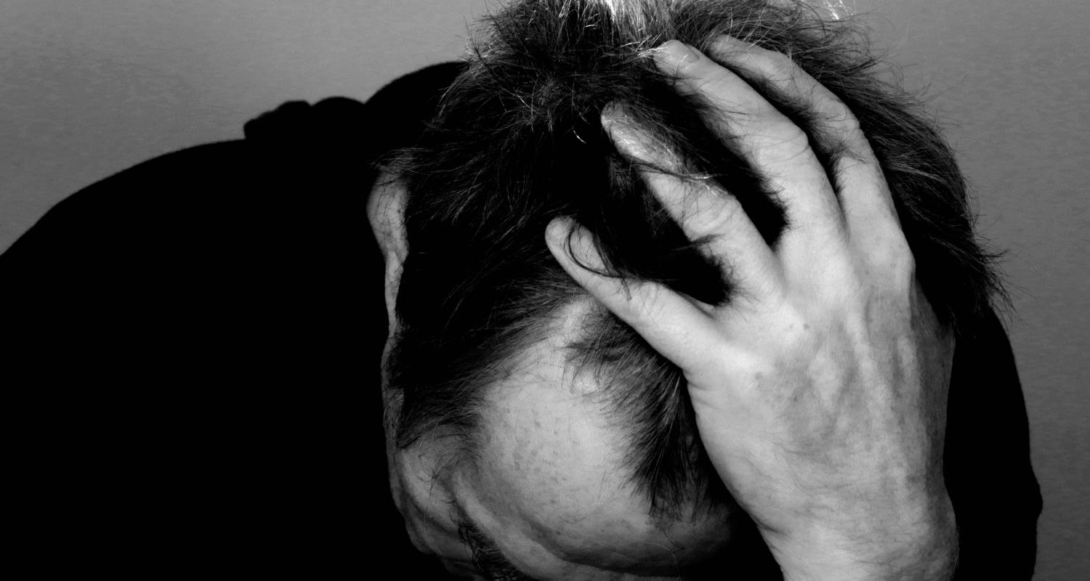
..the time is always right to do what is right.
Notes:
We may not always have solutions to such big problems, but help us to remember that the time is always right to do what is right.

Slide 13
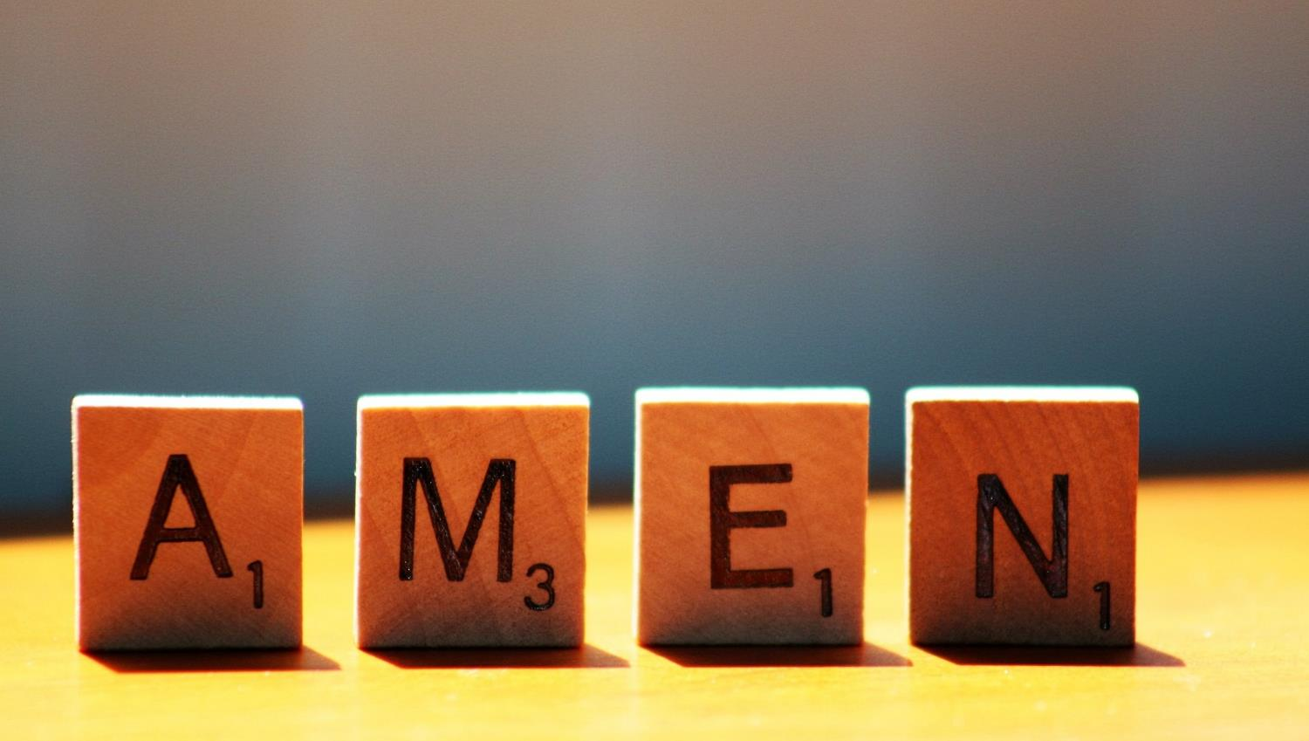

Slide 14
Leader: As we leave this place & time and go into the day ahead…
All: …may we remember that ‘the time is always right to do what is right.’

Slide 15
Think about making the right choices. Use a pipe cleaner or paper straw to make a ‘tick’ shape to leave as a sign you want to do what is right.

