Slide 1





We are here together….
May our attitudes make our school community a happy place today.
Notes:
Slide 1: Use the gathering words for this term
Leader: We are here together
ALL: May our attitudes make our school community a happy place today.

Slide 2



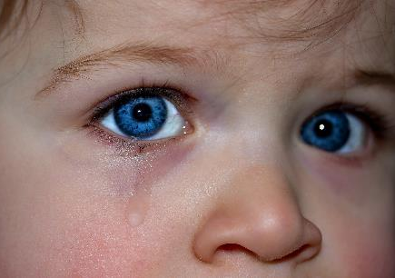
Notes:
Slide 2: I wonder how these people are feeling? [show images on slide, one by one] As human beings, one of the things we value most in each other is the ability to know how someone else is feeling – and being able be happy when they are happy, but especially to comfort them if they are sad. We call this being compassionate.

Slide 3


Beatitudes
Beati
‘How-to-be-attitudes’
Notes:
Slide 3: Jesus also valued this quality, and said it’s important in God’s Kingdom. We’ll find out more about this a little later….

Slide 4
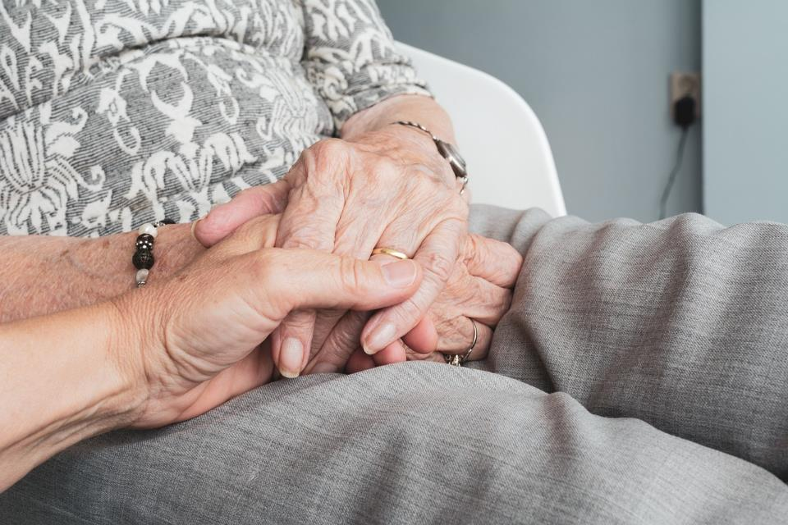
Compassion
Notes:
Slide 4: Although most of us would say that we do not enjoy being sad, experiencing this emotion helps us to learn this important skill of compassion in coming alongside others, especially when they are feeling sad.

Slide 5
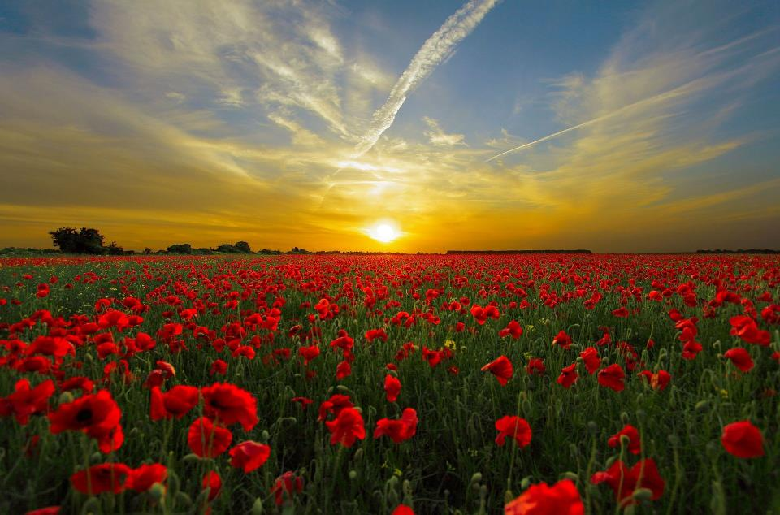

Remember….
Notes:
Slide 5: This week, we have an opportunity to do this on a very special day in the life of our nation – and other nations across the world. ‘Poppy Day’ or more correctly, Armistice Day, is a reminder to us to simply ‘remember’.

Slide 6
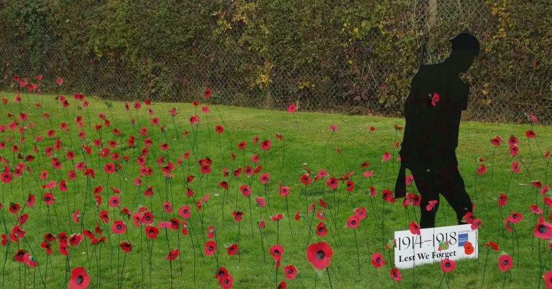
‘the war to end all wars’
Notes:
Slide 6: Since the end of the Great War (also known as WW1) in 1918, which people said was the ‘war to end all wars’, poppies have become a symbol for this act of remembering and being thankful.

Slide 7
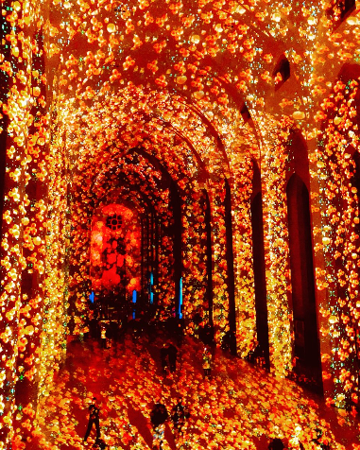
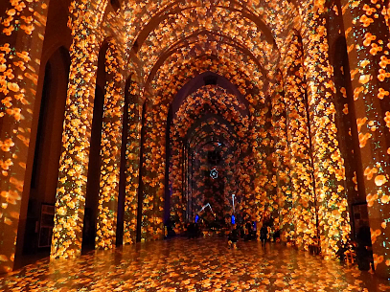
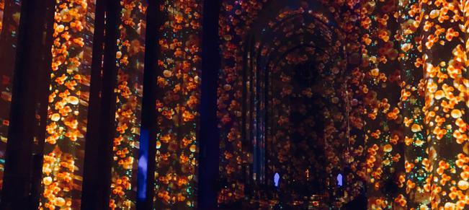
Poppy Fields Guildford Cathedral
Oct 2018
Notes:
Slide 7: Here, you can see our very own Guildford Cathedral, full of poppies, to mark 100 years since the First World War ended in 1918.

Slide 8
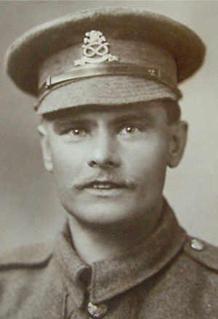
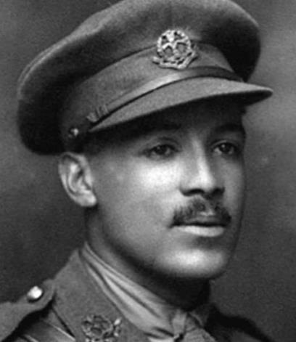
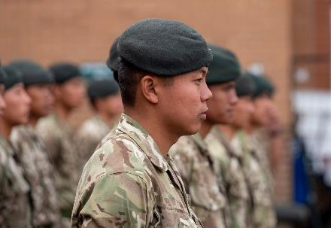
Lance Corporal William Coltman
(1891-1974)
2nd Lieutenant Walter Tull
(1888-1918)
Photo © Tull family archives & National Archives
Notes:
Slide 8: We remember the many acts of courage, selflessness and service of those who fought in past wars, and think about those who are still doing so. (The 2 servicemen featured on screen are Lance Corporal William Coltman and 2nd Lieutenant Walter Tull, whose stories we have told in previous resources)

Slide 9
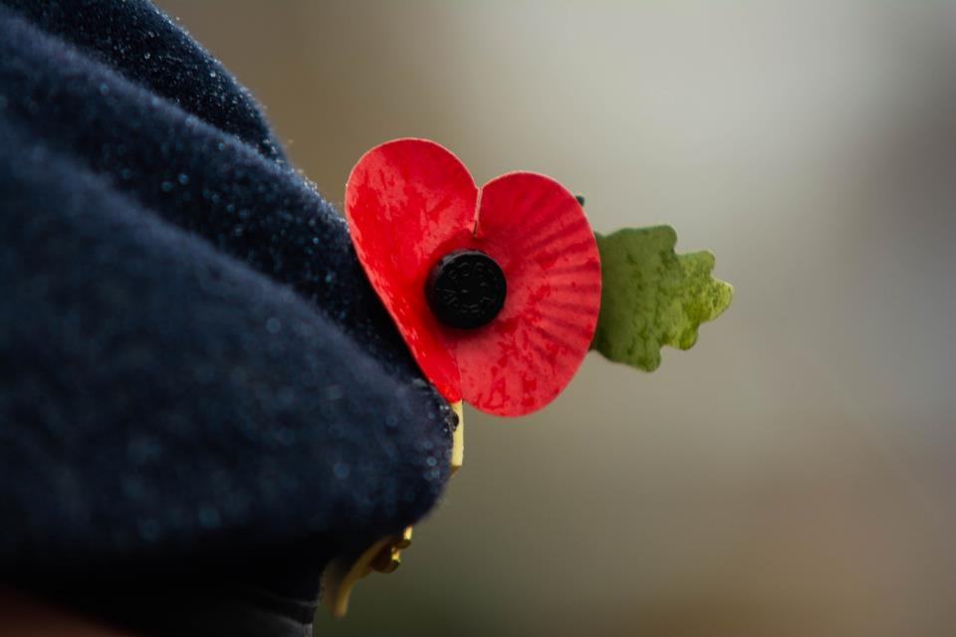
Notes:
Slide 9: We remember by wearing a poppy which helps us to show that we are grateful.

Slide 10
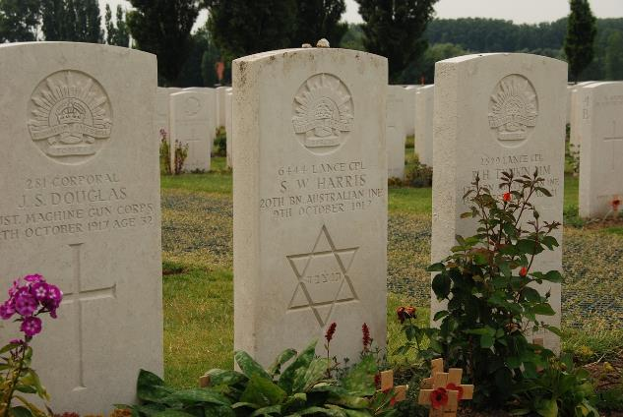
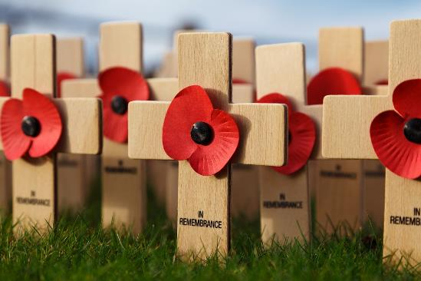
Notes:
Slide 10: But it’s also a time when we remember that war brings great sadness, especially for those who have lost people or places that they love. So, Remembrance Day also gives us a chance to show compassion towards those who might be feeling sad.

Slide 11

Notes:
Slide 11: The peace that we enjoy in our country was won at a very great cost, but as some of you might know, there are other places around the world where they do not yet have peace. And so, we can also show compassion by remembering these places this year. We will do this as we have an opportunity to pray in a little while.

Slide 12
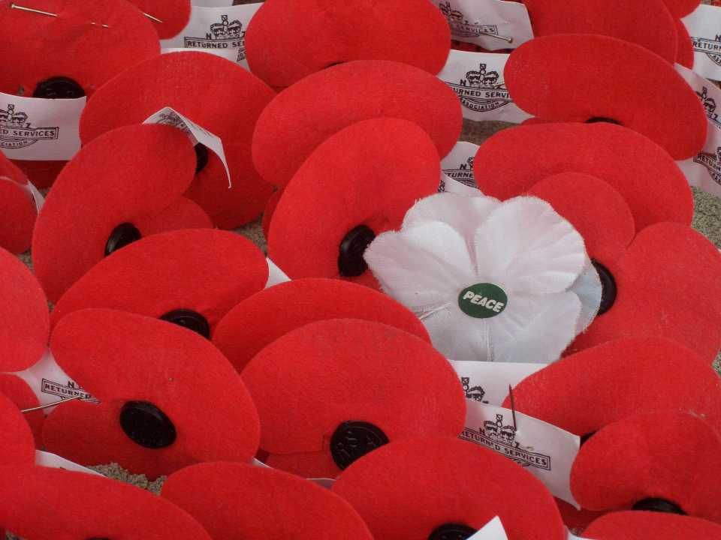
‘At the going down of the sun, and in the morning, we will remember them…’
‘We will remember them.’
Notes:
Slide 12: Each Remembrance Day we hear these words, originally from a poem called ‘For the Fallen’ (by Lawrence Binyon): ‘At the going down of the sun, and in the morning, we will remember them’, to which people respond with the words ‘We will remember them’ These are very solemn (serious) words because they contain a promise to remember. But they also contain a challenge for each day: to show in our everyday actions that we are grateful, that we are not taking our lives for granted – and that we too want to make a difference in the world.

Slide 13
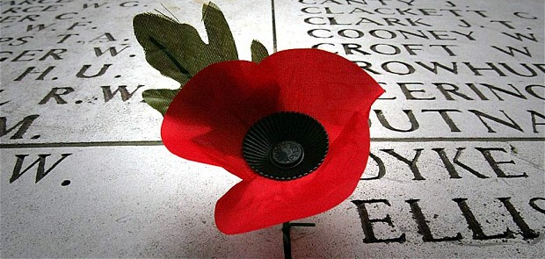
‘Poppies of compassion’
Notes:
Slide 13: So I wonder whether we might also try to do something to show we are remembering with compassion? I have 6 special poppies here with 6 different ideas for showing compassion to others. Let’s look at them together [read and display poppies] You might want to add to this ‘poppy garden’ if you think of more ideas during this week.

Slide 14
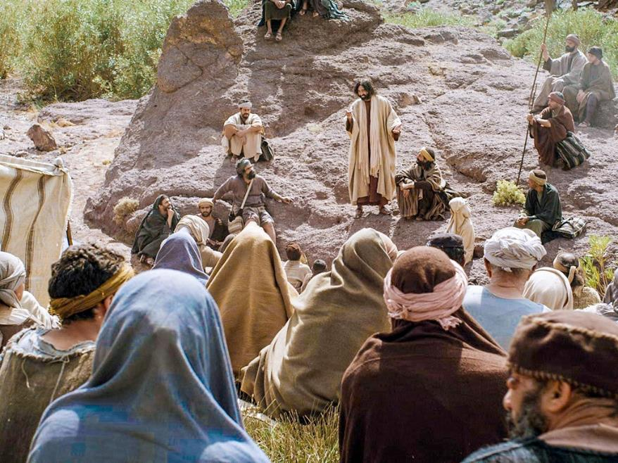

Those who are sad are truly happy, because God will comfort them.
Those who are sad will be comforted by God, so they can be truly happy.
Notes:
Slide 14: Now as we begin to draw our time to a close, let’s listen to the words of Jesus for this week. They might just be the most topsy-turvy yet!!: ‘Those who are sad are truly happy, because God will comfort them.’ .…I wonder how it might feel to be ‘comforted by God’?....[You might want to spend a short while talking about what children think this means]
Changing the words around might help us to understand this a little better!.... ‘Those who are sad will be comforted by God, so they can be truly happy.’ [talk again if you need to] As we’ve said in previous weeks, Jesus often said things that were difficult to understand! What he was not saying here is that people shouldn’t be sad when hard times come. Jesus experienced great sadness in his own life and knew how it felt. But what he wanted the people to realise was that they could bring their sadness to God, who cared deeply about them, so they are not alone in that sadness.

Slide 15

‘He is the God of all comfort: all comfort comes from God. He comforts us in all our troubles. Now we can comfort others when they are in trouble.’ I Corinthians 3:4
Notes:
Slide 15: For people who are Christians, this means that they can bring any sadness in their lives, however big or small, knowing that God cares about it and can bring them comfort – and that this is a good thing. That’s the ‘truly happy’ bit! In another part of the Bible, he is called the God of all comfort’. Listen to these words: ‘He is the God of all comfort: all comfort comes from God. He comforts us in all our troubles. Now we can comfort others when they are in trouble.’
So, there’s something that others can do to bring comfort to those who need it, even if all it means is sitting with someone whilst they are sad. This is something that can help us all.

Slide 16
‘We will remember them.’
Notes:
Slide 16: Responding (and words for worship): you might also wish to hold your own period of silence at this point.
….Let’s be still and quiet together now….
….we’ve heard words today about remembering with compassion…..
….we’ve also heard Jesus’ topsy-turvy words about God’s comfort….
….in the quietness of this moment, you might want to bring into your mind someone who is feeling sad and needs your compassion, or the comfort that God can bring….
….it might be that you want to think especially about those in our world whose lives are affected by war, or who may be feeling sad this Remembrance Day….
Prayer:
As you do, I am going to invite you to pray, using those words that we often hear on Remembrance Day, ‘We will remember them’
Join in the words to make this prayer yours if you would like to….

Slide 17

‘We will remember them.’
Notes:
Slide 17: God of all comfort
Thank you for those who gave their lives for our freedom
‘We will remember them’

Slide 18
‘We will remember them.’
Notes:
Slide 18: As we wear our poppies this year
‘We will remember them’

Slide 19
‘We will remember them.’
Notes:
Slide 19: As we think of places where peace is hard to find
‘We will remember them’

Slide 20

‘We will remember them.’
Notes:
Slide 20: As we show compassion to those around us
‘We will remember them’

Slide 21
‘We will remember them.’
Notes:
Slide 21: At the going down of the sun, and in the morning, we will remember them
‘We will remember them’

Slide 22


Slide 23


Leader: As we leave this place & time and go into the day ahead…
All: We will remember them, and live with compassion.

Slide 24

Notes:
Slide 24: Reflective areas
This week, you will need a red or blue cloth (red, like the poppies or blue, for sadness) and some glass beads to represent tears. Children can place a glass bead on the cloth as they think or pray about people who are sad. Or you could plant a poppy garden of compassionate actions, which you started in the collective worship.
You could also set up a Remembrance themed ‘prayer space’ using the suggestions from Prayer Spaces in Schools. Try Remembrance Ribbons, Dove of Peace or Poppy Prayers. Although perhaps more suitable for Juniors, the ideas could be adapted for KS1 by inviting them to hang a ribbon, or write a prayer in a dove outline or on a poppy, to gather in your own ‘Field of Remembrance’ in your reflective area.
A great book which picks up on this theme, written for anyone (religious or non-religious) is ‘The Grief Jar’ by Lynsey Shaw. It gives some really helpful messages to children about sitting with sadness. Pack your tissues – find out more here The Grief Jar - a Creative & Arts crowdfunding project in Plymouth by Lynsey Shaw (crowdfunder.co.uk) and buy it here: https://www.bearandgoosedesigns.co.uk/childrens-books/the-grief-jar/

