Slide 1

Leader: As we gather together
ALL: …we bring our hearts.
Notes:
Slide 1: Use the gathering words for this term, or your usual greeting if you prefer. The greeting comes with BSL signing; you can view the demos using links under the slide.
Leader: As we gather together,
ALL: …we bring our hearts
Signs for greeting: click on links
Hearts: British Sign Language BSL Video Dictionary - heart

Slide 2

Leader: As we gather together
ALL: …we share our thoughts.
Notes:
Slide 2: Use the gathering words for this term, or your usual greeting if you prefer. The greeting comes with BSL signing; you can view the demos using links under the slide.
Leader: As we gather together,
ALL: …we share our thoughts.
Signs for greeting: click on links
Thoughts: British Sign Language BSL Video Dictionary - thought

Slide 3





Leader: As community together
ALL: …we serve one another.
Notes:
Slide 3: Use the gathering words for this term, or your usual greeting if you prefer. The greeting comes with BSL signing; you can view the demos using links under the slide.
Leader: As community together,
ALL: …we serve one another.

Slide 4
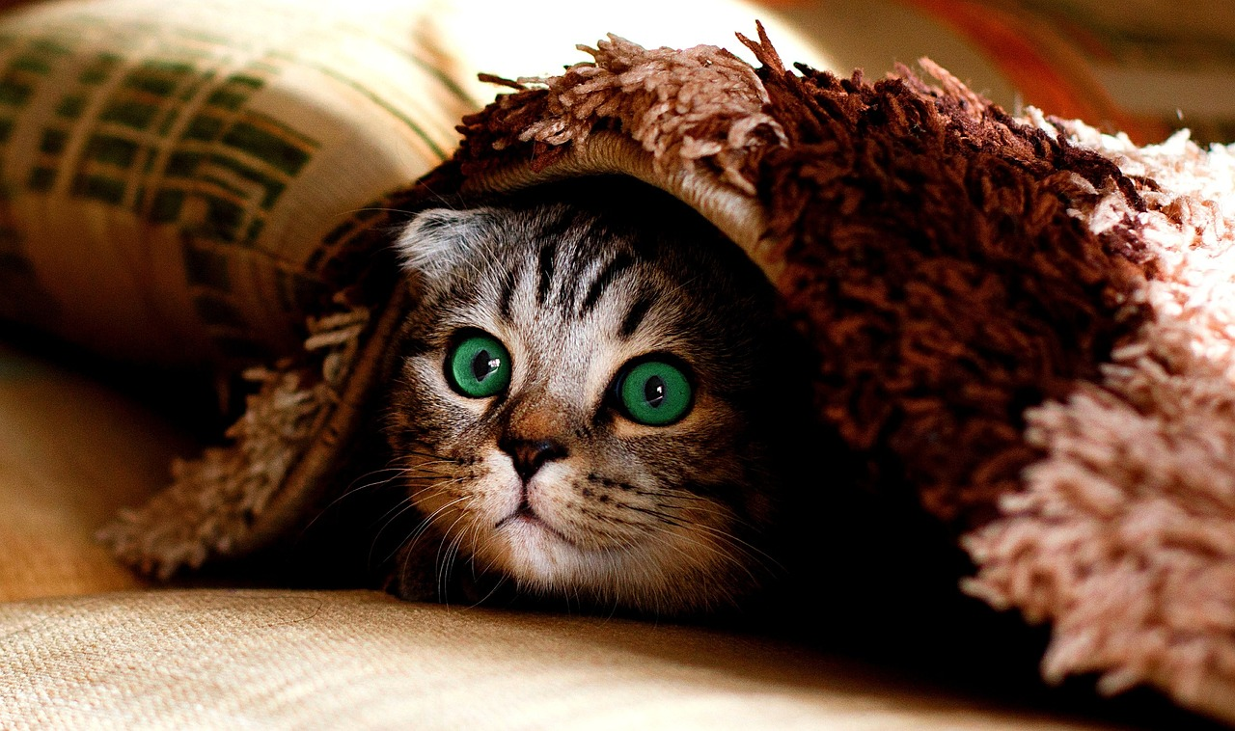
Hide and seek
Notes:
Slide 4: Hide and seek
Choose, either:
Hide some objects for children to find in a game of hide and seek around your hall space.
Bring in a sand tray and hide some objects for children to discover – make it into a timed challenge to keep it short!
Pairs discussion: talk about the best place you ever found to hide when playing hide and seek. What made it such a good place?
Set a whole school challenge: hide a favourite soft toy somewhere; whoever finds it gets to be the next person to hide it. What was the best hiding place?
What do we like about playing this game?

Slide 5





Songs from
the heart
Notes:
Slide 5: Songs from the heart
We’ve heard many of David’s words from the Psalms (recap some that children can remember)
Today’s words again reflect the experience that David had of God’s care of him….
But first, we’re going to play a game of hide and seek with what’s going on in some pictures from David’s life, rather than have a story this week!
As we click through the slides, we’ll only see a very small part of the picture – and we’ll have to talk together to see if we can work out what’s going on. Just to warn you, some will be easier than others!! [and for teachers, there are some words to guide your discussions]
Let’s begin with a practice – what can we see here?.....

Slide 6
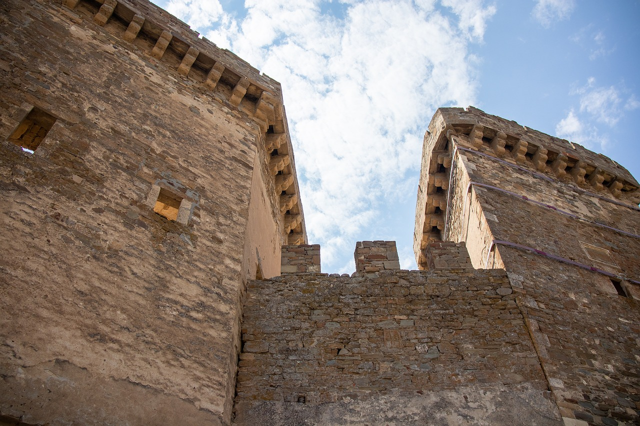
Notes:
Slide 6: [NB this is an image that will be helpful later on, so not a completely random choice!]
What can we see through the little peephole?
Let’s make it a bit wider….is it a bit easier to see now?
What are we looking at?
I wonder how this might make someone feel safe? [ask a few children to explain their thinking. It might have something to do with historical knowledge about why castles / fortresses were built, or just that it looks somewhere safe – they might reference images from films e.g. Harry Potter]
Back in history, castles were a way of keeping people safe when they were under attack (which happened a lot!). When attackers came, they would run into the castle and be safe – because they were built to do this!

Slide 7
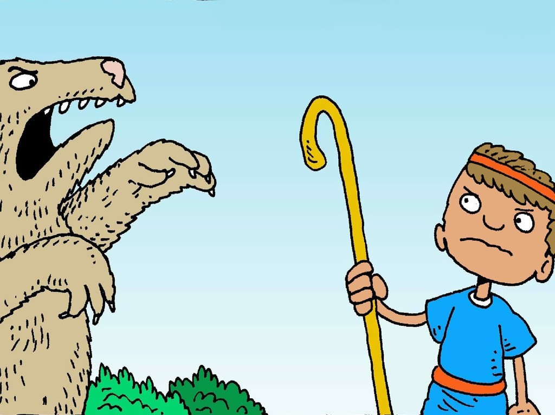
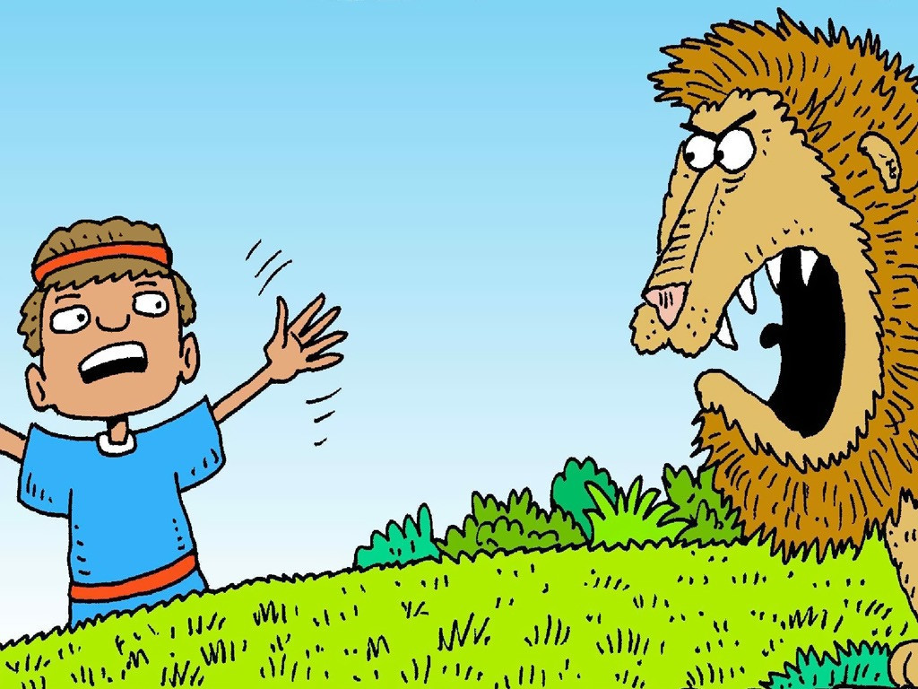
I don’t fear, because God is here!!
I don’t fear, because God is here!!
Notes:
Slide 7: David fights the bear and lion
What can we see through the little peephole?
Let’s make it a bit wider….is it a bit easier to see now? What are we looking at?
What is David doing with the lion and the bear?
Why was this a dangerous thing to do?
[give children time to talk together]
David’s reaction to this event was to say: I don’t fear, because God is here!!

Slide 8
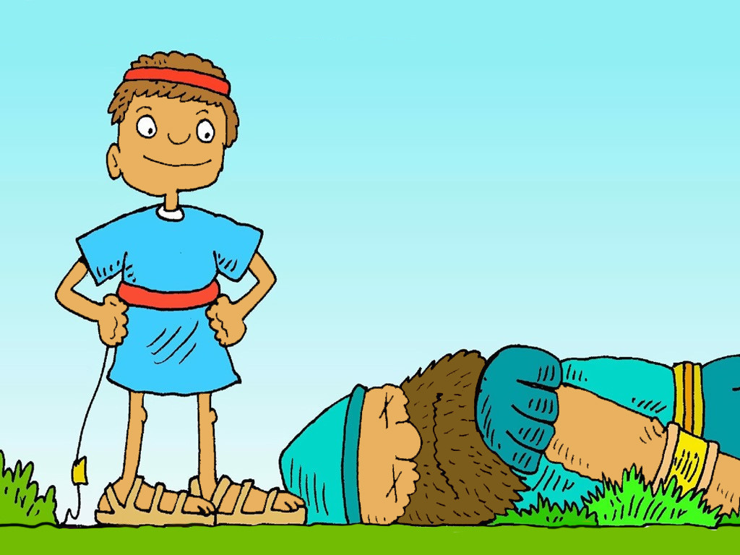
I don’t fear, because God is here!!
Notes:
Slide 8: David fights Goliath
What can we see through the little peephole?
Which part of David’s life story is this from? [hopefully this one is obvious!]
Let’s see if you’re right!….
[recap how God kept David safe against Goliath]
Again, David’s reaction to this event was to say: I don’t fear, because God is here!!

Slide 9
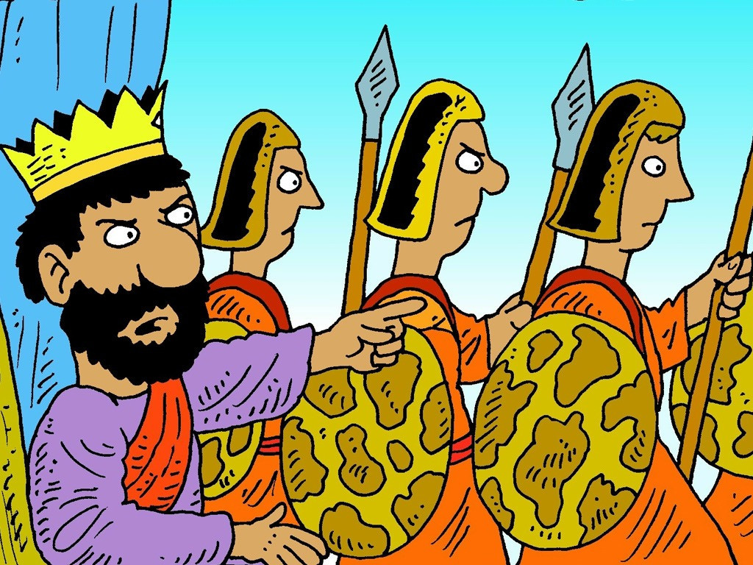
Notes:
Slide 9: Saul tries to capture David
What can we see through the little peephole?
What is happening here? Who are the men with spears, and what might they be going to do?
Let’s see if you’re right!….
King Saul was very jealous of David, and one story tells how he sent soldiers to try to capture David and kill him.

Slide 10
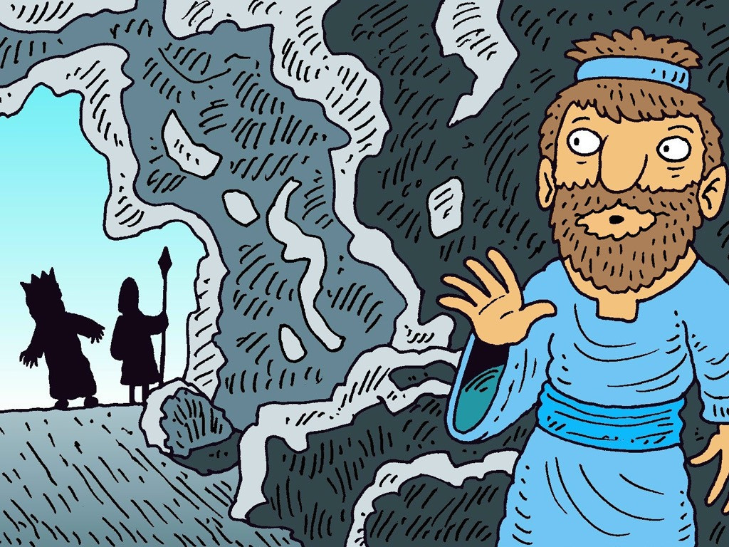
I don’t fear, because God is here!!
Notes:
Slide 10: the soldiers find David’s hiding place
What can we see through the little peephole?
King Saul’s soldiers were on the hunt for David, who hid in a cave. The story tells of how King Saul came into the cave where David was hiding, but miraculously, didn’t see David!
Again, David’s reaction to this event was to say: I don’t fear, because God is here!!

Slide 11
You are my hiding place.
You protect me from my troubles.
Psalm 32:7
I will say to the Lord, “You are my place of safety and protection. You are my God, and I trust you.” Psalm 91:2
Notes:
Slide 11: I will say to the Lord, “You are my place of safety and protection. You are my God, and I trust you.” Psalm 91:2
So now, perhaps it’s a bit easier to see how David was able to write these words about God.
David also wrote in another Psalm: You are my hiding place. You protect me from my troubles.

Slide 12
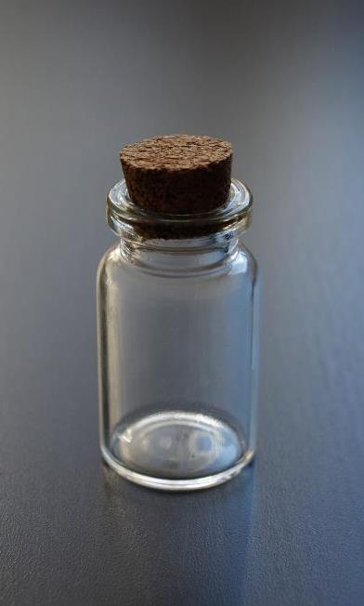

You have stored my tears
in your bottle
and counted each of them….
Psalm 56:8
God is close to the brokenhearted.
Psalm 34:18
Notes:
Slide 12: We heard last week that David felt that God was especially close when he was experiencing difficulties in his life.

Slide 13
You are my hiding place.
You protect me from my troubles.
Psalm 32:7
I will say to the Lord, “You are my place of safety and protection. You are my God, and I trust you.” Psalm 91:2
Notes:
Slide 13: David’s words in these Psalms show such trust and faith in God, because he had known God be so close to him during sad or difficult times in his life.

Slide 14
You are my hiding place.
You protect me from my troubles.
Psalm 32:7
I don’t fear, because God is here!!
Notes:
Slide 14: Responding (and words for worship): Let’s be still and quiet together now, and think about the things we’ve heard today. For God’s people, the words that David wrote are like precious treasure, reminding them that God is the same; he never changes and therefore he can be trusted at all times. In the story, we heard David say the words ‘I don’t fear, because God is here!!’
You might have experienced this yourselves, in your family, maybe when something might have frightened you and you ran to your mum or dad, or a place where you felt safe. [you might want to pause here and share some stories, or give children a few moments of stillness to think about this for themselves]

Slide 15
You are my hiding place.
You protect me from my troubles.
Psalm 32:7
…. I wonder what you think about David’s words?....
….I wonder where you go to when life is hard....the safe place for your soul?....
….I wonder how David’s words might be a comfort to people at difficult times?....
Notes:
Slide 15: Responding (and words for worship): We’ve heard today how David experienced God as his place of safety in life. He wrote:
You are my hiding place.
You protect me from my troubles.
Let’s wonder together for a few moments now….
…. I wonder what you think about David’s words?....
….I wonder where you go to when life is hard....the safe place for your soul?....
….I wonder how David’s words might be a comfort to people at difficult times?....

Slide 16
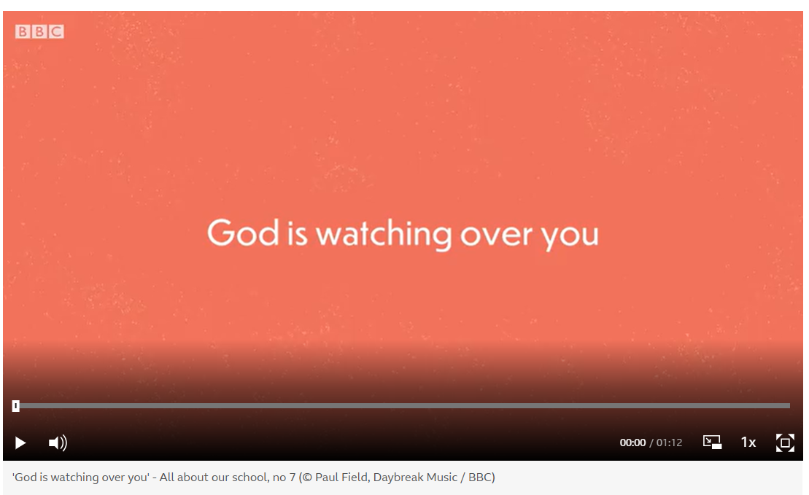
Notes:
Slide 16: Prayer
Instead of saying a prayer today, we are going to use a song – which by now, you will all probably know!
The words are based on another psalm written by King David, and speak of how God never sleeps, so is always able to watch over people [in a good way!]. If you want to look at these words during the week, you can find them here: Psalm 121 ICB - The Lord Guards His People - A song for - Bible Gateway
If you would prefer to just listen rather than sing and pray, then please do! [screen image links to the song]

Slide 17
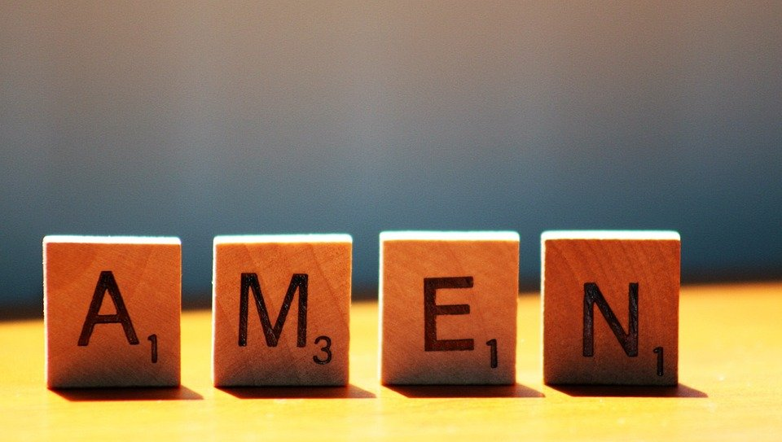
Notes:
Slide 17: Amen

Slide 18




Leader: As we leave this place & time and go into the day ahead…
All: …may we serve one another in our thoughts and words and actions.
Notes:
Sending: Slide 20
Leader: As we leave this place and time and go into the day ahead,
All: ….may we serve one another in our thoughts and words and actions.
Signs for response: click on links
Thoughts: British Sign Language BSL Video Dictionary - thought (signbsl.com)
Words (use 3rd definition): British Sign Language BSL Video Dictionary - word (signbsl.com)
Actions: British Sign Language BSL Video Dictionary - action (signbsl.com)

Slide 19
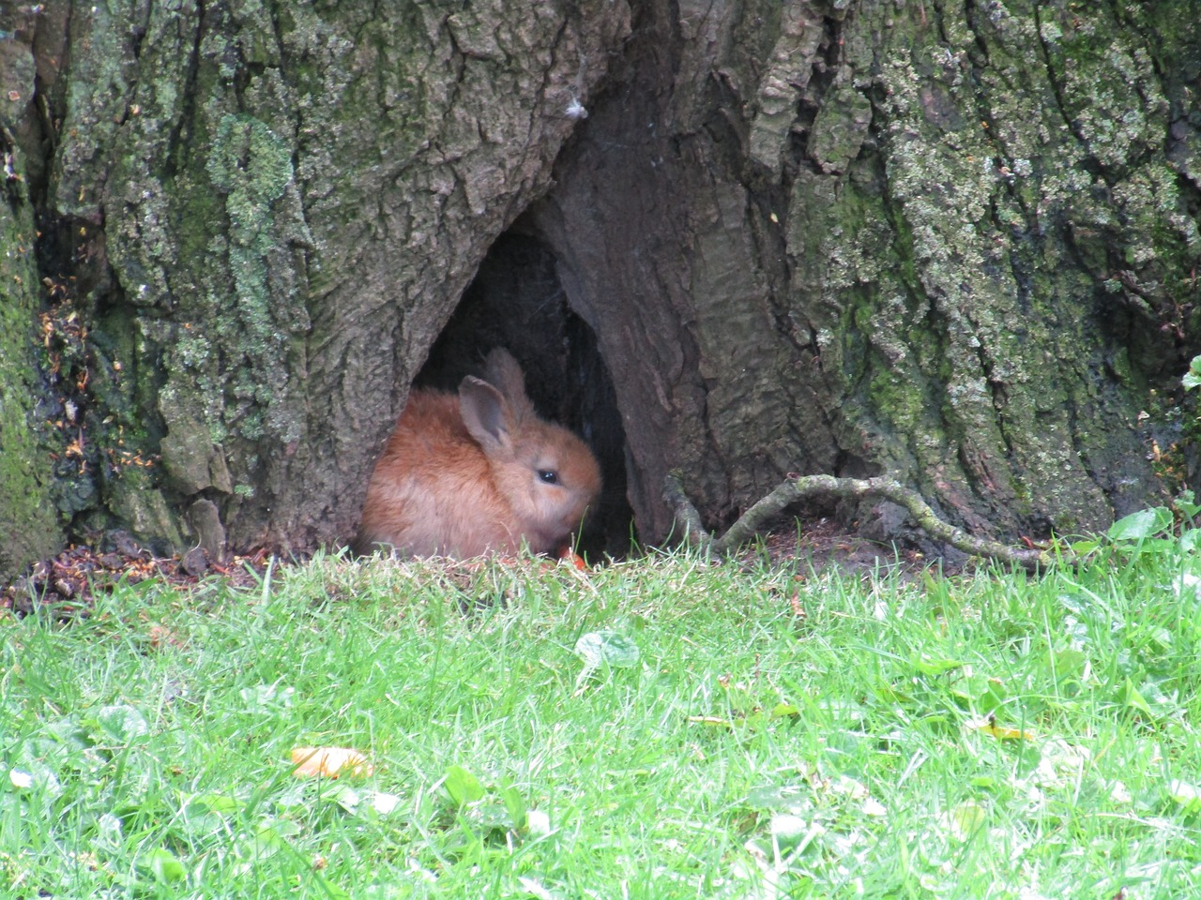
Notes:
Ideas for classroom reflection: Hide and seek
Go outdoors this week and find some really great hiding places for different types of wildlife e.g. if you have a pond area, can you spot tadpoles hiding under pondweed, or bugs hiding under logs to keep them damp. Don’t forget to keep them safe!! There are some great ideas and examples here: Psalm 91 Muddy Church: God's Protection

