Slide 1



Leader: We are here together
Children: With ears ready to hear and hands ready to serve.
ALL: May we be wise in all our actions today.
Notes:
Slide 1: Teach the new gathering words, which will be the same each week.
Leader: We are here together
Children: With ears ready to hear and hands ready to serve.
All: May we be wise in all our actions today.

Slide 2

Notes:
Slide 2: As you might have gathered from our new greeting, we’re going to start this brand new term – and a brand new year! – with a brand new theme: ‘Wise Words’.

Slide 3

King Solomon
Notes:
Slide 3: We’re going to start today finding out about a King called Solomon, whose wise words made him very famous.
How he got his wisdom is a whole story in itself!.....

Slide 4
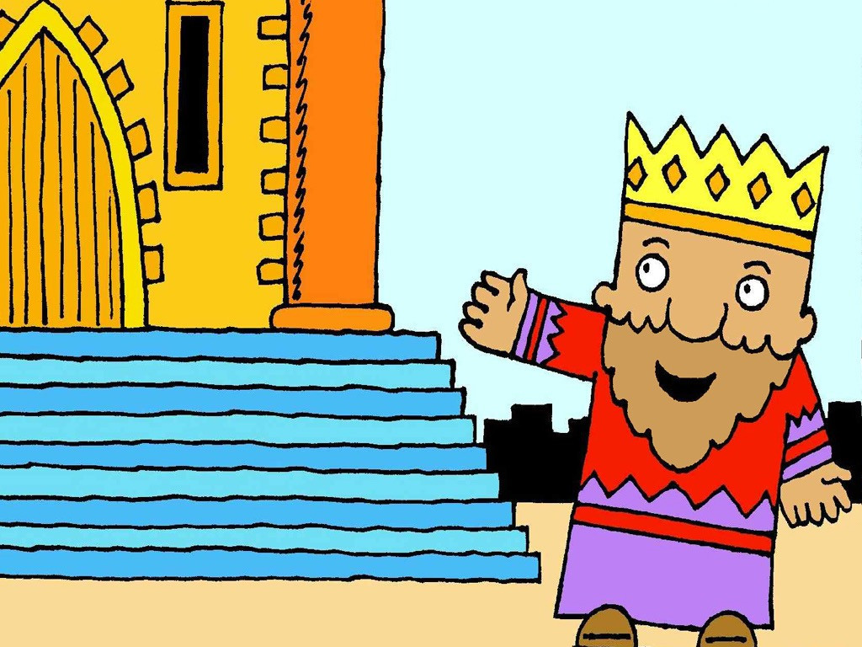
Notes:
Slide 4: When King David died, his son Solomon became the new King of Israel.

Slide 5
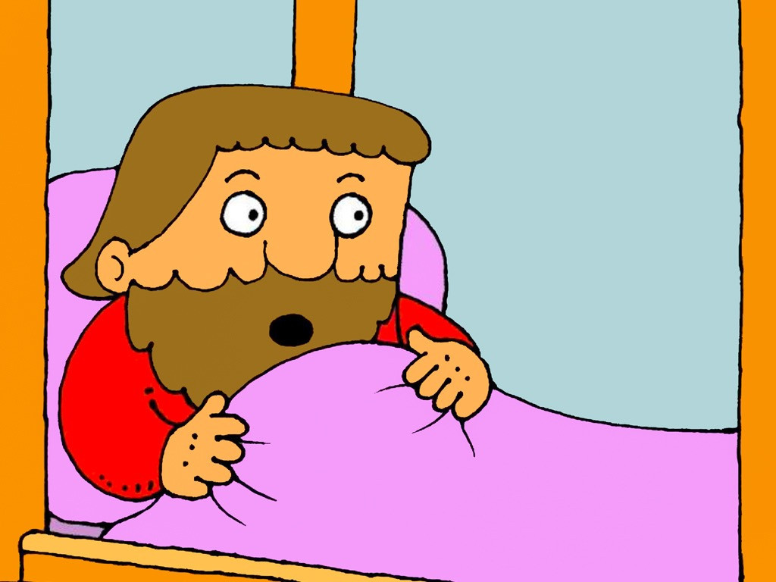
Notes:
Slide 5: One night, in a dream, King Solomon heard God speak to him saying, ‘Ask me for anything at all and I will give it to you.’

Slide 6
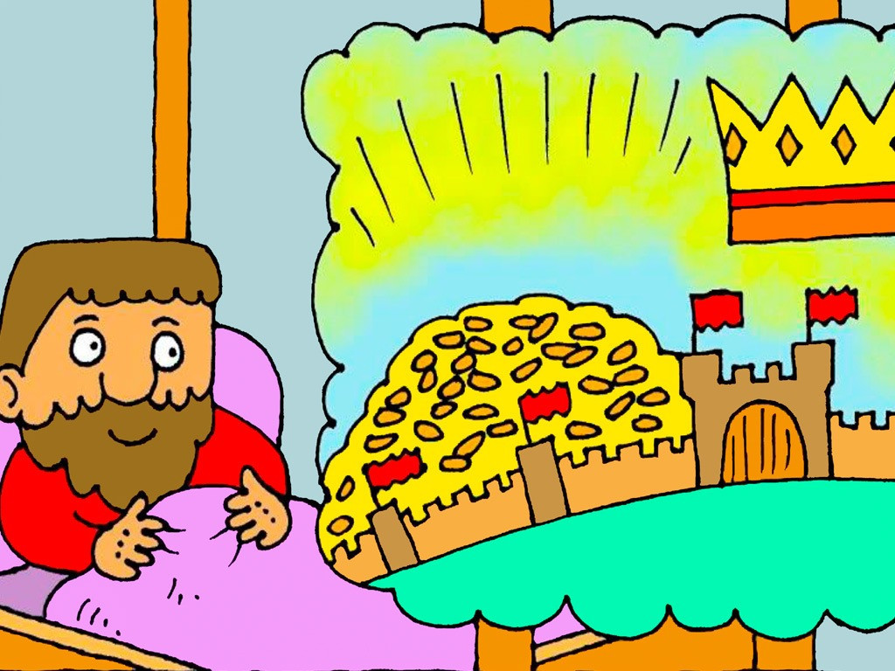

I’d like wisdom please, not gold!
Notes:
Slide 6: Solomon replied that he wanted to know how to be a good king and lead his people well.
‘I’d like wisdom please, not gold!’ he said.
God replied, ‘Because you did not ask for something for yourself, I will make you wise like no other king ever – and I will also make you rich and famous.’

Slide 7
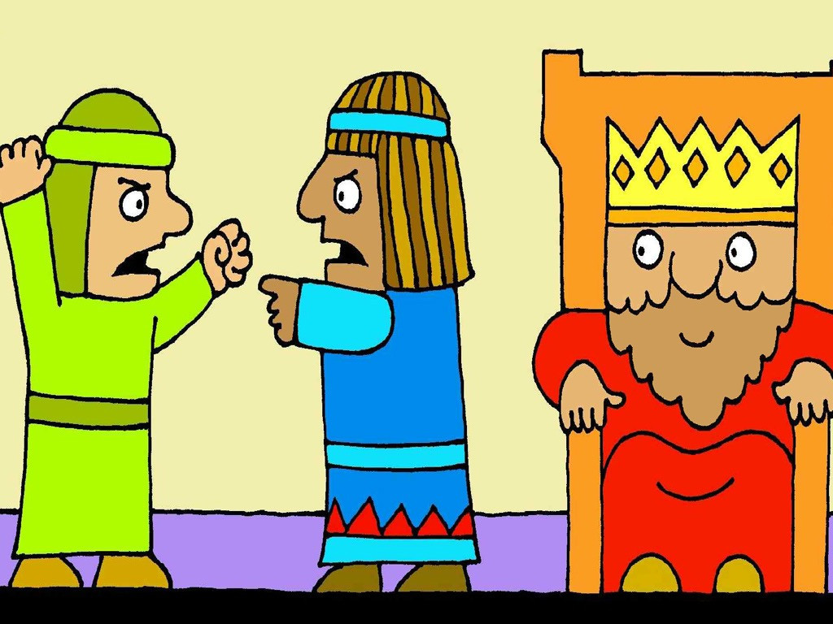
Notes:
Slide 7: When people argued and each thought the other person was wrong, they would tell King Solomon and he always had an answer that was right, fair and wise.

Slide 8
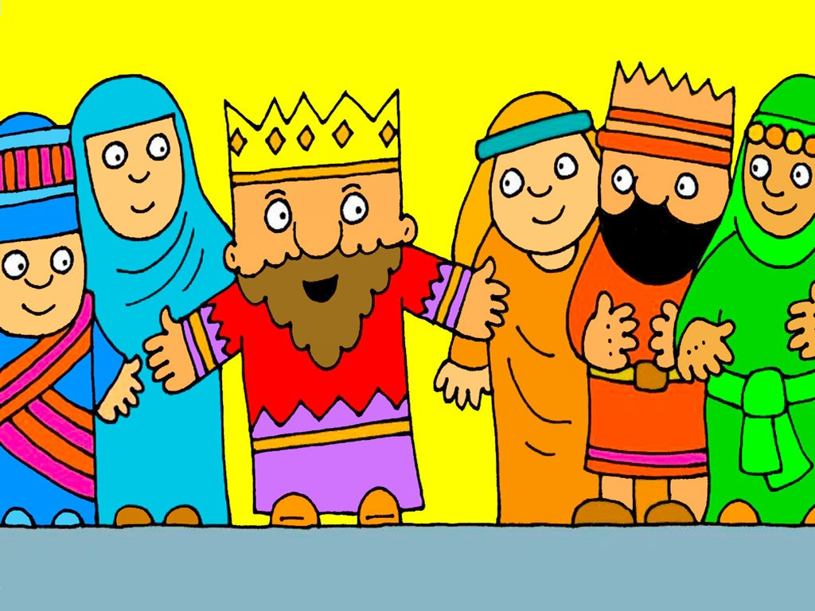
Notes:
Slide 8: People from all across the world heard how wise and fair King Solomon was and that he knew what was right and what was wrong. They came to hear the wise words God gave him.
And people all over the world still read these ancient words to help them to know how to be wise and how to live well.

Slide 9
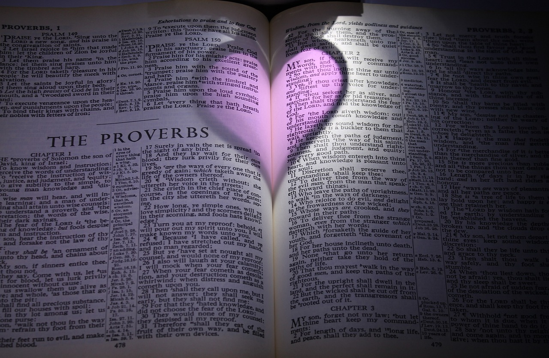
It’s wise to be patient,
but it’s foolish to lose your temper.
Notes:
Slide 9: King Solomon’s wise words can be found in a part of the Bible called ‘Proverbs’.
Many of the proverbs are written in pairs, like opposites – here’s one for us to start with, to show you how they work:
It’s wise to be patient,
but it’s foolish to lose your temper.
[Explore together how these words help to show people how to live well i.e. that being patient shows you are wise – and that losing your temper is something that is foolish. Hopefully most people will agree that this is true!]

Slide 10



wise
foolish
Notes:
Slide 10: We are going use some of Solomon’s wise words now to play a game. Your job as contestants in my game is to decide whether words read out by my panel here are wise or foolish.
Let’s welcome our panel [introduce them, quiz show style…. use your best quizmaster voice here!]Now, let’s get right to it and start our quiz: let’s play ‘Wise or Foolish?’ where you decide who’s wise and who’s not [use the cards that you have chosen, find out what your ‘audience’ think each time – and then each panel member shows the answer on the back. You might want to talk about some with children, if time allows.
Alternatively, use optional Slide 11]

Slide 11
someone who is hardworking
someone who is hardworking
someone who thinks only of themselves
someone who thinks only of themselves
someone who won’t share
someone who won’t share
someone who takes care of animals
someone who takes care of animals
Notes:
[Slide 11: optional]

Slide 12
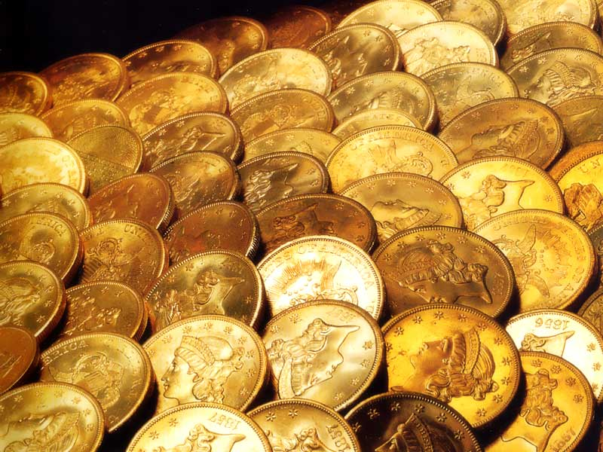

‘It is better to get wisdom than gold. It is better to choose understanding than silver!’ (Proverbs 16: 16)
Notes:
Slide 12: Responding and words for worship
Watch out for our wise owl words each week as we discover some more of King Solomon’s words, and use them to help us to think as a school community. Let’s pause and do this now…..
King Solomon wrote: ‘It is better to get wisdom than gold. It is better to choose understanding than silver!’
I wonder if you agree with him?!

Slide 13
….I wonder why wisdom might be worth more than gold?....
….I wonder how our school’s values might help us to be wise?....
….I wonder what being ‘wise’ means for you?....or what wise words you might want to live by this New Year?....
wise
Notes:
Slide 13: Although we made it into a game, wisdom, being wise, is something we hope that we help you to develop during your time with us in school.
Being wise is not just about knowing lots of facts, it’s about making good choices.
As we come towards the end of our time together today, let’s ask ourselves some ‘wondering’ questions about wisdom to help us to think….
….I wonder why wisdom might be worth more than gold?....
….I wonder how our school’s values might help us to be wise?....
….I wonder what being ‘wise’ means for you?....or what wise words you might want to live by this New Year?....

Slide 14


Happy New Year!
Notes:
Slide 14: At the start of a new calendar year, people often make New Year’s Resolutions, promises we make to ourselves about living in a better way, such as being more active.
Maybe some of the words we’ve thought about today might help us to make wise New Year’s Resolutions?

Slide 15
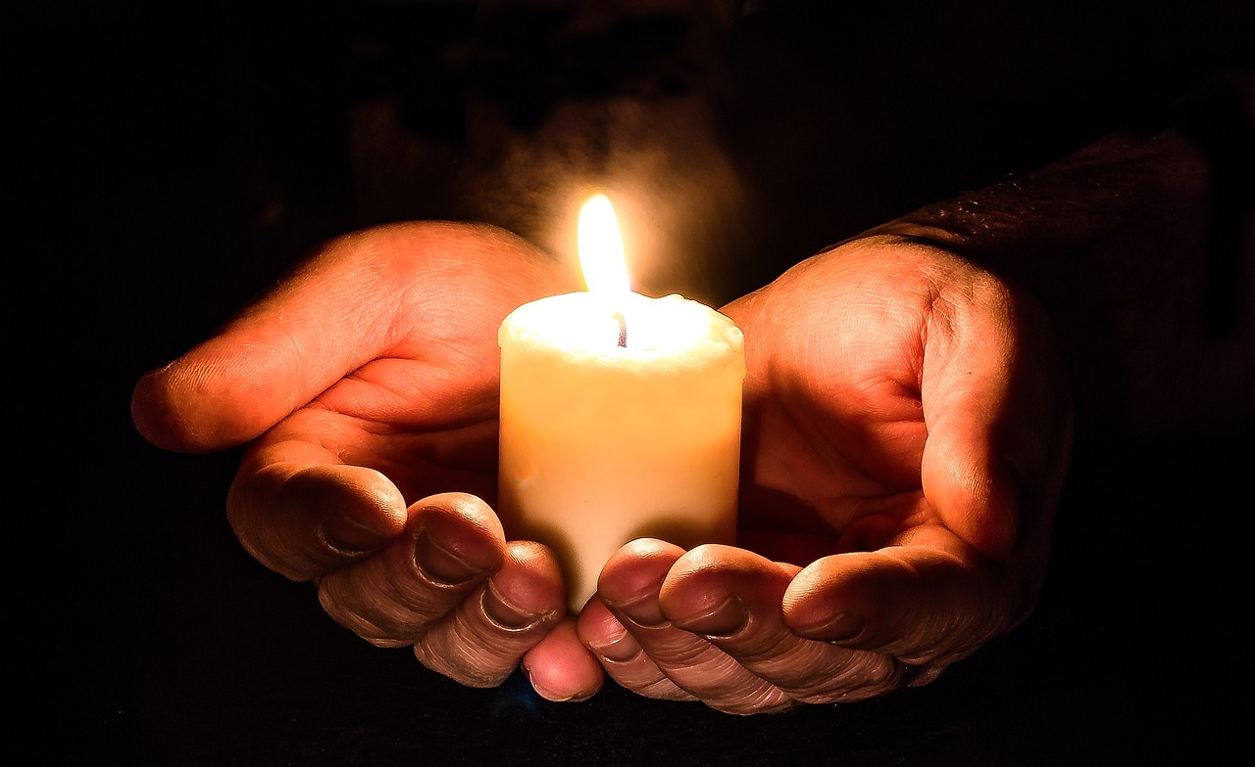
God,
help us to be wise.
Notes:
Slide 15: I’m going to pray now. If this is something that you feel comfortable doing, then after I say God’s name, ‘God’ you might want to join in with ‘help us to be wise.’
If you don’t want to pray, then use the quiet to be still with your own thoughts.

Slide 16
God,
help us to be wise.
Notes:
Slide 16: As we start this new term together, God, ‘help us to be wise.’

Slide 17
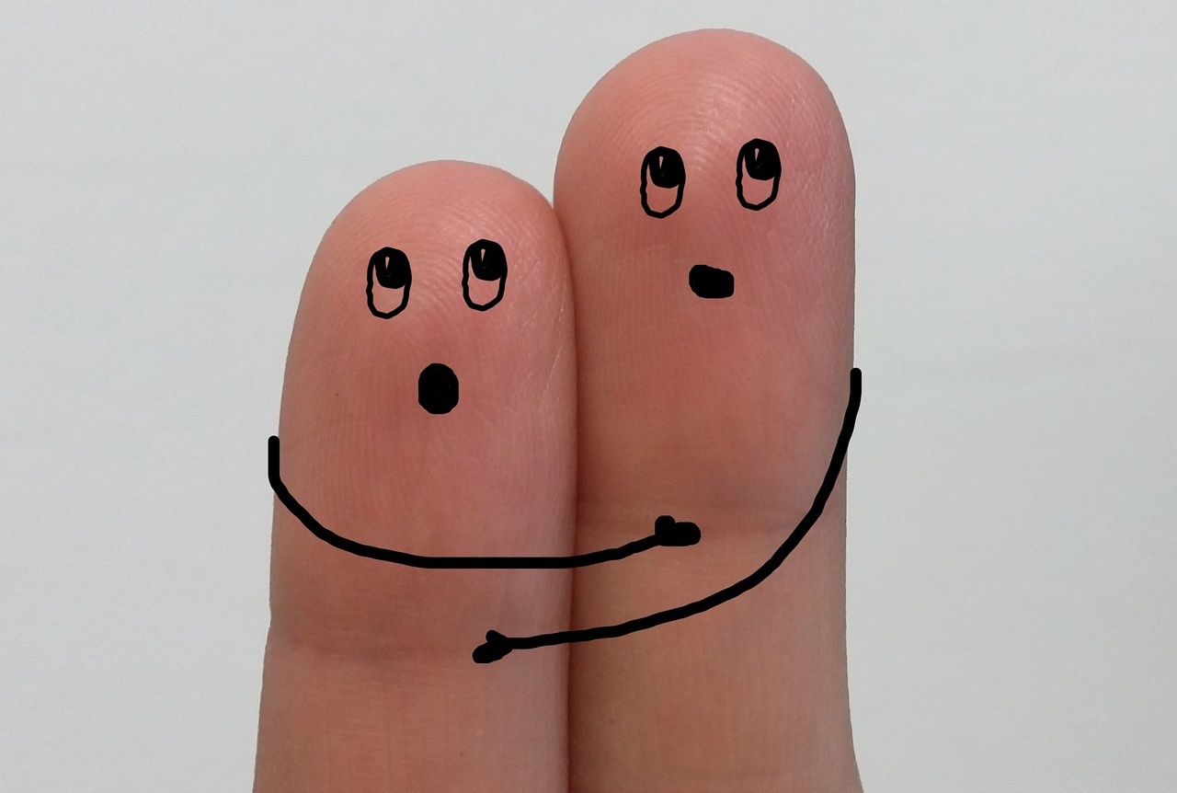
God,
help us to be wise.
Notes:
Slide 17: In our families and friendships, God, ‘help us to be wise.’

Slide 18

God,
help us to be wise.
Notes:
Slide 18: In the choices that we make, God, ‘help us to be wise.’

Slide 19
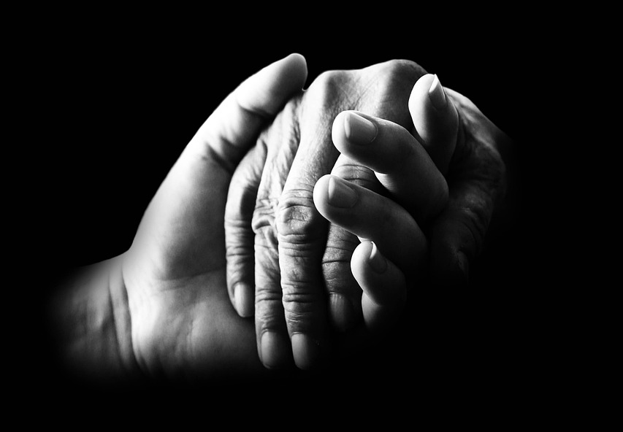
God,
help us to be wise.
Notes:
Slide 19: In the way that we live, God, ‘help us to be wise.’

Slide 20
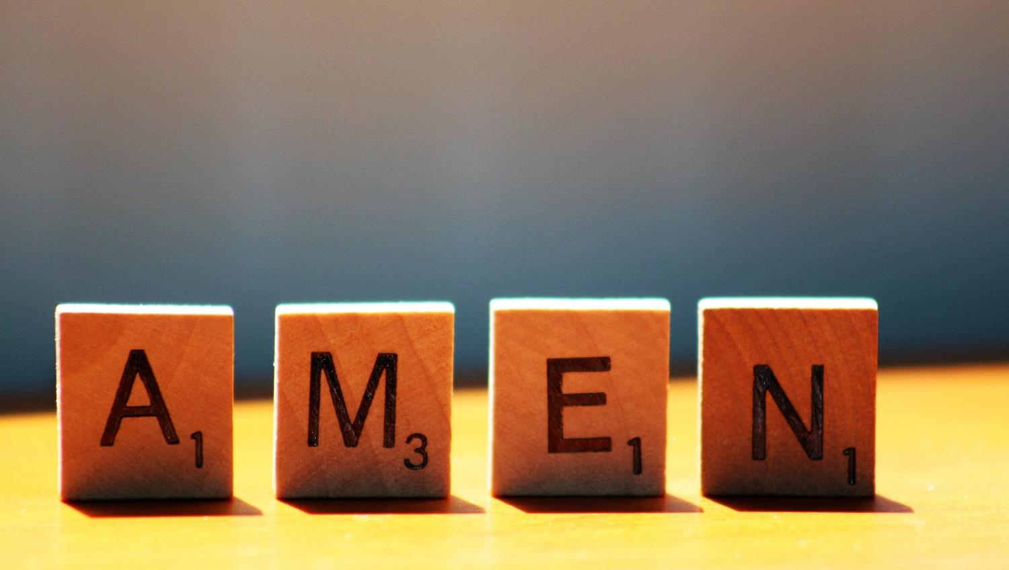

Slide 21


Leader: As we leave this place & time and go into the day ahead…
All: May today’s words help us to make wise choices.

Slide 22
Happy New Year!
Notes:
Slide 22: Reflective areas
At the start of a new calendar year, people often make New Year’s Resolutions, promises we make to ourselves about living in a better way, such as being more active.
Maybe some of the words we’ve thought about today might help us to make wise New Year’s Resolutions?

