Slide 1

All images copyright-free from pixabay, unless otherwise identified
Notes:
Slide 1: Welcome stilling exercise
Use the stilling slide if desired: the suggested words should be spoken slowly, leaving pauses inbetween to create a sense of stillness.
As you sit quietly, watch the word form….see if you can read what it says…..[PAUSE]
Now practise slower breathing…..in…..and out…..in……and out…..keep this going as you continue to watch….[PAUSE]
You maybe notice that you are feeling calmer and more relaxed….[PAUSE]
As you breathe, think about yourself and what you bring into this time today….. [PAUSE]
We come into this special / sacred space and time to be still….to think deeply…..to be together as a school community…..
In our time together today, we will have a quiz…..share some words together, and then think together about what they might mean for our school community.
But first, let’s welcome one another as we begin….

Slide 2
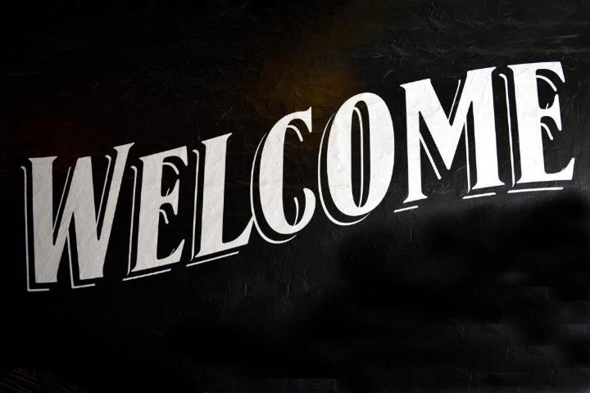
Notes:
Slide 1: Use a familiar gathering greeting to welcome your school community

Slide 3
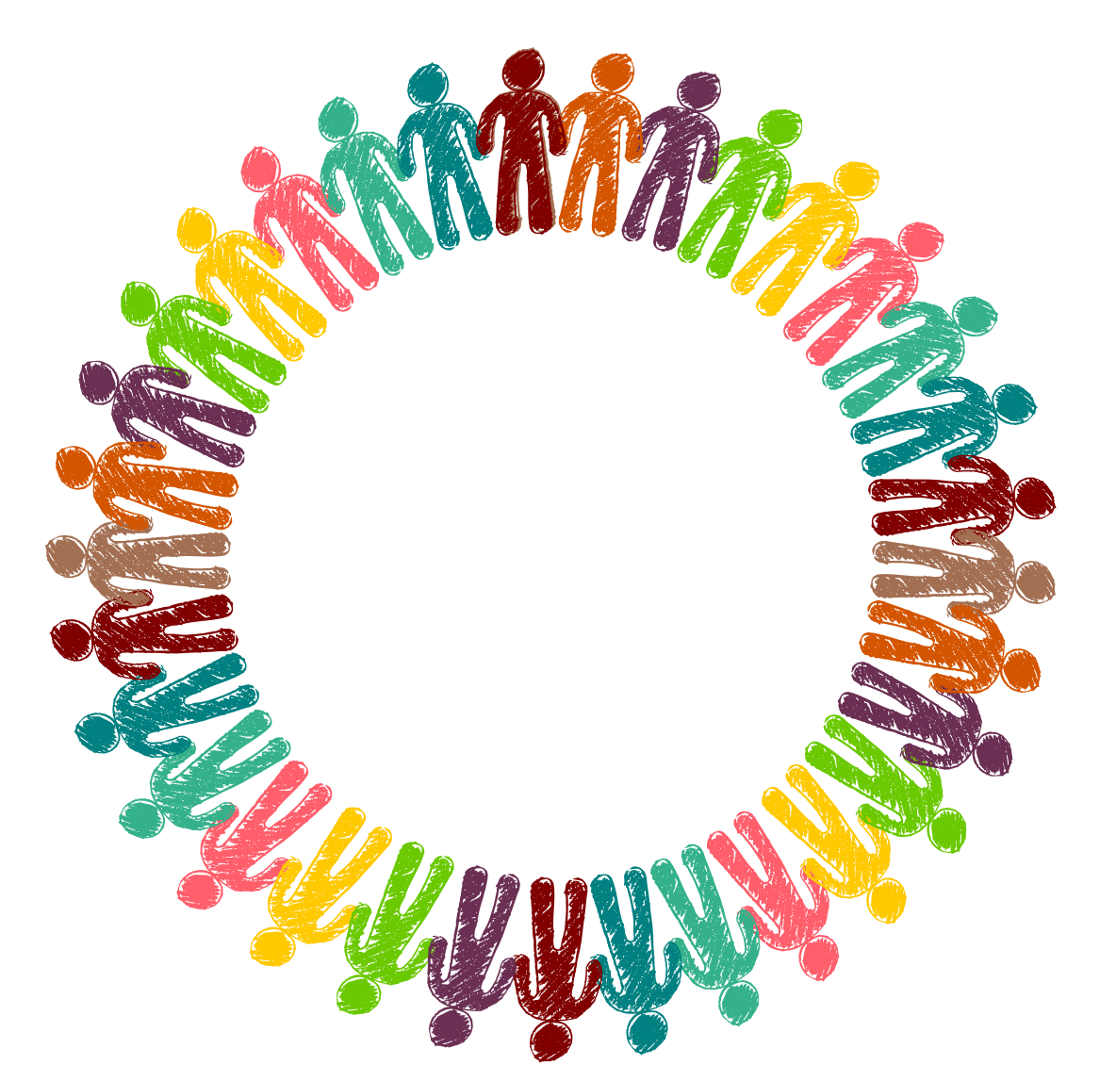
Welcome!
…around the
world
Notes:
Slide 3: Talk about why we welcome each other to collective worship in this way, with a greeting. ‘We’re going to find out how different communities around the world welcome each other. See if you can guess the country from the flag, we’ll hear some words of welcome that people in that country might use, and then we’ll find out what else they might do!’

Slide 4

UK
Welcome!
Hello!
Notes:
Slides 3&4: Let’s start with one you know….

Slide 5
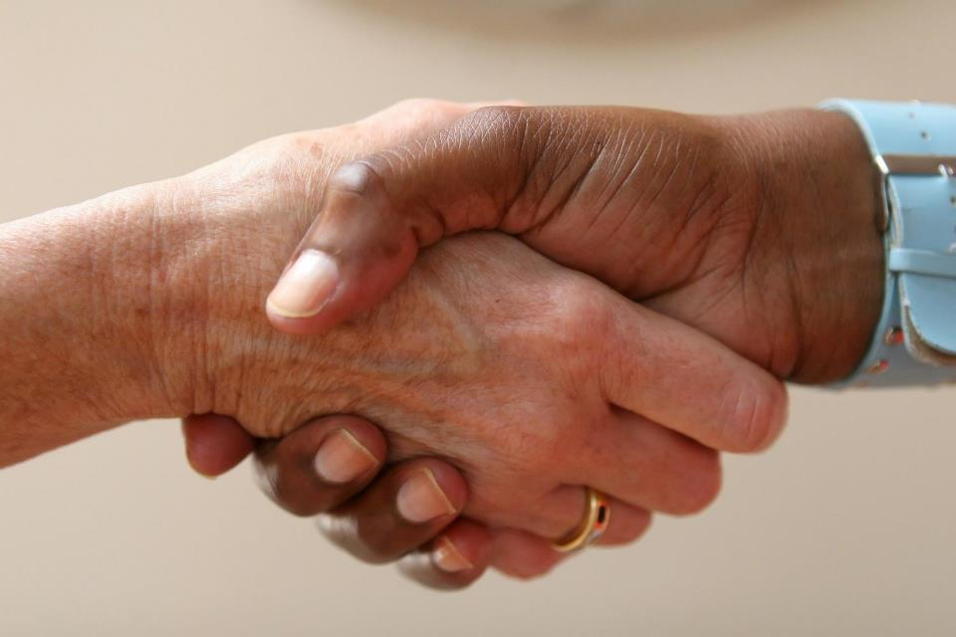
Notes:
….This is one way that people greet one another, but I expect you can think of more!

Slide 6

Kia ora!
New Zealand
Notes:
Slides 5&6: New Zealand.

Slide 7
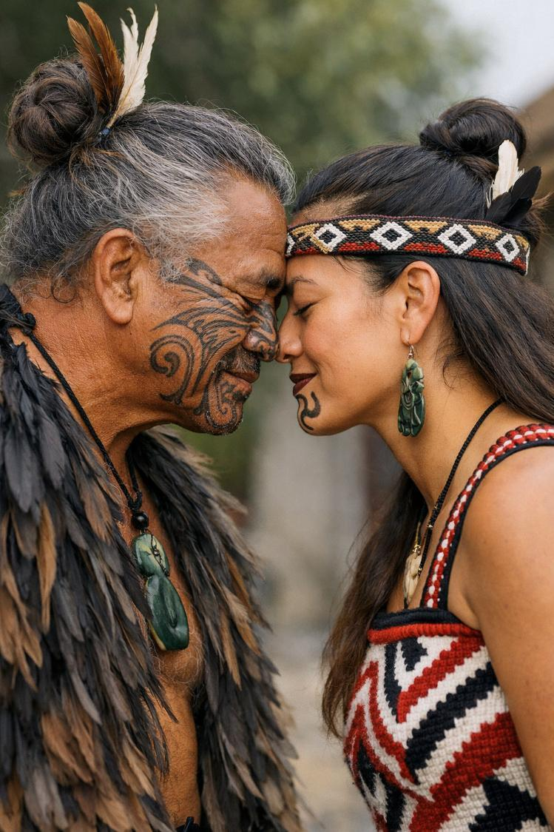
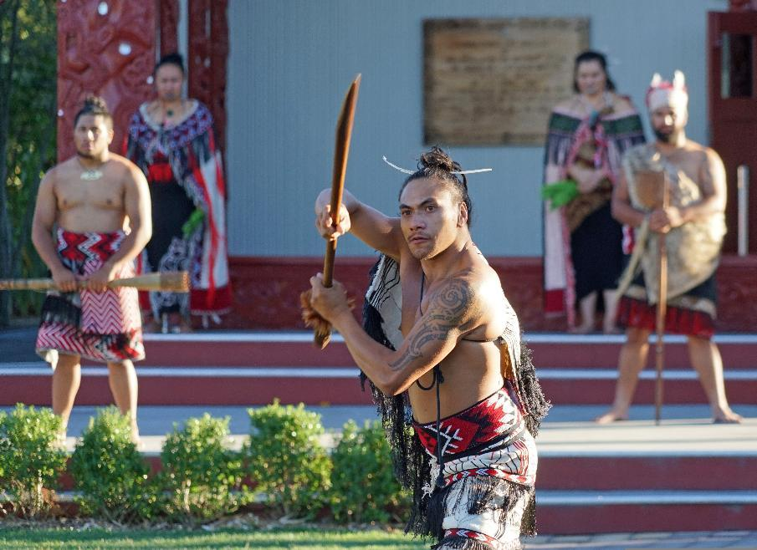
AI image respectfully generated by
MS-Copilot
Notes:
Maori tribespeople in New Zealand rub noses as a sign of welcome. There is also a rather more fierce traditional dance, called the haka, which is often used as a means of welcome.

Slide 8

Tibet
ཕེབས་པར་དགའ་བསུ་ཞུ། Heb-bar kaa-su-shu
Notes:
Slides 7&8: Tibet.

Slide 9
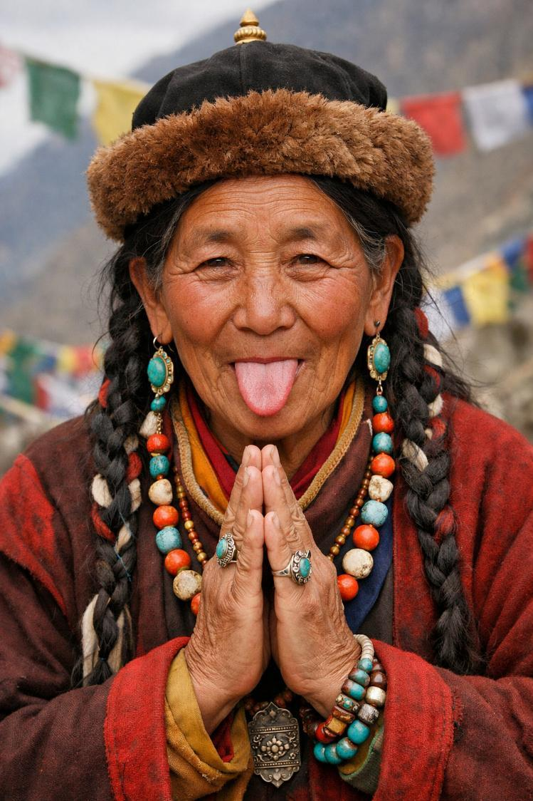
AI image respectfully generated by
MS-Copilot
Notes:
Some Tibetan tribespeople stick out their tongue at the other person as a greeting!

Slide 10

Japan
こんにちはKonnichi wa!
Notes:
Slides 9&10: Japan.

Slide 11
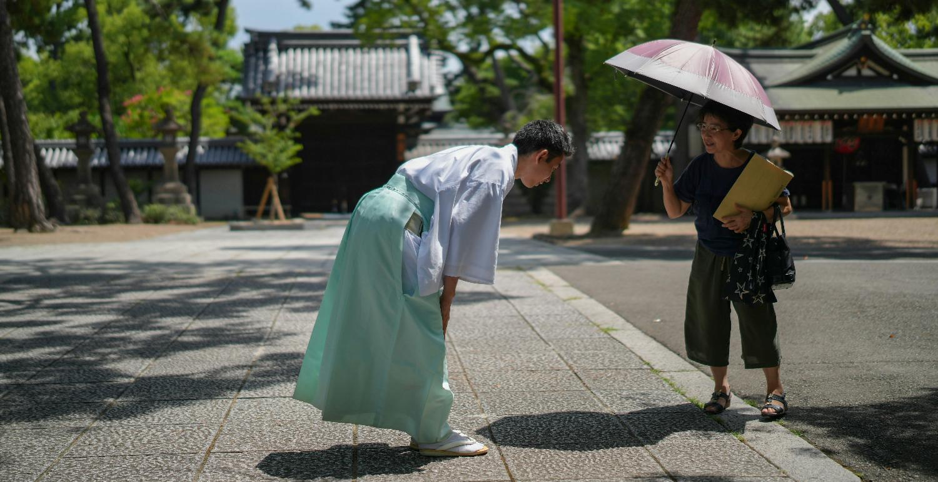
Photo by Buddy AN on Unsplash
©
Notes:
This is an informal bow used for all ranks and occasions.

Slide 12

France
Bienvenue!
Notes:
Slides 11&12: France.

Slide 13
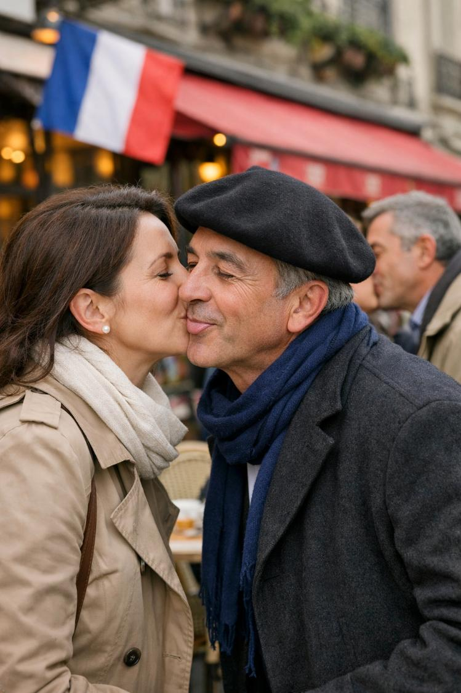
AI image respectfully generated by
MS-Copilot
Notes:
3 kisses, going from cheek to cheek, then back to the first cheek.

Slide 14

Kenya
Karibu!
Notes:
Slides 13&14: Kenya.

Slide 15
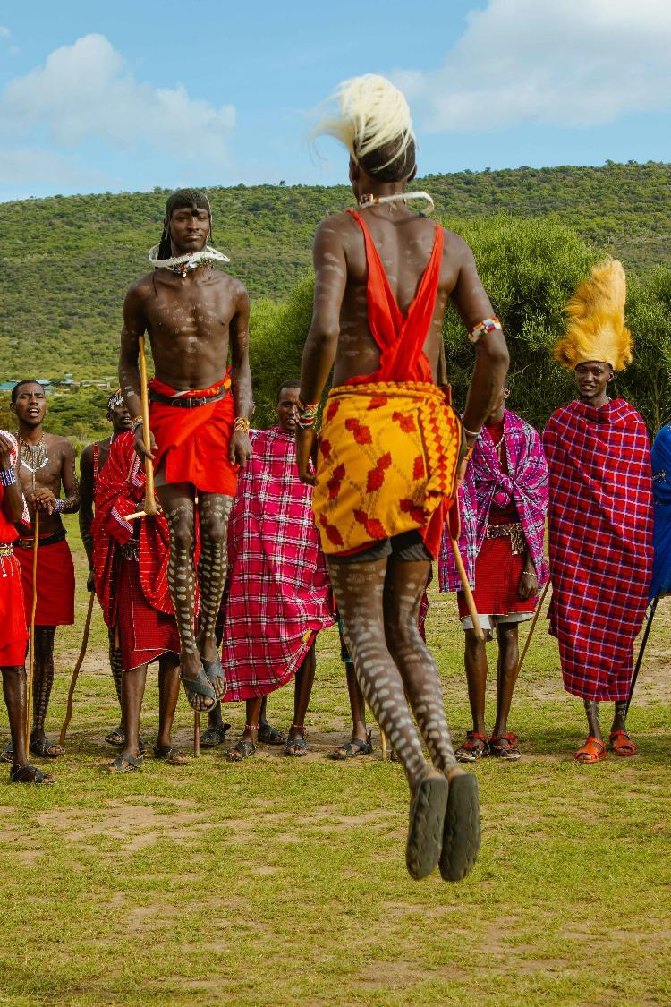
Photo by Brian Kungu on Unsplash
Notes:
Masai tribespeople traditionally welcome visitors to their village with a jumping dance. You can view one here!: https://www.youtube.com/watch?v=m6wIp4wZU9w or a female version here: https://www.youtube.com/watch?v=AVTP3vU9MLE

Slide 16
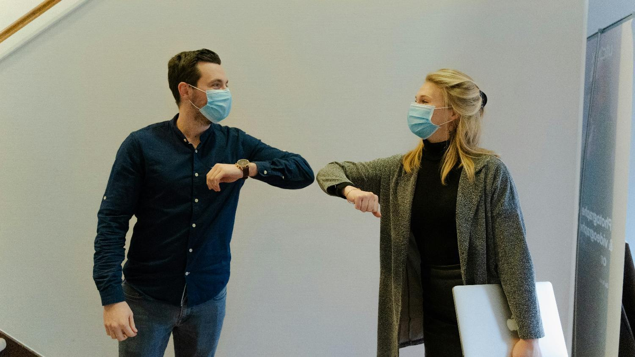
Notes:
Slide 16: And some of you might just remember back to the COVID-19 pandemic, when we were all social distancing, and this is how we had to greet each other!!

Slide 17
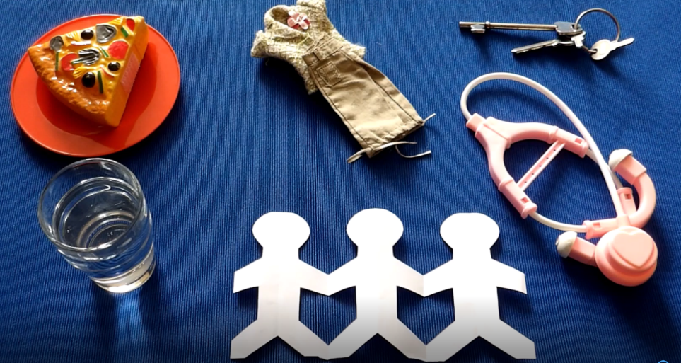
What did Jesus say about welcome?
Notes:
Slide 17: We’re going to hear some words about welcome now, spoken by Jesus. People often asked him questions about how to live, or what it should be like in God’s Kingdom. As you watch and listen, think about what he said, and how his words might help us to think about ways to be welcoming in our own school community….. [use script on page 3]

Slide 18
‘Whenever you welcomed these, you welcomed me.’
Notes:
Slide 18: After the ‘story’, talk about children’s ideas about welcome, linking them with your school’s vision and values & using the wondering questions from the script:
I wonder…..
...what you think about these ideas?....
I wonder why these things might be so important to God?
Or why Jesus chose these actions as the answer to peoples’ questions?
I wonder…..how might we do some of these things at this time?

Slide 19

I wonder how we can make our school a place of welcome?
Notes:
Responding (and words for worship):
Slide 19: …We’ve been thinking today about the different ways in which communities show welcome….
….we’ve been reminded of Jesus’ words about welcoming others in the way that we treat them….
……..
…we’ve also talked about how we might do this here, in ……. School.....
….I wonder how many other ways we might think of to be welcoming to others?….
….let’s spend a few quiet moments now, thinking about our own responses….
….and how we might put them into practice….
….now I’m going to offer some of our ideas to God in prayer and ask him to help us…. find a way to make the prayer yours if you’d like to join me…. There are some actions to join in with if it helps you….

Slide 20
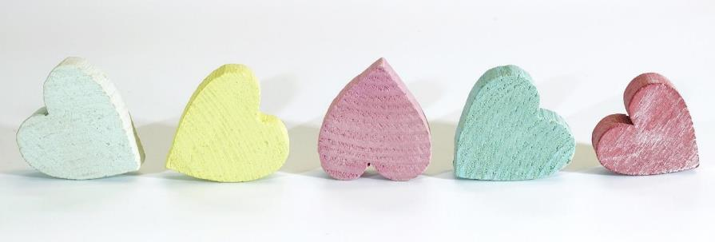
God, who welcomes all,
At the beginning of this new term,
teach us to be your hands and feet where we are,
At the beginning of this new term,
teach us to love as you love us
At the beginning of this new term,
teach us to welcome those in need
So that You are welcomed in this place.
Notes:
Slide 20: God, who welcomes all,
At the beginning of this new term, teach us to be your hands and feet where we are, [show hands, point to feet]
At the beginning of this new term, teach us to love as you love us [hands on heart]
At the beginning of this new term, teach us to welcome those in need. [extend hands in welcome]
So that You are welcomed in this place.

Slide 21


Slide 22

Leader: As we leave this place and time and go into the day ahead...
All: …may our school be a place of welcome.

Slide 23
Notes:
Slide 23: Reflection areas
Think: about ways in which we can be welcoming
Talk: with others about your ideas – are they all the same? Why is this?
Do: Draw round your hand. On the ‘palm’ or on each finger (for older children), write something they can do to be welcoming. Display these in your classroom reflection area.

