Slide 1


Leader: As we share these stories of leaders…
ALL: May we follow their example
in thoughts
and words
and actions.
Notes:
Slide 1:This term, we are going to be finding out about – and following the example of – leaders from all over the world, and so our new greeting reflects this.
Use these new gathering words for this term, or your usual greeting if you prefer. The greeting comes with BSL signing, you can view the demos using links under the slide.
Leader: As we share these stories of leaders…
ALL: May we follow their example in thoughts and words and actions.
Signs for greeting: click on links
Thoughts: British Sign Language BSL Video Dictionary - thought (signbsl.com)
Words (use 3rd definition): British Sign Language BSL Video Dictionary - word (signbsl.com)
Actions: British Sign Language BSL Video Dictionary - action (signbsl.com)

Slide 2
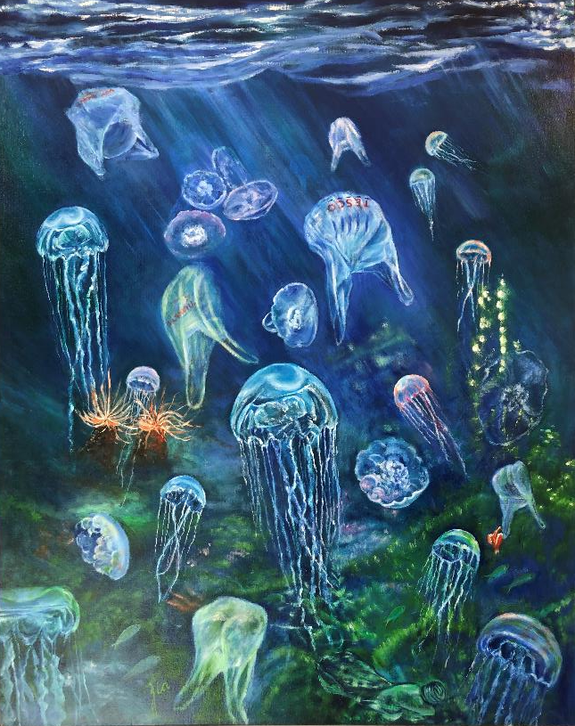
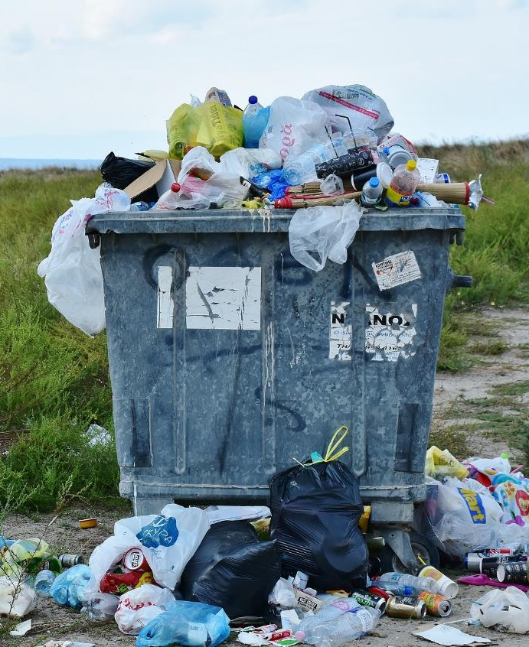
What are these pictures about?
Notes:
Slide 2: What are these pictures about? [Talk together for a few moments]
We know quite a lot about how our rubbish is affecting our oceans, our climate and our environment – and many of us try to take the part we have to play in this very seriously.

Slide 3

Earth Day: 22.4.23
Notes:
Slide 3: This coming Saturday is Earth Day, and it will be marked in different ways across the globe.
One Christian charity, TEAR Fund, is using the whole of this week to raise awareness of environmental issues in some of the poorest and most vulnerable communities across the world – in a very simple way. [You might want to get involved yourself as a school, but at least use the slides to explain the initiatives of Bin Twinning, shortly]

Slide 4
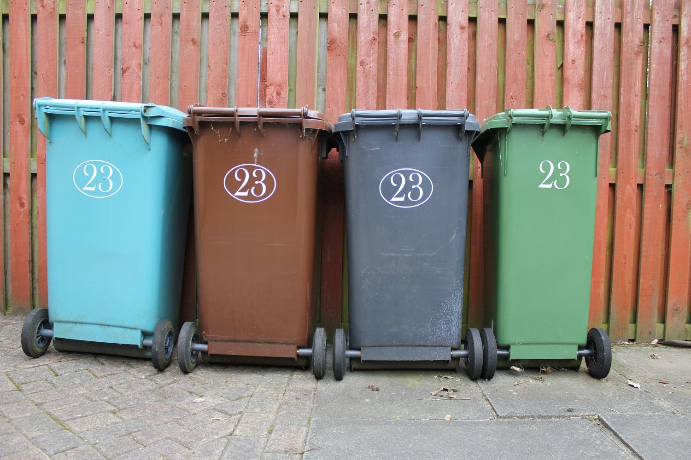
That’s RUBBISH!
Notes:
Slide 4: Before we find out a bit more, we’re going to take part in a rubbish activity! Here at the front, you’ll see some rubbish – and we’ll find out some facts about how important it is to be aware of what happens to our rubbish, and the difference that we can make in our world. [use your recycled rubbish facts]

Slide 5
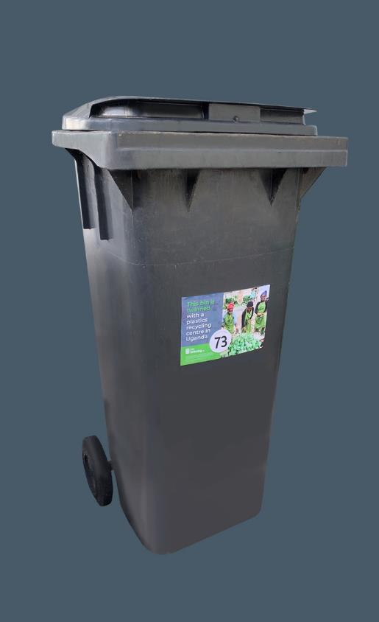

What is bin twinning?
Notes:
Slide 5: These slides come from TEAR Fund’s materials for schools: find the complete presentation here. Some words have been adapted for the ages of our pupils.
Bin-Twinning-intro-presentation.pptx (live.com)
The people who work for a charity called TEAR Fund are showing us how to be good leaders in looking after our world – and the people who share it with us.

Slide 6
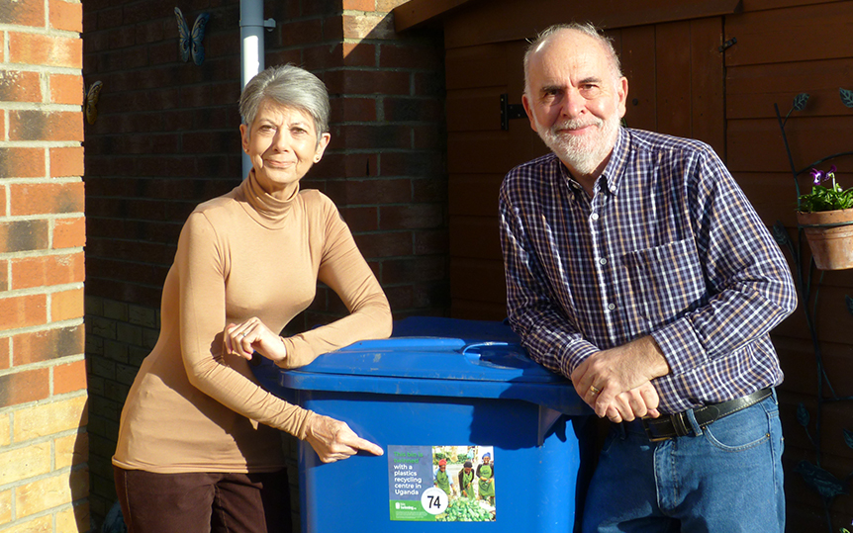

Notes:
Slide 6: Bin Twinning is a bit like Town Twinning, where two towns across the world are linked – but you link your bin…

Slide 7
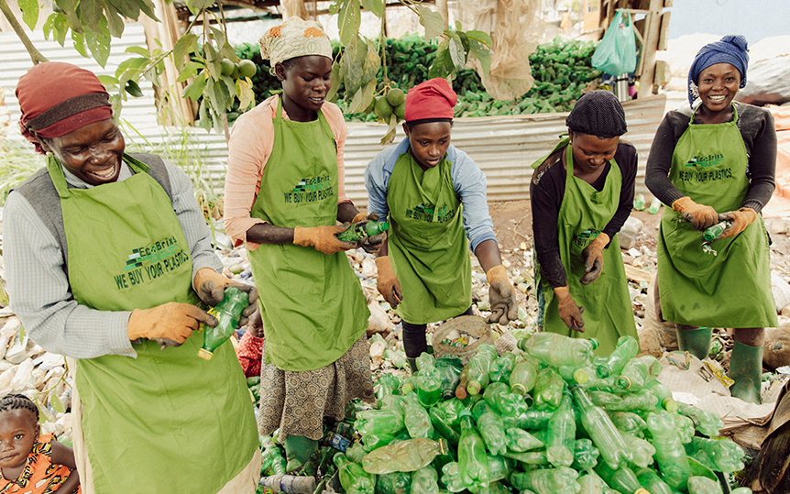
Notes:
Slide 7: …with a rubbish collection and recycling project in one of the poorest places on the planet.

Slide 8
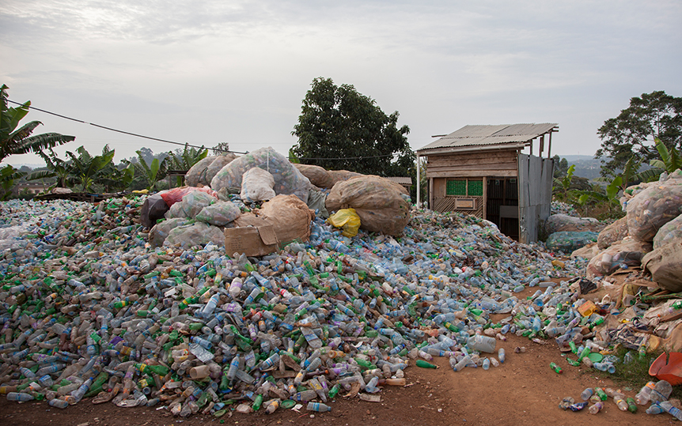

Notes:
Slide 8: 2 billion people in the world are living among mounds of rubbish, like this, because they don’t have their waste collected and safely disposed of.

Slide 9
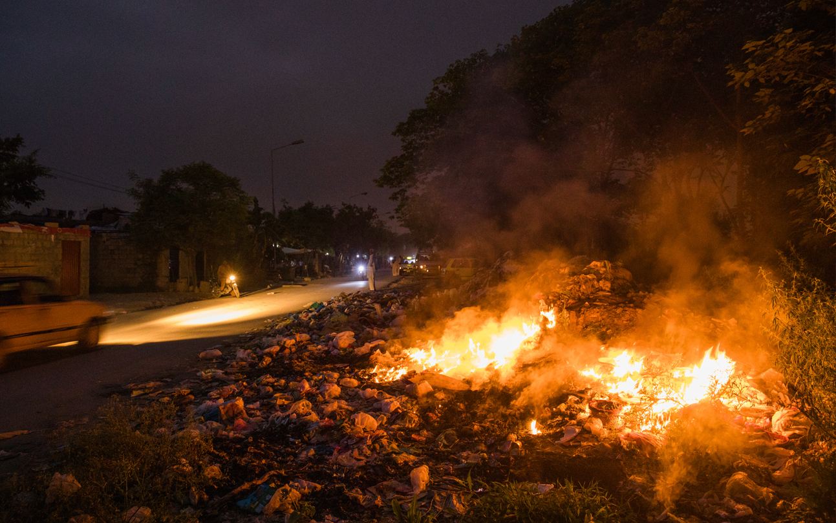
Notes:
Slide 9: In communities that don’t have waste collection services, residents feel they have no choice but to dump or burn their rubbish.
Waste either gets added to open dumps, thrown in waterways which lead out into the ocean, or it is burnt, creating toxic fumes and air pollution that are breathed in by local residents.

Slide 10
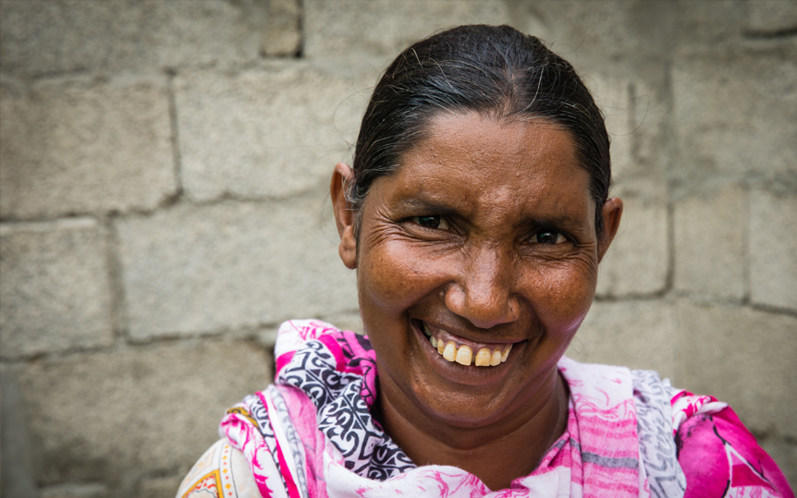
Notes:
Slide 10: This is Meera. The piles of rubbish in Meera’s community mean that there are lots of mosquitoes, which spread diseases. Recently, Meera was ill for months and medicines cost lots of money.

Slide 11
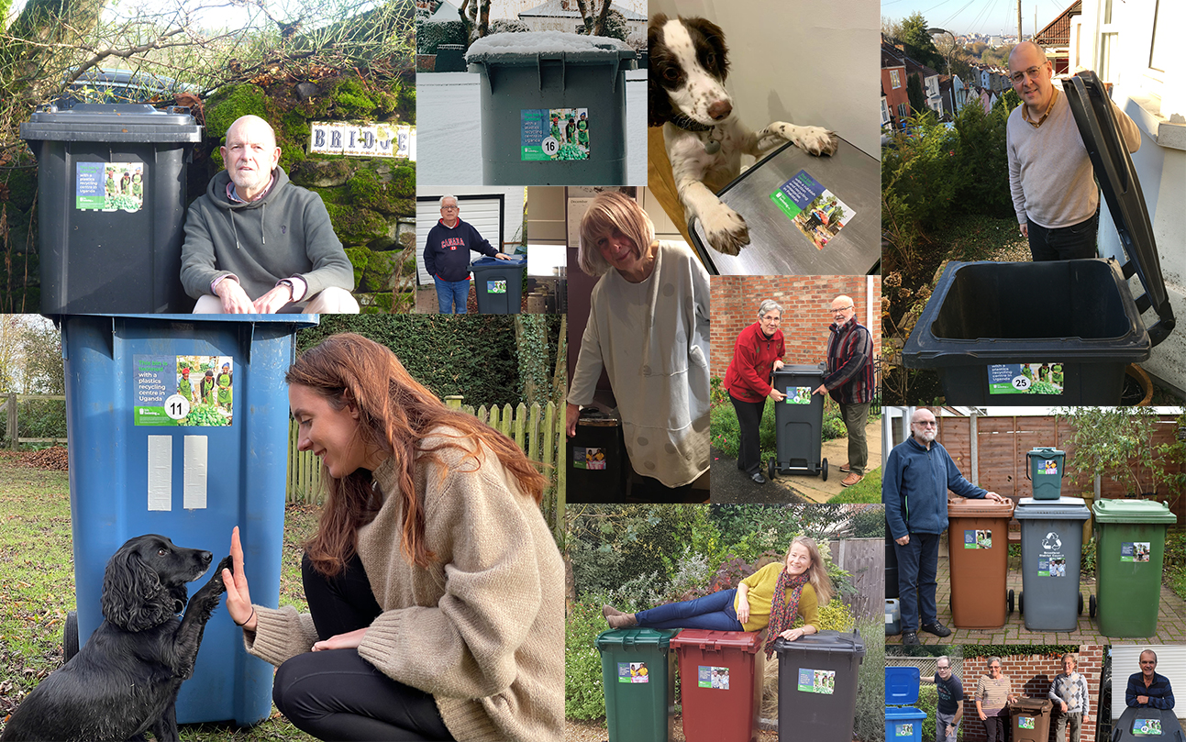
Notes:
Slide 11: All these people are twinning their bins! They donate money to TEAR Fund who give them a special sticker to show that their bin is twinned – and the money they have raised have done this….

Slide 12
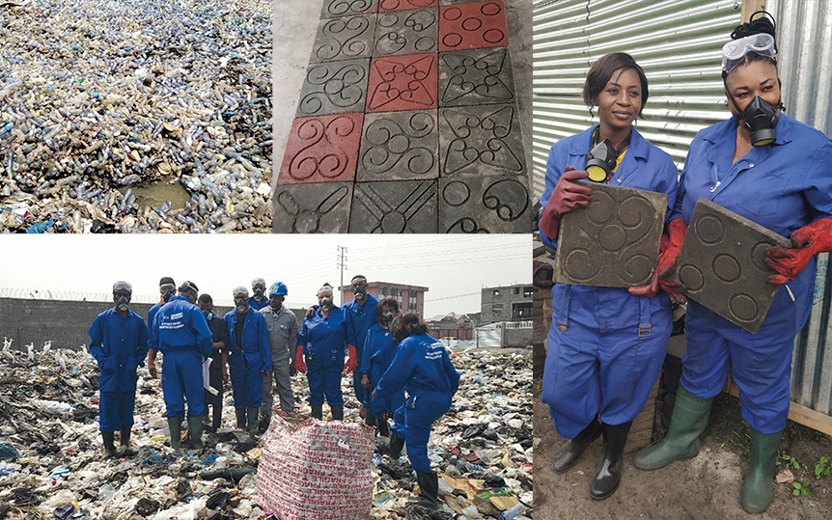
Notes:
Slide 12: Bin Twinning has helped to set up businesses that collect rubbish, dispose of it safely, and recycle as much as possible. Many of these projects upcycle waste into items for sale – from compost to paving blocks – and proceeds are given back to the local community and provide local people, from poor communities, with work.

Slide 13
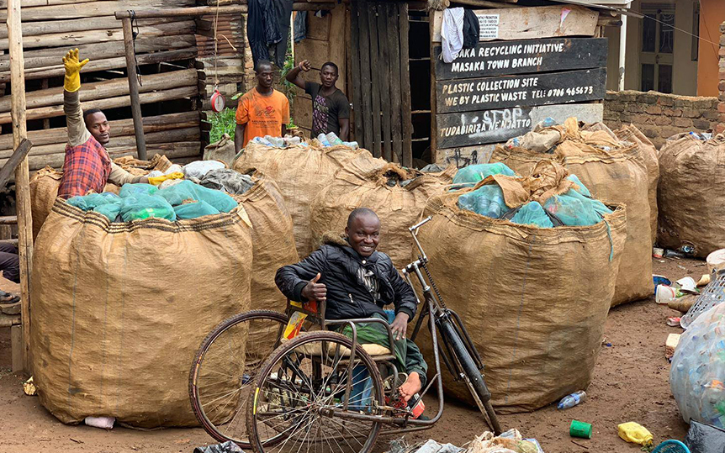

Notes:
Slide 13: So, if you were to twin your bin with Uganda, you’d be twinning with a recycling enterprise in Masaka that is setting up three paving block factories to recycle up to 30 tonnes of plastic each month. Many of the people who work there wouldn’t normally have the chance to work because they are women, or disabled.
Bin Twinning makes a big difference!!

Slide 14
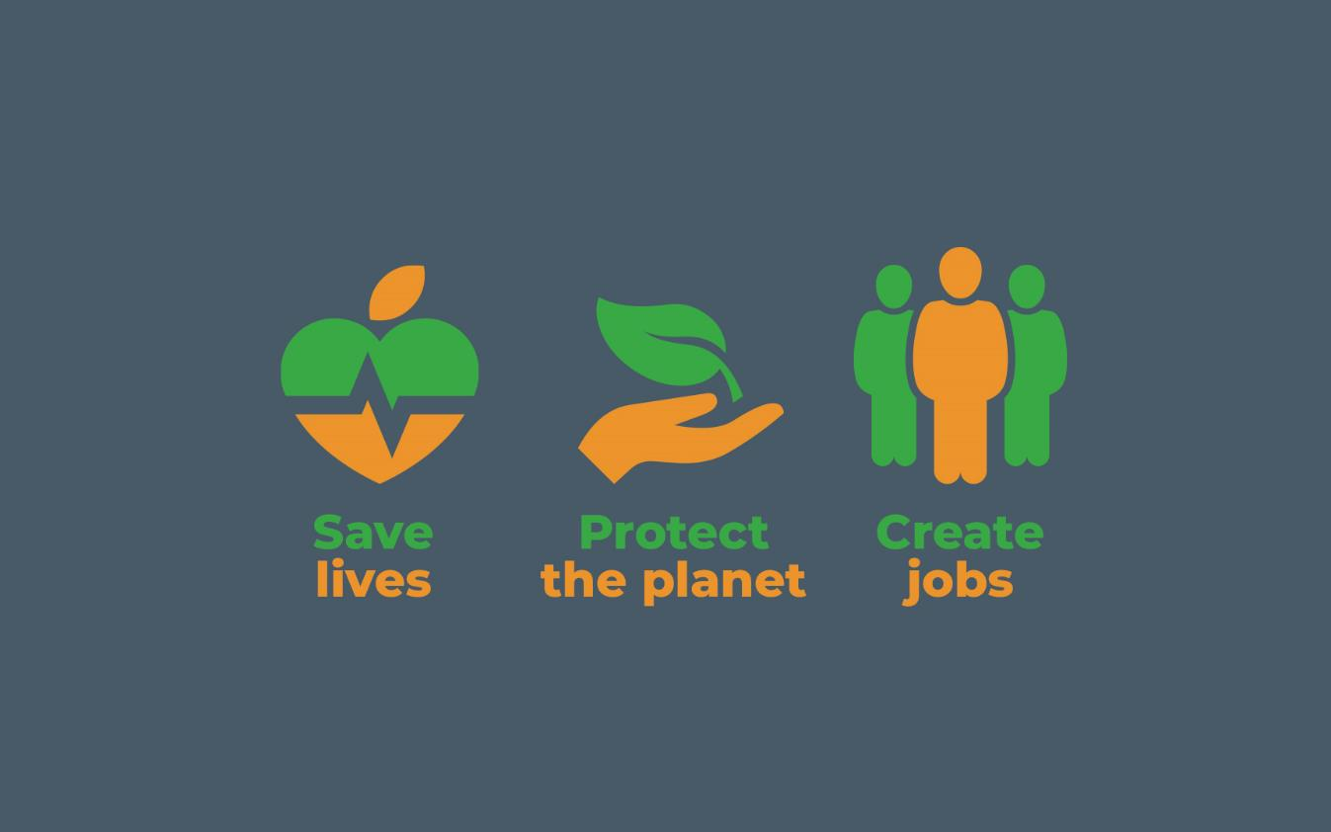
Notes:
Slide 14: With Bin Twinning, people are helping to….
Save lives – Protect the planet – Create jobs

Slide 15
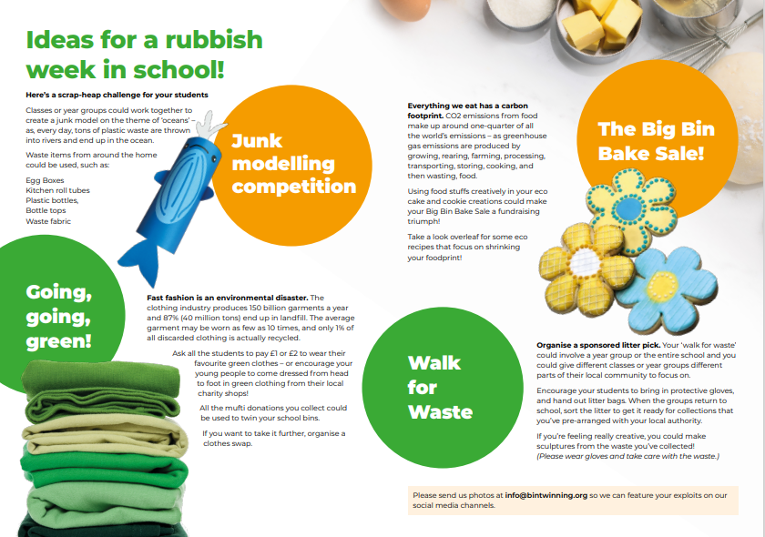
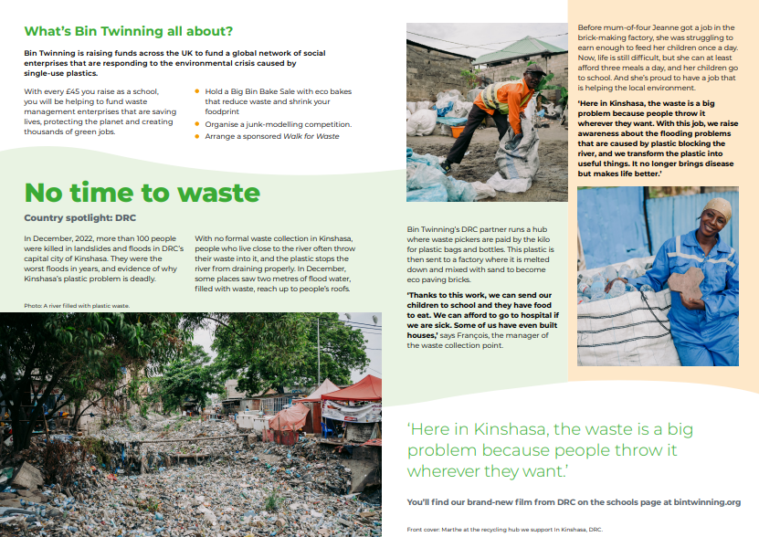
Lots of ways to help!
Notes:
Slide 15: There are lots of ideas to help you to do things in school this week to raise funds to twin your bins – or to help you to be less wasteful with plastics.

Slide 16
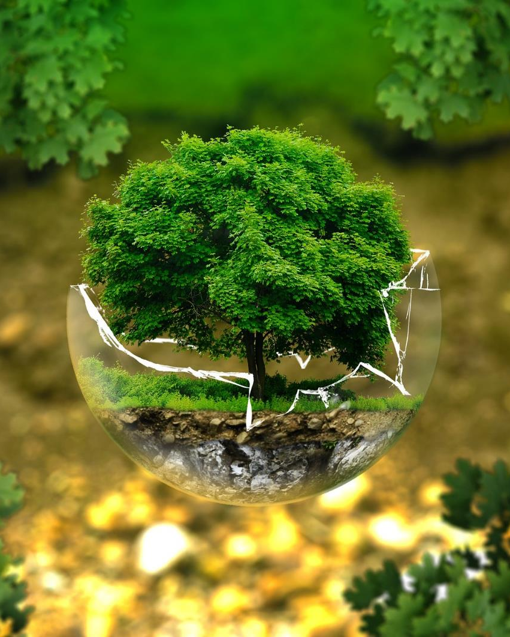
God put Adam in the Garden of Eden to care for it and work it. Genesis 2:15
Notes:
Slide 16: ….in the stillness of this moment, let’s be quiet and think…..
In the Bible, Christians read about God’s plan for the beautiful world he had made – you might remember that many times he said ‘That’s GOOD!’!! When he made people, it was clear that it was the people’s job to look after the world. So today, we are going to use some words that reflect this in our thoughts and prayers.

Slide 17
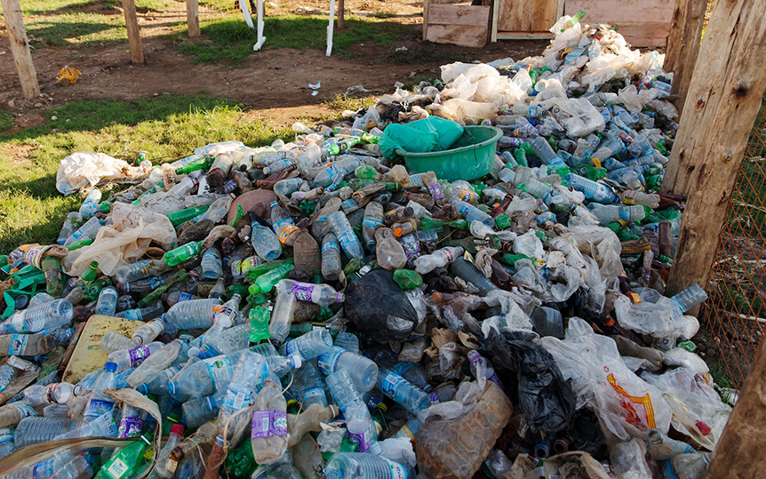
…. I wonder how you’d feel, living here?....
…. I wonder what you’d want to change?....
…. I wonder what we’ve learned today that might change our actions?....
….I wonder how our actions might show that we are caring for the world?....
Notes:
Slide 17:….we’ve heard today lots of facts about plastic waste and its impact on our world….
….and how 2 billion people across our world live in an environment that none of us would like….
…. I wonder how you’d feel, living here?....
…. I wonder what you’d want to change?....
…. I wonder what we’ve learned today that might change our actions?....
….I wonder how our actions might show that we are caring for the world?....
[give some space for silent reflection here]
I’m going to turn my thoughts into a prayer now. If you’d like to pray too, then join in with the words ‘We will care for all you’ve made.’

Slide 18
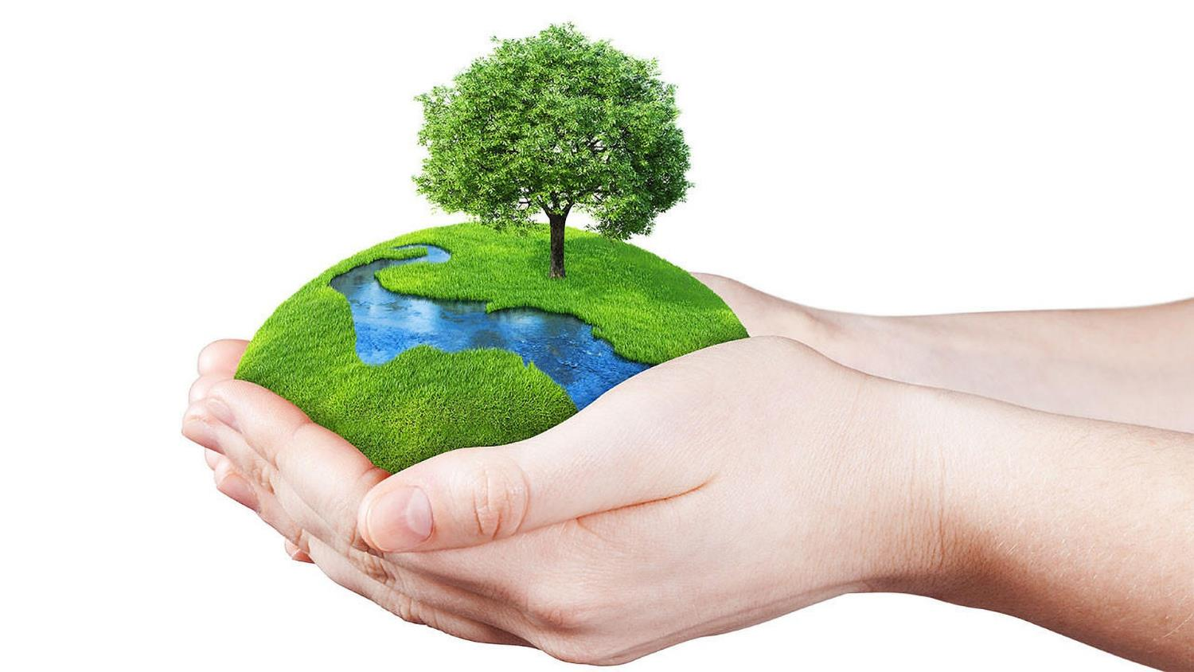
….we will care for all you’ve made.
Notes:
Slide 18: Creator God
You made our world beautiful, for us to share ….we will care for all you’ve made.

Slide 19
….we will care for all you’ve made.
Notes:
Slide 19: When we see something that’s wrong, ….we will care for all you’ve made.

Slide 20
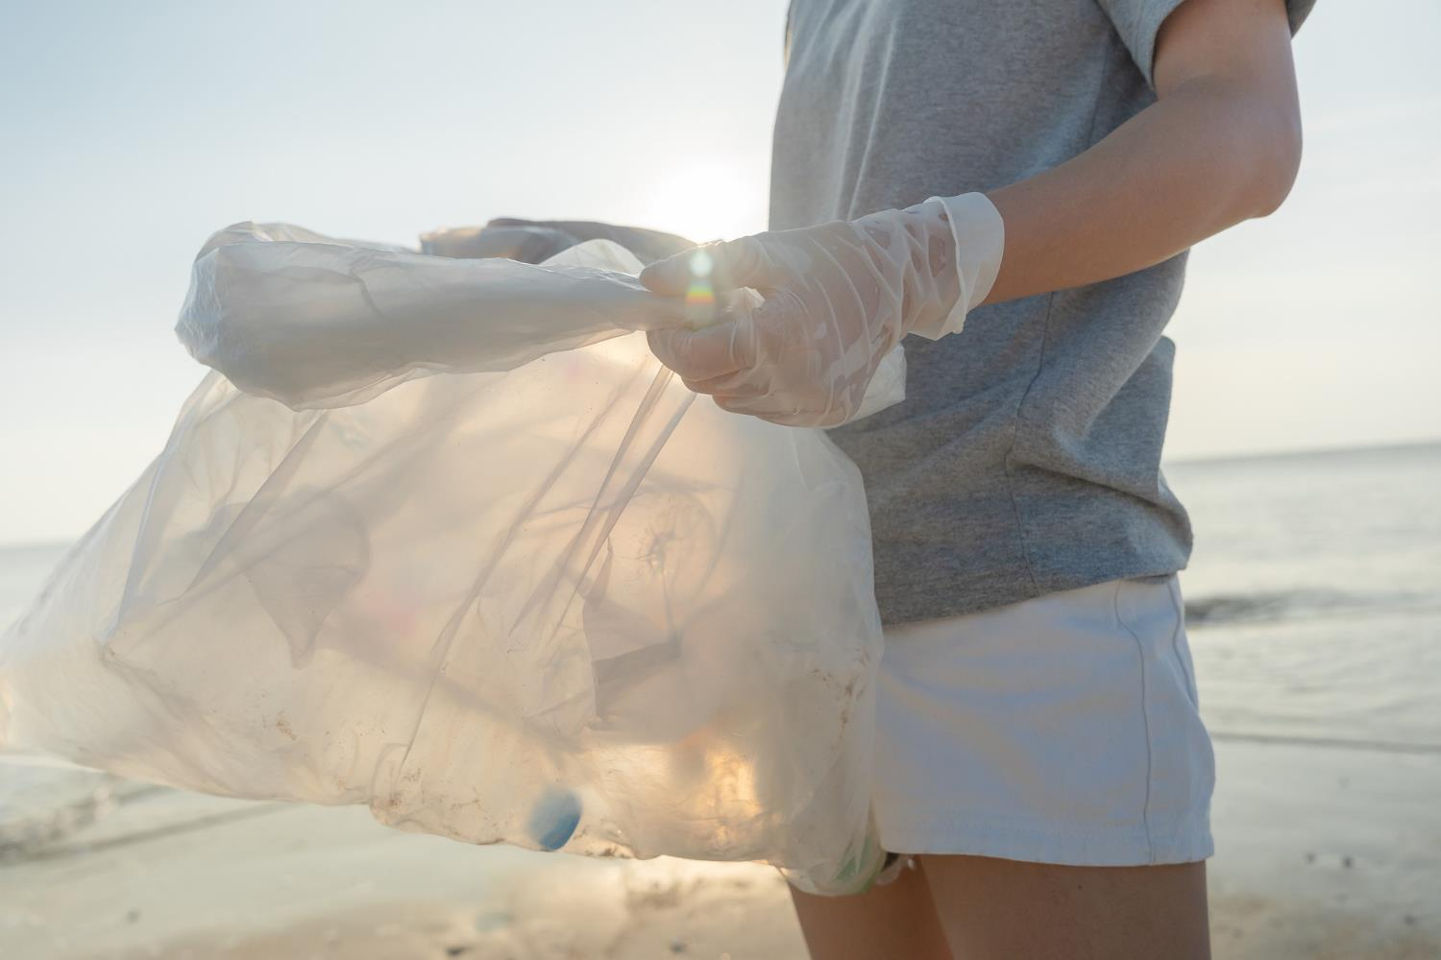
….we will care for all you’ve made.
Notes:
Slide 20: With every piece of rubbish that we clear away….we will care for all you’ve made.

Slide 21
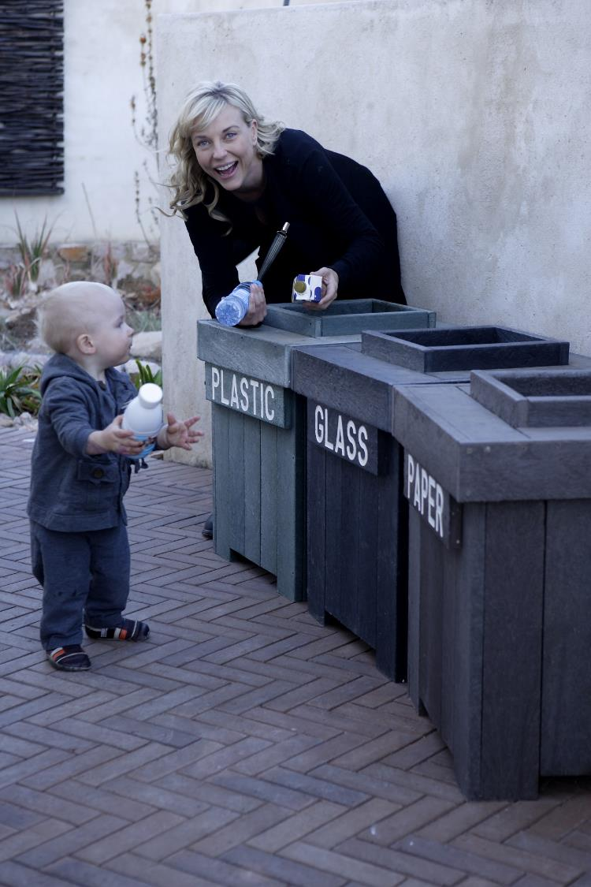
….we will care for all you’ve made.
Notes:
Slide 21: With every single thing that we recycle ….we will care for all you’ve made.

Slide 22
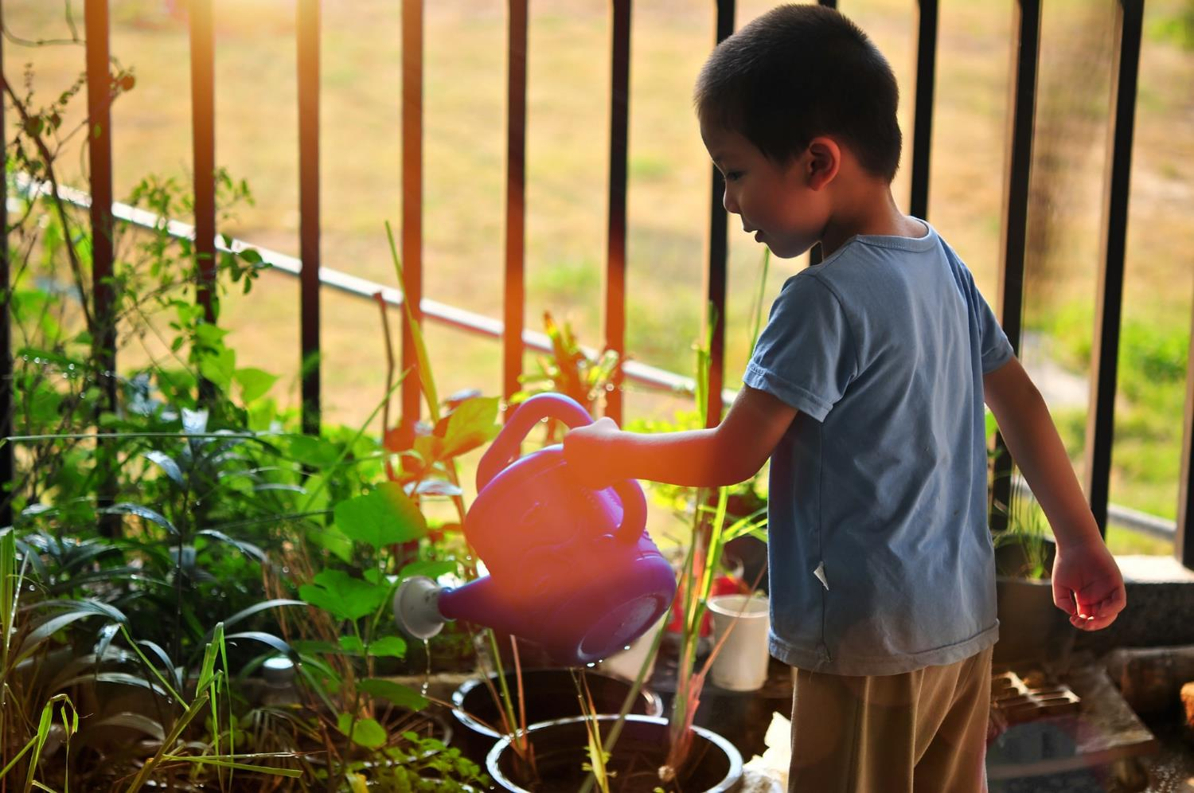
….we will care for all you’ve made.
Notes:
Slide 22: As your children on this earth, ….we will care for all you’ve made.

Slide 23


Slide 24




Leader: As we leave this place & time and go into the day ahead…
All: May our actions – and our bins! – make a difference.
Notes:
Sending: Slide 24
Leader: As we leave this place and time and go into the day ahead…
All: May our actions – and our bins! – make a difference.

