Slide 1

Notes:
Slide 1: Use a greeting that will be familiar to your school community.

Slide 2

What can you do better with others?
Notes:
Slide 2: I wonder how many things you can think of that you can do better together with others? Here are a few things to get you started….

Slide 3
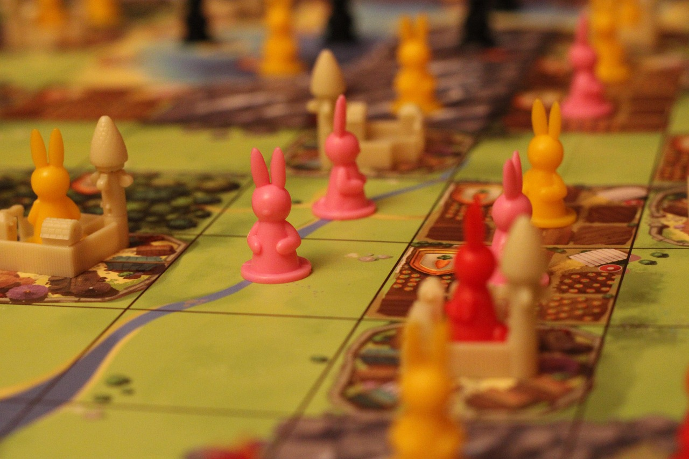
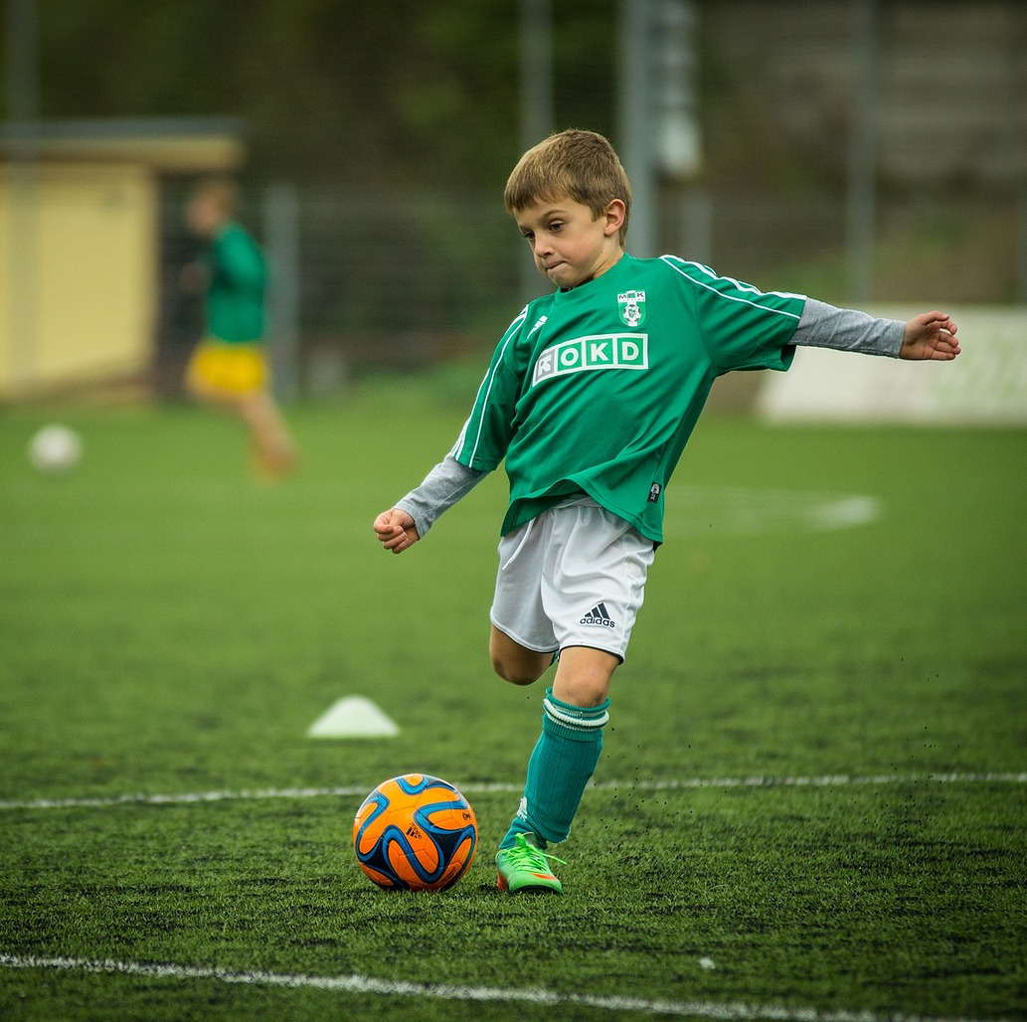
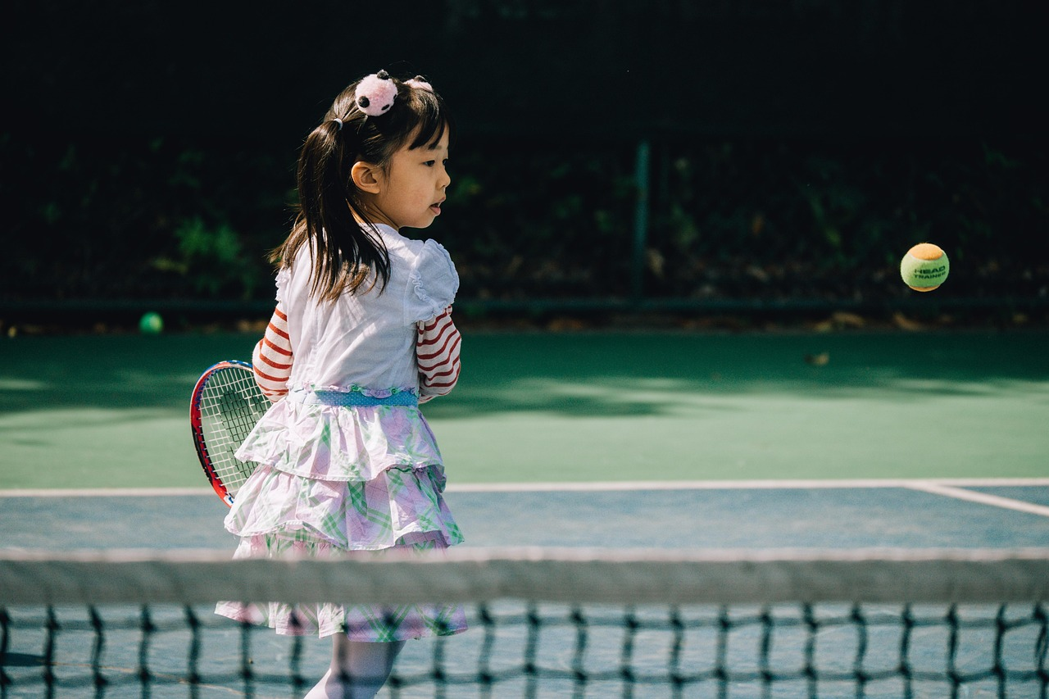
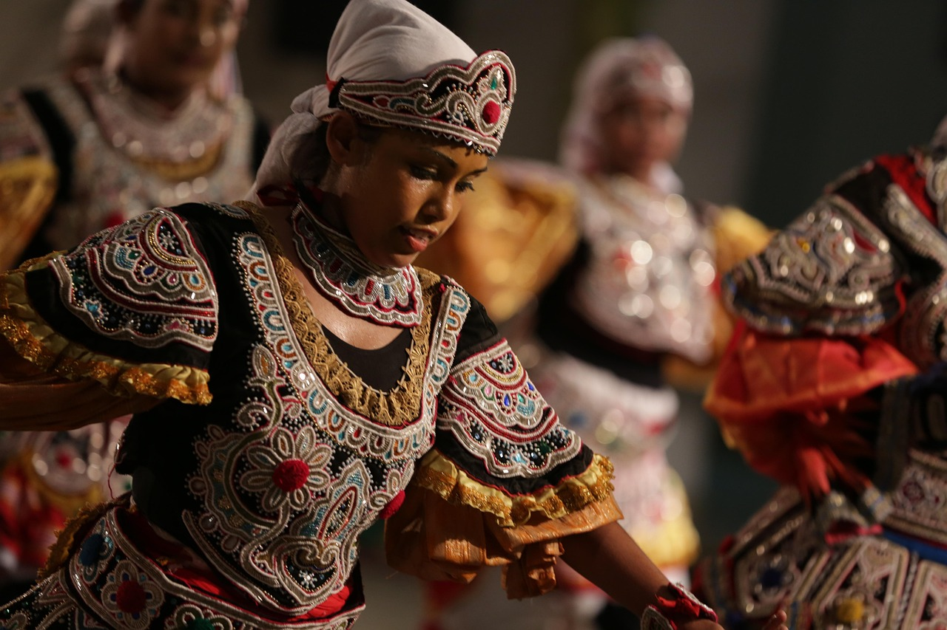
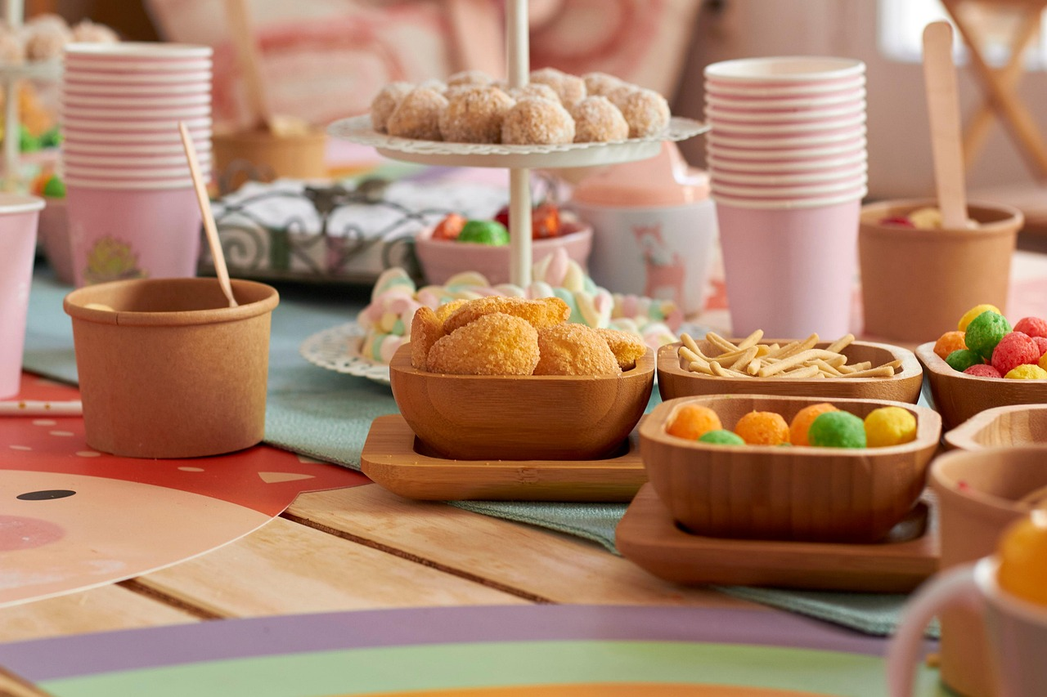

Notes:
Slide 3: [from top L-R: playing games; football; tennis; dancing; softplay; having a party]
Have a little chat with the people around you…. I wonder what other ideas you might think of together? [get feedback from groups]

Slide 4
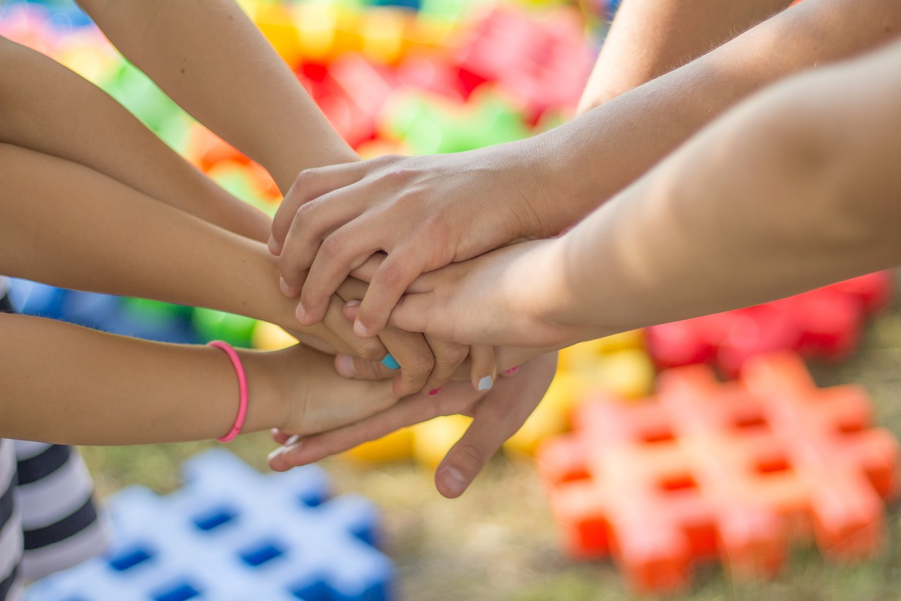
Welcome
Notes:
Slide 4: At the start of this new school year, and a whole new term of themes, we are going to spend some time together – recognising that it is good to be here as part of this school community, with all the things that we share in and work at together.
If you are new here, you are especially welcome – we are very excited to get to know you all and help you to be a part of our school family. Here at ……. School, we want to be a place where everyone is welcome, where everyone feels that they have a place. Our school’s values help us to do this…. [if you want to introduce your school values to newcomers, this would be the place here! Talk about how they help you to belong together.]

Slide 5

Notes:
Slide 5: This might’ve been another thing we could do together – especially if it’s a puzzle with as many pieces as this!!
We’re going to use it to help us to think now.
Every piece in a jigsaw puzzle is different and special.
Every piece has a place where it fits.
Even if you might be feeling a bit lost and overwhelmed, you have a place here and we are glad you have come.

Slide 6
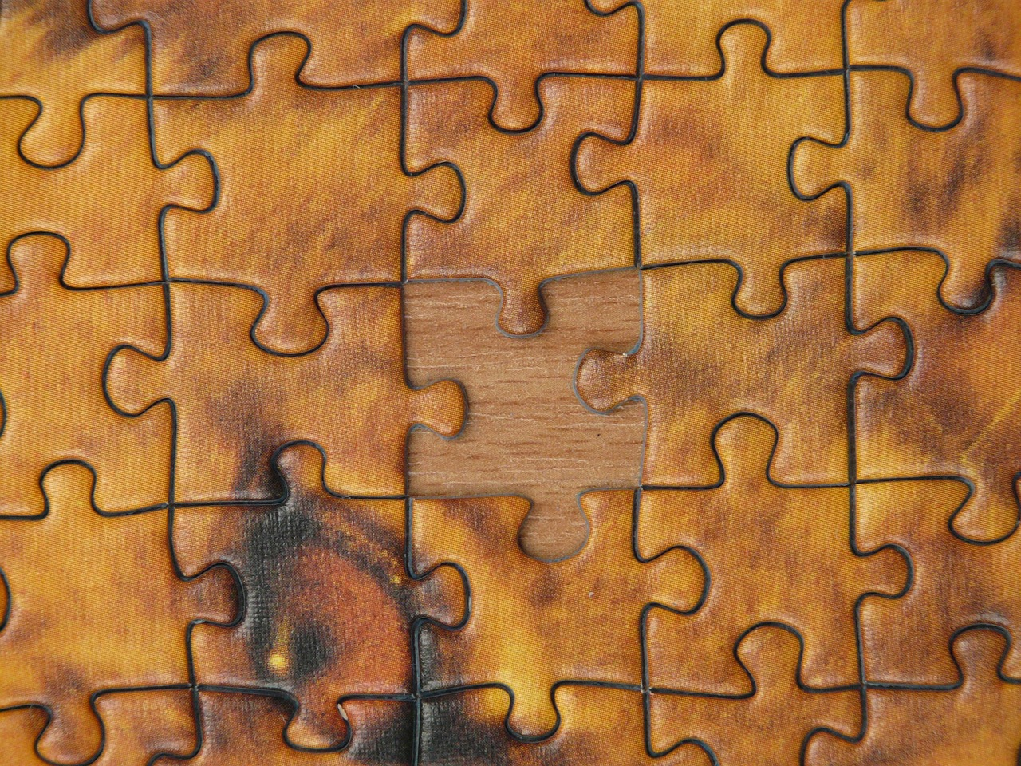
Notes:
Slide 6: We all know how frustrating it is when a jigsaw puzzle has missing pieces! Our school community is only complete when everyone is here, joined together by the things that are important to us as a school family, working together to help everyone to feel welcome.

Slide 7

Let us think about each other and help each other to show love and do good deeds. (Hebrews 10:24)
….I wonder how our school values might help us to help each other.…to show love and do good deeds?....
….I wonder how this might help new people to feel that they are welcome here?.....
Notes:
Slide 7: Responding and words for worship
These are some words from the Bible, the holy book for Christians. Let’s look at them together…..
Let us think about each other and help each other to show love and do good deeds.
In the quietness now, think about what these words might mean…. [you may want to ask children to talk with a partner, and tease out the meaning in an age-appropriate way]
These words remind us to do three things:
To think about each other…. To have each other in our minds when we speak and when we act.
To help each other to show love…. Even when we perhaps don’t feel like it!
To help each other to do good deeds
….I wonder how our school values might help us to help each other….to show love and do good deeds?....
….I wonder how this might help new people to feel that they are welcome here?.....

Slide 8
Dear God
Thank you that our school family is a place where we all fit in. Today and every day, let us think about each other and help each other to show love and do good deeds.
Notes:
Slide 8: Opportunity for reflection / prayer
I’m going to pray now. If this is something that you feel comfortable doing, then find a way to make the words your own. If you don’t want to pray, then use the quiet to be still with your own thoughts.
Dear God
Thank you that our school family is a place where we all fit in. Today and every day, let us think about each other and help each other to show love and do good deeds.

Slide 9


Slide 10

Notes:
Slide 10: And so this week, to show that we belong together, we are going to create a whole-school picture / each class is going to create a picture, using our hands. where everyone’s hand belongs. It will remind us that we are all part of the same school family, with our shared values.

Slide 11
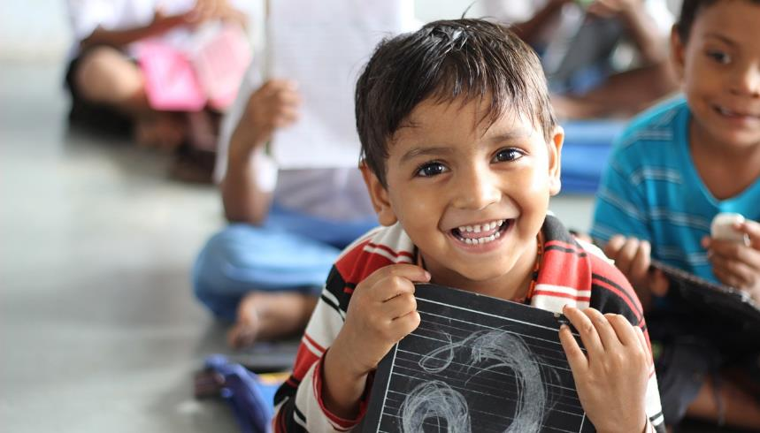


Leader: As we leave this place & time and go into the day ahead…
All: May our school be a place of welcome for everyone.

Slide 12

Notes:
Slide 12: Reflective areas
Do: Draw around your hand and cut it out. Write your name or draw yourself in the hand shape. Add your hand to the collage.
Think: What are things that are special to you? Are we all the same as one another?
Talk: What things are better done with others?
Can our ideas help us to make our school community a better place for everyone?

