Slide 1
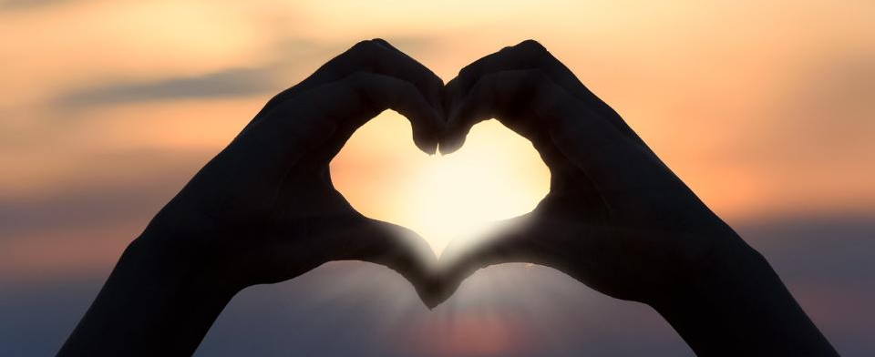
Leader: As we gather together
ALL: …we bring our hearts.
Notes:
Slide 1: Use the gathering words from last term, or your usual greeting if you prefer.
Leader: As we gather together,
ALL: …we bring our hearts
Signs for greeting: click on links
Hearts: British Sign Language BSL Video Dictionary - heart

Slide 2
Leader: As we gather together
ALL: …we share our thoughts.
Notes:
Slide 2: Use these new gathering words for this term, or your usual greeting if you prefer. The greeting comes with BSL signing; you can view the demos using links under the slide.
Leader: As we gather together,
ALL: …we share our thoughts.
Signs for greeting: click on links
Thoughts: British Sign Language BSL Video Dictionary - thought

Slide 3
Leader: As community together
ALL: …we serve one another.
Notes:
Slide 3: Use these new gathering words for this term, or your usual greeting if you prefer. The greeting comes with BSL signing; you can view the demos using links under the slide.
Leader: As community together,
ALL: …we serve one another.

Slide 4
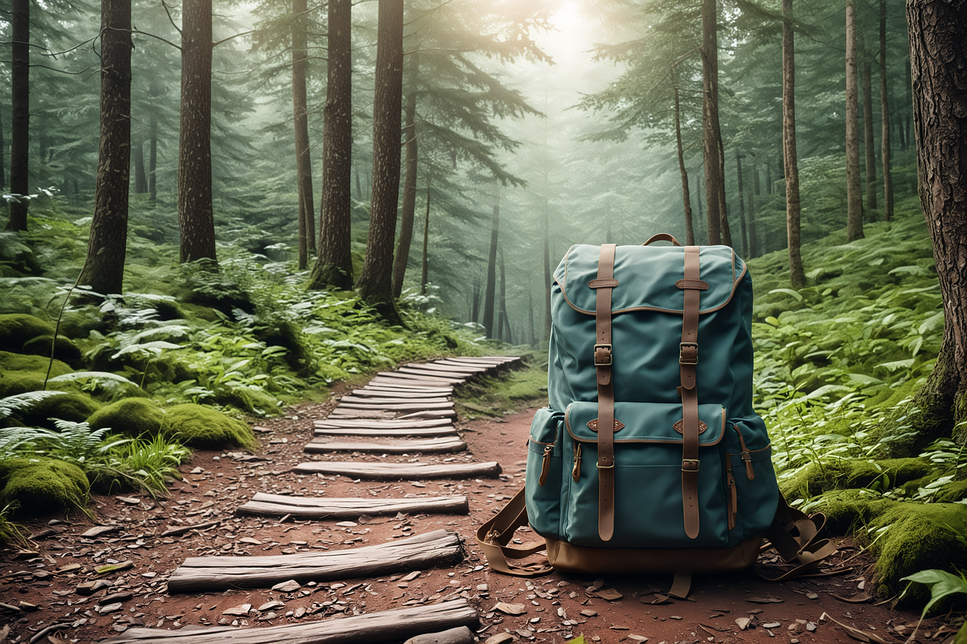
To boldly go….
Notes:
Slide 4: This term, we begin another new theme for our time together ‘To boldly go…..’, as we journey together towards the end of another year, but before we do that…..

Slide 5
Songs from
the heart
Notes:
Slide 5: Songs from the heart
….You might remember that we ended last term on a bit of a cliffhanger….. a ‘To be continued….’ moment at the end of our theme from the Psalms…

Slide 6
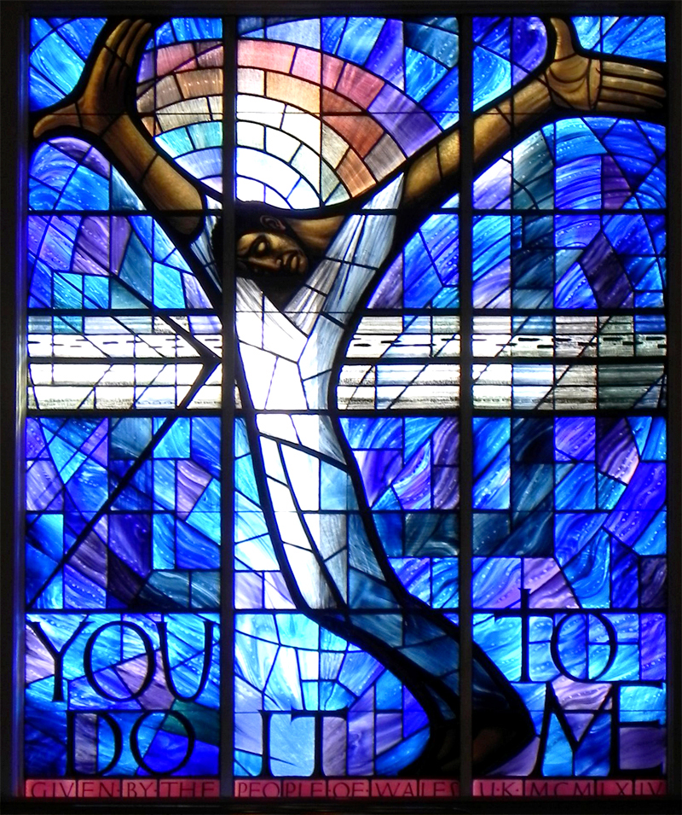
Notes:
Slide 6: …as we left the Easter story with Jesus on the cross. [You might want to recall some of the things you talked about together – if you can remember!] We recognised that the disciples, Jesus’ friends, were feeling very sad, very disappointed and also very frightened. But we also said that this wasn’t going to be the end, and that like the disciples, we were going to wait together to finish the story off.
So, let’s do that right now!

Slide 7
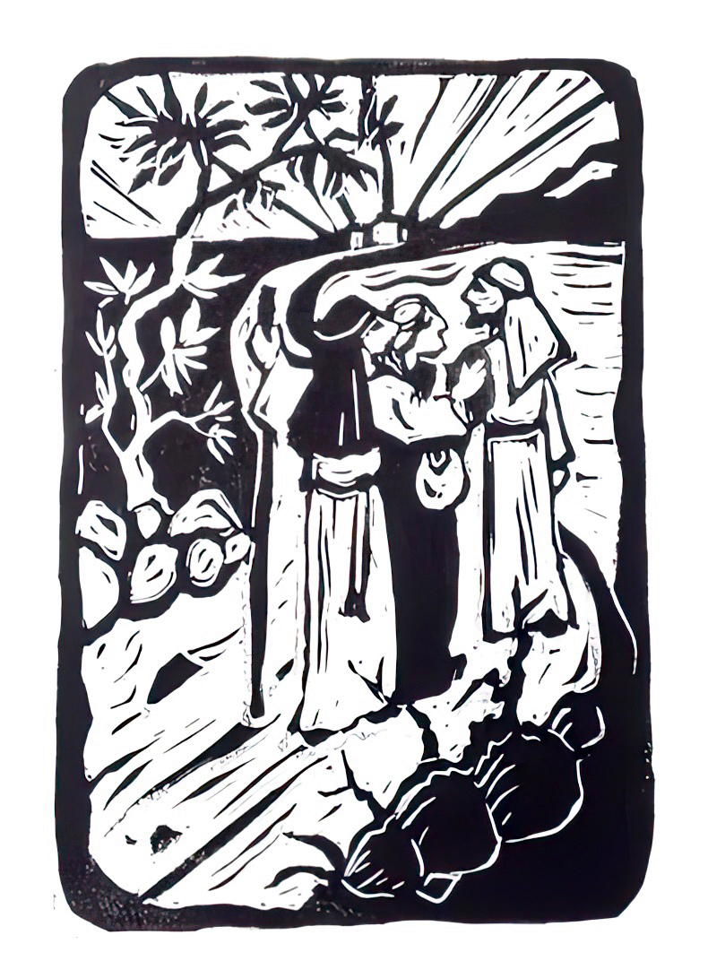
The Walk
Notes:
Slide 7: The Walk
There are some ways in which you can join in with this story [introduce actions, using script on p3. If you don’t want to use actions, then there is a photo version of the same story at the end of the PowerPoint]

Slide 8
Notes:
Slide 8: Paper people You will need the paper people for this section:
This part of the Easter story started with two friends walking together along the road….. [show the two paper people]
…..both feeling hopeless and troubled about Jesus’ death on the cross….[draw sad faces on them]
…..but that’s not where the story ended, because Jesus suddenly appeared, not dead, but very much alive and ate dinner with them!.... [open out the third figure]
….suddenly the friends were no longer sad and confused, but overjoyed…. [flip them over and add smiles to the friends’ faces on the blank side]

Slide 9
…. I wonder who is with you as you journey through life, and this summer term in particular?....
….I wonder which feelings in the story you most identified with?......
….I wonder if this idea might help you in the journey of your life today?....
Notes:
Slide 9: Responding (and words for worship):
As we reflect and wonder together today, let’s be still and quiet….
….it was good that the friends had each other for company as they started their journey…..
…..I wonder who is with you as you journey through life, and this summer term in particular?.....
[leave space to think]
….the friends had journeyed together from Jerusalem in sadness but returned to Jerusalem in great joy…..
….our feelings go with us as we journey through our lives….
….I wonder which feelings in the story you most identified with?......
[leave space to think]
…..the turning point in this story was when Jesus turned up on the road and joined them on their journey….
….for people who are Christians, this is a picture of how they feel about being on the journey of their lives, that God is with them, even in times when they might feel alone, like the friends in the story…..
…..I wonder if this idea might help you in the journey of your life today?....

Slide 10
Walk with us, God.
Notes:
Slide 10: Prayer: hold up your three figures again
As we look at the three figures joined together, you might want to use this prayer to bring your thoughts before God. I’m going to invite you to join me in saying ‘Walk with us, God’ as a response if you’d like to.

Slide 11
Notes:
Slide 11: In happy times and sad times
Walk with us, God.

Slide 12
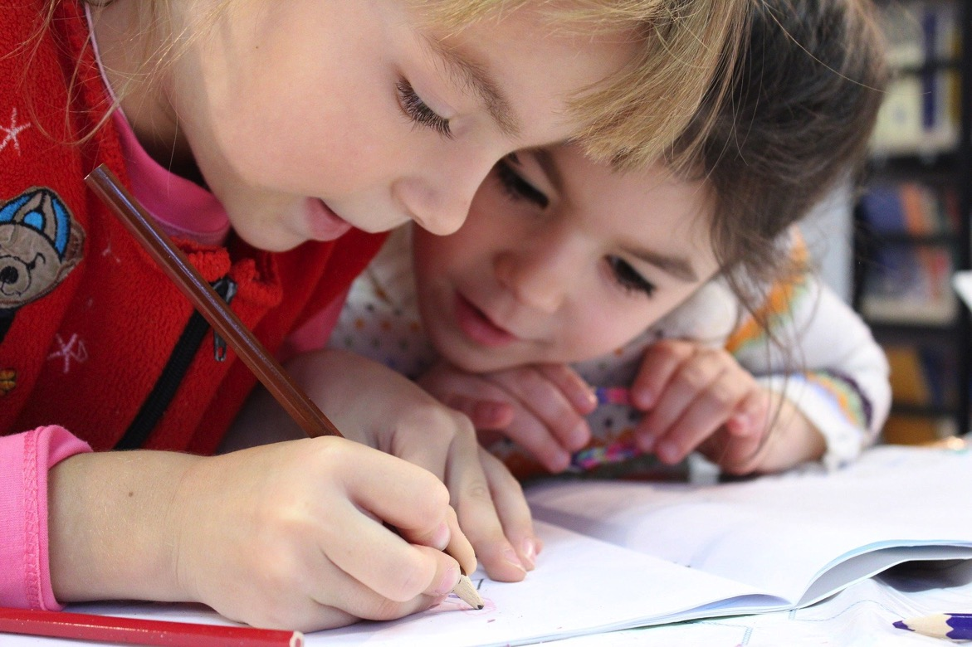
Walk with us, God.
Notes:
Slide 12: In our school and with our friends
Walk with us, God.

Slide 13
Walk with us, God.
Notes:
Slide 13: In our homes and with our families
Walk with us, God.

Slide 14
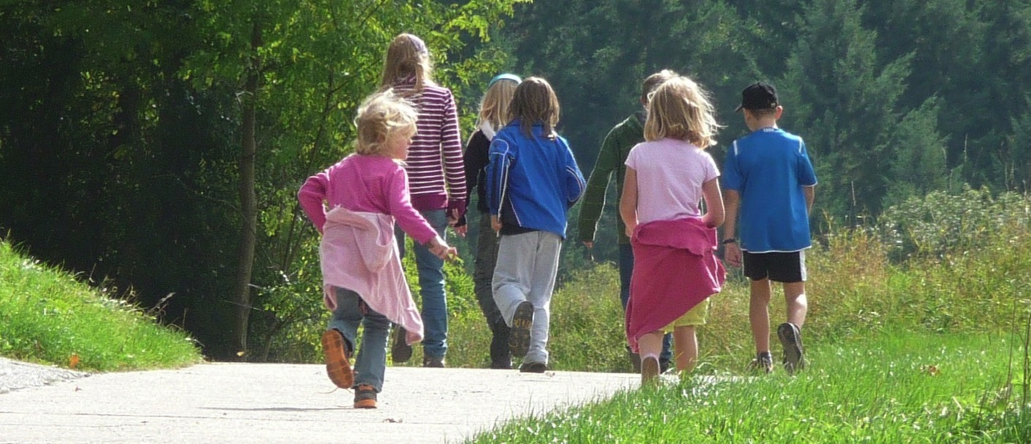
Walk with us, God.
Notes:
Slide 14: As we share in life together
Walk with us, God.

Slide 15
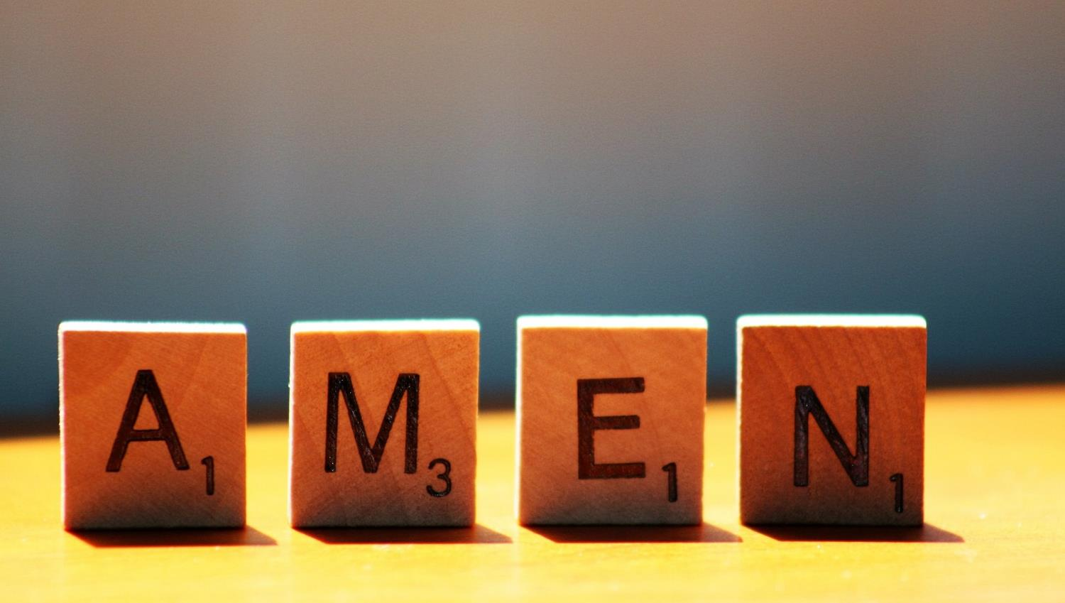

Slide 16
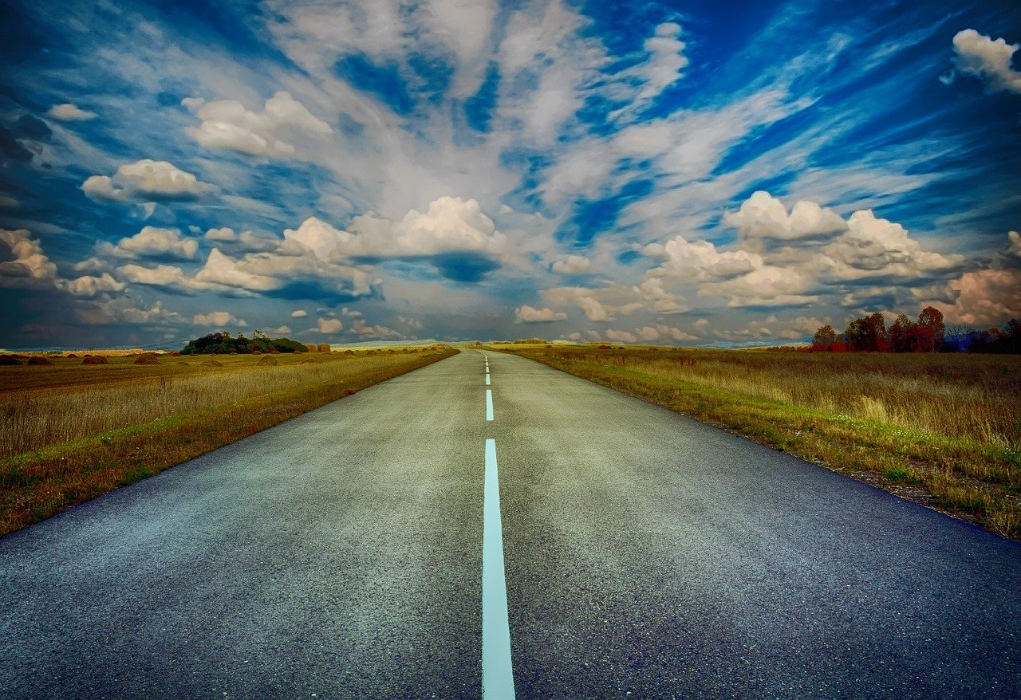
Leader: We have journeyed together today. As we leave this place and time and go into the day ahead…
ALL: …May God go with us.
Notes:
Slide 16: Teach the new leaving words for this term (which are very similar to the opening words you will use next week!):
As you’ve heard, we are beginning a whole new series today, as we travel together to the end of another school year. As we have a bit of a journey theme across the term, which will take us through the weeks together, it will come as no surprise that our greeting of each other during this term has a journey theme as well! Let’s learn this together…..
Leader: We have journeyed together today. As we leave this place and time and go into the day ahead….
ALL: ….May God go with us.
Sign for ‘God: British Sign Language BSL Video Dictionary - God
Sign for ‘go with us’ – we have invented this! After you’ve signed ‘God’, bring your finger down alongside your other finger and make them ‘journey together’ in front of you.

Slide 17
Who’s walking with you?

Slide 18
The Walk
Notes:
Alternative story:

Slide 19
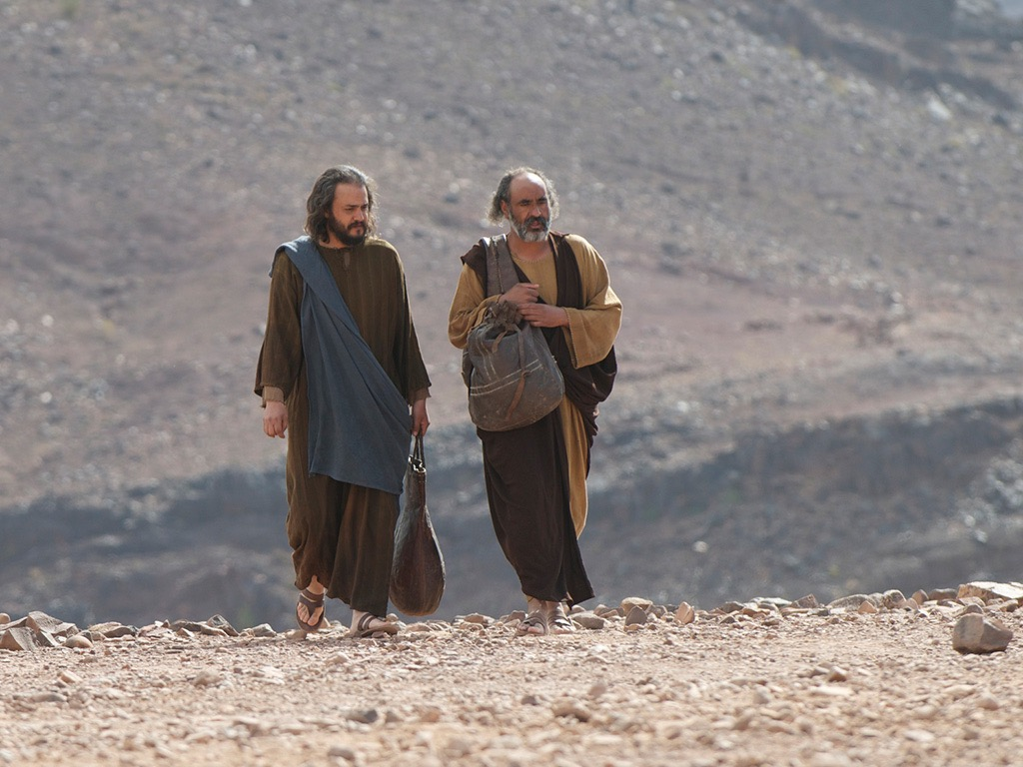
Notes:
It was Easter Day and two friends of Jesus were out walking from Jerusalem along the road to a village called Emmaus.

Slide 20
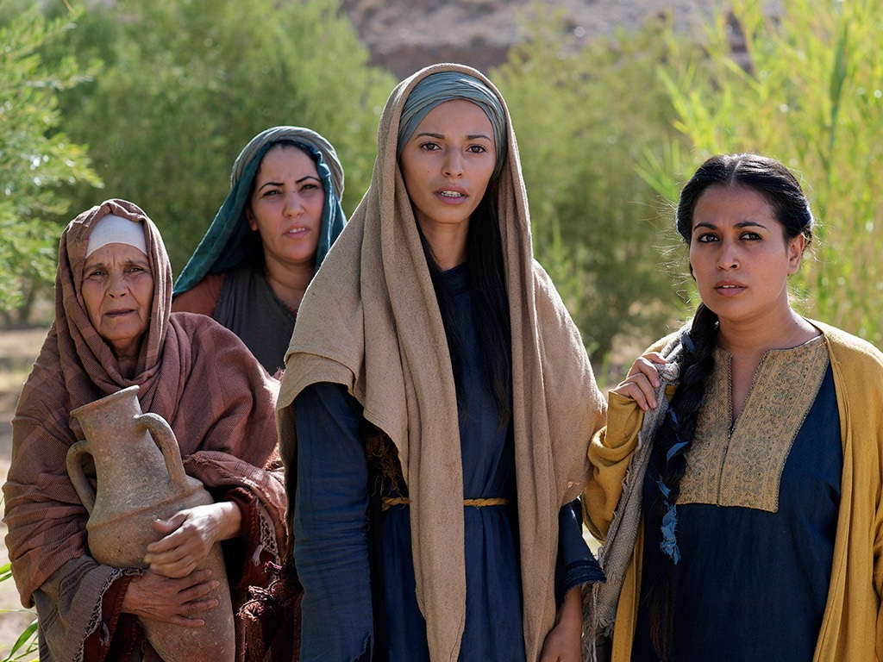
Notes:
The women had told them they’d seen Jesus, alive and well – but the friends didn’t really believe what they had heard. And now they were walking to Emmaus and as they walked, they talked about all the things that had happened: about how Jesus had died, about how disappointed they were and how sad they felt that he wasn’t walking with them along the road.

Slide 21
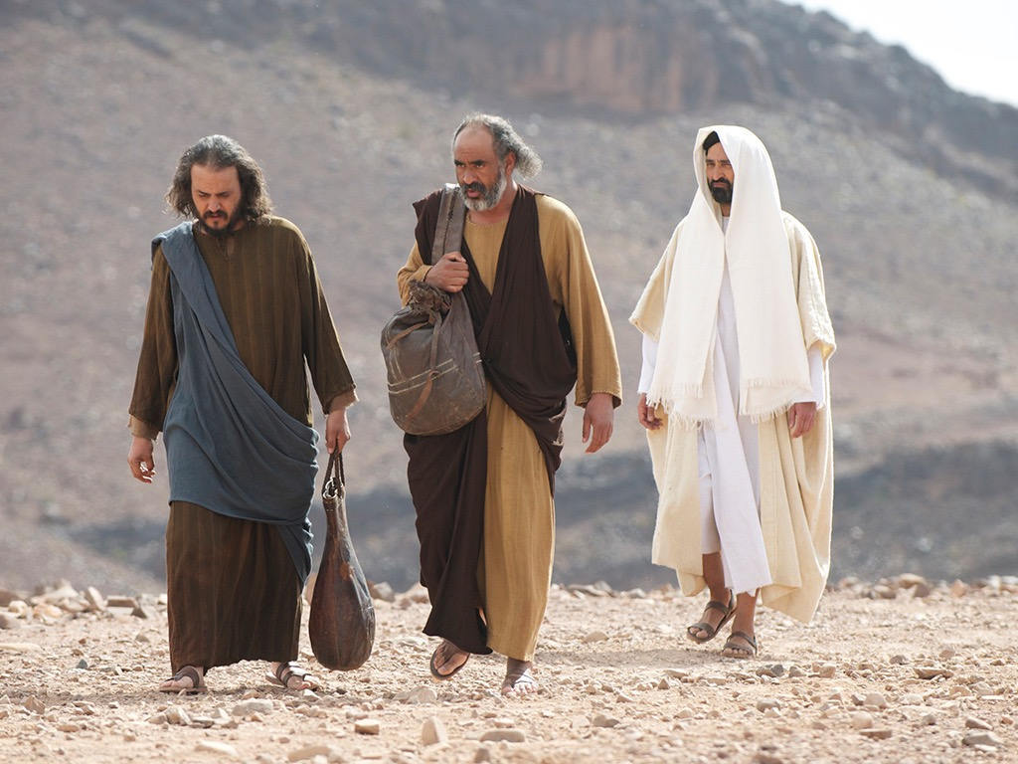
Notes:
As they talked, they noticed a stranger walking beside them. The stranger was Jesus, but the friends were so distracted and upset that they didn’t recognise him.
‘What are you talking to each other about?’ Jesus asked.

Slide 22
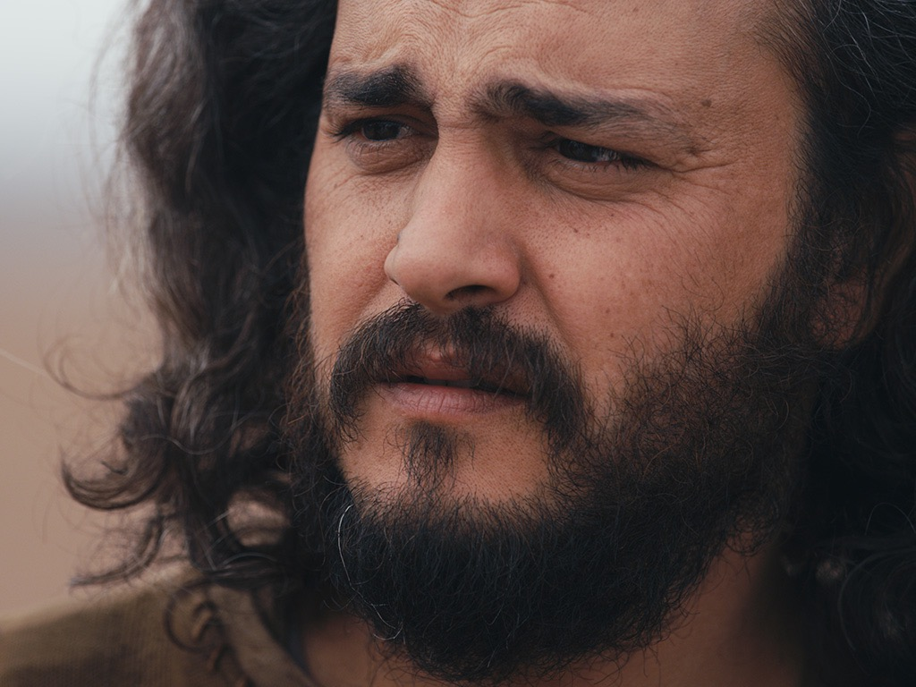
Notes:
‘Haven’t you heard?’ they replied. ‘The whole of Jerusalem has been talking about Jesus of Nazareth, a great teacher and prophet who we’d hoped would be the Messiah-King and save us all.’ And as they continued to walk, they told him all that had happened and how sad they were.

Slide 23
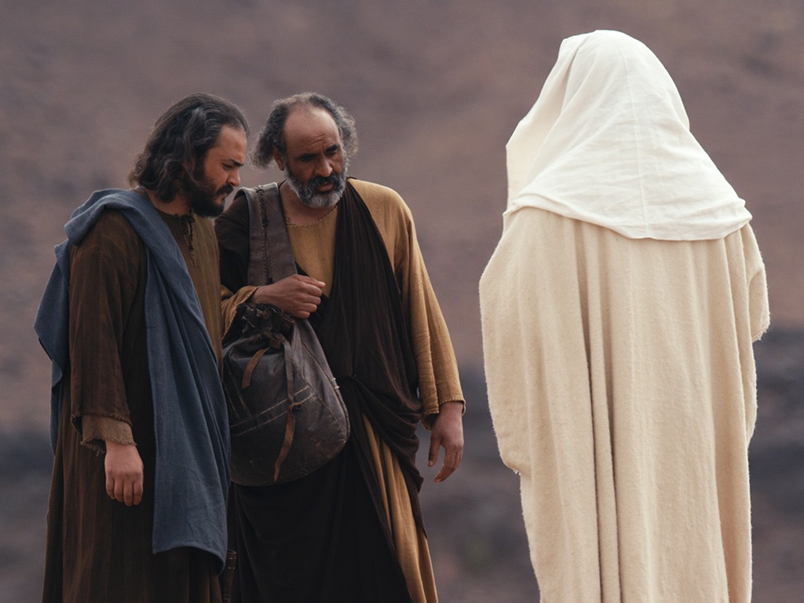
Notes:
Then Jesus said to them ‘Don’t you remember what has been written?’ and then as they walked, beginning with Moses, he explained everything. When they got close to Emmaus, the two friends said to Jesus, ‘Stay with us for a meal so we can carry on talking together.’ But they still didn’t realise it was Jesus.

Slide 24
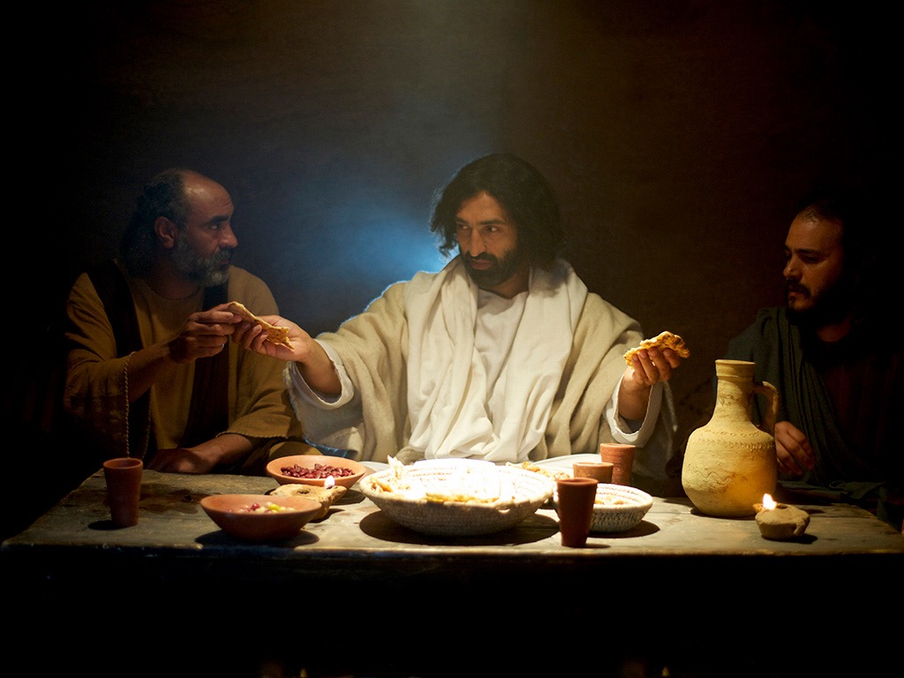
Notes:
When Jesus was at the table with them, he took the bread and gave it to them to eat. At that very moment, they saw who it was who had walked and talked with them: it was Jesus! Then, just as suddenly,

Slide 25
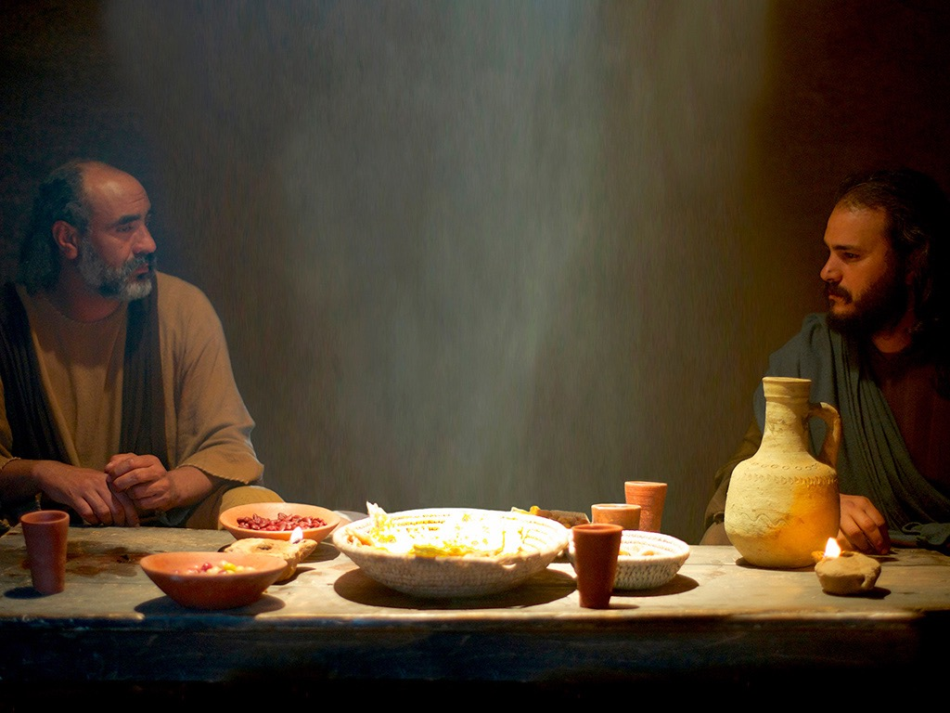
Notes:
…. he was gone again, but instead of being sad they both began to talk at once about what had just happened, and that Jesus was alive! ‘We have to tell the others what we have seen!’ they agreed.

Slide 26
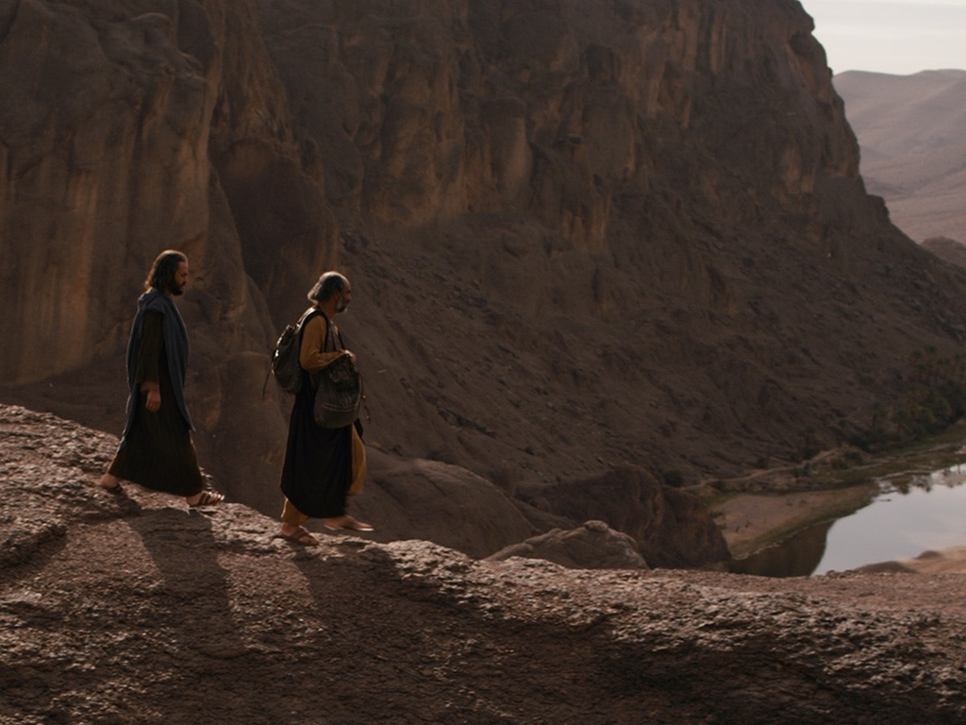
Notes:
And then they ran, not walked back along the Emmaus Road all the way to Jerusalem, to tell everyone what they had seen!

