Slide 1

All images copyright-free from pixabay, unless otherwise identified
Notes:
Slide 1: Sparkling story stilling exercise
Use the stilling slide if desired: the suggested words should be spoken slowly, leaving pauses inbetween to create a sense of stillness.
As you sit quietly, watch the confetti….[PAUSE]
Now practise slower breathing…..in…..and out…..in……and out…..keep this going as you continue to watch….[PAUSE]
You maybe notice that you are feeling calmer and more relaxed….[PAUSE]
As you breathe, think about yourself and what you bring into this time today….. [PAUSE]
We come into this special / sacred space and time to be still….to think deeply…..to be together as a school community…..
In our time together today, we will talk about stories, share a story – about stories!….and then think about stories together.
But first, let’s welcome one another as we begin….

Slide 2

As we gather to share today's story.
As we gather to share today's story.
Leader: As we gather to share our story today….
All: May we grow in our understanding.
Notes:
Slide 2: Use our new gathering words for this term, or your usual greeting if you prefer. These greetings may change slightly each week to reflect the spiritual elements that we will be exploring in each week’s materials.
Leader: As we gather to share our story today….
All: May we grow in our understanding.

Slide 3

Our favourite stories
Notes:
Slide 3: Our favourite stories Today we start a brand new series that will shape our times together, about stories. Before we begin, spend a few moments thinking about your favourites…. [you might want to use Think-Pair-Share to ensure all children have a chance to engage]

Slide 4
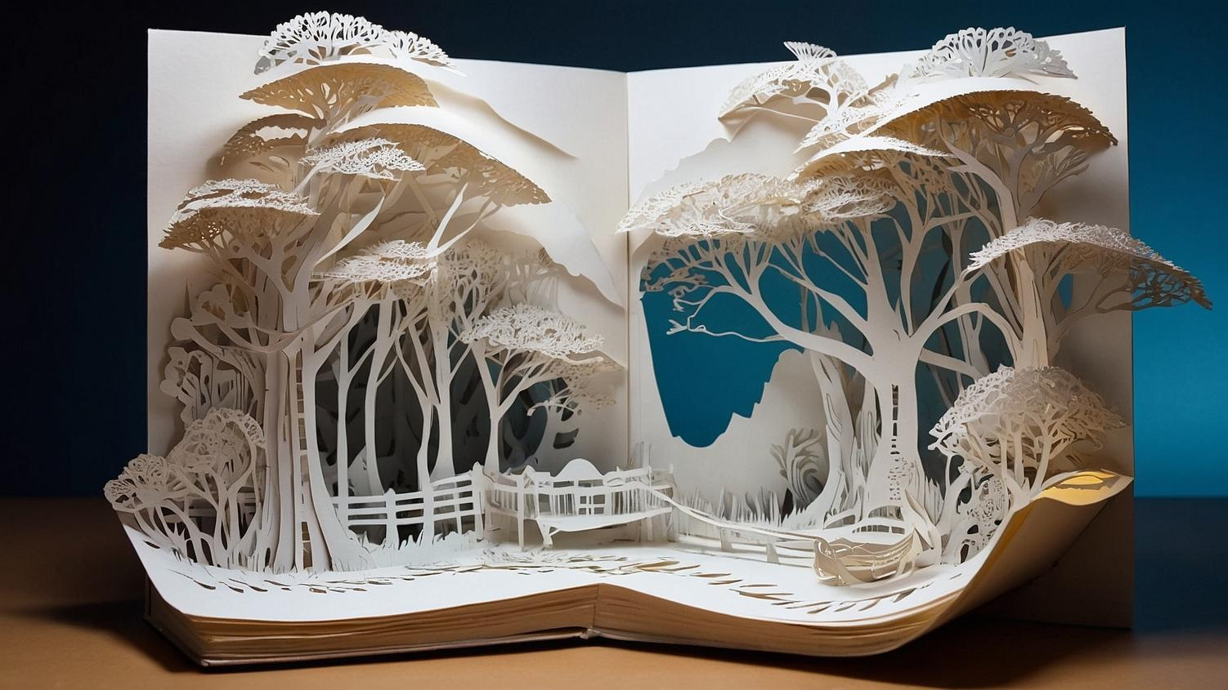
I will speak using stories; I will tell things that have been secret since the world was made.”
Notes:
Slide 4: “I will speak using stories; I will tell things that have been secret since the world was made.” Look at the words (from Matthew 13, quoting a much older verse from Psalm 78); don’t say where it comes from or who spoke the words, yet. Reflect on what ‘secrets’ they think a story might have to share – and whether children think stories are a good way to communicate ideas. You might need to help them with a familiar example from your library.

Slide 5

The power of a story
Notes:
Slide 5: Throughout this term, we will be exploring stories from across time and across the world – all of them with the power to help us to grow. And so today, as we begin this journey together, we are going to share a story….about stories – and about ourselves as human beings – with lots of space for us to wonder and think together….. [use script on p.3-4]
As we shared this story together, I wonder which stories you thought about, which might be the stories that you treasure in your heart?....or stories that have helped you to understand something important? [you might want to allow some talking time here, for children to begin to express their thoughts and ideas]

Slide 6
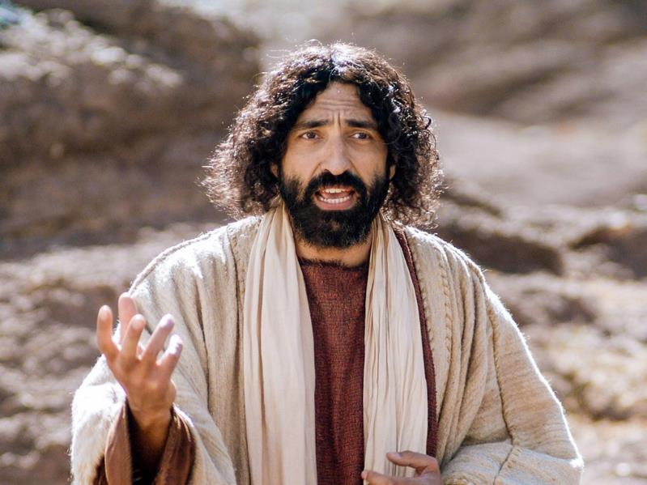

I will speak using stories; I will tell things that have been secret since the world was made.”
Notes:
Slide 6: We heard in our story about one great storyteller from human history – Jesus, who Christians believe is God’s Son, and came to earth to be the Great Rescuer. He spoke the words we looked at earlier: “I will speak using stories; I will tell things that have been secret since the world was made.”
People often asked Jesus big questions about God and what God’s kingdom is like, and he often replied to the question (as he did with many other questions!) by telling them a story – a parable, in fact, which is a story with a hidden meaning, like hidden treasure or a secret to find. During this first half of the term, we are going to be exploring together some of Jesus’ parables. They all mostly come from just one chapter of the gospel of Matthew chapter 13, and like all stories, there are things that will help us to think about ourselves, about others, about our world – and about things that lie beyond our world…..

Slide 7
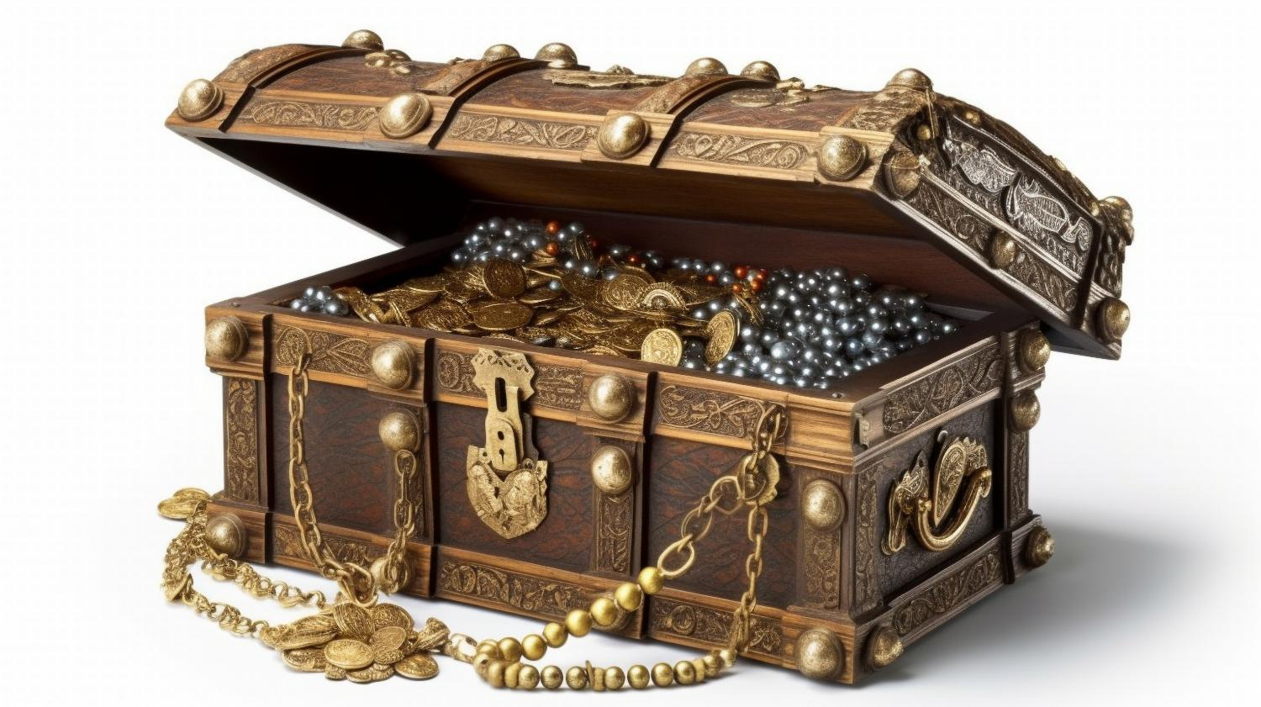
Old treasure, new treasure
Notes:
Slide 7: Old treasure, new treasure
One of the parables that Jesus told was about new and old treasure – about a wise man who gathered valuable things that were both old and new. In this parable, Jesus was helping his listeners to think about the stories and ideas that they collect, like treasure, in their memories and their hearts – and asking them to allow new ideas to be gathered alongside the old. It’s maybe a good idea for us to think about as we begin this new term. So, let’s wonder together now…..

Slide 8
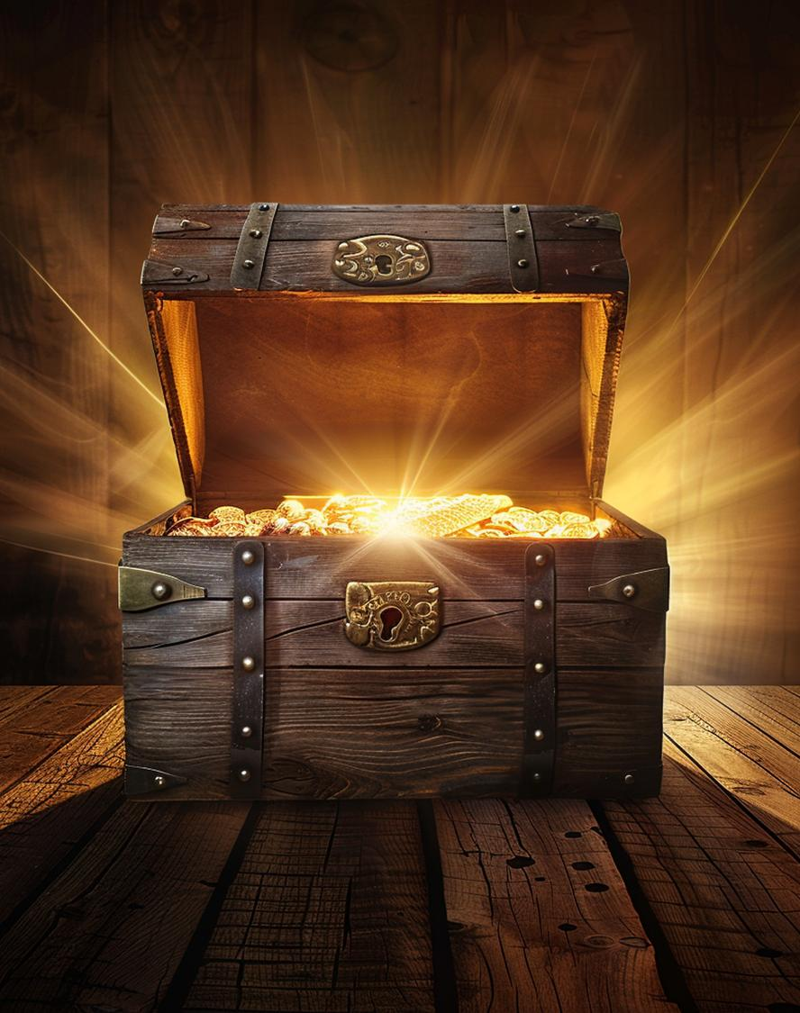
…I wonder which stories have come into your thoughts as we’ve been talking today?.....
…. I wonder how we might feel about discovering these…..and maybe some new ideas and new thinking?.....
Notes:
Slide 8: Responding (and words for worship)
Let’s be still and quiet together now…
…in the stillness, think about the things that you’ve heard today….
….we’ve reflected on the power of stories today….
…I wonder which stories have come into your thoughts as we’ve been talking today?.....
….maybe your favourite, familiar stories which you hold in your heart like treasure…..
.…We heard some words of Jesus about stories that hold secrets for us to find….
….I wonder how we might feel about discovering these…..and maybe some new ideas and new thinking?.....
I’m going to turn my thoughts into a prayer now, as I ask God to help us to put some of these ideas into practice.
Make the prayer your own if you’d like to…or if you’d prefer not to pray, then just sit quietly with your own thoughts.

Slide 9

…may we find treasure, old and new.
…may we find treasure, old and new.
Notes:
Slide 9: There are some words that you can join in with if you’d like to [explain these before using them]. After I say the words ‘In the stories that we share…..’ I invite you to respond with: ‘May we find treasure, old and new.’
Dear God
Thank you for the power of stories in our lives.
In the stories that we share….. May we find treasure, old and new.

Slide 10
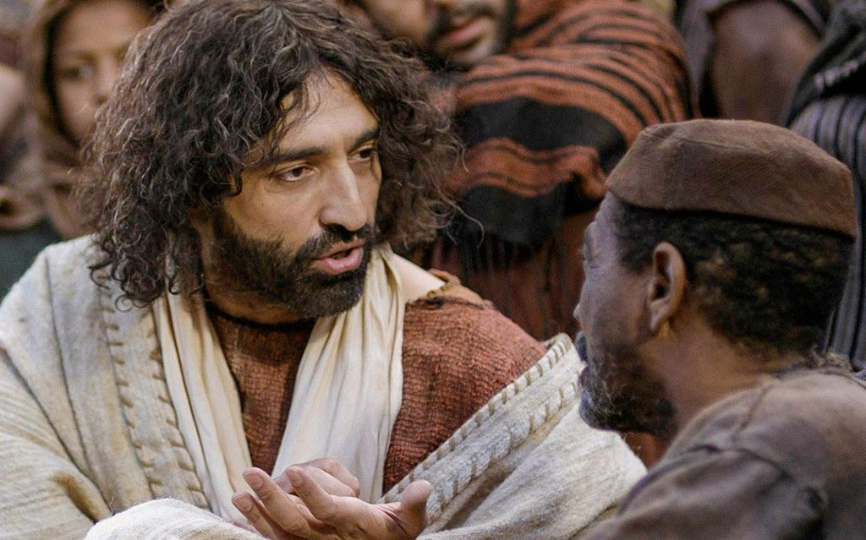

…may we find treasure, old and new.
Notes:
Slide 10: As we explore the parables of Jesus this term;
In the stories that we share….. May we find treasure, old and new.

Slide 11

…may we find treasure, old and new.
Notes:
Slide 11: As we encounter tales from different times and different places;
In the stories that we share….. May we find treasure, old and new.

Slide 12

…may we find treasure, old and new.
Notes:
Slide 12: In our lives together in our school,
In the stories that we share….. May we find treasure, old and new.

Slide 13


Slide 14
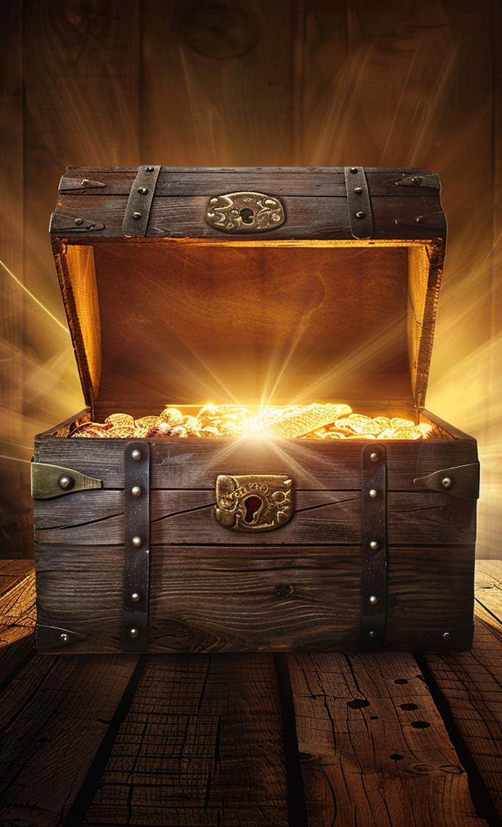


Leader: As we leave this place & time and go into the day ahead…
All: May we find treasure, old and new!
Notes:
Sending: Slide 14
We’re going to use again the words that we have just shared in prayer ‘May we find treasure, old and new.’
Leader: As we leave this place and time and go into the day ahead…
All: May we find treasure, old and new!

Slide 15
Notes:
Slide 15: Reflective areas
In your classroom this week, gather stories that have had an impact…..on individuals, on you as a class, on families at home….or in life.
Do: Bring in a treasured story, or gather them from your class library.
Think: As you look at our shared stories, which ones do you know? Which are new?
Talk: What ‘hidden treasure’ might they share with us? How do stories help us to understand each other, or how to treat others? Share some examples.

Slide 16
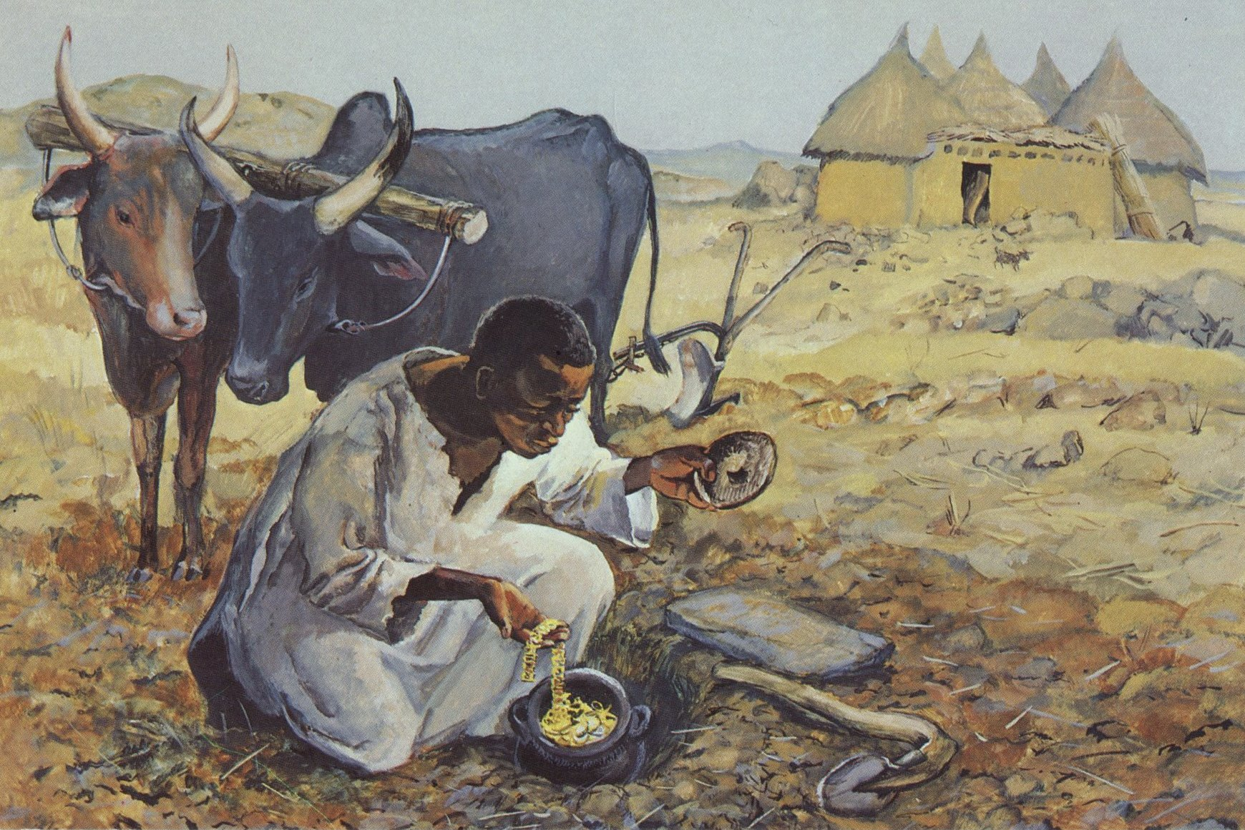
Notes:
Finding the treasure – Jesus MAFA project, Cameroon
Although this is an image that specifically relates to the parable of the treasure in the field, as we are not using this parable in this series, we are borrowing the image to illustrate finding new treasure…..
‘The Life of Jesus Mafa’ is a set of 63 pictures from the life and teaching of Jesus, viewed by the artist as if the events had taken place in a village in Cameroon.
Original source: https://diglib.library.vanderbilt.edu/act-imagelink.pl?RC=48286

