Slide 1

Notes:
Slide 1: Use a greeting that will be familiar to your school community.

Slide 2
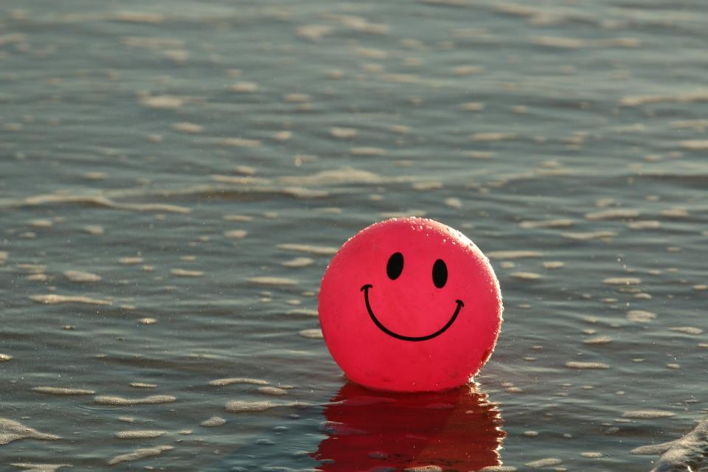

If you’re happy and you know it……
Notes:
Slide 2: I wonder how many of you know how this sentence starter ends: ‘If you’re happy and your know it…..’ [ask some children.]
Hopefully someone will say ‘Clap your hands!’ (Sing the song if you want to!)
Slides 3-9: We’re going to see if we can begin to answer the question, by doing just that, clapping your hands when you see something that makes you happy. If it’s something that makes you a little bit happy, then you can clap really really softly, like this (demonstrate a two-finger clap), or if it’s something that makes you really really happy, then clap like this (demonstrate a more enthusiastic clap) [go through slides or your ideas]

Slide 3
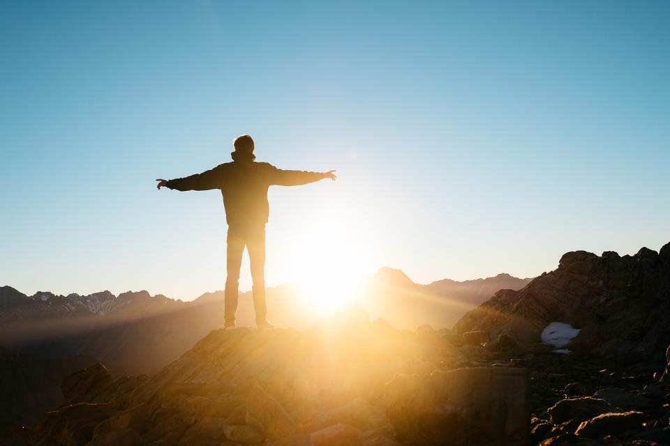
Notes:
….sunshine

Slide 4

Notes:
…rain

Slide 5
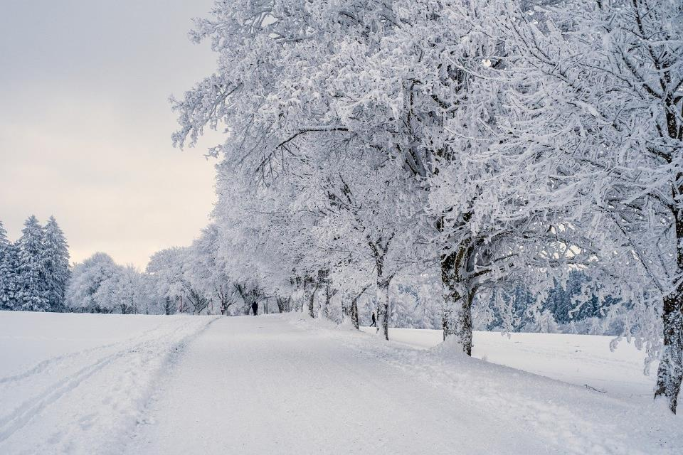
Notes:
…snow

Slide 6
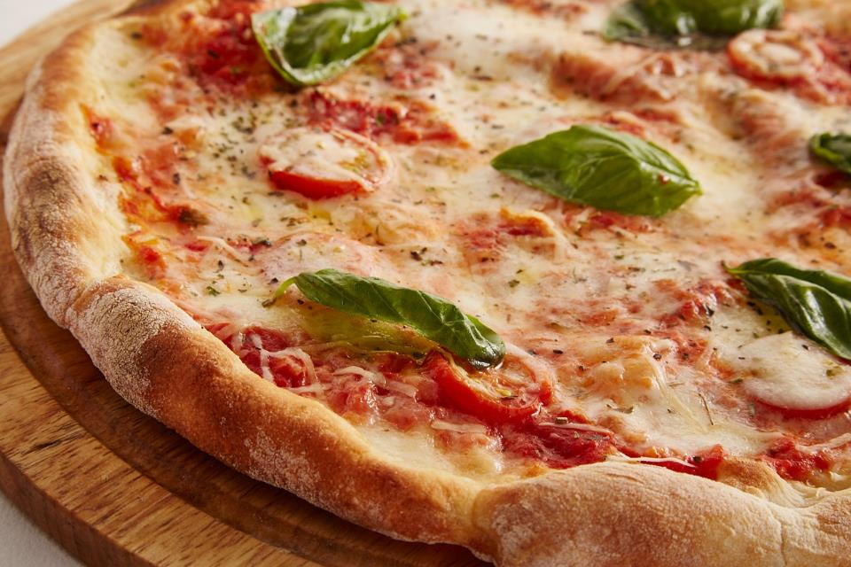
Notes:
…..pizza!

Slide 7
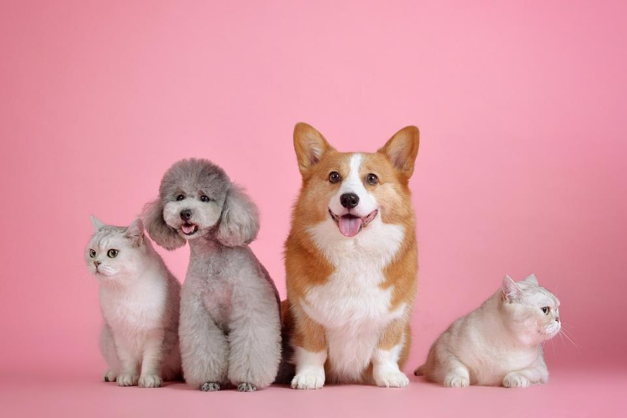
Notes:
….pets

Slide 8
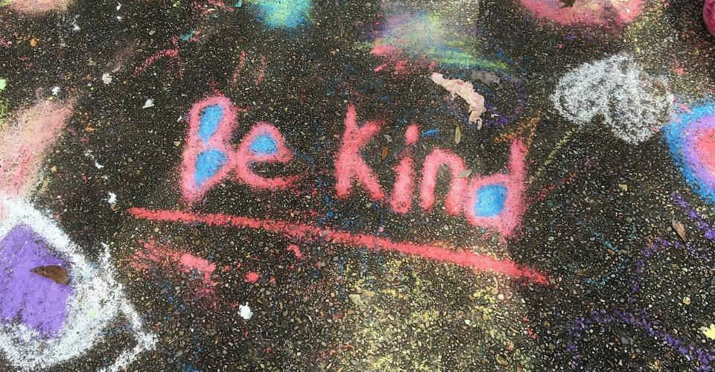
Notes:
…..being kind

Slide 9
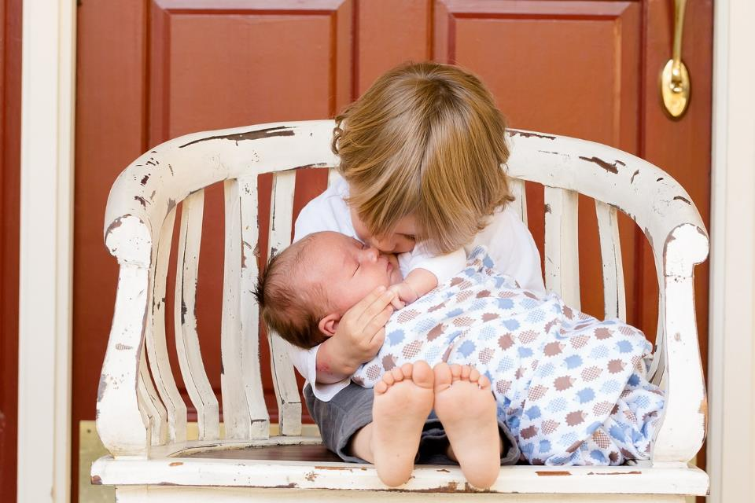
Notes:
….family

Slide 10
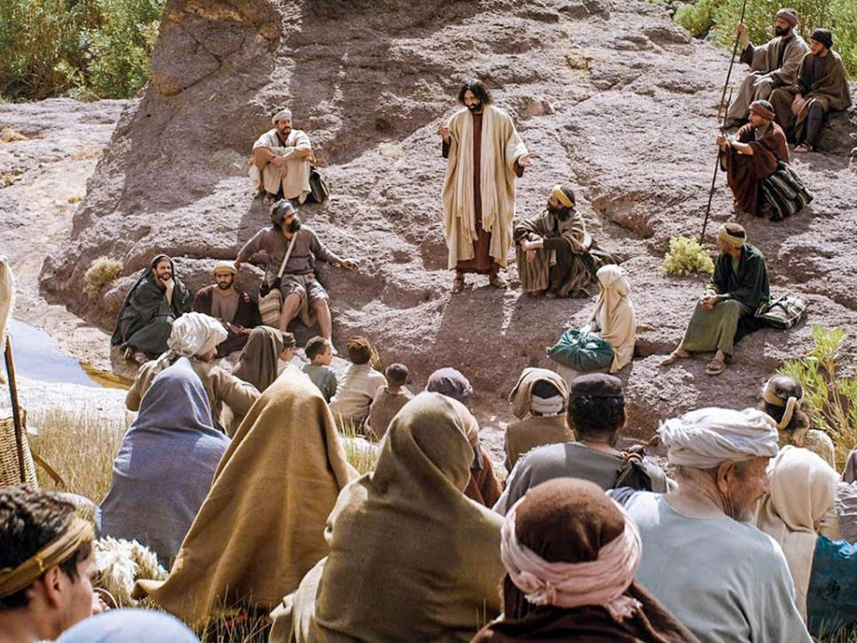
Notes:
Slide 10: It probably doesn’t surprise you to know that Jesus had a few things to say about happiness and where it might be found. Next week, we will be hearing the story of an occasion that is known as the ‘Sermon on the Mount’, which as you may have gathered from the title, takes place on a mountain, a bit like this one….!!

Slide 11
Our school values
Notes:
Slide 11: At the start of this new term, it’s always good to stop and reflect on the things that help to make our school a happy place for everyone. Here are our important values [and vision, if appropriate. Add these to this slide]
Let’s talk together about how these help us to work together as a school community – and make some promises to each other to do our best to live by these values during this school year.

Slide 12
….I wonder how our school values might help to make our community a happy place for everyone?....
….I wonder what difference they make to the way we live and work together?.....
Notes:
Slide 12: TALKING SLIDE ….I wonder how our school values might help to make our community a happy place for everyone?....
….I wonder what difference they make to the way we live and work together?.....

Slide 13

We promise….
Notes:
Slide 13: [optional] Create a school values promise ‘contract’, where you can simply agree to do your best to live by your school’s values this year. You will need to word this for yourselves, in order for it to be appropriate to your context.

Slide 14
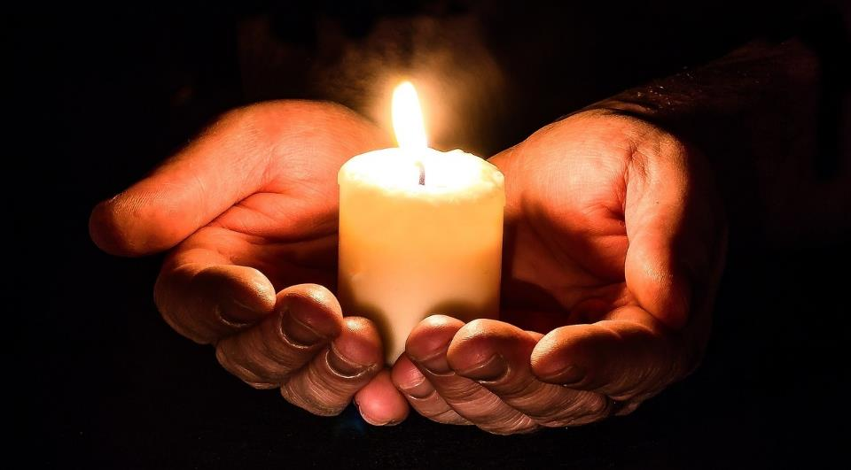
Notes:
Slide 14: Responding and words for worship
We’re going to be still with our own thoughts now……and think about how what we’ve heard and talked about might help us in our school community today….
We’ve been thinking about the many different things that makes us happy, and the way that our school values help us to do this as part of this community, where we live and work together.
[optional: We’ve also made a simple promise to each other to do our best to live by these values throughout this year]
Hold these values quietly in your heart now…..

Slide 15
You will be truly happy if….
Dear God
Thank you for our school’s values and how they help our school to be a happy place for everyone.
Please help us to live well together this year and to do our very best to keep the promises we have made.
Notes:
Slide 15: We’ve heard that Jesus also had something to say about how to live well together, when people gathered on the mountain to hear him teach. As we’ll hear next week, he said ‘You will be truly happy if……’
….I wonder how you might finish that sentence?....
[leave some quiet space for children to think]
Opportunity for reflection / prayer
I’m going to pray now. If this is something that you feel comfortable doing, then find a way to make the words your own. If you don’t want to pray, then use the quiet to be still with your own thoughts.
Dear God
Thank you for our school’s values and how they help our school to be a happy place for everyone.
Please help us to live well together this year and to do our very best to keep the promises we have made.

Slide 16
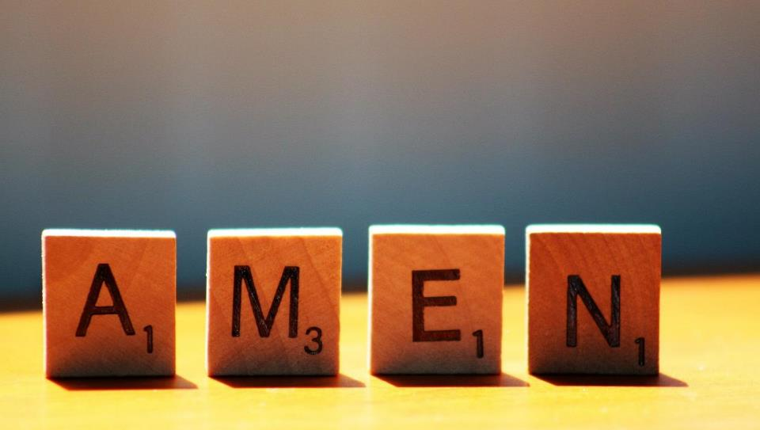

Slide 17
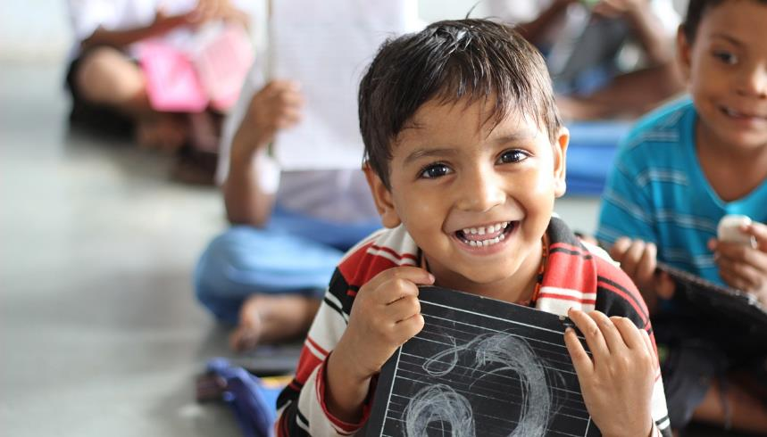


Leader: As we leave this place & time and go into the day ahead…
All: May our school’s values help each one of us to be happy.

Slide 18

Notes:
Slide 18: Reflective areas
Draw around your hand, write inside things that make you happy. Turn your thoughts into a prayer if you’d like to.

