Slide 1





All pictures copyright-free from pixabay
Notes:
Slide 1: Candle flame stilling exercise
Use the stilling slide if desired: the suggested words should be spoken slowly, leaving pauses inbetween to create a sense of stillness.
As you sit quietly, watch the candle flame flicker….[PAUSE]
Now practise slower breathing…..in…..and out…..in……and out…..keep this going as you continue to look at the flame….[PAUSE]
You maybe notice that you are feeling calmer and more relaxed….[PAUSE]
We come into this special / sacred space and time to be still….to think deeply…..to be together as a school community…..
In our time together today, we will find out how different places in the world celebrate New Year, think about some words from the Bible, and reflect together on new beginnings.
But first, let’s welcome one another as we begin….

Slide 2
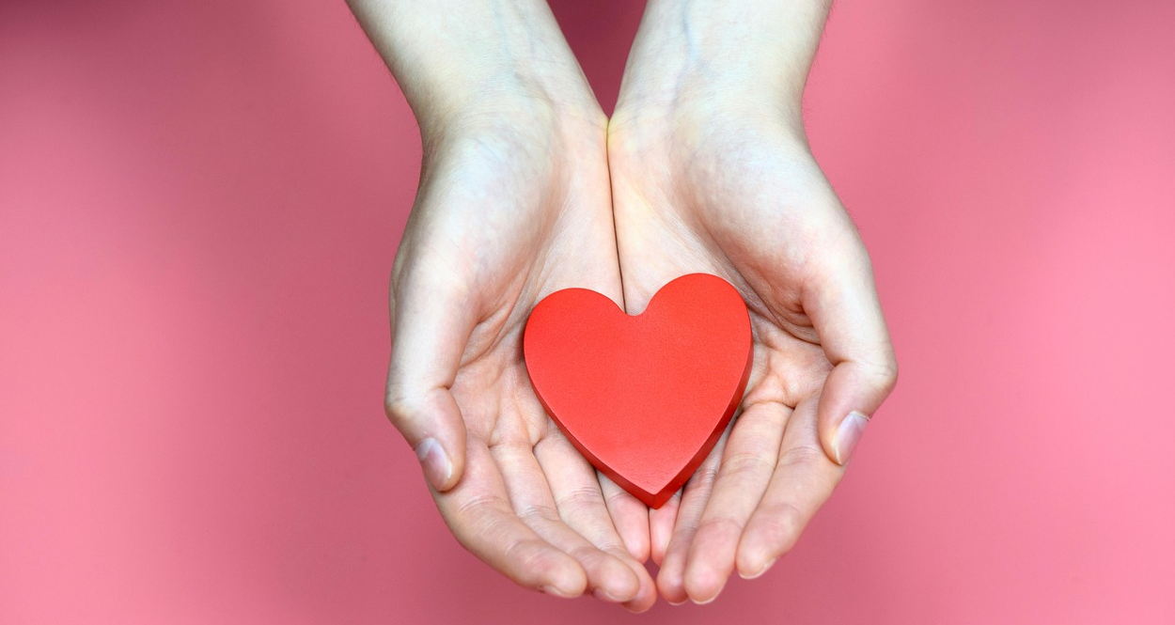
Leader: As we gather together today…
ALL: …we bring our thoughts and our hearts into this sacred space.
Notes:
Slide 2: Gathering
Today, we have some new words to say together….[teach them, using the BSL suggestions if desired]
Leader: As we gather together today….
ALL: ….we bring our thoughts and our hearts into this sacred* space.
Here are BSL actions for some of the words:
Leader’s words:
Gather: https://www.signbsl.com/sign/gather (1st video)
Today: https://www.signbsl.com/sign/today (1st video)
Pupils’ response:
Thoughts: https://www.signbsl.com/sign/thoughts (1st video)
Hearts: https://www.signbsl.com/sign/heart (1st video)
*NB The word sacred means ‘set apart’: for many people, this might have something to do with God, but we want to use this word here intentionally, to help communicate that the time that you spend together in collective worship/assembly is a special time for your school community, set apart from the busy-ness of the school day.

Slide 3

Notes:
Slide 3: The start of a new year is traditionally a time of new beginnings – a time to look back and be grateful, and a time to look forwards in anticipation. Today, we are going to do both of those things together….
We’re going to start by finding out how the new year is welcomed in across the world….

Slide 4
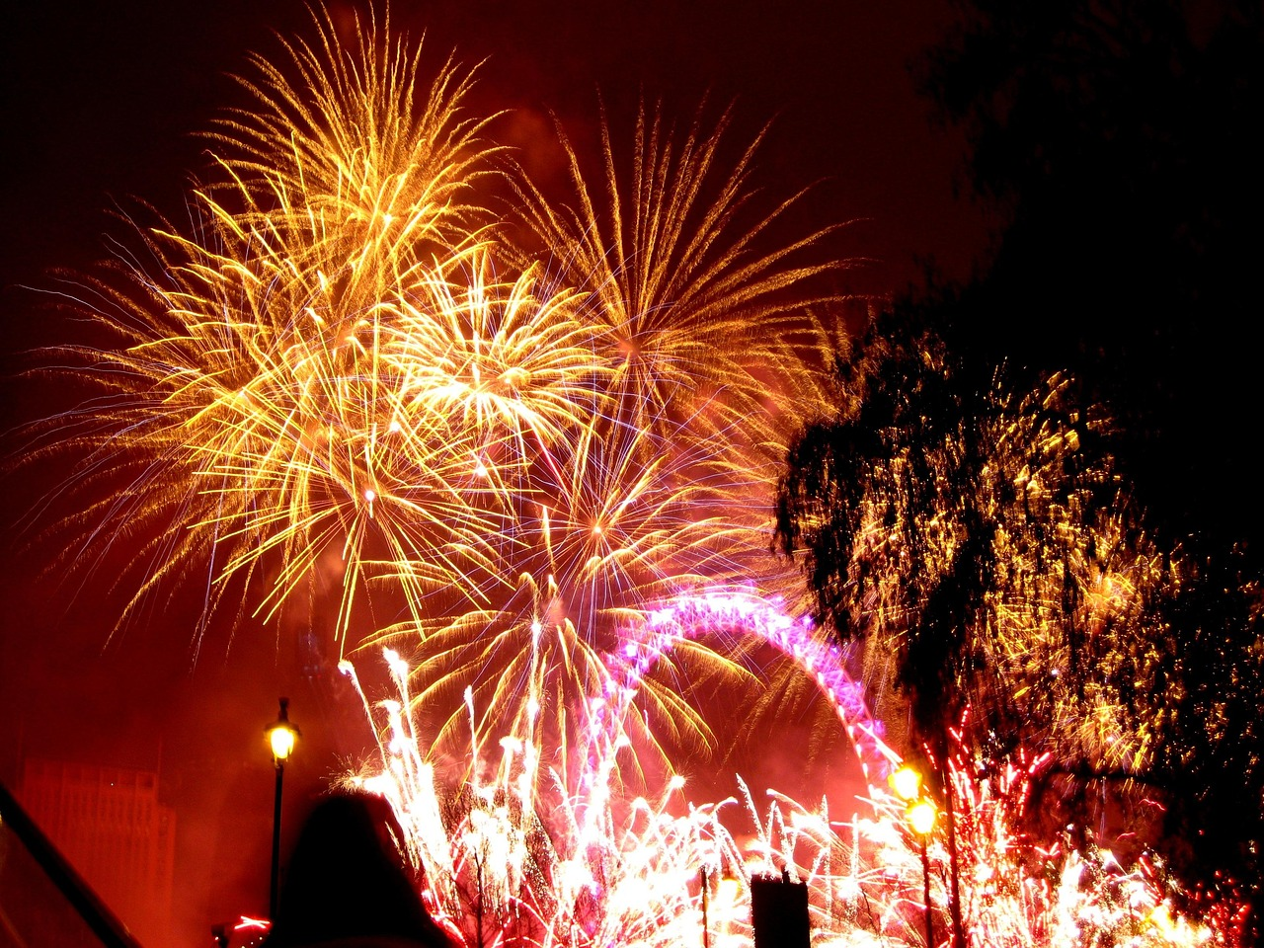
Notes:
Slide 4: Here in the UK, you will often see fireworks as Big Ben in London strikes 12 on the first day of the New Year.

Slide 5
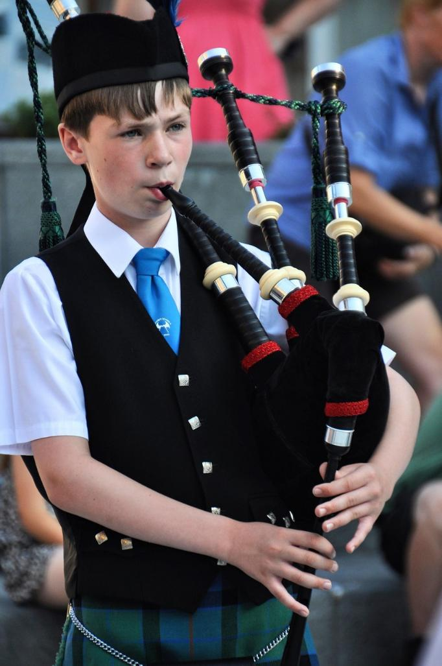
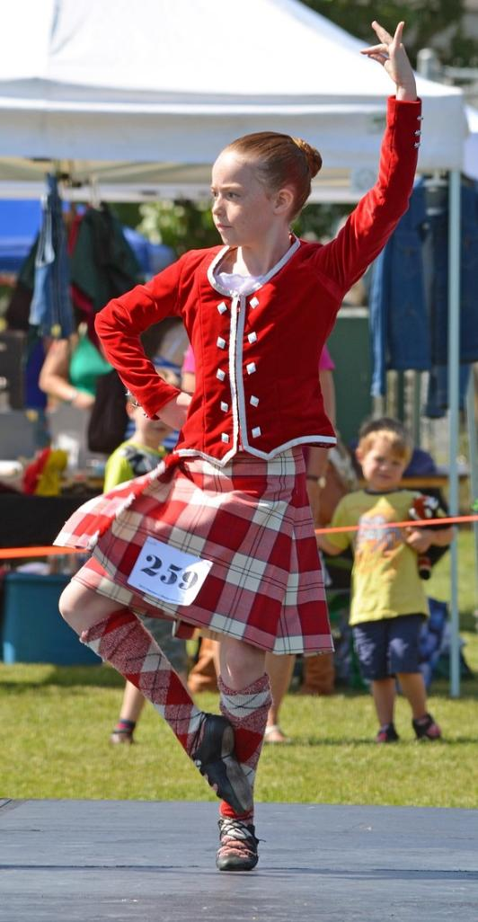
Notes:
Slide 5: …..or in Scotland, you might hear bagpipes playing and take part in a Ceilidh (pronounced kay-lee)

Slide 6
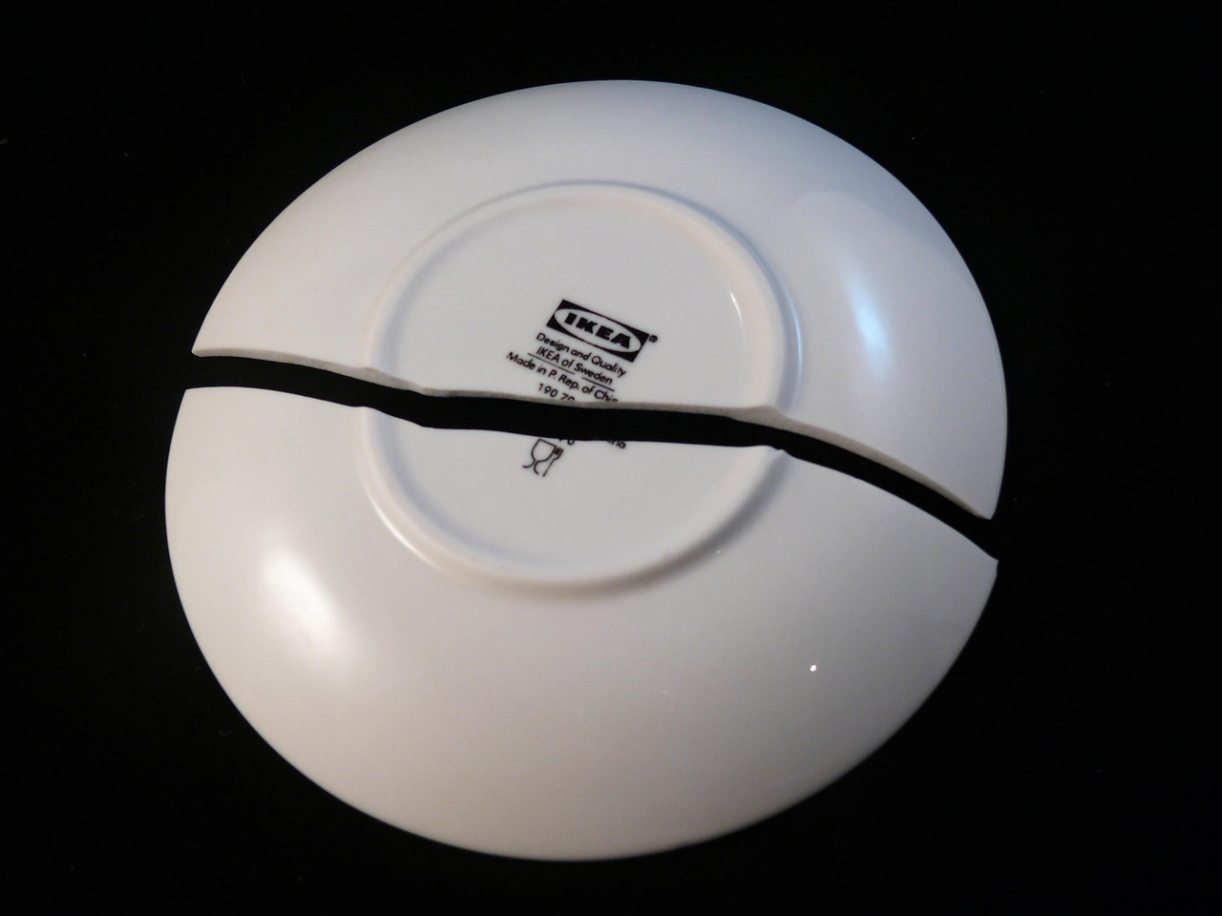
Notes:
Slide 6: If you are Danish, you might smash a plate on a friend’s doorstep to bring them good luck in the New Year! [apologies for the product placement here!]

Slide 7
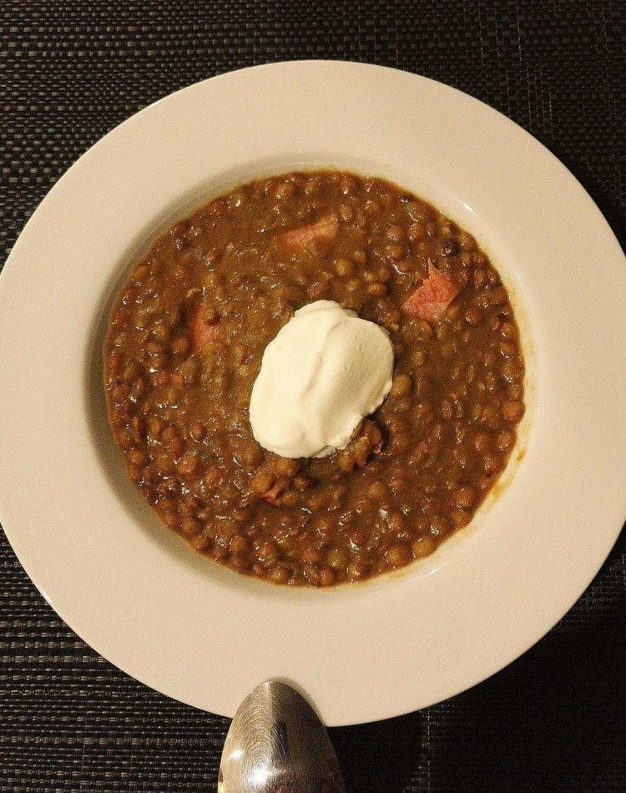
Notes:
Slide 7: In Brazil, people traditionally eat lentils, symbolising wishes for good fortune for the New Year.

Slide 8
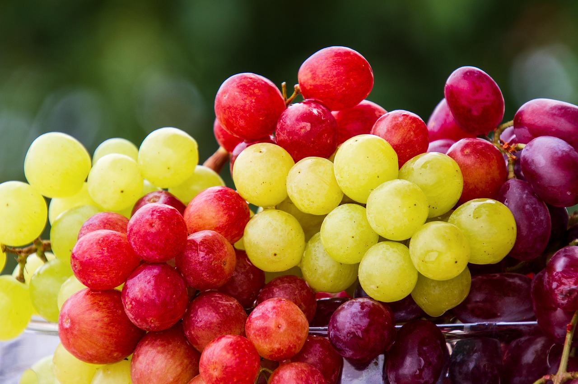
Notes:
Slide 8: In Spain, eating grapes is the thing to do: one each time the clock strikes midnight.

Slide 9

Notes:
Slide 9: In some South American countries, you might see people wandering around with empty suitcases, as they symbolise the desire for new adventures in the New Year.

Slide 10
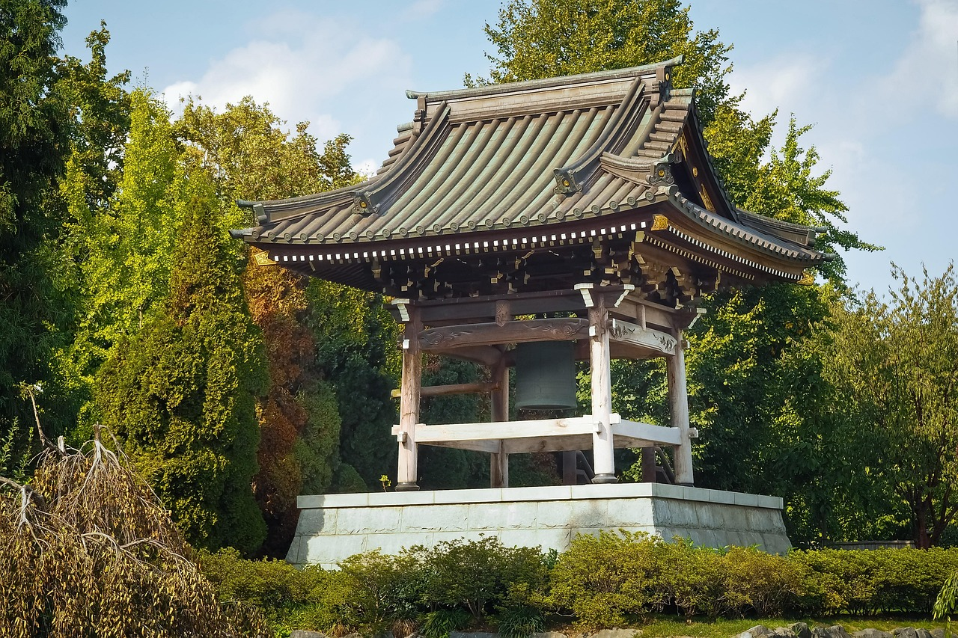
Notes:
Slide 10: And in some countries like Japan and Korea, it’s traditional to ring a big bell like this to ring in the New Year. In Japan, the bell is rung 108 times, so it’s quite a noisy way to celebrate!

Slide 11
Notes:
Slide 11: What all these traditions show is a desire for good things for a new year – it’s a universal expression of what it means to be a human being. [you might like to find out about any traditions from cultures you have represented in your own school community, or give pupils a chance to say how they celebrate the new year in their family, if they do this] A new year feels like a fresh beginning, and so people will often make New Year Resolutions where they promise to live well, or be a better person, or take up a new hobby. I wonder if any people you know have done this? [allow a few moments to discuss’] We are also beginning a new series together this term, and we will share new stories, new ideas, and new challenges. As we start this brand new year, we are going to pause and be still again for a few moments to reflect…..

Slide 12

….As you look back, I wonder what you are grateful for?....
….I wonder what you would wish or pray for this new year, 2026?....
....I wonder what you might like to be different about 2026?....
Notes:
Slide 12: Responding and words for worship
We’ve thought about the different ways in which the New Year is welcomed in across the world. Everywhere, people share their hopes and dreams…..
As you are still and quiet, I want you to think back over 2025…..
….I wonder what you are grateful for about last year, 2025?....
….I wonder what you would wish or pray for this new year, 2026?....
....I wonder what you might like to be different about 2026?....

Slide 13
…wise people will shine like the brightness of the sky. Those who teach others to live right will shine like stars forever and ever.
Daniel 12:3
Notes:
Slide 13: These words are over 2000 years old and written in a book in the Old Testament containing stories about a man called Daniel. Next week, we will hear more! Let me read you the words [repeat them if needed]:
…wise people will shine like the brightness of the sky. Those who teach others to live right will shine like stars forever and ever.
I wonder how these words might help us as we begin a new year? I wonder what it might mean for us to ‘shine like stars’ in 2026? I wonder how our actions might teach others to live well?....

Slide 14
Help us to shine!
Notes:
Slide 14: Opportunity for reflection/prayer
I’m going to use some words to help us to pray about this new year, and ask for God’s blessing over some of the people who are important to us. If this is something that you would like to join me with, then you will see these words ‘Help us to shine!’ throughout the prayer – do join in with them if you would like to.

Slide 15

Notes:
Slide 15: In the way that we care for one another…..

Slide 16
Help us to shine!
Notes:
Slide 16: ‘Help us to shine!’

Slide 17
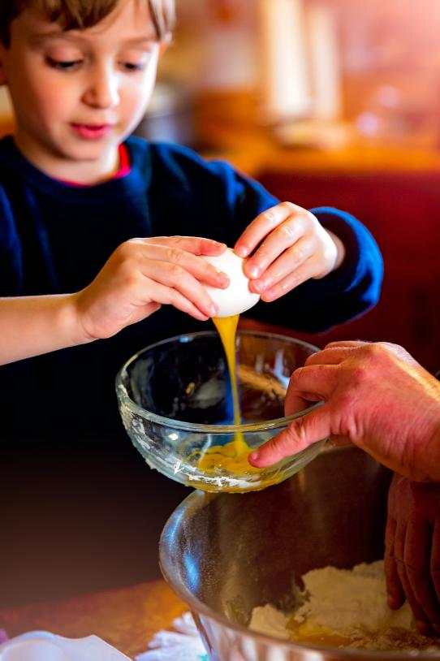
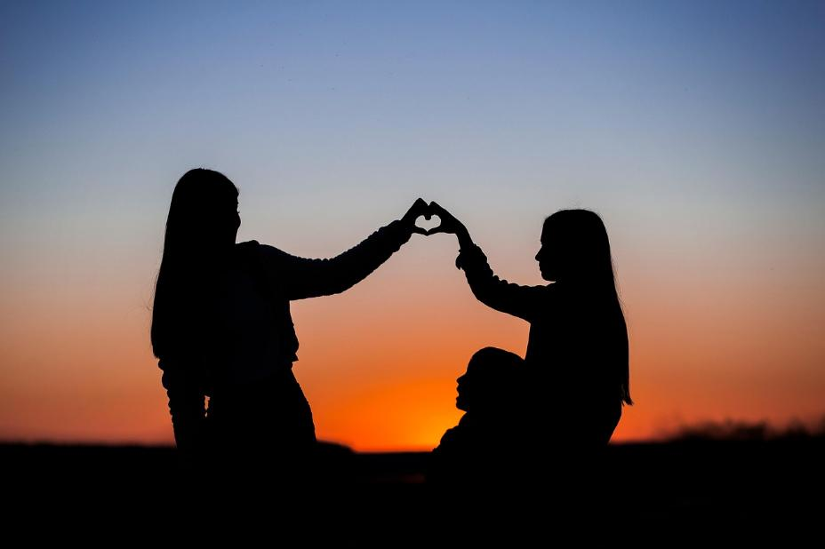
Notes:
Slide 17: In our homes and with our families….

Slide 18
Help us to shine!
Notes:
Slide 18: ‘Help us to shine!’

Slide 19
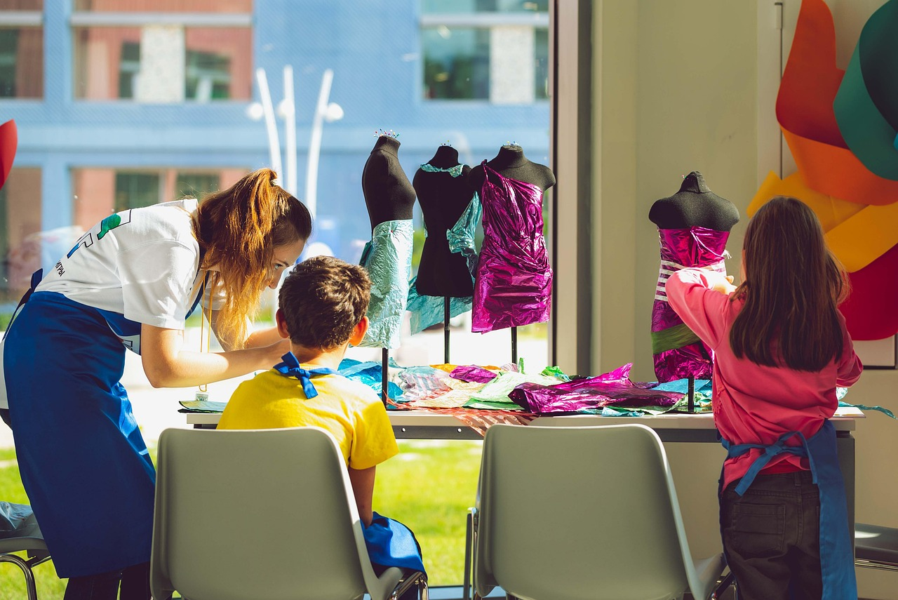
Notes:
Slide 19: In our work and in our classrooms….

Slide 20
Help us to shine!
Notes:
Slide 20: ‘Help us to shine!’

Slide 21
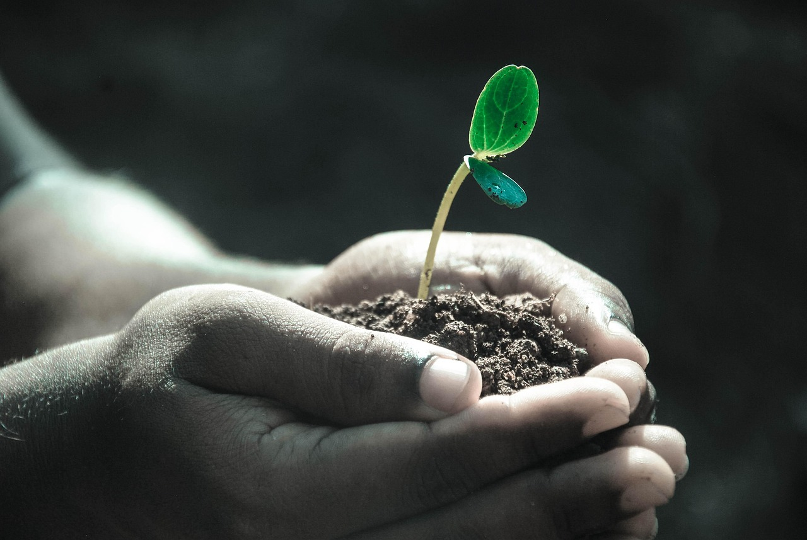
Notes:
Slide 21: In how we care for the world that is our home….

Slide 22
Help us to shine!
Notes:
Slide 22: ‘Help us to shine!’

Slide 23
Notes:
Slide 23: Throughout this new year….

Slide 24
Help us to shine!
Notes:
Slide 24: ‘Help us to shine!’

Slide 25


Slide 26
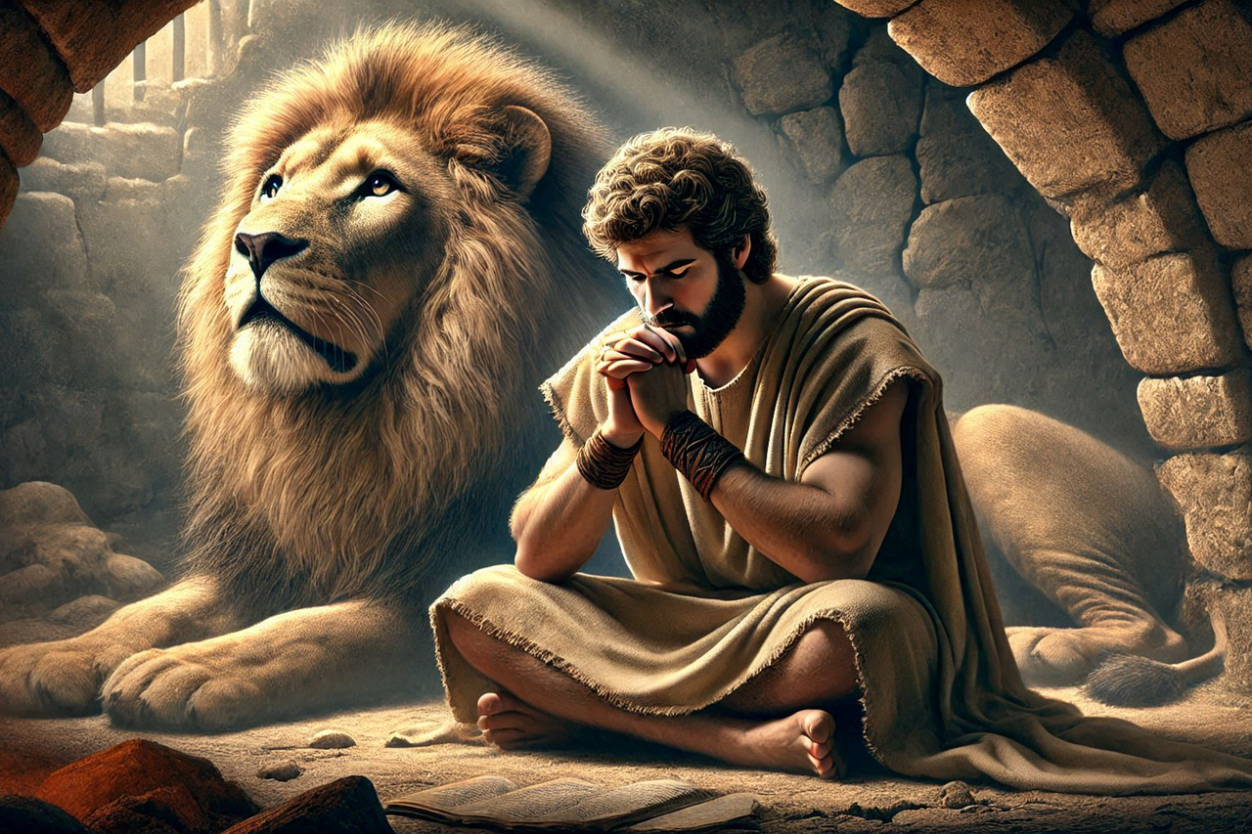
Shine like stars!
Notes:
Slide 26: Shine like stars!
Next week, we will begin a new series based on the story of a man named Daniel who lived through challenging times. You heard some words from the part of the Bible where this story is written earlier, and we will be finding out some of the things that helped him to ‘shine like a star’. And yes…..there will be lions!!

Slide 27


Leader: As we leave this place & time and go into the day ahead…
All: May we shine like stars!
Notes:
These are the new sending words for this term.
Sending: Slide 27
Leader: As we leave this place & time and go into the day ahead…
All: May we shine like stars!
Pupils’ response:
Shine: https://www.signbsl.com/sign/shine (4th video)
Stars: https://www.signbsl.com/sign/stars (4th video)

Slide 28
Notes:
Slide 28: Reflective areas
Think: What are you looking forward to in this new year?
Talk: What might you wish for your family, your school, or our world in 2026?
Do: Take a star shape and write or draw your thoughts on it. You might want to hang these up in your classroom.

