Slide 1





We are here together in our school family. May God be with us…
...and watch over us.
Notes:
Slide 1: Use these new gathering words for this term, or your usual greeting if you prefer.

Slide 2
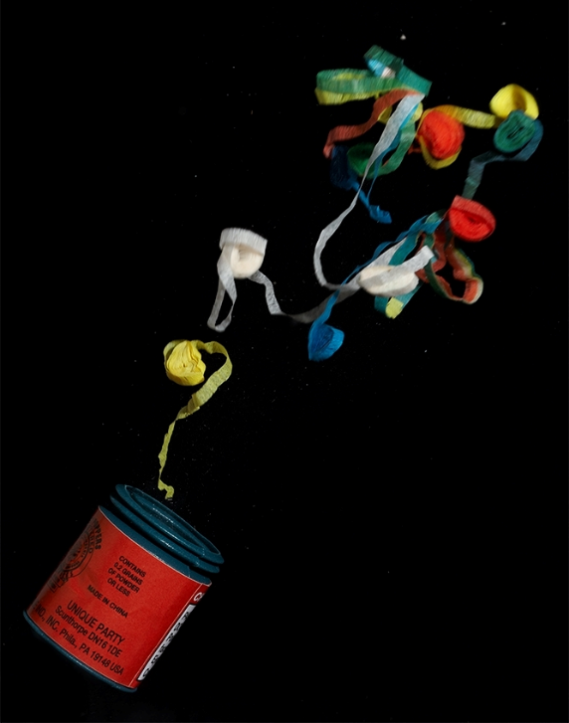
Happy New Year!
Notes:
Slide 2: Happy New Year!!!

Slide 3
2022
Notes:
Slide 3: ‘Welcome to 2022! At this time of year – as a brand new year starts – we often take time to think back over the year that’s just ended.

Slide 4
Notes:
Add your own slides of school / other events to look back on.

Slide 5
2021
Notes:
Slide 5: For many of us here, there will have been big milestones during 2021….. special birthdays….learning to read…..or swim…..or play an instrument….. I wonder what you might say has been the most memorable moment in your year? [ask a few children / adults if time allows]

Slide 6

Notes:
Slide 6: Another thing that we sometimes do at the start of a new year is to think ahead....about things we’d like to happen….. or hopes that we have…..or things we’d like to get better at…People call this making ‘New Year’s Resolutions’. We’re going to think some more about this now – and what it might mean for us…..

Slide 7

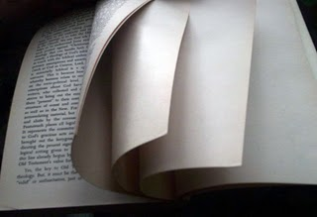
‘turning over a new leaf’
Notes:
Slide 7: People sometimes say that at the start of a new year, they are going to ‘turn over a new leaf’. What a strange thing to say! I wonder what you imagine that might mean?....
‘Turning over a new leaf’ is an old phrase that means we are starting again – like turning to a clean, new page in your writing book. It means that we can leave behind in the old year the things that we know we haven’t done so well and make a fresh start. The Bible is full of stories about Jesus giving people a chance to start again – to leave their ‘old’ lives and begin again.

Slide 8
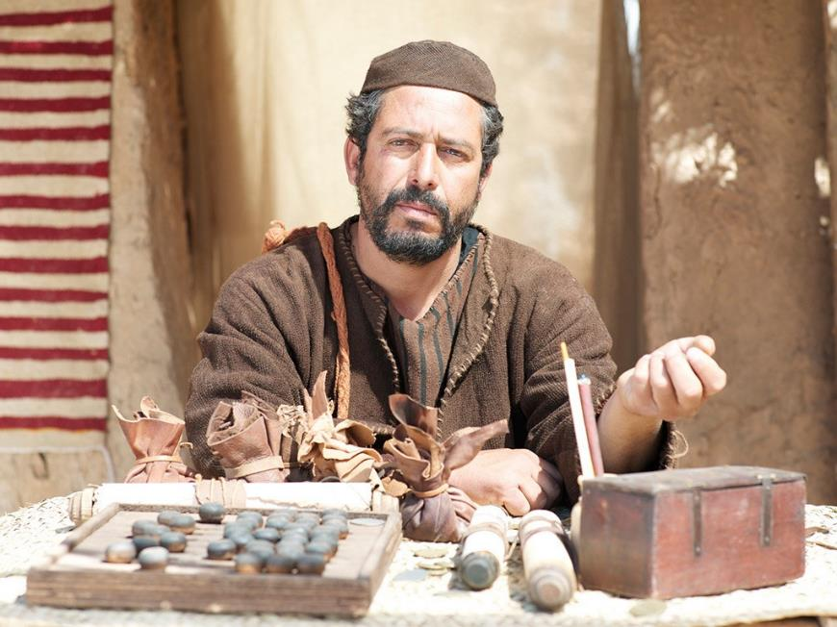
Notes:
Slide 8: Matthew, one of Jesus’ disciples, was one of the most unpopular people in Jesus’ home town of Nazareth, because he was a tax collector. But Jesus gave him a chance to start again…. and Matthew became one of Jesus’ closest friends: in fact, it’s thanks to Matthew that we know many of the things that Jesus did, because he wrote them down in the book of the Bible named…..MATTHEW! Matthew was only one of a whole host of people who Jesus offered a new start to: and a new year gives us an opportunity to do the same for others, and for ourselves.

Slide 9

Notes:
Slide 9: I wonder what ‘turning a new leaf’ might look like for us at the start of 2022? Here are a few ideas to get us started [use the leaf shapes you have made, including the blank one at the end….]

Slide 10

turn over
a new leaf
Notes:
Slide 10: Responding (words for worship):
Let’s be still and quiet together now….
…in the stillness, think about the things that you’ve heard today, and decide for yourself on something you might want to make as your new year resolution at the start of this brand new year…..something that you might write onto this new leaf….
….maybe it’ll be a new skill you’d like to develop…..
…..something that you want to get better at…..
…..or something you could do to help someone else…..
…..or for the world around us…..
…..or to make this school, or our world, an even better place to be…..
I’m going to turn my thoughts into a prayer now, as I ask God to help us to put some of these ideas into practice. Make the prayer your own if you’d like to…or if you’d prefer not to pray, then just sit quietly with your own thoughts.

Slide 11
Notes:
Slide 11:
Dear God
Thank you for 2021, the old year that lies behind us, and for all the memories it’s made. Thank you for this new year, 2022, the year that lies ahead of us now – and for all that this new year might be. Help us as we make our resolutions and ‘turn over a new leaf’. Help us to work on them, whatever they might be, so that our families, our school and our world is a better and happier place for everyone.

Slide 12


Slide 13



turn over
a new leaf
Leader: As we leave this place & time and go into the day ahead…
All: Let’s turn over a new leaf!
Notes:
Sending: Slide 13
Leader: As we leave this place and time and go into the day ahead…
All: Let’s ‘turn over a new leaf’!

