Slide 1
On the journey of life….
....we are glad to be together as a school community.
Notes:
Slide 1: Use these gathering words for this term, or your usual greeting if you prefer. Why not invent some actions to make them extra memorable?!

Slide 2
As we gather today….
....may we learn from each other and hear from God.
Notes:
Slide 2: Use these gathering words for this term, or your usual greeting if you prefer. Why not invent some actions to make them extra memorable?!

Slide 3
Moses: Are we nearly there yet?!
Autumn 2023
Notes:
Slide 3: Last week, we heard how God gave Moses ten good rules to help the people to live well together. We have been thinking through this past week about rules that are important to us, so I wonder what conclusions you’ve come to about why rules are important – here in school, as well as in life? [talk together, based on your classroom findings]
So, now let’s rejoin our Moses saga, where we left Moses up the mountain….. We’re going to take this story much slower today, and spend some time pondering some really big questions as we go through. [so we’ll be ‘wondering’ throughout the story]
It’s really important to remember that as we begin this part of the story, we know about the Ten Rules – but Moses has not come back to the people yet…

Slide 4
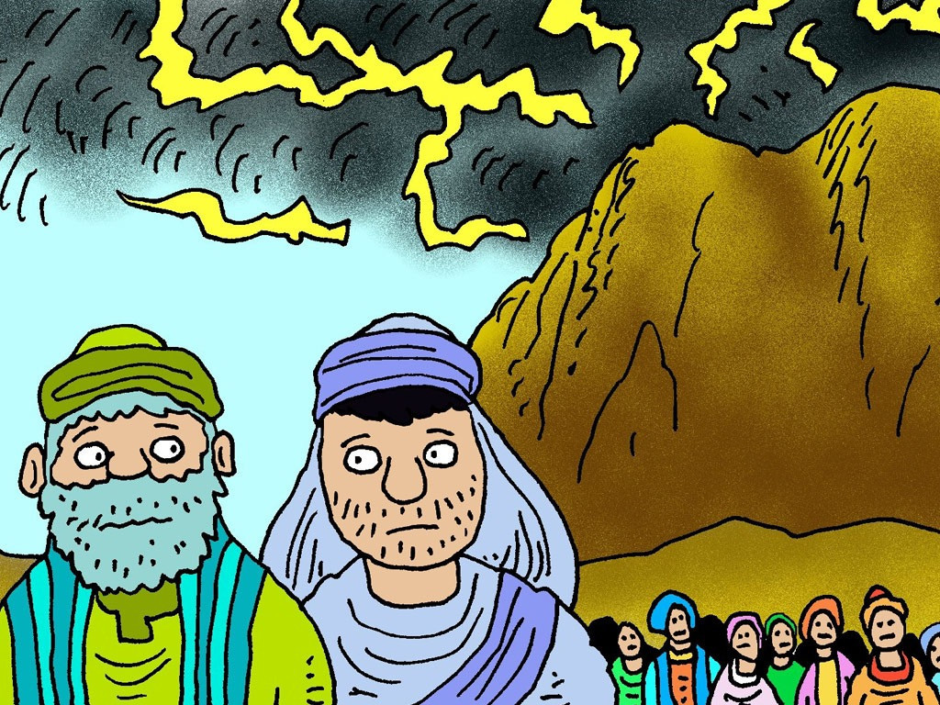
I wonder what the people are thinking about?
Notes:
Slide 4: Aaron and Joshua were left in charge of the people of Israel, while Moses went up Mount Sinai to talk to God. Aaron was Moses’ brother, who had been helping Moses to lead the people.
The people waited for a very long time for Moses to come back again.
I wonder what the people are thinking about?

Slide 5
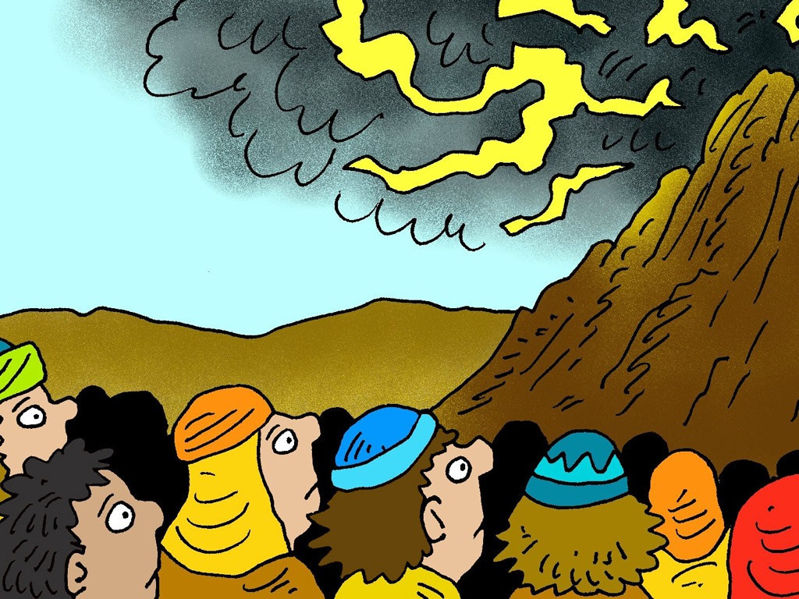
Notes:
Slide 5: They waited 40 days for Moses to come back down the mountain. It seemed so long that they thought he must have died.

Slide 6
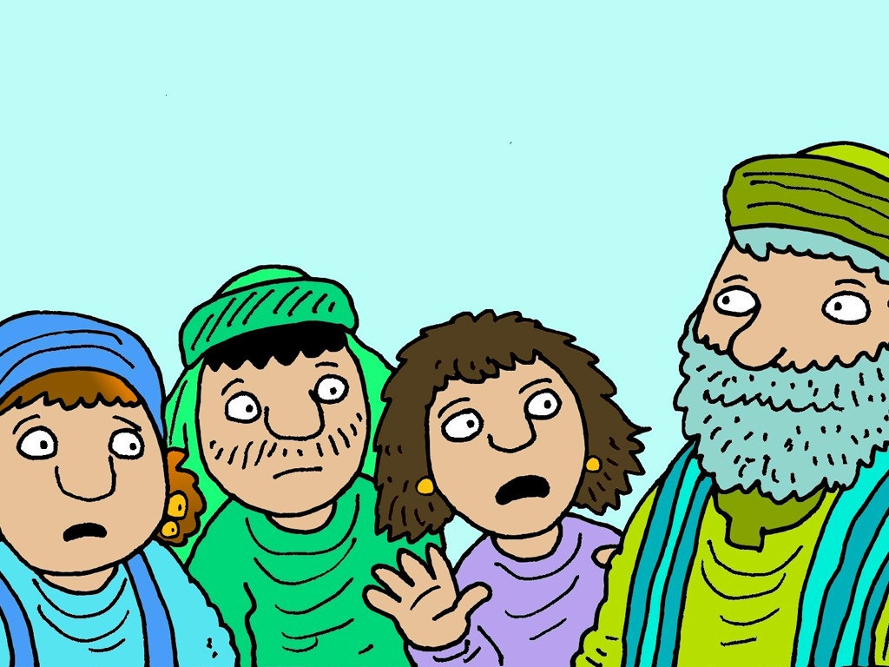
I wonder what Aaron thinks about their idea?
Notes:
Slide 6: ‘We don’t know what has happened to Moses,’ the people complained.
‘We will make our own god,’ they said. ‘We are tired of waiting for Moses.’
I wonder what Aaron thinks about their idea?

Slide 7
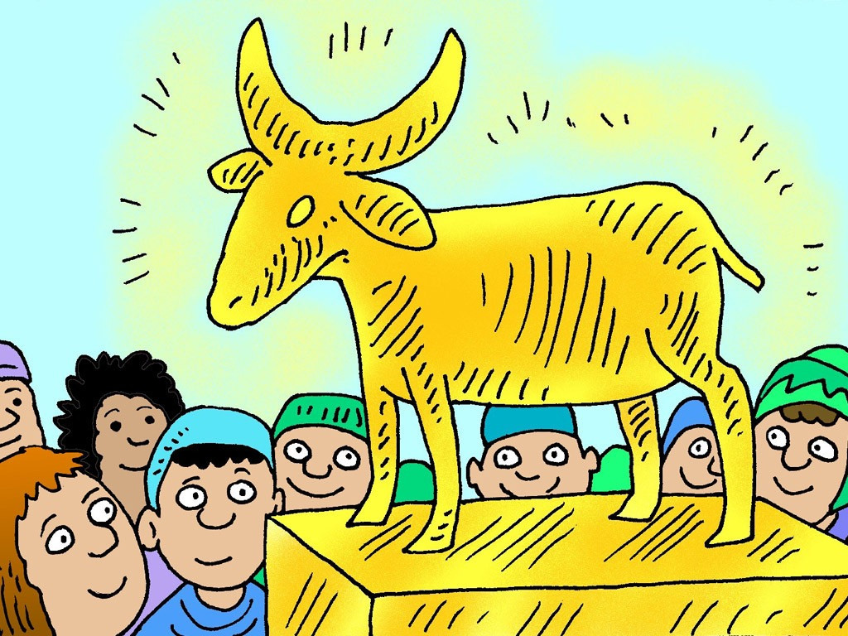
Notes:
Slide 7: Aaron told the people to bring their gold earrings to make into a god. He melted the gold in a very hot fire and made a statue of a calf out of gold.

Slide 8
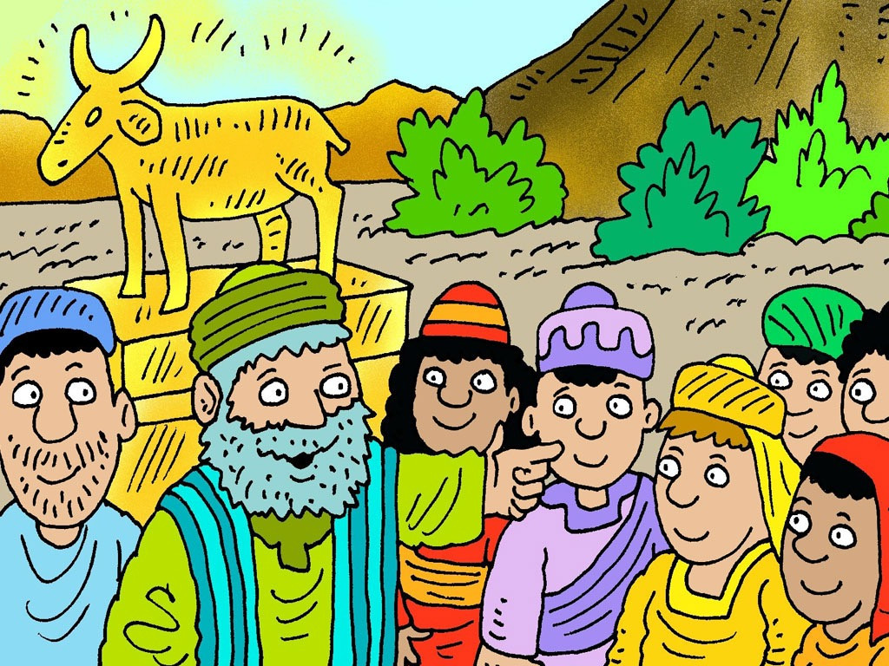
I wonder what Moses – and God – might think about this?
Notes:
Slide 8: ‘Tomorrow we will have a feast and pray to our new god,’ he said. ‘Go home and prepare a meat offering to burn on the altar.’
I wonder what Moses – and God – might think about this?

Slide 9
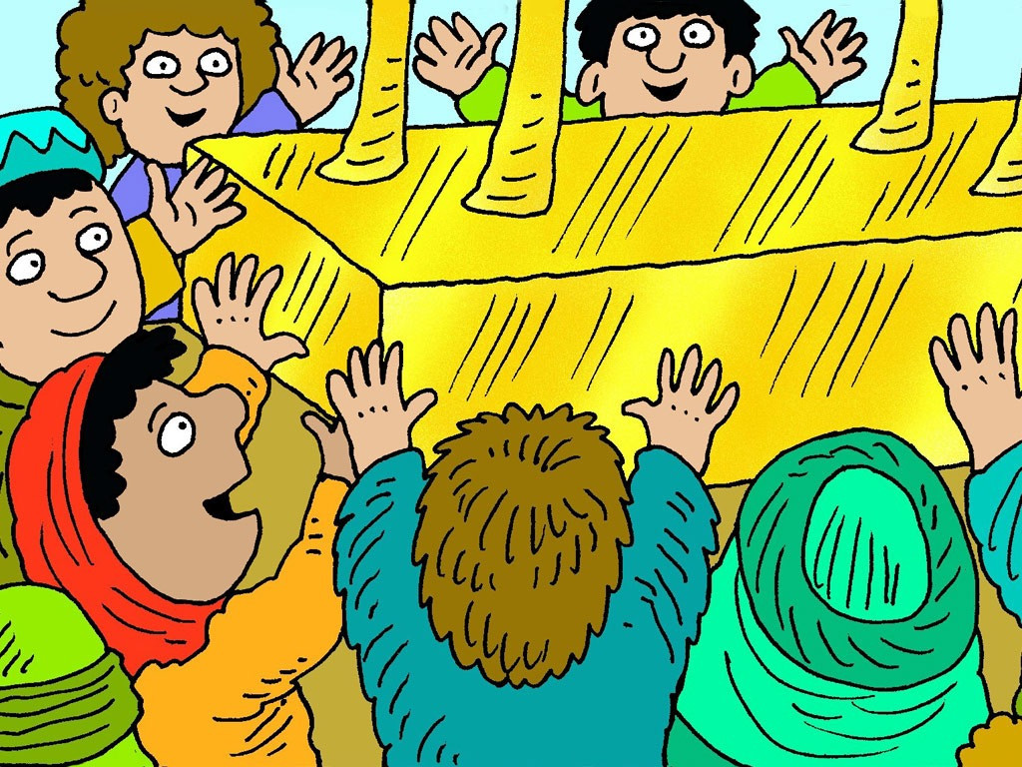
Notes:
Slide 9: The next day they burnt their offerings and danced and sang. But a calf made out of gold was not a real, living god and could not hear, or answer prayer.

Slide 10
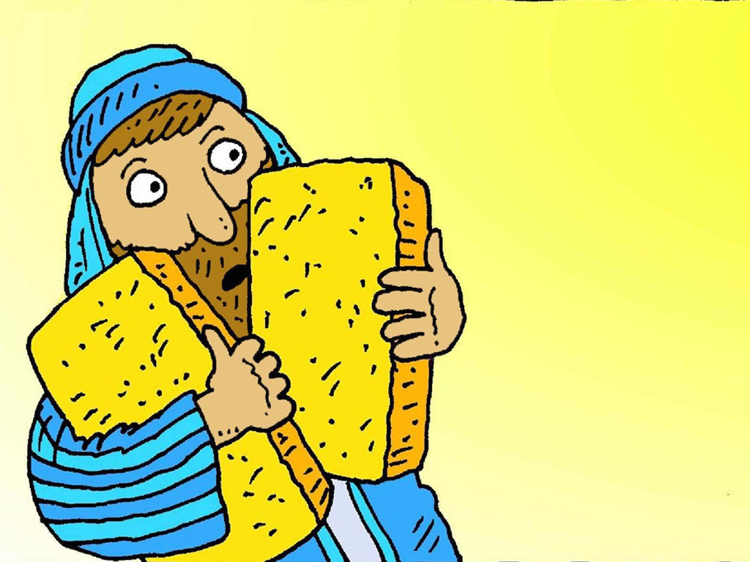
I wonder what Moses might say to the people?
Notes:
Slide 10: Moses came down from the mountain, carrying the Ten Good Rules.
I wonder what he might say to the people?

Slide 11
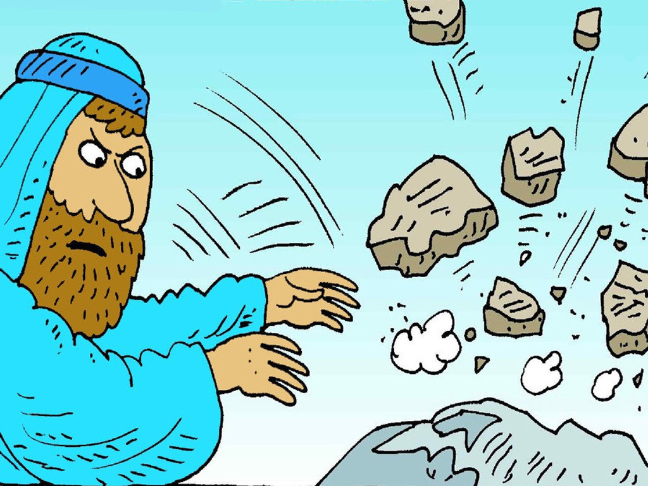
I wonder why Moses did this?
Notes:
Slide 11: He broke the stones God had written on.
I wonder why Moses did this?
Moses was very disappointed with what the people had done. Then everyone remembered how God had saved them and they were sorry.

Slide 12
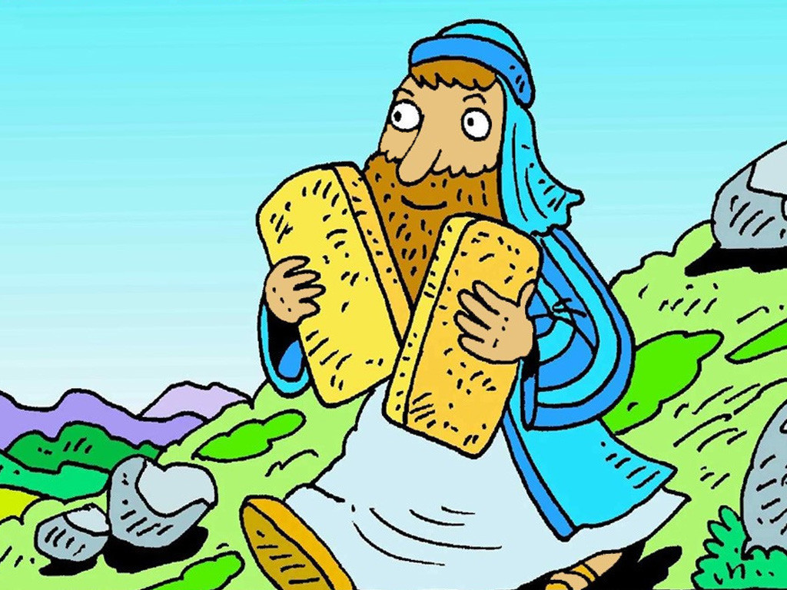
I wonder if they will….?
Notes:
Slide 12: Moses went back up the mountain again, with two new stones. God gave Moses the new rules again. ‘Tell the people to live by these good rules,’ God said. ‘Help them to remember
I wonder if they will…..?
[Cliffhanger sound effects]

Slide 13
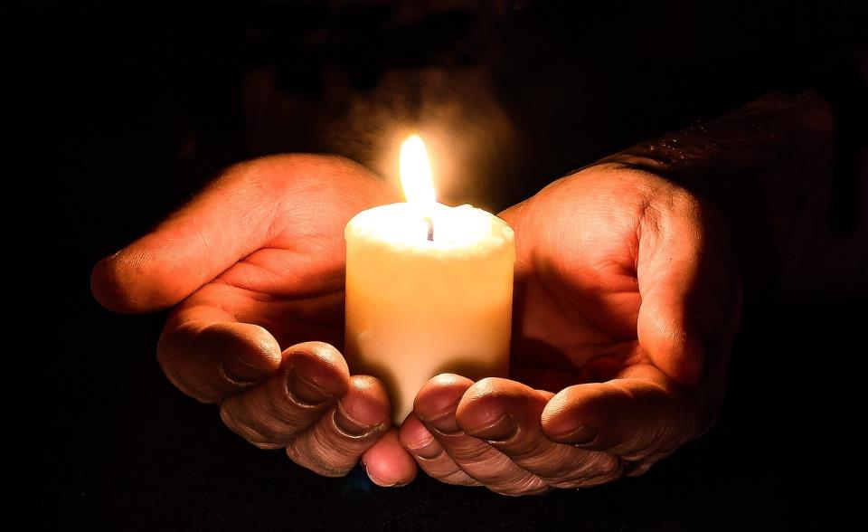
….I wonder what it might mean for someone to ‘put God first’?....
….I wonder what’s first in your life?....
….I wonder how our times together at school help us to focus on things that we ‘put first’?
Notes:
Slide 13: Let’s be still together and turn our ‘wondering’ thoughts to our own school community….. [Pause and talk together, as time allows]
….I wonder what it might mean for someone to ‘put God first’?....
….I wonder what’s first in your life?....
….I wonder how our times together at school help us to focus on things that we ‘put first’?

Slide 14
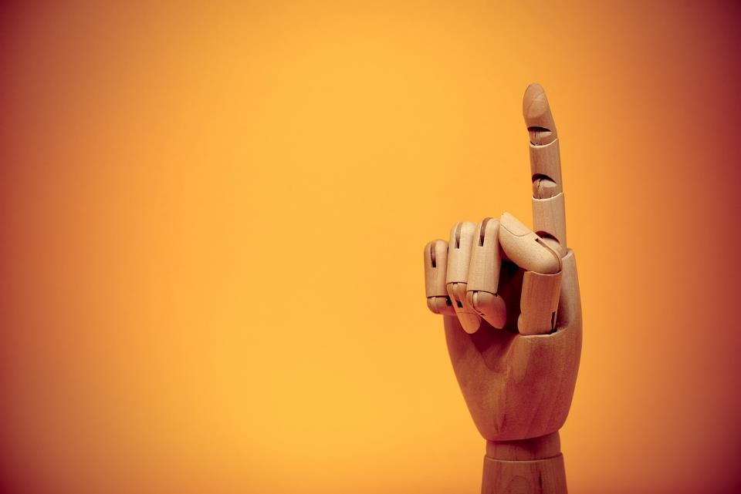
Dear God
Please help us to make good choices about the things that we put first in our own lives. May these things help us to live well together as a school community.
Notes:
Slide 14: Prayer
Now I’m going to use the words of a prayer to draw our time together today to a close. Make it your own if you would like to, or just be still and quiet with your own thoughts.

Slide 15
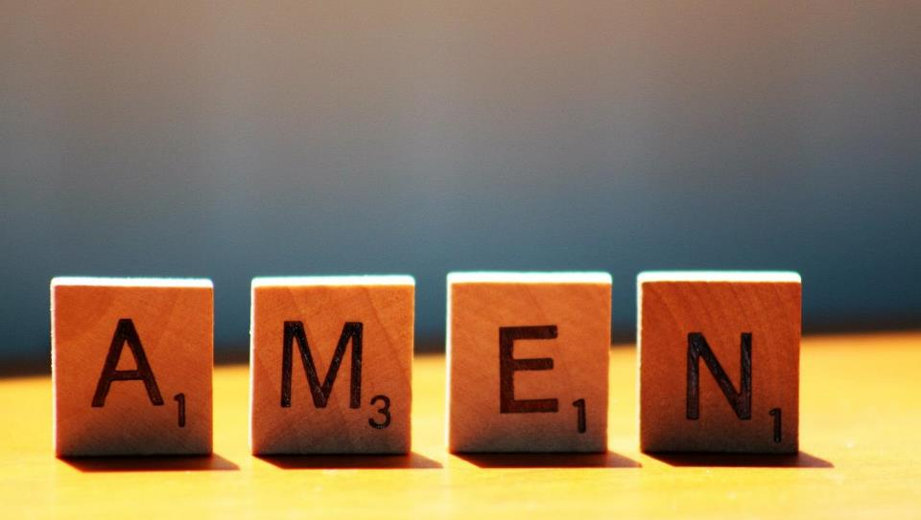

Slide 16
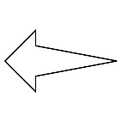
Leader: As we leave this place & time and go into the day ahead…
All: May today’s words help us to become a stronger community.
Notes:
Slide 16: Remind children of today’s key message – to consider what we ‘put first’

Slide 17
Notes:
Reflective activity: Golden paper
Cut up some small squares of special gold paper. Children reflect and then write on the paper something that they put first, the most important thing for them.

