Slide 1





On the journey of life….
....we are glad to be together as a school community.
Notes:
Slide 1: Use these gathering words for this term, or your usual greeting if you prefer. Why not invent some actions to make them extra memorable?!

Slide 2
As we gather today….
....may we learn from each other and hear from God.
Notes:
Slide 2: Use these gathering words for this term, or your usual greeting if you prefer. Why not invent some actions to make them extra memorable?!

Slide 3


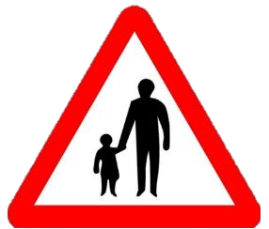








Notes:
Slide 3: Know your highway code! This is a book of rules to help people to stay safe on the roads. You probably know this one [GIVE WAY]
Look at the different road signs [choose some / all] – do children know what they mean? Why are they mostly pictures, not words? Why is it important to have rules on the roads? What about rules in life?

Slide 4
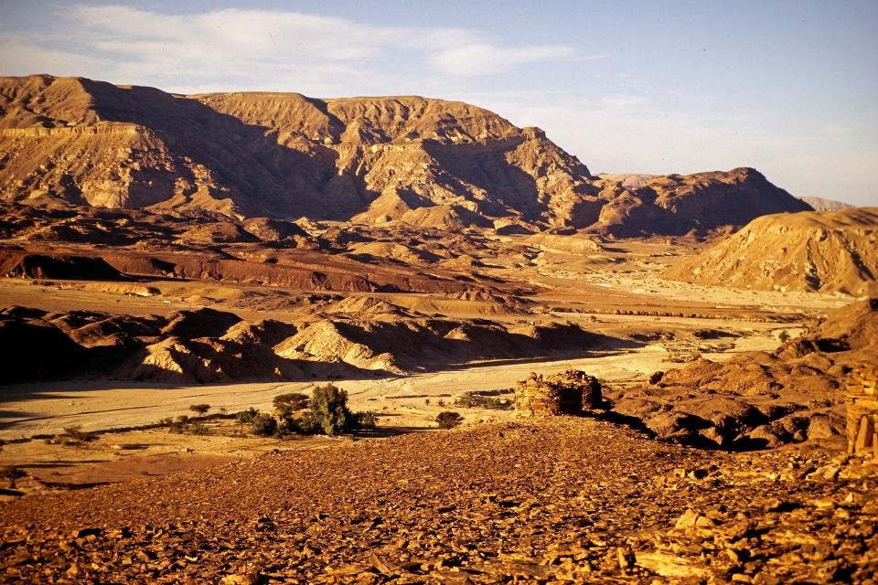
Picture copyright-free from pixabay
The Rules
Notes:
Slide 4: We’re going to use the road signs again now, to tell the next part of our Moses saga, which includes some very important rules. [use script p.3 & roadsigns on Slides 5-13]

Slide 5

Picture © Department of Transport
Notes:
Slide 5: The Israelites had just walked right through the Red Sea, on dry land, with the Egyptian army in hot pursuit. God himself had opened the sea up right in front of them and kept the waters back until they were all safely through to the other side. God had promised them a land where they would be free forever.

Slide 6

Picture © Department of Transport
Notes:
Slide 6: But now it felt like they’d taken a wrong turn, because they were stuck in the desert and they didn’t know where they were going. God’s people wondered if they would ever find their promised home. And so they complained, just like every other person who’s been on a long journey…. “Are we nearly there yet!”

Slide 7
Notes:
Slide 7: Despite all their moaning, God promised the people that he would look after them and travel with them on their journey. He gave them food to eat – and water to drink. But the people still complained.

Slide 8
Picture © Department of Transport
Notes:
Slide 8: Then God sent Moses up into the mountains and gave him ten good rules to help the people know how to live good lives. ‘These good rules will keep you safe and show others that I am your God, and you are my people,’ God said to Moses.

Slide 9

Picture © Department of Transport
Notes:
Slide 9: So Moses told the Israelites the rules. ‘Love God and worship only Him. This is very important!’

Slide 10
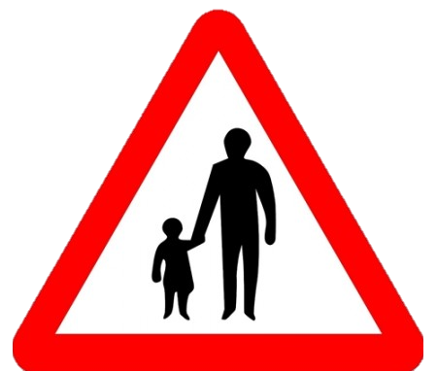
Picture © Department of Transport
Notes:
Slide 10: There are rules to help you to get along together. You must treat each other with love and respect.

Slide 11

Picture © Department of Transport
Notes:
Slide 11: ‘You should work hard for six days, but on the seventh,’ Moses explained, ‘you should STOP. If God rested on the seventh day, then so should you! This day of rest is a sign that you are free, and no longer slaves in Egypt. It is a gift for you and all you love. Celebrate Shabbat!’

Slide 12

Picture © Department of Transport
Notes:
Slide 12: …STOP. If God rested on the seventh day, then so should you! This day of rest is a sign that you are free, and no longer slaves in Egypt. It is a gift for you and all you love. Celebrate Shabbat!’

Slide 13
Picture © Department of Transport
Notes:
Slide 13: ‘And always remember,’ God told them, on many occasions, ‘I am your God, and you are my people. Whatever happens, you don’t need to be afraid. I will go with you.’ But the people often forgot this important information, as we’ll find out next week, when everything goes wrong…..! [add your own cliffhanger sound effects here!!!]

Slide 14
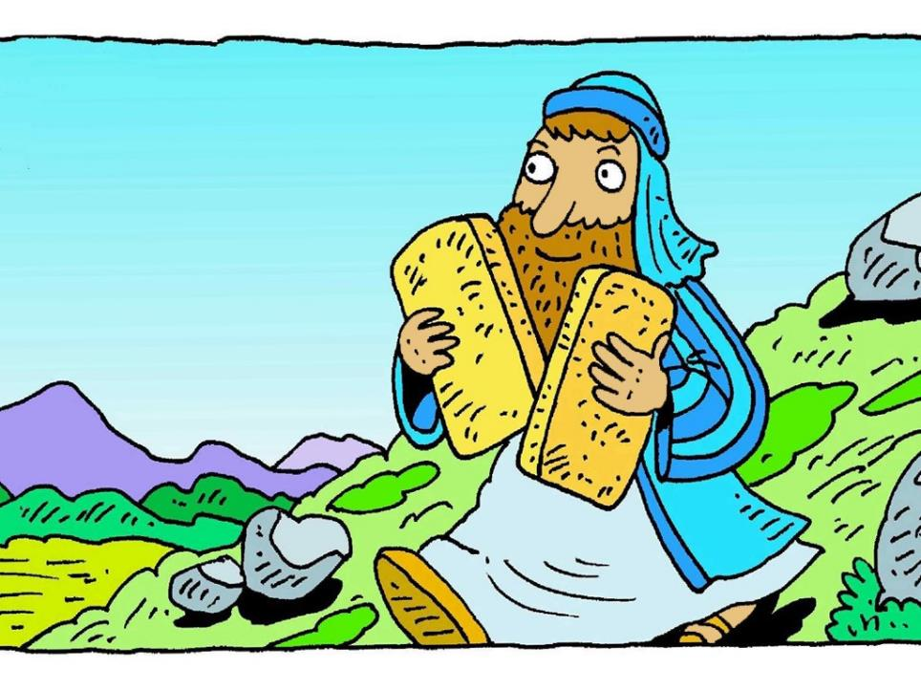
I wonder how the rules helped God’s people as they travelled?...
I wonder whether one rule is more important than the others?....
I wonder how rules help us in our school community?
Notes:
Slide 14: Let’s wonder together about this story now…. I wonder how the rules helped God’s people as they travelled?... I wonder whether one rule is more important than the others?.... I wonder how rules help us in our school community?.... [talk about your ideas together]

Slide 15
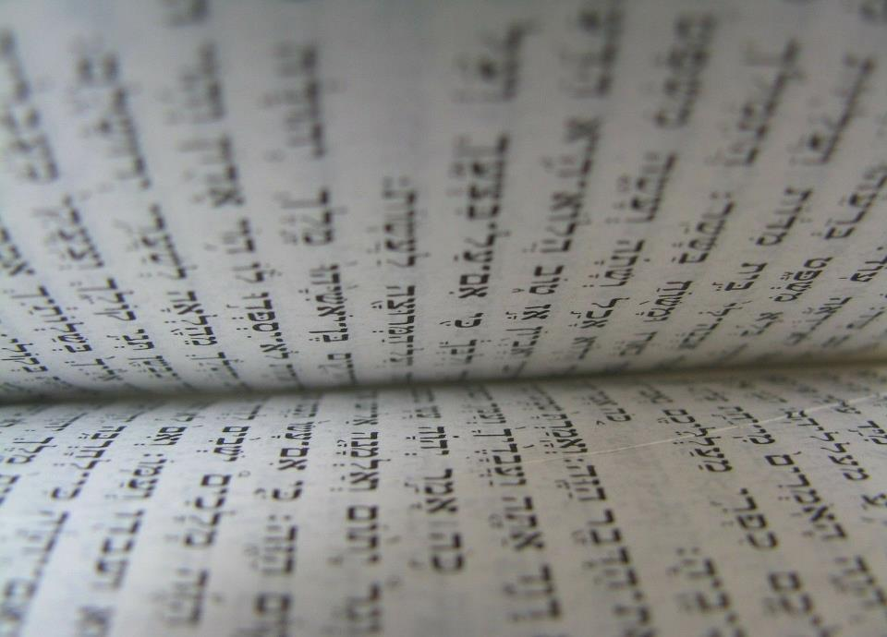
Notes:
Slide 15 [optional]: You can find the ten good rules in the Jewish holy book, the Torah – and in the Old Testament part of the Christian Bible, in Exodus chapter 20.

Slide 16
Notes:
Slide 16: Responding (words for worship):
But first, let’s be still and quiet and continue to think about what today’s story might have to say to us, in our school community….
…We’ve been thinking today about the story of God’s ten good rules….
….they were given to Moses to help God’s people to live well together…..
….I wonder what you think about the rules that God gave?....
…..I wonder which rules you think are important for us to live well together?.....
….I wonder if you have an important rule that you try to live your life by?…..
……………….

Slide 17
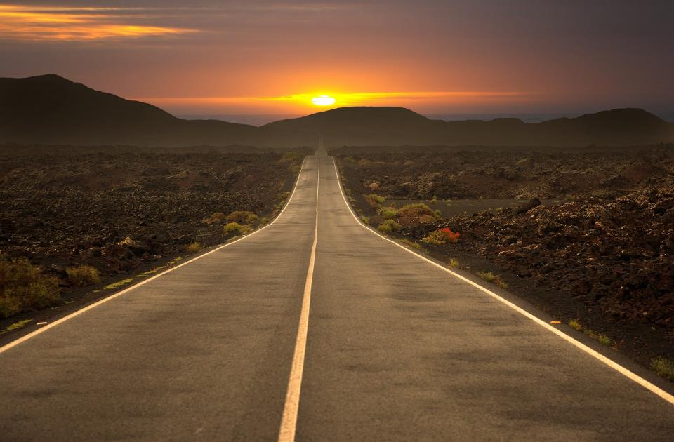
Dear God
As we travel on the road of life, help us to live well together. May we remember that rules make life fair for everyone.
Notes:
Slide 17: Prayer
Now I’m going to use the words of a prayer to draw our time together today to a close. Make it your own if you would like to, or just be still and quiet with your own thoughts.

Slide 18
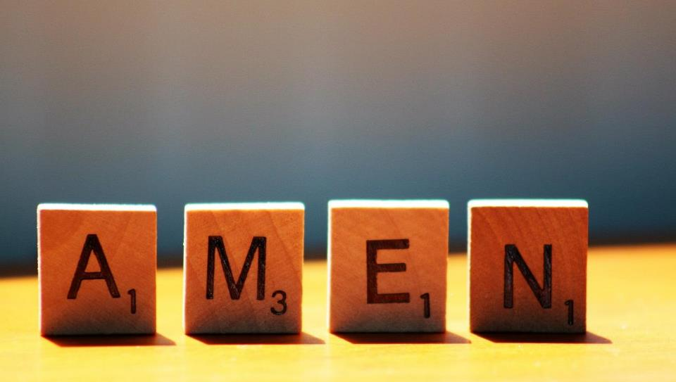

Slide 19



Leader: As we leave this place & time and go into the day ahead…
All: May today’s words help us to become a stronger community.
Notes:
Slide 22: Remind children of today’s key message – to remember to be grateful

Slide 20
Notes:
Reflective activity: Road sign reflections
Print some roadsign outlines (differing shapes) for children to choose from (some included here). Leave the middle blank. Children write a rule for living that applies to them – or they could choose one of the Ten Good Rules from the story. Put these into a ‘Book of Rules’ – or hang them up in your reflective area.
For older children, you could alternatively use the reflection cards on p. 6.

