Slide 1
Picture copyright-free from pixabay
The Rules
Notes:
This is a child-friendly version of the Ten Commandments, mostly thanks to FreeBibleImages again!

Slide 2
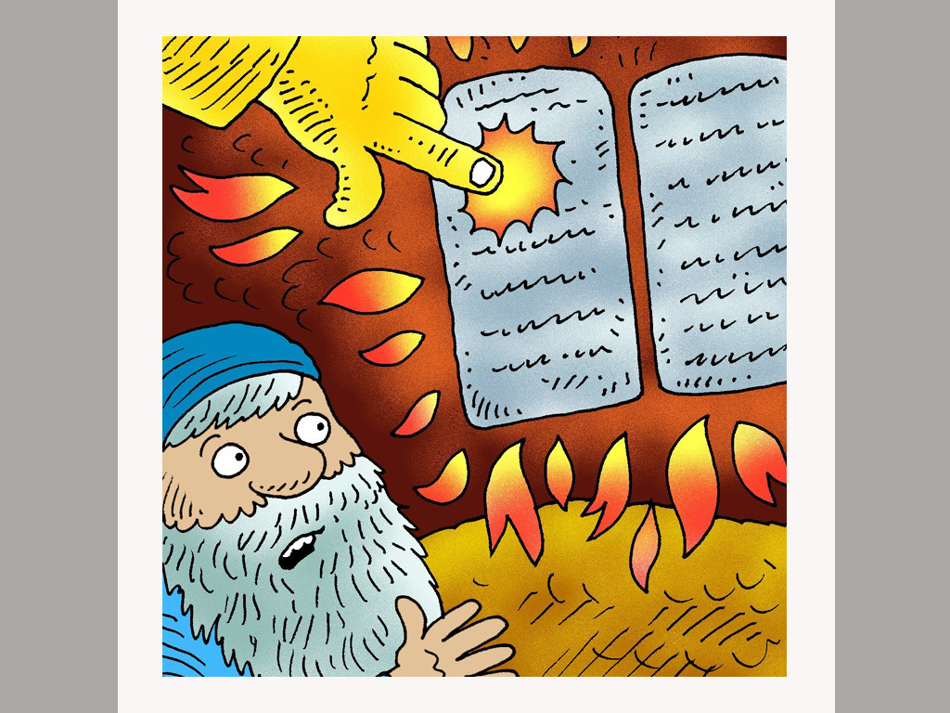
Notes:
The Ten Commandments are ten good rules to help God’s people to live at peace with God and each other.

Slide 3
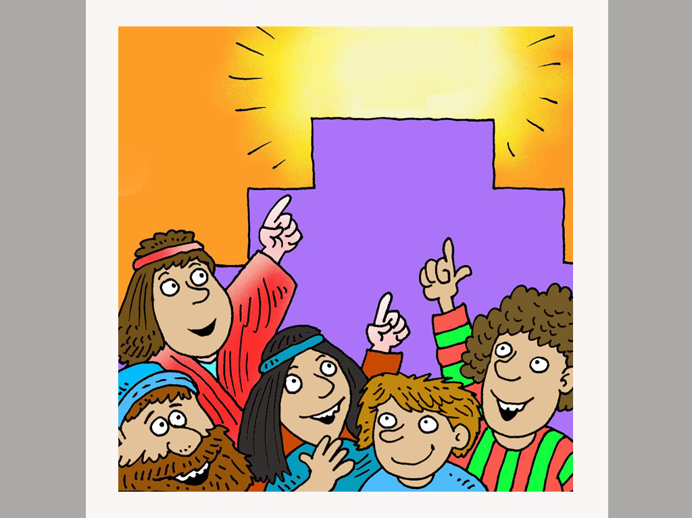
Notes:
Rule number 1.
God is the one true God. Put Him first in your life and make Him more important than anyone or anything else.

Slide 4
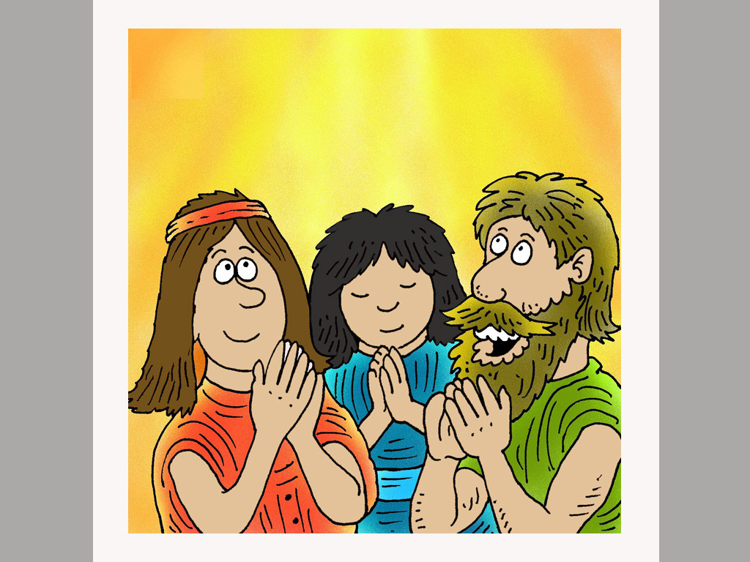
Notes:
Rule number 2.
You should only worship and serve God not anyone or anything else.

Slide 5
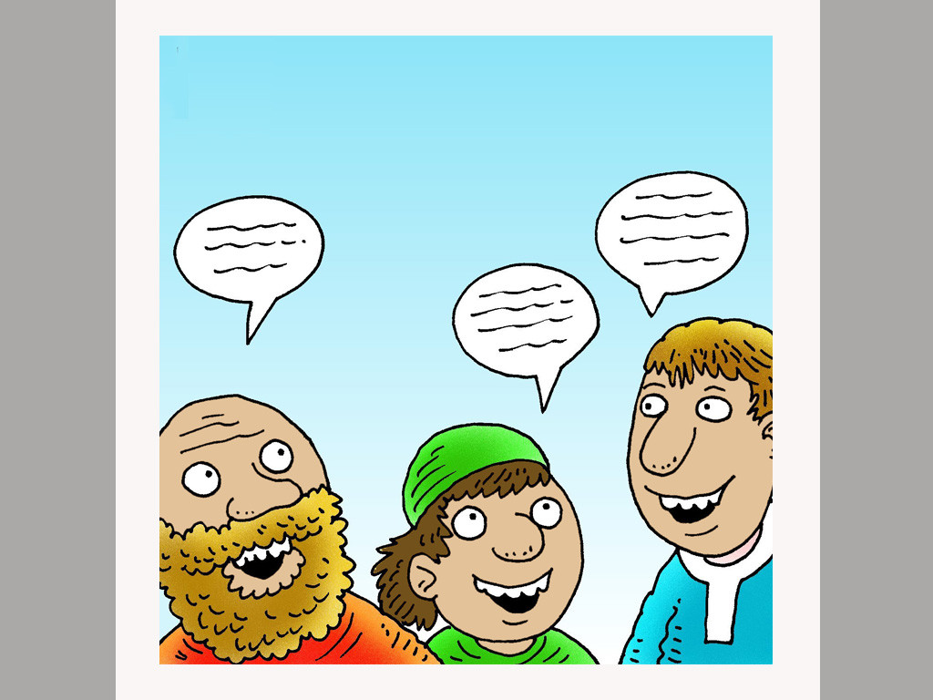
Notes:
Rule number 3.
You must only ever use God’s name with respect and reverence, never as a name to mock or swear.

Slide 6
Notes:
Rule number 4.
You must remember the Sabbath as a day a rest. You can work on the six other days but the Sabbath day is a holy day to worship God and relax.

Slide 7
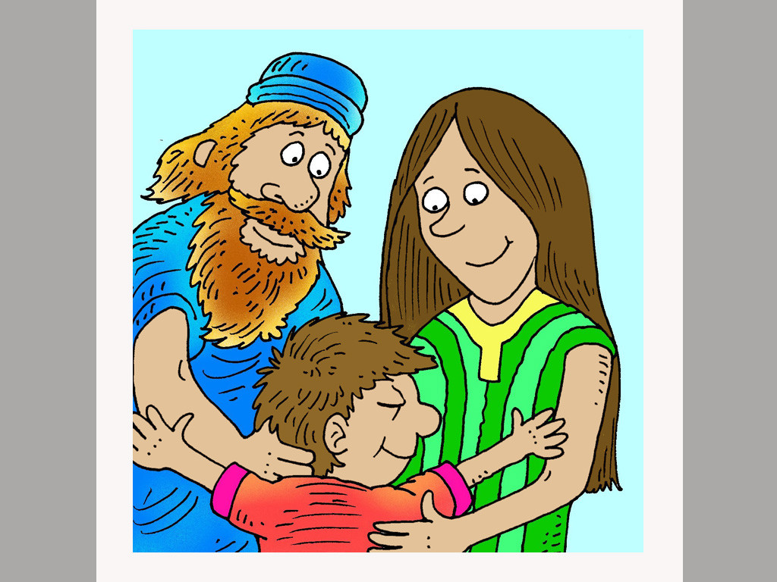
Notes:
Rule number 5.
You must honour and obey your parents. God promises a long life to you if you do.

Slide 8
Notes:
Rule number 6.
You must never kill anyone.

Slide 9
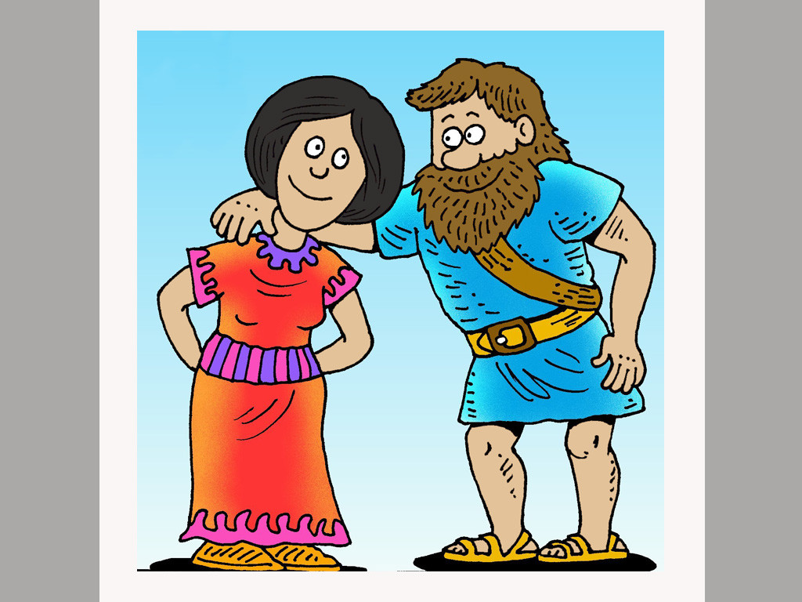
Notes:
Rule number 7.
You must be faithful to the person you marry.

Slide 10
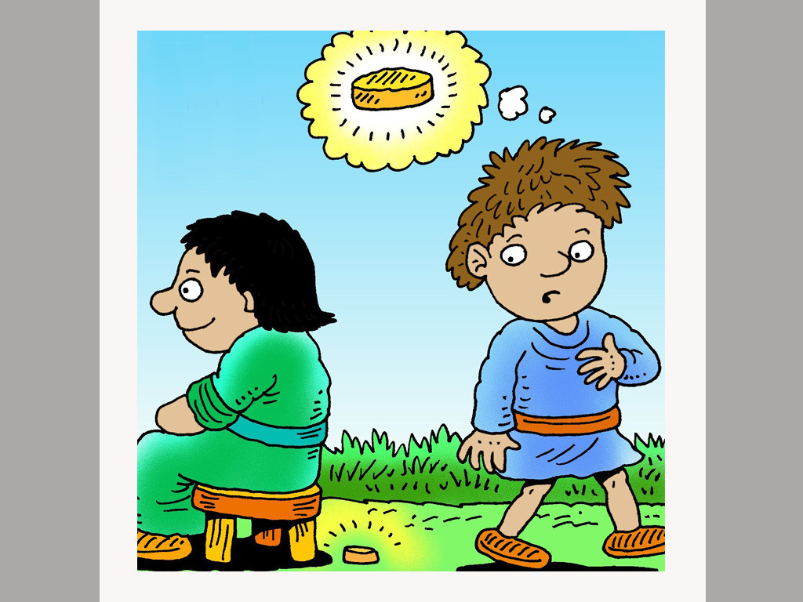
Notes:
Rule number 8.
You must not steal. Respect other people’s property.

Slide 11
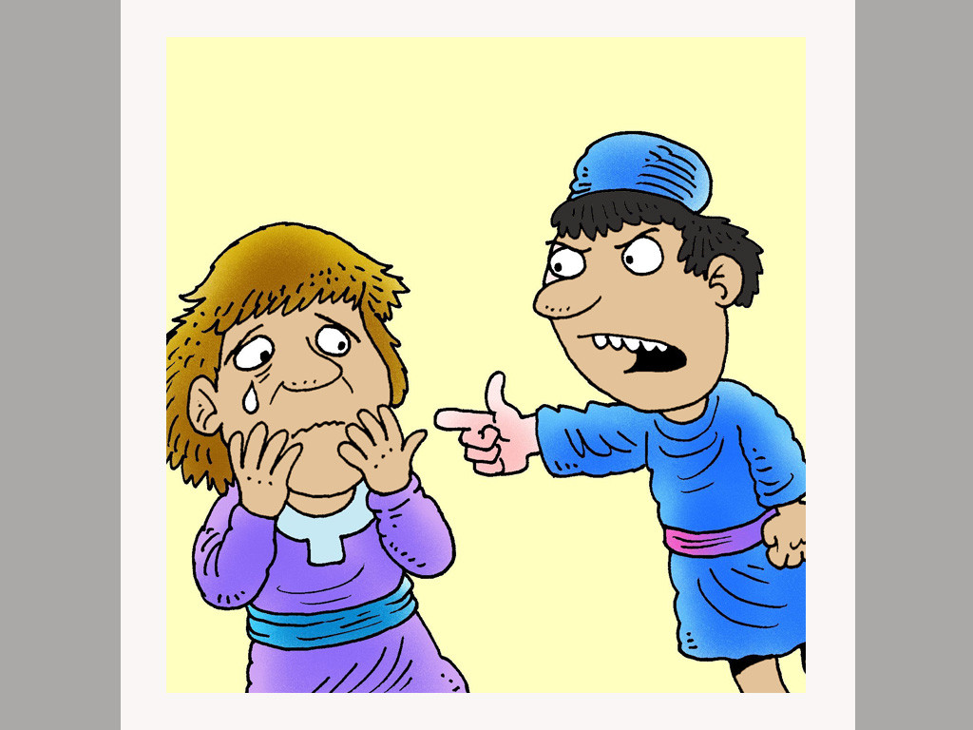
Notes:
Rule number 9.
Do not tell lies. This includes saying things about other people that are not true.

Slide 12
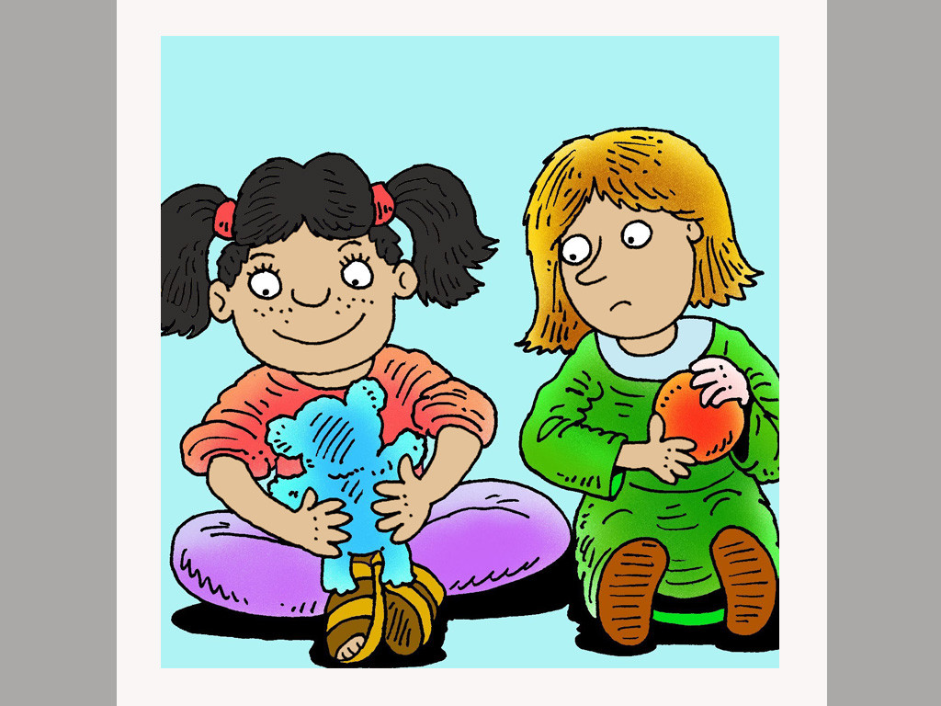
Notes:
Rule number 10.
Do not be envious of what other have or be greedy.

