Slide 1





On the journey of life….
....we are glad to be together as a school community.
Notes:
Slide 1: Use these gathering words for this term, or your usual greeting if you prefer. Why not invent some actions to make them extra memorable?!

Slide 2
As we gather today….
....may we learn from each other and hear from God.
Notes:
Slide 2: Use these gathering words for this term, or your usual greeting if you prefer. Why not invent some actions to make them extra memorable?!

Slide 3
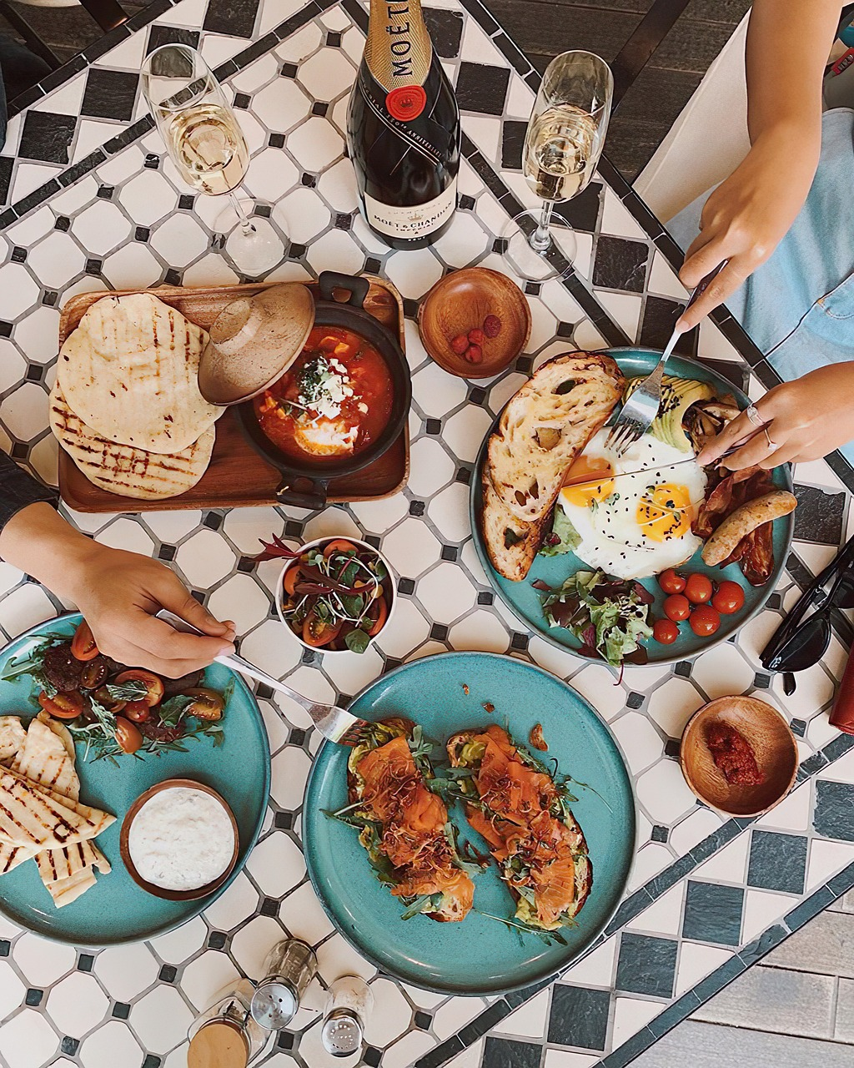
Food! Glorious Food!
Notes:
Slide 3: Two weeks ago, we celebrated HARVEST, and thought about how food sometimes helps us to remember things. This week the theme is quite similar as it is the time that Jewish communities will be celebrating their harvest festival, called Sukkot.

Slide 4
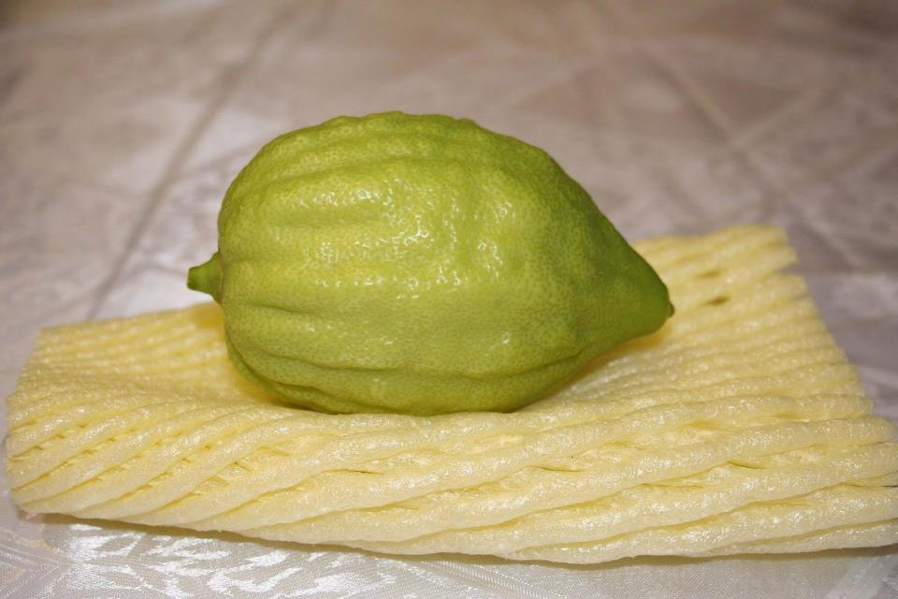
Sukkot
Notes:
Slide 4: Sukkot happened this year between dusk on 29th September and dusk last Friday on 6th October. During Sukkot, Jewish families will eat outdoors in shelters that they build out of tree branches, and they’ll hang up fruit, like this rather strange-looking lemon, called an ‘etrog’, to decorate their shelters as a reminder to be thankful and remember…which is a very familiar message to us as well!

Slide 5
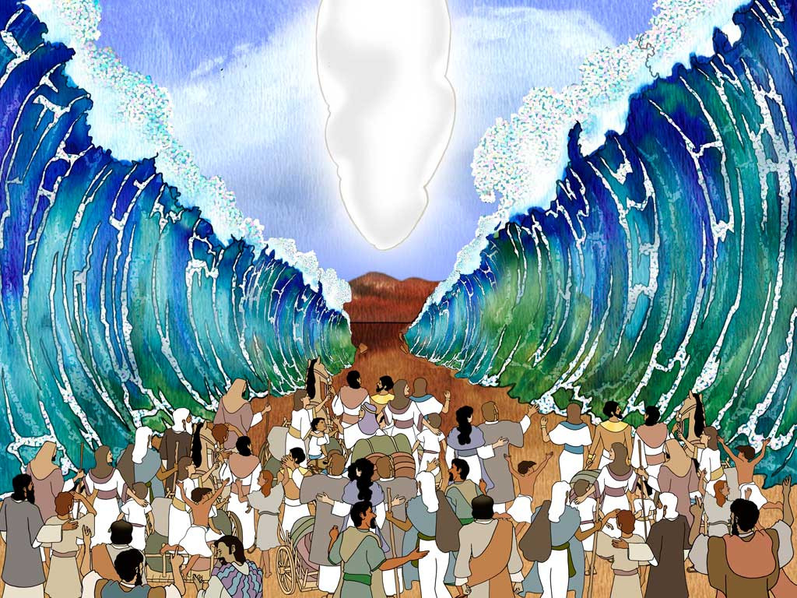

Moses: Are we nearly there yet?!
Autumn 2023
Notes:
Slide 5: When we left Moses last week…..the people had crossed the Red Sea – another miracle! – and were continuing on their journey to land that God had promised them.
The story that is at the heart of Sukkot is the next part in our story. We’re going to share together the story families retell at Sukkot, which helps them to remember the time that God’s people spent in the desert, on their epic journey to a new home. And in a very Jewish way, there are places where you can join in [use the script, rehearsing the actions together briefly first.]

Slide 6
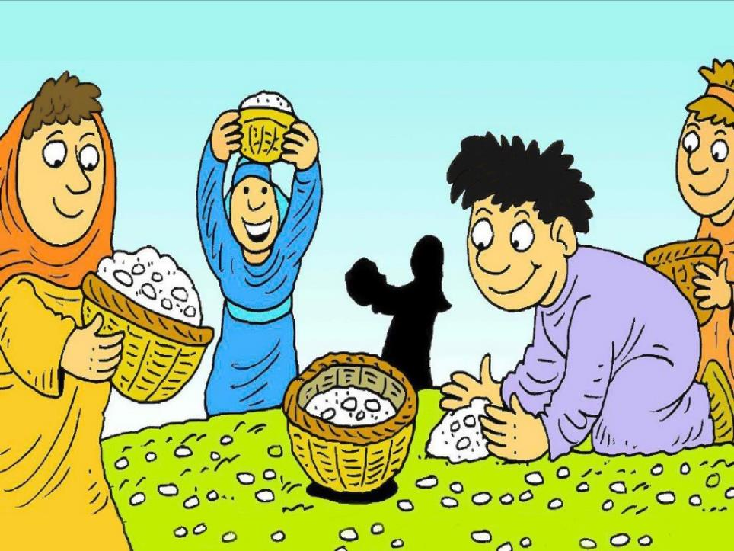
“God will provide!”
Notes:
Slide 6: The story that is at the heart of Sukkot is the next part in our story. We’re going to share together the story families retell at Sukkot, which helps them to remember the time that God’s people spent in the desert, on their epic journey to a new home. And in a very Jewish way, there are places where you can join in, with some actions [use the script, rehearsing the actions together briefly first.] but also these words ‘God will provide!’
Slide 6 [after the story]: I wonder which part of the story you think was the most important to remember? For Jewish people, it’s the fact that God provided – in amazing ways – and God’s people were told to always remember this.

Slide 7
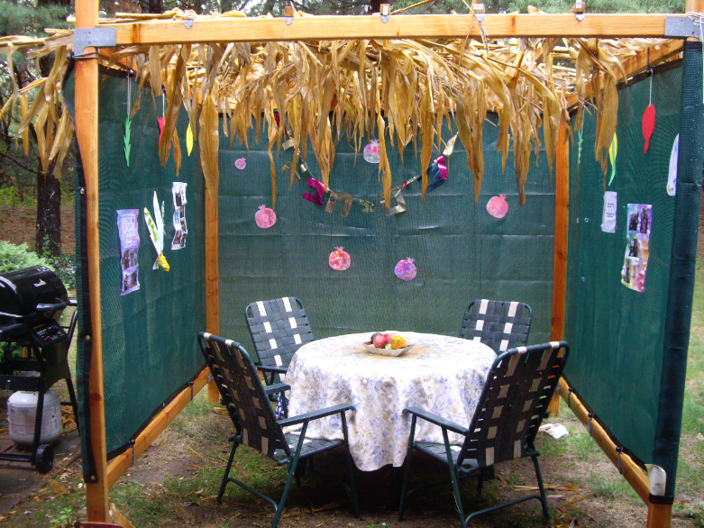
a sukkah
Notes:
Slide 7: At this time of year, eating in a sukkah, and being thankful is a really important way in which Jewish families remember. Many times in their history, God asked them to remember times like this, when he had rescued them, but also not to forget that they had been slaves, so that they would always remember how (or how not!) to treat others. So Sukkot is a time for Jewish people to remember and be thankful.

Slide 8


What are we grateful for?
Notes:
Slide 8: We’re going to collect OUR ideas about things we’re thankful for now – on these oranges & lemons and hang them up as a reminder for us....[gather a few ideas from the assembled children, or if time allows, children can draw or write on one side of their fruit, or maybe speak it out loud as they hang their fruit up.]

Slide 9
…. I wonder what you’ve eaten this morning that you are grateful for?....
.....or something you’re looking forward to eating at lunchtime......or your very favourite meal?.......
…I wonder what other things you might think of that are a part of your lives, that you are grateful for?.....
…. I wonder how we might be grateful as a community?....
Notes:
Slide 9: Responding (words for worship):
I’m going to give you some space and time to think…..
….the story we heard today started with God’s people complaining….
…I wonder if you’ve ever done this?! Of course….we all have…..
….but this story is a reminder that despite the complaining, God saw what the people needed and provided for them….
…I wonder what you’ve eaten this morning that you are grateful for.....
.....or something you’re looking forward to eating at lunchtime......or your very favourite meal.......
....I wonder what other things you might think of that are a part of your lives, that you are grateful for?.....
.....maybe family.......friends.......school......love.......health….our blessings…
…. I wonder how we might be grateful as a community?....
…..some people would say that these good things come from God: Jewish people take time to be thankful during Sukkot….
.....take time now to be grateful for some of these things.....
I’m going to do that right now, in a thankyou prayer. Make it yours if you’d like to by joining with me to say the words ‘we are grateful’ after I say the word ‘God’…or if you’d prefer not to pray, then just sit quietly with your own thoughts.

Slide 10
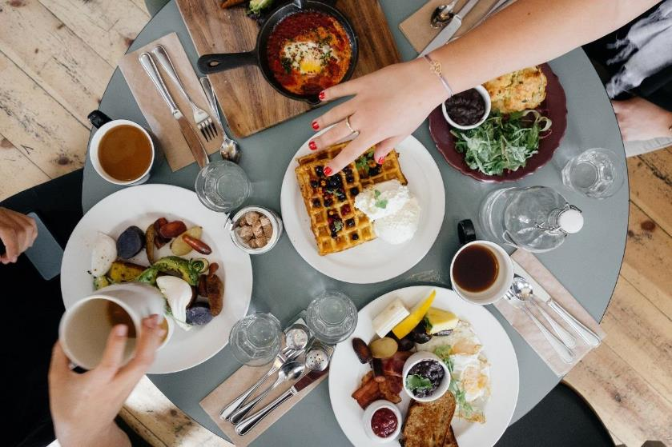
….we are grateful!
Notes:
Slide 10: For food on our tables – God, we are grateful!

Slide 11

….we are grateful!
Notes:
Slide 11: For love in our hearts – God, we are grateful!

Slide 12
….we are grateful!
Notes:
Slide 12: For a chance to be grateful – God we are grateful!

Slide 13
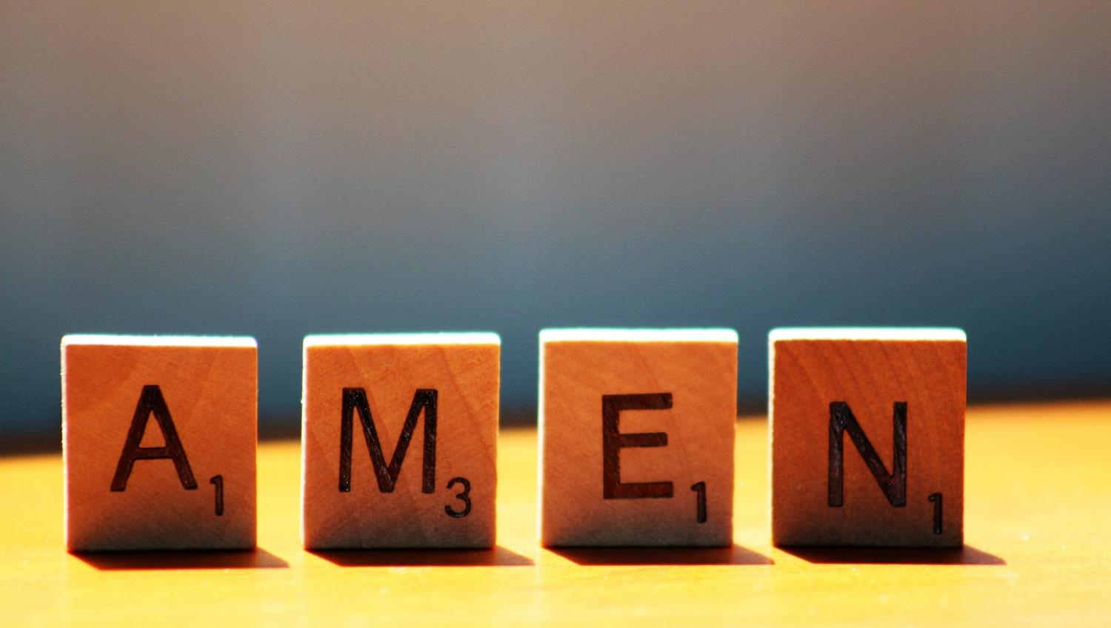

Slide 14



Leader: As we leave this place & time and go into the day ahead…
All: May today’s words help us to become a stronger community.
Notes:
Slide 22: Remind children of today’s key message – to remember to be grateful

Slide 15
Notes:
Slide 15: Make a ‘sukkah’
Create a sukkah in your reflective area, or even better, create an outdoor reflection area for the duration of Sukkot: hang fairy lights, assemble artificial plants / branches and hang up the oranges and lemons from the reflection included in the collective worship.
Have your week of collective worships outside and remember the story of what God provided in the desert and the tents that the Israelites lived in. Talk about how doing worship outside feels different.
Do the opposite of the Israelites in the desert!: encourage your class to spend the week not complaining about any food they’re not keen on but be thankful instead.

