Slide 1





On the journey of life….
....we are glad to be together as a school community.
Notes:
Slide 1: Use these gathering words for this term, or your usual greeting if you prefer. Why not invent some actions to make them extra memorable?!

Slide 2
As we gather today….
....may we learn from each other and hear from God.
Notes:
Slide 2: Use these gathering words for this term, or your usual greeting if you prefer. Why not invent some actions to make them extra memorable?!

Slide 3
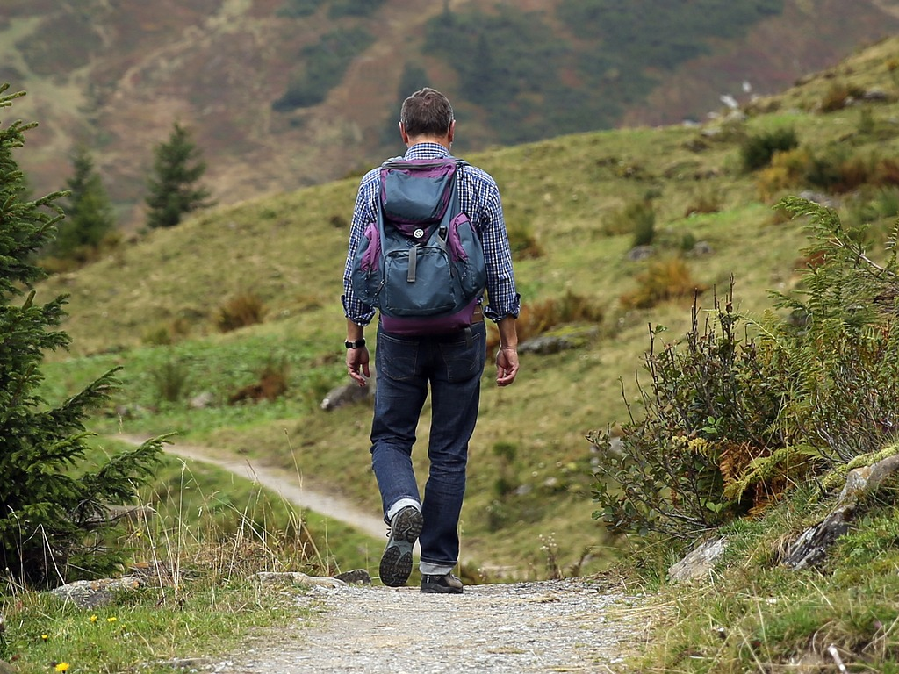
How would you cross…?
Notes:
Slide 3: How would you cross…..? Today’s assembly will take us into the next part of Moses’ adventure and the first part of the journey of God’s people out of Egypt. We’re going to think about some different crossings – [including a very active one in a moment! If you use slide 9]
I’ll show you some pictures – and you decide how someone would go across.
So, how would you cross…..

Slide 4

Notes:
Slide 4: …a pedestrian (zebra) crossing? [NB emphasise road safety]

Slide 5
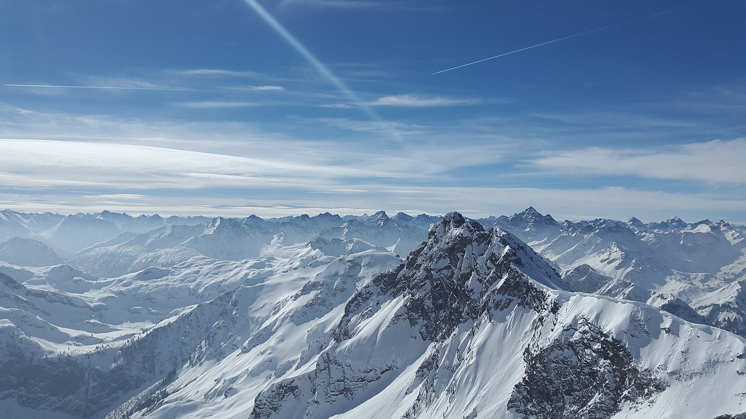
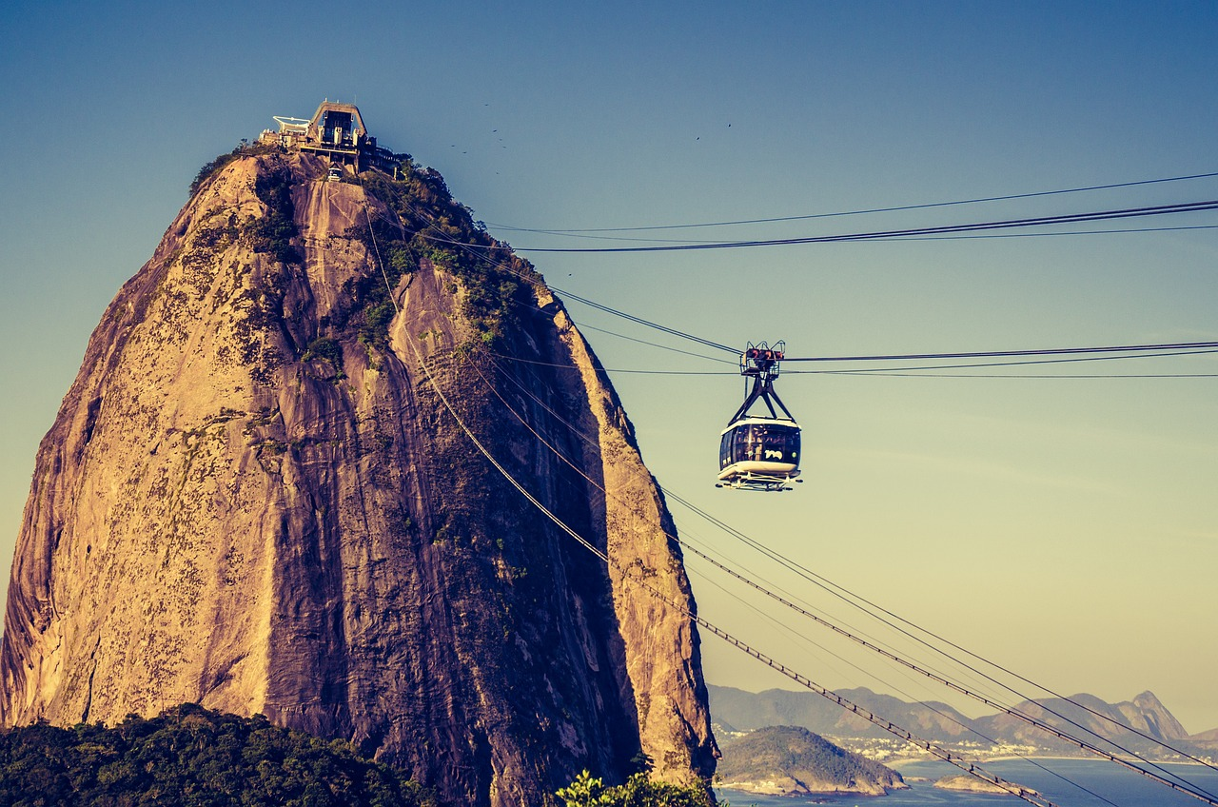
Notes:
Slide 5: …mountains?
You would need special clothes to keep you warm and safe – and you might need to climb, scramble etc. or maybe use a cable car!

Slide 6
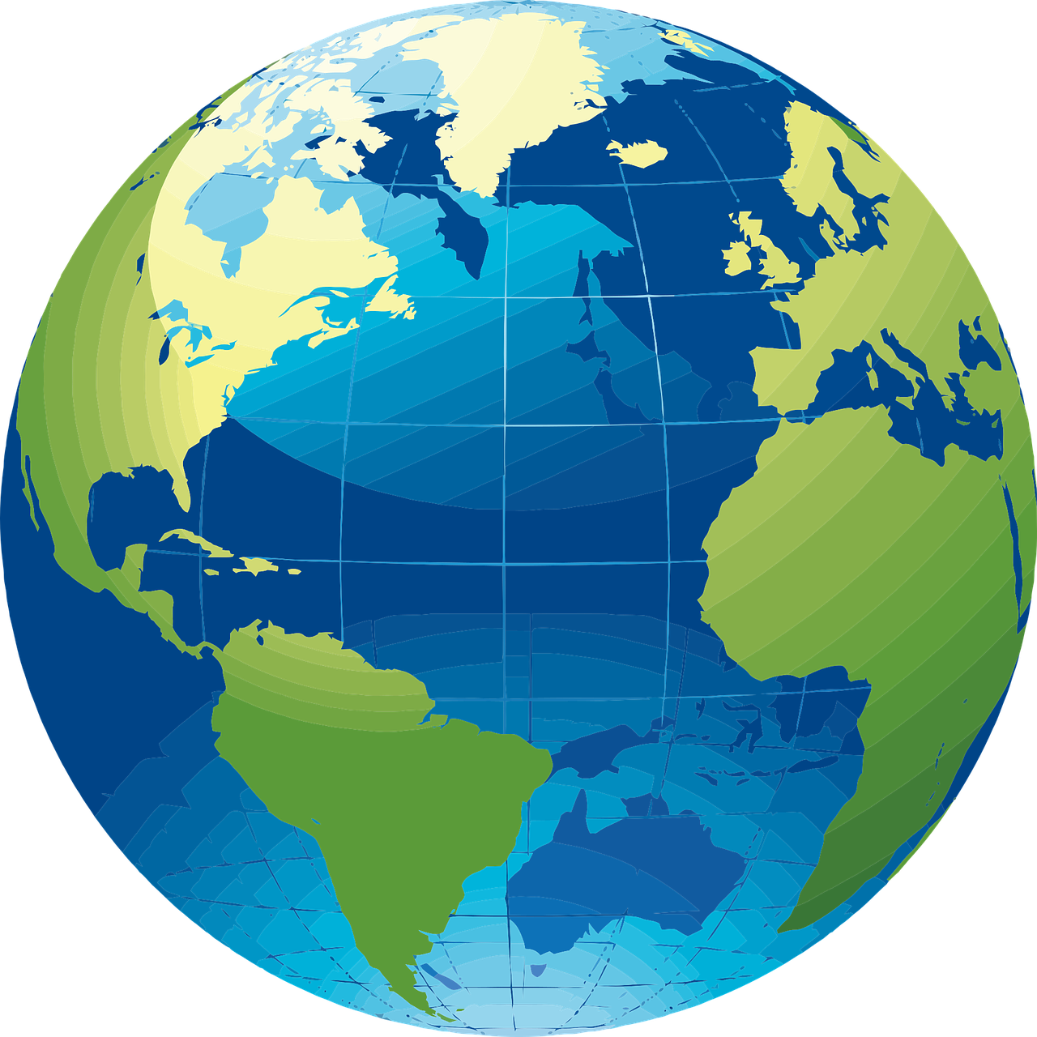
Notes:
Slide 6:….the world, from here…to here?
Fly, boat

Slide 7
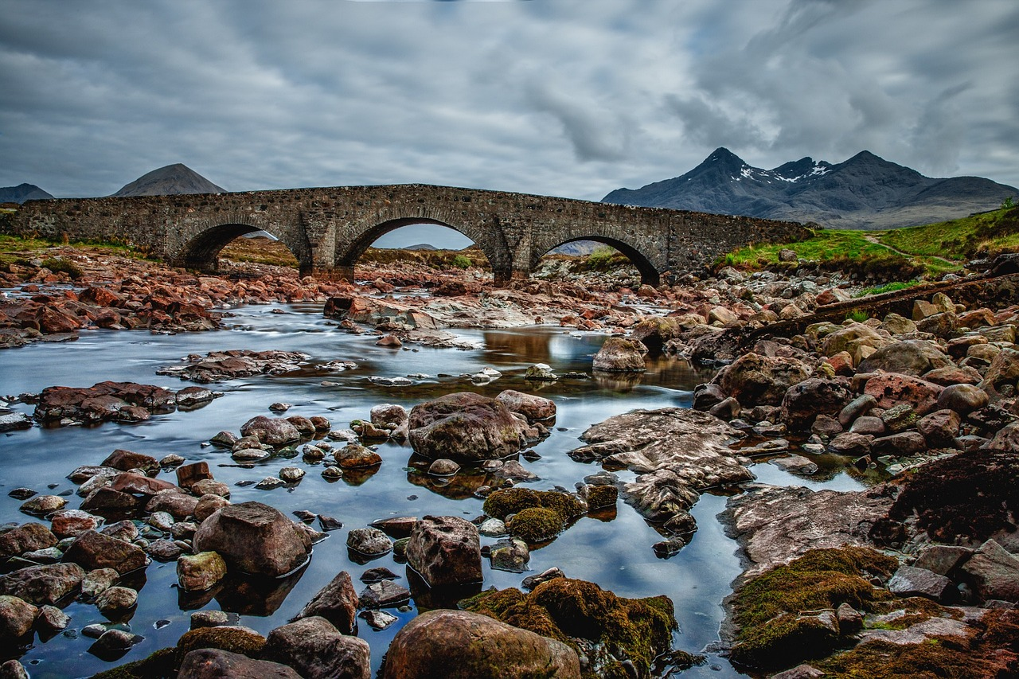
Notes:
Slide 7: …this river
Use the bridge! Or maybe very carefully across the rocks if the river was very shallow.

Slide 8
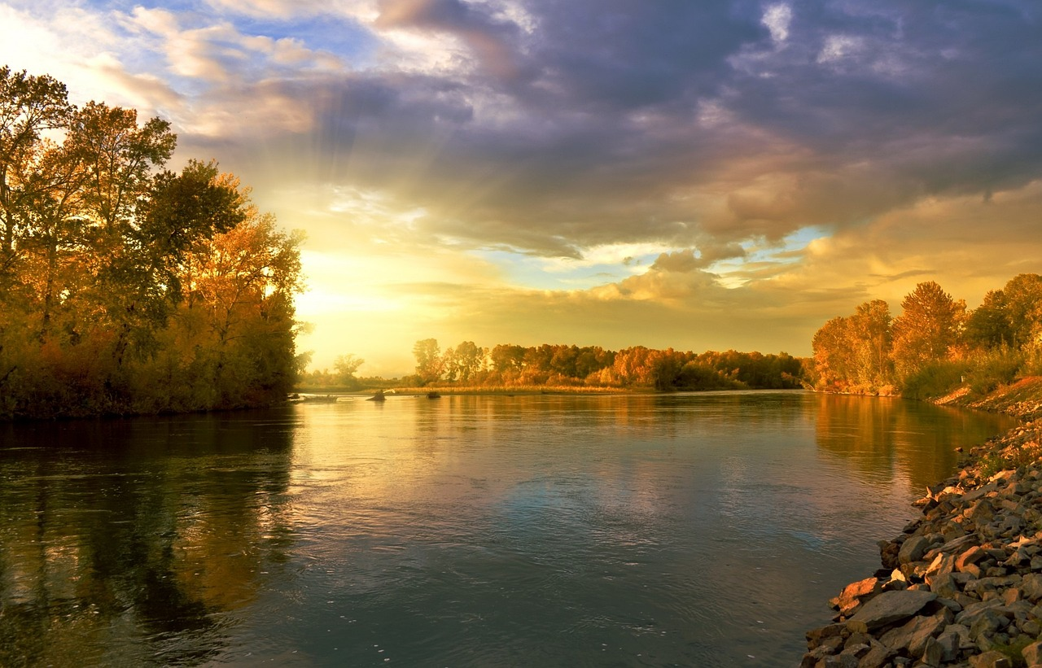
Notes:
Slide 8: So how about this river? How might you cross this? Do you think it’s deep?

Slide 9
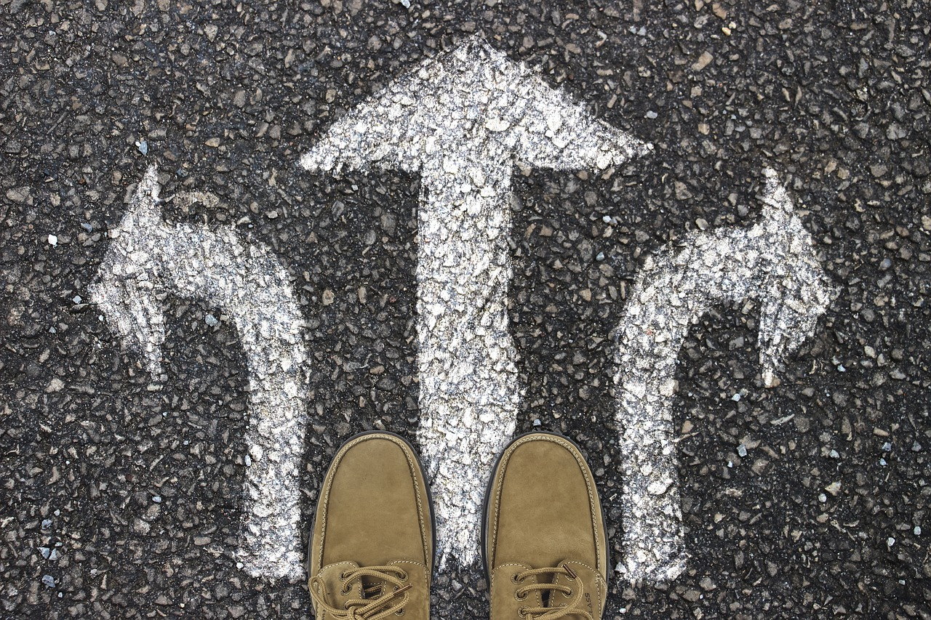
Notes:
Slide 9: The crossing challenge
Set a challenge now, if you want to, to see if 2 teams of 3 children (& 2 hoops per team) can get themselves across the front of the hall, only stepping into a PE hoop. They must not set foot on the ground outside of the hoop. Can they work together?

Slide 10
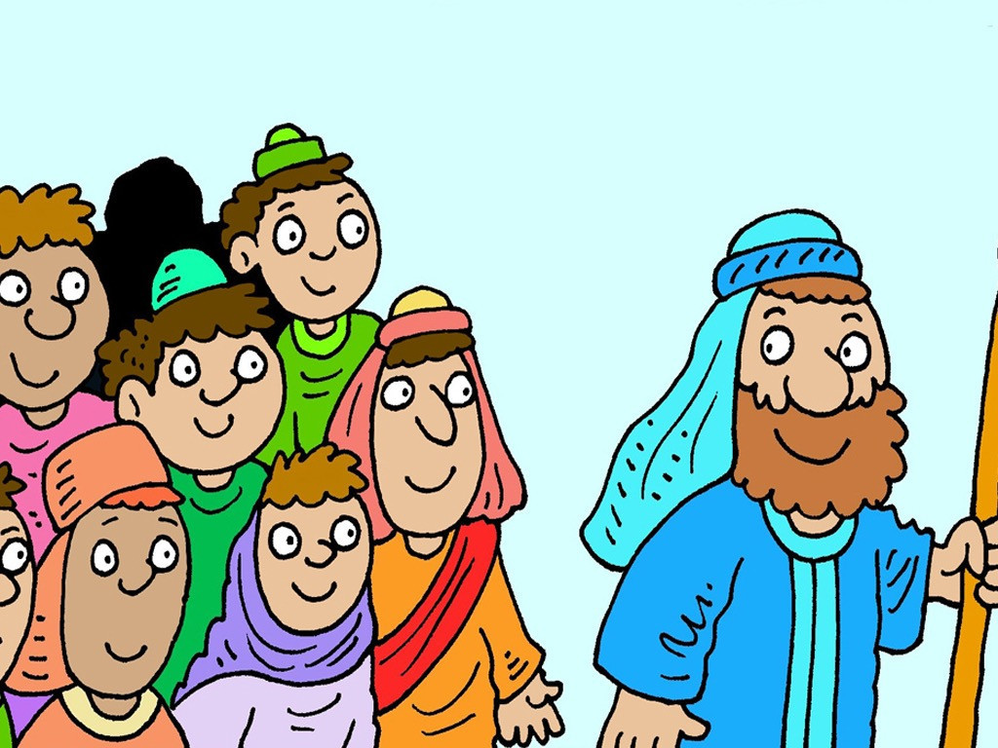
Moses: Are we nearly there yet?!
Autumn 2023
Notes:
Slide 10: When we left Moses last week….. all the children of Israel were getting ready to leave Egypt and had just eaten their first ever Passover meal (though they didn’t know that yet!). After 430 years of being slaves they were free, just as God had promised!
So, let’s find out what happens after last week’s cliffhanger moment….!!

Slide 11
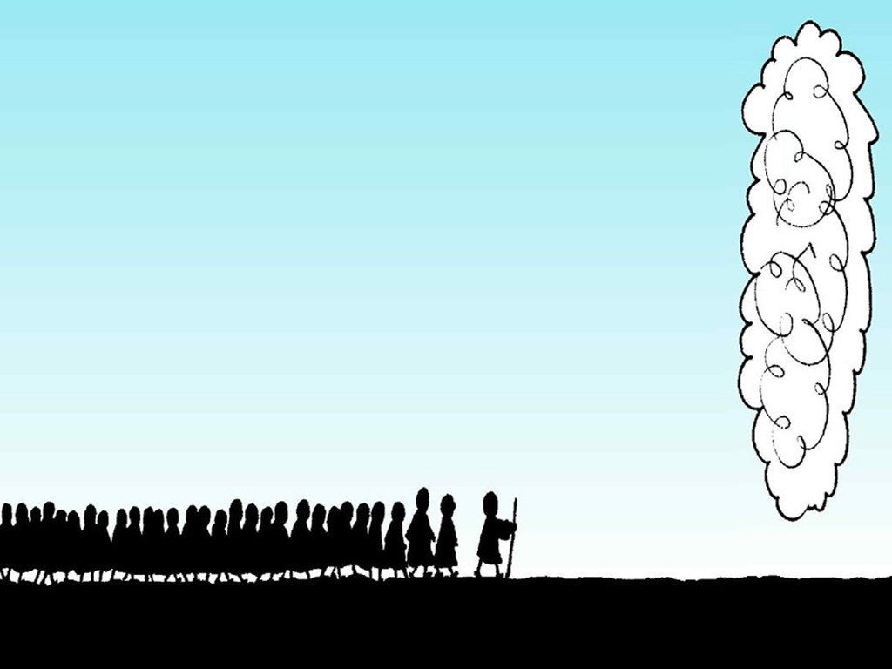
Notes:
Slide 11: Moses took the children of Israel from Egypt into the desert. God went ahead of them, in a tall cloud, every day.

Slide 12
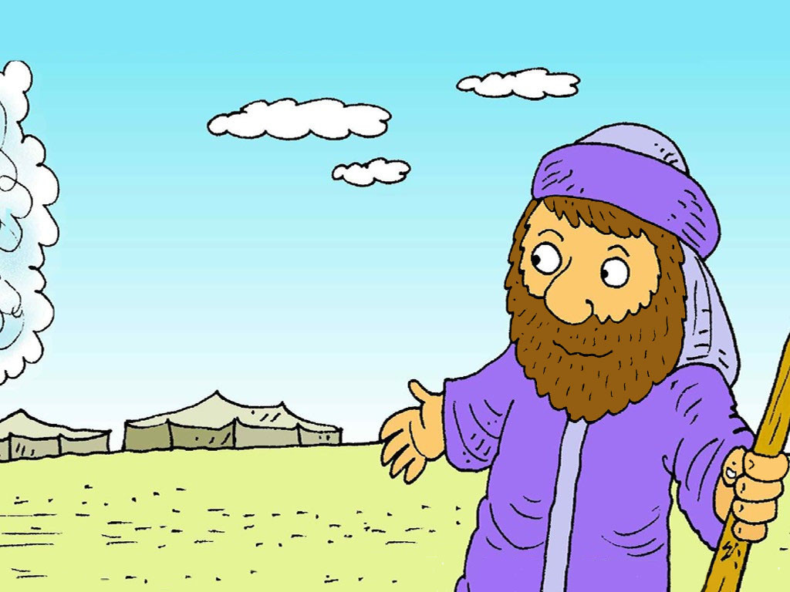
Notes:
Slide 12: Wherever the cloud stopped, the people stopped and set up their tents, until the cloud moved again.

Slide 13
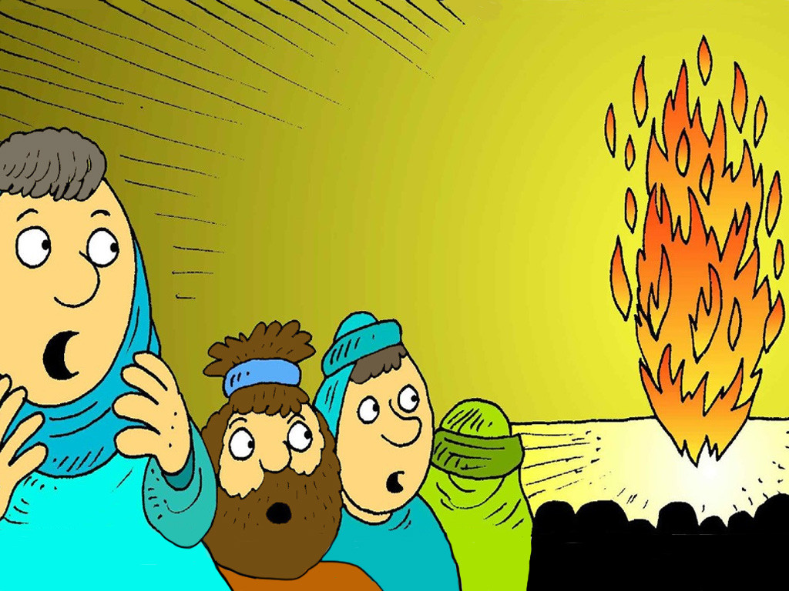
Notes:
Slide 13: God was with them, every night, in a tall pillar of fire. God kept them safe.

Slide 14
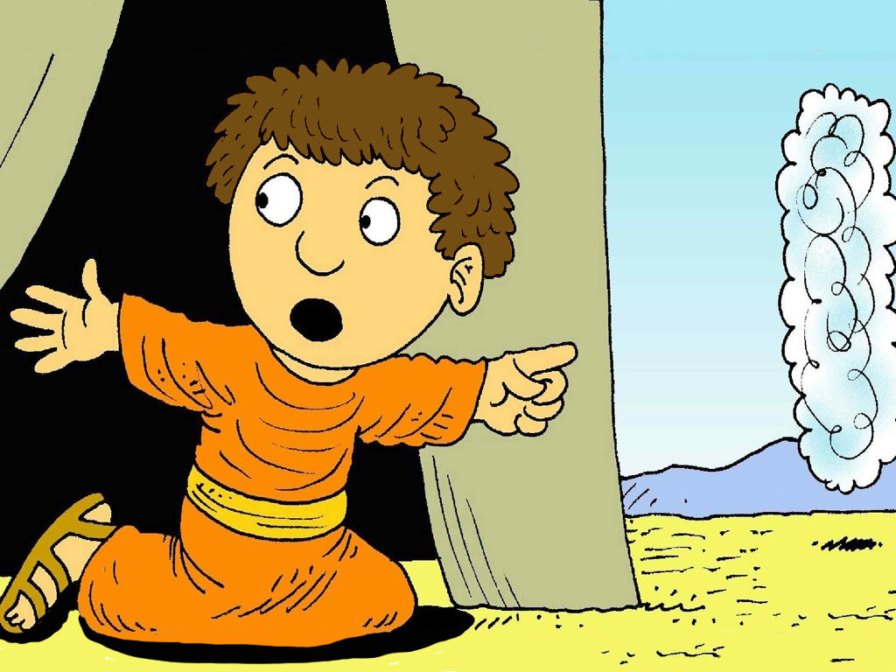
Notes:
Slide 14: Sometimes the cloud would stop for a long time. Then the cloud would move. ‘Follow the cloud,’ someone would shout.

Slide 15
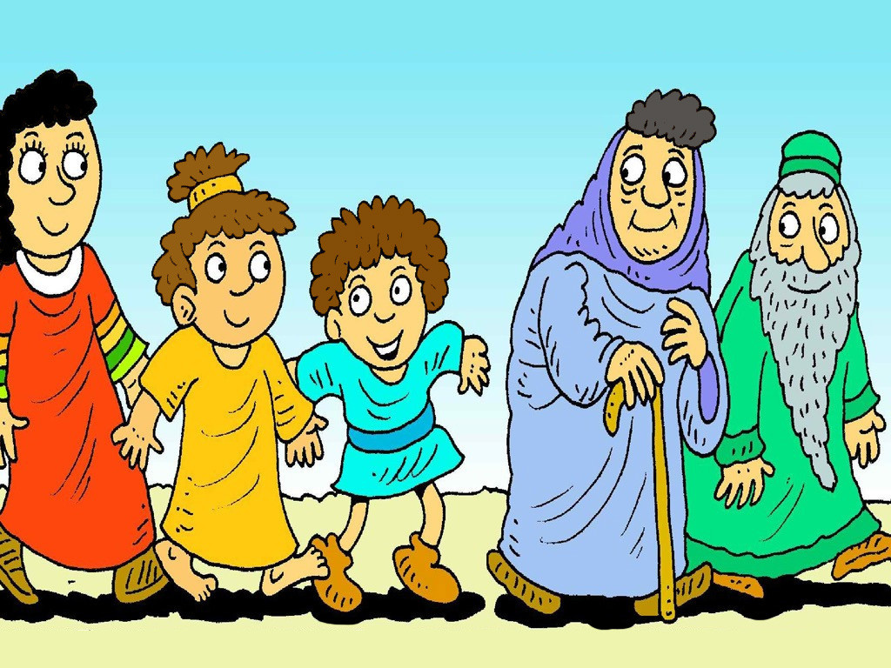
Notes:
Slide 15: But God’s presence in the cloud only moved as fast as the old people and the little children could walk.

Slide 16
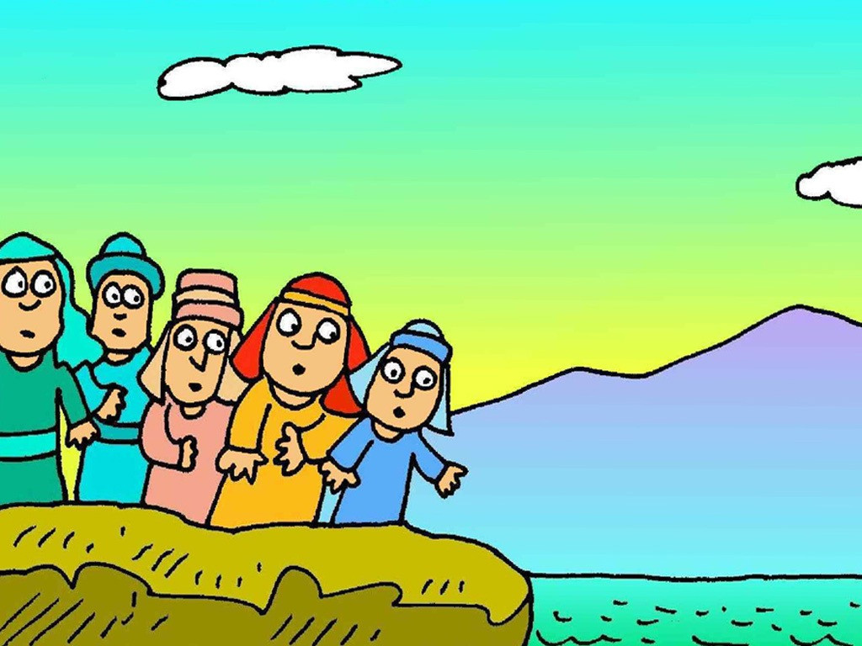
Notes:
Slide 16: Very soon, the people came to the Red Sea. The water was very deep and they could not get across. The soldiers were nearly catching up and the people didn’t know what to do.
How would they get across the wide, Red Sea? [ask children to problem-solve for a short while]
If you want to, you could use another song in the middle of our story that explains what happened next. [Click on the Israelites in the slide and the song will pop up in YouTube!]
You may wish to repeat this to allow children to join in – it’s not hard.

Slide 17
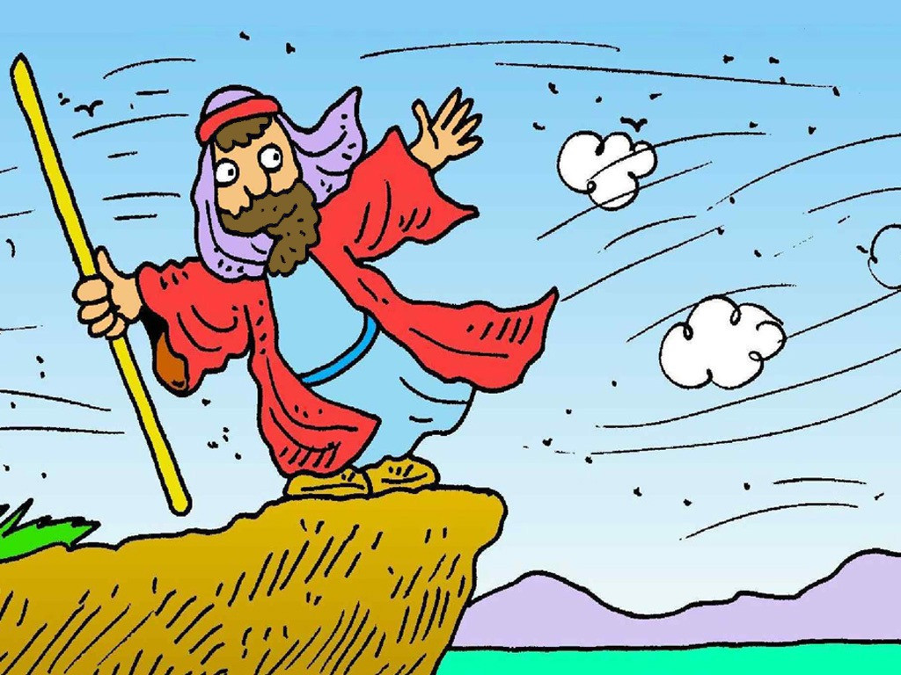
Notes:
Slide 17: So, God sent a big, strong wind. It blew a path in the sea, so that everyone could walk safely across the dry path, to the other side.

Slide 18
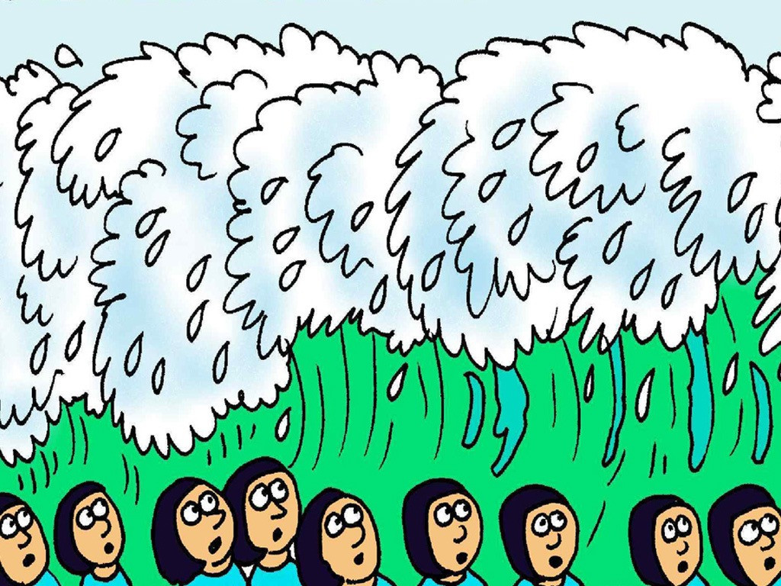
Notes:
Slide 18: But Pharoah’s soldiers were not quite so fortunate. When they tried to follow across the path and capture the Israelites, the wind stopped blowing and the waves came crashing down. God helped Moses, just like He promised.

Slide 19
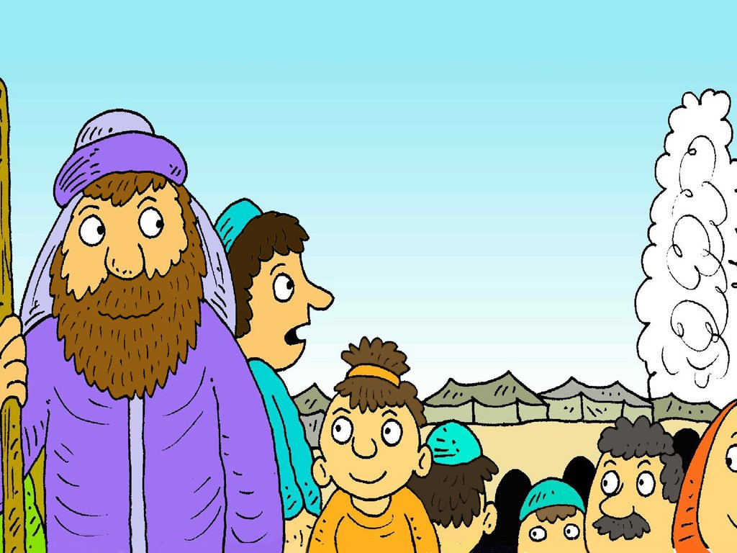
Notes:
Slide 19: Moses knew that God was always with them and would take them safely, to their new land. But although they had crossed the Red Sea, there was still a very long journey ahead of them – and the people were beginning to complain….. [add your own cliffhanger sound effects here!!!]

Slide 20
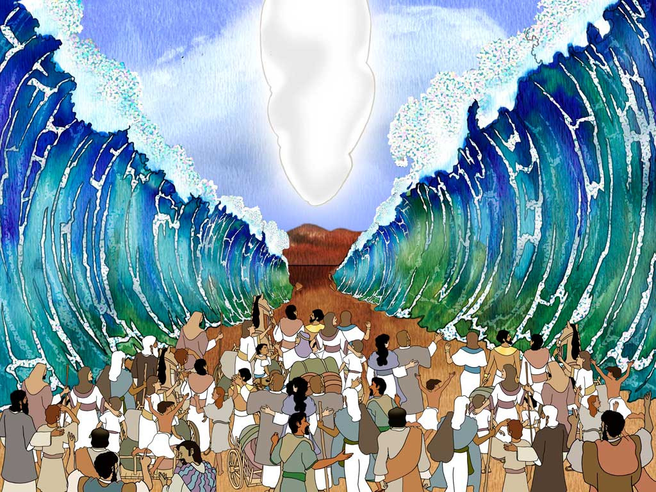
…I wonder how the people are feeling about the long journey that lies ahead of them?.....
…. I wonder what they might be complaining about?....
…. I wonder how it felt to be walking through the Red Sea, knowing that God had kept you safe?....
Notes:
Slide 20: Responding (words for worship):
We are going to take some time now to think about the part of the story we’ve shared today.
You might want to close your eyes to help you to focus…..
…I wonder how the people are feeling about the long journey that lies ahead of them?.....
…. I wonder what they might be complaining about?....
…. I wonder how it felt to be walking through the Red Sea, knowing that God had kept you safe?....

Slide 21
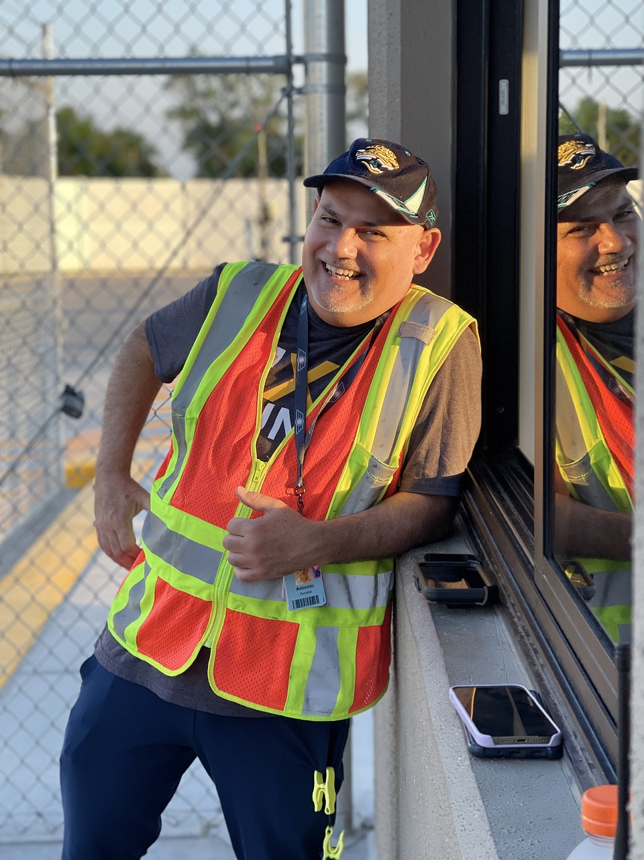
We are kept safe…
…keep them safe.
Notes:
Slide 21: Prayer
At the very beginning of our term, we thought about people who are important to us, who we wanted to be kept safe.
For our time together today, we are going to think about people whose work can sometimes be dangerous, people who work hard to keep us safe.
So, if you’d like to join me in praying like this, then use the words …keep them safe.’ after I say the words ‘Please God…’
God who protects, we are grateful for people who help to keep us safe.

Slide 22
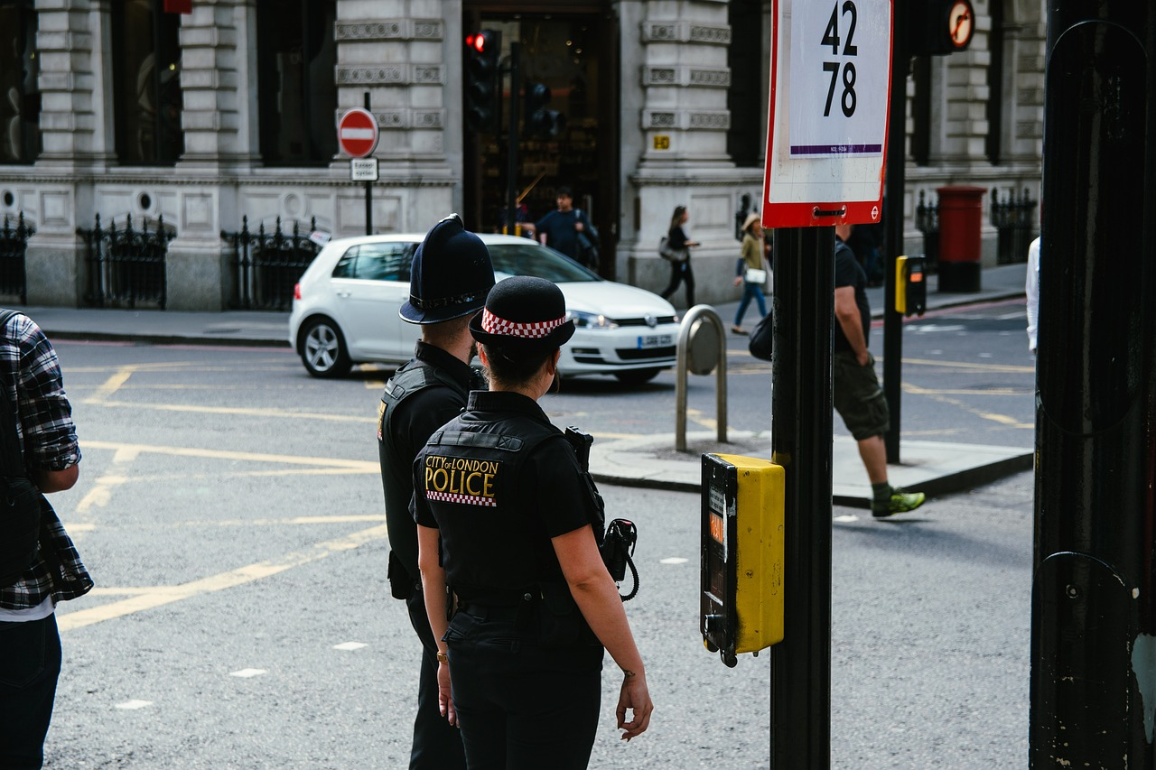
…keep them safe.
Notes:
Slide 22:
For police officers on our streets and in our neighbourhoods, please God….keep them safe.

Slide 23
…keep them safe.
Notes:
Slide 23:
For construction workers who work on our buildings and make them safe for us to live and work in, please God….keep them safe.

Slide 24
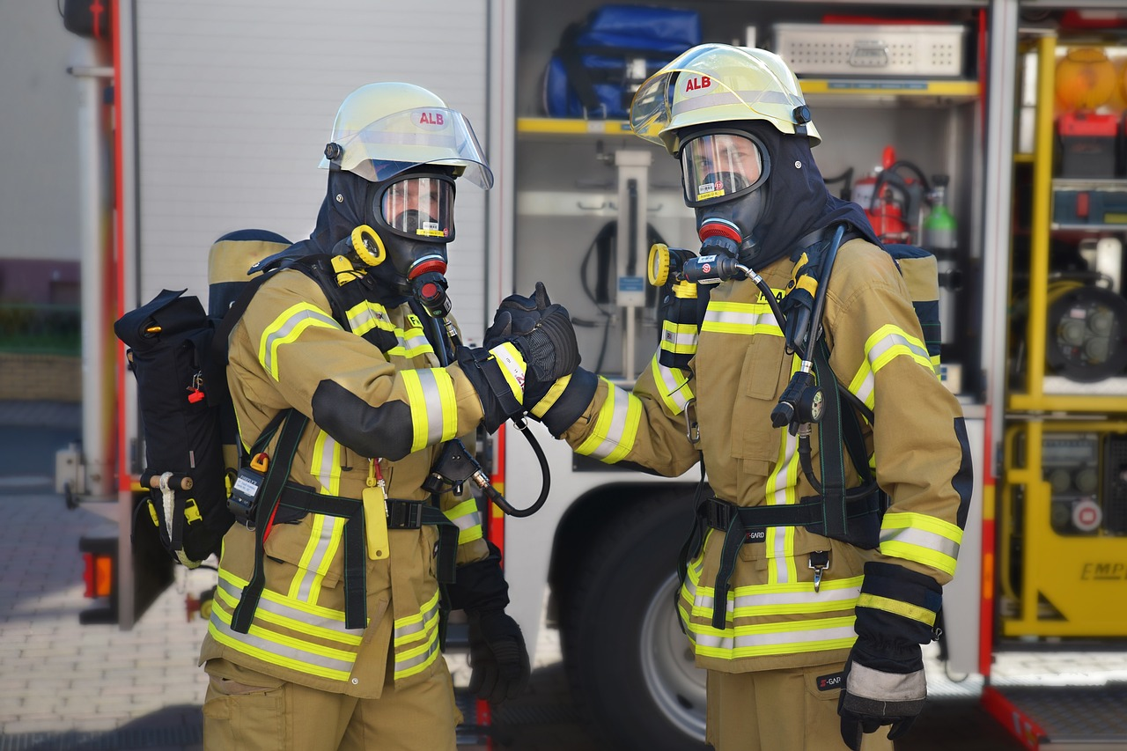
…keep them safe.
Notes:
Slide 24:
For fire fighters who rescue people from danger, please God….keep them safe.

Slide 25
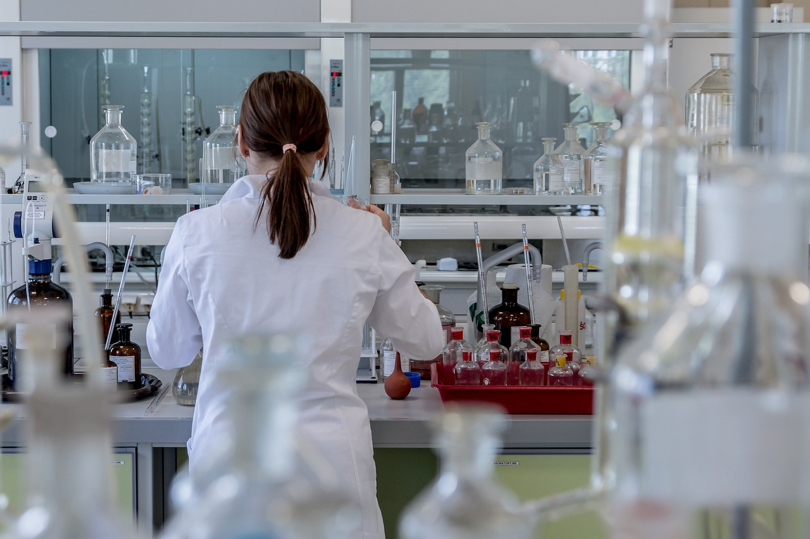
…keep them safe.
Notes:
Slide 25:
For all who work in labs to make medicines to treat us when we are ill, please God….keep them safe.

Slide 26
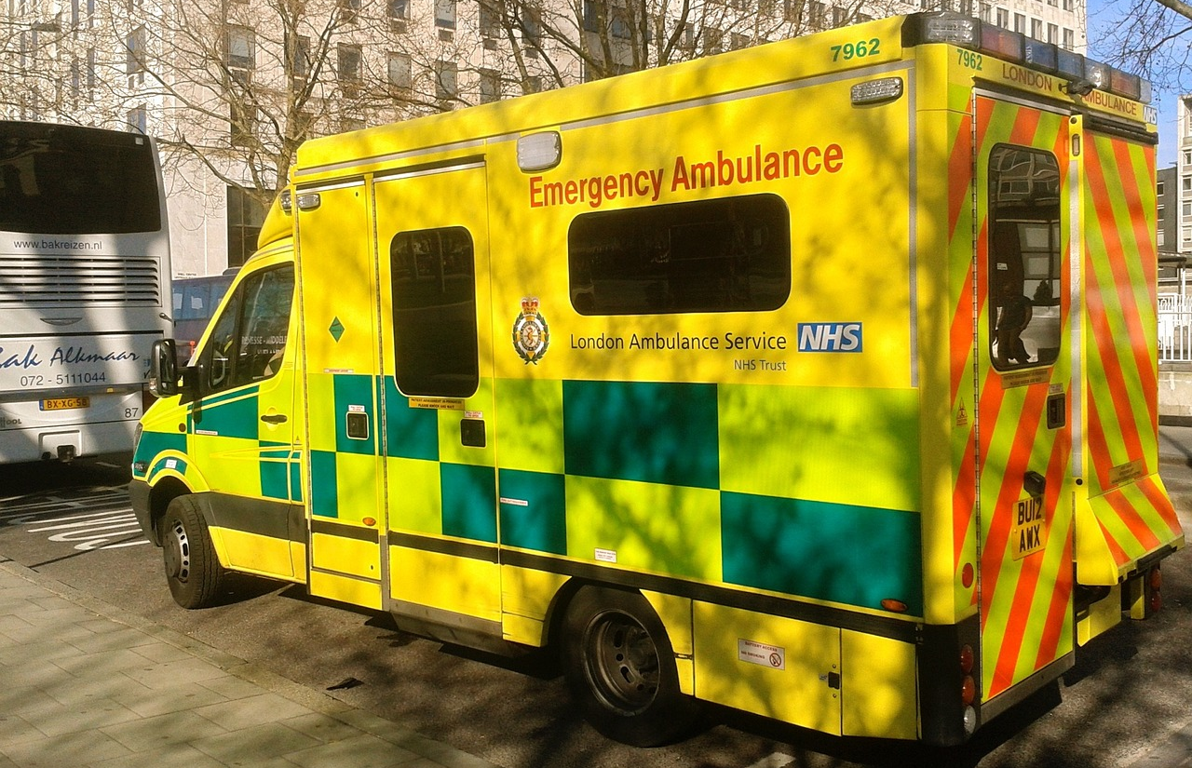
…keep them safe.
Notes:
Slide 26:
For paramedics, who help when there are accidents, please God….keep them safe.
For all who work to keep us safe, please God….keep them safe.

Slide 27
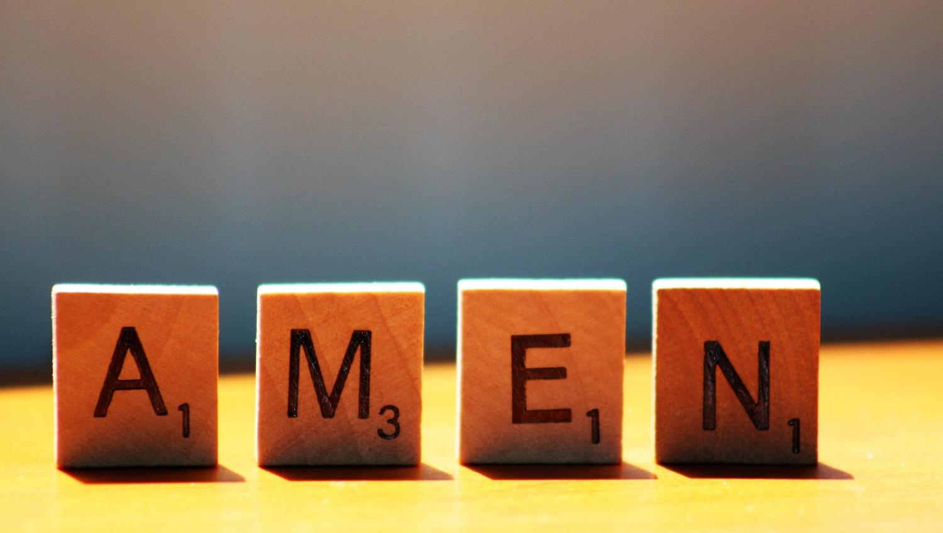

Slide 28

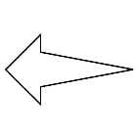

Leader: As we leave this place & time and go into the day ahead…
All: May today’s words help us to become a stronger community.
Notes:
Slide 22: Remind children of today’s key message – to remember to be grateful

Slide 29

Notes:
Slide 29: Reflective / prayer idea, using bright paper or sticky notes
God kept the people safe
God kept the people safe. Use bright sticky notes / paper to be grateful to / pray for the people who keep us safe.

