Slide 1
On the journey of life….
....we are glad to be together as a school community.
Notes:
Slide 1: Use these gathering words for this term, or your usual greeting if you prefer. Why not invent some actions to make them extra memorable?!

Slide 2
As we gather today….
....may we learn from each other and hear from God.
Notes:
Slide 2: Use these gathering words for this term, or your usual greeting if you prefer. Why not invent some actions to make them extra memorable?!

Slide 3
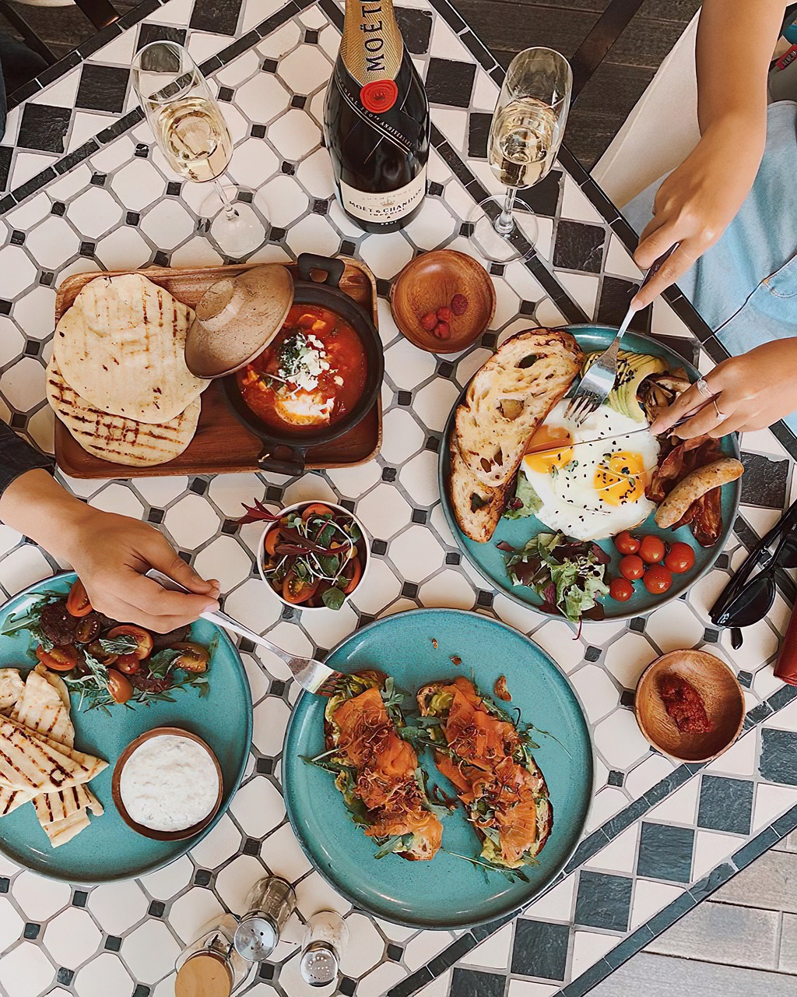
Food! Glorious Food!
Notes:
Slide 3: Who likes food?!
Today’s assembly is going to have a bit of a food theme, so to get us started (and our mouths watering!) let’s have a look at some food and decide when we might eat certain things…and why.

Slide 4
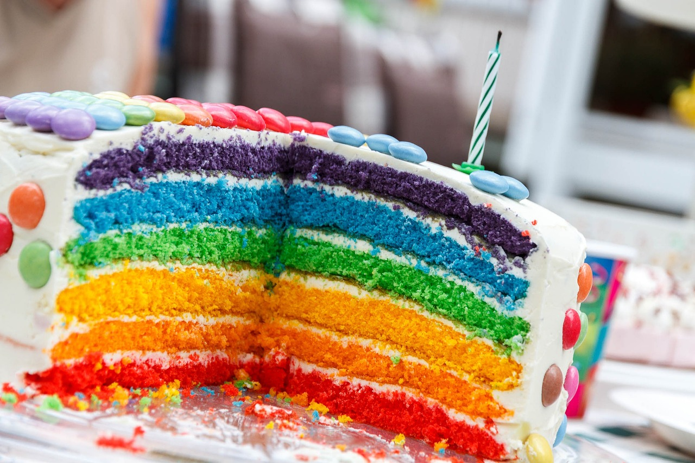
Notes:
Slide 4: Birthday – to celebrate being a whole year older

Slide 5
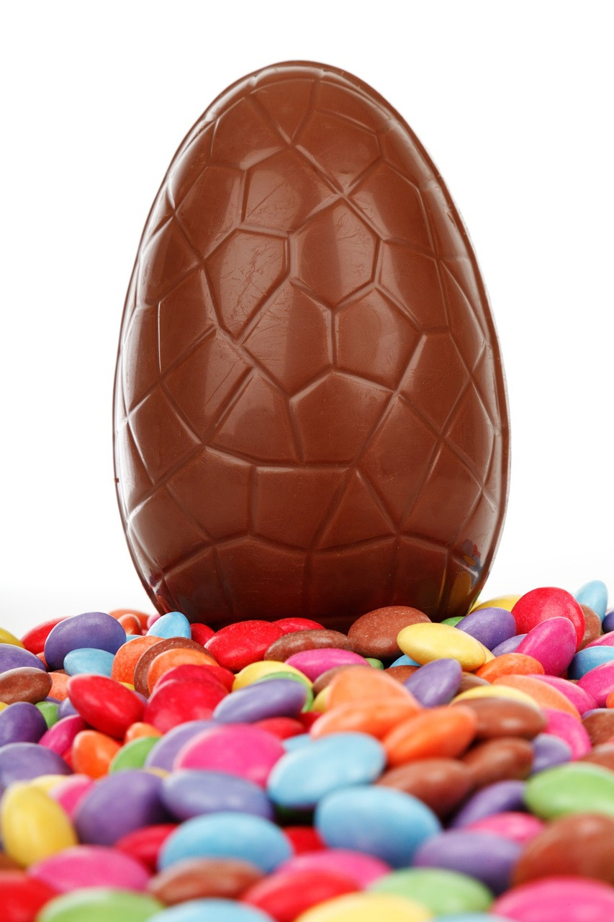
Notes:
Slide 5: Easter egg – the egg is shaped like the empty tomb at the resurrection of Jesus

Slide 6
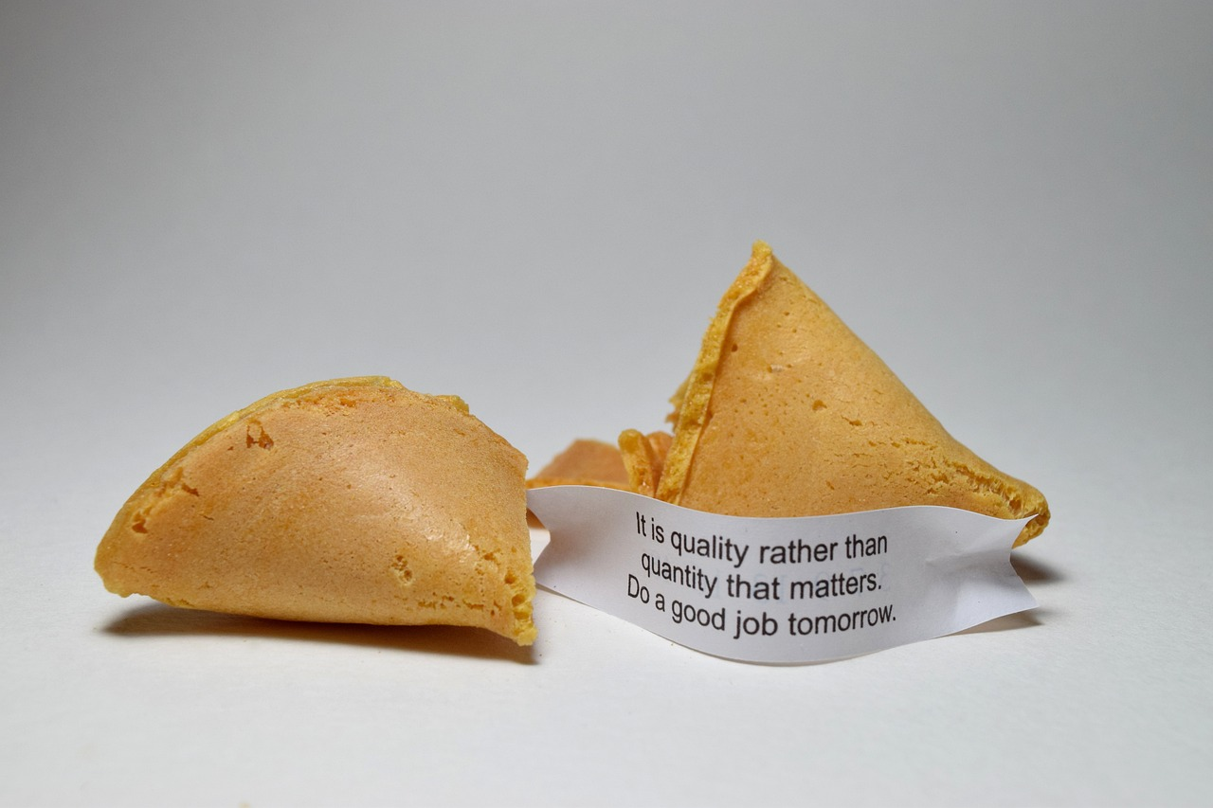
Notes:
Slide 6: Fortune cookies – which are a part of Chinese New Year festivals and often contain wise words to act on.

Slide 7
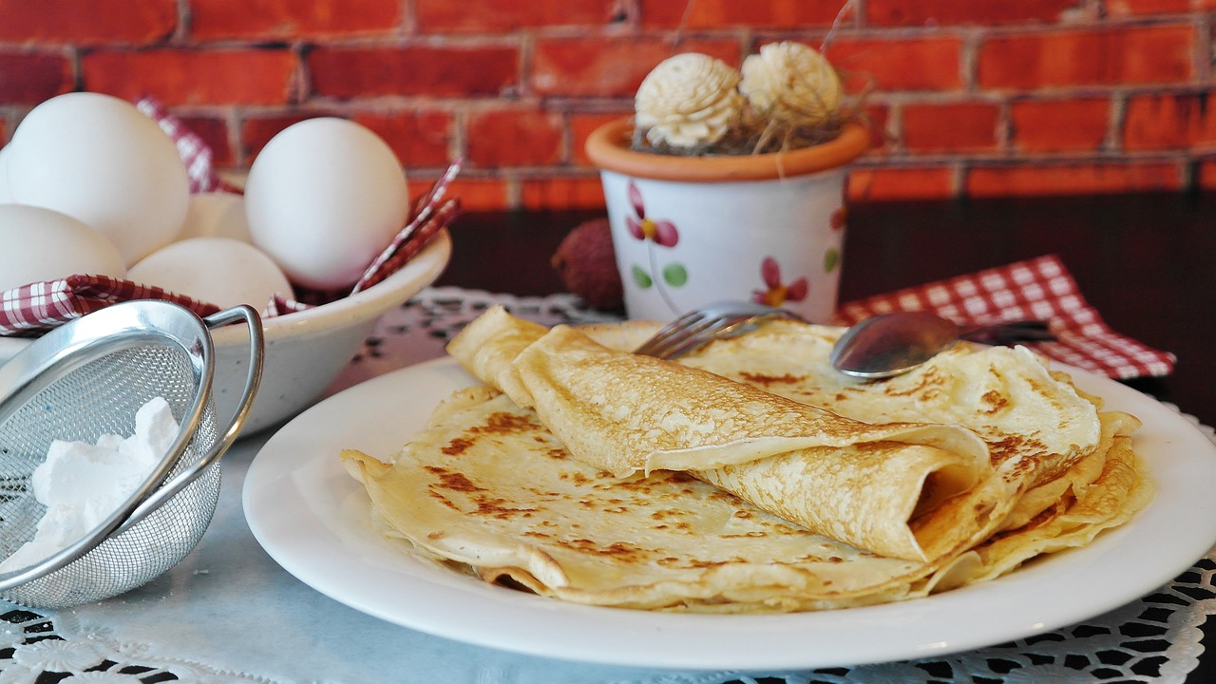
Notes:
Slide 7: Pancakes – the start of Lent, 40 days before Easter, remembering Jesus’ time in the desert

Slide 8
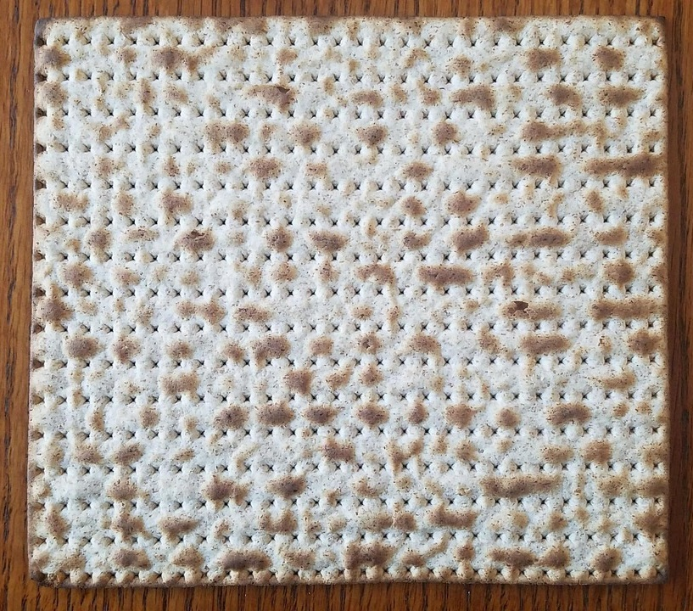
Notes:
Slide 8: So what’s this?!! Talk together about what this might be – it’s possible that some older pupils might know, but the best guess might relate to it being a cream cracker – which isn’t a bad guess!
This is a matza – a very flat kind of bread – which is eaten as part of a Jewish festival that’s linked to the next part of our Moses story: I’ll tell you more a bit later! But for now, keep your eyes and ears open to see if you can work out why….

Slide 9
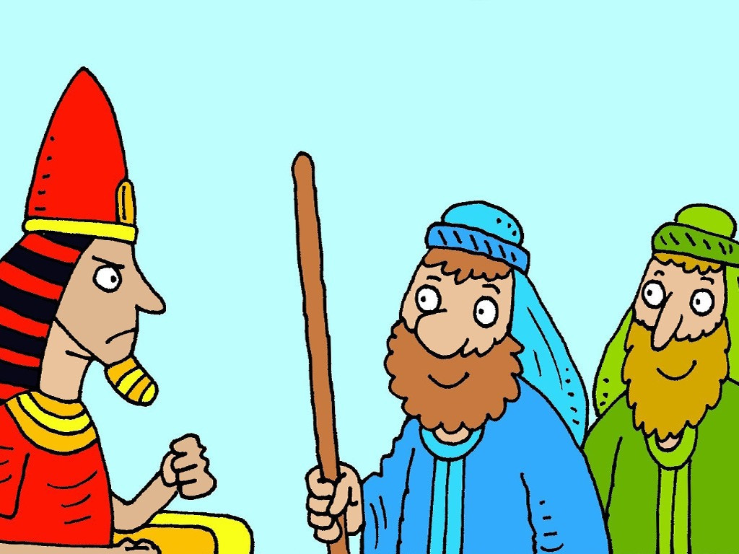
Stop the plague and you can go!
Moses: Are we nearly there yet?!
Autumn 2023
Notes:
Once again, we are very grateful to © FreeBibleImages for the Moses story pictures, with text adapted for this collective worship
Slide 9:
When we left Moses last week…..

Slide 10
?
!
Notes:
Slide 10:
…our story ended [sing it, as last week if you can!]:
‘And so God sent one final plague…
I’ll tell you all next week!........’
So Moses and Aaron had been to see Pharoah 10 times: 9 times he’d made – and broken – his promise to let God’s people go.
The final plague was even more terrible than the previous 9 and it plays a big part in the festival that uses the special flat bread, so let’s find out what happened next….

Slide 11
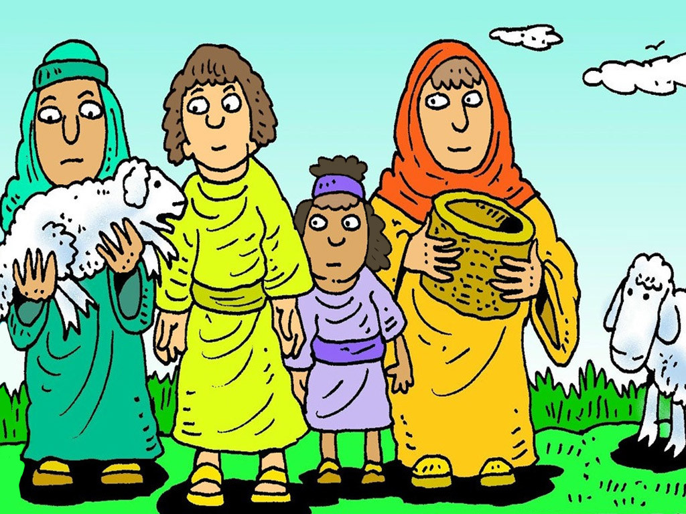
Notes:
Slide 11: God told Moses, ‘Gather the people of Israel and tell every family of Israel that they must eat a meal of roast lamb, with herb sauce and bread. It will be a quick meal, because you need to be ready to leave when Pharoah agrees to let you go.’

Slide 12
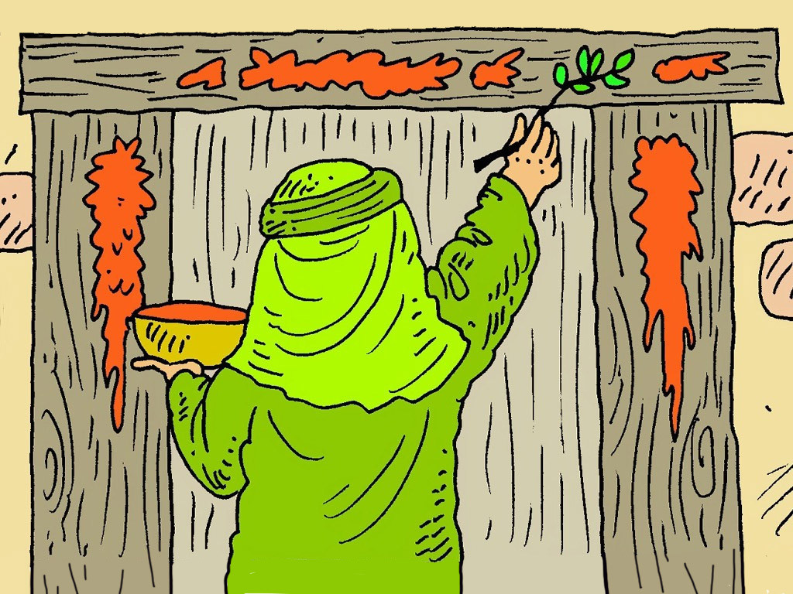
Notes:
Slide 12: ‘Take a small branch and paint the blood of the lamb around the door frame. It will keep you safe from the death that will come on the land. You must remember how you were slaves in Egypt, and this day of freedom, for all time,’ said God.

Slide 13
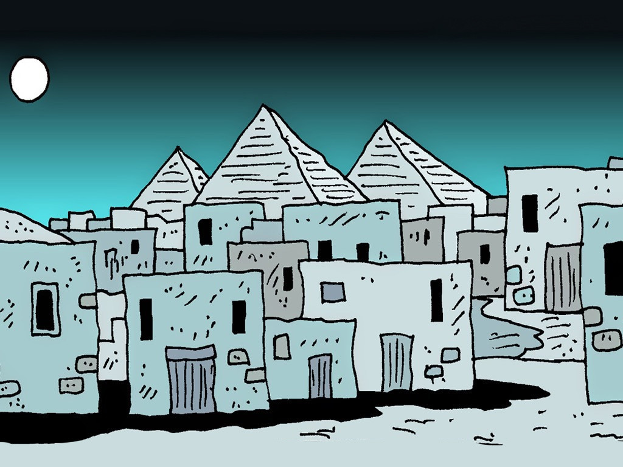
Notes:
Slide 13: ‘Stay inside your house because death will pass through the city. The oldest son in each family will die because Pharaoh will not listen and let God’s people go.’

Slide 14
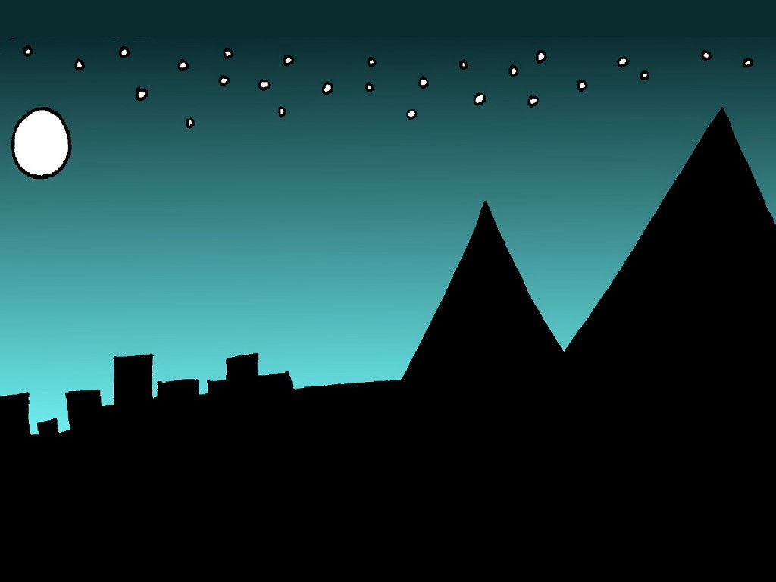
Notes:
Slide 14: So, the families of Israel did as God told Moses and prayed that God would keep them safe. They gathered to eat their meal of lamb, herbs and bread, but it all happened more quickly than they were expecting….That night, even Pharaoh's eldest son became sick and died. But God kept the families of Israel safe.

Slide 15
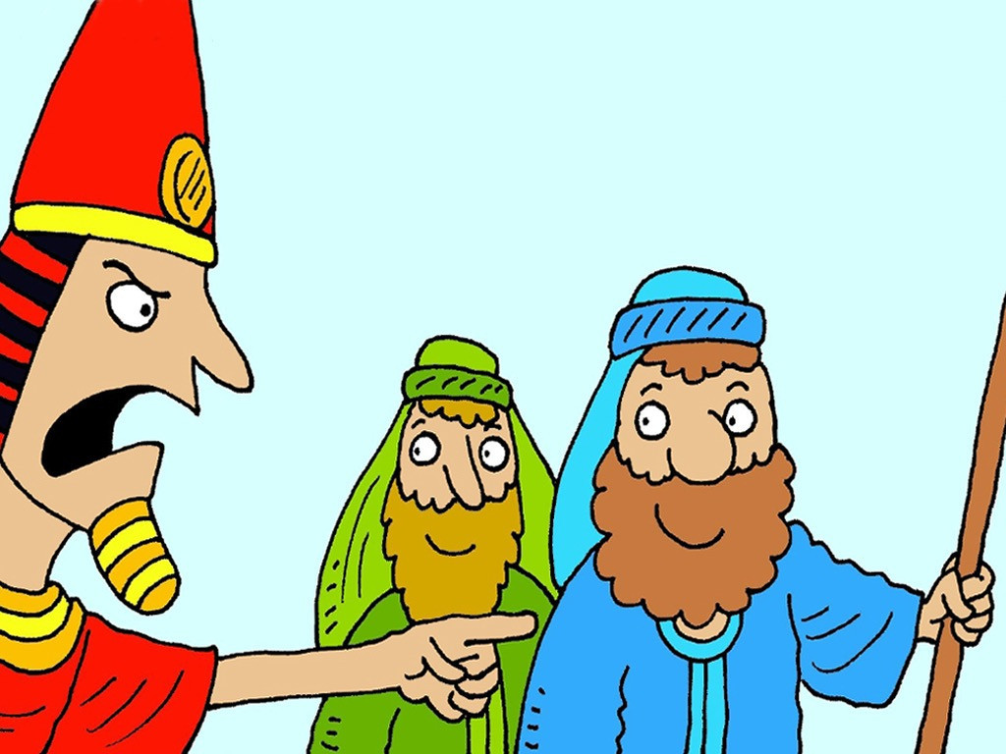
GO!
Notes:
Slide 15: And so, Pharaoh finally changed his mind. He summoned Moses and Aaron in the middle of the night and told them to go!

Slide 16
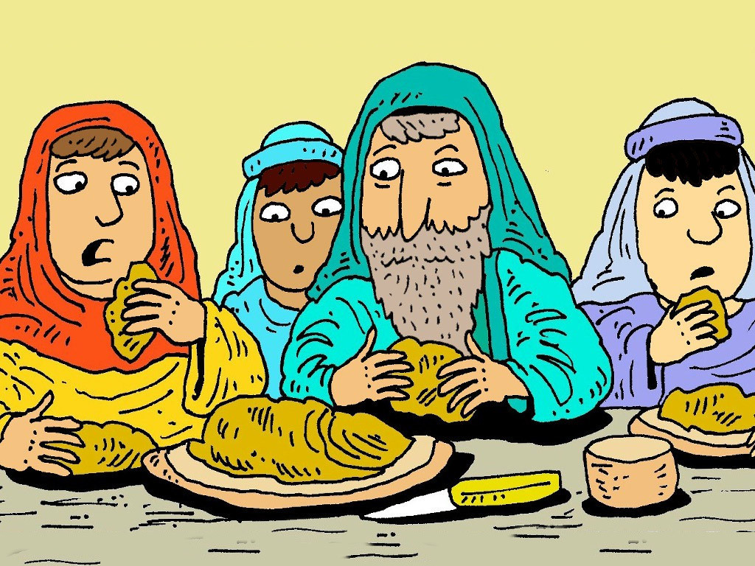
Notes:
Slide 16: The people of Israel didn’t even have time to put yeast in their bread….but packed it up with all that they owned, before Pharoah changed his mind!

Slide 17
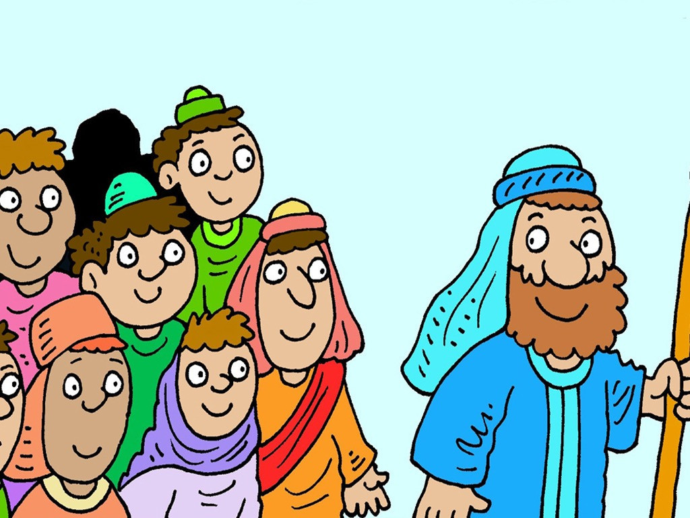
Notes:
Slide 17: And so early the next morning, all the children of Israel left Egypt. After 430 years of being slaves they were free, just as God had promised! But this was only just the start of their big adventures…..
[add your own cliffhanger sound effects here!!!]

Slide 18
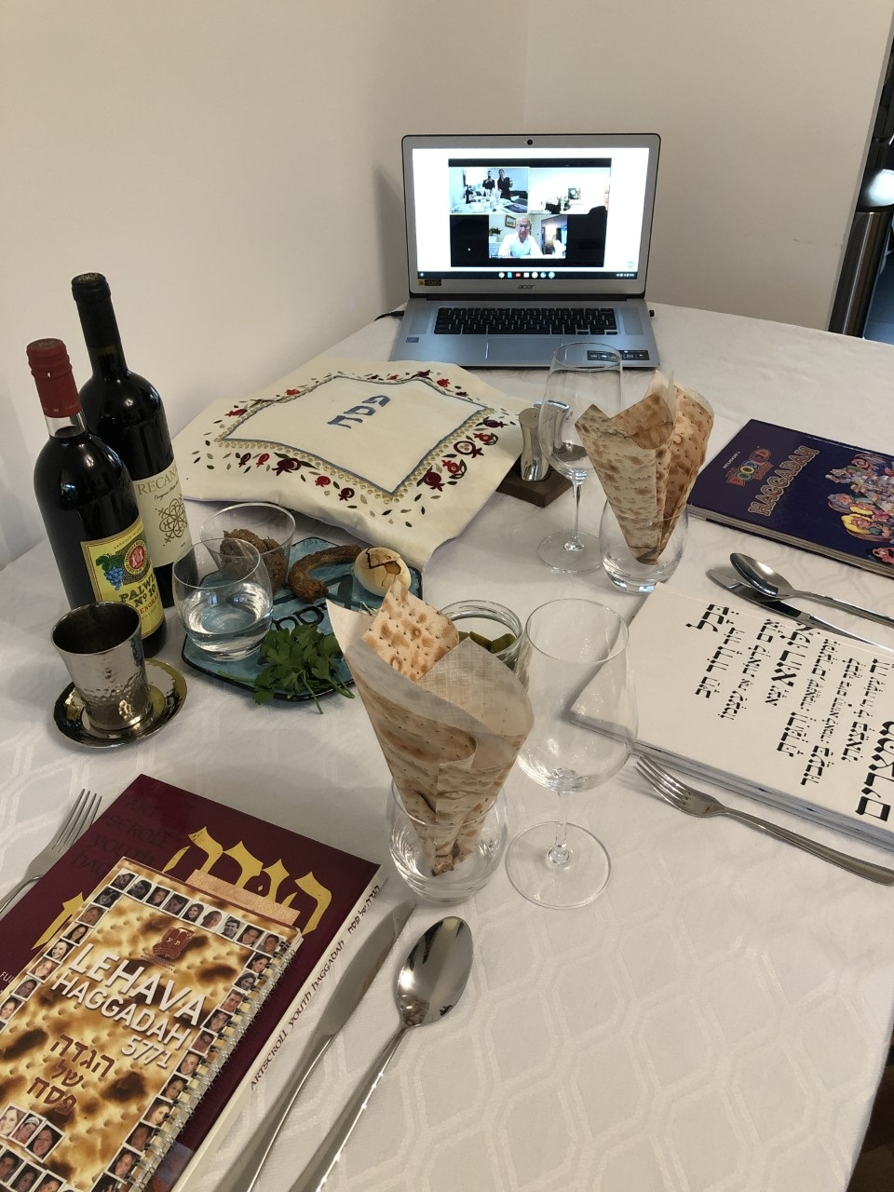
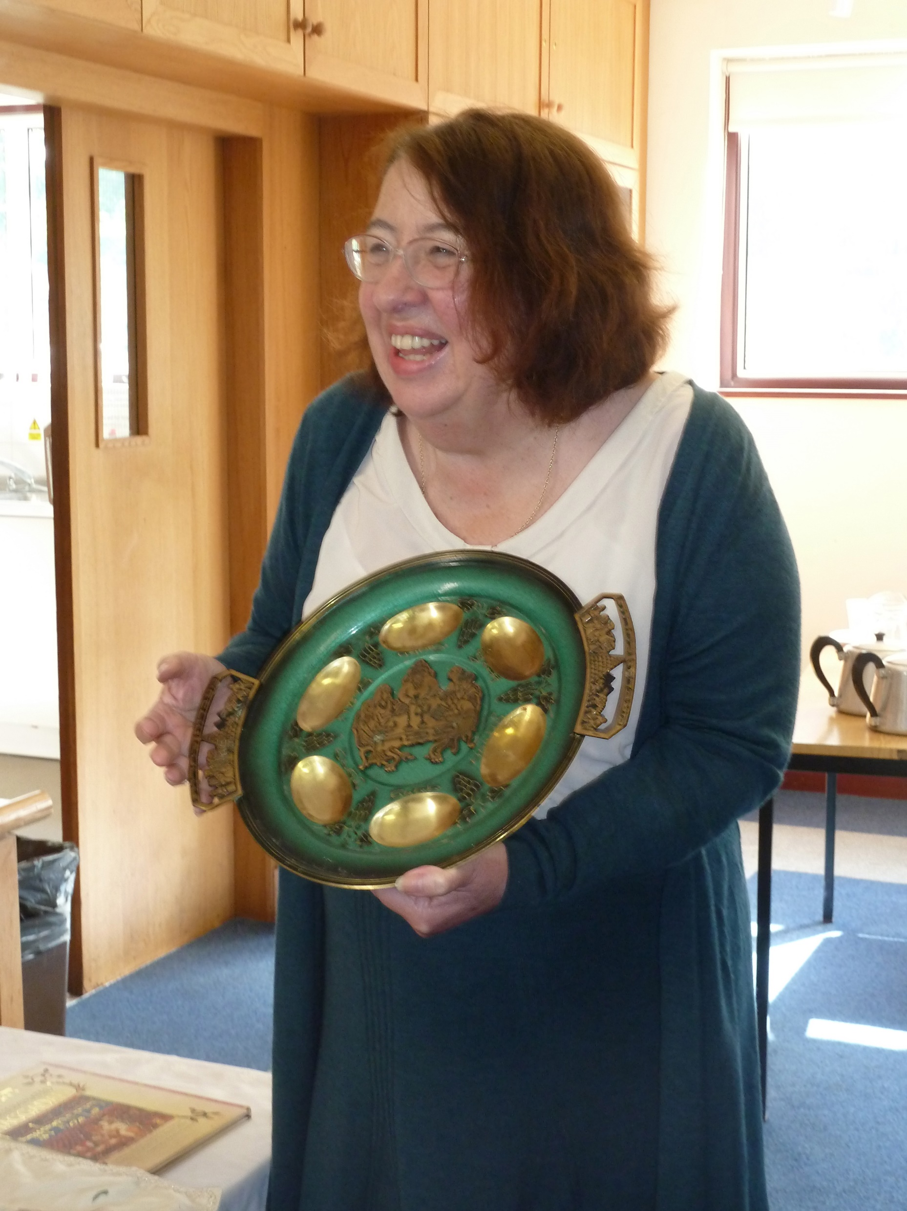
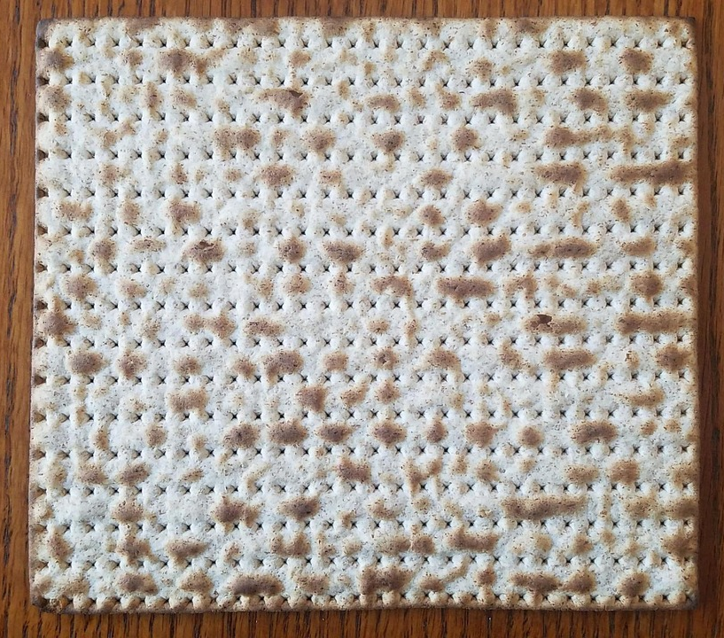
‘Remember….’
Notes:
Photo, left © Jewish Museum, Passover in lockdown; right © Surrey SACRE
Slide 18: This is how Jewish people today do what God commanded the people when they left Egypt – to remember how they had been slaves, but that he had set them free. The festival is called Passover, because death ‘passed over’, and happens around our Easter time.
As well as being a serious time to remember, it’s also lots of fun – and has a special meal that happens, with special food put onto a plate called a seder plate [you can see it in the photo]. Each item has a place on the plate, and in the story – including matzah, which symbolises the flat bread that God’s people carried out of Egypt when they left.

Slide 19
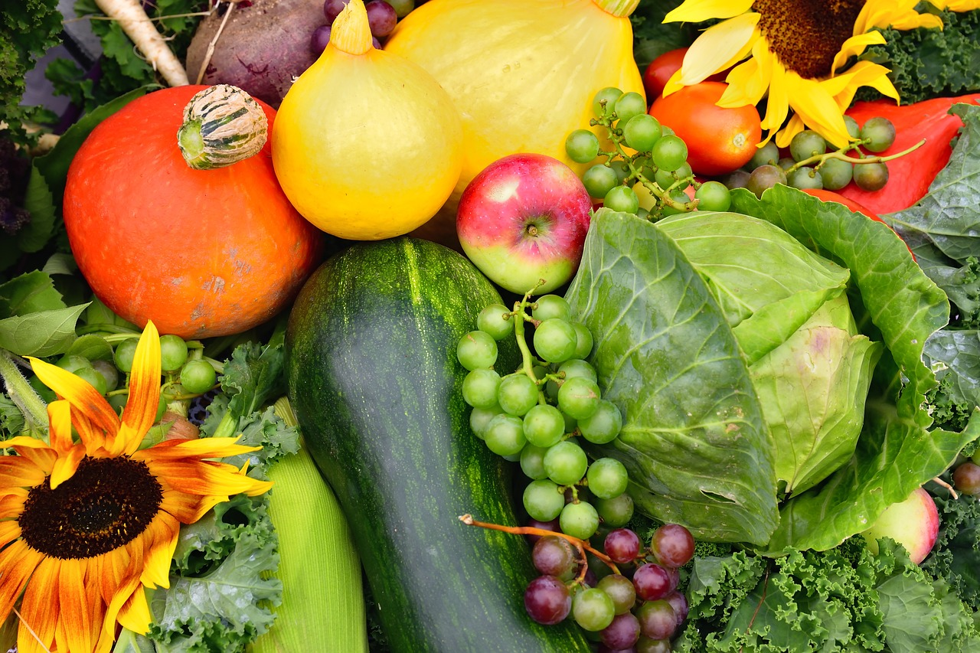
…. I wonder what these things might remind us of?....
…I wonder how Harvest time reminds us to be thankful?......or what other things we might want to be grateful for today?.....
…. I wonder how being grateful might help us to build a stronger community?....
Notes:
Slide 19: In schools this week, many of us will be thinking about food too: it’s Harvest Festival time!! The foods we grow and buy can be reminders for us to be thankful too….
So let’s pause and do that now….
…..as we look at the picture, I wonder what these things might remind us of?....
….I wonder how Harvest time reminds us to be thankful?....or what other things we might want to be grateful for today?.....
….I wonder how being grateful might help us to build a stronger community?....

Slide 20
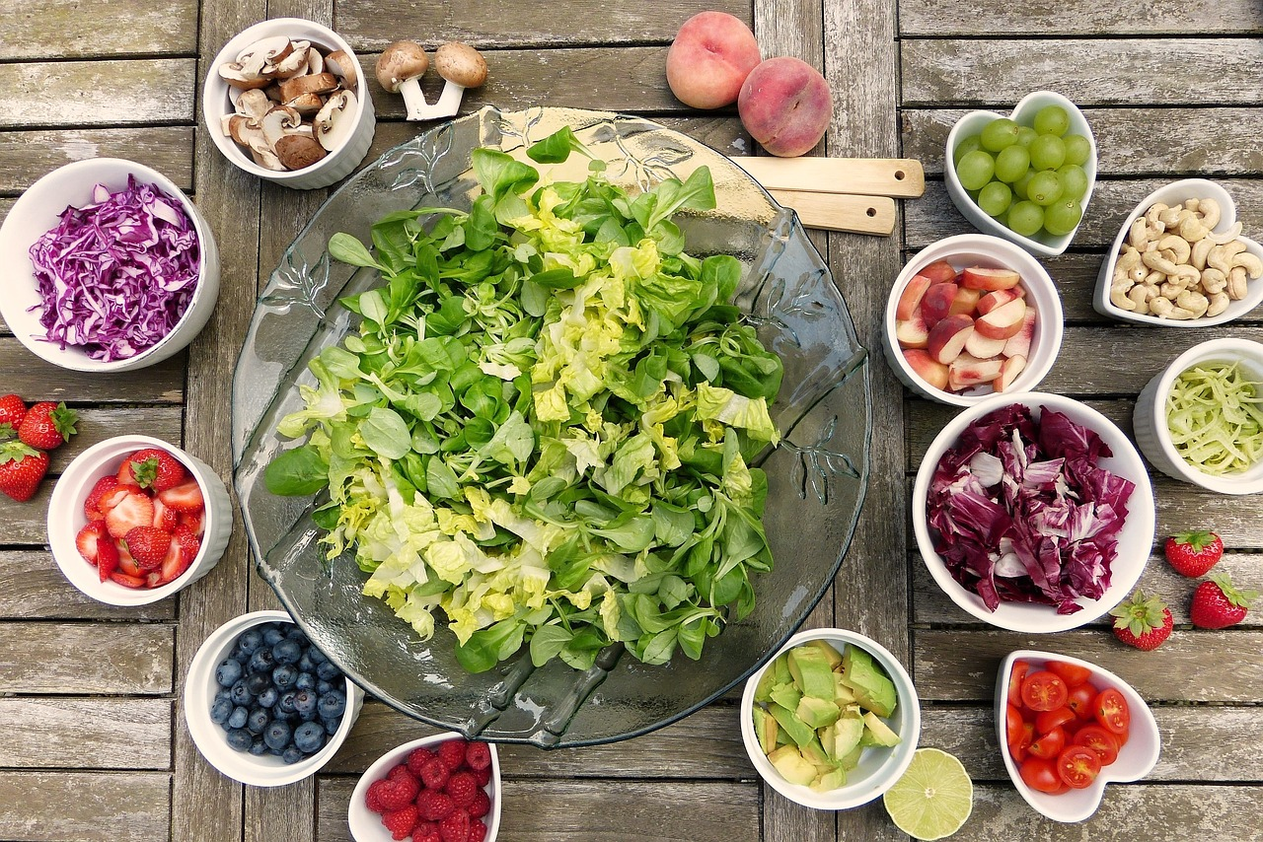
We are grateful for…
Notes:
Slide 20: Prayer
Today, we are going to pray in a very different way – as always, you can choose to pray, or not to…..
For a few moments, we’ll be quiet and think, but we are going to pray a very LOUD prayer shortly….
In the stillness now, think about one thing that you are super-grateful for and hold it in your thoughts……
Now, after I say the words ‘We are grateful for…..’, we’re going to shout out the thing that we’ve been thinking about in one big, thankful prayer. Are you ready?!
We are grateful for……

Slide 21
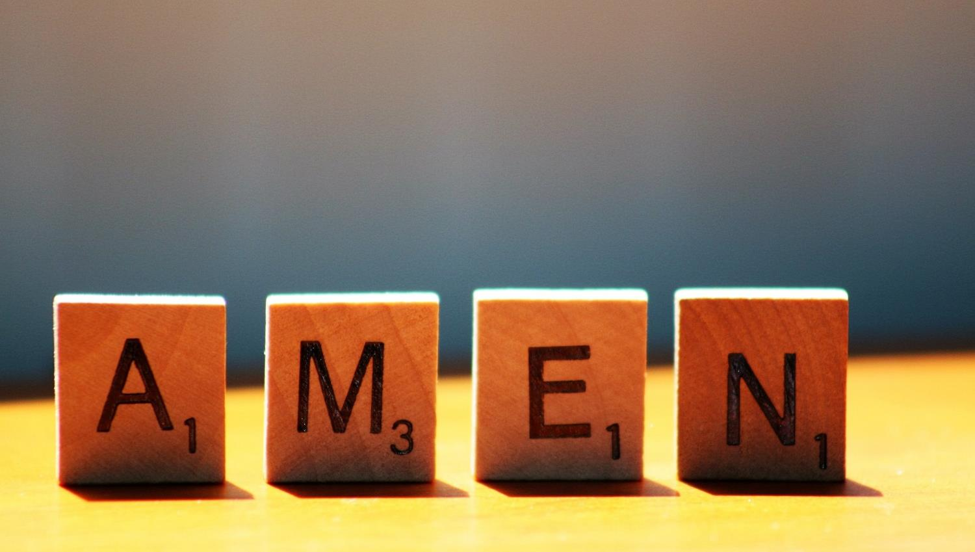

Slide 22
Leader: As we leave this place & time and go into the day ahead…
All: May today’s words help us to become a stronger community.
Notes:
Slide 22: Remind children of today’s key message – to remember to be grateful

Slide 23
Notes:
Slide : Make a seder plate
Our theme this week reminds us that we have much to be thankful for at Harvest time. Like Jewish people will put special foods on their seder plate to help them to remember how God set them free, draw some things on your plate to help you to remember or say thank you this Harvest time – or for anything else that you are grateful for.

