Slide 1
On the journey of life….
....we are glad to be together as a school community.
Notes:
Slide 1: Use these gathering words for this term, or your usual greeting if you prefer. Why not invent some actions to make them extra memorable?!

Slide 2
As we gather today….
....may we learn from each other and hear from God.
Notes:
Slide 2: Use these gathering words for this term, or your usual greeting if you prefer. Why not invent some actions to make them extra memorable?!

Slide 3
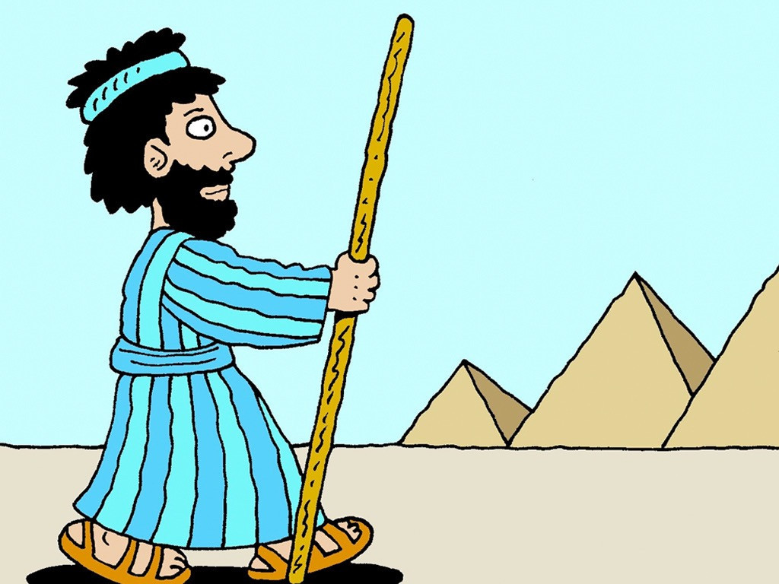
Moses: Are we nearly there yet?!
Autumn 2023
Notes:
Once again, we are very grateful to © FreeBibleImages for the Moses story pictures
Slide 3:
When we left Moses last week, God had given him a very important – and difficult! – job to do, to go to Pharoah and ask him to let the Israelites leave Egypt and journey to the Promised Land.
We’re going to pick the story up in a few moments but first…..there are some things about this next part of the story that you should know before we start.
As we heard last week, the Pharoah in Joseph’s time had given his family the land of Goshen to live in, but after he died the new Pharaoh king treated the Israelites badly and now they were his slaves.

Slide 4
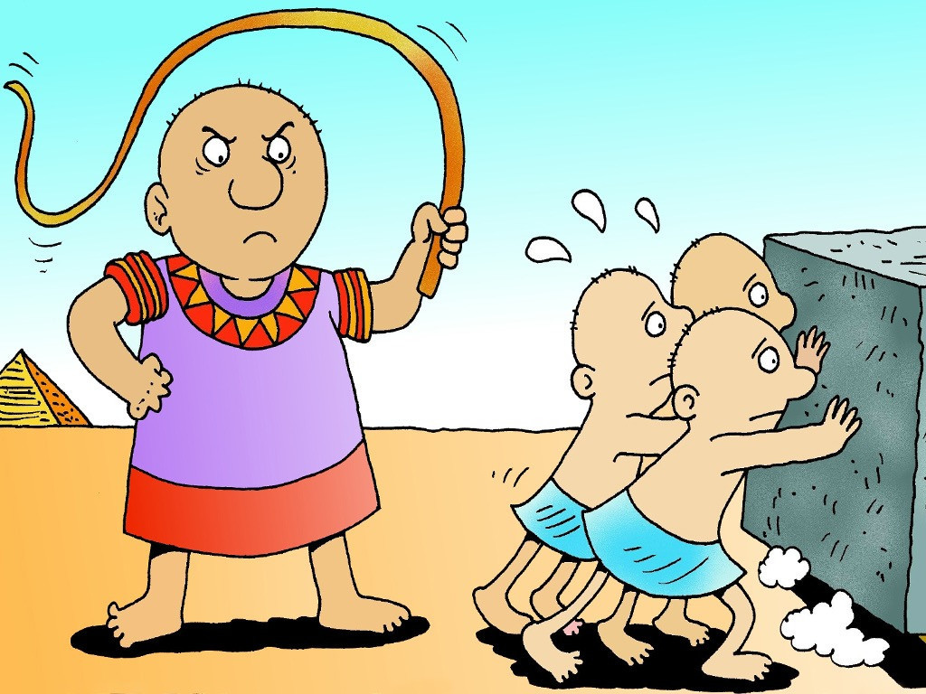
Notes:
Slide 4:
He made them work hard for hardly any money, he ordered his men to whip them, for hardly any reason and worst of all he gave them a nearly impossible job to do.
Their work was to make bricks that would be used to build Egypt’s mighty pyramids, but Pharoah wouldn’t give them any straw to put into the bricks – he told them that they had to go and find it for themselves.
Pharoah was a cruel, unkind ruler – and it’s no wonder that God, who had called Moses in the burning bush, saw what Pharoah was doing and decided he could stand it no longer. And so, God chose Moses to face Pharoah, to ask him to let the slaves go free and then to lead the people to the Promised Land. But if Pharoah chose to be stubborn, and not release the people, there would be consequences – and these come in the form of ten very strange things, in the Bible they are called ‘plagues’.
So that’s where we’ll pick up the story in a moment, but first, for something almost completely different!

Slide 5
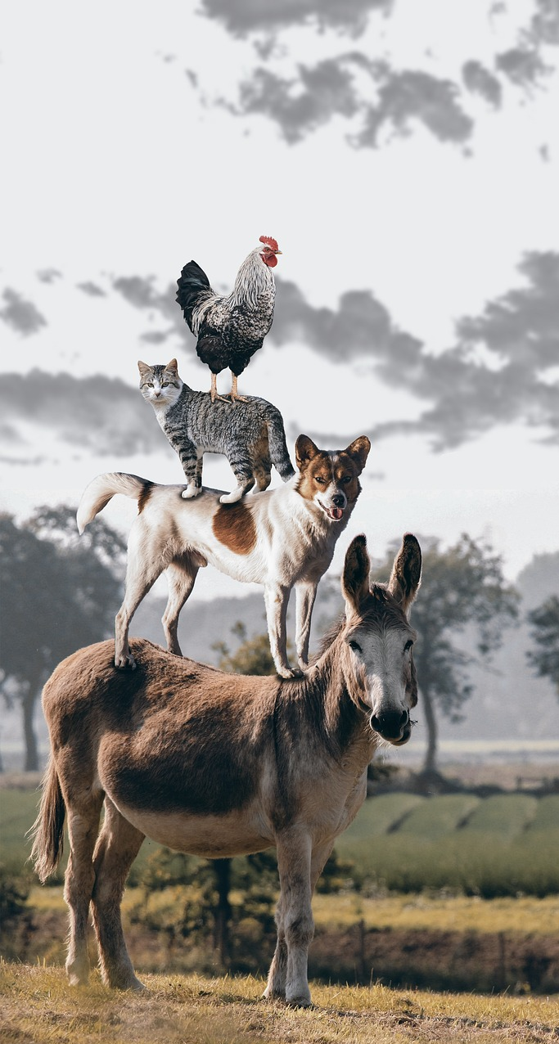
Old Macdonald had a farm…
Notes:
Slide 5: Old Macdonald had a farm….
I wonder if you know this nursery rhyme? [Have a quick sing-along if you need to, to remind yourselves…]
We are going to use the tune of Old Macdonald to tell the next part of Moses’ story, about Pharoah and the plagues, but before we do, let me teach you how the words will go!

Slide 6
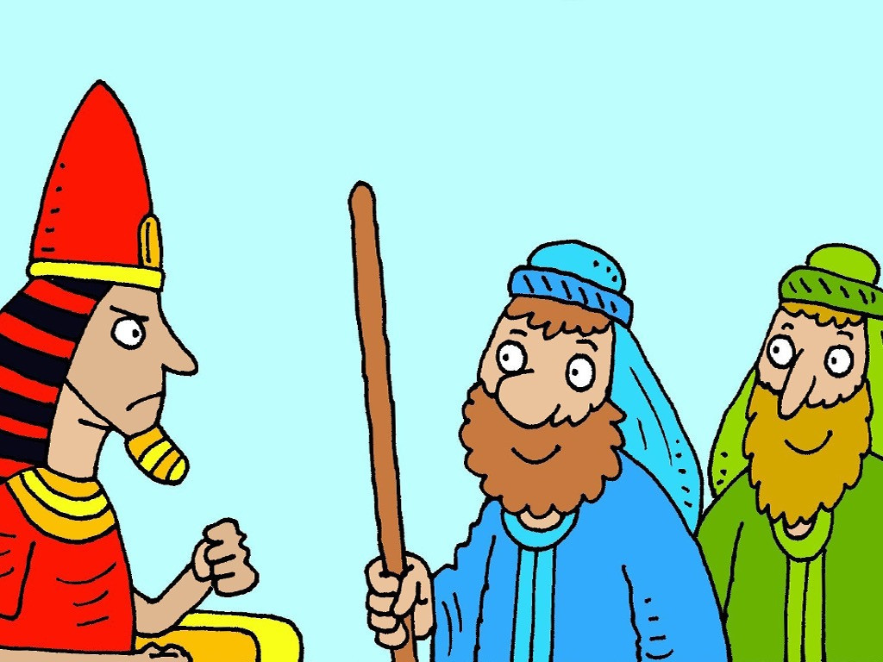
Stop the plague and you can go!
NO!
Notes:
Slide 6:
To the part of the tune that goes ‘Old Macdonald had a farm’, we are going to sing these words, which are Pharoah’s words
‘Stop the plague and you can go!’
To the part of the tune that goes ‘E-I-E-I-O!’ we are going to sing these words, ‘But then he changed his mind…..NO!’ (which he does, every time!)
And then to the bit that goes ‘And on that farm there was a ……’, I will tell you what happens because of Pharoah’s choice – and then you can join me with the join-in part! It’s very easy and you’ll soon get the hang of it.
So let’s begin…..

Slide 7
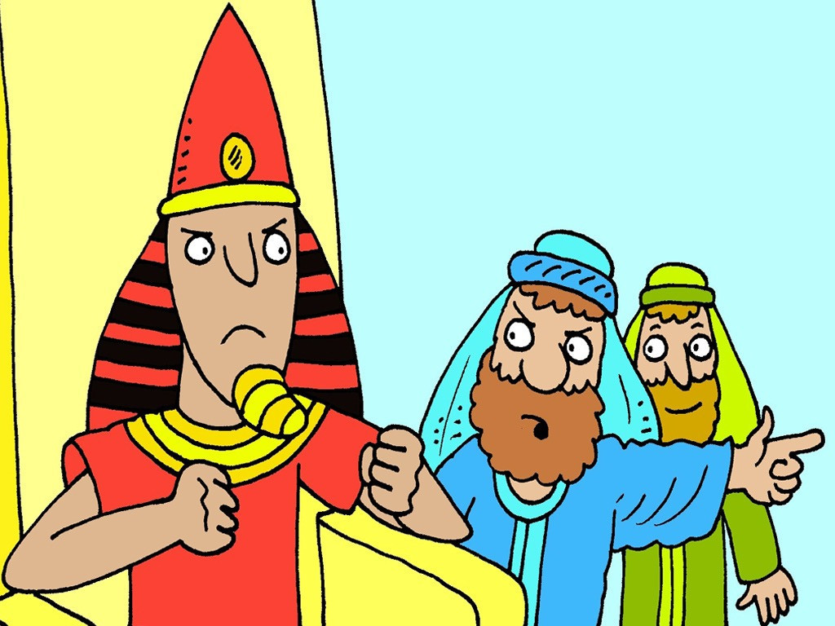
Pharoah, let God’s people go!
NO!
Notes:
Slide 7:
I’m going to start the song, with Moses: [to this same tune]
Pharoah, let God’s people go!’
‘But Pharoah just said: ‘NO!’

Slide 8
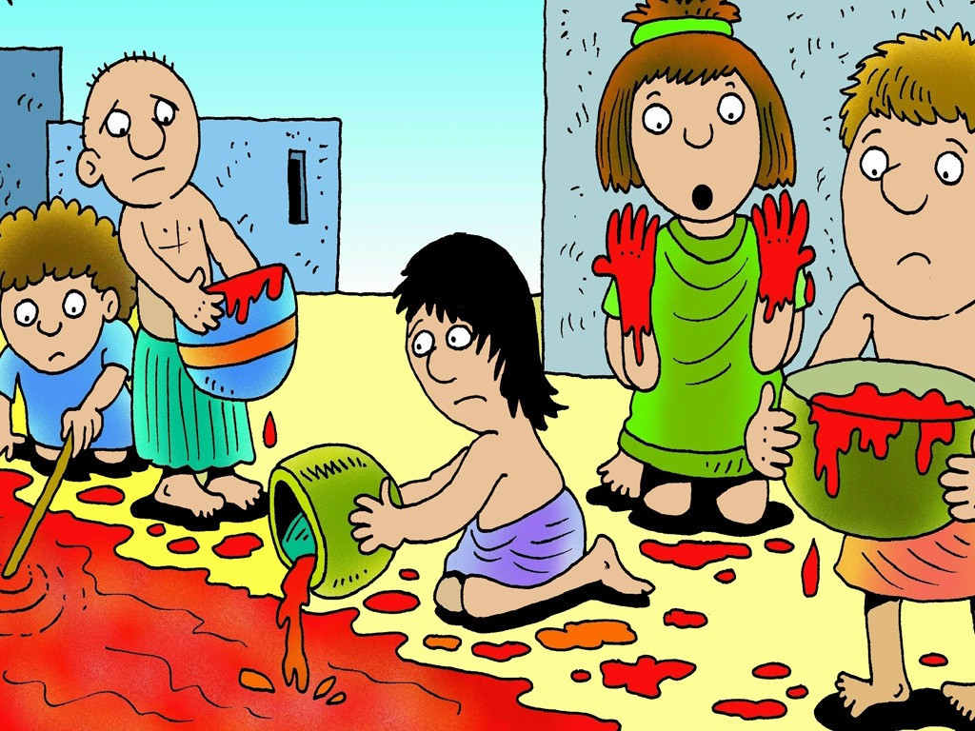
NO!
Notes:
Slide 8:
And so God sent a river of blood, cos Pharoah just said ‘NO!’
With a ‘Yuck! Yuck!’ [hold nose] here and a ‘Yuck! Yuck!’ there
Here a ‘Yuck!’, there a ‘Yuck!’ everywhere a ‘Yuck! Yuck!’

Slide 9
Stop the plague and you can go!
NO!
Notes:
Slide 9:
‘Stop the plague and you can go!’
But then he changed his mind…..NO!

Slide 10
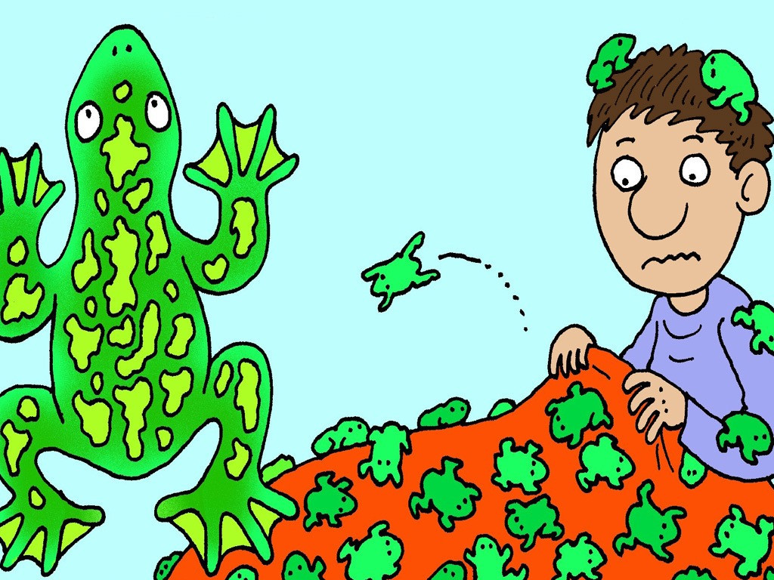
NO!
Notes:
Slide 10:
So next there were some jumping frogs, cos Pharoah just said ‘NO!’
With a ‘Ribbit! Ribbit!’ [small jump] here and a ‘Ribbit! Ribbit!’ there
Here a ‘Ribbit!’, there a ‘Ribbit!’ everywhere a ‘Ribbit! Ribbit!’

Slide 11
Stop the plague and you can go!
NO!
Notes:
Slide 11:
‘Stop the plague and you can go!’
But then he changed his mind…..NO!

Slide 12
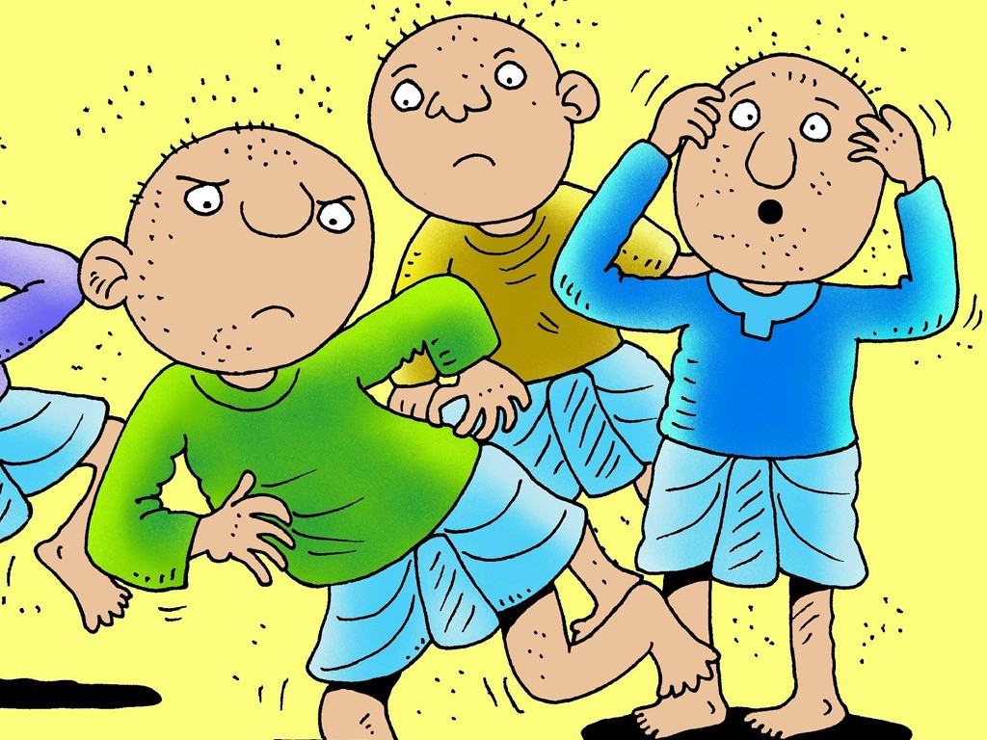
NO!
Notes:
Slide 12:
So next there were some biting gnats, cos Pharoah just said ‘NO!’
With a ‘Scritch! Scratch!’ [pretend to scratch] here and a ‘Scritch! Scratch!’ there
Here a ‘Scritch!’, there a ‘Scratch!’ everywhere a ‘‘Scritch! Scratch!’ !’

Slide 13
Stop the plague and you can go!
NO!
Notes:
Slide 13:
‘Stop the plague and you can go!’
But then he changed his mind…..NO!

Slide 14
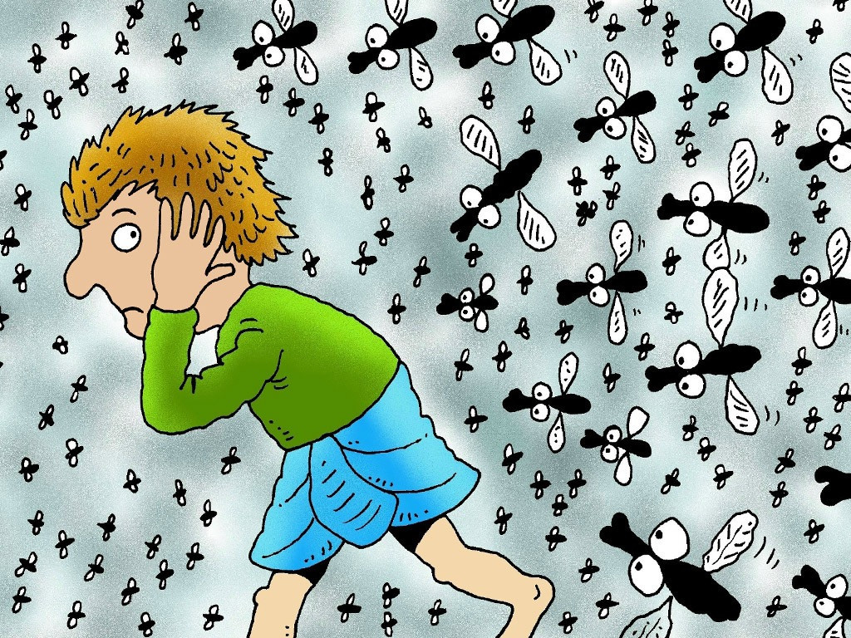
NO!
Notes:
Slide 14:
So next there were some buzzing flies, cos Pharoah just said ‘NO!’
With a ‘Buzz! Buzz!’ [small wings] here and a ‘Buzz! Buzz!’ there
Here a ‘Buzz!’, there a ‘Buzz!’ everywhere a ‘Buzz! Buzz!’

Slide 15
Stop the plague and you can go!
NO!
Notes:
Slide 15:
‘Stop the plague and you can go!’
But then he changed his mind…..NO!

Slide 16
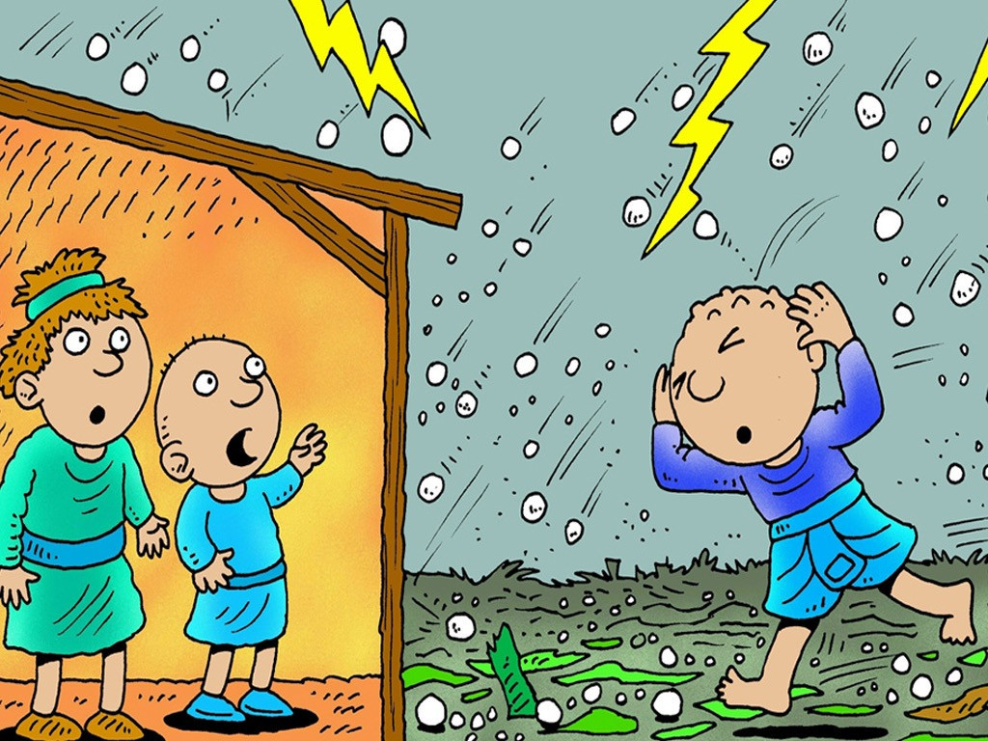
NO!
Notes:
Slide 16:
And so God sent a big hail storm, cos Pharoah just said ‘NO!’
With a ‘Ping! Pong!’ [duck down as if avoiding hailstones] here and a ‘Ping! Pong!’ there
Here a ‘Ping!’ there a ‘Pong!’, everywhere a ‘Ping! Pong!’

Slide 17
Stop the plague and you can go!
NO!
Notes:
Slide 17:
‘Stop the plague and you can go!’
But then he changed his mind…..NO!

Slide 18
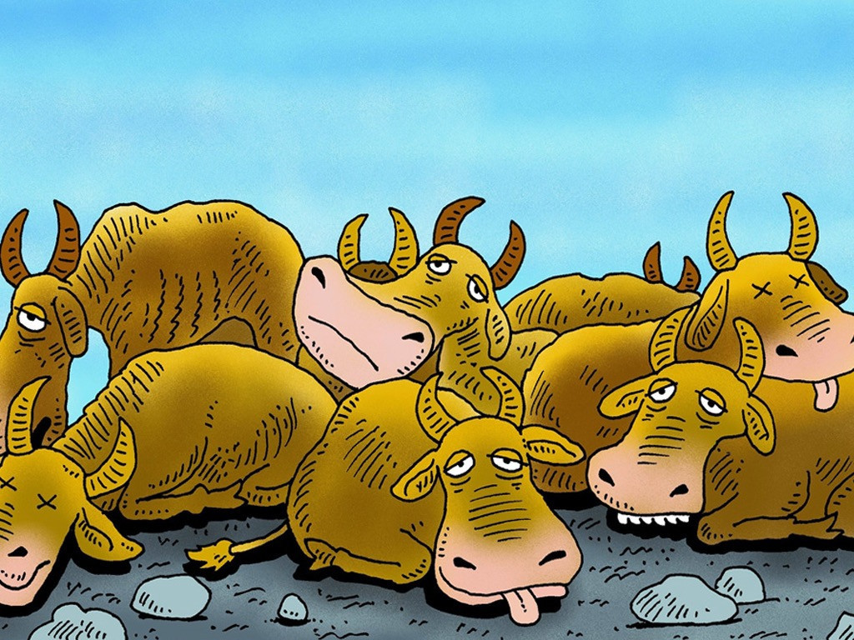
NO!
Notes:
Slide 18:
And then the animals got quite sick cos Pharoah just said ‘NO!’
With a ‘Bluh! Bluh!’ here [tongue out] and a ‘Bluh! Bluh!’ there
Here a ‘Bluh!’ there a ‘Bluh!’ everywhere a ‘Bluh! Bluh!’

Slide 19
Stop the plague and you can go!
NO!
Notes:
Slide 19:
‘Stop the plague and you can go!’
But then he changed his mind…..NO!

Slide 20
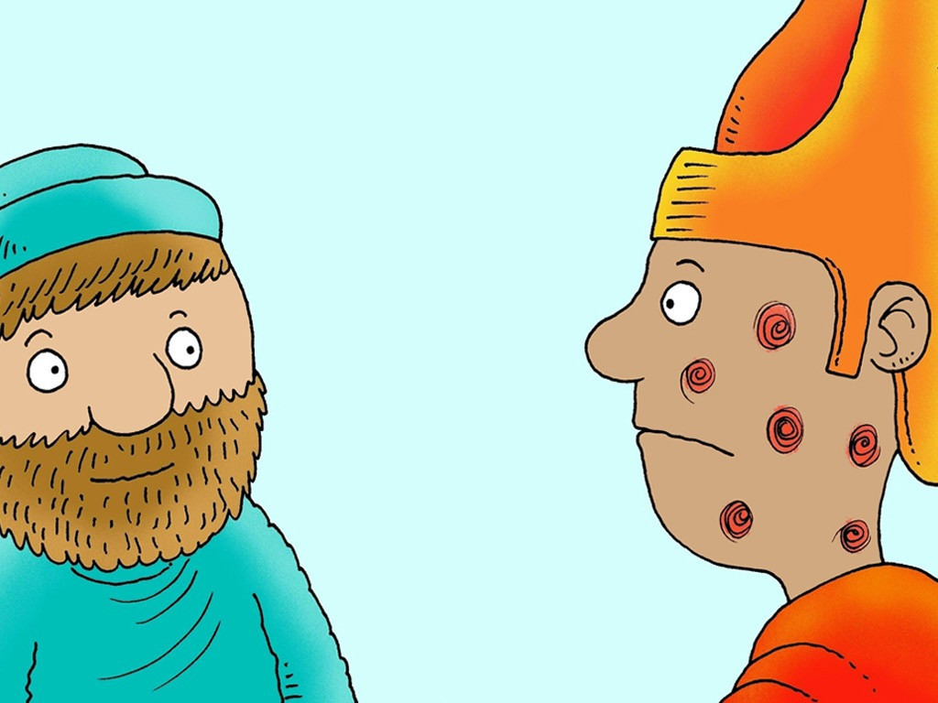
NO!
Notes:
Slide 20:
So next there were some big fat spots cos Pharoah just said ‘NO!’
With an ‘Ouch! Ouch!’ [hold arm] here and an ‘Ouch! Ouch!’ there
Here an ‘Ouch!’ there an ‘Ouch!’ everywhere an ‘Ouch! Ouch!’

Slide 21
Stop the plague and you can go!
NO!
Notes:
Slide 21:
‘Stop the plague and you can go!’
But then he changed his mind…..NO!

Slide 22
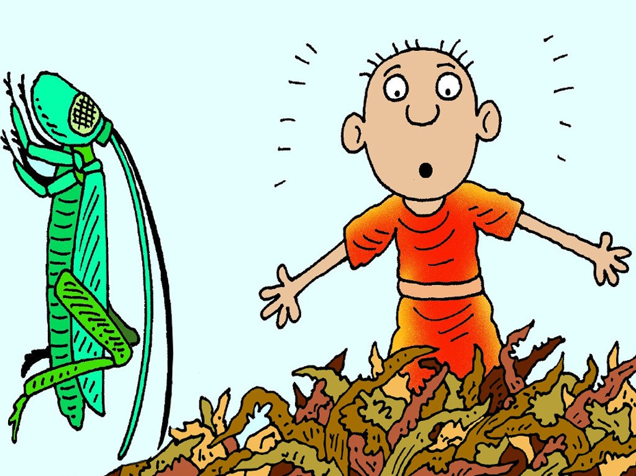
NO!
NO!
Notes:
Slide 22:
So next there came some greedy locusts, cos Pharoah just said ‘NO!’
With a ‘Nibble! Nibble!’ here and a ‘Nibble! Nibble!’ there
Here a ‘Nibble!’ there a ‘Nibble!’ everywhere a ‘Nibble! Nibble!’

Slide 23
Stop the plague and you can go!
NO!
Notes:
Slide 23:
‘Stop the plague and you can go!’
But then he changed his mind…..NO!

Slide 24
NO!
Notes:
Slide 24:
So then there was a DARK DARK day. cos Pharoah just said ‘NO!’
With an ‘Oh-Oh!’ [hands out in front like you’re feeling in the dark] here and an ‘Oh-Oh!’ there
Here an ‘Oh-Oh!’ there an ‘Oh-Oh!’ everywhere an ‘Oh-Oh! Oh-Oh!’

Slide 25
Stop the plague and you can go!
NO!
Notes:
Slide 25:
‘Stop the plague and you can go!’
But then he changed his mind…..NO!

Slide 26
?
Notes:
Slide 26:
And so God sent one final plague…
I’ll tell you all next week!........
[add your own cliffhanger sound effects here!!!]

Slide 27
‘I will be with you’
Notes:
Slide 27:
So at the end of a very long story, which we’ve been a part of, we’re going to pause and think about what’s happened – and what we might learn from it about God, and about being a community.
What I didn’t say in the story is that all the strange and challenging things that happened, the plagues, only happened to the Egyptians – the people of God were all kept safe, which is what he had promised Moses last week. ‘I will be with you…’
And each time Pharoah said he’d let the people go, if God took the plague away (which he did!) – then he changed his mind and refused to let the people leave.

Slide 28
….I wonder why Pharoah was so stubborn and wouldn’t let God’s people go?....
….I wonder how God’s people felt, knowing that God had seen?…..
…I wonder why justice – fairness – is so important to God?...
….I wonder what you might want God to notice – or act on?....or how we might play our part?....
‘I have seen….’
Notes:
Slide 28:
We also heard at the beginning, but might have forgotten in all the activity of telling it, is the message that God noticed what was happening to his people: he says ‘I have seen….’ God noticed – and acted to put things right.
This is a message that we often hear in the Bible when people are being treated unfairly by cruel leaders.
We’re going to be quiet and still and wonder together now….
….I wonder why Pharoah was so stubborn and wouldn’t let God’s people go?....
….I wonder how God’s people felt, knowing that God had seen?…..
…I wonder why justice – fairness – is so important to God?...
….I wonder what you might want God to notice – or act on?....or how we might play our part?...
There are many things that happen to people across the world, and in our own communities, that are every bit as unfair as how the Egyptians treated the Israelites. [If you have older pupils, you may wish to pause here and talk about some of them e.g. homelessness, refugees, war in Ukraine etc.]
And in our own lives and our own community, it might bring you comfort to know that whatever you face, God sees…..
Bring all these thoughts quietly before God now, if you’d like to, as I pray

Slide 29
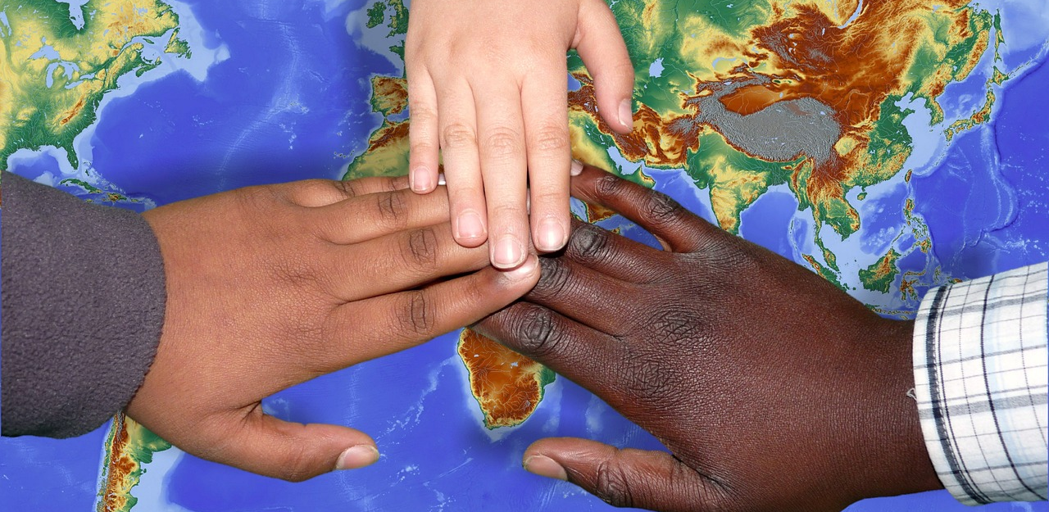
God who sees all
We bring our thoughts to you now as we think about things that are unfair in our world….
…things that we see, you see too.
May we, like you, notice what’s going on around us, act justly and treat others fairly.
Notes:
Slide 29: Prayer
I am going to use some words to help us to pray now…which you can use to help you to pray if this is something that you’re comfortable with. If not, then just continue to be still with your own thoughts.
God who sees all
We bring our thoughts to you now as we think about things that are unfair in our world….
…things that we see, you see too.
May we, like you, notice what’s going on around us, act justly and treat others fairly.

Slide 30
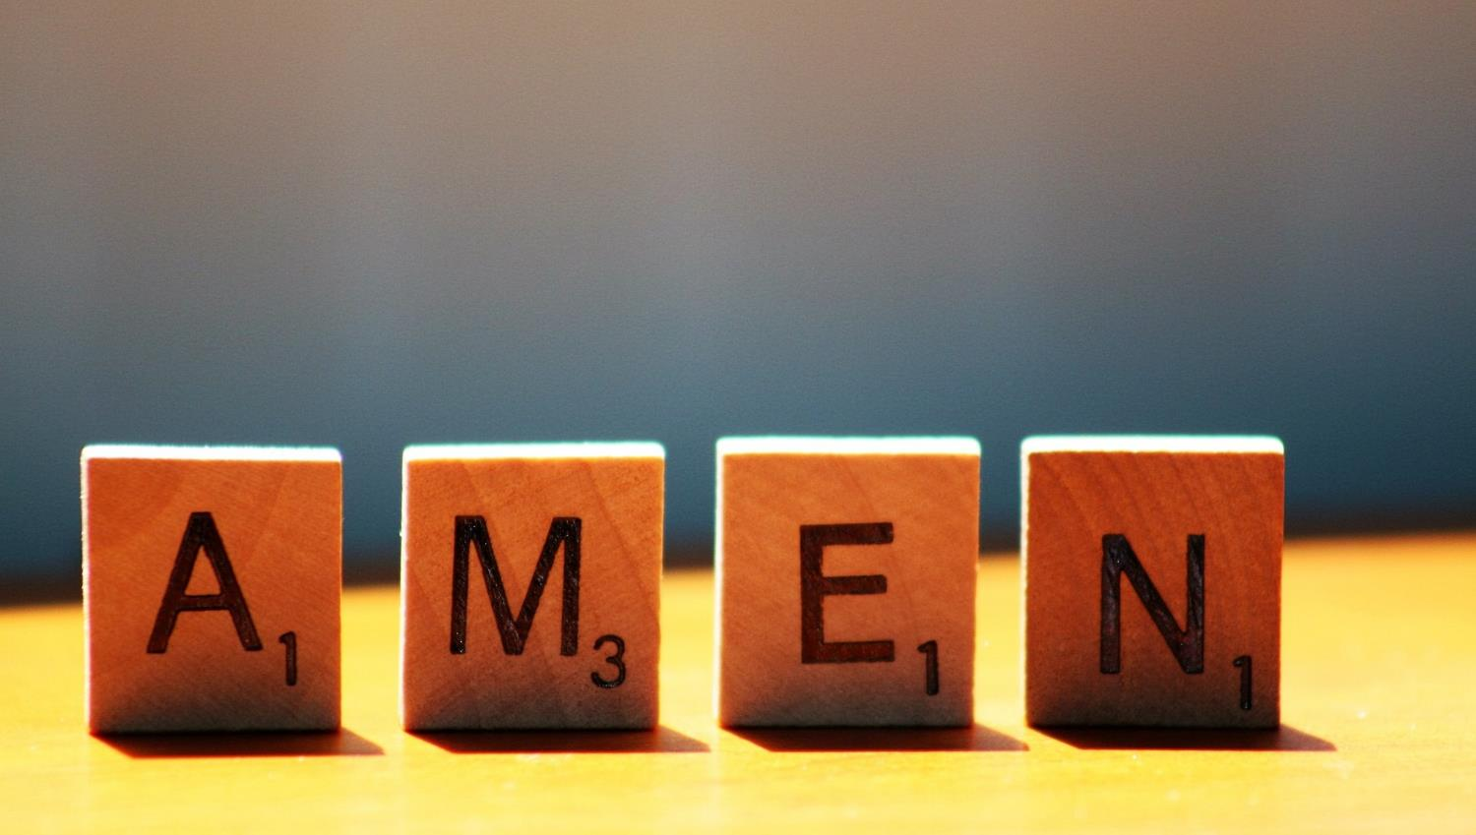

Slide 31
Leader: As we leave this place & time and go into the day ahead…
All: May today’s words help us to become a stronger community.
Notes:
Slide 31: Remind children of today’s key message – that God sees us and things that are unfair, and will act.
We can each help to make our school community a fair place in the way we treat each other

Slide 32
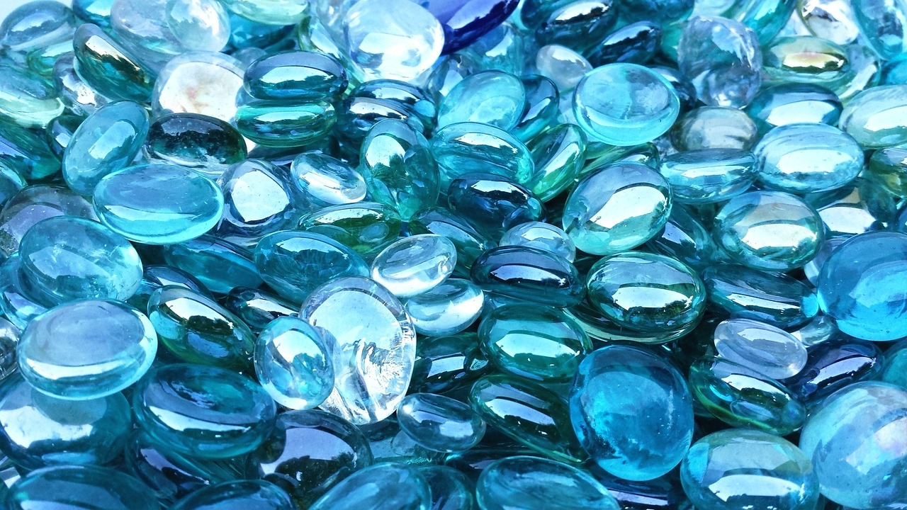
Notes:
Slide 31: Reflective prayer activity explanation
‘We are all seen….’
Our theme this week reminds us that each of us is precious and seen by God – and the things that matter to us, that we think are unfair, God sees too.
Take a ‘gemstone’ and hold it in your hand while you think.
When you are ready, place it in the bowl and remember that God sees.
You might also want to pray.

